Slide 1
Wounds in the Operating Room Wednesday, September 18, 2024
Notes:
1

Slide 2
Agenda
What instruments are used?
Techniques of debridement
What is the role of pathology?
Regenerative Medicine: Acell
Regenerative Medicine: Leukine
Regenerative Medicine: Apligraf
Regenerative Medicine: Integra
Hidradenitis Suppurativa
Diabetic Foot Ulcers
Venous Ulcers
Pressure Ulcers
Necrotizing Fasciitis

Slide 3
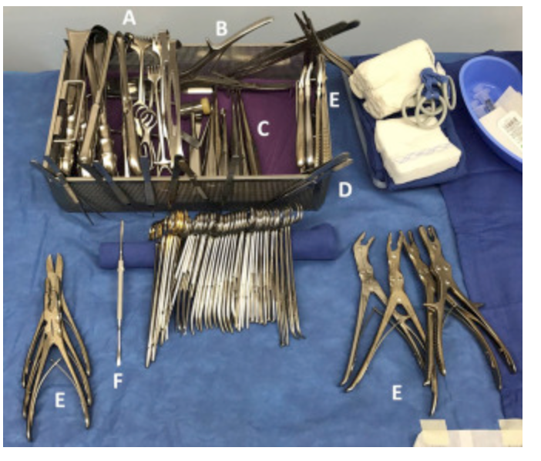
What instruments are used?
The instruments used most frequently by our wound surgeons include:
scalpel (10-, 15-, and 20-blade),
Metzenbaum scissors, curettes,
rongeurs,
electrocautery,
osteotomes,
pulse lavage,
smoke evacuator,
and sagittal saw.
The 10-blade scalpel is used frequently for tangential shaving of long wounds, and the 15-blade scalpel is used for general debriding. It is imperative to change the blade often to maintain a sharp and accurate cutting edge. This will eliminate tissue shearing and damage of surrounding tissue
Instrument tray. The wound tray that we have developed includes: (A) retractors, (B) bone cutters, (C) curettes, (D) forceps, (E) rongeurs, and (F) elevators.
Howell, R. S., Gorenstein, S., Castellano, M., Slone, E., Woods, J. S., Gillette, B. M., Donovan, V., Criscitelli, T., Brem, H., & Brathwaite, C. (2018). Wound Care Center of Excellence: Guide to Operative Technique for Chronic Wounds. Journal of the American College of Surgeons, 226(2), e7–e17. https://doi.org/10.1016/j.jamcollsurg.2017.11.002

Slide 4
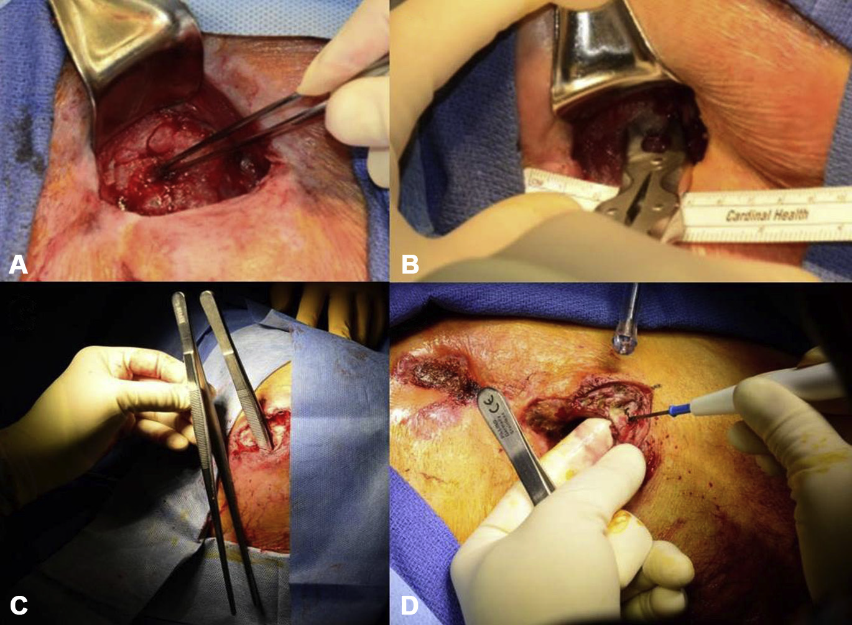
Techniques of debridement
Debridement of a pressure wound. (A) A stage IV sacral pressure wound with necrotic sacrum indicated by the forceps. (B) A rongeur is used to debride the necrotic bone and the specimen is sent to microbiology and pathology for analysis. (C) Extensive tunneling is demonstrated with the use of DeBakey forceps. (D) Undermining is removed by triangulation of the skin overlying the wound.
Howell, R. S., Gorenstein, S., Castellano, M., Slone, E., Woods, J. S., Gillette, B. M., Donovan, V., Criscitelli, T., Brem, H., & Brathwaite, C. (2018). Wound Care Center of Excellence: Guide to Operative Technique for Chronic Wounds. Journal of the American College of Surgeons, 226(2), e7–e17. https://doi.org/10.1016/j.jamcollsurg.2017.11.002

Slide 5
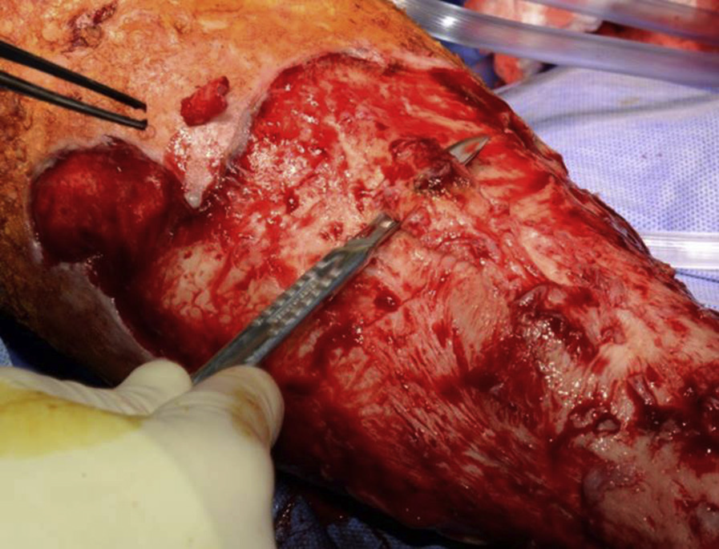
Techniques of debridement
Debridement of venous ulcer. Venous wounds are vigorously scrubbed with a surgical chlorhexidine brush to remove biofilm, coupled with tangential shaving of the ulcer down to a layer of viable-appearing tissue.
Howell, R. S., Gorenstein, S., Castellano, M., Slone, E., Woods, J. S., Gillette, B. M., Donovan, V., Criscitelli, T., Brem, H., & Brathwaite, C. (2018). Wound Care Center of Excellence: Guide to Operative Technique for Chronic Wounds. Journal of the American College of Surgeons, 226(2), e7–e17. https://doi.org/10.1016/j.jamcollsurg.2017.11.002

Slide 6
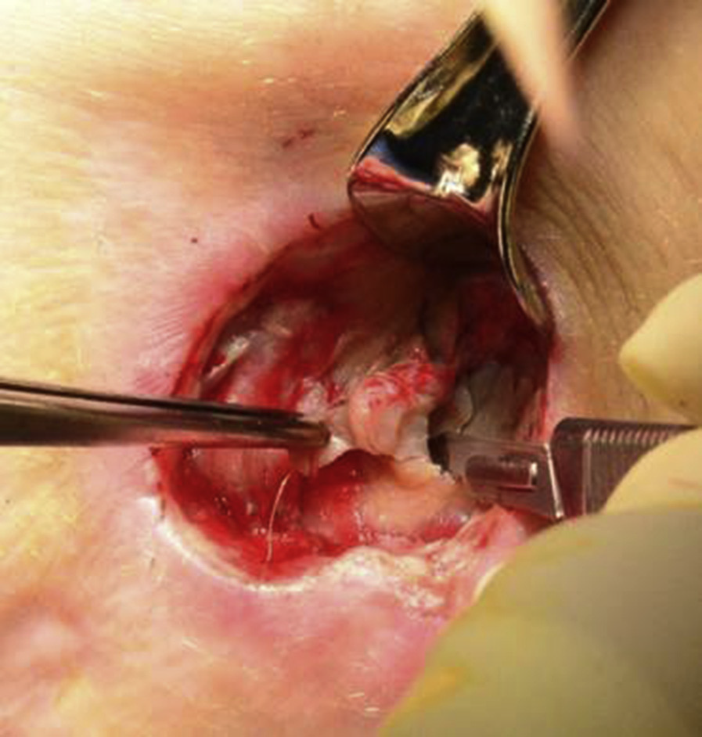
What is the role of pathology?
Skin-edge and wound-base specimens are taken during each debridement to evaluate viability of deep-tissue margins and to rule out pathology such as carcinoma, necrosis, osteomyelitis, and active infection, as evidenced by inflammatory cell infiltrates.
These specimens are transported to pathology in formalin. When infection is suspected, aerobic and anaerobic wound cultures are obtained to tailor antibiotic therapy. Unused sterile instruments are used to collect cultures, which are sent fresh in a sterile cup.
Cultures are sent in thioglycolate broth when anaerobic pathogens are suspected. When vasculitis or pyoderma is suspected, a specimen is collected from the nearby healthy-appearing skin that is not part of the gross wound and sent in Michel’s transport medium to allow for immunofluorescent-based analysis.
Howell, R. S., Gorenstein, S., Castellano, M., Slone, E., Woods, J. S., Gillette, B. M., Donovan, V., Criscitelli, T., Brem, H., & Brathwaite, C. (2018). Wound Care Center of Excellence: Guide to Operative Technique for Chronic Wounds. Journal of the American College of Surgeons, 226(2), e7–e17. https://doi.org/10.1016/j.jamcollsurg.2017.11.002

Slide 7
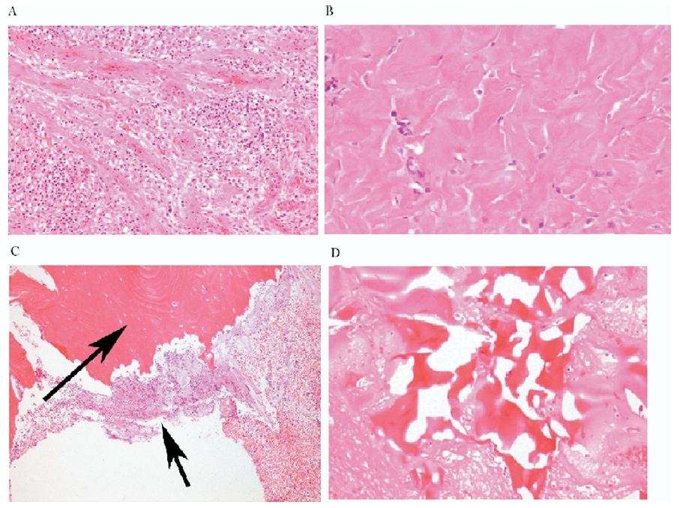
What is the role of pathology?
A
B
Granulation tissue
Fibrosis
Osteomyelitis
Reactive bone
C
D
Golinko et al., Operative Debridement of Diabetic Foot Ulcers. J Am Coll Surg 2008; 207:e1-e6.

Slide 8
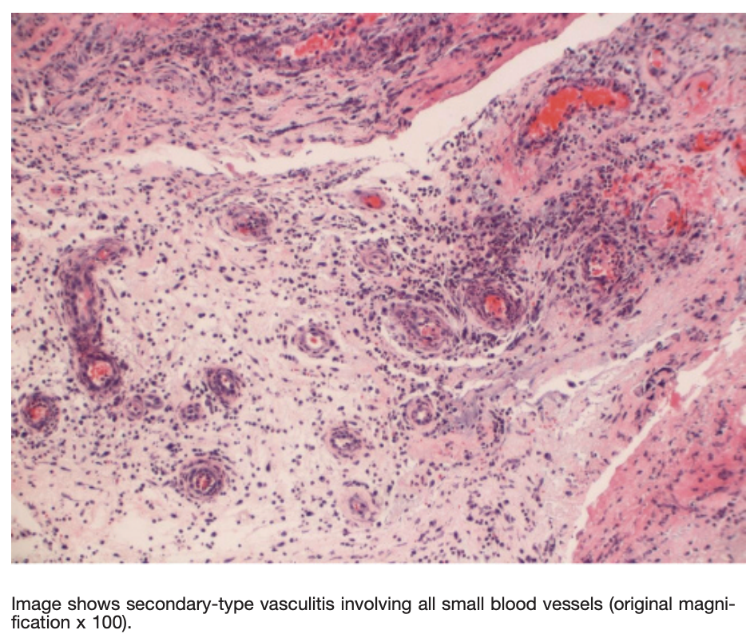
What is the role of pathology?
Knowledge of histopathologic alterations present in wound tissue is fundamental to successful debridement and healing.
Pathologic evaluation can help distinguish healing from a nonhealing wound edge; however for chronic wounds refractory to standard debridement and treatment protocols, a detailed analysis of wound edge histopathology may be necessary to guide therapeutic interventions and debridement.
Turi, G. K., Donovan, V., DiGregorio, J., Criscitelli, T. M., Kashan, B., Barrientos, S., Balingcongan, J. R., Gorenstein, S., & Brem, H. (2016). Major Histopathologic Diagnoses of Chronic Wounds. Advances in skin & wound care, 29(8), 376–382. https://doi.org/10.1097/01.ASW.0000484665.45022.b3

Slide 9
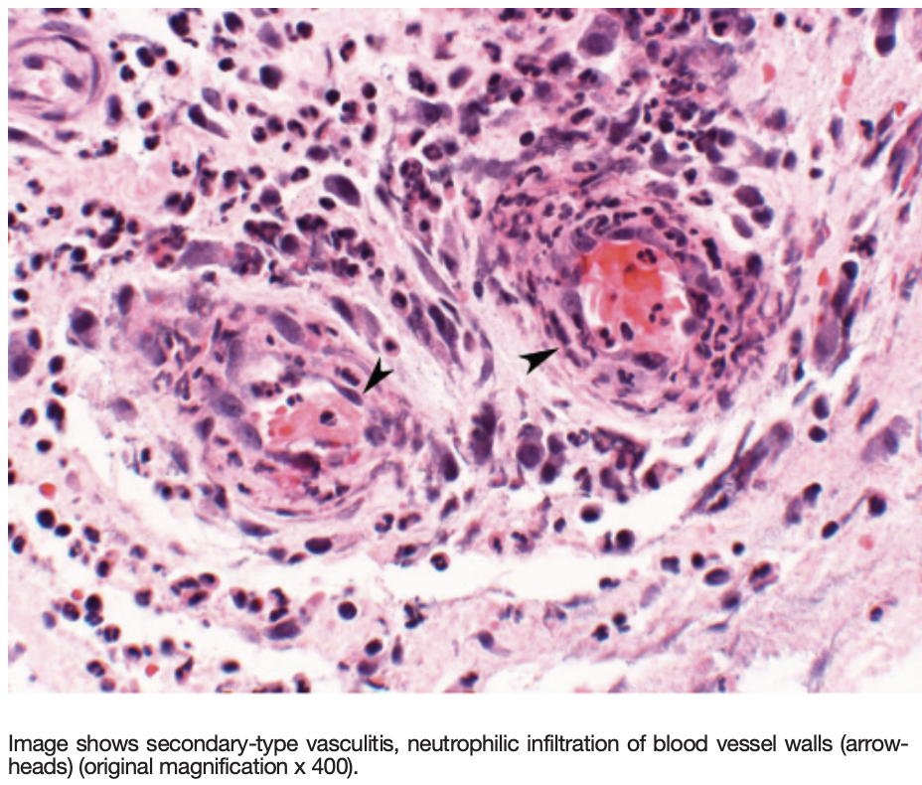
What is the role of pathology?
Although clinical signs and symptoms may heighten clinical suspicion of osteomyelitis, tissue culture, specificity, and histologic findings in bone tissue are crucial to treatment.
A thorough history and physical examination, multimodality specialty involvement, and treatments, along with accurate diagnosis through histopathologic analysis of wound biopsies from routine debridements, can help tailor treatment regimens.
Turi, G. K., Donovan, V., DiGregorio, J., Criscitelli, T. M., Kashan, B., Barrientos, S., Balingcongan, J. R., Gorenstein, S., & Brem, H. (2016). Major Histopathologic Diagnoses of Chronic Wounds. Advances in skin & wound care, 29(8), 376–382. https://doi.org/10.1097/01.ASW.0000484665.45022.b3

Slide 10
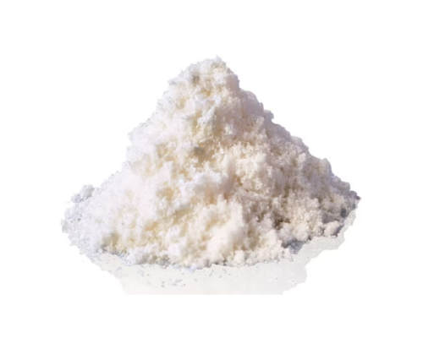
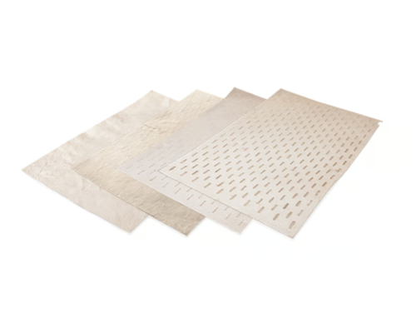
Regenerative Medicine: Acell
Porcine mesothelium is a tissue rich in connective tissue (CT, e.g. collagens types I and III, elastin, fibronectin) and basement membrane (BM, e.g. collagen type IV and laminin) proteins and growth factors (e.g. FGF-2, TGF-β, VEGF).
These extracellular matrix (ECM) components present recognition motifs that promote the attachment and proliferation of cells, contributing to the high cytocompatibility and low immunogenicity in vitro of porcine mesothelium and allowing re-epithelialization in vitro, promoted by its BM components.
Growth factors retained within the porcine mesothelium matrix promote wound healing events, such as cell proliferation and angiogenesis in vivo. Such features clearly illustrate their potential in the wound healing scenario, where cell proliferation, re-epithelialization, and angiogenesis are desirable events to be promoted.
UBM Micromatrix
Cytal wound matrix
Pang, X., Dong, N., & Zheng, Z. (2020). Small Leucine-Rich Proteoglycans in Skin Wound Healing. Frontiers in pharmacology, 10, 1649. https://doi.org/10.3389/fphar.2019.01649

Slide 11
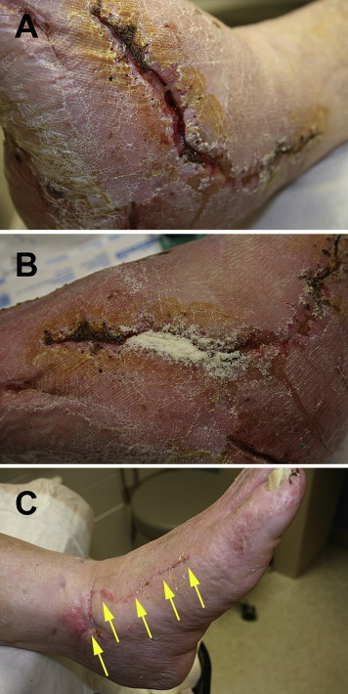
Regenerative Medicine: Acell
A, Dehiscence to the lateral surgical wound that was present for 6 weeks and was nonresponsive to standard postoperative wound care of moist gauze dressings.
B, UBM micronized particles were poured into the tunneling aspect of the wound and covered with a nonadherent dressing and sterile gauze.
C, The wound was healed after 4 weeks of treatment.
Kimmel, H., Rahn, M., & Gilbert, T. W. (2010). The clinical effectiveness in wound healing with extracellular matrix derived from porcine urinary bladder matrix: a case series on severe chronic wounds. The journal of the American College of Certified Wound Specialists, 2(3), 55–59. https://doi.org/10.1016/j.jcws.2010.11.002

Slide 12
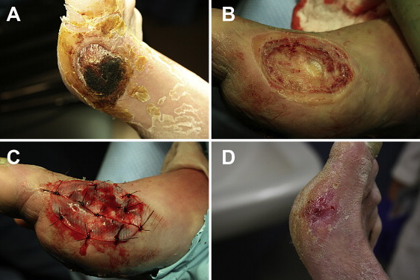
Regenerative Medicine: Acell
A, A necrotic diabetic ulcer to the medial aspect of the patient’s right foot.
B, Debridement in the operating room down to joint capsule.
C, A thick UBM sheet was hydrated in normal saline, fenestrated, and then sutured to the wound base.
D, The full thickness wound was healed in 13 weeks from the date of surgery.
Kimmel, H., Rahn, M., & Gilbert, T. W. (2010). The clinical effectiveness in wound healing with extracellular matrix derived from porcine urinary bladder matrix: a case series on severe chronic wounds. The journal of the American College of Certified Wound Specialists, 2(3), 55–59. https://doi.org/10.1016/j.jcws.2010.11.002

Slide 13
Regenerative Medicine: Leukine
September 1999
Double-blind, randomized, placebo controlled trial
Evaluating pressure ulcer therapy, n= 61
Findings:
GM-CSF acts early for wound contraction
Greater acceleration of pressure ulcer healing via deposition of extracellular matrix and contraction
Robson et al., Sequential cytokine therapy for pressure ulcers: clinical and mechanistic response. Ann Surg. 2000;231(4):600-11.

Slide 14
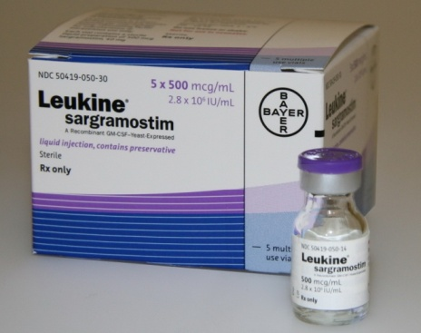
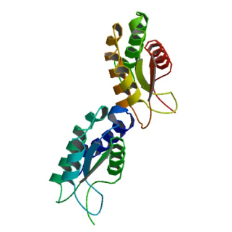
Regenerative Medicine: Leukine
Approved by US FDA in 1991
Synthetic, injectable/topical or intravenous granulocyte-macrophage colony stimulating factor (GM-CSF)
Supports survival, clonal expansion, differentiation of hematopoietic progenitor cells and increased neovascularization
Induces progenitor cells to divide and differentiate in the granulocyte-macrophage pathways
Fang et al., Granulocyte-macrophage colony-stimulating factor enhances wound healing in diabetes via upregulation of proinflammatory cytokines. Br J Dermatol. 2010;162(3):478-86.
Notes:
used to help increase the number and function of WBCs

Slide 15
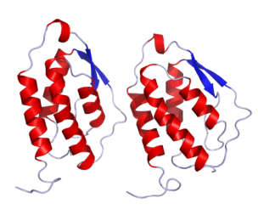
Regenerative Medicine: Leukine
Monomeric glycoprotein
Functions as a cytokine
Secreted by macrophages, T-cells, mast cells, NK cells, endothelial cells and fibroblasts
Important hematopoietic growth factor and immune modulator
Application of GM-CSF as an immune adjuvant
Increases dendritic cell maturation and function^{3,4}
Increases macrophage activity^{3,4}
³Delneste et al., Interferon-gamma switches monocyte differentiation from dendritic cells to macrophages. Blood 2003;101:143–50.
⁴Shi et al., Granulocyte-macrophage colony-stimulating factor (GM-CSF) and T-cell responses: what we do and don't know. Cell Research 2006;16: 123-133.

Slide 16
Regenerative Medicine: Leukine
Although diabetes negatively affects multiple aspects of wound healing GM‐CSF activation is particularly impacted. Compared to acute/healthy wounds diabetic foot ulcers (DFU) only partially activate GM‐CSF activity. There is a deleterious chain of events associated with this unfortunate sequala.
DFUs also have a high proportion of monocytes and an absence of activated macrophages which results in an impaired inflammatory response. This may potentially serve as a vital point for GM‐CSF to act as a companion diagnostic/theragnostic modality to help modulate the inflammatory response in wound healing.
Correcting macrophage immune dysfunction with exogenous GM‐CSF may help restore the immune balance in the wound ecosystem and jumpstart the wound healing cascade.
Ead, J. K., & Armstrong, D. G. (2023). Granulocyte-macrophage colony-stimulating factor: Conductor of the wound healing orchestra?. International wound journal, 20(4), 1229–1234. https://doi.org/10.1111/iwj.13919

Slide 17
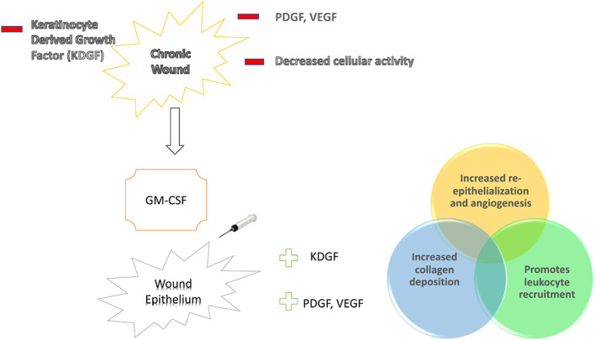
Regenerative Medicine: Leukine
Ead, J. K., & Armstrong, D. G. (2023). Granulocyte-macrophage colony-stimulating factor: Conductor of the wound healing orchestra?. International wound journal, 20(4), 1229–1234. https://doi.org/10.1111/iwj.13919

Slide 18
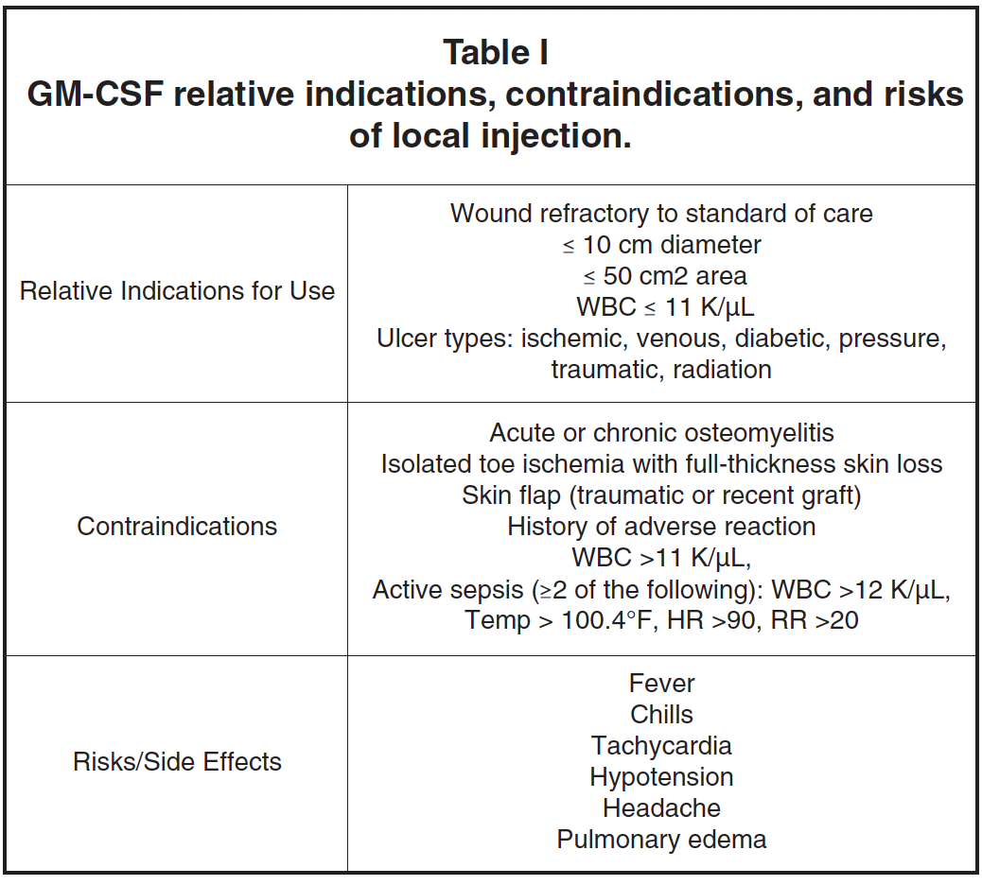
Regenerative Medicine: Leukine
Brem, H., Howell, R., Criscitelli, T., Senderowicz, A., Siegart, N., Gorenstein, S., & Gillette, B. (2018). Practical Application of Granulocyte-Macrophage Colony-Stimulating Factor (GM-CSF) in Patients with Wounds. Surgical technology international, 32, 61–66.

Slide 19
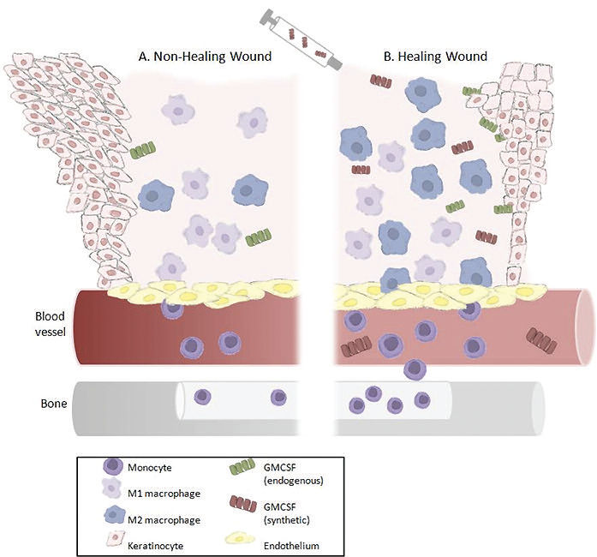
Regenerative Medicine: Leukine
The non-healing wound edge depicts heaped, non-migrating keratinocytes releasing very little endogenous GM-CSF and exhibiting both hyperkeratotic and parakeratotic features (abnormal increase in the number of layers and nucleated cells in the stratum corneum, respectively).
The altered immune response to the chronic wound results in low amounts of monocytes being stimulated and released from the bone marrow into the circulation. The non-healing wound bed contains an unbalanced M1:M2 ratio, resulting in a pro-inflammatory environment and inactivated macrophages releasing little to no endogenous GM-CSF. B. After debridement of the wound and injection of synthetic GM-CSF, the healing wound edge exhibits proliferating and migrating keratinocytes releasing endogenous GM-CSF.
The bone marrow is also stimulated to release monocytes that home to the wound bed and differentiate into macrophages. The wound bed environment then favors rapid polarization of the activated macrophages, resulting in an anti-inflammatory M1:M2 balance. In addition, GM-CSF stimulates endothelial cell differentiation, which facilitates wound contraction.
Brem, H., Howell, R., Criscitelli, T., Senderowicz, A., Siegart, N., Gorenstein, S., & Gillette, B. (2018). Practical Application of Granulocyte-Macrophage Colony-Stimulating Factor (GM-CSF) in Patients with Wounds. Surgical technology international, 32, 61–66.

Slide 20
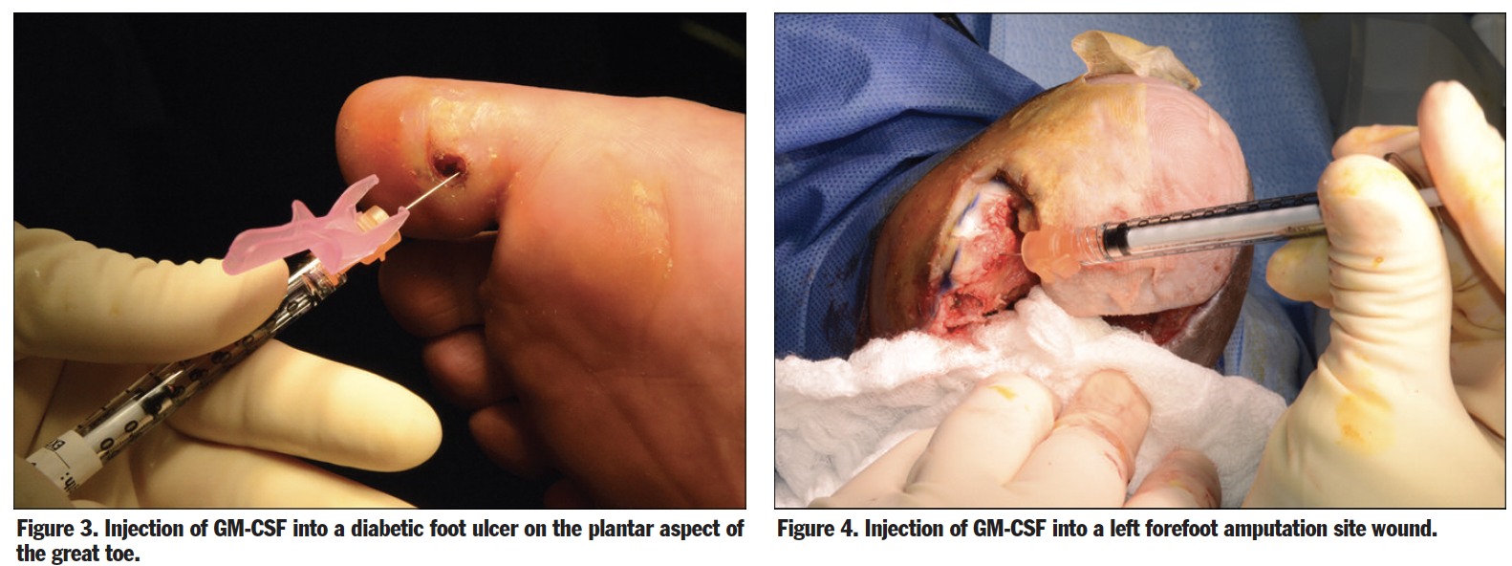
Regenerative Medicine: Leukine
Brem, H., Howell, R., Criscitelli, T., Senderowicz, A., Siegart, N., Gorenstein, S., & Gillette, B. (2018). Practical Application of Granulocyte-Macrophage Colony-Stimulating Factor (GM-CSF) in Patients with Wounds. Surgical technology international, 32, 61–66.

Slide 21
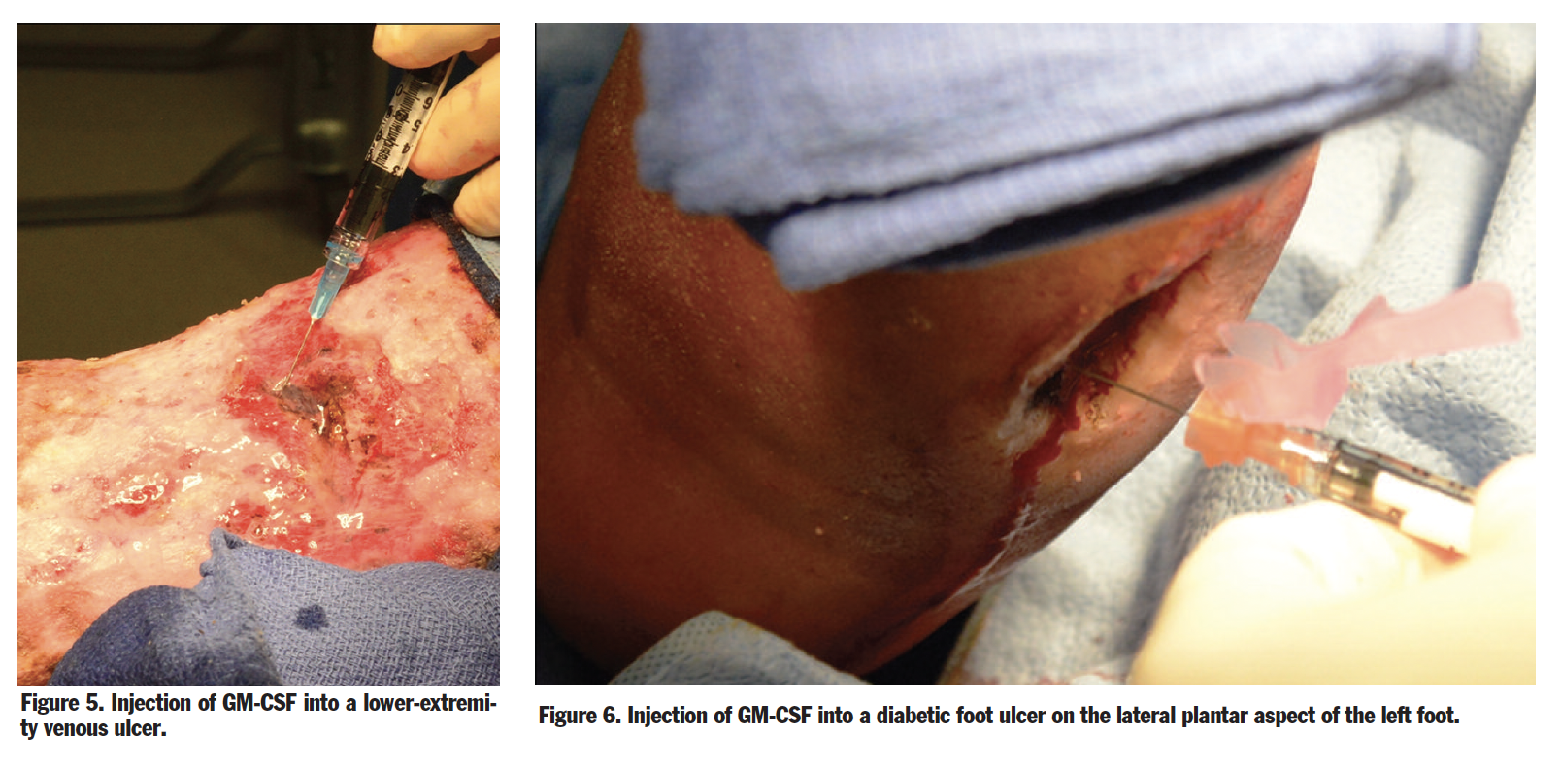
Regenerative Medicine: Leukine
Brem, H., Howell, R., Criscitelli, T., Senderowicz, A., Siegart, N., Gorenstein, S., & Gillette, B. (2018). Practical Application of Granulocyte-Macrophage Colony-Stimulating Factor (GM-CSF) in Patients with Wounds. Surgical technology international, 32, 61–66.

Slide 22
Regenerative Medicine: Leukine
In vitro studies have demonstrated that this growth factor increases migration and proliferation of endothelial cells suggesting a role in angiogenesis.¹
In patients with DFUs, subcutaneous injections of GM-CSF resulted in quicker resolution of cellulitis, a trend toward ulcer healing and lower incidence of amputation.²
¹Bussolino et al., Granulocyte and granulocyte-macrophage-colony stimulating factors induce human endothelial cells to migrate and proliferate. Nature 1989;337:471–3
²Gough et al., Randomised placebo-controlled trial of granulocyte-colony stimulating factor in diabetic foot infection. Lancet 1997;350:855–9.

Slide 23
Regenerative Medicine: Leukine
March 2010, Clinical study comparing GM-CSF in DM vs. non-DM mice
Results:
50% reduced GM-CSF production in mice with DM vs. non-DM. No beneficial effects in non-DM mice
Exogenous GM-CSF substantially enhanced wound healing in DM mice
Increased neovascularization, macrophage and neutrophil infiltration
Fang et al., Granulocyte-macrophage colony-stimulating factor enhances wound healing in diabetes via upregulation of proinflammatory cytokines. Br J Dermatol. 2010;162(3):478-86.

Slide 24
Regenerative Medicine: Leukine
May 2014
Routinely use Leukine for physiologically impaired ulcers
Adjunct to debridement when refractory to standard treatment
Dose: 500μg locally up to two times per week
Barrientos et al., Clinical application of growth factors and cytokines in wound healing. Wound Repair Regen. 2014;22(5):569-78.

Slide 25
Regenerative Medicine: Apligraf
Apligraf (previously known as “Graftskin” and “human skin equivalent”) is a tissue-engineered biological dressing for wounds. Apligraf is composed of male neonatal fibroblasts (taken from discarded foreskin of a newborn baby) which are initially placed in a bovine type I collagen matrix. Over time a neodermis produced by the neonatal fibroblasts develops an epidermal sheet. In other words, it is a bioengineered skin substitute with two layers:
Epidermal layer: Contains living keratinocytes and stem cells that provide potent healing signals (growth factors/cytokines)
Dermal layer: Contains living fibroblasts that proliferate and produce human collagen and other extracellular matrix proteins (which regulate tissue formation) as well as growth factors/cytokines.
Brem H, Balledux J, Sukkarieh T, Carson P, Falanga V. Healing of venous ulcers of long duration with a bilayered living skin substitute: results from a general surgery and dermatology department. Dermatol Surg. 2001 Nov;27(11):915-9. doi: 10.1046/j.1524-4725.2001.01092.x. PMID: 11737123

Slide 26
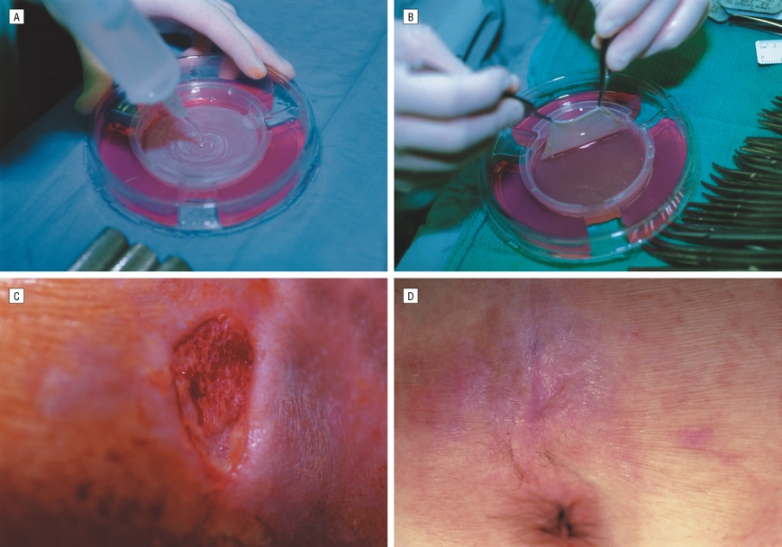
Regenerative Medicine: Apligraf
A, Saline being applied in Petri dish (keratinocyte layer) such that Apligraf can be easily removed from its culture medium. B, Apligraf being lifted with 2 smooth forceps (fibroblast side showing). C, Quadriplegic who had nonhealing sacral ulcer. In this photograph, the wound was debrided down to subcutaneous tissue. D, This wound healed 3 weeks after application of the skin graft, 1 week before photograph was taken
Brem H, Balledux J, Sukkarieh T, Carson P, Falanga V. Healing of venous ulcers of long duration with a bilayered living skin substitute: results from a general surgery and dermatology department. Dermatol Surg. 2001 Nov;27(11):915-9. doi: 10.1046/j.1524-4725.2001.01092.x. PMID: 11737123

Slide 27
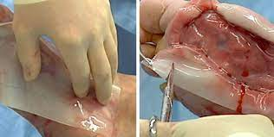
Regenerative Medicine: Integra
Integra Wound Matrix is an advanced wound care device comprised of a porous matrix of cross-linked bovine tendon collagen and glycosaminoglycan. The collagen-glycosaminoglycan biodegradable matrix provides a scaffold for cellular invasion and capillary growth. Integra Wound Matrix provides coverage over exposed bone, tendon, cartilage and joints.

Slide 28
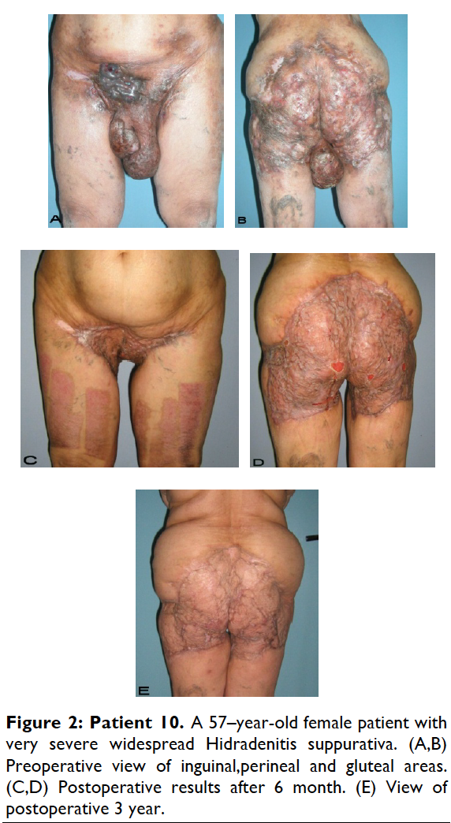
Hidradenitis Suppurativa
Hidradenitis suppurativa (HS) is a common dermatologic condition that frequently presents in emergency and inpatient settings.
• Anemia, leukocytosis, neutrophilia, an elevated erythrocyte sedimentation rate, and an elevated C-reactive protein level are common markers of chronic inflammation in HS patients and might not signify infection.
• Acute management of HS should focus on anti-inflammatory and antibiotic regimens, with increasing severity dictating the need for more aggressive therapy.
• Longitudinal outpatient care coordination with a dermatologist and primary care physician is imperative for limiting emergency department and inpatient care utilization.
Charrow, A., Savage, K. T., Flood, K., & Kimball, A. B. (2019). Hidradenitis suppurativa for the dermatologic hospitalist. Cutis, 104(5), 276–280.
Gierek, M., Ochała-Gierek, G., Kitala, D., Łabuś, W., & Bergler-Czop, B. (2022). Surgical management of hidradenitis suppurativa. Postepy dermatologii i alergologii, 39(6), 1015–1020. https://doi.org/10.5114/ada.2022.115323

Slide 29
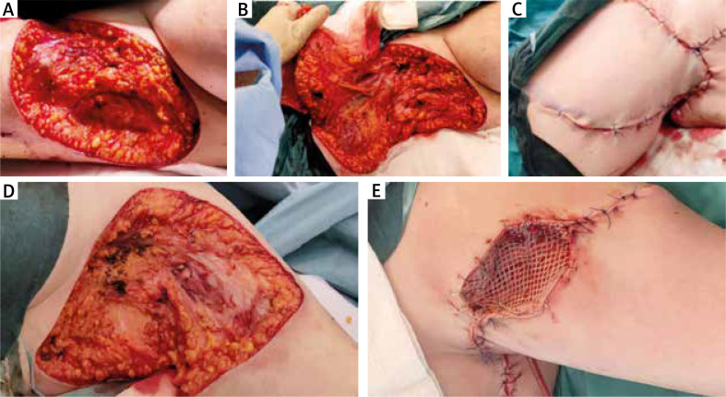
Hidradenitis Suppurativa
A – Wide resection of the right axilla. B – Flap preparation. C – Successful wound closure with rotatory local flap. D – Wide excision of the left axilla. E – Successful reconstruction with local flap and skin graft (mixed technique)
Gierek, M., Ochała-Gierek, G., Kitala, D., Łabuś, W., & Bergler-Czop, B. (2022). Surgical management of hidradenitis suppurativa. Postepy dermatologii i alergologii, 39(6), 1015–1020. https://doi.org/10.5114/ada.2022.115323

Slide 30
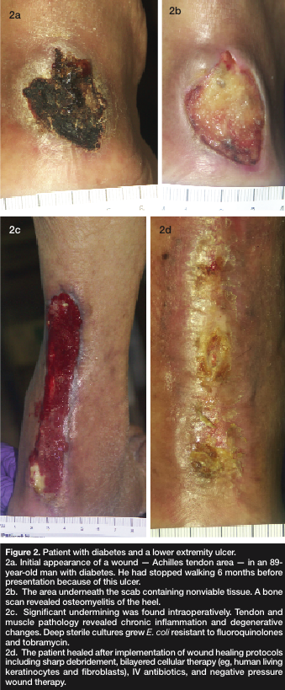
Diabetic Foot Ulcer
Patient with diabetes and lower extremity ulcer.
2a: Initial appearance of wound—achilles tendon area—89 year old patient with diabetes. He had stopped walking six months prior due to ulcer.
2b: The area underneath the scab containing non-viable tissue. A bone scan revealed osteomyelitis of the heel.
2c: significant undermining was found intraoperatively. Tendon and muscle pathology revealed chronic inflammation and degenerative changes. Deep sterile cultures revealed E. coli resistant to fluoroquinalones and tobramycin.
2d: the patient healed after implementation of the protocols including sharp debridement, bilayered cellular therapy (e.g., human living keratinocytes and fibroblasts), IV antibiotics, and negative pressure therapy.
Golinko MS, Clark S, Rennert R, Flattau A, Boulton AJ, Brem H. Wound emergencies: the importance of assessment, documentation, and early treatment using a wound electronic medical record. Ostomy Wound Manage. 2009;55(5):54-61.

Slide 31
Venous Ulcer
(Left) This patient, an obese woman, presented with a cellulitic infected venous ulcer. (Right) This figure demonstrates healing after a combination of antibiotics, human skin equivalent, and compression therapy.
Brem H, et al. Protocol for the successful treatment of venous ulcers. American Journal of Surgery. 2004 (Suppl)188: 1S-8S.

Slide 32
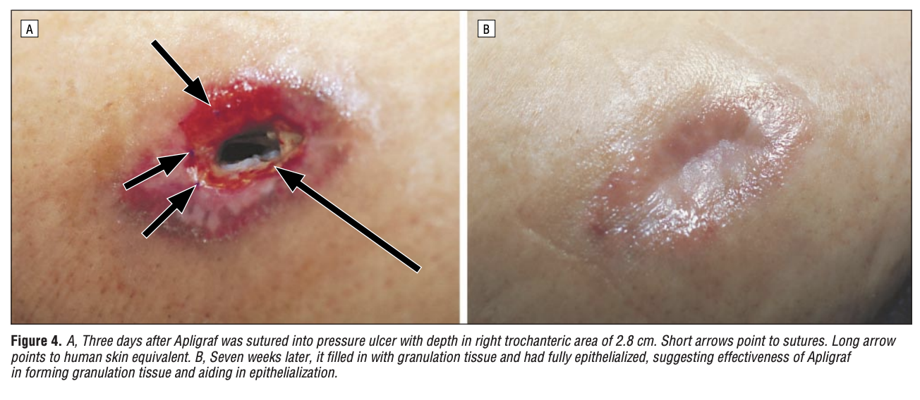
Pressure Ulcer
Brem, H., Balledux, J., Bloom, T., Kerstein, M. D., & Hollier, L. (2000). Healing of diabetic foot ulcers and pressure ulcers with human skin equivalent: a new paradigm in wound healing. Archives of surgery (Chicago, Ill. : 1960), 135(6), 627–634. https://doi.org/10.1001/archsurg.135.6.627

Slide 33
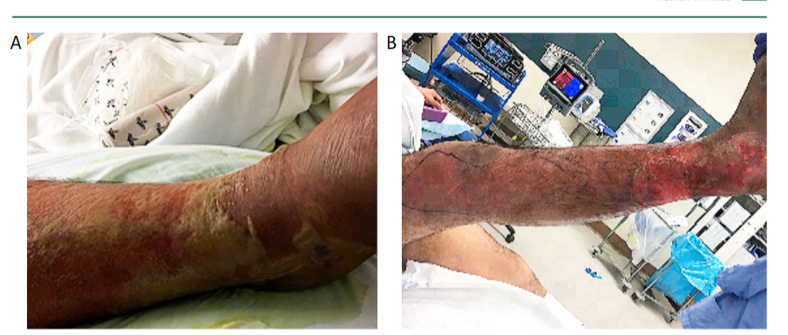
Necrotizing Fasciitis
Necrotizing fasciitis of the right lower limb. (A) Day 4 of symptoms with erythema, edema and blisters. (B): Day 5 of symptoms with skin peeling off.
Chen LL, Fasolka B, Treacy C. Necrotizing fasciitis: A comprehensive review. Nursing. 2020 Sep;50(9):34-40. doi: 10.1097/01.NURSE.0000694752.85118.62. PMID: 32826674; PMCID: PMC8828282.

Slide 34
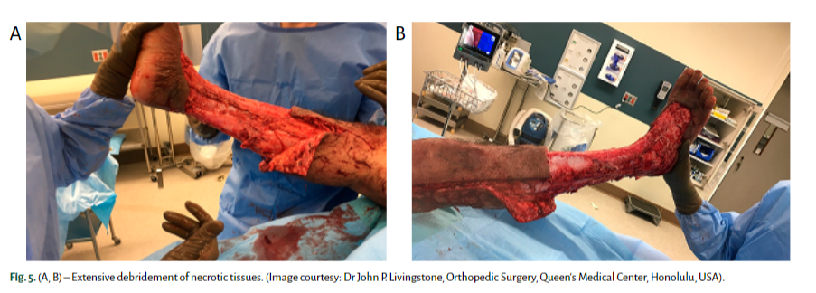
Necrotizing Fasciitis
Early and aggressive surgical debridement of necrotic tissue is the cornerstone of management. It reduces the infection burden, minimizes ultimate tissue loss, reduces the need for amputation and thereby, decreases mortality.
Debridement should be extensive and all the necrotic and poorly perfused tissues that can be easily elevated off the fascia with gentle pressure should be excised
Chen LL, Fasolka B, Treacy C. Necrotizing fasciitis: A comprehensive review. Nursing. 2020 Sep;50(9):34-40. doi: 10.1097/01.NURSE.0000694752.85118.62. PMID: 32826674; PMCID: PMC8828282.

