Slide 1
Wounds in the Emergency Department Wednesday, October 2, 2024
Notes:
1

Slide 2
Agenda
What are leading skin conditions that bring patients to ED?
What is new in laceration management
How should the wound be anesthetized?
What is the best material to close lacerations?
What types of dressings should be applied?
How to prevent pressure injuries in the ED?
How to diagnose and treat acute compartment syndrome?
What is surgical treatment for diabetic forefoot osteomyelitis?
How to treat septic arthritis?
How to treat Fournier’s gangrene with septic shock?
How to manage Steven Johnson syndrome?
How to treat dental emergencies?
What is treatment for autonomic dysreflexia with neurologic complications?
How can negative pressure wound therapy help in early-stage management of complex wounds?
Negative pressure wound therapy
Are antibiotic-impregnated calcium sulfate beads effective in accelerating healing?

Slide 3
What Are Leading Skin Conditions that Bring Patients to ED?
Percentage of each diagnostic category among patients seen in the emergency department (ED) for skin conditions. Among patients with skin infections, the fraction of those diagnosed as having cellulitis is in red.
Baibergenova A, et al. Skin Conditions That Bring Patients to Emergency Departments
JAMA Dermatology 2011 (147)1:118-120.

Slide 4
What Is New in Laceration Management?
Since the turn of the 21st century, the major advances that have improved outcomes are in the following areas:
Anesthetics
Closure methods
Dressings

Slide 5
How Should the Wound Be Anesthetized?
Anesthetic | Maximum Dose | Maximum Volume (mL) | Onset (min) | Duration (h)
Lidocaine 1% ∗ | 5 mg/kg | 35 † | <2 | 0.5–1
Lidocaine 1% with epinephrine ‡ | 7 mg/kg | 49 † | <2 | 2–6
Bupivacaine 0.25% § | 175 mg | 70 | 2–10 | 2–4
Bupivacaine 0.25% with epinephrine ‡ | 225 mg | 90 | 2–10 | 3–7
Diphenhydramine 1% | 100 mg | 10 | 15 | 3
Procaine 0.25% | 600 mg | 240 | 2–5 | 1–1.5
Maximum volume refers to the amount of solution that can be infiltrated for a single procedure.
∗ Concentration of 1% means 1 g/100 mL, or 10 mg/mL.
† When using 2% lidocaine, the maximum volume is halved: 17 mL for lidocaine without epinephrine and 24 mL for lidocaine with epinephrine.
‡ Epinephrine concentration is normally written as 1:100,000 or 1:200,000, corresponding to 10 μg/mL and 5 μg/mL, respectively.
§ Maximum dosage of bupivacaine as given by manufacturer. For pediatrics, most sources list 1.5–2.5 mg/kg for local infiltrate.
Mankowitz SL, Laceration management. Journal of Emergency Medicine 2017 (53)3:369-382.

Slide 6
What Is the Best Material to Close Lacerations?
Closure using relatively painless methods, such as the HAT or skin adhesive are suitable for patients with fear of needls. When sutures are required, absorbable sutures can often be used in place of nonabsorbable sutures without concerns about dehiscence or infection
Surgical zippers: Although limited to linear lacerations, zippers offer painless and atraumatic closure and are generally faster than sutures. Similar to tissue adhesive, the zipper device peels off spontaneously after 7–10 days.
Newly developed subcuticular absorbable staples have shown promise in clinical studies. In one nonrandomized study of 100 patients undergoing breast surgery, the authors found comparable cosmetic outcomes between absorbable staples and traditional subcuticular sutures
Mankowitz SL, Laceration management. Journal of Emergency Medicine 2017 (53)3:369-382.

Slide 7
What Types of Dressings Should Be Applied?
Dressing Type | Description | Fluid Absorption | Dressing Change Frequency | Cost ∗ ($)
Gauze | Cotton or synthetic mesh, opaque | +++ | 12–24 h | 3.05
Film | Thin plastic transparent membrane | − | 7 d | 0.39
Hydrocolloid | Thicker plastic translucent membrane | + | 7 d | 0.41
Foam | Thick, opaque | ++ | 3 d | 1.65
∗ Cost is based on retail cost in US dollars as of May 2, 2017. Assumptions include purchase of sufficient quantities of dressings to cover a 5-cm diameter wound and last until suture removal in 7 days. Hospital acquisition cost is likely to be much less. Cost of gauze includes purchase of adhesive tape.
Mankowitz SL, Laceration management. Journal of Emergency Medicine 2017 (53)3:369-382.

Slide 8
How to Prevent Pressure Injuries in the ED
PIs are the result of a complex number of biomechanical, physiological, and environmental interactions.
PI assessment should be conducted within 4 hours of admission to ED using the Braden scale. Rapid assessment can be carried out by focusing on age and presence of elevated CRP levels and the potential for the patient to remain in the ED for a protracted time.
Minimize exposure to unrelieved pressure, shear, and moisture through the implementation of repositioning schedules and ensuring the skin is protected from bodily fluids.
Removal medical devices (e.g., backboards and cervical collars) as soon as the absence of spinal injury. Heel elevation using longitudinally positioned pillows or the use of specialty off‐loading devices significantly reduce heel PI development.
Santamaria N, et al. Preventing pressure injuries in the emergency department: Current evidence and practice considerations. International Wound Journal 2019; (16)3: 746-752.

Slide 9
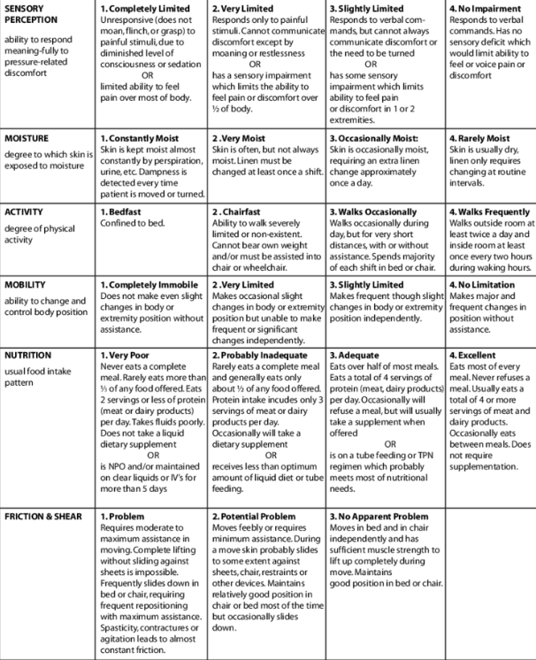
How to Prevent Pressure Injuries in the ED
Santamaria N, et al. Preventing pressure injuries in the emergency department: Current evidence and practice considerations. International Wound Journal 2019; (16)3: 746-752.

Slide 10
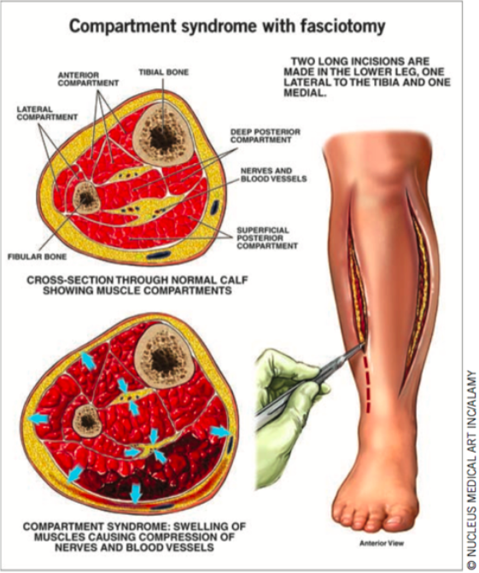
How to Diagnose and Treat Acute Compartment Syndrome?
Clinical hallmarks are defined as the 5Ps: pain out of proportion, pallor, paresthesia, paralysis, and pulselessness.
Immediate surgical fasciotomy can prevent severe sequelae
Timing is crucial in order to avoid irreversible ischemic changes. Prophylactic fasciotomy can induce major complications.
For fracture patients with blister, indication for fasciotomy should be strictly controlled especially for patients without severe soft tissue injury.
Determination of traumatic etiology is essential for the treatment of these patients.
Guo J, et al. Acute compartment syndrome: cause, diagnosis, and new viewpoint. Medicine 2019 ;98(27):1-6.

Slide 11
What Is Surgical Treatment for Diabetic Forefoot Osteomyelitis?
Clinical courses of all patients based on histopathological examinations. *1st Exam 5 1st histopathological confirmation of the bone margin after surgery based on MRI. **This patient had bilateral ischemic DFO and is included among the 16 pts with ischemic DFO who healed.
Fuji M, et al. Surgical treatment strategy for diabetic forefoot osteomyelitis. Wound Repair and Regeneration 2019; (24): 447-453.

Slide 12
How to Treat Septic Arthritis?
Diagnosis: Blood tests are inadequate to exclude septic arthritis. Blood cultures should be obtained in all patients with suspected septic arthritis, as they can help identify the etiologic agent if the synovial fluid culture is negative. (up to 14% of patients with negative synovial fluid cultures will have positive blood cultures)
Aspiration of synovial fluid is criterion standard for diagnosing septic arthritis. Synovial fluid analysis can also help with determining alternate etiologies for the joint effusion (e.g., including hemarthrosis, gout, etc.)

Slide 13
How to Treat Fournier’s Gangrene With Septic Shock
Zhou Z, et al. Fournier’s Gangrene With Septic Shock and Multiple Organ Dysfunction Syndrome. The International Journal of Lower Extremity Wounds 2019, 18(1): 94–96.

Slide 14
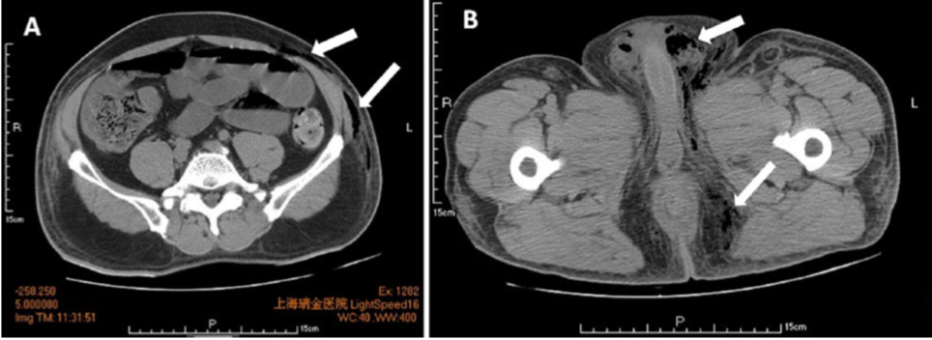
How to Treat Fournier’s Gangrene With Septic Shock (continued)
Diagnosis: Physical examination combined with CT, ultrasonography, and clinical findings
CT images can reveal perirectal abscesses and trace of fascial air along the perineum, scrotum, and lower abdomen.
Zhou Z, et al. Fournier’s Gangrene With Septic Shock and Multiple Organ Dysfunction Syndrome. The International Journal of Lower Extremity Wounds 2019, 18(1): 94–96.
Computed tomography (CT) image of the lower abdominal, scrotal, and perineal regions. The CT scan shows subcutaneous emphysema in addition to air in the lower abdomen, scrotum, and perianal fascia (arrows).

Slide 15
How to Manage Steven Johnson Syndrome?
The most frequently used treatments for SJS/TEN are systemic corticosteroids, immunoglobulins, and cyclosporine A.
Malik MN, et al. Pancytopenia in a Patient with Stevens-Johnson Syndrome: A Case Report with Literature Review. Cureus 2019 May; 11(5): e4702.

Slide 16
How to Treat Dental Emergencies?
With traumatic fractures, loosening, or complete avulsion of the tooth, the primary goal of treatment is to preserve or restore the integrity of the tooth and the secondary goal is cosmesis.
Primary teeth are never replaced if avulsed.
Dental infections range from simple caries to life-threatening infections, such as acute necrotizing ulcerative gingivitis and Ludwig angina. In the emergency department (ED), assessing the extent of infection, antibiotic and analgesia administration, imaging, and prompt referral to a dentist or oral surgeon are paramount.
Key ED procedures include dental blocks for pain relief, reducing and splinting teeth, and achieving hemostasis.
Hammel JM, et al. Dental Emergencies. Emergency Medical Clinics of North America 2019 (37)1: 81-93.

Slide 17
What Is Treatment for Autonomic Dysreflexia with Neurologic Complications?
MRI consistent with posterior reversible encephalopathy syndrome. (A) Transverse imaging (T2, top; fluid-attenuated inversion recovery, middle; and diffusion- weighted imaging, bottom) shows cortical edema in the left pari- etal lobe (red arrows). The normal findings on diffusion-weighted imaging (bottom) suggest vasogenic rather than cytotoxic edema. (B) Contiguous sagittal fluid-attenuated inversion recovery images confirmed vasogenic edema in cortical (red arrows) and subcortical (white arrows) areas. Further areas of cortical and sub- cortical edema were present throughout the parietal and occipital lobes bilaterally (not shown). Given the patient’s acute, severe hypertension, the imaging findings were consistent with mild but evolving posterior reversible encephalopathy syndrome.
Squair JW, et al. Emergency management of autonomic dysreflexia with neurologic complications. CMAJ 2016 (188)15:1100-1103.

Slide 18
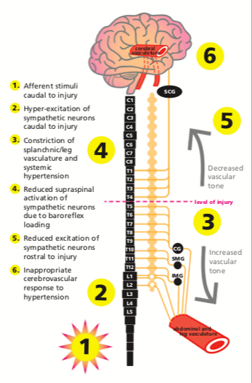
What Is Treatment for Autonomic Dysreflexia with Neurologic Complications?
Theoretical framework underlying cerebrovascular events induced by autonomic dysreflexia. In this case, the level of the patient’s injury may have played a role in the development of autonomic dysreflexia–induced posterior reversible encephalop- athy syndrome. Specifically, hyperexcitation of the sympathetic preganglionic neurons below the level of injury and a subse- quent increase in blood pressure would result in dilatation of the cerebral blood vessels because of intact supraspinal regulation of the superior cervical ganglion (SCG). Paradoxic baroreflex- mediated relaxation of the cerebral arteries would impair auto- regulation of the increasing blood pressure and expose the deli- cate cerebral microvasculature to insulting elevation in cerebral blood flow, potentially compromising the integrity of the blood– brain barrier. CG = celiac ganglion, IMG = inferior mesenteric gan- glion, SMG = superior mesenteric ganglion
Squair JW, et al. Emergency management of autonomic dysreflexia with neurologic complications. CMAJ 2016 (188)15:1100-1103.

Slide 19
How Can Negative Pressure Wound Therapy Help in Early-stage Management of Complex Wounds?
Early stage clinical decision points are indicated by purple boxes and options for wound preparation modalities are indicated by blue boxes. Dashed lines present potential early stage wound management options. NPWTi-d:Negative pressure wound therapy with instillation and dwell time. ROCF-CC:Reticulated open cell foam dressing with through holes. AWD: Advanced wound dressing.
Obst MA, et al. Early-stage Management of Complex Wounds Using Negative Pressure Wound Therapy With Instillation and a Dressing With Through Holes Wounds 2019;31(5):E33–E36..

Slide 20
Negative Pressure Wound Therapy
Obst MA, et al. Early-stage Management of Complex Wounds Using Negative Pressure Wound Therapy With Instillation and a Dressing With Through Holes Wounds 2019;31(5):E33–E36..

Slide 21
Negative Pressure Wound Therapy
Obst MA, et al. Early-stage Management of Complex Wounds Using Negative Pressure Wound Therapy With Instillation and a Dressing With Through Holes Wounds 2019;31(5):E33–E36..

Slide 22
Are Antibiotic-impregnated calcium sulfate beads effective in accelerating healing?
Key outcome measures of patients (N=42) in each group
Dekker AP, et al. Do Antibiotic-impregnated Calcium Sulfate Beads Improve the Healing of Neuropathic Foot Ulcers with Osteomyelitis Undergoing Surgical Debridement? Wounds 2019;31(6):145-150..

Slide 23
Are Antibiotic-impregnated calcium sulfate beads effective in accelerating healing? (continued)
Dekker AP, et al. Do Antibiotic-impregnated Calcium Sulfate Beads Improve the Healing of Neuropathic Foot Ulcers with Osteomyelitis Undergoing Surgical Debridement? Wounds 2019;31(6):145-150..

