Slide 1
Venous Ulcers Wednesday, October 2, 2024
Notes:
1

Slide 2
Agenda
Venous ulcer protocol
What is pathophysiology?
How are venous ulcers diagnosed?
What are the risk factors?
Physical exam?
What noninvasive diagnostic modalities are available?
Radiographic testing
Laboratory tests
What is histopathology?
Surgical debridement
What are recommended treatment options?
What types of dressings are available?
What are key recommendations?
How effective is cellular therapy?
What are guidelines? (Society for Vascular Surgery/American Venous Forum)
What is Marjolin’s ulcer?
How to distinguish ulcerated basal cell carcinomas from venous ulcers?
Clinical presentation
What is role of systemic T-cell vs. localized T-cell lymphoma for treatment?
What is role of radiation therapy in lymphoma?

Slide 3
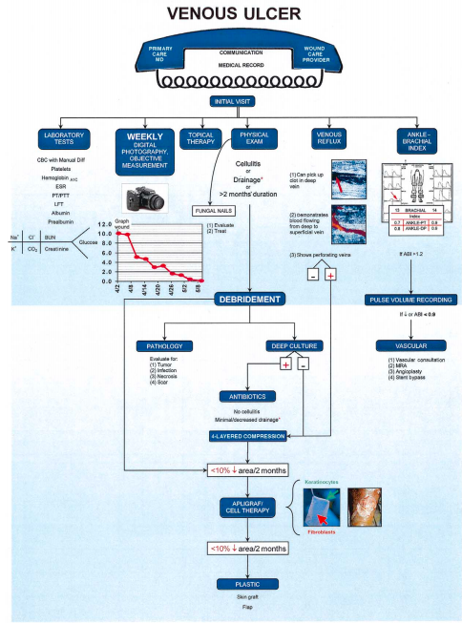
Venous Ulcer Protocol
Brem H, Kirsner RS, Falanga V. Protocol for the successful treatment of venous ulcers. Am J Surg. 2004;188(1A Suppl):1-8.

Slide 4
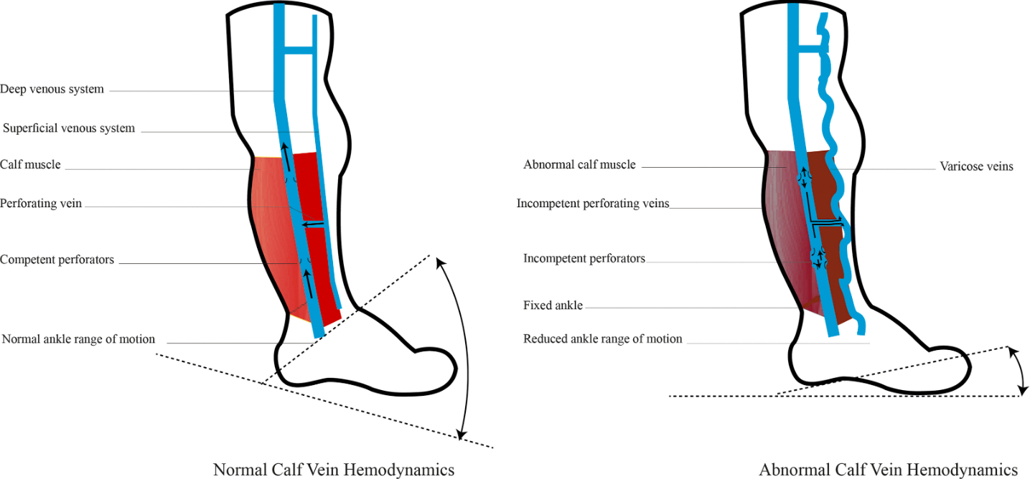
What is the pathophysiology of venous disease/venous ulcers?
Valve dysfunction, outflow obstruction, arteriovenous malformation, and calf muscle pump failure contribute to the pathogenesis of venous disease.
Alavi A, et al. What’s New: Management of venous leg ulcers: approach to venous leg ulcers. Journal of the American Academy of Dermatology. 2016;74(4):627-640.

Slide 5
How are venous ulcers diagnosed?
A detailed history and physical examination is imperative to establish the etiology of venous disease and rule out conditions that may present with similar signs and symptoms.
Systemic conditions such as congestive heart failure, kidney failure, liver failure, or nephrotic syndrome commonly present with leg edema.
Comorbid conditions including obesity, diabetes, rheumatoid disease, hypertension, and aging complicate healing. Evaluation for arterial insufficiency will identify the 15% to 20% of patients who have mixed arterial and venous disease [Grade 1B per Clinical Practice Guidelines (CPG)].
Doppler evaluation and measurement of ankle brachial index (ABI) is recommended for patients without palpable pulses.
If the ABI <= 0.9, it is recommended that patients see a vascular specialist before compression or operative intervention for venous leg ulcer is undertaken.
Underlying thrombophilia should be considered in patients with VLUs, especially those with history of DVT.
Gould L, Brem H, et al. Modalities to Treat Venous Ulcers: Compression, Surgery, and Bioengineered Tissue. Plast Reconstr Surg. 2016;138(3S):199S-208S. doi:10.1097/PRS.0000000000002677.

Slide 6
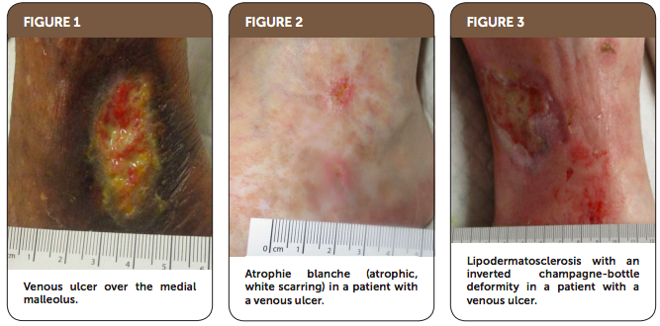
How to recognize venous ulcers?
Bonkemeyer MS. Venous Ulcers: Diagnosis and Treatment Am Fam Physician. 2019 Sep 01 2019. Vol. 100 (5), pp. 298-305.

Slide 7
Venous Ulcers: What are the risk factors?
Risk factors for venous disease include obesity, advanced age, prolonged standing, physical inactivity, greater height, and genetic predisposition.
These factors lead to prolonged venous hypertension resulting in chronic inflammation in the veins and surrounding tissue.
Although the majority of venous hypertension can be ascribed to reflux through incompetent valves, additional causes include venous outflow obstruction and failure of the calf-muscle pump owing to obesity or leg immobility.
Gould L, Brem H, et al. Modalities to Treat Venous Ulcers: Compression, Surgery, and Bioengineered Tissue. Plast Reconstr Surg. 2016;138(3S):199S-208S. doi:10.1097/PRS.0000000000002677.

Slide 8
Physical Exam
Exact anatomical location of wound, e.g.:
Plantar or dorsal surface of toe 1,2,3,4,5)
If plantar, identify which metatarsal
Heel/ankle/calf, anterior tibia, lateral or medial
If patient has heel ulcer, do they have sacral, buttock, occiput, or hip ulcer?
Length, width, depth of wound
Fungal toenails (e.g., yes/no? which ones?)
Characterization of skin around wound (e.g., erythema, callus? pustules? dermatitis? hyperpigmentation?)
Pus
Tenderness
Drainage
Characterization of granulation tissue (e.g., discolored, well-vascularized?)
Undermining of wound edges (i.e., how many centimeters?)
Warmth
Induration
Odor
Probes to bone (yes/no)
If patient has foot ulcer, peripheral sensory neuropathy (10 g Semes Weinst monofilament, 128 Hz tuning for, vibration perception threshold testing)
Biomechanical problems (assess by x-ray and ambulation exam)
Pulse exam
Absent or diminished (dorsalis pedis, posterior tibial)
Contralateral foot/leg (e.g., comment on ulceration, callus, dermatitis, hyperpigmentation, erythema, and edema)

Slide 9
What noninvasive diagnostic modalities are available?
Noninvasive diagnostic modalities aid in establishing the diagnosis of CVI and can measure the severity and location of the abnormal venous anatomy.
This may help guide the type of therapy and provide a basis for long-term follow-up. Venous Duplex ultrasound is the preferred noninvasive test for patients with VLU (Grade 1B per CPG).
It provides objective evidence of venous disease and gives information about the pathophysiology (reflux, obstruction) and anatomic location (superficial, deep, perforator).
Valvular incompetence is present when reflux time (reversal of flow with provocative maneuvers like Valsalva) is >=0.5 seconds for superficial, tibial, deep femoral, and perforator veins; >=1.0 seconds for femoral and popliteal veins.
Other noninvasive tests may be used for patients with equivocal findings on Venous Duplex or in recurrent/recalcitrant ulcers (Grade 2B per CPG) to establish diagnosis and assess disease severity.
Venous refill time <18 to 20 seconds by photoplethysmography is indicative of CVI (normal = 18-20s).
Venous filling index > 4 ml/s by air plethysmography correlates with reflux (normal < 2 ml/s).
Gould L, Brem H, et al. Modalities to Treat Venous Ulcers: Compression, Surgery, and Bioengineered Tissue. Plast Reconstr Surg. 2016;138(3S):199S-208S. doi:10.1097/PRS.0000000000002677.

Slide 10
Radiographic Testing
x-ray (e.g., foot, tibia, fibula).
All patients with diabetes and any patient with a diminished pulse should have bilateral ankle brachial indices.
Unless a pulse is clearly palpable, noninvasive vascular ankle-brachial index testing, and all patients with diabetes over 50 should be screened with an ankle-brachial index, whether or not they have an ulcer.

Slide 11
Laboratory Tests
Procalcitonin
C-Reactive Protein
Hemoglobin A1c
Albumin, pre-albumin
Vitamin D level
Complete blood count with manual differential
Prothrombin time/partial thromboplastin time
Comprehensive metabolic panel
Lipid profile
Erythrocyte sedimentation rate
Thyroid-stimulating hormone (TSH) thyroxine (T4) and triodothyronine (T3)
Aspartate Aminotransferase (AST)
Alkaline phosphatase (ALP)
Gamma‐Glutamyl Transpeptidase (GGT)
Alanine aminotransferase (ALT)
Urine analysis
Urinary microalbumin

Slide 12
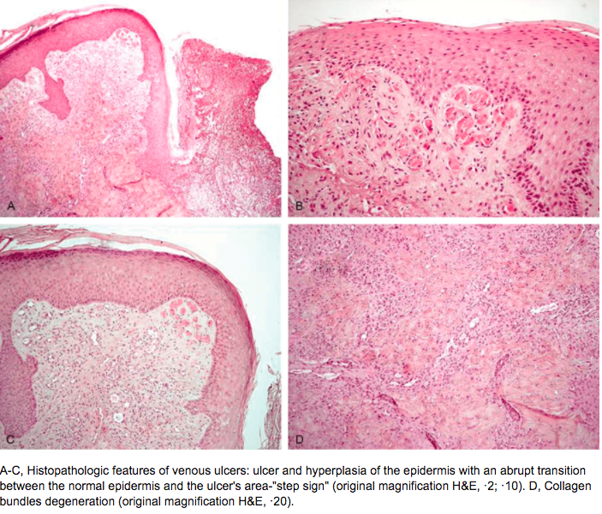
What is the histopathology of venous ulcers?
Misciali, Cosimo & Dika, Emi & Baraldi, Carlotta & Fanti, Pier & Mirelli, Michele & Stella, Andrea & Bertoncelli, Marco & Patrizi, Annalisa. (2014). Vascular Leg Ulcers: Histopathologic Study of 293 Patients. The American Journal of dermatopathology. 36.

Slide 13
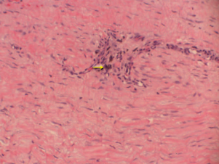
How to interpret pathology in venous ulcers?
Hematoxylin and eosin stain of debrided tissue from a venous ulcer depicting dense fibrous connective tissue with hemosiderin deposition (arrow).
Gould LJ, et al. Modalities to treat venous ulcers: compression, surgery, and bioengineered tissue. Plastic and Reconstructive Surgery. 2016 Sep; 138(3 Suppl): 199S-208S.

Slide 14
Surgical Debridement
Osteomyelitis
Substantial non-viable tissue
Joint involvement
Significant undermining
Infection
Non-healing, drainage

Slide 15
What are recommended treatment options for venous ulcers?
Bonkemeyer MS. Venous Ulcers: Diagnosis and Treatment Am Fam Physician. 2019 Sep 01 100 (5): 298-305.

Slide 16
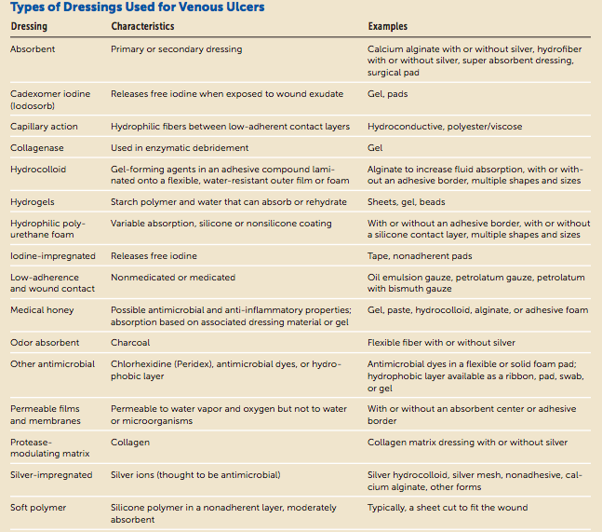
What types of dressings are available for venous ulcers?
.
Bonkemeyer MS. Venous Ulcers: Diagnosis and Treatment Am Fam Physician. 2019 Sep 01 100 (5): 298-305.

Slide 17
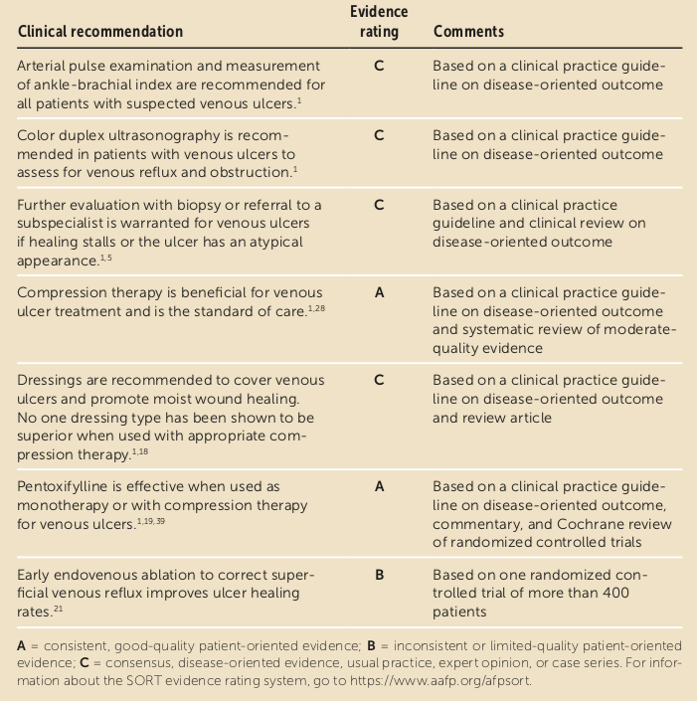
Venous Ulcers: What are key recommendations for practice?
Bonkemeyer MS. Venous Ulcers: Diagnosis and Treatment Am Fam Physician. 2019 Sep 01 100 (5): 298-305.

Slide 18
How effective is cellular therapy in treatment of venous leg ulcers?
(Left) This patient, an obese woman, presented with a cellulitic infected venous ulcer. (Right) This figure demonstrates healing after a combination of antibiotics, human skin equivalent, and compression therapy.
Brem H, et al. Protocol for the successful treatment of venous ulcers. American Journal of Surgery. 2004 (Suppl)188: 1S-8S.

Slide 19
Society for Vascular Surgery/American Venous ForumJoint Clinical Practice Guidelines Committee—Venous Leg Ulcer
Rule out arterial disease
if present, must be treated.
Evaluate for superficial/deep/perforator reflux and venous outflow obstruction
Venous reflux study (which includes DVT study)
If superficial reflux present
thermal ablation/ligation/stripping
+/- CT venogram to assess venous outflow obstruction.
If venous outflow obstruction present or inconclusive based on CTV, proceed with Venogram/IVUS (venous stenting)
O'Donnell TF Jr, Passman MA, Marston WA, et al. Management of venous leg ulcers: clinical practice guidelines of the Society for Vascular Surgery ® and the American Venous Forum. J Vasc Surg. 2014;60(2 Suppl):3S-59S. doi:10.1016/j.jvs.2014.04.049

Slide 20
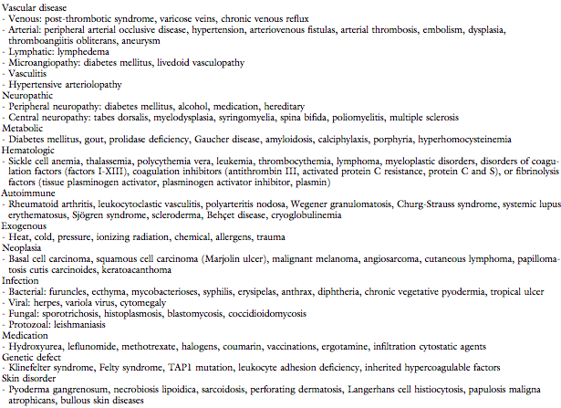
Society for Vascular Surgery/American Venous ForumJoint Clinical Practice Guidelines Committee—Venous Leg Ulcer
Differential diagnosis for leg ulcers
O'Donnell TF Jr, Passman MA, Marston WA, et al. Management of venous leg ulcers: clinical practice guidelines of the Society for Vascular Surgery ® and the American Venous Forum. J Vasc Surg. 2014;60(2 Suppl):3S-59S. doi:10.1016/j.jvs.2014.04.049

Slide 21
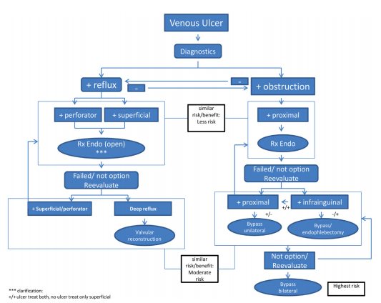
Society for Vascular Surgery/American Venous ForumJoint Clinical Practice Guidelines Committee—Venous Leg Ulcer
Proposed algorithm for operative and endovascular treatment of patients with venous leg ulcer (VLU) based on involved anatomic venous system and presence of venous reflux or obstruction. The risk-to-benefit ratio is weighed for those procedures with more risk (lower, moderate, higher) considered later in the treatment when the benefit is similar.
O'Donnell TF Jr, Passman MA, Marston WA, et al. Management of venous leg ulcers: clinical practice guidelines of the Society for Vascular Surgery ® and the American Venous Forum. J Vasc Surg. 2014;60(2 Suppl):3S-59S. doi:10.1016/j.jvs.2014.04.049

Slide 22
What is Marjolin’s ulcer?
Squamous cell carcinoma (SCC) has been commonly reported by foot and ankle specialists.
Marjolin's ulcer is a malignancy that involves a posttraumatic scar or ulceration that can develop into SCC from chronic neuropathic pedal wounds, venous stasis, or decubitus ulcerations.
Most Marjolin's ulcers are found in the lower extremity, specifically the feet, and it is twice as common in females as males.
Biopsy of the tumor is the reference standard to diagnose SCC, and wide excision of SCC is the most common treatment option.
Tchanque-Fossuo CN, Millsop JW, Johnson MA, Dahle SE, Isseroff RR. Ulcerated Basal Cell Carcinomas Masquerading as Venous Leg Ulcers. Adv Skin Wound Care. 2018;31(3):130-134.

Slide 23
What is definition of Marjolin’s ulcer?
De novo SCC is a particularly aggressive variant of SCC which lacks a precursor and will thus arise independently on skin which has been chronically injured or diseased. It is not correlated with sun exposure, nor will it show any evidence of previous actinic lesions or SCCS.
Generally, de novo SCC will emerge in the setting of long-standing ulcers, burn scars, or osteomyelitis. It can also be seen in chronic inflammatory conditions such as discoid lupus erythematosus and dystrophic epidermolysis bullosa. The tendency for malignancies to develop in burn scars was first described by Marjolin in 1827, and accordingly, are referred to today as Marjolin's ulcers.
Unlike conventional SCCs, which tend to occur on the face, neck, hands, and other sun-damage prone areas, de novo SCCs are most commonly found on the lower extremities, where burn scars are more prevalent.
Although females on average sustain a greater number of burn injuries than males, there is a predilection for malignant scar development in men, and de novo SCCs are significantly more likely to be found in males than in females. They usually emerge 20 to 40 years after the original trauma occurred, and will present clinically as nonhealing, exophytic growths or indurated ulcers which have recently became painful and may have a foul smelling discharge
Yanofsky VR, Mercer SE, Phelps RG. Histopathological variants of cutaneous squamous cell carcinoma: a review. J Skin Cancer. 2011;2011:210813. doi:10.1155/2011/210813

Slide 24
What is definition of Marjolin’s ulcer?
Frequency of histopathologic diagnoses
Pathologic diagnosis | Frequency NO. (%)
Well differentiated SCC | 32 (38.6%)
SCC, differentiation not reported | 20(24.1%)
Moderately Differentiated SCC | 11(13.2%)
BCC | 8(9.6%)
Poorly Differentiatd SCC | 5(6.0%)
Melanoma | 2(2.4%)
Verrucous carcinoma | 2(2.4%)
MFH | 1(1.2%)
Mucoepidermoid carcinoma | 1(1.2%)
Leiomyosarcoma | 1(1.2%)
Sadegh Fazeli M, Lebaschi AH, Hajirostam M, Keramati MR. Marjolin's ulcer: clinical and pathologic features of 83 cases and review of literature. Med J Islam Repub Iran. 2013;27(4):215-224.

Slide 25
How to treat Marjolin’s ulcer?
Preoperative clinical images showing the right posterior plantar heel with the tumor centrally located within the site of the pressure ulceration. The ulcer measured 3.0 cm long, 3.0 cm wide, and 1.5 cm deep.
Cavaliere R, Mercado DM, Mani M. Squamous Cell Carcinoma From Marjolin's Ulcer of the Foot in a Diabetic Patient: Case Study. J Foot Ankle Surg. 2018;57(4):838-843.
.

Slide 26
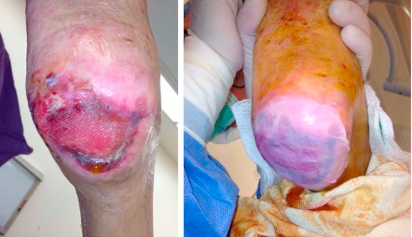
How to treat Marjolin’s ulcer?
Intraoperative application of Apligraf to the right heel ulceration. This was performed to assist in delayed primary closure in an effort to prevent recurrence.
Cavaliere R, Mercado DM, Mani M. Squamous Cell Carcinoma From Marjolin's Ulcer of the Foot in a Diabetic Patient: Case Study. J Foot Ankle Surg. 2018;57(4):838-843.
.

Slide 27
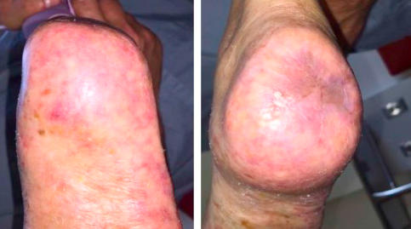
How to treat Marjolin’s ulcer?
View ~1 year postoperatively. The surgical site had healed with no open lesions or signs of recurrence at the site of resection.
Cavaliere R, Mercado DM, Mani M. Squamous Cell Carcinoma From Marjolin's Ulcer of the Foot in a Diabetic Patient: Case Study. J Foot Ankle Surg. 2018;57(4):838-843.
.

Slide 28
How to distinguish ulcerated basal cell carcinomas from venous ulcers?
Tchanque-Fossuo CN, Millsop JW, Johnson MA, Dahle SE, Isseroff RR. Ulcerated Basal Cell Carcinomas Masquerading as Venous Leg Ulcers. Adv Skin Wound Care. 2018;31(3):130-134.
.

Slide 29
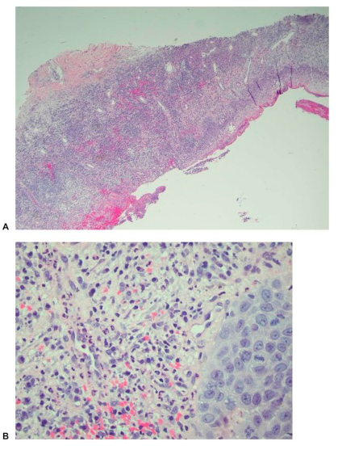
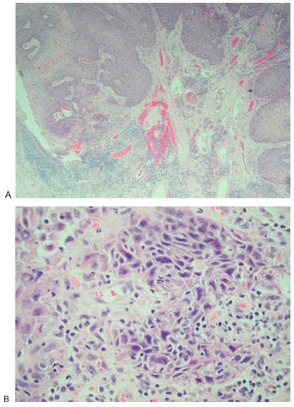
How to distinguish biopsies of ulcerated basal cell carcinomas from venous ulcers?
(A) Skin biopsy showing epidermal ulceration (original magnification × 40; hematoxylin and eosin stain) composed of (B) acute and chronic inflammatory cells and organizing granulation tissue, with reactive degenerative changes (original magnification × 400; hematoxylin and eosin stain).
(A) Well-differentiated, invasive squamous cell carcinoma showing ulceration (original magnification × 40; hematoxylin and eosin stain). (B) Nest of mild to moderate atypical cells showing abundant eosinophilic cytoplasm and large nuclei with vesicular chromatin (original magnification × 400; hematoxylin and eosin stain).
.
Cavaliere R, Mercado DM, Mani M. Squamous Cell Carcinoma From Marjolin's Ulcer of the Foot in a Diabetic Patient: Case Study. J Foot Ankle Surg. 2018;57(4):838-843.

Slide 30
How to identify a tumor masquerading as a wound—not Marjolin’s ulcer?
In 1986, Harold F. Dvorak, Professor of Pathology at Harvard Medical School Boston, published an essay in the New England Journal of Medicine entitled "Tumors: Wounds that do not heal" that pointed out the similarities exist between tumor stroma generation and wound healing. Cancers share many features in common with tissue regeneration, including immune response, cell proliferation, cell migration, tissue remodeling, and cell death.
Based on the then recent discovery of vascular permeability factor (VPF)/VEGF, Dvorak suggested that tumors behaved as wounds that do not heal. More particularly, he proposed that tumors co-opted the wound-healing response to induce the stroma they required for maintenance and growth. Work over the past few decades has supported this hypothesis and has put it on a firmer molecular basis.
VPF/VEGF initiates a sequence of events in both tumors and wounds that includes the following: increased vascular permeability; extravasation of plasma, fibrinogen and other plasma proteins; activation of the clotting system outside the vascular system; deposition of an extravascular fibrin gel that serves as a provisional stroma and a favorable matrix for cell migration; induction of angiogenesis and arterio-venogenesis; subsequent degradation of fibrin and its replacement by "granulation tissue" (highly vascular connective tissue); and, finally, vascular resorption and collagen synthesis, resulting in the formation of dense fibrous connective tissue (called "scar tissue" in wounds and "desmoplasia" in cancer). A similar sequence of events also takes place in a variety of important inflammatory diseases that involve cellular immunity.
Dvorak HF. Tumors: wounds that do not heal. Similarities between tumor stroma generation and wound healing. N Engl J Med. 1986;315(26):1650-1659.
Dvorak HF. Tumors: wounds that do not heal-redux. Cancer Immunol Res. 2015;3(1):1-11.

Slide 31
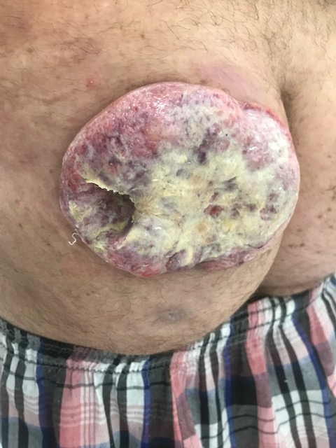
Clinical Presentation: JM

Slide 32
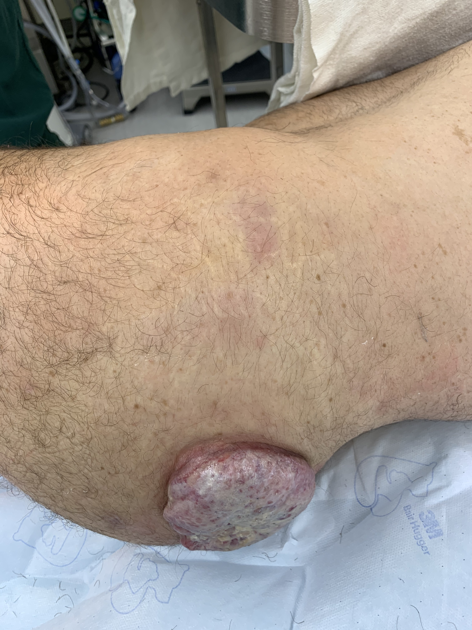
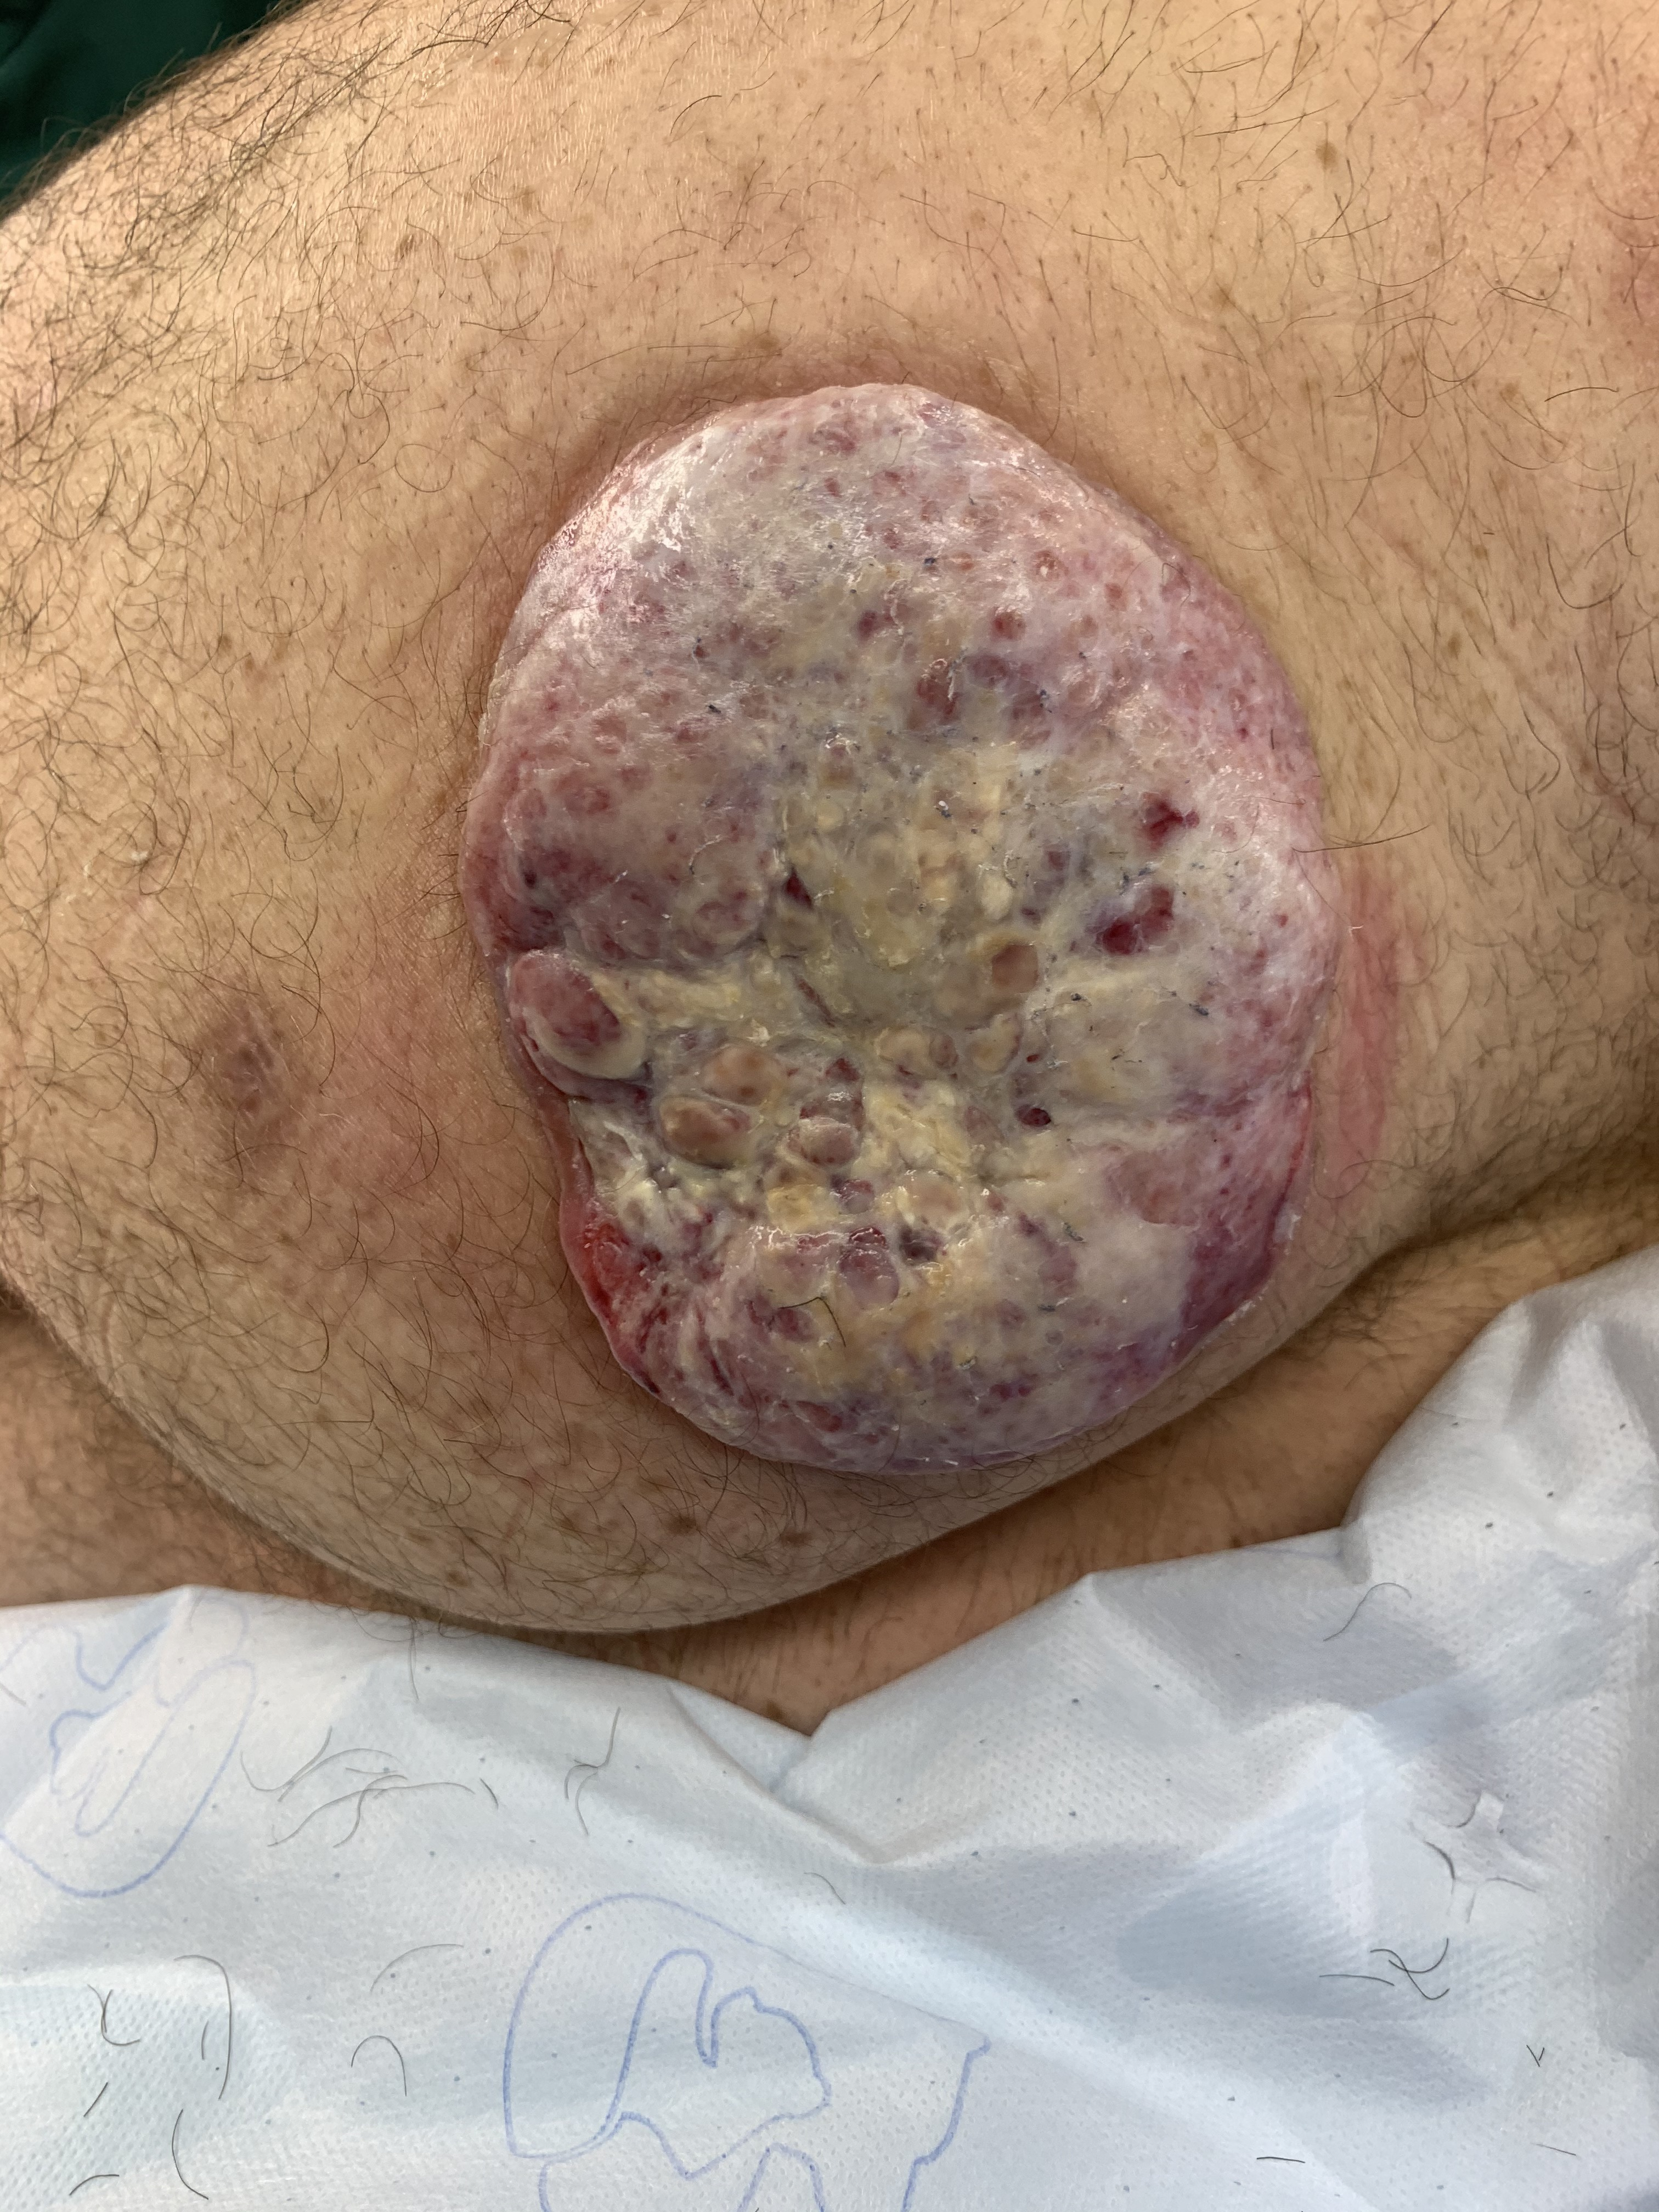
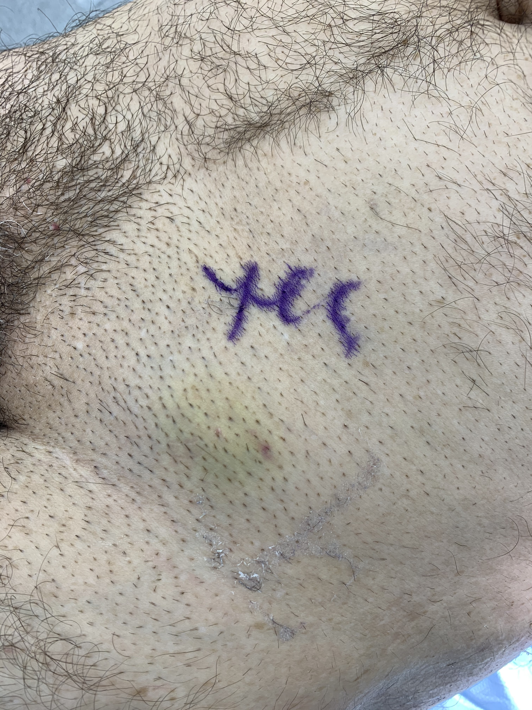
Procedures
Excision of left inguinal necrotic lymph node, incisional biopsy of left gluteal mass and left posterior hip soft tissue mass

Slide 33
Clinical Presentation: JM
Age: 51
The mass began as a pimple 9/2019 and has increased in size. I performed a biopsy on 5/22 showing no clear evidence of malignancy. Admitted patient for biopsy and secondary infection and he signed out AMA. He states the mass has become painful. BMI 26.4
ROS: denies weight loss, back pain, nausea, vomiting, night sweats, dysuria, diarrhea, constipation
Fam Hx: mother died of cancer at 53yo
Physical Exam:
Gen: no acute distress, AAOx3
Cardiac: NSR
Pulm: non-labored respirations
Abdomen: soft, non-tender, non-distended
Skin exam: left gluteal mass measuring 9cmx5cm, fixed left inguinal node lymphadenopathy 4x4cm, non-tender, no ulceration

Slide 34
JM: Hospital Day 1-3
Pathology 5/22
Fragments of fibroconnective tissue showing acute and chronic inflammation, granulation tissue, focal lymphoid aggregates and necrosis
CT chest, abdomen, pelvis 5/22
Increased cutaneous thickening and nodularity in the left gluteal region, with increasing nodules in the left lateral aspect of the buttocks
Mass extending to left gluteus maximus muscle with attenuated, but intact fat plane
Necrotic left inguinal lymph node/abscess
Left inguinal lymph node FNA
Predominantly necrotic tissue with findings most compatible with a lymphoproliferative disorder

Slide 35
JM: Labs
G6PD pending
B2-microglobulin 1.95
CRP <0.29, ESR 12
HIV non-reactive
LDH 431
Hep B non-reactive

Slide 37
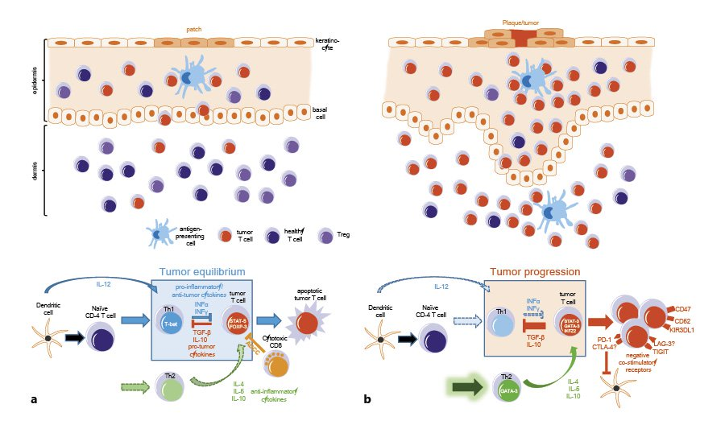
What is role of systemic T-cell vs localized T-cell lymphoma for treatment?
Immune responses in early- and advanced-stage Cutaneous T-Cell Lymphoma (CTCL).
a Early-stage CTCL. Upper panel: schematic illustration of the cellular composition in patch-stage disease. Small populations of tumor T cells are present mostly in the epidermis and are held in check by surrounding healthy T cells and regulatory T cells.
Lower panel: immunosurveillance mechanisms are partially intact, the antitumor Th1 immune response can control tumor progression, leading to a tumor equilibrium.
b Advanced-stage CTCL. Upper panel: schematic illustration of the cellular composition in plaque/tumor stage disease. The number of infiltrating tumor T cells is largely increased and present now also in the dermis, while the number of healthy T cells and T regulatory cells is decreased. Lower panel: immunosurveillance of the tumor is largely defective. A skewed Th1 immune response and an increased Th2 response, among other mechanisms, lead to immune escape of tumor cells and allow tumor progression.
Bobrowicz M, Fassnacht C, Ignatova D, Chang YT, Dimitriou F, Guenova E. Pathogenesis and Therapy of Primary Cutaneous T-Cell Lymphoma: Collegium Internationale Allergologicum (CIA) Update 2020 [published online ahead of print, 2020 Jul 20]. Int Arch Allergy Immunol. 2020;1-13. doi:10.1159/000509281

Slide 38
What is role of systemic T-cell vs localized T-cell lymphoma for treatment?
Treatment of Cutaneous T-Cell Lymphoma depends on the stage of the disease and the general condition of the patient.
Early disease stages of MF (IA-IIA) can be controlled with skin – directed therapy, such as topical steroids, light treatment and radiation.
Systemic treatments, such as retinoids and IFN-α have been recommended as second-line treatment of MF stages IA, IB and IIA. The 5-year survival for these patients is around 90%, significantly better compared with 30%–50% for advanced disease (IIB–IVB).
Chemotherapy agents, such as monochemotherapy (gemcitabine, pegylated liposomal doxorubicine) and polychemotherapy, as well as newer systemic agents (brentuximab-vedotin and mogamulizumab) are recommended in advanced disease stage. Large cell transformation in histology, expression of CD30 and folliculotropic subtype of MF have been reported to have a more aggressive course and poorer prognosis. Although rare cases of CD4⁻ CD8⁺ , CD4⁻ CD8⁻ , or CD4⁺CD8⁺ immunophenotypes have been described in MF, these differences in phenotype do not affected the prognosis of the disease. However, a phenotypic switch from CD4⁺ to CD4⁻ in the lesion has been suggested a portend of poor outcome
Bobrowicz M, Fassnacht C, Ignatova D, Chang YT, Dimitriou F, Guenova E. Pathogenesis and Therapy of Primary Cutaneous T-Cell Lymphoma: Collegium Internationale Allergologicum (CIA) Update 2020 [published online ahead of print, 2020 Jul 20]. Int Arch Allergy Immunol. 2020;1-13. doi:10.1159/000509281

Slide 39
What is role of radiation therapy in lymphoma?
Cutaneous T-cell lymphoma (CTCL) is a rare non-Hodgkin lymphoma that originates from skin-homing T lymphocytes. Although most patients present with early-stage disease (stage IAIIA) and are likely to experience a favorable prognosis, advanced stage disease (stage IIB-IVB) has been associated with inferior outcomes and a median survival of 2 to 5 years.
Total skin electron beam is a well-established treatment modality for advanced CTCL and has been associated with a near 100% response rate in the skin, with most achieving a complete response when delivered at conventional doses.
Total skin electron beam can be used as an individual regimen or as part of a conditioning regimen in total body irradiation for allogeneic hematopoietic stem cell transplantation.
Kudelka MR, Switchenko JM, Lechowicz MJ, et al. Maintenance Therapy for Cutaneous T-cell Lymphoma After Total Skin Electron Irradiation: Evidence for Improved Overall Survival With Ultraviolet Therapy [published online ahead of print, 2020 Jun 30]. Clin Lymphoma Myeloma Leuk. 2020;S2152-2650(20)30318-9. doi:10.1016/j.clml.2020.06.020

Slide 40
What is role of radiation therapy in lymphoma?
A single-center retrospective analysis of 101 patients with cutaneous T-cell lymphoma (CTCL) who had received total skin electron beam therapy from 1998 to 2018 at the Winship Cancer Institute of Emory University compared the overall survival and progression-free survival for patients had received maintenance therapy, including retinoids, interferon, ultraviolet therapy, nitrogen mustard, and extracorporeal photopheresis compared with those who had not.
They found that all-comer maintenance therapy after total skin electron beam therapy was associated with prolonged progression-free survival and that the specific maintenance regimen of UV therapy was associated with improved overall survival.
Maintenance therapy improved progression-free survival for patients with all stages of CTCL.
UV-based maintenance improved progression-free survival and overall surival in a subset of patients with CTCL.
More multicenter and prospective studies are needed to fully evaluate UV-based maintenance therapies after total skin electron beam therapy for CTCL.
Kudelka MR, Switchenko JM, Lechowicz MJ, et al. Maintenance Therapy for Cutaneous T-cell Lymphoma After Total Skin Electron Irradiation: Evidence for Improved Overall Survival With Ultraviolet Therapy [published online ahead of print, 2020 Jun 30]. Clin Lymphoma Myeloma Leuk. 2020;S2152-2650(20)30318-9. doi:10.1016/j.clml.2020.06.020

