Slide 1





Use of the Wound Electronic Medical Record (WEMR) in Improving Wound Healing
Wednesday, October 2, 2024
Notes:
1

Slide 2
Agenda
What is the WEMR?
How to use WEMR to measure healing?
What’s new in the field of wound photography and quantification?
Can early inpatient treatment protocols halt progression of pressure ulcers using WEMR
WEMR and when to amputate?

Slide 3
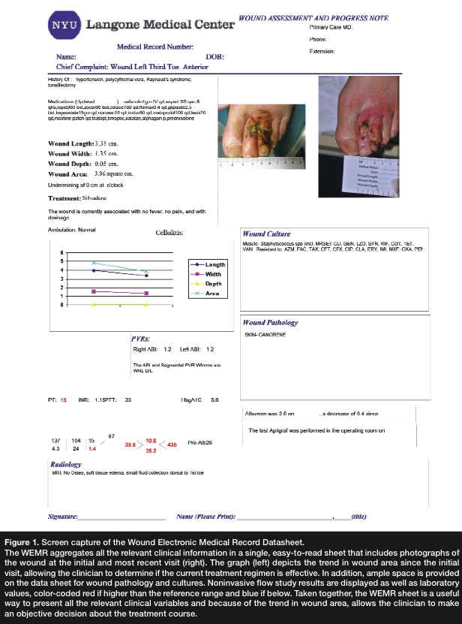
What is the WEMR?
All wounds are examined, photographed, measured, and documented in the Wound Electronic Medical Record (WEMR) database. The WEMR displays on a single printed sheet or computer screen the wound measurements (ie, length, width, depth, and area graphed over time), as well as digital photographs of the wound, vascular testing results (ie, noninvasive flow studies [NIFS]), bacterial cultures, laboratory values, and radiology and pathology reports, in addition to notations regarding amount of drainage, undermining, and presence or absence of cellulitis and pain. Providers can view these data in a single comprehensive Wound Report Form that displays a graph of healing rate, providing an objective framework for each treatment decision.
Golinko MS, Clark S, Rennert R, Flattau A, Boulton AJ, Brem H. Wound emergencies: the importance of assessment, documentation, and early treatment using a wound electronic medical record. Ostomy Wound Manage. 2009 May 1;55(5):54-61. PMID: 19471049.

Slide 4
What is the WEMR?
The WEMR aggregates all of the relevant clinical information in a single, easy-to-read sheet that includes photographs of the wound at the initial and most recent visit. In addition, space is provided on the data sheet for wound pathology and cultures. Noninvasive flow study results are displayed as well as laboratory values, color-coded red if higher than the reference range and blue if below. Taken together, the WEMR sheet is a useful way to present all of the relevant clinical variables and because of the trend in wound are, allows the clinical to make an objective decision about the treatment course.
Golinko MS, Clark S, Rennert R, Flattau A, Boulton AJ, Brem H. Wound emergencies: the importance of assessment, documentation, and early treatment using a wound electronic medical record. Ostomy Wound Manage. 2009 May 1;55(5):54-61. PMID: 19471049.

Slide 5
How to use WEMR to measure healing?
Infection. A nonhealing wound, as measured by change in area, is often a sign of occult infection. Use of an informatics system such as the WEMR in the emergency room or clinic setting would allow clinicians to determine if the wound is not healing as compared to previous visits.
Patients with chronic wounds may not present with classic signs of soft tissue infection, such as redness, warmth, swelling, and pain, particularly if they have impaired immune response from aging or impaired local vasodilatation linked to neuropathy. Hence, absence of these classic signs does not rule out a wound infection; the clinician should be aware of the atypical signs of a chronic wound infection and devise a treatment plan. In any person with diabetes and wound pain, even a small ulcer may harbor an infection. Increased drainage in a chronic wound is often a sign of persistent infection. Although the drainage may not be purulent, discoloration or an increase in drainage may be a sign of persistent infection that requires treatment.
Golinko MS, Clark S, Rennert R, Flattau A, Boulton AJ, Brem H. Wound emergencies: the importance of assessment, documentation, and early treatment using a wound electronic medical record. Ostomy Wound Manage. 2009 May 1;55(5):54-61. PMID: 19471049.

Slide 6
What’s New in the Field of Wound Photography and Quantification

Slide 7
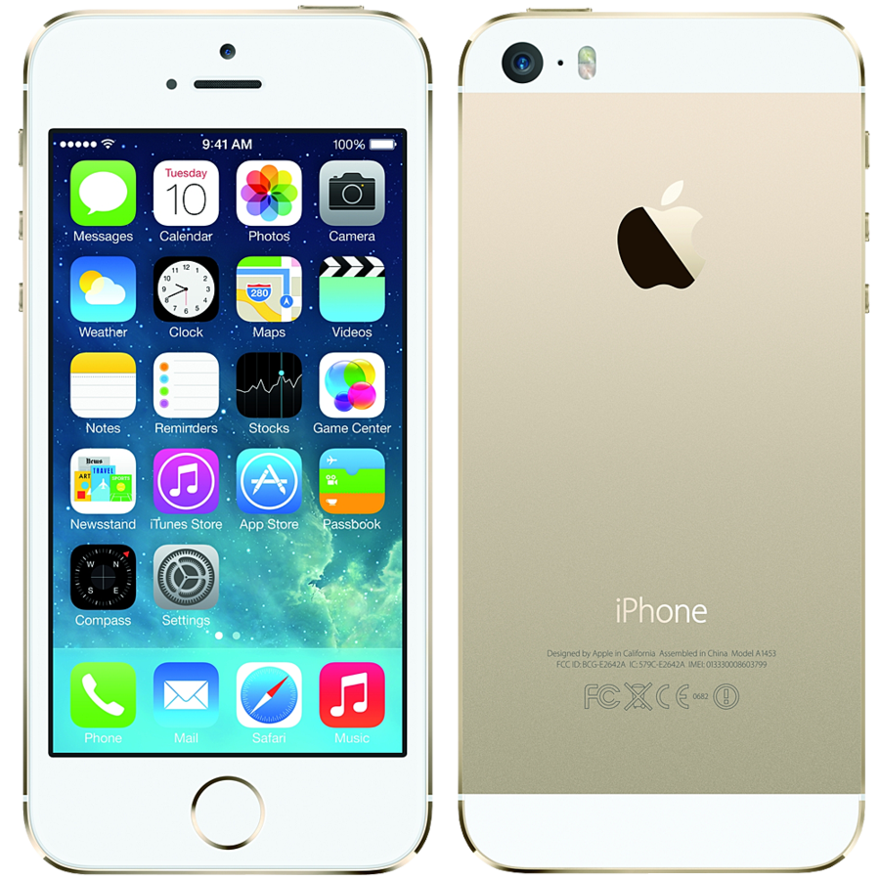
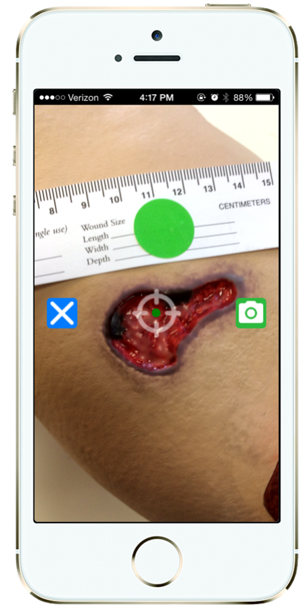
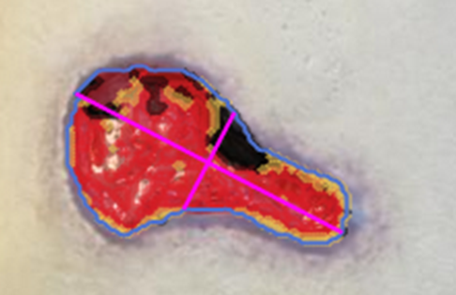
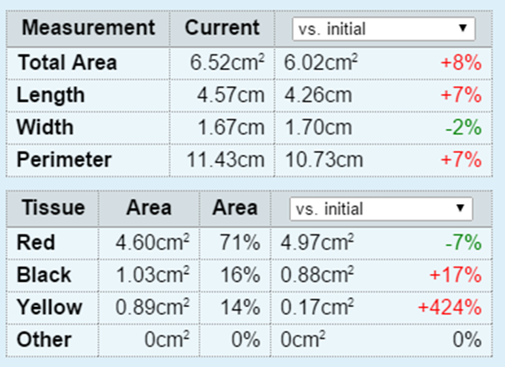
Mobile Wound Analysis
Automatic measurements using start-of-the art machine learning

Slide 8
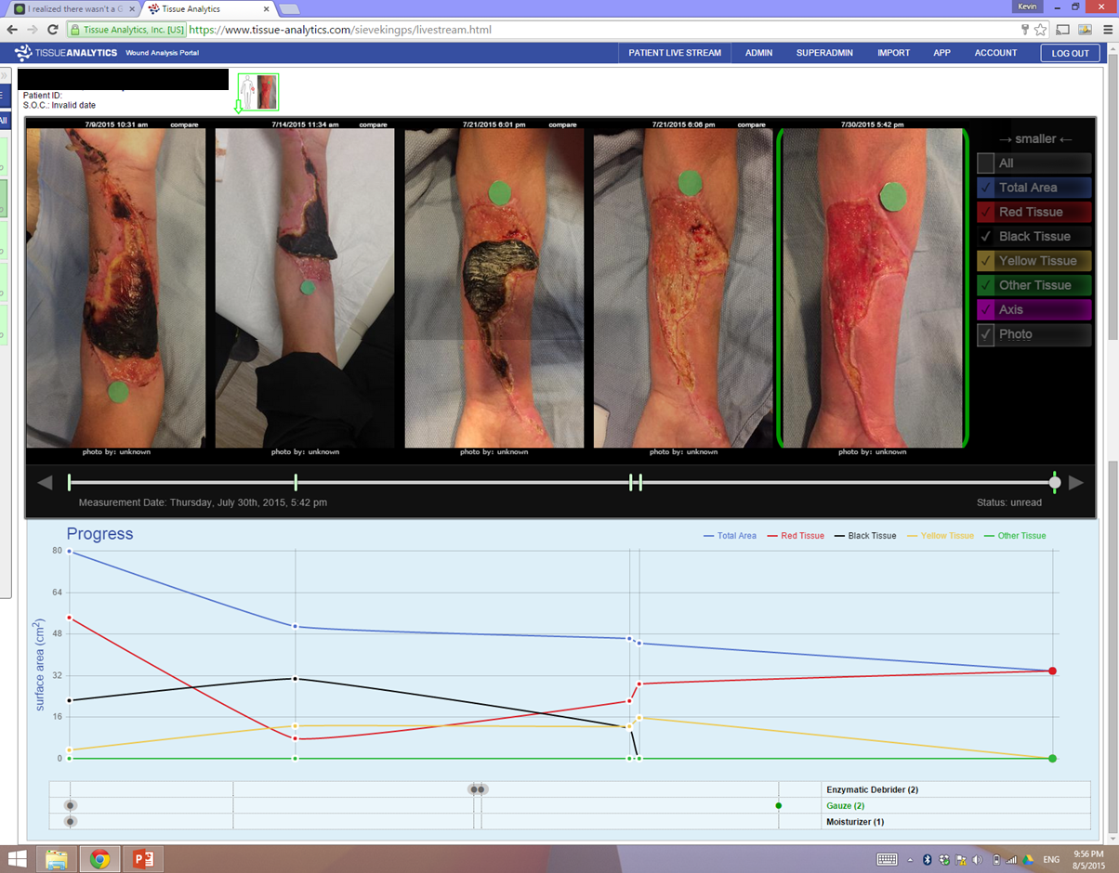
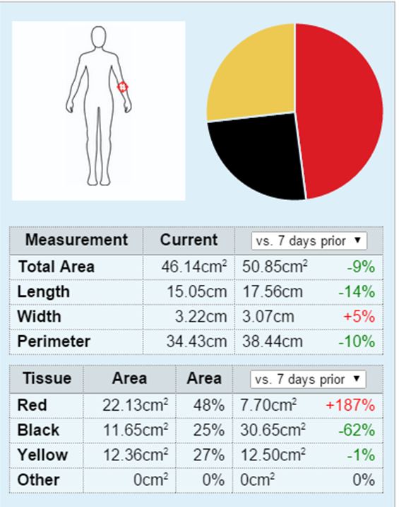
Web Portal for Wound Tracking
Chart of healing progress

Slide 9
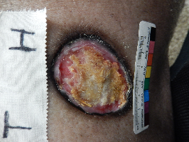
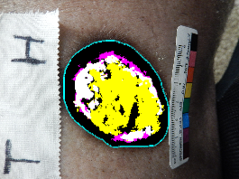
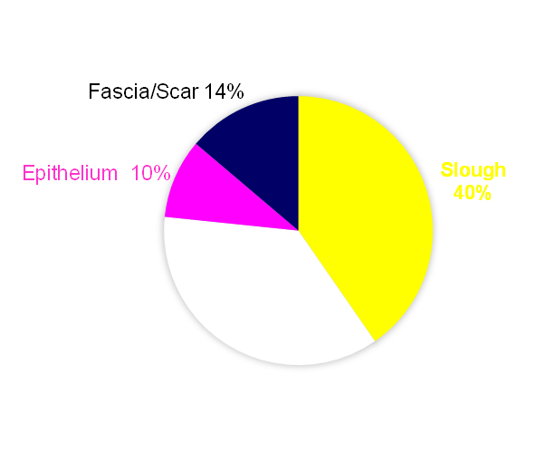
Wound Analysis
LEGEND
Granulation
Slough
Hyperpigmentation
Epithelium
Fascia/Scar
Necrosis
Hyperpigmentation
36%
Other
Type | Area (cm²) | Percentage
Granulation | 0 | 0
Slough | 2.28 | 42.07%
Hyperpigmentation | 2.05 | 37.82%
Epithelium | 0.54 | 9.96%
Fascia/Scar | 0.79 | 14.39%
Necrosis | 0 | 0
Other | 0 | 0
Total | 5.42 | 100%

Slide 10
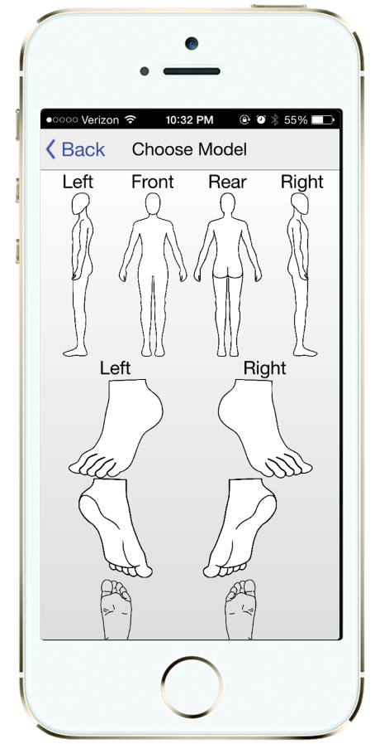
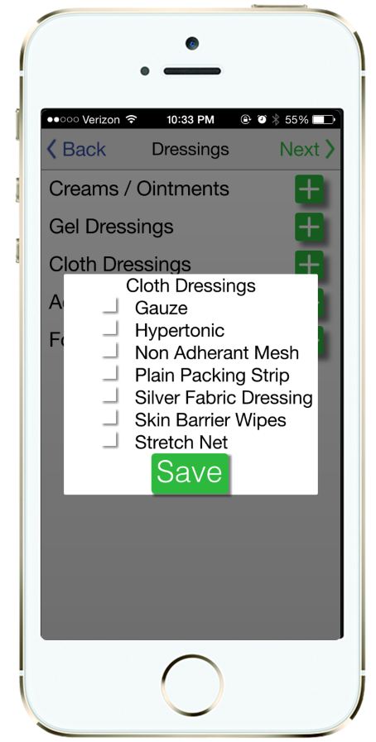
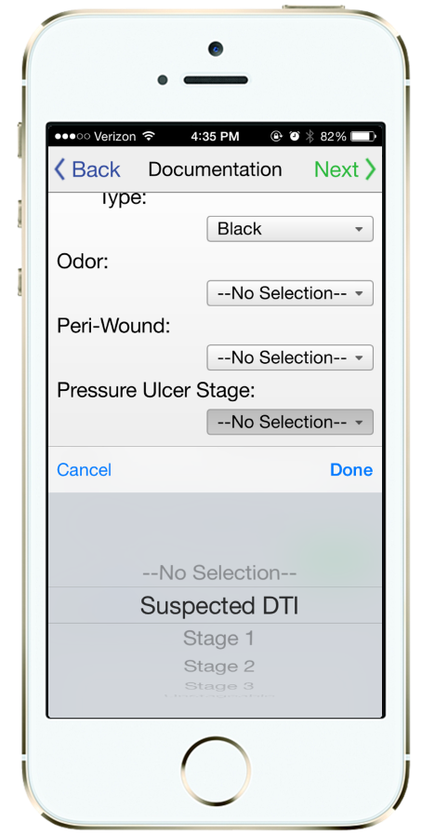
Complete Wound Documentation
60 seconds to log in, take photograph, and complete documentation

Slide 11
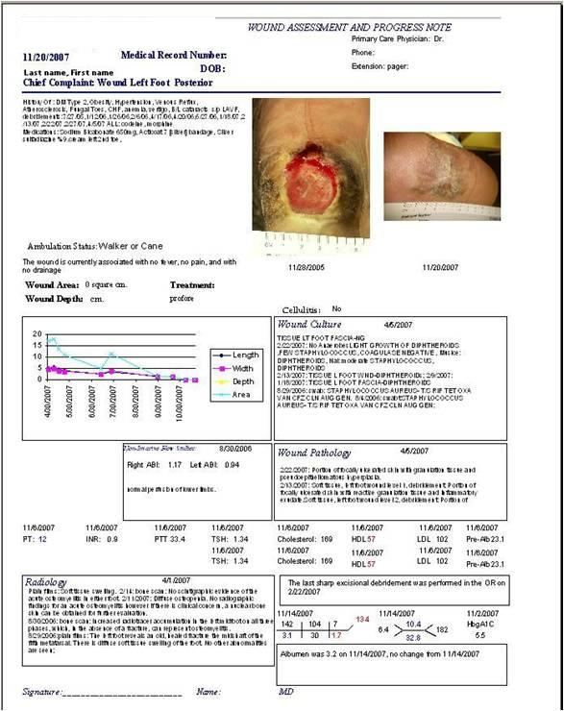
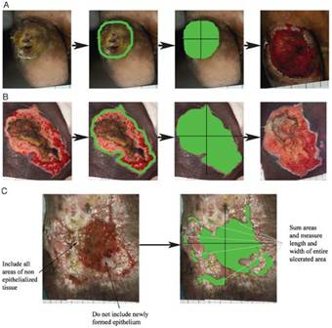
Clinical Decision Support Can Improve Healing Rates
Figure 2.
Standardized wound photography and measurement
Figure 1.
Printed data summary to track healing progress
Rennert et al., Standardization of wound photography using the Wound Electronic
Medical Record. Advances in skin & wound care.2009;22:32-38.

Slide 12
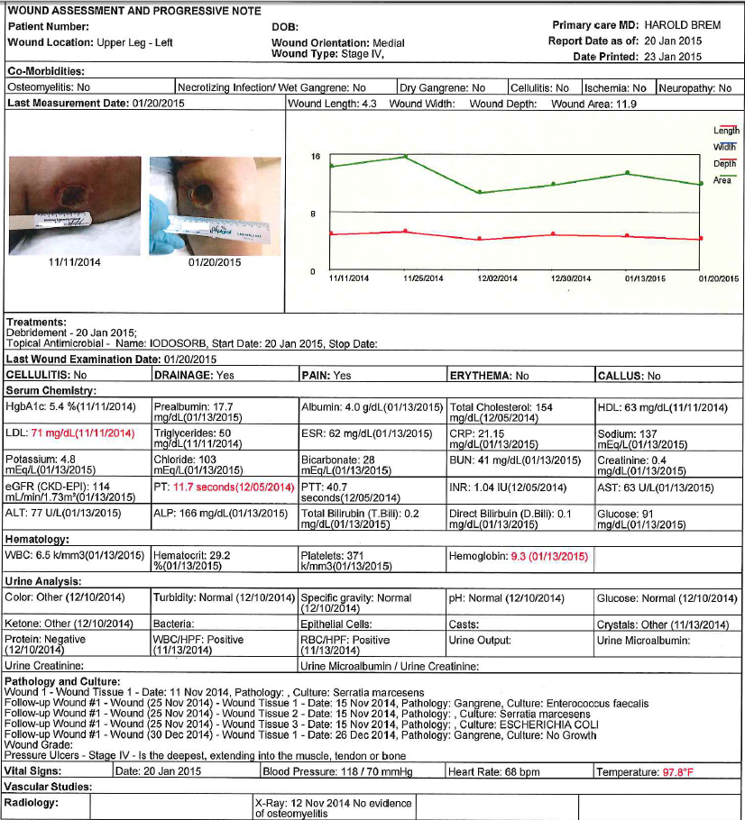
CDS/WEMR
Clinical Decision Support/ Wound Electronic Medical Record. IRB #13308, 13309

Slide 13
Can Early Inpatient Treatment Protocols Halt Progression of Pressure Ulcers (N=150) Using an Electronic Medical Record?
MH50 = time wound area decreases by 50%

Slide 14
Can Early Inpatient Treatment Protocols Halt Progression of Pressure Ulcers (N=150) Using an Electronic Medical Record?
Stage III- MH50 = 41 days
Stage IV- MH50 = 66 days
MH50 = time wound area decreases by 50%

Slide 15
WEMR and When To Amputate?
If a patient is refractory (no decrease in wound area <2 weeks) to simultaneous treatment (IV antibiotics, deep tissue debridement, offloading and biological therapy), early amputation is indicated
Use of the WEMR resulted in an amputation rate of 13% for persons with diabetic foot ulcers in a tertiary referral practice
Although major amputations are thought to be primarily due to arterial inflow and minor due to bone infection, we observed a similar percentage of osteomyelitis in the wounds that preceded a minor or a major amputation
Patients with fewer visits were more likely to be amputated
Further use of the WEMR may decrease both minor and major amputations
Preliminary Development of a Diabetic Foot Ulcer Database from a Wound Electronic Medical Record: A Tool to Decrease Limb Amputations. Michael S. Golinko, David J. Margolis, Adit Tal, Ole Hoffstad, Andrew J. M. Boulton, Harold Brem. Wound Repair and Regeneration,Sept–Oct 2009.; 17(5): 657-665.

