Slide 1
Treatment of Osteomyelitis Wednesday, August 28, 2024
Notes:
1

Slide 2
Agenda
What is osteomyelitis?
What does osteomyelitis look like?
How is osteomyelitis classified?
How is osteomyelitis treated?
What are the recent randomized trials
What are antibiotic treatments for osteomyelitis?
What is the microbiology?
What instruments are used?
What are relevant lab values?
What are relevant imaging studies?
What are the recent randomized clinical trials?
What do the RCTs say?
Overview of antibiotic treatments
What is the role of cultures?
What are adverse events?
What is role of ESR & CRP values?
What do the guidelines say?

Slide 3
What is osteomyelitis?
Osteomyelitis is an inflammatory condition of bone secondary to an infectious process.
Osteomyelitis is usually clinically diagnosed with support from imaging and laboratory findings.
Bone biopsy and microbial cultures offer definitive diagnosis. Plain film radiography should be performed as initial imaging, but sensitivity is low in the early stages of disease.
Magnetic resonance imaging with and without contrast media has a higher sensitivity for identifying areas of bone necrosis in later stages. Staging based on major and minor risk factors can help stratify patients for surgical treatment.
Antibiotics are the primary treatment option and should be tailored based on culture results and individual patient factors.
Surgical bony debridement is often needed, and further surgical intervention may be warranted in high-risk patients or those with extensive disease..
Bury, D. C., Rogers, T. S., & Dickman, M. M. (2021). Osteomyelitis: Diagnosis and Treatment. American family physician, 104(4), 395–402.

Slide 4
What is osteomyelitis?
Osteomyelitis is a complex and potentially devastating condition. Good outcomes can be achieved through a combined orthoplastic approach and relies on good microbiology tissue diagnosis, thorough debridement, robust soft tissue cover and mechanical stability.
Turi, George K. MD; Donovan, Virginia MD; DiGregorio, Julie CCRP; Criscitelli, Theresa M. EdD, RN, CNOR; Kashan, Benjamin MD; Barrientos, Stephan MD; Balingcongan, Jose Ramon PA-C; Gorenstein, Scott MD, FACEP; Brem, Harold MD, FACS. Major Histopathologic Diagnoses of Chronic Wounds. Advances in Skin & Wound Care 29(8):p 376-382, August 2016. | DOI: 10.1097/01.ASW.0000484665.45022.b3

Slide 5
What does osteomyelitis look like?
Acute Osteomyelitis
Osteomyelitis is defined histologically as acute or chronic inflammation in bone tissue, confirmation of which is important for clinical diagnosis.¹¹ Historically, osteomyelitis has been clinically categorized as acute or chronic in nature. The characterization of osteomyelitis is now predicated on pathological description and diagnosis as opposed to the clinical onset of disease. Tissue culture, specificity, and histologic findings in bone tissue of osteomyelitis specimens are crucial to treatment. Although clinical signs and symptoms may heighten clinical suspicion of osteomyelitis, the criterion standard for diagnosis is bone biopsy and microbiological analysis of bone culture. Clinical signs may include localized bone pain, erythema, and drainage around the affected area.
Turi, George K. MD; Donovan, Virginia MD; DiGregorio, Julie CCRP; Criscitelli, Theresa M. EdD, RN, CNOR; Kashan, Benjamin MD; Barrientos, Stephan MD; Balingcongan, Jose Ramon PA-C; Gorenstein, Scott MD, FACEP; Brem, Harold MD, FACS. Major Histopathologic Diagnoses of Chronic Wounds. Advances in Skin & Wound Care 29(8):p 376-382, August 2016. | DOI: 10.1097/01.ASW.0000484665.45022.b3

Slide 6
What does osteomyelitis look like?
Acute Osteomyelitis
In addition, there was evidence of bone detritus as indicated by necrotic fragments of cortical bone in the bone marrow
Turi, George K. MD; Donovan, Virginia MD; DiGregorio, Julie CCRP; Criscitelli, Theresa M. EdD, RN, CNOR; Kashan, Benjamin MD; Barrientos, Stephan MD; Balingcongan, Jose Ramon PA-C; Gorenstein, Scott MD, FACEP; Brem, Harold MD, FACS. Major Histopathologic Diagnoses of Chronic Wounds. Advances in Skin & Wound Care 29(8):p 376-382, August 2016. | DOI: 10.1097/01.ASW.0000484665.45022.b3

Slide 7
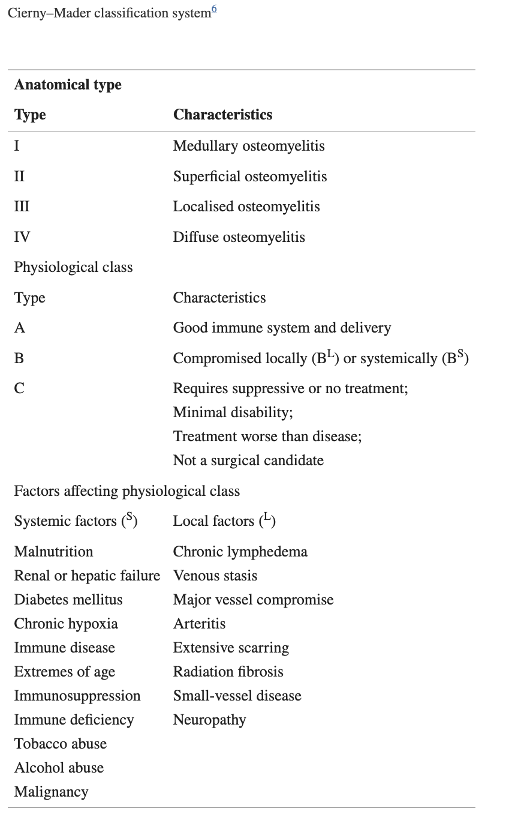
How is osteomyelitis classified?
The most widely-used classification system of chronic osteomyelitis in adults is the Cierny–Mader classification.
It incorporates prognostic factors and delineates treatment for each clinical stage according to the anatomical type and physiological class of the host.
Panteli M, Giannoudis PV. Chronic osteomyelitis: what the surgeon needs to know. EFORT Open Rev. 2017 Mar 13;1(5):128-135. doi: 10.1302/2058-5241.1.000017. PMID: 28461939; PMCID: PMC5367612.

Slide 8
How is osteomyelitis classified?
The most widely-used classification system of chronic osteomyelitis in adults is the Cierny–Mader classification.
It incorporates prognostic factors and delineates treatment for each clinical stage according to the anatomical type and physiological class of the host.
Panteli M, Giannoudis PV. Chronic osteomyelitis: what the surgeon needs to know. EFORT Open Rev. 2017 Mar 13;1(5):128-135. doi: 10.1302/2058-5241.1.000017. PMID: 28461939; PMCID: PMC5367612.

Slide 9
How is osteomyelitis treated?
Knowledge of histopathologic alterations present in wound tissue is fundamental to successful debridement and healing. Pathologic evaluation can help distinguish healing from nonhealing wound edge; however for chronic wounds refractory to standard debridement and treatment protocols, a detailed analysis of wound edge histopathology may be necessary to guide therapeutic interventions and debridement.
Although clinical signs and symptoms may heighten clinical suspicion of osteomyelitis, tissue culture, specificity, and histological findings in bone tissue are crucial to treatment
A thorough history and physical examination, multimodality specialty involvement, and treatments, along with accurate diagnosis through histopathologic analysis of wound biopsies from routine debridements, can help tailor treatment regimens.
Turi, George K. MD; Donovan, Virginia MD; DiGregorio, Julie CCRP; Criscitelli, Theresa M. EdD, RN, CNOR; Kashan, Benjamin MD; Barrientos, Stephan MD; Balingcongan, Jose Ramon PA-C; Gorenstein, Scott MD, FACEP; Brem, Harold MD, FACS. Major Histopathologic Diagnoses of Chronic Wounds. Advances in Skin & Wound Care 29(8):p 376-382, August 2016. | DOI: 10.1097/01.ASW.0000484665.45022.b3

Slide 10
What is the microbiology of bone samples for patients with osteomyelitis?
Microbiology of bone sample cultures in 40 diabetic patients with osteomyelitis of the foot
Pathogens | Overall (%) total number of strains = 58 | 6 weeks (%) total number of strains = 30 | 12 weeks (%) total number of strains = 28 | P
Gram-positive cocci | 48 (82.7) | 24 (80) | 24 (85.7) | 0.73
S. aureus, total | 20 (34.5) | 8 (26.7) | 12 (42.8) | 0.27
S. aureus resistant to methicillin | 7 (12.1) | 3 (10) | 4 (14.3) | 0.70
Coagulase-negative staphylococci | 17 (29.3) | 9 (30) | 8 (28.6) | 1
Streptococcus spp. | 2 (3.4) | 1 (3.3) | 1 (3.6) | 1
Enterococcus spp. | 6 (6.9) | 4 (13.3) | 2 (7.2) | 0.67
Corynebacterium spp. | 3 (7.5) | 2 (6.7) | 1 (3.6) | 1
Gram-negative bacilli | 9 (15.5) | 5 (16.7) | 4 (14.3) | 1
Pseudomonas aeruginosa | 2 (3.4) | 1 (3.3) | 1 (3.6) | 1
Proteus spp. | 4 (6.9) | 2 (6.7) | 2 (7.2) | 1
Escherichia coli | 2 (3.4) | 2 (6.7) | 0 | 0.49
Morganella morganii | 1 (1.7) | 0 | 1 (3.6) | 0.48
Obligate anaerobes | 1 (2.5) | 1 (3.3) | 0 | 0.48
Polymicrobial infections | 18/40 (45) | 10/20 (50)
Howell, R. S., Gorenstein, S., Castellano, M., Slone, E., Woods, J. S., Gillette, B. M., Donovan, V., Criscitelli, T., Brem, H., & Brathwaite, C. (2018). Wound Care Center of Excellence: Guide to Operative Technique for Chronic Wounds. Journal of the American College of Surgeons, 226(2), e7–e17. https://doi.org/10.1016/j.jamcollsurg.2017.11.002

Slide 11
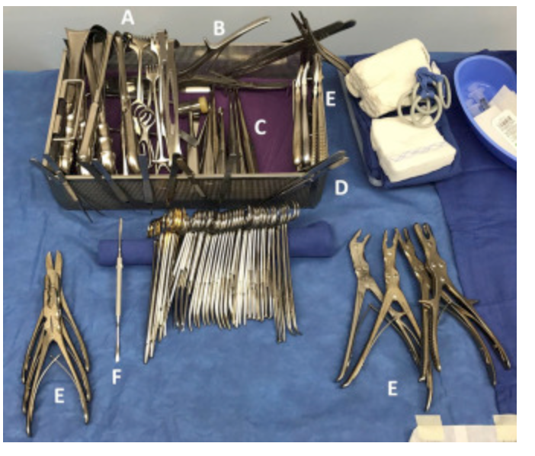
What instruments are used?
The instruments used most frequently by our wound surgeons include:
scalpel (10-, 15-, and 20-blade),
Metzenbaum scissors, curettes,
rongeurs,
electrocautery,
osteotomes,
pulse lavage,
smoke evacuator,
and sagittal saw.
The 10-blade scalpel is used frequently for tangential shaving of long wounds, and the 15-blade scalpel is used for general debriding. It is imperative to change the blade often to maintain a sharp and accurate cutting edge. This will eliminate tissue shearing and damage of surrounding tissue
Instrument tray. The wound tray that we have developed includes: (A) retractors, (B) bone cutters, (C) curettes, (D) forceps, (E) rongeurs, and (F) elevators.
Howell, R. S., Gorenstein, S., Castellano, M., Slone, E., Woods, J. S., Gillette, B. M., Donovan, V., Criscitelli, T., Brem, H., & Brathwaite, C. (2018). Wound Care Center of Excellence: Guide to Operative Technique for Chronic Wounds. Journal of the American College of Surgeons, 226(2), e7–e17. https://doi.org/10.1016/j.jamcollsurg.2017.11.002

Slide 12
What are the relevant laboratory values?
Laboratory data collected during the initial evaluation should include complete blood count with manual differential, prothrombin time, partial thromboplastin time, basic metabolic panel, lipid profile, hemoglobin A1c level, hepatic function panel, pre-albumin level, erythrocyte sedimentation rate (ESR), thyroid stimulating hormone level, and urinary micro-albumin level.
These tests are important to establish baseline values and should be routinely measured during the treatment of chronic wounds because they reflect the status of comorbid medical conditions such as diabetes and hypercholesterolemia as well as nutrition status.
Elevated levels of C-reactive protein, increased ESR, leukocytosis, and positive blood cultures are common signs of infection, but have low specificity for osteomyelitis. These tests are not specific enough to diagnose osteomyelitis; abnormal values should only be used to raise clinical suspicion and evaluate treatment.
Rennert, R., Golinko, M., Yan, A., Flattau, A., Tomic-Canic, M., & Brem, H. (2009). Developing and evaluating outcomes of an evidence-based protocol for the treatment of osteomyelitis in Stage IV pressure ulcers: a literature and wound electronic medical record database review. Ostomy/wound management, 55(3), 42–53.

Slide 13
What are relevant imaging studies?
X-rays. Although x-rays are commonly used in evaluating osteomyelitis in patients with Stage IV pressure ulcers, the literature suggests that the role of x-rays for diagnosis is limited. Plain films show soft tissue swelling, narrowing or widening of joint spaces, bone destruction, periosteal and endosteal reactive changes, heterotopic new bone formation, sclerosis, and cortical thickening and irregularities.
The bony changes associated with osteomyelitis, such as periosteal reactive changes or erosion, also may manifest in noninfected bone.
Although it is important to interpret old and new radiographs together to accurately assess change, a literature review conducted by Wrobel et al⁷² concluded that in the presence of an overlying ulcer, the diagnostic sensitivity and specificity of plain films are approximately 50% and 80%, respectively. Therefore the main role of plain-film radiography is to support clinical suspicion of infection, to diagnose severe osteomyelitis, or to guide further diagnostic methods and/or bone biopsy.
Rennert, R., Golinko, M., Yan, A., Flattau, A., Tomic-Canic, M., & Brem, H. (2009). Developing and evaluating outcomes of an evidence-based protocol for the treatment of osteomyelitis in Stage IV pressure ulcers: a literature and wound electronic medical record database review. Ostomy/wound management, 55(3), 42–53.

Slide 14
What are recent Randomized Clinical Trials?
Karim Gariani, Truong-Thanh Pham, Benjamin Kressmann, François R Jornayvaz, Giacomo Gastaldi, Dimitrios Stafylakis, Jacques Philippe, Benjamin A Lipsky, lker Uçkay, Three Weeks Versus Six Weeks of Antibiotic Therapy for Diabetic Foot Osteomyelitis: A Prospective, Randomized, Noninferiority Pilot Trial, Clinical Infectious Diseases, Volume 73, Issue 7, 1 October 2021, Pages e1539–e1545, https://doi.org/10.1093/cid/ciaa1758
Bessesen, M.T., Doros, G., Henrie, A.M. et al. A multicenter randomized placebo controlled trial of rifampin to reduce pedal amputations for osteomyelitis in veterans with diabetes (VA INTREPID). BMC Infect Dis 20, 23 (2020). https://doi.org/10.1186/s12879-019-4751-3
Urania Rappo, Sailaja Puttagunta, Vadym Shevchenko, Alena Shevchenko, Alena Jandourek, Pedro L Gonzalez, Amy Suen, Veronica Mas Casullo, David Melnick, Rosa Miceli, Milan Kovacevic, Gertjan De Bock, Michael W Dunne, Dalbavancin for the Treatment of Osteomyelitis in Adult Patients: A Randomized Clinical Trial of Efficacy and Safety, Open Forum Infectious Diseases, Volume 6, Issue 1, January 2019, ofy331, https://doi.org/10.1093/ofid/ofy331
Tone, A., Nguyen, S., Devemy, F., Topolinski, H., Valette, M., Cazaubiel, M., Fayard, A., Beltrand, É., Lemaire, C., & Senneville, É. (2015). Six-week versus twelve-week antibiotic therapy for nonsurgically treated diabetic foot osteomyelitis: a multicenter open-label controlled randomized study. Diabetes care, 38(2), 302–307. https://doi.org/10.2337/dc14-1514
José Luis Lázaro-Martínez, Javier Aragón-Sánchez, Esther García-Morales; Antibiotics Versus Conservative Surgery for Treating Diabetic Foot Osteomyelitis: A Randomized Comparative Trial. Diabetes Care 1 March 2014; 37 (3): 789–795. https://doi.org/10.2337/dc13-1526
Peltola, Heikki MD*; Pääkkönen, Markus MD†‡; Kallio, Pentti MD, PhD*; Kallio, Markku J. T. MD* The Osteomyelitis-Septic Arthritis Study Group. Short- Versus Long-term Antimicrobial Treatment for Acute Hematogenous Osteomyelitis of Childhood: Prospective, Randomized Trial on 131 Culture-positive Cases. The Pediatric Infectious Disease Journal 29(12):p 1123-1128, December 2010. | DOI: 10.1097/INF.0b013e3181f55a89
McKee, Michael D MD, FRCSC; Li-Bland, Esther A MD; Wild, Lisa M BSc(N); Schemitsch, Emil H MD, FRCS(C). A Prospective, Randomized Clinical Trial Comparing an Antibiotic-Impregnated Bioabsorbable Bone Substitute With Standard Antibiotic-Impregnated Cement Beads in the Treatment of Chronic Osteomyelitis and Infected Nonunion. Journal of Orthopaedic Trauma 24(8):p 483-490, August 2010. | DOI: 10.1097/BOT.0b013e3181df91d9
Karamanis, Eirinaios M. MD*; Matthaiou, Dimitrios K. MD*; Moraitis, Lampros I.†; Falagas, Matthew E. MD, MSc, DSc*‡§. Fluoroquinolones Versus β-Lactam Based Regimens for the Treatment of Osteomyelitis: A Meta-Analysis of Randomized Controlled Trials. Spine 33(10):p E297-E304, May 1, 2008. | DOI: 10.1097/BRS.0b013e31816f6c22

Slide 15
What do the RCTs say?
Gariani, et al. In this prospective-randomized pilot trial investigating the duration of postdebridement antibiotic therapy for diabetic foot osteomyelitis, a short duration three weeks) was non-inferior to long duration (six weeks) for the outcomes of achieving clinical remission or the occurrence of antibiotic-related adverse
Among 93 enrolled patients (18% females; median age 65 years), 44 were randomized to the 3-week arm and 49 to the 6-week arm. The median number of surgical debridement was 1 (range, 0-2 interventions). In the intention-to-treat (ITT) population, remission occurred in 37 (84%) of the patients in the 3- week arm compared to 36 (73%) in the 6-week arm (p=0.21). The number of AE was similar in the two study arms (17/44 vs. 16/49; p=0.51), as were the remission incidences in the per-protocol (PP) population (33/39 vs. 32/43; p=0.26). In multivariate analysis, treatment with the shorter antibiotic course was not significantly associated with remission (for the ITT population, hazard ratio 1.1, 95%CI 0.6-1.7; for the PP population hazard ratio 0.8, 95%CI 0.5-1.4).
In this randomized, controlled pilot trial, a post-debridement systemic antibiotic therapy course for Diabetic foot osteomyelitis of 3-weeks gave similar (and statistically non-inferior) incidences of remission and AE to a course of 6 weeks.
Gariani, Karim; Pham, Truong-Thanh; Kressmann, Benjamin; Jornayvaz, François R; Gastaldi, Giacomo; Stafylakis, Dimitrios; Philippe, Jacques; Lipsky, Benjamin A; Uçkay, İlker (2021). Three versus six weeks of antibiotic therapy for diabetic foot osteomyelitis: A prospective, randomized, non-inferiority pilot trial. Clinical Infectious Diseases, 73(7):e1539-e1545.

Slide 16
What do the RCTs say?
Lazaro-Martinez, et al. compare the outcomes of the treatment of diabetic foot osteomyelitis in patients treated exclusively with antibiotics versus patients who underwent conservative surgery, following up the patients for a period of 12 weeks after healing.
We measured inflammatory markers in blood samples from the patients in both groups at the beginning of the study (day 0) and 12 weeks after primary healing. Inflammatory markers were defined as follows: leukocytosis was defined as a white blood cell count >11 × 10⁹/L; elevated erythrocyte sedimentation rate (ESR) was defined as an ESR >20 mm/h; and elevated C-reactive protein (CRP) was defined as a CRP level >28.5 nmol/L.
Antibiotic therapy and surgical treatment had similar outcomes in terms of healing rates, time to healing, and short-term complications in patients with neuropathic forefoot ulcers complicated by osteomyelitis without ischemia or necrotizing soft tissue infections.
José Luis Lázaro-Martínez, Javier Aragón-Sánchez, Esther García-Morales; Antibiotics Versus Conservative Surgery for Treating Diabetic Foot Osteomyelitis: A Randomized Comparative Trial. Diabetes Care 1 March 2014; 37 (3): 789–795. https://doi.org/10.2337/dc13-1526

Slide 17
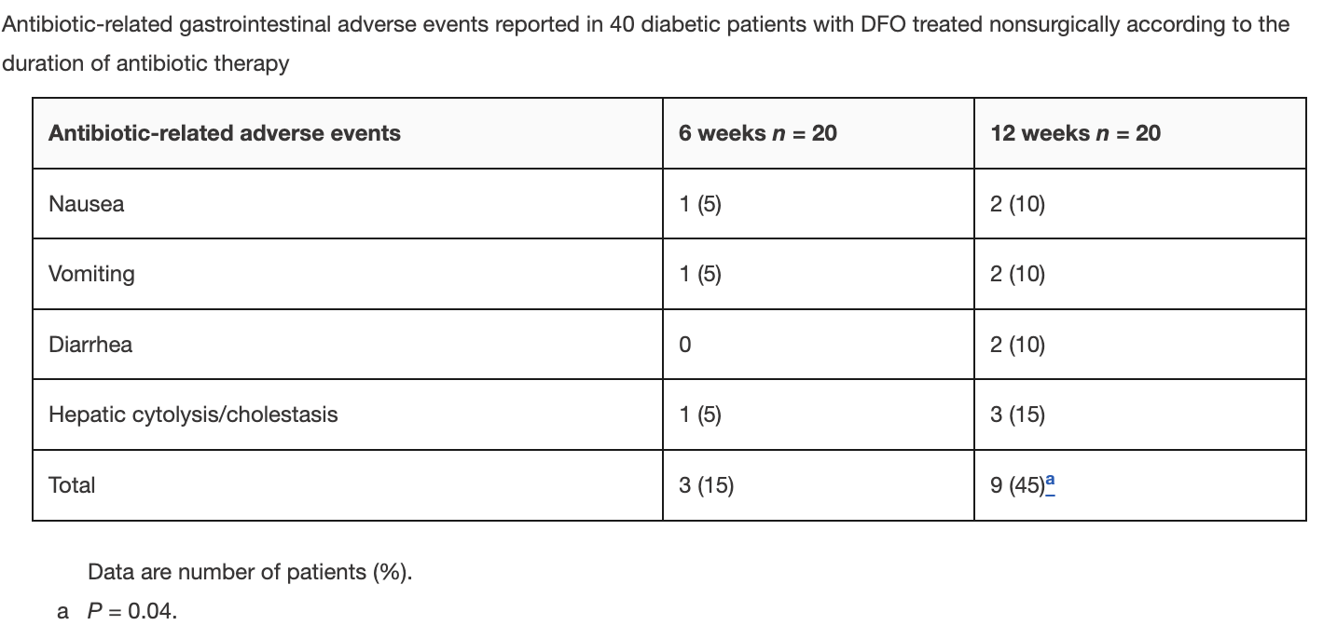
What do the RCTs say?
Tone et al. sought to compare the effectiveness of 6 versus 12 weeks of antibiotic therapy in patients with DFO treated nonsurgically (i.e., antibiotics alone).
In a prospective randomized trial comparing 6- versus 12-week duration of antibiotic treatment. Remission of osteomyelitis during the monitoring period was defined as complete and persistent (>4 weeks) healing of the wound (if present initially), absence of recurrent infection at the initial site or that of adjacent rays, and no need for surgical bone resection or amputation at the end of a follow-up period of at least 12 months after completion of antibiotic treatment.
6-week duration of antibiotic therapy may be sufficient in patients with DFO for whom nonsurgical treatment is considered.
Alina Tone, Sophie Nguyen, Fabrice Devemy, Hélène Topolinski, Michel Valette, Marie Cazaubiel, Armelle Fayard, Éric Beltrand, Christine Lemaire, Éric Senneville; Six-Week Versus Twelve-Week Antibiotic Therapy for Nonsurgically Treated Diabetic Foot Osteomyelitis: A Multicenter Open-Label Controlled Randomized Study. Diabetes Care 1 February 2015; 38 (2): 302–307. https://doi.org/10.2337/dc14-1514

Slide 18
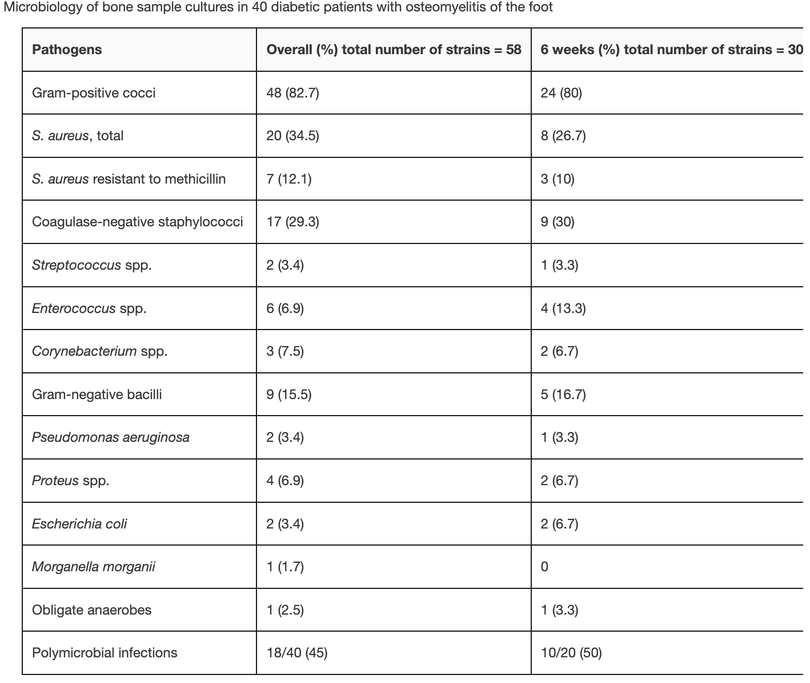
What do the RCTs say?
Tone et al on microbiology of bone cultures
Alina Tone, Sophie Nguyen, Fabrice Devemy, Hélène Topolinski, Michel Valette, Marie Cazaubiel, Armelle Fayard, Éric Beltrand, Christine Lemaire, Éric Senneville; Six-Week Versus Twelve-Week Antibiotic Therapy for Nonsurgically Treated Diabetic Foot Osteomyelitis: A Multicenter Open-Label Controlled Randomized Study. Diabetes Care 1 February 2015; 38 (2): 302–307. https://doi.org/10.2337/dc14-1514

Slide 19
Overview of antibiotic treatments for osteomyelitis
Chronic osteomyelitis represents a progressive inflammatory process caused by pathogens, resulting in bone destruction and sequestrum formation.
It may present with periods of quiescence of variable duration, whereas its occurrence, type, severity and prognosis is multifactorial.
The ‘gold standard’ for the diagnosis of chronic osteomyelitis is the presence of positive bone cultures and histopathologic examination of the bone.
A combined antimicrobial and surgical treatment should be considered in all cases, including appropriate dead space management and subsequent reconstruction.
Relapse can occur, even following an apparently successful treatment, which has a major impact on the quality of life of patients and is a substantial financial burden to any healthcare system.
Panteli, M., & Giannoudis, P. V. (2017). Chronic osteomyelitis: what the surgeon needs to know. EFORT open reviews, 1(5), 128–135. https://doi.org/10.1302/2058-5241.1.000017

Slide 20
Overview of antibiotic treatments for osteomyelitis
According to a systematic review (Cortes-Penfield et al, 2019), traditional teachings (eg, that antimicrobials must be given parenterally, selected based upon ratios of achieved bone vs serum drug levels, and continued for 4–6 weeks) are supported by limited data.
In the case of oral vs parenteral therapy for osteomyelitis, the highest-quality available data demonstrate the noninferiority of oral therapy. In our view, the literature does not support a general preference for parenteral antibiotics in osteomyelitis.
Few human clinical outcomes data support the relevance of antibiotic “bone penetration”; additionally, studies of drug levels in bone yielded similar results across most antibiotic classes, so the value of this frequently taught clinical pearl seems limited.
4–6 weeks may be inadequate for patients at high risk of recurrent infections, such as those with infection due to MRSA, end-stage renal disease, and uncontrolled infectious foci.
Nicolás W Cortés-Penfield, Prathit A Kulkarni, The History of Antibiotic Treatment of Osteomyelitis, Open Forum Infectious Diseases, Volume 6, Issue 5, May 2019, ofz181, https://doi.org/10.1093/ofid/ofz181

Slide 21
Overview of antibiotic treatments for osteomyelitis
McKee et al. performed a retrospective, observational cohort study of adult patients diagnosed with osteomyelitis and an infected non-union. They compared the effectiveness of an antibiotic-impregnated bioabsorbable bone substitute (BBS, tobramycin-impregnated medical-grade calcium sulfate) with antibiotic-impregnated polymethylmethacrylate (PMMA) cement beads after surgical débridement in patients with chronic nonhematogenous osteomyelitis and/or infected nonunion.
Patients were matched 1:2 to dalbavancin (administered as 2 doses separated by 1 week) or SoC treatment for osteomyelitis according to the Charlson Comorbidity Index, site of infection, and causative pathogen. The primary objective was to determine the incidence of treatment failure after a 1-year follow-up period. Secondary objectives included hospital length of stay (LOS), infection-related 1-year readmission rates, and treatment-related adverse events.
Main Outcome Measurements:
Eradication of infection, new bone growth, rate of union, repeat operative procedures complications.
McKee, Michael D MD, FRCSC; Li-Bland, Esther A MD; Wild, Lisa M BSc(N); Schemitsch, Emil H MD, FRCS(C). A Prospective, Randomized Clinical Trial Comparing an Antibiotic-Impregnated Bioabsorbable Bone Substitute With Standard Antibiotic-Impregnated Cement Beads in the Treatment of Chronic Osteomyelitis and Infected Nonunion. Journal of Orthopaedic Trauma 24(8):p 483-490, August 2010. | DOI: 10.1097/BOT.0b013e3181df91d9

Slide 22
Overview of antibiotic treatments for osteomyelitis
In the BBS group, infection was eradicated in 86% (12 of 14) of patients. Seven of eight patients achieved union of their nonunion, and five patients underwent seven further surgical procedures. In the PMMA group, infection was eradicated in 86% (12 of 14) of patients. Six of eight patients achieved union of their nonunion, and nine patients required 15 further surgical procedures. There were more reoperations in the PMMA group (15 versus seven, P = 0.04), and these procedures tended to be of greater magnitude.
Conclusions:
In the treatment of chronic osteomyelitis and infected nonunion, the use of an antibiotic-impregnated BBS is equivalent to standard surgical therapy in eradicating infection and that it may reduce the number of subsequent surgical procedures. A larger, definitive study on this topic is required.
McKee, Michael D MD, FRCSC; Li-Bland, Esther A MD; Wild, Lisa M BSc(N); Schemitsch, Emil H MD, FRCS(C). A Prospective, Randomized Clinical Trial Comparing an Antibiotic-Impregnated Bioabsorbable Bone Substitute With Standard Antibiotic-Impregnated Cement Beads in the Treatment of Chronic Osteomyelitis and Infected Nonunion. Journal of Orthopaedic Trauma 24(8):p 483-490, August 2010. | DOI: 10.1097/BOT.0b013e3181df91d9

Slide 23
What is role of cultures?
Bone cultures are necessary to determine the true pathogens of bone infections. The approach to treatment of osteomyelitis is complex, and often requires a multidisciplinary approach, with input from radiologists, vascular and orthopedic surgeons, infectious disease specialists, and wound care and rehabilitation specialists.
6-week duration was associated with outcomes that were similar to those for the 12-week duration, but there was a significantly smaller number of adverse events in the shorter treatment-duration group.
Fritz, J. M., & McDonald, J. R. (2008). Osteomyelitis: approach to diagnosis and treatment. The Physician and sportsmedicine, 36(1), nihpa116823. https://doi.org/10.3810/psm.2008.12.11

Slide 24
What is role of cultures?
Blood cultures should always be obtained when osteomyelitis is suspected, though they are often negative except in cases of hematogenous osteomyelitis. The gold standard for the diagnosis of osteomyelitis is bone biopsy with histopathologic examination and tissue culture. When the patient is clinically stable, one should consider delaying empiric antimicrobial treatment until bone biopsy is performed. An open approach is ideal to ensure that adequate specimen is obtained, particularly when prosthetic material is involved.⁷ Needle biopsy is often used, and the sensitivity and specificity using this modality has been reported as 87% and 93%, respectively.⁸ Specimens should undergo both aerobic and anaerobic bacterial culture. In addition, fungal and mycobacterial cultures should be performed when clinical suspicion of these organisms is present.
Patients with suspected osteomyelitis often present with ulcers or draining wounds. If no purulent material is present, these should not be cultured. If bone biopsy cannot be obtained, culture of purulent material from such sites may be obtained, though it is never definitive and must be interpreted with caution. Surface cultures often grow only skin flora, and frequently miss the primary pathogen, or secondary pathogen(s) in the case of polymicrobial infection. Heavy growth of a common pathogen is suggestive but not diagnostic of its involvement. The presence of S. aureus in surface cultures has been correlated to its presence in deep cultures ⁹⁻¹⁰.
Fritz, J. M., & McDonald, J. R. (2008). Osteomyelitis: approach to diagnosis and treatment. The Physician and sportsmedicine, 36(1), nihpa116823. https://doi.org/10.3810/psm.2008.12.11

Slide 25
What are adverse events?
The medical approach to DFO is often criticized for collateral damage due to antibiotic use, especially the emergence of bacterial resistance, but also adverse events, in particular, Clostridium difficile–associated diarrhea (CDAD), along with significant cost.
In this study, gastrointestinal adverse events were reported in significantly more patients receiving 12 weeks of antibiotic treatment than in those receiving only 6 weeks, but the use of rifampin combinations in the majority of our patients (27/40; 67.5%) may have influenced these results.
Fritz, J. M., & McDonald, J. R. (2008). Osteomyelitis: approach to diagnosis and treatment. The Physician and sportsmedicine, 36(1), nihpa116823. https://doi.org/10.3810/psm.2008.12.11

Slide 26
What is role of ESR & CRP values?
Distinguishing osteomyelitis from soft-tissue infection of the foot is important because osteomyelitis is associated with more operations, amputation, and prolonged antibiotic exposure. Both erythrocyte sedimentation rate (ESR) and C-reactive protein (CRP) are routinely ordered inflammatory biomarkers for evaluating foot infection.
When initial evaluation is inconclusive, advanced imaging is indicated, and high clinical or radiographic suspicion of osteomyelitis may indicate bone biopsy to identify organisms and antibiotic sensitivity. Although ESR and CRP levels are helpful for distinguishing osteomyelitis from soft-tissue infections in patients with diabetes-related foot infections, parameters regarding optimal cutoff values for those tests have not, to our knowledge, been defined.
Lavery, L. A., Ahn, J., Ryan, E. C., Bhavan, K., Oz, O. K., La Fontaine, J., & Wukich, D. K. (2019). What are the Optimal Cutoff Values for ESR and CRP to Diagnose Osteomyelitis in Patients with Diabetes-related Foot Infections?. Clinical orthopaedics and related research, 477(7), 1594–1602. https://doi.org/10.1097/CORR.0000000000000718

Slide 27
What are key ESR & CRP values?
Lavery et al, reviewed the records of 1842 patients between 18 and 89 years of age
An ESR of 60 mm/h and a CRP level of 7.9 mg/dL were determined to be the optimal cutoff points for predicting osteomyelitis based on results of the ROC analysis. The ESR threshold of 60 mm/h demonstrated a sensitivity of 74% (95% confidence interval [CI], 67–80) and specificity of 56% (95% CI, 48–63) for osteomyelitis, whereas the CRP threshold of 7.9 mg/dL had a sensitivity of 49% (95% CI, 41–57) and specificity of 80% (95% CI, 74–86). If the ESR is < 30 mm/h, the likelihood of osteomyelitis is low. However, if ESR is > 60 mm/h and CRP level is > 7.9 mg/dL, the likelihood of osteomyelitis is high, and treatment of suspected osteomyelitis should be strongly considered.
While ESR is better for ruling out osteomyelitis initially, CRP helps distinguish osteomyelitis from soft-tissue infection in patients with high ESR values. Further prospective studies addressing the prognostic value of ESR and CRP are needed, and a more comprehensive diagnostic algorithm should be developed to include other diagnostic tests such as probe-to-bone and imaging.
Lavery, L. A., Ahn, J., Ryan, E. C., Bhavan, K., Oz, O. K., La Fontaine, J., & Wukich, D. K. (2019). What are the Optimal Cutoff Values for ESR and CRP to Diagnose Osteomyelitis in Patients with Diabetes-related Foot Infections?. Clinical orthopaedics and related research, 477(7), 1594–1602. https://doi.org/10.1097/CORR.0000000000000718

Slide 28
What are the guidelines?
Infectious Disease Society of America Clinical Practice Guidelines for the Diagnosis and Treatment of Native Vertebral Osteomyelitis in Adults
Clinical Diagnostics
I. When Should the Diagnosis of NVO Be Considered?
Clinicians should suspect the diagnosis of NVO in patients with new or worsening back or neck pain and fever (strong, low).
Clinicians should suspect the diagnosis of NVO in patients with new or worsening back or neck pain and elevated ESR or CRP (strong, low).
Clinicians should suspect the diagnosis of NVO in patients with new or worsening back or neck pain and bloodstream infection or infective endocarditis (strong, low).
Clinicians may consider the diagnosis of NVO in patients who present with fever and new neurologic symptoms with or without back pain (weak, low).
Clinicians may consider the diagnosis of NVO in patients who present with new localized neck or back pain, following a recent episode of Staphylococcus aureus bloodstream infection (weak, low).
Elie F. Berbari and others, 2015 Infectious Diseases Society of America (IDSA) Clinical Practice Guidelines for the Diagnosis and Treatment of Native Vertebral Osteomyelitis in Adults, Clinical Infectious Diseases, Volume 61, Issue 6, 15 September 2015, Pages e26–e46, https://doi.org/10.1093/cid/civ482

Slide 29
What are the guidelines?
Infectious Disease Society of America Clinical Practice Guidelines for the Diagnosis and Treatment of Native Vertebral Osteomyelitis in Adults
II. What Is the Appropriate Diagnostic Evaluation of Patients With Suspected NVO?
We recommend performing a pertinent medical and motor/sensory neurologic examination in patients with suspected NVO (strong, low).
We recommend obtaining bacterial (aerobic and anaerobic) blood cultures (2 sets) and baseline ESR and CRP in all patients with suspected NVO (strong, low).
We recommend a spine MRI in patients with suspected NVO (strong, low).
We suggest a combination spine gallium/Tc99 bone scan, or computed tomography scan or a positron emission tomography scan in patients with suspected NVO when MRI cannot be obtained (eg, implantable cardiac devices, cochlear implants, claustrophobia, or unavailability) (weak, low).
We recommend obtaining blood cultures and serologic tests for Brucella species in patients with subacute NVO residing in endemic areas for brucellosis (strong, low).
We suggest obtaining fungal blood cultures in patients with suspected NVO and at risk for fungal infection (epidemiologic risk or host risk factors) (weak, low).
We suggest performing a purified protein derivative (PPD) test or obtaining an interferon-γ release assay in patients with subacute NVO and at risk for Mycobacterium tuberculosis NVO (ie, originating or residing in endemic regions or having risk factors) (weak, low).
In patients with suspected NVO, evaluation by an infectious disease specialist and a spine surgeon may be considered (weak, low).
Elie F. Berbari and others, 2015 Infectious Diseases Society of America (IDSA) Clinical Practice Guidelines for the Diagnosis and Treatment of Native Vertebral Osteomyelitis in Adults, Clinical Infectious Diseases, Volume 61, Issue 6, 15 September 2015, Pages e26–e46, https://doi.org/10.1093/cid/civ482

Slide 30
What are the guidelines?
Infectious Disease Society of America Clinical Practice Guidelines for the Diagnosis and Treatment of Native Vertebral Osteomyelitis in Adults
III. When Should an Image-Guided Aspiration Biopsy or Additional Workup Be Performed in Patients With NVO?
We recommend an image-guided aspiration biopsy in patients with suspected NVO (based on clinical, laboratory, and imaging studies) when a microbiologic diagnosis for a known associated organism (S. aureus, Staphylococcus lugdunensis, and Brucella species) has not been established by blood cultures or serologic tests (strong, low).
We advise against performing an image-guided aspiration biopsy in patients with S. aureus, S. lugdunensis, or Brucella species bloodstream infection suspected of having NVO based on clinical, laboratory, and imaging studies (strong, low).
We advise against performing an image-guided aspiration biopsy in patients with suspected subacute NVO (high endemic setting) and strongly positive Brucella serology (strong, low).
.
Elie F. Berbari and others, 2015 Infectious Diseases Society of America (IDSA) Clinical Practice Guidelines for the Diagnosis and Treatment of Native Vertebral Osteomyelitis in Adults, Clinical Infectious Diseases, Volume 61, Issue 6, 15 September 2015, Pages e26–e46, https://doi.org/10.1093/cid/civ482

Slide 31
What are the guidelines?
Infectious Disease Society of America Clinical Practice Guidelines for the Diagnosis and Treatment of Native Vertebral Osteomyelitis in Adults
IV. How Long Should Antimicrobial Therapy Be Withheld Prior to an Image-Guided Diagnostic Aspiration Biopsy in Patients With Suspected NVO?
In patients with neurologic compromise with or without impending sepsis or hemodynamic instability, we recommend immediate surgical intervention and initiation of empiric antimicrobial therapy (strong, low).
Elie F. Berbari and others, 2015 Infectious Diseases Society of America (IDSA) Clinical Practice Guidelines for the Diagnosis and Treatment of Native Vertebral Osteomyelitis in Adults, Clinical Infectious Diseases, Volume 61, Issue 6, 15 September 2015, Pages e26–e46, https://doi.org/10.1093/cid/civ482

Slide 32
What are the guidelines?
Infectious Disease Society of America Clinical Practice Guidelines for the Diagnosis and Treatment of Native Vertebral Osteomyelitis in Adults
V. When Is It Appropriate to Send Fungal, Mycobacterial, or Brucellar Cultures or Other Specialized Testing Following an Image-Guided Aspiration Biopsy in Patients With Suspected NVO?
We suggest the addition of fungal, mycobacterial, or brucellar cultures on image-guided biopsy and aspiration specimens in patients with suspected NVO if epidemiologic, host risk factors, or characteristic radiologic clues are present (weak, low).
We suggest the addition of fungal and mycobacterial cultures and bacterial nucleic acid amplification testing to appropriately stored specimens if aerobic and anaerobic bacterial cultures reveal no growth in patients with suspected NVO (weak, low).
VI. When Is It Appropriate to Send the Specimens for Pathologic Examination Following an Image-Guided Aspiration Biopsy in Patients With Suspected NVO?
If adequate tissue can be safely obtained, pathologic specimens should be sent from all patients to help confirm a diagnosis of NVO and guide further diagnostic testing, especially in the setting of negative cultures (strong, low).
Elie F. Berbari and others, 2015 Infectious Diseases Society of America (IDSA) Clinical Practice Guidelines for the Diagnosis and Treatment of Native Vertebral Osteomyelitis in Adults, Clinical Infectious Diseases, Volume 61, Issue 6, 15 September 2015, Pages e26–e46, https://doi.org/10.1093/cid/civ482

Slide 33
What are the guidelines?
Infectious Disease Society of America Clinical Practice Guidelines for the Diagnosis and Treatment of Native Vertebral Osteomyelitis in Adults
VII. What Is the Preferred Next Step in Patients With Nondiagnostic Image-Guided Aspiration Biopsy and Suspected NVO?
In the absence of concomitant bloodstream infection, we recommend obtaining a second aspiration biopsy in patients with suspected NVO in whom the original image-guided aspiration biopsy specimen grew a skin contaminant (coagulase-negative staphylococci [except S. lugdunensis], Propionibacterium species, or diphtheroids) (strong, low).
In patients with a nondiagnostic first image-guided aspiration biopsy and suspected NVO, further testing should be done to exclude difficult-to-grow organisms (eg, anaerobes, fungi, Brucella species, or mycobacteria) (strong, low).
In patients with suspected NVO and a nondiagnostic image-guided aspiration biopsy and laboratory workup, we suggest either repeating a second image-guided aspiration biopsy, performing percutaneous endoscopic discectomy and drainage (PEDD), or proceeding with an open excisional biopsy (weak, low).
Elie F. Berbari and others, 2015 Infectious Diseases Society of America (IDSA) Clinical Practice Guidelines for the Diagnosis and Treatment of Native Vertebral Osteomyelitis in Adults, Clinical Infectious Diseases, Volume 61, Issue 6, 15 September 2015, Pages e26–e46, https://doi.org/10.1093/cid/civ482

Slide 34
What are the guidelines?
Infectious Disease Society of America Clinical Practice Guidelines for the Diagnosis and Treatment of Native Vertebral Osteomyelitis in Adults
Clinical Therapy
VIII. When Should Empiric Antimicrobial Therapy Be Started in Patients With NVO?
In patients with normal and stable neurologic examination and stable hemodynamics, we suggest holding empiric antimicrobial therapy until a microbiologic diagnosis is established (weak, low).
In patients with hemodynamic instability, sepsis, septic shock, or severe or progressive neurologic symptoms, we suggest the initiation of empiric antimicrobial therapy in conjunction with an attempt at establishing a microbiologic diagnosis (weak, low).
IX. What Is the Optimal Duration of Antimicrobial Therapy in Patients With NVO?
We recommend a total duration of 6 weeks of parenteral or highly bioavailable oral antimicrobial therapy for most patients with bacterial NVO (strong, low).
We recommend a total duration of 3 months of antimicrobial therapy for most patients with NVO due to Brucella species (strong, moderate).
Elie F. Berbari and others, 2015 Infectious Diseases Society of America (IDSA) Clinical Practice Guidelines for the Diagnosis and Treatment of Native Vertebral Osteomyelitis in Adults, Clinical Infectious Diseases, Volume 61, Issue 6, 15 September 2015, Pages e26–e46, https://doi.org/10.1093/cid/civ482

Slide 35
What are the guidelines?
Infectious Disease Society of America Clinical Practice Guidelines for the Diagnosis and Treatment of Native Vertebral Osteomyelitis in Adults
X. What Are the Indications for a Surgical Intervention in Patients With NVO?
We recommend surgical intervention in patients with progressive neurologic deficits, progressive deformity, and spinal instability with or without pain despite adequate antimicrobial therapy (strong, low).
We suggest surgical debridement with or without stabilization in patients with persistent or recurrent bloodstream infection (without alternative source) or worsening pain despite appropriate medical therapy (weak, low).
We advise against surgical debridement and/or stabilization in patients who have worsening bony imaging findings at 4–6 weeks in the setting of improvement in clinical symptoms, physical examination, and inflammatory markers (weak, low).
Elie F. Berbari and others, 2015 Infectious Diseases Society of America (IDSA) Clinical Practice Guidelines for the Diagnosis and Treatment of Native Vertebral Osteomyelitis in Adults, Clinical Infectious Diseases, Volume 61, Issue 6, 15 September 2015, Pages e26–e46, https://doi.org/10.1093/cid/civ482

Slide 36
What are the guidelines?
Infectious Disease Society of America Clinical Practice Guidelines for the Diagnosis and Treatment of Native Vertebral Osteomyelitis in Adults
Clinical Follow-Up
XI. How Should Failure of Therapy Be Defined in Treated Patients With NVO?
We suggest that persistent pain, residual neurologic deficits, elevated markers of systemic inflammation, or radiographic findings alone do not necessarily signify treatment failure in treated NVO patients (weak, low).
XII. What Is the Role of Systemic Inflammatory Markers and MRI in the Follow-up of Treated Patients With NVO?
We suggest monitoring systemic inflammatory markers (ESR and or CRP) in patients with NVO after approximately 4 weeks of antimicrobial therapy, in conjunction with a clinical assessment (weak, low).
We recommend against routinely ordering follow-up MRI in patients with NVO in whom a favorable clinical and laboratory response to antimicrobial therapy was observed (strong, low).
We suggest performing a follow-up MRI to assess evolutionary changes of the epidural and paraspinal soft tissues in patients with NVO who are judged to have a poor clinical response to therapy (weak, low).
Elie F. Berbari and others, 2015 Infectious Diseases Society of America (IDSA) Clinical Practice Guidelines for the Diagnosis and Treatment of Native Vertebral Osteomyelitis in Adults, Clinical Infectious Diseases, Volume 61, Issue 6, 15 September 2015, Pages e26–e46, https://doi.org/10.1093/cid/civ482

Slide 37
What are the guidelines?
Infectious Disease Society of America Clinical Practice Guidelines for the Diagnosis and Treatment of Native Vertebral Osteomyelitis in Adults
XIII. How Do You Approach a Patient With NVO and Suspected Treatment Failure?
In patients with NVO and suspected treatment failure, we suggest obtaining markers of systemic inflammation (ESR and CRP). Unchanged or increasing values after 4 weeks of treatment should increase suspicion for treatment failure (weak, low).
We recommend obtaining a follow-up MRI with emphasis on evolutionary changes in the paraspinal and epidural soft tissue findings in patients with NVO and suspected treatment failure (strong, low).
In patients with NVO and clinical and radiographic evidence of treatment failure, we suggest obtaining additional tissue samples for microbiologic (bacteria, fungal, and mycobacterial) and histopathologic examination, either by image-guided aspiration biopsy or through surgical sampling (weak, very low).
In patients with NVO and clinical and radiographic evidence of treatment failure, we suggest consultation with a spine surgeon and an infectious disease physician (weak, very low).
Elie F. Berbari and others, 2015 Infectious Diseases Society of America (IDSA) Clinical Practice Guidelines for the Diagnosis and Treatment of Native Vertebral Osteomyelitis in Adults, Clinical Infectious Diseases, Volume 61, Issue 6, 15 September 2015, Pages e26–e46, https://doi.org/10.1093/cid/civ482

Slide 38
What are the guidelines?
Clinical Practice Guideline by the Pediatric Infectious Diseases Society and the Infectious Diseases Society of America
I. What noninvasive diagnostic laboratory tests should be performed in children with suspected acute hematogenous osteomyelitis (AHO)?
Recommendations:
In children with suspected AHO, we recommend performing blood culture prior to the administration of antimicrobial therapy (strong recommendation and moderate certainty of evidence).
In children with suspected AHO, we suggest performing a serum C-reactive protein (CRP) on initial evaluation (conditional recommendation and very low certainty of evidence). Comment: Serum CRP has a low accuracy to establish the diagnosis of AHO, but in situations where AHO is confirmed, the serum CRP performed on initial evaluation can serve as the baseline value for sequential monitoring.
In children with suspected AHO, we suggest against using serum procalcitonin (PCT) (conditional recommendation and low certainty of evidence).
Woods, C. R., Bradley, J. S., Chatterjee, A., Copley, L. A., Robinson, J., Kronman, M. P., Arrieta, A., Fowler, S. L., Harrison, C., Carrillo-Marquez, M. A., Arnold, S. R., Eppes, S. C., Stadler, L. P., Allen, C. H., Mazur, L. J., Creech, C. B., Shah, S. S., Zaoutis, T., Feldman, D. S., & Lavergne, V. (2021). Clinical Practice Guideline by the Pediatric Infectious Diseases Society and the Infectious Diseases Society of America: 2021 Guideline on Diagnosis and Management of Acute Hematogenous Osteomyelitis in Pediatrics. Journal of the Pediatric Infectious Diseases Society, 10(8), 801–844. https://doi.org/10.1093/jpids/piab027

Slide 39
What are the guidelines?
Clinical Practice Guideline by the Pediatric Infectious Diseases Society and the Infectious Diseases Society of America
II. What imaging studies should be performed in children with suspected AHO?
Recommendations:
In children with suspected AHO, we recommend obtaining plain radiography of the potentially infected bone(s) rather than not performing plain radiographs (strong recommendation and moderate certainty of evidence).
In children with suspected AHO requiring further imaging studies to confirm the diagnosis, we suggest magnetic resonance imaging (MRI) rather than scintigraphy (bone scan), computerized tomographic (CT) scan, or ultrasound (US) (conditional recommendation and very low certainty of evidence).
Woods, C. R., Bradley, J. S., Chatterjee, A., Copley, L. A., Robinson, J., Kronman, M. P., Arrieta, A., Fowler, S. L., Harrison, C., Carrillo-Marquez, M. A., Arnold, S. R., Eppes, S. C., Stadler, L. P., Allen, C. H., Mazur, L. J., Creech, C. B., Shah, S. S., Zaoutis, T., Feldman, D. S., & Lavergne, V. (2021). Clinical Practice Guideline by the Pediatric Infectious Diseases Society and the Infectious Diseases Society of America: 2021 Guideline on Diagnosis and Management of Acute Hematogenous Osteomyelitis in Pediatrics. Journal of the Pediatric Infectious Diseases Society, 10(8), 801–844. https://doi.org/10.1093/jpids/piab027

Slide 40
What are the guidelines?
American Family Physician
The incidence of chronic osteomyelitis is increasing because of the prevalence of predisposing conditions such as diabetes mellitus and peripheral vascular disease.
The increased availability of sensitive imaging tests, such as magnetic resonance imaging and bone scintigraphy, has improved diagnostic accuracy and the ability to characterize the infection.
Plain radiography is a useful initial investigation to identify alternative diagnoses and potential complications. Direct sampling of the wound for culture and antimicrobial sensitivity is essential to target treatment. The increased incidence of methicillin-resistant Staphylococcus aureus osteomyelitis complicates antibiotic selection. Surgical debridement is usually necessary in chronic cases. The recurrence rate remains high despite surgical intervention and long-term antibiotic therapy. Acute hematogenous osteomyelitis in children typically can be treated with a four-week course of antibiotics. In adults, the duration of antibiotic treatment for chronic osteomyelitis is typically several weeks longer. In both situations, however, empiric antibiotic coverage for S. aureus is indicated.
Hatzenbuehler, J., & Pulling, T. J. (2011). Diagnosis and management of osteomyelitis. American family physician, 84(9), 1027–1033.

Slide 41
The Future Looks Bright

