Slide 1
Wound Healing Outcomes
Division of Wound Healing and Regenerative Medicine
Department of Surgery
Newark Beth Israel Medical Center
July 28, 2020
NJwoundhealing.org

Slide 2
Agenda
Clinical presentation: LW
Pathology
How to diagnose osteomyelitis: imaging/pathology?
How to diagnose pelvic osteomyelitis?
Clinical presentation: MW
Pathology: Dr. Hudacko
Clinical presentation: AB
Dr. Rothkopf: Nutrition
Pathology: Dr. Hudacko
Next week’s agenda

Slide 3
Clinical Presentation: LW
Age: 63
Terminal wean 7/17
Surgery 7/14: left BKA
Evaluation for right BKA (7/14/20)
CT Scan results: Sacral decubitus ulcer ending with sacral osteomyelitis

Slide 4
Clinical Presentation: LW (continued)
CAT said no, pathology said yes
Osteomyelitis and hospice
Covid-19, SARS-CoV-2 March and May 19 end stage renal disease

Slide 5
Clinical Presentation: LW (continued) Culture reports
 | Methicillin-Sensitive Staph aureus |  | Morganella morganii
Drug | MIC Interp | MIC Dilutn | MIC Interp | MIC Dilutn
Ampicillin |  |  | R
Ampicilin/Subactam |  |  | S | 4
Aztreonam |  |  | S | <=1
Cefazolin |  |  | R
Cefepime |  |  | S | <=1
Ceftazidime |  |  | S | <=1
Ceftriaxone |  |  | S | <=1
Ciprofloxacin | S | <=0.5
Clindamycin | R
Doxycycline | S | <=0.5
Erythromycin | R | >=0
Gentamicin | Pos | <=0.5 | S | <=1
Inducible Clindamycin Resistance | S | Pos
Levofloxacin |  | <=0.12 |  | <=0.12
Menopenem |  |  | S | <=0.25
Moxifloxacin | S | <=0.25
Oxacilin | S | <=0.25
Piperacilin/Tazobactam |  |  | S | <=4
Rifampin | S | <=0.5
Tetracycline | S | <=1
Tobramycin |  |  | S | <=1
Trimethoprim/Sulfia | S | <=10 | S | <=20
Vancomycin | S | 1

Slide 6
Clinical Presentation: LW
Pathology report:
Sacral wound, superficial: fibroadipose tissue with acute inflammation and necrosis
Left heel ulcer, superficial: skin and subcutis showing ulceration, acute suppurative ischemia
Sacral bone: acute osteomyelitis
Left calcaneus: chronic fibrosing osteomyelitis

Slide 7
How to diagnose osteomyelitis: imaging/pathology?
A diagnosis of osteomyelitis should be considered, unless proven otherwise, when there are signs of deep wounds in the sinus tract that probe to the bone, exposed bones or chronic nonhealing ulcers despite standard medical care. Further investigations, such as laboratory tests, diagnostic imaging (plain radiography, magnetic resonance imaging, WBC-labeled scintigraphy) and bone culture or biopsy can aid in the confirmation of osteomyelitis (strong; moderate).
In all patients suspected of having diabetic foot infection, plain film radiography of the foot is recommended to determine bone abnormalities (deformities, damage), soft tissue gases and foreign bodies (strong; moderate).
Plain film radiography is commonly used as first-line medical imaging in the assessment of the musculoskeletal structure of the lower extremities. Apart from being affordable, convenient and relatively fast, it also offers clinicians a bird’s eye view of any abnormalities in the bones and soft tissues (fractures, dislocations, malalignments, variant or accessory bones, the presence of foreign bodies, soft tissue gases) and allows them to dynamically monitor disease progression and the perioperative assessment of recovery, develop a roadmap with other medical imaging modalities and assess vascular calcification, neuropathic osteoarthropathy and bone deformities.
Wang A, Lv G, Cheng X, et al. Guidelines on multidisciplinary approaches for the prevention and management of diabetic foot disease (2020 edition). Burns Trauma. 2020;8:tkaa017. Published 2020 Jul 6. doi:10.1093/burnst/tkaa017

Slide 8
How to diagnose osteomyelitis: imaging/pathology?
MRI is the preferred and most advanced imaging method for aiding in the diagnosis of diabetic foot ostemyelitis. In active osteomyelitis, the bone marrow exhibits a hypointense signal on T1-weighted images and a hyperintense signal on T2-weighted images. In contrast, both the T1-weighted and T2-weighted images show reduced signal intensity during the chronic phase. The sensitivity of MRI is 90% (range, 77–100%), which is better than that of PR, technetium-99m bone scan or leukocyte scintigraphy.
Nuclear medicine scans may have some value in the diagnosis of DFO, especially when MRI is contraindicated. Direct scintigraphy and two-dimensional processed images can be used in combination with various radioisotopes and increase DFO diagnosis accuracy. Typical findings of hyperperfusion, hyperemia and bone resorption are suggestive of DFO. Nuclear medicine scans exhibit higher sensitivity but lower specificity and poor anatomical localization compared with MRI.
Bone biopsy and bone cultures should be considered the gold standard for the diagnosis of diabetic foot osteomyelitis (strong; high). Confirmation of the diagnosis of diabetic foot osteomyelitis is largely based on the isolation of bacteria in bone tissue, the discovery of osteonecrosis and histopathological findings of inflammatory cell infiltration. Bone biopsy is performed under surgical debridement or percutaneous puncture under fluoroscopy or computed tomography guidance and is considered the gold standard for the diagnosis of osteomyelitis. The sensitivity and specificity of bone biopsy can reach 95% and 90%, respectively. Bone biopsy has not only played a role in the diagnosis of osteomyelitis but also provided guidance in the identification of pathogenic bacteria and their antibiotic sensitivity.
Wang A, Lv G, Cheng X, et al. Guidelines on multidisciplinary approaches for the prevention and management of diabetic foot disease (2020 edition). Burns Trauma. 2020;8:tkaa017. Published 2020 Jul 6. doi:10.1093/burnst/tkaa017

Slide 9
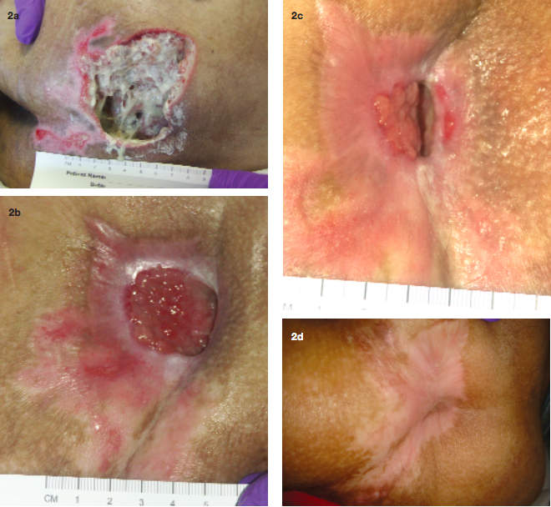
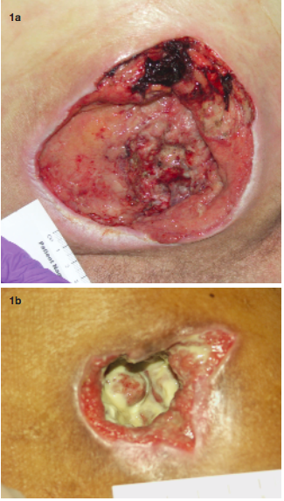
How to diagnose osteomyelitis: imaging/pathology?
Examples of patients with Stage IV pressure ulcers with underlying osteomyelitis: ischium (1a) and trochanteric (1b).
A 51-year-old woman with paralysis presented with gangrene and osteomyelitis (she grew MRSA from her bone) of her sacral ulcer (Figure 2a). The wound eventually healed after implementing the treatment protocol. (Figure 2b-d).
Rennert R, Golinko M, Yan A, Flattau A, Tomic-Canic M, Brem H. Developing and evaluating outcomes of an evidence-based protocol for the treatment of osteomyelitis in Stage IV pressure ulcers: a literature and wound electronic medical record database review. Ostomy Wound Manage. 2009;55(3):42-53.

Slide 10
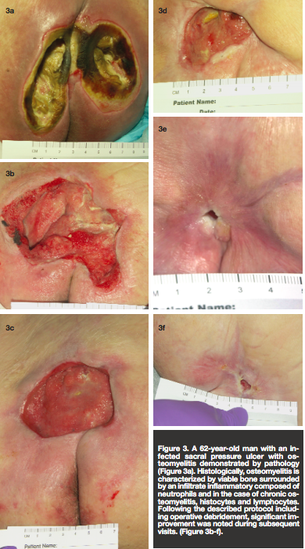
How to diagnose osteomyelitis: imaging/pathology?
A 62-year-old man with an infected sacral pressure ulcer with osteomyelitis demonstrated by pathology (Figure 3a). Histologically, osteomyelitis is characterized by viable bone surrounded by an infiltrate inflammatory composed of neutrophils and in the case of chronic osteomyelitis, histocytes and lymphocytes. Following the described protocol including operative debridement, significant improvement was noted during subsequent visits. (Figure 3b-f).
Rennert R, Golinko M, Yan A, Flattau A, Tomic-Canic M, Brem H. Developing and evaluating outcomes of an evidence-based protocol for the treatment of osteomyelitis in Stage IV pressure ulcers: a literature and wound electronic medical record database review. Ostomy Wound Manage. 2009;55(3):42-53.

Slide 11
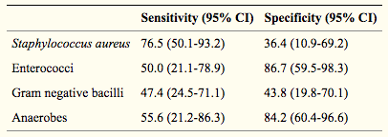
How to diagnose pelvic osteomyelitis?
Pressure ulcer-related pelvic osteomyelitis is a relatively under-studied entity in the field of bone infection.
Diagnosis itself can be difficult, and contrary to the widely held belief, exposed bone is not necessarily synonymous with histological evidence of osteomyelitis. Furthermore, the specificity of CT and MRI has been questioned when histology is considered the gold standard. The optimum duration of antimicrobial therapy has not been defined, nor the sub-group of patients who will derive benefit from surgical intervention.
Sensitivity and specificity of superficial wound swabs compared to deep bone samples
Russell CD, Tsang SJ, Simpson AHRW, Sutherland RK. Outcomes, Microbiology and Antimicrobial Usage in Pressure Ulcer-Related Pelvic Osteomyelitis: Messages for Clinical Practice. J Bone Jt Infect. 2020;5(2):67-75. Published 2020 Mar 26. doi:10.7150/jbji.41779

Slide 12
How to diagnose pelvic osteomyelitis?
Microbiological evaluation should involve deep bone sampling and not rely on superficial wound swabs. Antimicrobial duration is not associated with risk of treatment failure and shorter courses may be appropriate in some cases.
The role of antimicrobials may be secondary to optimizing the bio-psycho-social factors required for successful surgical intervention and subsequent wound healing.
Almost one quarter of patients died within one-year of their index episode and therefore anticipatory care planning should be considered.
A holistic approach to management is required, including dietetics, careful discharge planning, social care, tissue viability, infection specialists, plastic surgeons and orthopedic surgeons.
Russell CD, Tsang SJ, Simpson AHRW, Sutherland RK. Outcomes, Microbiology and Antimicrobial Usage in Pressure Ulcer-Related Pelvic Osteomyelitis: Messages for Clinical Practice. J Bone Jt Infect. 2020;5(2):67-75. Published 2020 Mar 26. doi:10.7150/jbji.41779

Slide 13
Clinical Presentation: MW
Age: 33
Chest x-ray 1/2019 right lower lobe opacification
Admitted: 1/19- 3/19/20
Pneumonia refractory to Vancomycin and Menopenem
History of bilateral pleural infusions
Procedures:
in NBI ICU, patient received tracheostomy 1/25
Veno-Venous Extracorporeal Membrane Oxygenation cannulation on 1/25
Veno-Venous Extracorporeal Membrane Oxygenation decannulation on 2/5
PEG tube placement 2/8
R subclavian permacath placement 2/8
Telemetry on 2/12

Slide 14
Clinical Presentation: MW
Pathology
Sacral ulcer: skin, subcutis and muscle with ulceration and necrosis
Periosteum and bone of sacrum: Fibroadipose tissue and acute fibrinous exudate, as well as fragments of bone with few plasma cells, suggestive of chronic osteomyelitis.

Slide 15
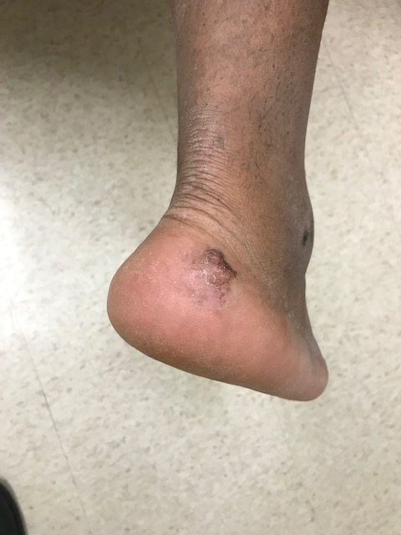
Clinical Presentation: MW

Slide 16
Clinical Presentation: MW (continued)
Culture reports
 | Serratia marcescens |  | Enterococcus faecalis
Drug | MIC Interp | MIC Dilutn | MIC Interp | MIC Dilutn
Ampicillin |  |  | S | <=2
Aztreonam | S | <=1
Cefazolin | R | >=64
Cefepime | S | <=1
Ceftazidime | S | <=1
Ceftriaxone | S | <=1
Gentamicin | S | <=1
Gentamicin Synergy |  |  | S | Syn-S
Levofloxacin | S | <=0.12
Menopenem | S | <=0.25
Streptomycin synergy |  |  | S | Syn-S
Tobramycin | S | <=1
Vancomycin |  |  | S | 1

Slide 17
Clinical Presentation: MW (continued)
Culture reports
 | Serratia marcescens
Drug | MIC Interp | MIC Dilutn
Aztreonam | S | <=1
Cefazolin | R | >=64
Cefepime | S | <=1
Ceftazidime | S | <=1
Ceftriaxone | S | <=1
Gentamicin | S | <=1
Levofloxacin | S | 0.25
Menopenem | S | <=0.25
Tobramycin | S | <=1

Slide 18
Clinical Presentation: AB
Age: 92
PMHx of LLL CA s/p (VATS left lower lobectomy in 2012), HTN, CAD, pacemaker insertion, osteoarthritis, and glaucoma who presents for evaluation of decreasing energy level and sores on backside. Patient is extremely drowsy. Decreased appetite. Lower back pain. Legs started swelling 2 weeks prior, and sores on buttocks and lower back noted by daughter.
Lung carcinoma
Left lower lobe lumpectomy
Severe vitamin B1, C & D deficiencies.
Supplements started.
Appetite stimulation started.

Slide 19
Nutrition: Dr Rothkopf

Slide 20
Clinical Presentation: AB (Nutrition)
Patient is a 92-year-old female with a significant history of lung cancer, hypertension, coronary artery disease, osteoarthritis and glaucoma who presented with confusion and an unstageable midline sacral decubitus with necrotic tissue to the bone and bilateral stage II ischial pressure ulcers. She was found to have osteomyelitis of the coccyx on CT imaging. She underwent extensive wound debridement by Dr. Brem. A metabolic consultation was requested to optimize her condition for wound healing.

Slide 21
Clinical Presentation: AB (Nutrition)
Patient was assessed as having moderate to severe protein calorie malnutrition based on a sub-optimal oral intake, weight loss with evidence of bitemporal and upper extremity muscle wasting and orbital fat depletion on physical examination. A metabolic laboratory evaluation revealed evidence of severe iron (fe=16), thiamine (B1 non-detectable), pyridoxine (B6 non-detectable), ascorbate (VC non-detectable) and ergocalciferol (VD=12) deficiencies. A three day calorie count recorded an average intake of 500 kcal per day, roughly 25% of her requirements. Micronutrient support was provided by intravenous and oral routes. Appetite stimulation therapy was initiated with mirtazapine. The patient gradually improved and was discharged to home.

Slide 22
Clinical Presentation: AB (continued)
Pathology report:
Sacral and bilateral buttock superficial wound (debridement): necrotic fibroadipose tissue with minute fragments of bone and focal acute inflammation
Right ischial bone (debridement): fragments of lamellar bone with osteonecrosis, focal marrow space fibrosis, neutrophil granulocytes and plasma cells compatible with acute / chronic osteomyelitis.
Right ischial bone (debridement): lamellar bone and attached fibrocartilage with acute osteomyelitis
7/19/20: little bacteroides distasonis.
Yeast

Slide 23
Clinical Presentation: AB (continued) Culture report
 | Candida albicans |  | Candida (Torulopsis) glabrata
Drug | MIC Interp | MIC Dilutn | MIC Interp | MIC Dilutn
Caspofungin | S | <=0.25 | S | <=0.25
Fluconazole | S | <=1 | S | 4
Voriconazole | S | <=0.12 | S | <=0.12
7/18/2020: Light growth of yeast
7/19/2020: Scant growth of Candida (Torulopsis) glabrata
Hospice care

Slide 24
Next week’s agenda
Acute limb ischemia
Tumor masquerading as wound—not Marjolin’s ulcer
Maggots in wound
Limb salvage: importance of proximal bone biopsy
Patient presents with diagnosis of vasculitis on steroids: our protocol at The Beth

