Slide 1
Wound Healing Outcomes
Division of Wound Healing and Regenerative Medicine
Department of Surgery
Newark Beth Israel Medical Center
July 21, 2020
njwoundhealing.org

Slide 2
Agenda
Clinical Presentation: AD—sequelae of Covid-19
Chronic osteomyelitis: what is it?
High costs of stage IV decubitus ulcers
Clinical Presentation: RG
What is the role of pathology in diagnosis of vasculitis?
What is definition of hidradenitis?
Clinical Presentation: RD
What is definition of Marjolin’s ulcer?
What is the criteria for hospice (e.g. for dementia)?
Covid-19 PCR testing

Slide 3
Clinical Presentation: AD
Age: 53
History: SARS-2-CoV-2 pneumonia
type 2 Diabetes Mellitus
INPT: Hospital day #98
Sepsis from stage IV decubitus ulcer
sacral and bi-lateral buttock ulcer (12.5 x 11.5 x 4.0 cm)
Pathology: left ischial bone, chronic osteomyelitis

Slide 4
Clinical Presentation: AD (continued)
EEG results 5/18/20: Abnormal EEG with delta slowing over left hemisphere suggest underlying structural lesion which is potentially epileptogenic. Postictal effect can be the other differential. Later part tracing technically limited study, however, there was suggestion of delta range activity over both hemispheres. Neuroimaging and further video EEG as indicated. Clinical correlation advised.
Thrombosis seen in intramuscular calf veins of right lower extremity. Deep vein thrombosis seen of left lower extremity. Veins are dilated with intraluminal echolucent thrombus consistent with acute disease. No evidence of superficial vein thrombosis of the right or left lower extremity.
OR debridement: 6/15/2020

Slide 5
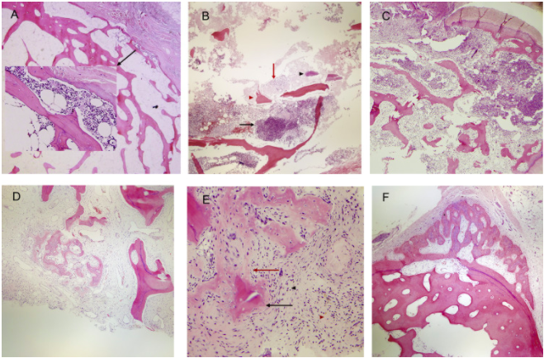
What is definition of chronic osteomyelitis?
Chronic osteomyelitis: histologically defined as bone tissue that has a significant amount of fibrosis surrounding devitalized tissue, accompanied by heavy infiltration of lymphocytes and plasma cells and few polymorphonuclear neutrophilic leukocytes.
Categories of osteomyelitis. (A) Acute osteomyelitis (early): small focus of neutrophils in the marrow space eroding the bone (magnification ×4 and ×20, hematoxylin-eosin [H&E] stain).
(B) Acute osteomyelitis: abscess formation (black arrow), fibrinoid necrosis (red arrow), bacteria (black arrowhead), necrotic bone (red arrowhead) and bone erosion (asterisk) (magnification ×4, H&E stain).
(C) Acute and chronic osteomyelitis: acute inflammation and abscess (right), draining fistula (top) with numerous sequestra and early fibroplasia with chronic inflammation (bottom left) (magnification ×4, H&E stain).
(D) Chronic osteomyelitis: involucrum and bony remodeling in a background of marrow fibrosis with plasmacytic inflammation and granulation tissue (red arrowhead) (magnification ×4, H&E stain).
(E) Chronic active osteomyelitis: Sequestrum (black arrow) and early involucrum (red arrow) in a background of dense marrow fibrosis with numerous plasma cells (black arrowhead) and a small aggregate of neutrophils (red arrowhead).
(F) Chronic inactive osteomyelitis: undulating, thick periosteal reaction with dense marrow fibrosis, scattered plasma cells and bone remodeling.
Sybenga A, et al. Diagnosing osteomyelitis: a histology guide for pathologists. J of Foot & Ankle Surg. 2019 (59)1: P75-85.

Slide 6
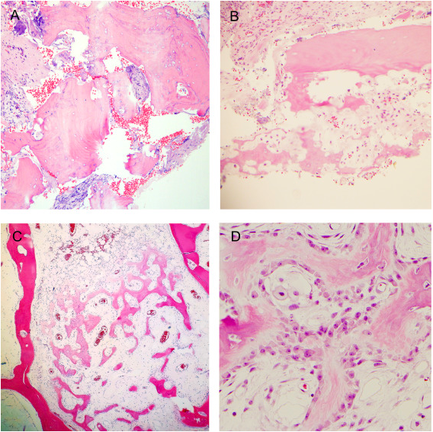
What are major criteria for chronic osteomyelitis?
Sequestrum: large fragment of necrotic bone with surrounding fibrosis and inflammation (magnification ×4, hematoxylin-eosin [H&E] stain). Note the empty lacunae.
Sequestrum: small fragments of necrotic bone with surrounding fibrosis and inflammation (magnification ×10, H&E stain).
Involucrum within the marrow space (magnification ×4, H&E stain).
Involucrum within the marrow space (magnification ×40, H&E stain).
Sybenga A, et al. Diagnosing osteomyelitis: a histology guide for pathologists. J of Foot & Ankle Surg. 2019 (59)1: P75-85.

Slide 7
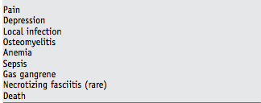
The high costs of stage IV decubitus ulcers
Co-author Bruce C. Vladeck was Administrator of the Health Care Financing Administration (HCFA) of the U.S. Department of Health and Human Services. In that position, he directed the Medicare and Medicaid programs, providing health insurance to more than 65 million Americans with combined annual expenditures of more than $300 billion, and played a central role in the formulation and enactment of the Medicare, Medicaid, and Child Health provisions of the Balanced Budget Act of 1997.
Costs resulting from ulcer progression and its associated medical complications may be prevented by early recognition and treatment of pressure ulcers and monitoring for complications. The exorbitant morbidity, mortality, and costs attributable to stage IV pressure ulcers demand a better understanding of the molecular basis of physiologic impairment, which will lead to new pharmacologic therapies
Brem H, Maggi J, Nierman D, Rolnitzky L, Bell D, Rennert R, Golinko M, Yan A, Lyder C, Vladeck B. High cost of stage IV pressure ulcers. Am J Surg. 2010;200(4):473-477.

Slide 8
Clinical Presentation: RG
Date: July 21
Age: 61
History: BMI 44.7 (morbidly obese)
Pathology Note: Immunofluorescence studies are performed using antibodies to IgG IgA IgM C3 Ciq and fibrinogen. Control tissue stained appropriately. There is no immunopathologic deposition along the epidermis , dermal epidermal junction or vasculature with any immune reactant. IgG stains occasional dermal inflammatory cells as does IgA. There is very focal granular staining along the dermal epidermal junction with C3 which is considered to be a nonspecific finding.
Referred in 2013 for anemia and monoclonal spike, IgG kappa.
2013 bone biopsy results: maturing trilineage hematopoiesis, mild plasmacytosis 6% of the cellularity. Also had positive ANA so was referred to rheumatologist whom she saw last month. According to patient, rheumatologist said everything was okay.
Lost her husband 5/2020.

Slide 9
Clinical Presentation: RG (continued)
Procedure:
1. excision of mass, left axilla, and debridement of wounds down to and including level of fascia.
2. Incision and drainage of complex abscess, right medial breast.
3. Excision of four separate masses of tissue and three on the right, one on the left, and debridement of wounds down to fascia. Right perivaginal, right inferior labia majora and lateral to the left labia tissue and debridement of these wounds down to fascia.
4. examination of back and buttocks that did not show any purulence.

Slide 10
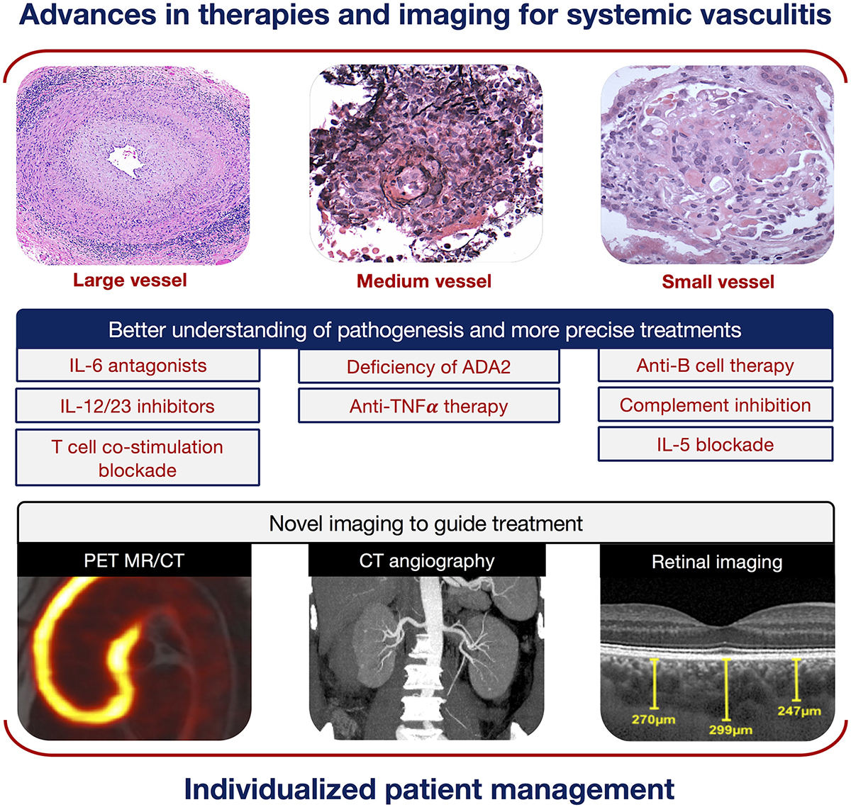
What is relation of pathogenesis and treatment in vasculitis?
The emergence of novel biologics offers more precise targeting of the immune response in large vessel vasculitis and has shown promise in minimizing glucocorticoid reliance.
Farrah TE, Basu N, Dweck M, Calcagno C, Fayad ZA, Dhaun N. Advances in Therapies and Imaging for Systemic Vasculitis. Arterioscler Thromb Vasc Biol. 2019;39(8):1520-1541.

Slide 11
What is definition of Hidradenitis suppurativa?
Infundibular hyperkeratosis, hyperplasia of the follicular epithelium and perifolliculitis are major histopathological characteristics of hidradenitis suppurativa/acne inversa.
These apparently precede rupture of the follicle.
In particular, hyperplasia of the follicular epithelium probably marks the beginning of sinus formation, which usually spreads horizontally.
Psoriasiform hyperplasia of the interfollicular epidermis with subepidermal inflammatory infiltrate might be interpreted as an inflammation‐driven process basically identical to that which is evident at the terminal follicle.
However, it does not lead to harmful and progressive sequelae like those (rupture, sinus tracts) seen at the terminal follicles.
von Laffert M, Stadie V, Wohlrab J, Marsch WC. Hidradenitis suppurativa/acne inversa: bilocated epithelial hyperplasia with very different sequelae. Br J Dermatol. 2011;164(2):367-371.

Slide 12
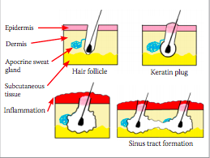
What is definition of Hidradenitis suppurativa?
Schematic representation of the pathophysiology of HS. Follicles adjacent to the apocrine glands become occluded leading to inflammation, rupture and sinus formation
Ferris A, Harding K. Hidradenitis suppurativa: a clinical summary. Wounds UK. 2019; 15(1): 53-57.

Slide 13
Clinical Presentation: RD
Age: 70
History: dementia, hypertension, type 2 Diabetes Mellitus,
End stage renal disease
January 7, 2020: ORIF for right hip intrtrochanteric fracture. Length was 180, diamter was 11 and no complications. Dag screw was 95, distal lock was 40 mm.
3/11/2020: biopsy showing squamous cell carcinoma
7/2/2020: left above knee amputation
Discharge: 7/8/2020
Readmission: 7/10/2020 X-ray of hip shows: intratrochanteric fracture of proximal femur.
Superficial sacral decubitus ulcer

Slide 14
What is definition of Marjolin’s ulcer?
De novo SCC is a particularly aggressive variant of SCC which lacks a precursor and will thus arise independently on skin which has been chronically injured or diseased. It is not correlated with sun exposure, nor will it show any evidence of previous actinic lesions or SCCS.
Generally, de novo SCC will emerge in the setting of long-standing ulcers, burn scars, or osteomyelitis. It can also be seen in chronic inflammatory conditions such as discoid lupus erythematosus and dystrophic epidermolysis bullosa. The tendency for malignancies to develop in burn scars was first described by Marjolin in 1827, and accordingly, are referred to today as Marjolin's ulcers.
Unlike conventional SCCs, which tend to occur on the face, neck, hands, and other sun-damage prone areas, de novo SCCs are most commonly found on the lower extremities, where burn scars are more prevalent.
Although females on average sustain a greater number of burn injuries than males, there is a predilection for malignant scar development in men, and de novo SCCs are significantly more likely to be found in males than in females. They usually emerge 20 to 40 years after the original trauma occurred, and will present clinically as nonhealing, exophytic growths or indurated ulcers which have recently became painful and may have a foul smelling discharge
Yanofsky VR, Mercer SE, Phelps RG. Histopathological variants of cutaneous squamous cell carcinoma: a review. J Skin Cancer. 2011;2011:210813. doi:10.1155/2011/210813

Slide 15
What is definition of Marjolin’s ulcer?
Frequency of histopathologic diagnoses
Pathologic diagnosis | Frequency NO. (%)
Well differentiated SCC | 32 (38.6%)
SCC, differentiation not reported | 20(24.1%)
Moderately Differentiated SCC | 11(13.2%)
BCC | 8(9.6%)
Poorly Differentiatd SCC | 5(6.0%)
Melanoma | 2(2.4%)
Verrucous carcinoma | 2(2.4%)
MFH | 1(1.2%)
Mucoepidermoid carcinoma | 1(1.2%)
Leiomyosarcoma | 1(1.2%)
Sadegh Fazeli M, Lebaschi AH, Hajirostam M, Keramati MR. Marjolin's ulcer: clinical and pathologic features of 83 cases and review of literature. Med J Islam Repub Iran. 2013;27(4):215-224.

Slide 16
What is criteria for hospice?
An abridged version of the currently outlined assessment criteria for the progression of diseases and non-disease baseline guidelines as obtained from the Centers of Medicare and Medicaid Services
Part 1: Decline in a patient's clinical status guidelines
A. Progression of disease via worsening status, symptoms, signs, laboratory results: Clinical Status:
Refractory or recurring infections
Progressive inanition which is documented by several measures such as 10% body weight loss, decreased albumin, dysphagia leading to aspiration, among others
Symptoms: Include a number of symptoms including nausea and vomiting, dyspnea, persisting cough, diarrhea, and progressive pain
Signs: Include a number of clinical signs including hypotension, edema, ascites, progressive weakness, new altered mental status, among others
Laboratory Results:
Include a number of laboratory findings including worsening pCO2/pO2/SaO2 values, worsening liver function tests, worsening tumor markers, and volatile sodium and potassium, among others
Teoli D, Bhardwaj A. Hospice Appropriate Diagnoses. [Updated 2019 Feb 9]. In: StatPearls [Internet]. Treasure Island (FL): StatPearls Publishing; 2020 Jan

Slide 17
What is criteria for hospice?
B. Progressive disease leading to worsened Karnofsky Performance Status or Palliative Performance Score
C. Worsened Functional Assessment Staging of diagnosed dementia.
D. Requiring assistance with additional ADL's
E. Worsening refractory stage 3 to stage 4 pressure ulcers despite wound care
F. Increasing healthcare utilization in the form of emergency visits, hospital admissions, and physician appointments related to the primary hospice diagnosis before seeking hospice benefit
Teoli D, Bhardwaj A. Hospice Appropriate Diagnoses. [Updated 2019 Feb 9]. In: StatPearls [Internet]. Treasure Island (FL): StatPearls Publishing; 2020 Jan

Slide 18
What is criteria for hospice?
Part 2. Non-disease specific baseline guidelines (both points A and B must be satisfied).
A. Physiologic impairment of functional status as interpreted via the Karnofsky Performance Status or Palliative Performance Score of less than 70 percent
B. Individual needs assistance for greater than or equal to 2 ADL's: Ambulation; Transfer; Dressing; Feeding; Continence; Bathing.
C. Co-morbidities: when the condition is not the designated primary hospice diagnosis, the presence of significant disease thought to contribute to a prognosis of 6 months or less survival should be considered, such as:COPD, CHF, Ischemic heart disease, Diabetes mellitus, Neurologic disease (CVA, ALS, MS, Parkinson's), Renal failure, Liver Disease, Neoplasia, Acquired immune deficiency syndrome/HIV, Dementia, Refractory severe autoimmune disease (e.g., lupus or rheumatoid arthritis)
Teoli D, Bhardwaj A. Hospice Appropriate Diagnoses. [Updated 2019 Feb 9]. In: StatPearls [Internet]. Treasure Island (FL): StatPearls Publishing; 2020 Jan

Slide 19
What is criteria for hospice for dementia?
Stage 7C or beyond according to FAST Scale
AND one or more in the past 12 months:
Aspiration pneumonia
Pyelonephritis
Septicemia
multiple pressure ulcers (stage 3-4)
Recurrent fever
Inability to maintain sufficient fluid and calorie intake in past 6 months (10% weight loss or albumin <2.5)
Other significant condition that suggests limited prognosis
www.medicare.gov/coverage/hospice-care

Slide 20
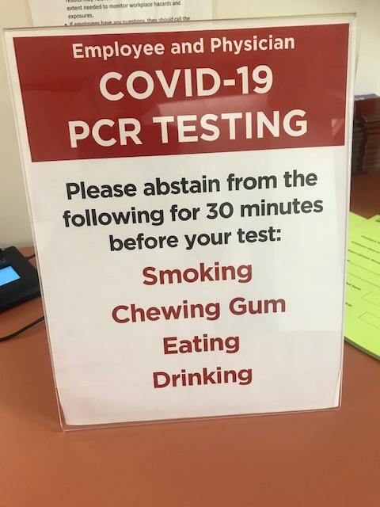
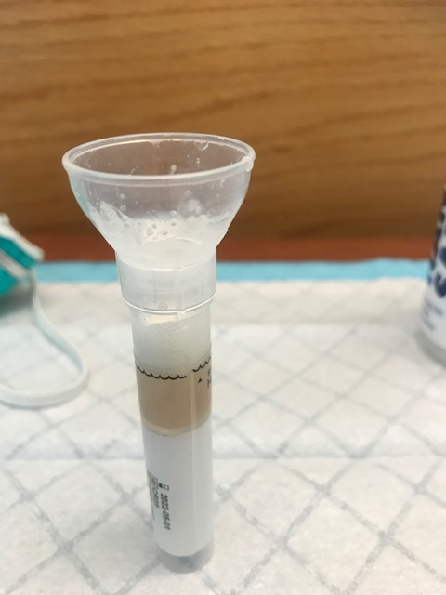
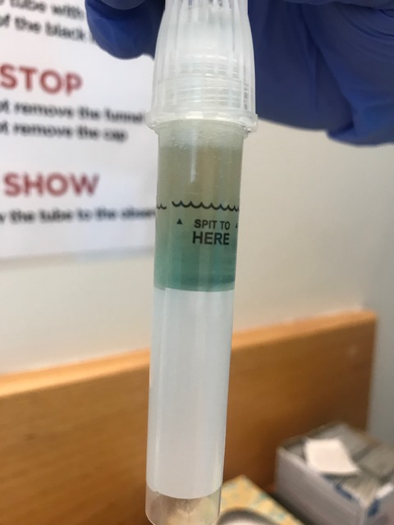
How is Covid-19 PCR testing done?
The testing involves a spit test. (it takes approximately 10 minutes to generate enough saliva).

Slide 21
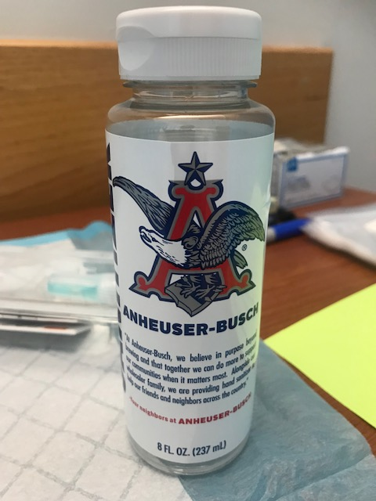
How is Covid-19 PCR testing done?
As a bonus, you get to use Anheuser-Busch products to help with the process.

