Slide 1
Techniques of Debridement Wednesday, October 2, 2024
Notes:
1

Slide 2
Agenda
What instruments are used?
Techniques of debridement
What is the molecular basis of debridement?
What is the role of pathology?
Regenerative Medicine: Acell
Regenerative Medicine: Leukine
Regenerative Medicine: Apligraf
Regenerative Medicine: Integra
Hidradenitis Suppurativa
Diabetic Foot Ulcers
Venous Ulcers
Pressure Ulcers
Necrotizing Fasciitis

Slide 3
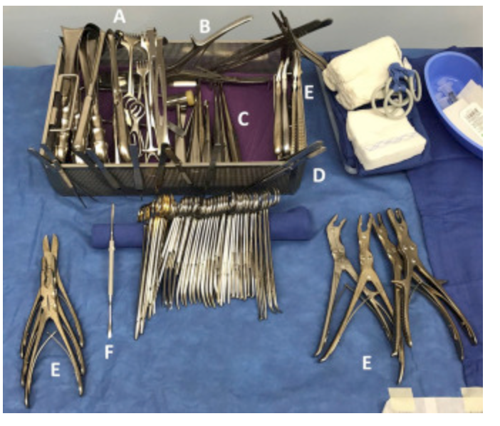
What instruments are used?
The instruments used most frequently by our wound surgeons include:
scalpel (10-, 15-, and 20-blade),
Metzenbaum scissors, curettes,
rongeurs,
electrocautery,
osteotomes,
pulse lavage,
smoke evacuator,
and sagittal saw.
The 10-blade scalpel is used frequently for tangential shaving of long wounds, and the 15-blade scalpel is used for general debriding. It is imperative to change the blade often to maintain a sharp and accurate cutting edge. This will eliminate tissue shearing and damage of surrounding tissue
Instrument tray. The wound tray that we have developed includes: (A) retractors, (B) bone cutters, (C) curettes, (D) forceps, (E) rongeurs, and (F) elevators.
Howell, R. S., Gorenstein, S., Castellano, M., Slone, E., Woods, J. S., Gillette, B. M., Donovan, V., Criscitelli, T., Brem, H., & Brathwaite, C. (2018). Wound Care Center of Excellence: Guide to Operative Technique for Chronic Wounds. Journal of the American College of Surgeons, 226(2), e7–e17. https://doi.org/10.1016/j.jamcollsurg.2017.11.002

Slide 4
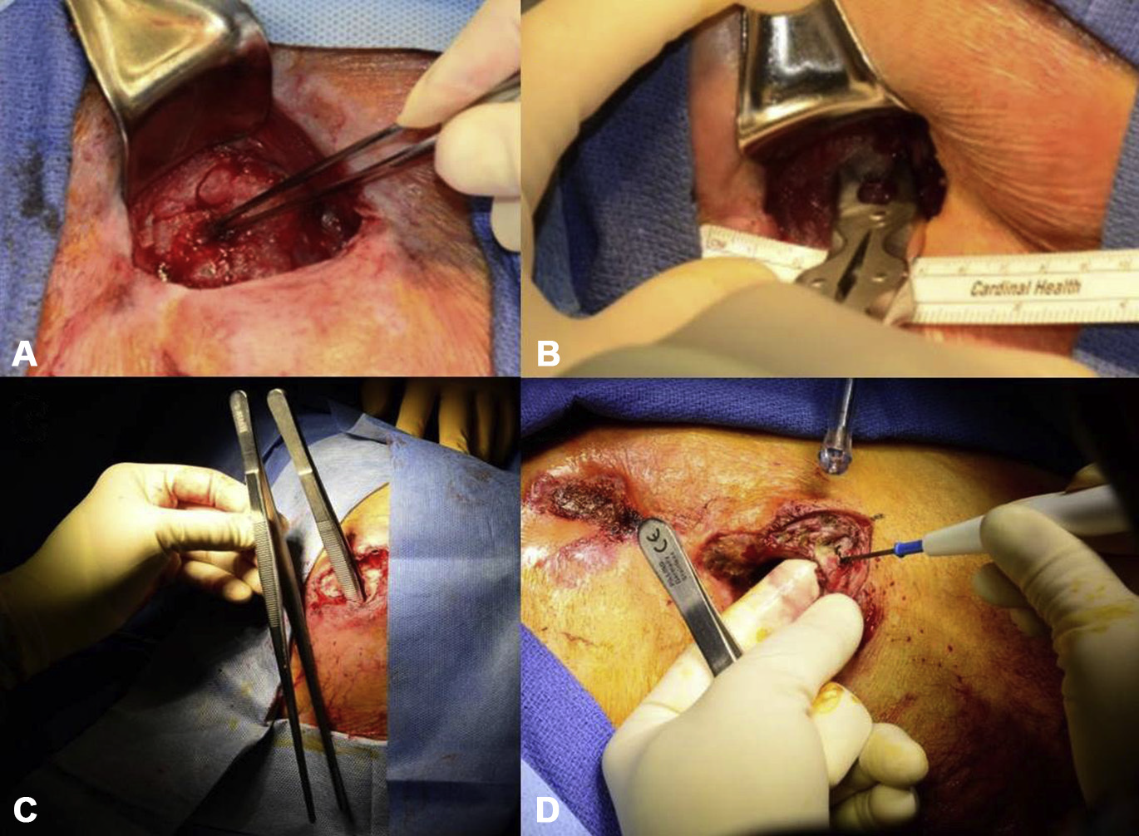
Techniques of debridement
Debridement of a pressure wound. (A) A stage IV sacral pressure wound with necrotic sacrum indicated by the forceps. (B) A rongeur is used to debride the necrotic bone and the specimen is sent to microbiology and pathology for analysis. (C) Extensive tunneling is demonstrated with the use of DeBakey forceps. (D) Undermining is removed by triangulation of the skin overlying the wound.
Howell, R. S., Gorenstein, S., Castellano, M., Slone, E., Woods, J. S., Gillette, B. M., Donovan, V., Criscitelli, T., Brem, H., & Brathwaite, C. (2018). Wound Care Center of Excellence: Guide to Operative Technique for Chronic Wounds. Journal of the American College of Surgeons, 226(2), e7–e17. https://doi.org/10.1016/j.jamcollsurg.2017.11.002

Slide 5
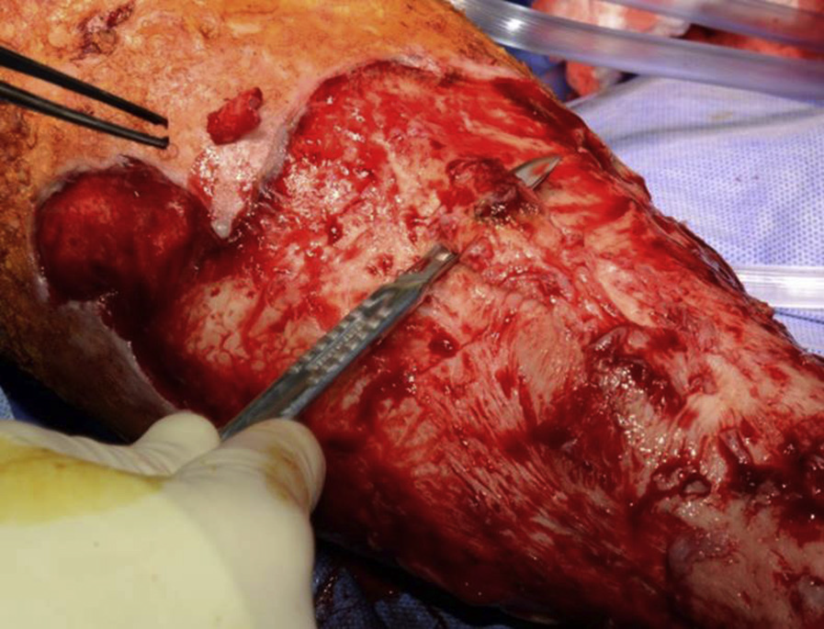
Techniques of debridement
Debridement of venous ulcer. Venous wounds are vigorously scrubbed with a surgical chlorhexidine brush to remove biofilm, coupled with tangential shaving of the ulcer down to a layer of viable-appearing tissue.
Howell, R. S., Gorenstein, S., Castellano, M., Slone, E., Woods, J. S., Gillette, B. M., Donovan, V., Criscitelli, T., Brem, H., & Brathwaite, C. (2018). Wound Care Center of Excellence: Guide to Operative Technique for Chronic Wounds. Journal of the American College of Surgeons, 226(2), e7–e17. https://doi.org/10.1016/j.jamcollsurg.2017.11.002

Slide 6
What is the molecular basis of debridement?
Top: A typical foot ulcer in a patient with diabetes.
(i) The nonhealing edge (callus) containing cells with molecular markers indicative of healing impairment.
(ii) Phenotypically normal but physiologically impaired cells, which can be stimulated to heal. Despite a wound’s appearance after debridement. It may not be healing and may need to be evaluated for the presence of molecular markers of inhibition and/or hyperkeratotic tissue.
Once a wound is debrided, pathology analyses along with immunohistochemistry determine whether debridement was sufficient. If not (see lower left), cells positive for c-myc (green) and nuclear β-catenin (purple) will be found, indicating presence of ulcerogenic cells and successful debridement.
Brem H, Tomic-Canic M. Cellular and molecular basis of wound healing in diabetes. J Clin Invest. 2007 (117)5: 1219-1222.

Slide 7
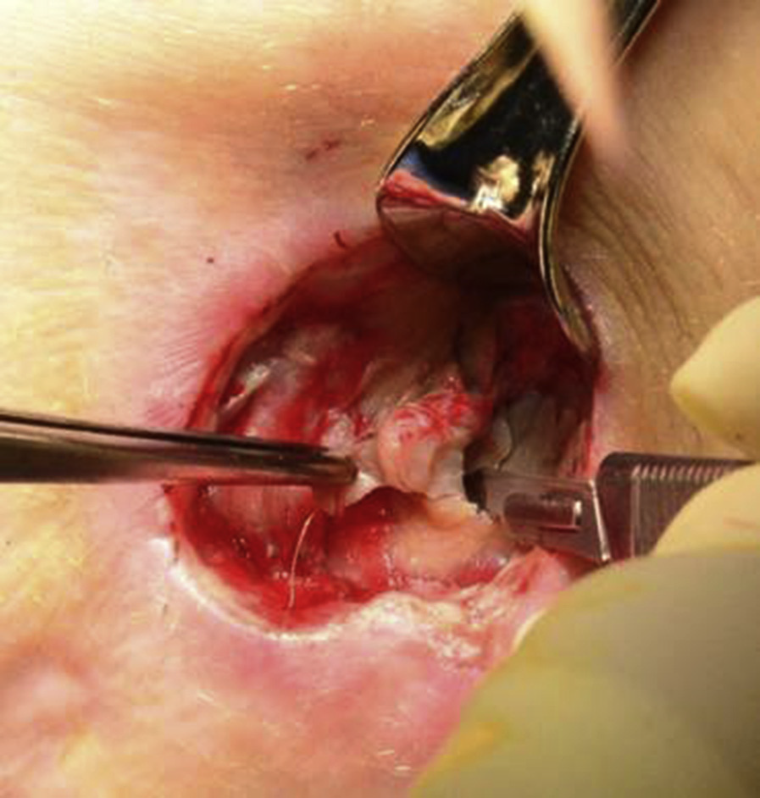
What is the role of pathology?
Skin-edge and wound-base specimens are taken during each debridement to evaluate viability of deep-tissue margins and to rule out pathology such as carcinoma, necrosis, osteomyelitis, and active infection, as evidenced by inflammatory cell infiltrates.
These specimens are transported to pathology in formalin. When infection is suspected, aerobic and anaerobic wound cultures are obtained to tailor antibiotic therapy. Unused sterile instruments are used to collect cultures, which are sent fresh in a sterile cup.
Cultures are sent in thioglycolate broth when anaerobic pathogens are suspected. When vasculitis or pyoderma is suspected, a specimen is collected from the nearby healthy-appearing skin that is not part of the gross wound and sent in Michel’s transport medium to allow for immunofluorescent-based analysis.
Howell, R. S., Gorenstein, S., Castellano, M., Slone, E., Woods, J. S., Gillette, B. M., Donovan, V., Criscitelli, T., Brem, H., & Brathwaite, C. (2018). Wound Care Center of Excellence: Guide to Operative Technique for Chronic Wounds. Journal of the American College of Surgeons, 226(2), e7–e17. https://doi.org/10.1016/j.jamcollsurg.2017.11.002

Slide 8
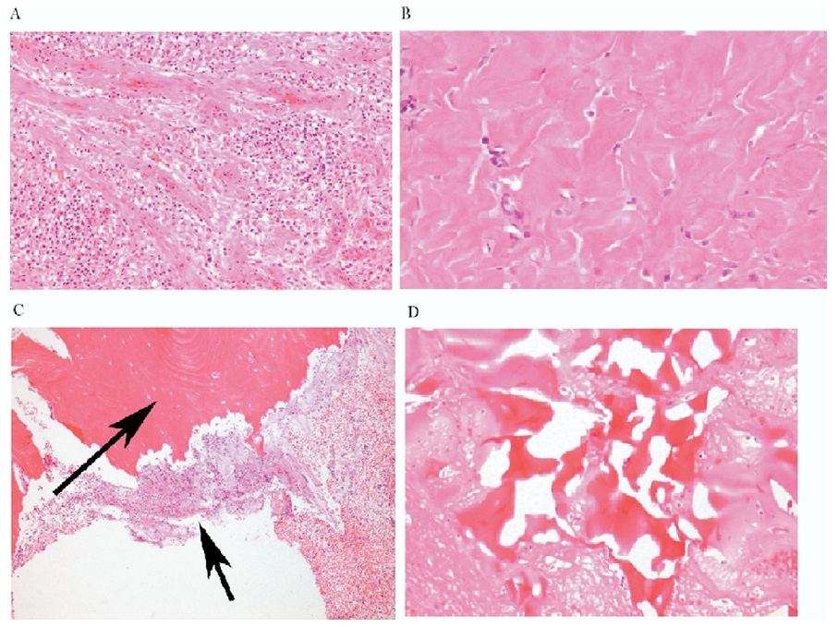
What is the role of pathology?
A
B
Granulation tissue
Fibrosis
Osteomyelitis
Reactive bone
C
D
Golinko et al., Operative Debridement of Diabetic Foot Ulcers. J Am Coll Surg 2008; 207:e1-e6.

Slide 9
What Are the Operative Techniques for Chronic Wounds?
General principles of debridement. Wounds exhibiting features necessitating debridement: (A) nonviable/ necrotic tissue, (B) callus, (C) nonmigratory heaped or rolled skin edges, (D) exudate, (E) tunneling, and (F) undermining.
Howell RS, et al. Wound Care Center of Excellence: Guide to Operative Technique for Chronic Wounds. J Am Coll Surg, 2018; 226(2):e7-e17.

Slide 10
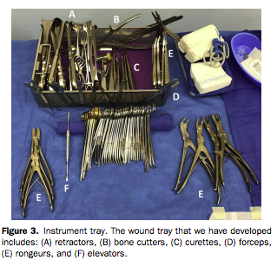
What Are the Operative Techniques for Chronic Wounds?
Howell RS, et al. Wound Care Center of Excellence: Guide to Operative Technique for Chronic Wounds. J Am Coll Surg, 2018; 226(2):e7-e17.

Slide 11
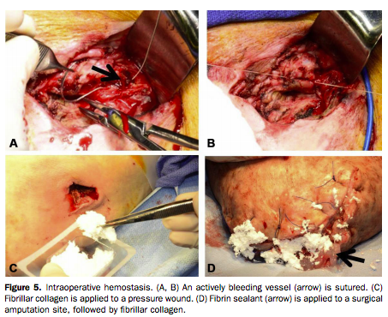
What Are the Operative Techniques for Chronic Wounds?
Howell RS, et al. Wound Care Center of Excellence: Guide to Operative Technique for Chronic Wounds. J Am Coll Surg, 2018; 226(2):e7-e17.

Slide 12
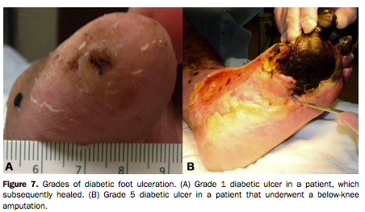
What Are the Operative Techniques for Chronic Wounds?
Howell RS, et al. Wound Care Center of Excellence: Guide to Operative Technique for Chronic Wounds. J Am Coll Surg, 2018; 226(2):e7-e17.

Slide 13
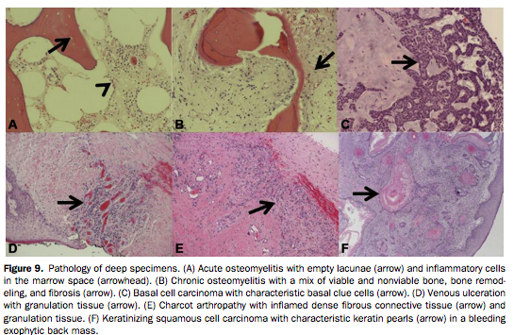
What Are the Operative Techniques for Chronic Wounds? (continued)
Howell RS, et al. Wound Care Center of Excellence: Guide to Operative Technique for Chronic Wounds. J Am Coll Surg, 2018; 226(2):e7-e17.

Slide 14
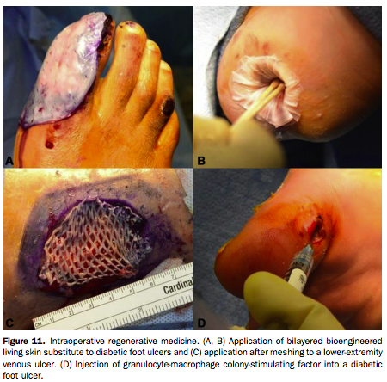
What Are the Operative Techniques for Chronic Wounds? (continued)
Howell RS, et al. Wound Care Center of Excellence: Guide to Operative Technique for Chronic Wounds. J Am Coll Surg, 2018; 226(2):e7-e17.

Slide 15
What Are the Operative Techniques for Chronic Wounds? (continued)
Howell RS, et al. Wound Care Center of Excellence: Guide to Operative Technique for Chronic Wounds. J Am Coll Surg, 2018; 226(2):e7-e17.

Slide 16
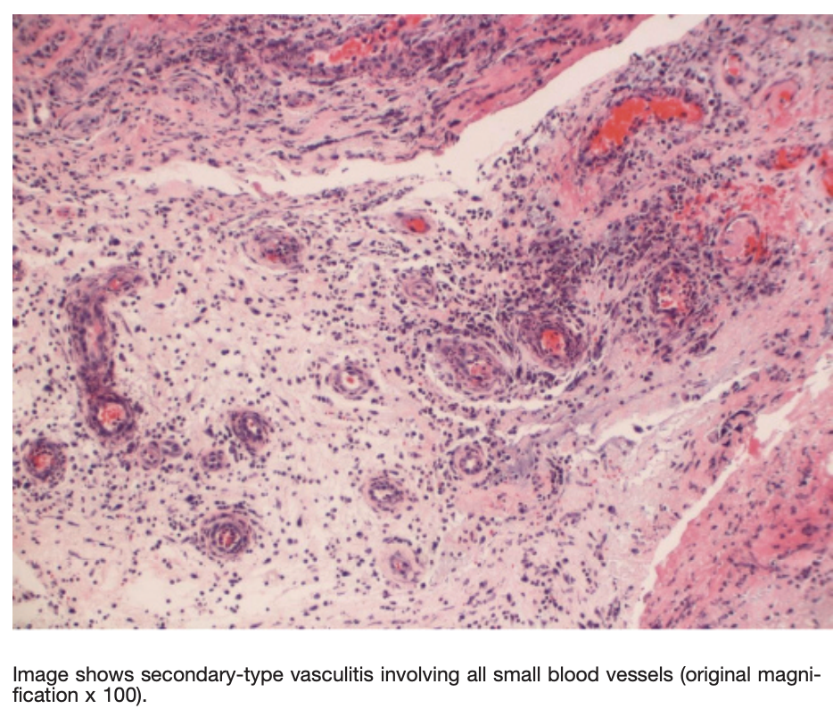
What is the role of pathology?
Knowledge of histopathologic alterations present in wound tissue is fundamental to successful debridement and healing.
Pathologic evaluation can help distinguish healing from a nonhealing wound edge; however for chronic wounds refractory to standard debridement and treatment protocols, a detailed analysis of wound edge histopathology may be necessary to guide therapeutic interventions and debridement.
Turi, G. K., Donovan, V., DiGregorio, J., Criscitelli, T. M., Kashan, B., Barrientos, S., Balingcongan, J. R., Gorenstein, S., & Brem, H. (2016). Major Histopathologic Diagnoses of Chronic Wounds. Advances in skin & wound care, 29(8), 376–382. https://doi.org/10.1097/01.ASW.0000484665.45022.b3

Slide 17
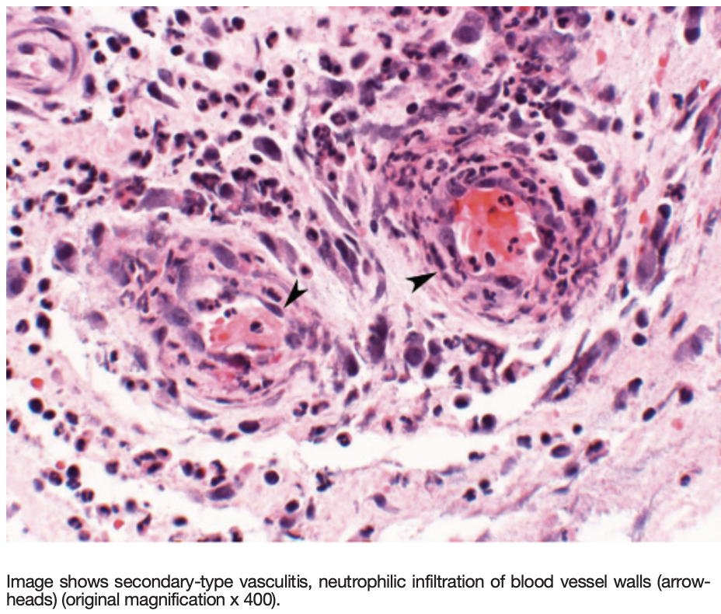
What is the role of pathology?
Although clinical signs and symptoms may heighten clinical suspicion of osteomyelitis, tissue culture, specificity, and histologic findings in bone tissue are crucial to treatment.
A thorough history and physical examination, multimodality specialty involvement, and treatments, along with accurate diagnosis through histopathologic analysis of wound biopsies from routine debridements, can help tailor treatment regimens.
Turi, G. K., Donovan, V., DiGregorio, J., Criscitelli, T. M., Kashan, B., Barrientos, S., Balingcongan, J. R., Gorenstein, S., & Brem, H. (2016). Major Histopathologic Diagnoses of Chronic Wounds. Advances in skin & wound care, 29(8), 376–382. https://doi.org/10.1097/01.ASW.0000484665.45022.b3

Slide 18
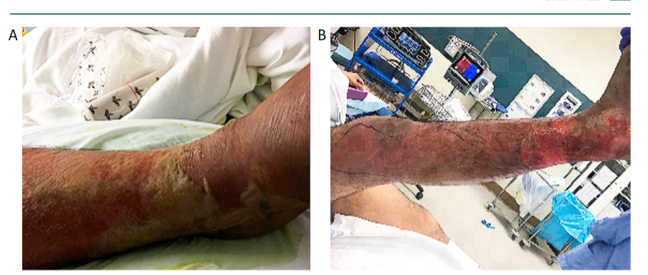
Necrotizing Fasciitis
Necrotizing fasciitis of the right lower limb. (A) Day 4 of symptoms with erythema, edema and blisters. (B): Day 5 of symptoms with skin peeling off.
Chen LL, Fasolka B, Treacy C. Necrotizing fasciitis: A comprehensive review. Nursing. 2020 Sep;50(9):34-40. doi: 10.1097/01.NURSE.0000694752.85118.62. PMID: 32826674; PMCID: PMC8828282.

Slide 19
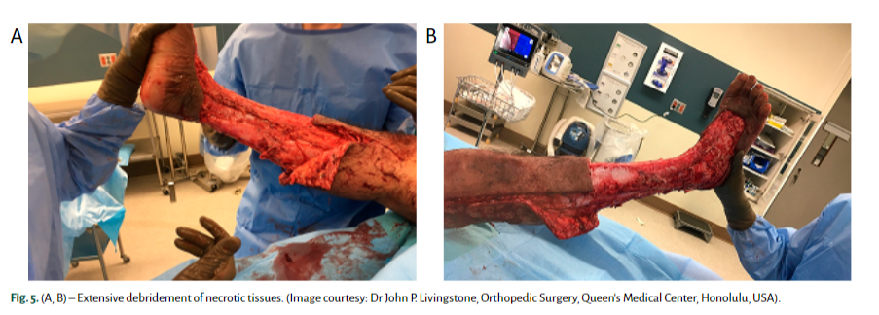
Necrotizing Fasciitis
Early and aggressive surgical debridement of necrotic tissue is the cornerstone of management. It reduces the infection burden, minimizes ultimate tissue loss, reduces the need for amputation and thereby, decreases mortality.
Debridement should be extensive and all the necrotic and poorly perfused tissues that can be easily elevated off the fascia with gentle pressure should be excised
Chen LL, Fasolka B, Treacy C. Necrotizing fasciitis: A comprehensive review. Nursing. 2020 Sep;50(9):34-40. doi: 10.1097/01.NURSE.0000694752.85118.62. PMID: 32826674; PMCID: PMC8828282.

