Slide 1
Role of Pathology in Diagnosis and Treatment of Chronic Wounds Wednesday, October 2, 2024
Notes:
1

Slide 2
Agenda
What is the Importance of Pathological Diagnosis After Debridement?
What is the histopathology of vasculitis?
What is histopathology of osteomyelitis?
What is histopathology of acute vs. chronic osteomyelitis?
What is histopathology of pelvic osteomyelitis?
What is importance of proximal bone biopsy?
What is the histopathology of venous ulcers?
What is histopathology of necrotizing fasciitis?

Slide 3
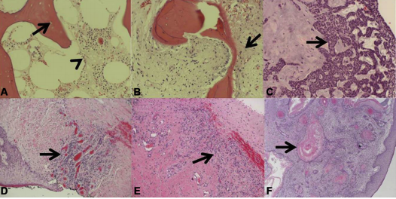
What is the Importance of Pathological Diagnosis After Debridement?
Pathology of deep specimens. (A) acute osteomyelitis with empty lacunae (arrow) and inflammatory cells in the marrow space (arrowhead). (B) chronic osteomyelitis with a mix of viable and nonviable bone, bone remodeling, and fibrosis (arrow). (C ) basal cell carcinoma with characteristic basal clue cells (arrow). (D) venous ulceration with granulation tissue (arrow). (E ) charcot arthopathy with inflamed dense fibrous connective tissue (arrow) and granulation tissue. (F) keratinizing squamous cell carcinoma with characteristic keratin pearls (arrow) in a bleeding exophytic back mass.
Howell RS, et al. Wound care center of excellence: guide to operative technique for chronic wounds. J Am Coll Surg 2018 (226)2: e7-e17.

Slide 4
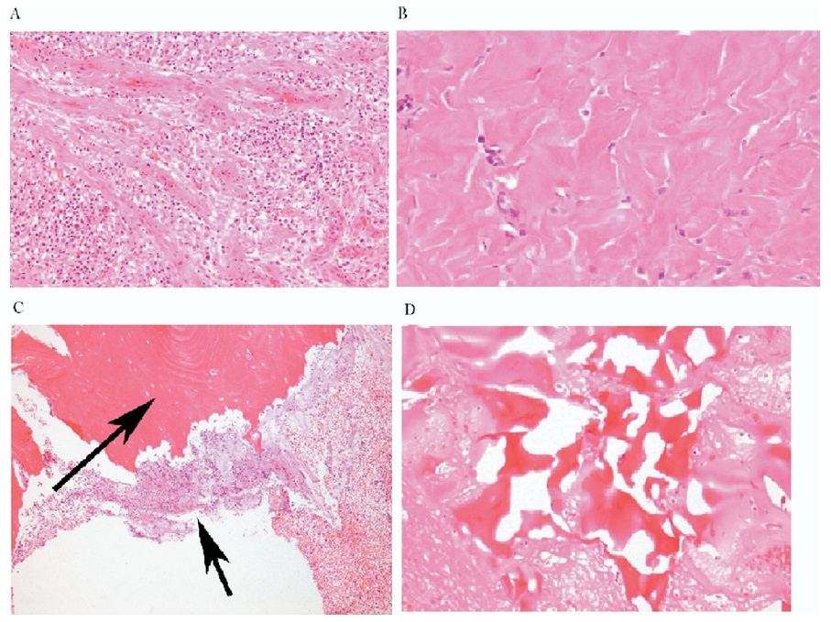
Pathological Importance of the Tissue Left Behind
A
B
Granulation tissue
Fibrosis
Osteomyelitis
Reactive bone
C
D
Golinko et al. Operative Debridement of Diabetic Foot Ulcers. J Am Coll Surg 2008; 207:e1-e6

Slide 5
Cutaneous Granulomatosis with Polyangiitis – Vasculitis. Perivascular inflammation with plasma cell infiltration. (40x)
White arrow: blood vessel
Yellow arrows: plasma cells
Turi GK, et al. Major Histopathologic Diagnoses of Chronic Wounds. Adv Skin Wound Care. 2016;29(8):E1.

Slide 6
What is histopathology of secondary-type vasculitis?
Turi GK, et al. Major Histopathologic Diagnoses of Chronic Wounds. Adv Skin Wound Care. 2016;29(8):E1.

Slide 7
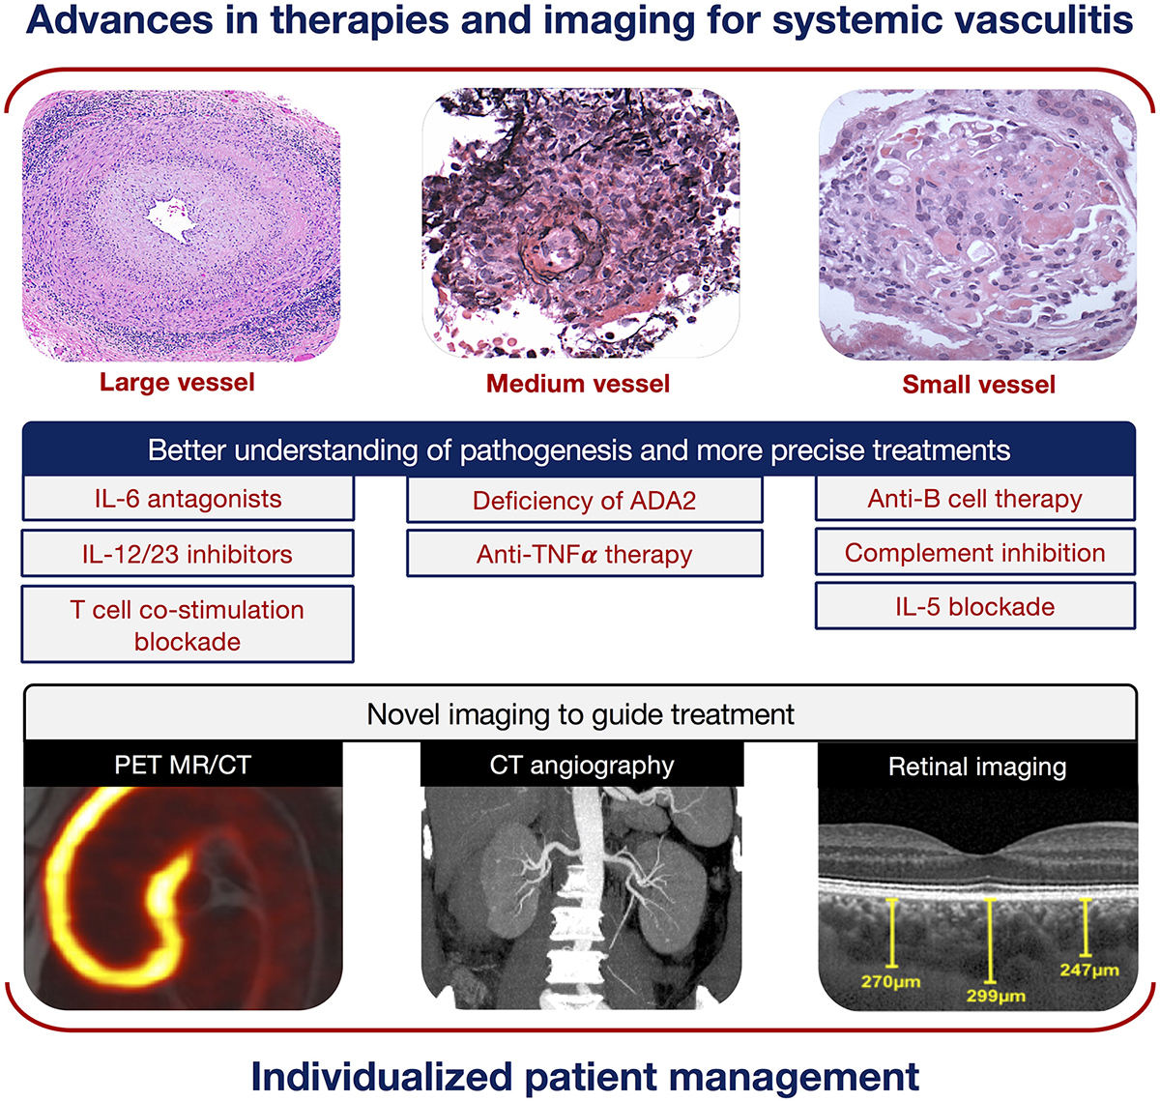
What is relation of pathogenesis and treatment in vasculitis?
The emergence of novel biologics offers more precise targeting of the immune response in large vessel vasculitis and has shown promise in minimizing glucocorticoid reliance.
Farrah TE, Basu N, Dweck M, Calcagno C, Fayad ZA, Dhaun N. Advances in Therapies and Imaging for Systemic Vasculitis. Arterioscler Thromb Vasc Biol. 2019;39(8):1520-1541.

Slide 8
What is the histopathology of osteomyelitis?
A diagnosis of osteomyelitis should be considered, unless proven otherwise, when there are signs of deep wounds in the sinus tract that probe to the bone, exposed bones or chronic nonhealing ulcers despite standard medical care. Further investigations, such as laboratory tests, diagnostic imaging (plain radiography, magnetic resonance imaging, WBC-labeled scintigraphy) and bone culture or biopsy can aid in the confirmation of osteomyelitis (strong; moderate).
Bone biopsy and bone cultures should be considered the gold standard for the diagnosis of diabetic foot osteomyelitis (strong; high). Confirmation of the diagnosis of diabetic foot osteomyelitis is largely based on the isolation of bacteria in bone tissue, the discovery of osteonecrosis and histopathological findings of inflammatory cell infiltration.
Bone biopsy is performed under surgical debridement or percutaneous puncture under fluoroscopy or computed tomography guidance and is considered the gold standard for the diagnosis of osteomyelitis. The sensitivity and specificity of bone biopsy can reach 95% and 90%, respectively.
Bone biopsy has not only played a role in the diagnosis of osteomyelitis but also provided guidance in the identification of pathogenic bacteria and their antibiotic sensitivity.
Wang A, Lv G, Cheng X, et al. Guidelines on multidisciplinary approaches for the prevention and management of diabetic foot disease (2020 edition). Burns Trauma. 2020;8:tkaa017. Published 2020 Jul 6. doi:10.1093/burnst/tkaa017

Slide 9
What is histopathology of osteomyelitis?
Turi GK, et al. Major Histopathologic Diagnoses of Chronic Wounds. Adv Skin Wound Care. 2016;29(8):E1.

Slide 10
What is histopathology of acute osteomyelitis?
Turi GK, et al. Major Histopathologic Diagnoses of Chronic Wounds. Adv Skin Wound Care. 2016;29(8):E1.

Slide 11
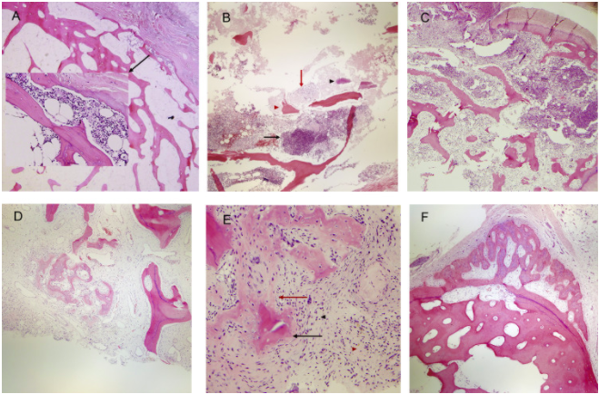
What is definition of chronic osteomyelitis?
Chronic osteomyelitis: histologically defined as bone tissue that has a significant amount of fibrosis surrounding devitalized tissue, accompanied by heavy infiltration of lymphocytes and plasma cells and few polymorphonuclear neutrophilic leukocytes.
Categories of osteomyelitis. (A) Acute osteomyelitis (early): small focus of neutrophils in the marrow space eroding the bone (magnification ×4 and ×20, hematoxylin-eosin [H&E] stain).
(B) Acute osteomyelitis: abscess formation (black arrow), fibrinoid necrosis (red arrow), bacteria (black arrowhead), necrotic bone (red arrowhead) and bone erosion (asterisk) (magnification ×4, H&E stain).
(C) Acute and chronic osteomyelitis: acute inflammation and abscess (right), draining fistula (top) with numerous sequestra and early fibroplasia with chronic inflammation (bottom left) (magnification ×4, H&E stain).
(D) Chronic osteomyelitis: involucrum and bony remodeling in a background of marrow fibrosis with plasmacytic inflammation and granulation tissue (red arrowhead) (magnification ×4, H&E stain).
(E) Chronic active osteomyelitis: Sequestrum (black arrow) and early involucrum (red arrow) in a background of dense marrow fibrosis with numerous plasma cells (black arrowhead) and a small aggregate of neutrophils (red arrowhead).
(F) Chronic inactive osteomyelitis: undulating, thick periosteal reaction with dense marrow fibrosis, scattered plasma cells and bone remodeling.
Sybenga A, et al. Diagnosing osteomyelitis: a histology guide for pathologists. J of Foot & Ankle Surg. 2019 (59)1: P75-85.

Slide 12
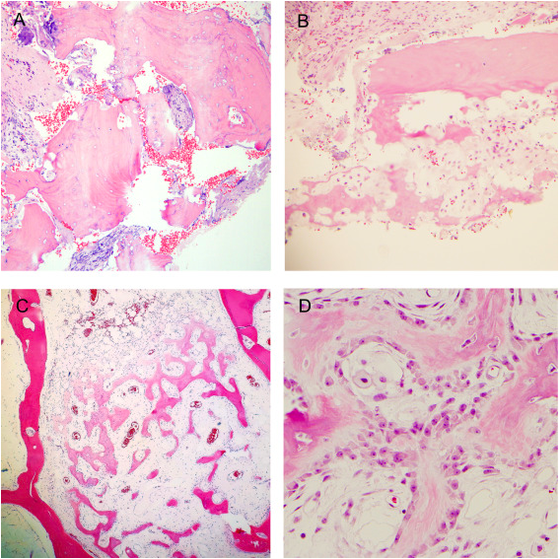
What are major criteria for chronic osteomyelitis?
Sequestrum: large fragment of necrotic bone with surrounding fibrosis and inflammation (magnification ×4, hematoxylin-eosin [H&E] stain). Note the empty lacunae.
Sequestrum: small fragments of necrotic bone with surrounding fibrosis and inflammation (magnification ×10, H&E stain).
Involucrum within the marrow space (magnification ×4, H&E stain).
Involucrum within the marrow space (magnification ×40, H&E stain).
Sybenga A, et al. Diagnosing osteomyelitis: a histology guide for pathologists. J of Foot & Ankle Surg. 2019 (59)1: P75-85.

Slide 13
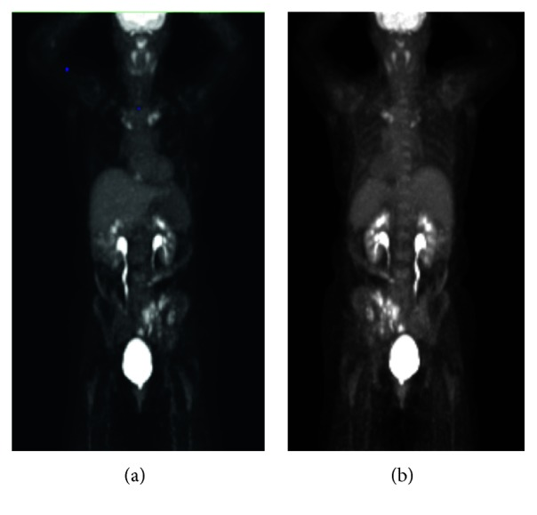
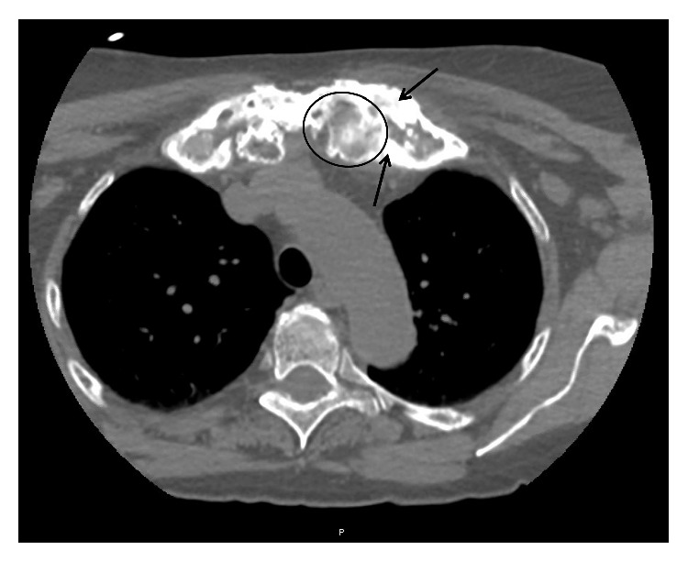
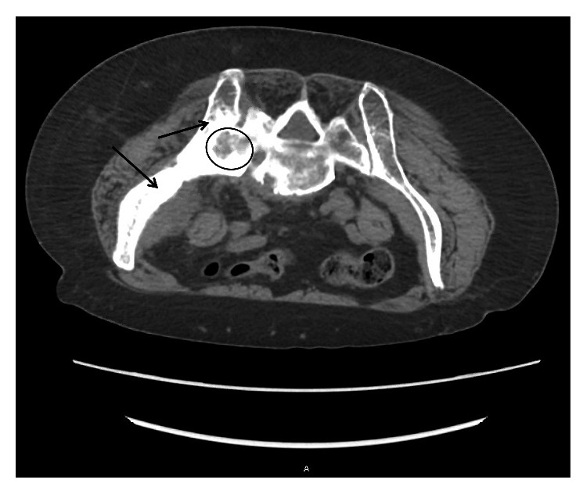
What is importance of proximal bone biopsy?
Chronic recurrent multifocal osteomyelitis (CRMO) is the most severe form of chronic nonbacterial osteomyelitis (CNO) and is a rare autoinflammatory bone disorder that mostly affects children and adolescents. CRMO is a diagnosis of exclusion, resulting in often-delayed diagnosis with over one year on average from onset of symptoms to time of diagnosis. Initial diagnosis is rare in adults.
CT biopsy imaging axial body view with slice thickness 5.00 demonstrating lytic (example inside circle) and sclerotic lesions (examples of thickened bone pointed to with arrows) of the left sacrum and left ileum. Also, notice fusion of the left sacro-iliac joint. For reference, the patient is prone in this image as it was taken during the time of biopsy; therefore, the left ileum/sacrum is on the left of the image.
CT biopsy imaging axial body view with a slice thickness of 2.00 demonstrating lytic (example inside circle) and sclerotic lesions (examples of thickened bone pointed to with arrows) of the left medial clavicle and left first rib.
PET scan whole body performed on 1/9/2019. (a) Anterior view and (b) posterior view with hypermetabolism of the left side of pelvis and ileum and bilateral medial clavicles
Mahady S, Ladani A. Clinical and Diagnostic Considerations for Atypical, Adult Onset Presentation of Chronic Recurrent Multifocal Osteomyelitis (CRMO). Case Rep Rheumatol. 2019;2019:8206892. Published 2019 Sep 29. doi:10.1155/2019/8206892

Slide 14
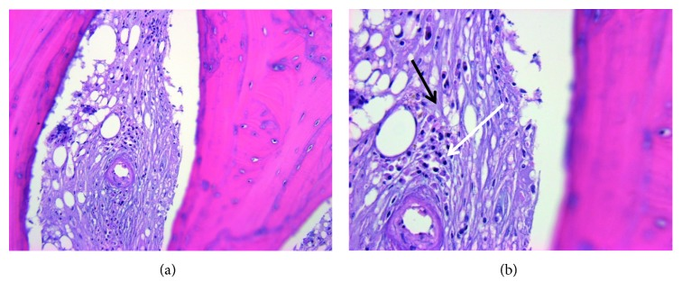
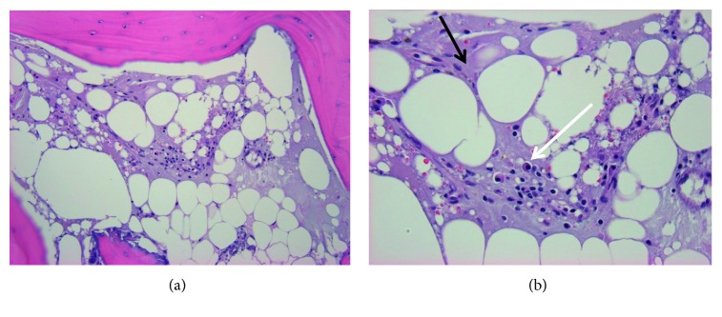
What is importance of proximal bone biopsy?
Chronic recurrent multifocal osteomyelitis (CRMO) is the most severe form of chronic nonbacterial osteomyelitis (CNO) and is a rare autoinflammatory bone disorder that mostly affects children and adolescents. CRMO is a diagnosis of exclusion, resulting in often-delayed diagnosis with over one year on average from onset of symptoms to time of diagnosis. Initial diagnosis is rare in adults.
Bone biopsy of the left medial clavicle performed on 1/21/2019. (a) H&E 200x marrow fibrosis with plasma cell infiltrate. (b) H&E 400x marrow fibrosis (lighter purple color throughout indicated by black arrow) in place of a fatty marrow background with plasma cell infiltrate that contains eccentric nuclei (area indicated by white arrow) representing changes indicative of chronic inflammation.
Bone biopsy of the left medial clavicle performed on 1/21/2019. (a) H&E 200x marrow fibrosis with plasma cell infiltrate. (b) H&E 400x marrow fibrosis (lighter purple color throughout indicated by black arrow) in place of a fatty marrow background with plasma cell infiltrate that contains eccentric nuclei (area indicated by white arrow) representing changes indicative of chronic inflammation.
Mahady S, Ladani A. Clinical and Diagnostic Considerations for Atypical, Adult Onset Presentation of Chronic Recurrent Multifocal Osteomyelitis (CRMO). Case Rep Rheumatol. 2019;2019:8206892. Published 2019 Sep 29. doi:10.1155/2019/8206892

Slide 15
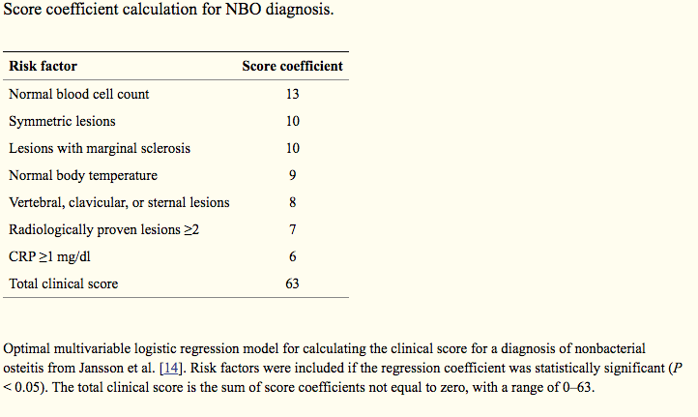
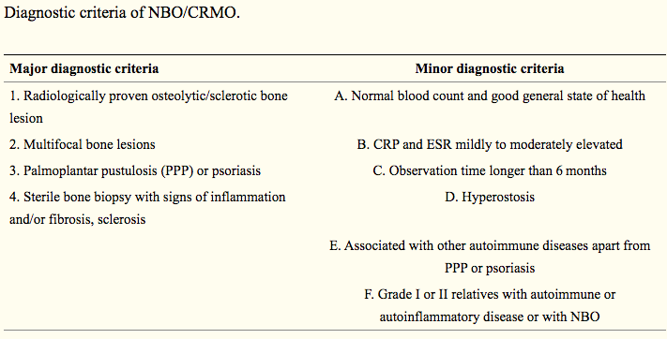
What is importance of proximal bone biopsy?
While the diagnosis of Chronic recurrent multifocal osteomyelitis (CRMO) is primarily based on exclusion of other differential diagnoses, history of recurrent bone pain, and the presence of sclerotic bone lesions, there do exist some diagnostic tools such as the diagnostic criteria and score coefficient calculation.
However, based on this necessity of exclusion of other differential diagnosis, bone biopsy remains mandatory in particular in adult patients. It is important to improve the clinical understanding of CRMO by the documentation of more cases, route of diagnosis, and treatment choices made in order to help develop clearer diagnostic and treatment guidelines.
Mahady S, Ladani A. Clinical and Diagnostic Considerations for Atypical, Adult Onset Presentation of Chronic Recurrent Multifocal Osteomyelitis (CRMO). Case Rep Rheumatol. 2019;2019:8206892. Published 2019 Sep 29. doi:10.1155/2019/8206892

Slide 16
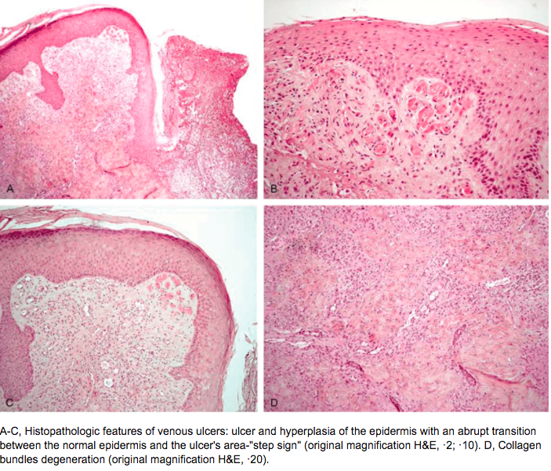
What is the histopathology of venous ulcers?
Misciali, Cosimo & Dika, Emi & Baraldi, Carlotta & Fanti, Pier & Mirelli, Michele & Stella, Andrea & Bertoncelli, Marco & Patrizi, Annalisa. (2014). Vascular Leg Ulcers: Histopathologic Study of 293 Patients. The American Journal of dermatopathology. 36.

Slide 17
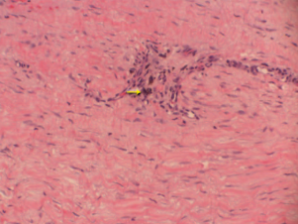
What is the histopathology of venous ulcers?
Hematoxylin and eosin stain of debrided tissue from a venous ulcer depicting dense fibrous connective tissue with hemosiderin deposition (arrow).
Gould LJ, et al. Modalities to treat venous ulcers: compression, surgery, and bioengineered tissue. Plastic and Reconstructive Surgery. 2016 Sep; 138(3 Suppl): 199S-208S.

Slide 18
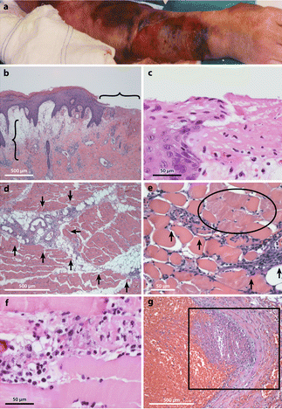
What is histopathology of necrotizing fasciitis?
Histopathology features of human necrotizing fasciitis.
A: The arm of this patient infected with group A Streptococcusis very swollen and bruised. A large ulcer is developing on the dorsal forearm. However, the visual appearance still greatly underestimates the true severity of the underlying infection. B: Microscopic evaluation of the skin shows an erosion of the epidermis (horizontal bracket), edematous thickening of the dermis (vertical bracket), and sparse inflammatory cell infiltrate (original magnification 2×). C: These histopathological features of the ulcer and dermal-epidermal junction are better seen at high magnification. D: In the infected deep soft tissue, there are marked necrosis, acute inflammatory cell infiltration, and bacterial organisms that are primarily concentrated along the major fascial planes (arrows). E: The necrosis is observed to extend beyond the fascial planes to also infiltrate along individual muscle fibers (arrows). Numerous nonviable muscle cells are present alongside the advancing infection (circled region). F: At high magnification, four severely damaged muscle fibers are seen. G A characteristic feature of human necrotizing fasciitis is vascular thrombosis (boxed region) and hemorrhage.
Olsen RJ, Musser JM. Molecular pathogenesis of necrotizing fasciitis. Annu Rev Pathol. 2010;5:1-31. doi:10.1146/annurev-pathol-121808-102135

Slide 19
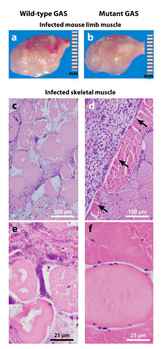
What is pathology of necrotizing fasciitis?
Animal models of group A Streptococcus(GAS) necrotizing fasciitis. To investigate a particular gene of interest, animals are infected intramuscularly with either the wild-type or the isogenic mutant strain, and parameters of disease severity are compared.
(a, b) Photographs of infected mouse limbs demonstrate that the wild-type GAS strain (panel a) causes larger, more hemorrhagic lesions compared to the mutant strain (panel b).
(c, d) Micrographs of infected nonhuman primate limb muscle excised from the inoculation site show that the wild-type GAS strain causes much more severe, widespread fascial and myocyte necrosis (panel c) compared to the confined lesion (arrows) caused by the mutant strain (panel d). (e, f) These features are better seen at high magnification (panel ecompared to panel f).
Olsen RJ, Musser JM. Molecular pathogenesis of necrotizing fasciitis. Annu Rev Pathol. 2010;5:1-31. doi:10.1146/annurev-pathol-121808-102135

