Slide 1
Regenerative Medicine in Wound Healing Wednesday, October 2, 2024
Notes:
1

Slide 2
Agenda
What is the cellular basis for healing?
Regenerative Medicine: Acell
Regenerative Medicine: Leukine
Regenerative Medicine: Apligraf
Regenerative Medicine: Integra
How effective is porcine mesothelium matrix?
What is efficacy of human amniotic membrane on diabetic ulcers?
What are self-assembled nanomaterials (e.g., PurAply)?
What is Veraflo?

Slide 3
What is the Cellular Basis of Healing?

Slide 4
Current Clinical Therapies
Leukine
Granulocyte-macrophage colony stimulating factor
Apligraf
Other growth factors
Platelet-Derived Growth Factor-BB (PDGF-BB)
Extra-cellular matrix
Negative-pressure therapy

Slide 5
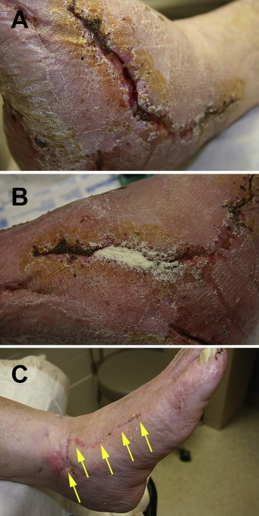
Regenerative Medicine: Acell
Figure A: Dehiscence to the lateral surgical wound that was present for 6 weeks and was nonresponsive to standard postoperative wound care of moist gauze dressings.
Figure B: UBM micronized particles were poured into the tunneling aspect of the wound and covered with a nonadherent dressing and sterile gauze.
Figure C: The wound was healed after 4 weeks of treatment.
Kimmel, H., Rahn, M., & Gilbert, T. W. (2010). The clinical effectiveness in wound healing with extracellular matrix derived from porcine urinary bladder matrix: a case series on severe chronic wounds. The journal of the American College of Certified Wound Specialists, 2(3), 55–59. https://doi.org/10.1016/j.jcws.2010.11.002

Slide 6
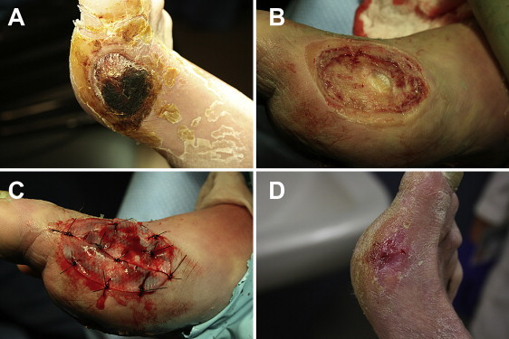
Regenerative Medicine: Acell
Figure A: A necrotic diabetic ulcer to the medial aspect of the patient’s right foot.
Figure B: Debridement in the operating room down to joint capsule.
Figure C: A thick UBM sheet was hydrated in normal saline, fenestrated, and then sutured to the wound base.
Figure D: The full thickness wound was healed in 13 weeks from the date of surgery.
Kimmel, H., Rahn, M., & Gilbert, T. W. (2010). The clinical effectiveness in wound healing with extracellular matrix derived from porcine urinary bladder matrix: a case series on severe chronic wounds. The journal of the American College of Certified Wound Specialists, 2(3), 55–59. https://doi.org/10.1016/j.jcws.2010.11.002

Slide 7
Regenerative Medicine: Leukine
September 1999
Double-blind, randomized, placebo-controlled trial
Evaluating pressure ulcer therapy, n= 61
Findings:
GM-CSF acts early for wound contraction
Greater acceleration of pressure ulcer healing via deposition of extracellular matrix and contraction
Robson et al., Sequential cytokine therapy for pressure ulcers: clinical and mechanistic response. Ann Surg. 2000;231(4):600-11.

Slide 8
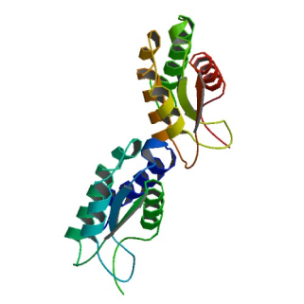
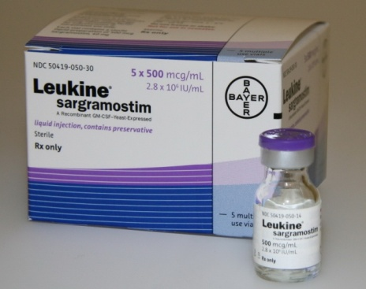
Regenerative Medicine: Leukine
Approved by US FDA in 1991
Synthetic, injectable/topical or intravenous granulocyte-macrophage colony stimulating factor (GM-CSF)
Supports survival, clonal expansion, differentiation of hematopoietic progenitor cells and increased neovascularization
Induces progenitor cells to divide and differentiate in the granulocyte-macrophage pathways
Fang et al., Granulocyte-macrophage colony-stimulating factor enhances wound healing in diabetes via upregulation of proinflammatory cytokines. Br J Dermatol. 2010;162(3):478-86.
Notes:
used to help increase the number and function of WBCs

Slide 9
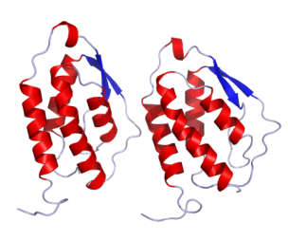
Regenerative Medicine: Leukine
Monomeric glycoprotein
Functions as a cytokine
Secreted by macrophages, T-cells, mast cells, NK cells, endothelial cells, and fibroblasts
Important hematopoietic growth factor and immune modulator
Application of GM-CSF as an immune adjuvant
Increases dendritic cell maturation and function
Increases macrophage activity
Delneste et al., Interferon-gamma switches monocyte differentiation from dendritic cells to macrophages. Blood 2003;101:143–50.
Shi et al., Granulocyte-macrophage colony-stimulating factor (GM-CSF) and T-cell responses: what we do and don't know. Cell Research 2006;16: 123-133.

Slide 10
Regenerative Medicine: Leukine
Although diabetes negatively affects multiple aspects of wound healing GM‐CSF activation is particularly impacted. Compared to acute/healthy wounds diabetic foot ulcers (DFU) only partially activate GM‐CSF activity. There is a deleterious chain of events associated with this unfortunate sequala.
DFUs also have a high proportion of monocytes and an absence of activated macrophages which results in an impaired inflammatory response. This may potentially serve as a vital point for GM‐CSF to act as a companion diagnostic/theragnostic modality to help modulate the inflammatory response in wound healing.
Correcting macrophage immune dysfunction with exogenous GM‐CSF may help restore the immune balance in the wound ecosystem and jumpstart the wound healing cascade.
Ead, J. K., & Armstrong, D. G. (2023). Granulocyte-macrophage colony-stimulating factor: Conductor of the wound healing orchestra?. International wound journal, 20(4), 1229–1234. https://doi.org/10.1111/iwj.13919

Slide 11
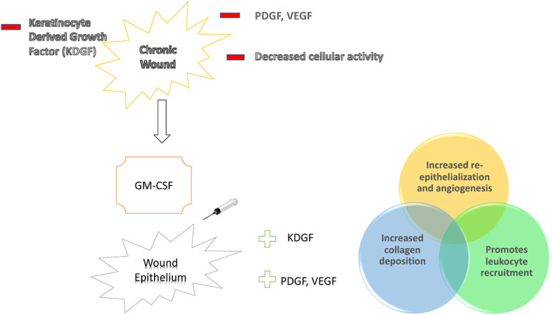
Regenerative Medicine: Leukine
Ead, J. K., & Armstrong, D. G. (2023). Granulocyte-macrophage colony-stimulating factor: Conductor of the wound healing orchestra?. International wound journal, 20(4), 1229–1234. https://doi.org/10.1111/iwj.13919

Slide 12
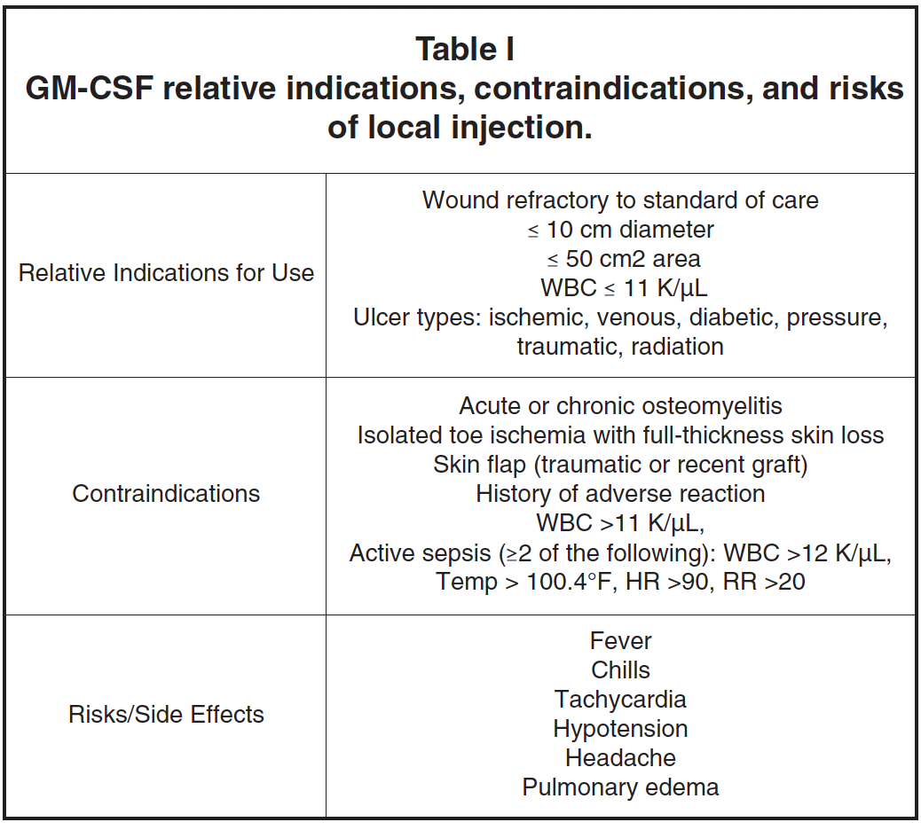
Regenerative Medicine: Leukine
Brem, H., Howell, R., Criscitelli, T., Senderowicz, A., Siegart, N., Gorenstein, S., & Gillette, B. (2018). Practical Application of Granulocyte-Macrophage Colony-Stimulating Factor (GM-CSF) in Patients with Wounds. Surgical technology international, 32, 61–66.

Slide 13
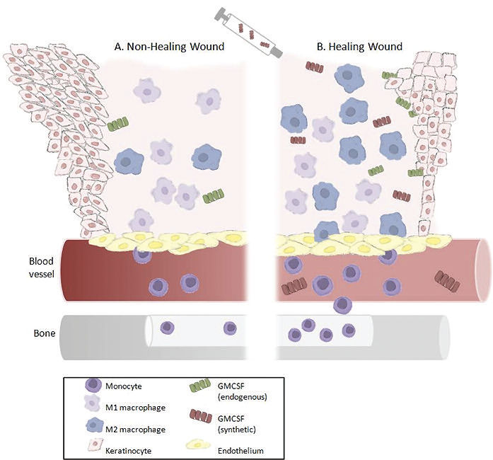
Regenerative Medicine: Leukine
The non-healing wound edge depicts heaped, non-migrating keratinocytes releasing very little endogenous GM-CSF and exhibiting both hyperkeratotic and parakeratotic features (abnormal increase in the number of layers and nucleated cells in the stratum corneum, respectively).
The altered immune response to the chronic wound results in low amounts of monocytes being stimulated and released from the bone marrow into the circulation. The non-healing wound bed contains an unbalanced M1:M2 ratio, resulting in a pro-inflammatory environment and inactivated macrophages releasing little to no endogenous GM-CSF. B. After debridement of the wound and injection of synthetic GM-CSF, the healing wound edge exhibits proliferating and migrating keratinocytes releasing endogenous GM-CSF.
The bone marrow is also stimulated to release monocytes that home to the wound bed and differentiate into macrophages. The wound bed environment then favors rapid polarization of the activated macrophages, resulting in an anti-inflammatory M1:M2 balance. In addition, GM-CSF stimulates endothelial cell differentiation, which facilitates wound contraction.
Brem, H., Howell, R., Criscitelli, T., Senderowicz, A., Siegart, N., Gorenstein, S., & Gillette, B. (2018). Practical Application of Granulocyte-Macrophage Colony-Stimulating Factor (GM-CSF) in Patients with Wounds. Surgical technology international, 32, 61–66.

Slide 14
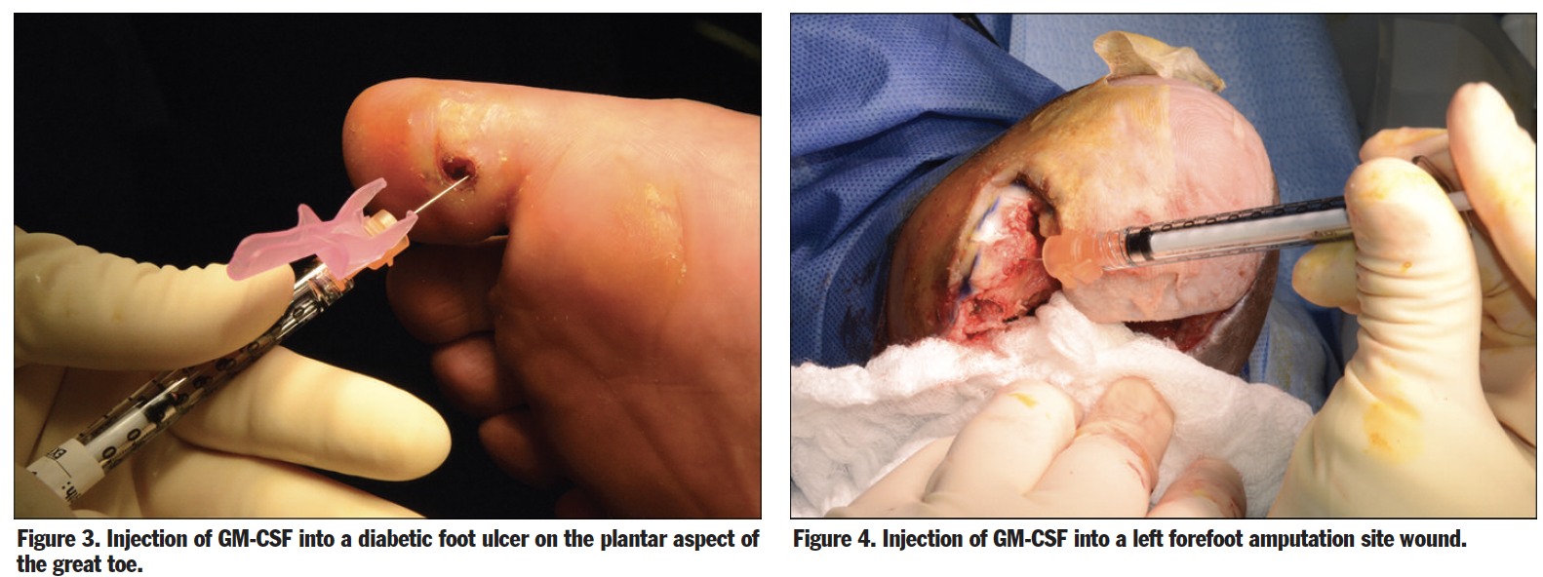
Regenerative Medicine: Leukine
Brem, H., Howell, R., Criscitelli, T., Senderowicz, A., Siegart, N., Gorenstein, S., & Gillette, B. (2018). Practical Application of Granulocyte-Macrophage Colony-Stimulating Factor (GM-CSF) in Patients with Wounds. Surgical technology international, 32, 61–66.

Slide 15
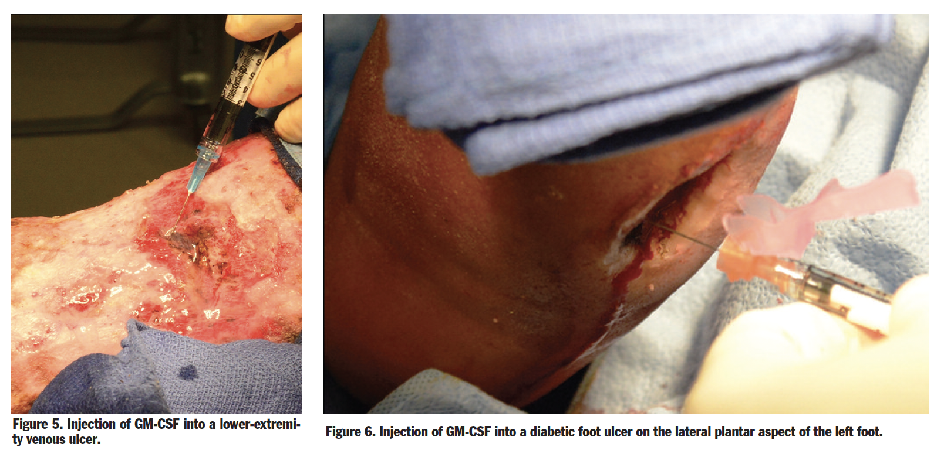
Regenerative Medicine: Leukine
Brem, H., Howell, R., Criscitelli, T., Senderowicz, A., Siegart, N., Gorenstein, S., & Gillette, B. (2018). Practical Application of Granulocyte-Macrophage Colony-Stimulating Factor (GM-CSF) in Patients with Wounds. Surgical technology international, 32, 61–66.

Slide 16
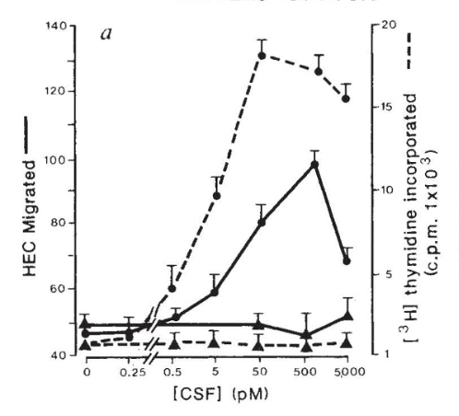
Regenerative Medicine: Leukine
In vitro studies have demonstrated that this growth factor increases migration and proliferation of endothelial cells suggesting a role in angiogenesis.¹
In patients with DFUs, subcutaneous injections of GM-CSF resulted in quicker resolution of cellulitis, a trend toward ulcer healing and lower incidence of amputation.²
¹Bussolino et al., Granulocyte and granulocyte-macrophage-colony stimulating factors induce human endothelial cells to migrate and proliferate. Nature 1989;337:471–3
²Gough et al., Randomised placebo-controlled trial of granulocyte-colony stimulating factor in diabetic foot infection. Lancet 1997;350:855–9.

Slide 17
Regenerative Medicine: Leukine
March 2010, Clinical study comparing GM-CSF in DM vs. non-DM mice
Results:
50% reduced GM-CSF production in mice with DM vs. non-DM. No beneficial effects in non-DM mice
Exogenous GM-CSF substantially enhanced wound healing in DM mice
Increased neovascularization, macrophage and neutrophil infiltration
Fang et al., Granulocyte-macrophage colony-stimulating factor enhances wound healing in diabetes via upregulation of proinflammatory cytokines. Br J Dermatol. 2010;162(3):478-86.

Slide 18
September 1999
Double-blind, randomized, placebo controlled trial
Evaluating pressure ulcer therapy, n= 61
Findings:
GM-CSF acts early for wound contraction
Greater acceleration of pressure ulcer healing via deposition of extracellular matrix and contraction
Robson MC, Hill DP, Smith PD, Wang X, Meyer-Siegler K, Ko F, et al. Sequential cytokine therapy for pressure ulcers: clinical and mechanistic response. Ann Surg. 2000;231(4):600-11.

Slide 19
Regenerative Medicine: Leukine
May 2014
Routinely use Leukine for physiologically impaired ulcers
Adjunct to debridement when refractory to standard treatment
Dose: 500μg locally up to two times per week
Barrientos et al., Clinical application of growth factors and cytokines in wound healing. Wound Repair Regen. 2014;22(5):569-78.

Slide 20
Granulocyte Macrophage Colony Stimulating Factor (GM-CSF)
Monomeric glycoprotein
Secreted by macrophages, T-cells, mast cells, NK cells, endothelial cells and fibroblasts
Functions as a cytokine
Important hematopoietic growth factor and immune modulator
Application of GM-CSF as an immune adjuvant
Increases dendritic cell maturation and function^{3,4}
Increases macrophage activity^{3,4}
³Delneste Y, Charbonnier P, Herbault N, et al Interferon-gamma switches monocyte differentiation from dendritic cells to macrophages. Blood 2003; 101:143–50.
⁴Shi et al. Granulocyte-macrophage colony-stimulating factor (GM-CSF) and T-cell responses: what we do and don't know. Cell Research 2006; 16: 123-133.

Slide 21
GM-CSF Promotes Wound Healing
In vitro studies have demonstrated that this growth factor increases migration and proliferation of endothelial cells suggesting a role in angiogenesis.⁵
In patients with DFUs, subcutaneous injections of GM-CSF resulted in quicker resolution of cellulitis, a trend toward ulcer healing and lower incidence of amputation.⁶
⁵Bussolino F, Wang JM, Defilippi P, Turrini F, Sanavio F, Edgell CJ, Aglietta M, Arese P, Mantovani A. Granulocyte and granulocyte-macrophage-colony stimulating factors induce human endothelial cells to migrate and proliferate. Nature 1989; 337: 471–3
⁶Gough A, Clapperton M, Rolando N, Foster AV, Philpott-Howard J, Edmonds ME. Randomised placebo-controlled trial of granulocyte-colony stimulating factor in diabetic foot infection. Lancet 1997; 350: 855–9.

Slide 22
Leukine (Sargramostim)
Approved by US FDA in 1991
Synthetic, injectable/topical or intravenous granulocyte-macrophage colony stimulating factor (GM-CSF)
Supports survival, clonal expansion, differentiation of hematopoietic progenitor cells and increased neovascularization
Induces progenitor cells to divide and differentiate in the granulocyte-macrophage pathways
http://www.drugbank.ca/drugs/DB00020
http://www.drug3k.com/imagepages/12164/image7.html
Fang Y et al. Granulocyte-macrophage colony-stimulating factor enhances wound healing in diabetes via upregulation of proinflammatory cytokines. Br J Dermatol. 2010;162(3):478-86.
http://products.sanofi.us/Leukine/Leukine.html
Notes:
used to help increase the number and function of WBCs

Slide 23
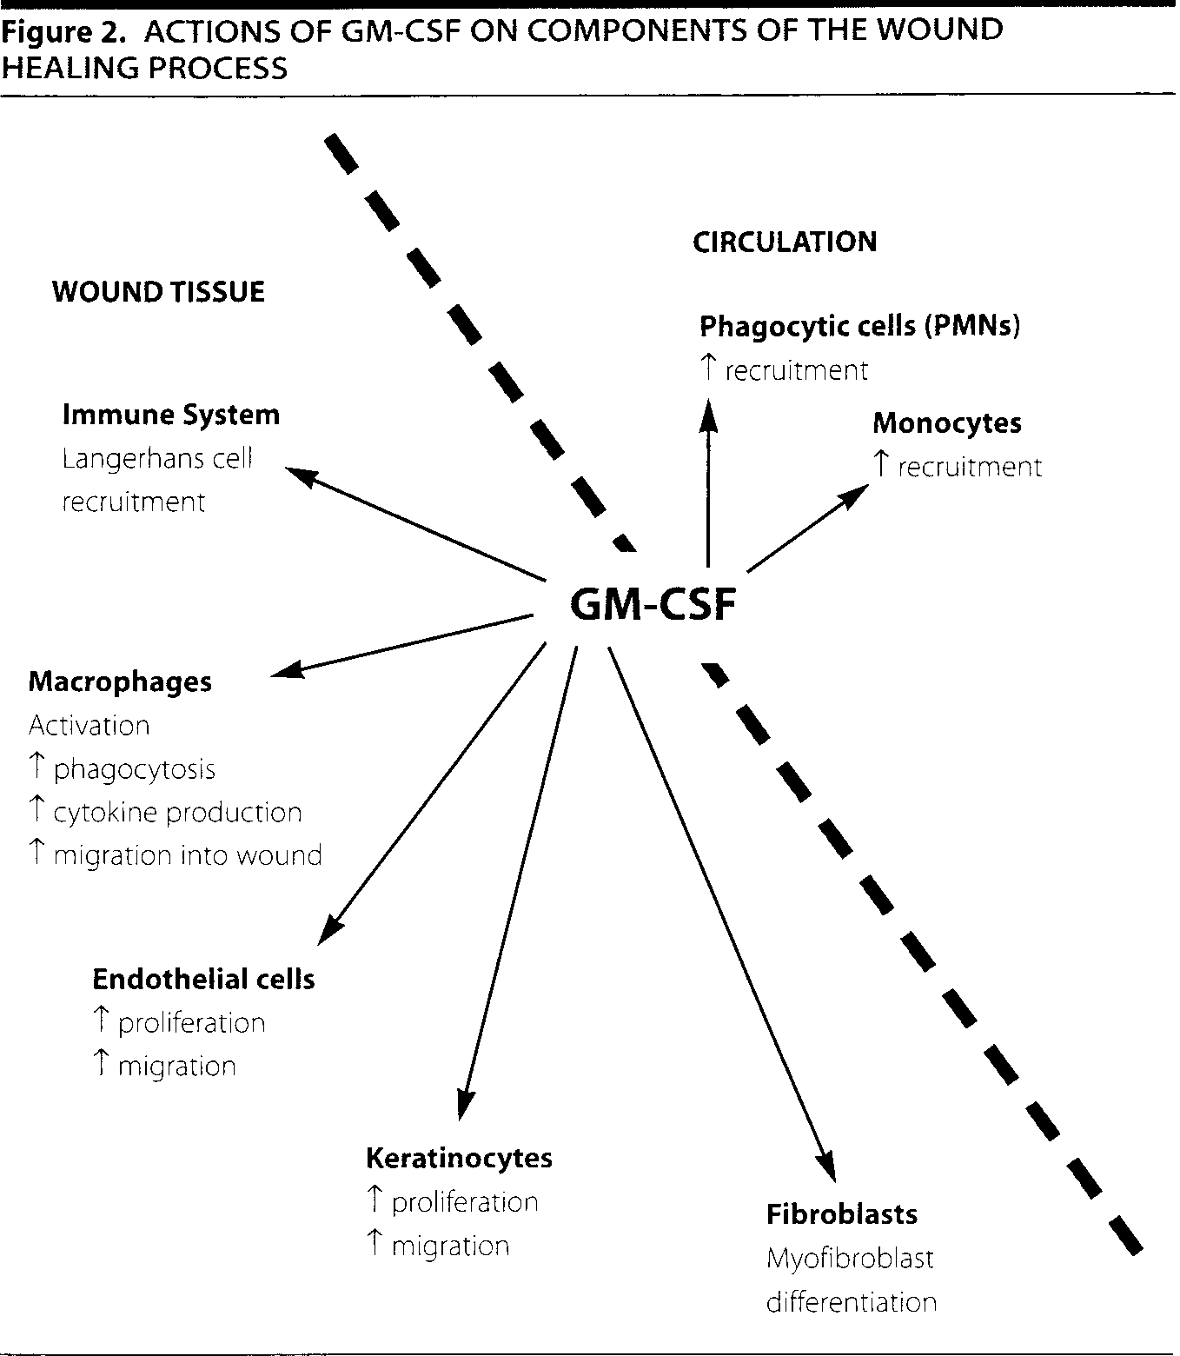
Groves RW, Schmidt-Lucke JA. Recombinant human GM-CSF in the treatment of poorly healing wounds. Adv Skin Wound Care. 2000;13(3 Pt 1):107-12.

Slide 24
Leukine uses
After bone marrow transplantation (to increase the number and function of WBCs)
Bone marrow transplantation failure or engraftment delay
Before and after peripheral blood stem cell transplantation
Following induction chemotherapy in elderly patients with acute myelogenous leukemia (AML)
http://www.leukine.com/patient-index

Slide 25
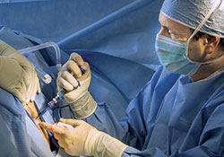
Leukine uses
Adjunct to:
High-dose chemotherapy
Aplastic anemia
Crohn's disease
Malignant melanoma
Myelodysplastic syndrome
Neutropenia & neutropenic disorder
Pulmonary alveolar proteinosis
Wound healing
http://longisland.mdnews.com/articles/LocalArticle?id=42780
Ref.: Leukine package insert

Slide 26
Dosing Schedule for Diabetic Wounds
100mcg/m² topical daily
OR
5.0mcg/kg perilesional injection x1 initial
2.5mcg/kg perilesional injection subsequent daily dose
Gough A et al. Randomised placebo-controlled trial of granulocyte-colony stimulating factor in diabetic foot infection. Lancet. 1997;350(9081):855-9.

Slide 27
Contraindications
High levels of leukemic blasts in bone marrow or peripheral blood (≥ 10%)
Allergy to yeast
Within 24h before/after chemotherapy/radiation
Newborns (fatal “gasping syndrome”)
Cautions
Lithium therapy and corticosteroids
Pregnancy risk: Category C (risk cannot be ruled out)
http://www.leukine.com/patient-interstitial
Notes:
Cautions: both and increase WBCs
The “gasping syndrome” (characterized by central nervous system depression, metabolic acidosis, gasping respirations, and high levels of benzyl alcohol and its metabolites found in the blood and urine) has been associated with benzyl alcohol dosages >99 mg/kg/day in neonates and low-birth weight infants

Slide 28
Regenerative Medicine: Apligraf
Apligraf (previously known as “Graftskin” and “human skin equivalent”) is a tissue-engineered biological dressing for wounds. Apligraf is composed of male neonatal fibroblasts (taken from discarded foreskin of a newborn baby) which are initially placed in a bovine type I collagen matrix. Over time a neodermis produced by the neonatal fibroblasts develops an epidermal sheet. In other words, it is a bioengineered skin substitute with two layers:
Epidermal layer: Contains living keratinocytes and stem cells that provide potent healing signals (growth factors/cytokines)
Dermal layer: Contains living fibroblasts that proliferate and produce human collagen and other extracellular matrix proteins (which regulate tissue formation) as well as growth factors/cytokines.
Brem H, Balledux J, Sukkarieh T, Carson P, Falanga V. Healing of venous ulcers of long duration with a bilayered living skin substitute: results from a general surgery and dermatology department. Dermatol Surg. 2001 Nov;27(11):915-9. doi: 10.1046/j.1524-4725.2001.01092.x. PMID: 11737123

Slide 29
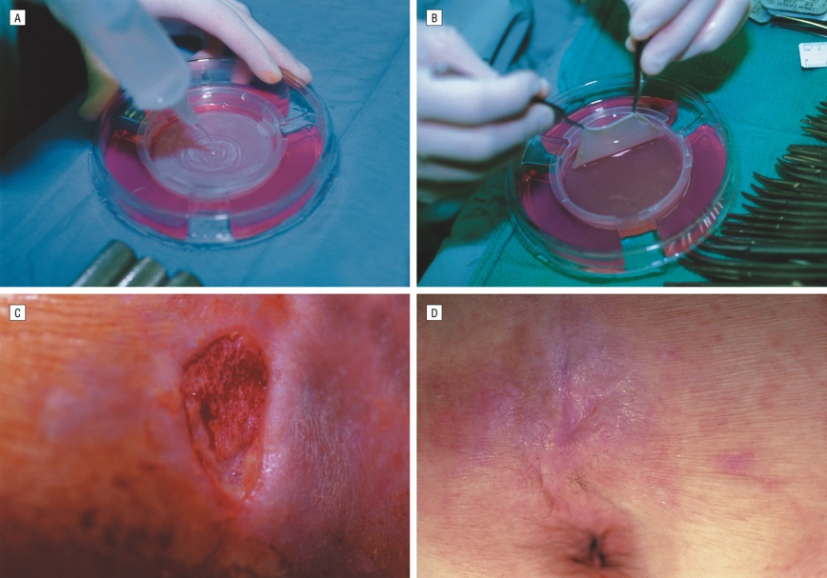
Regenerative Medicine: Apligraf
Figure A: Saline being applied in Petri dish (keratinocyte layer) such that Apligraf can be easily removed from its culture medium
Figure B: Apligraf being lifted with 2 smooth forceps (fibroblast side showing)
Figure C: Quadriplegic who had nonhealing sacral ulcer. In this photograph, the wound was debrided down to subcutaneous tissue
Figure D: This wound healed 3 weeks after application of the skin graft, 1 week before photograph was taken
Brem H, Balledux J, Sukkarieh T, Carson P, Falanga V. Healing of venous ulcers of long duration with a bilayered living skin substitute: results from a general surgery and dermatology department. Dermatol Surg. 2001 Nov;27(11):915-9. doi: 10.1046/j.1524-4725.2001.01092.x. PMID: 11737123

Slide 30
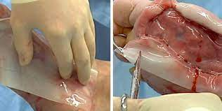
Regenerative Medicine: Integra
Integra Wound Matrix is an advanced wound care device comprised of a porous matrix of cross-linked bovine tendon collagen and glycosaminoglycan
The collagen-glycosaminoglycan biodegradable matrix provides a scaffold for cellular invasion and capillary growth
Integra Wound Matrix provides coverage over exposed bone, tendon, cartilage and joints.

Slide 31
How effective is porcine mesothelium matrix as a biomaterial for wound healing?
Porcine mesothelium is a tissue rich in connective tissue (CT, e.g. collagens types I and III, elastin, fibronectin) and basement membrane (BM, e.g. collagen type IV and laminin) proteins and growth factors (e.g. FGF-2, TGF-β, VEGF)
Growth factors retained within the porcine mesothelium matrix promote wound healing events, such as cell proliferation and angiogenesis in vivo. Such features clearly illustrate their potential in the wound healing scenario, where cell proliferation, re-epithelialization, and angiogenesis are desirable events to be promoted.
Despite all these advantages, commercially available porcine mesothelium grafts have only been used in breast, cartilage, and nasal reconstruction and as a tendon protector sheet.
Capella-Monsonís H, Tilbury MA, Wall JG, Zeugolis DI. Porcine mesothelium matrix as a biomaterial for wound healing applications. Mater Today Bio. 2020;7:100057. Published 2020 May 17.
.

Slide 32
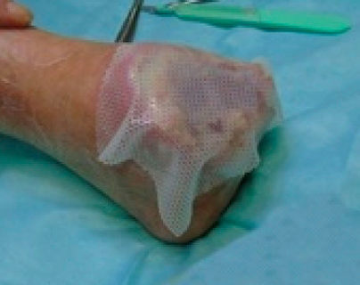
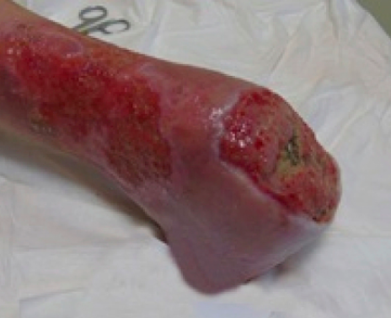
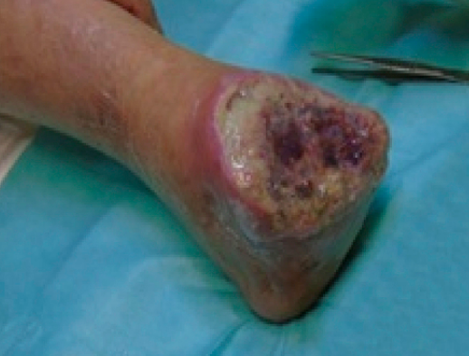
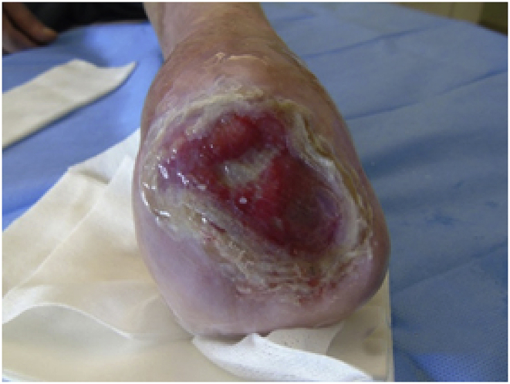
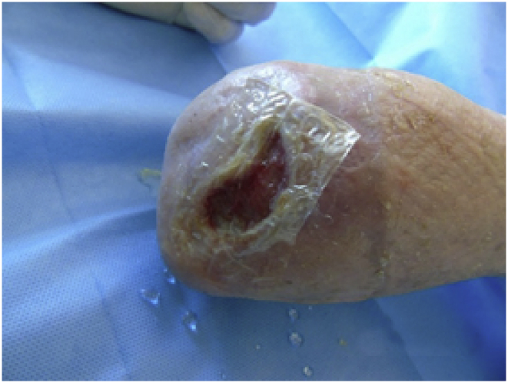
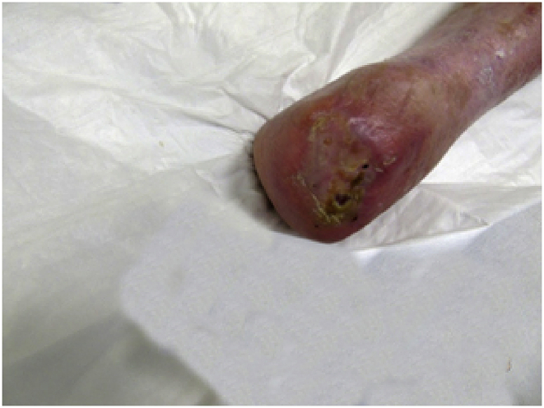
What is efficacy of human amniotic membrane (HAM) on diabetic foot ulcers?
“in vivo” and "in vitro" activity and efficacy of the HAM in subjects with chronic diabetic skin lesion. This clinical case showed that the HAM promote the wound healing of complex chronic skin lesion in a follow-up period of 6 months after the first graft.
First graft with HAM, measuring 10 × 12.5 cm
Application of Mepitel and coverage with sterile gauze and bandage.
After the lesion stopped healing, a second HAM (10 × 12.5 cm) was applied
new smaller HAM (6 × 6 cm).
HAM (3 × 3 cm)
complete healing
.
Chisari LM, Antonino G, Chisari G, Borzì AM, Chisari CG. Clinical bacteriological aspects of the Human Amniotic Membrane in the diabetic foot. A case report. Ann Med Surg (Lond). 2020;55:174-176. Published 2020 May 16. doi:10.1016/j.amsu.2020.04.020

Slide 33
What are self-assembled nanomaterials (e.g., PurAply)
Self-assembled nanomaterials are made of small building blocks (peptides or amphiphiles) that self-assemble to make larger complex structures, such as hydrogel scaffolds, and nanoparticles.
Self-assembly is generally driven by noncovalent interactions, but covalent crosslinking can be introduced to stabilize structures.
Self-assembled materials can serve as scaffolds that favor cell migration and proliferation, but also controlled release of bioactive peptides and antibiotics to the wound.
Self-assembled materials of different types may be combined to provide multiprong therapies that address multiple wound healing mechanisms.
Kang HJ, Chen N, Dash BC, Hsia HC, Berthiaume F. Self-Assembled Nanomaterials for Chronic Skin Wound Healing [published online ahead of print, 2020 Jun 2]. Adv Wound Care (New Rochelle).
.

Slide 34
What is Veraflo?
Although standard negative pressure wound therapy (NPWT) has been used to successfully manage both acute and chronic wounds since 1997, the benefits of regular wound cleansing between dressing changes have become more apparent in recent years to address healing impediments.
Instillation of a topical solution with removal via alternating negative pressure cycles is an important evolution of the NPWT concept.
During negative pressure wound therapy with instillation and dwell time (NPWTi‐d), a topical wound solution is instilled and allowed to dwell in the wound at set intervals to facilitate regular wound cleansing and wound bed preparation to help promote wound healing in certain complex wounds.
Kim PJ, Attinger CE, Constantine T, et al. Negative pressure wound therapy with instillation: International consensus guidelines update. Int Wound J. 2020;17(1):174-186.
.

Slide 35
How to use Veraflo?
In general, ROCF‐CC dressings with through holes were recommended over standard ROCF‐V dressings (without through holes) in wounds that contain areas of devitalised tissue.
Although the two dressings are suited for different wound environments, panel members recommended similar NPWTi‐d device settings for each of the dressings.
Panel members recommended instillation of saline with a dwell time of 10 minutes and a negative pressure time phase of 2.0 to 3.0 hours with ROCF‐V dressing and 2.0 to 2.5 hours with ROCF‐CC dressing at −125 mmHg for most wounds.
In the past 5 years, there has been a shift to normal saline as the first choice of instilled topical solution for most wounds vs topical antiseptic solutions, which were previously used more often as first‐line instilled topical solutions.
Kim PJ, Attinger CE, Constantine T, et al. Negative pressure wound therapy with instillation: International consensus guidelines update. Int Wound J. 2020;17(1):174-186.
.

