Slide 1
Wound Healing Outcomes
Division of Wound Healing and Regenerative Medicine
Department of Surgery
Newark Beth Israel Medical Center
July 7, 2020
Harold Brem, MD FACS
harold.brem@rwjbh.org
newjerseywoundhealing.org

Slide 2
Agenda
Protocols
Pathology
Case presentations past week:
Right Leg Amputation
Osteomyelitis left ischium
LT Hidradenitis
VP Hidradenitis inguinal area and scrotum
RG Hidradenitis perivaginal
Marjolin’s ulcer leading to limb loss
Nutrition (case presentation Dr. Rothkopf)
Hyperbaric oxygen/regenerative medicine (radiation injury, lung carcinoma; multisystem inflammatory syndrome in children)
Regenerative medicine

Slide 3
What are the new benchmarks?
Time to surgery

Slide 4
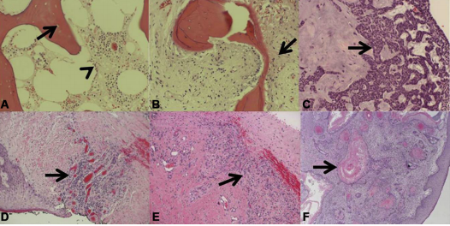
Protocols: what are indications for debridement?
Pathology of deep specimens. (A) acute osteomyelitis with empty lacunae (arrow) and inflammatory cells in the marrow space (arrowhead). (B) chronic osteomyelitis with a mix of viable and nonviable bone, bone remodeling, and fibrosis (arrow). (C ) basal cell carcinoma with characteristic basal clue cells (arrow). (D) venous ulceration with granulation tissue (arrow). (E ) charcot arthopathy with inflamed dense fibrous connective tissue (arrow) and granulation tissue. (F) keratinizing squamous cell carcinoma with characteristic keratin pearls (arrow) in a bleeding exophytic back mass.
Howell RS, et al. Wound care center of excellence: guide to operative technique for chronic wounds. J Am Coll Surg 2018 (226)2: e7-e17.

Slide 5
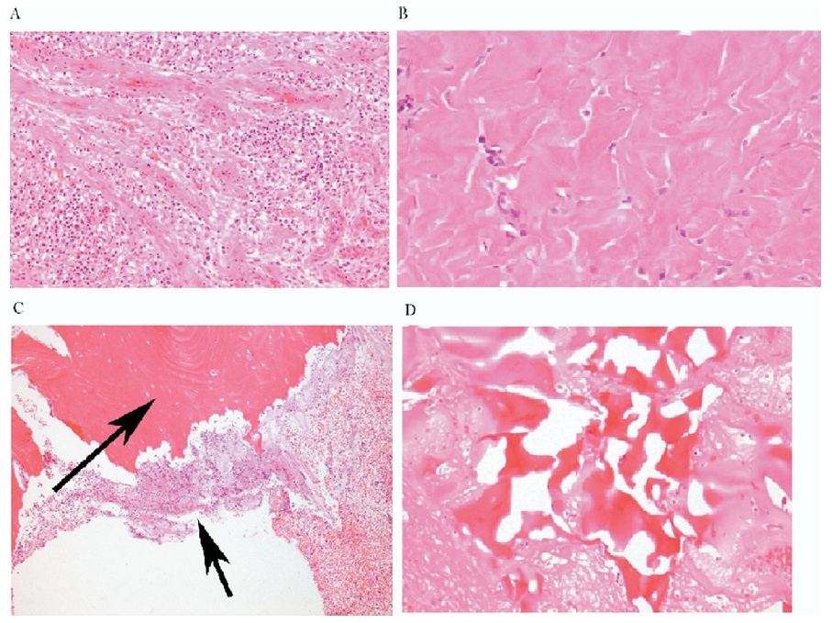
Protocols: what is pathological Importance of the tissue left behind?
A
B
Granulation tissue
Fibrosis
Osteomyelitis
Reactive bone
C
D
Golinko et al. Operative Debridement of Diabetic Foot Ulcers. J Am Coll Surg 2008; 207:e1-e6

Slide 6
Pressure ulcer cause of sepsis?

Slide 7
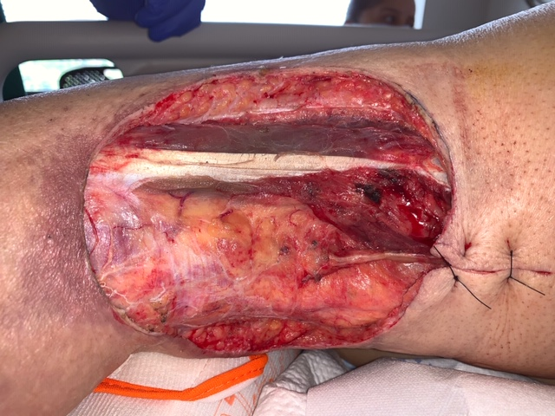
?

Slide 8
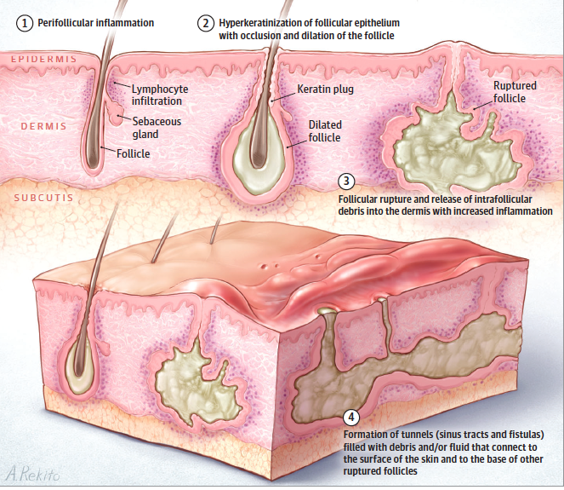
Pathology: What is hidradenitis suppurativa?
Hidradenitis suppurativa is a chronic, inflammatory, recurring, debilitating skin disease of the hair follicles that usually presents after puberty with painful, deep-seated, inflamed lesions in the apocrine gland-bearing areas of the body (most commonly the axillae, inguinal, and anogenital regions).
Although it occurs in about 0.05 and 4% of the general population, its incidence in pediatric populations is unknown.
Early recognition and treatment is crucial in order to minimize subsequent life-course effects of this disease.
Lindenhardt Saunte DM, et al. Hidradenitis suppurativa: Advances in diagnosis and treatment. JAMA 2017 (318)20: 2019-2032.

Slide 9
What are the inflammatory pathways for hidradenitis suppurativa?
Maarouf M, Clark AK, Lee DE, Shi VY. Targeted treatments for hidradenitis suppurativa: a review of the current literature and ongoing clinical trials. J Dermatolog Treat. 2018;29(5):441-449.

Slide 10
What is the pathophysiology of hidradenitis suppurativa?
As the follicle dilates, it eventually ruptures and affects adjacent apocrine ducts. Spillage of adnexal contents results in lympho-histiocytic inflammation, secondary bacterial infection, and biofilm formation, further amplifying the immune response.
This, together with extension of suppurative material to adjacent tissue, causes ulceration, fibrosis, and sinus tract formation
Maarouf M, Clark AK, Lee DE, Shi VY. Targeted treatments for hidradenitis suppurativa: a review of the current literature and ongoing clinical trials. J Dermatolog Treat. 2018;29(5):441-449.

Slide 11
What are the treatment options hidradenitis suppurativa?
The multifactorial pathogenesis of HS presents a variety of options for treatment. As we enter the dawn of targeted therapies for HS, the use of biologic treatments has the potential to dampen disease severity at multiple inflammatory points.
Although the only FDA-approved medication for HS is adalimumab, several other biologics have demonstrated potential in targeting inflammatory cytokines involved in HS, including TNF-α (etanercept, infliximab), IL-1 (anakinra), IL-17A (secukinumab), IL-12/23 (ustekinumab), and PDE4 (apremilast).
Agents that block other inflammatory mediators detected in HS patients may lead to the development of new targeted therapies.
Maarouf M, Clark AK, Lee DE, Shi VY. Targeted treatments for hidradenitis suppurativa: a review of the current literature and ongoing clinical trials. J Dermatolog Treat. 2018;29(5):441-449.

Slide 12
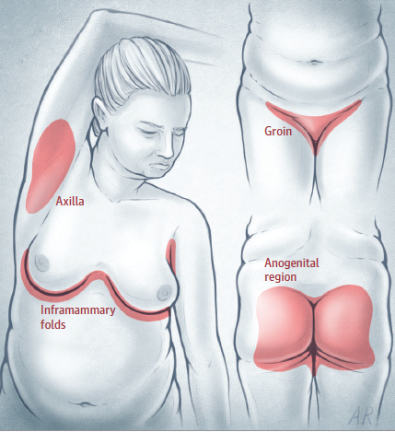
What are the current treatments for hidradenitis suppurativa in children
Typical hidradenitis suppuration distribution
Pediatric patients with Hidradenitis suppurativa should be examined for possible endocrine co-morbidities (premature adrenarche or diabetes).
If obese, weight loss is beneficial.
In addition to topical and systemic therapies for lesions, surgery may be necessary for scarred lesions and may include de-roofing and excisions. Incision and drainage is generally not recommended.
Lindenhardt Saunte DM, et al. Hidradenitis suppurativa: Advances in diagnosis and treatment. JAMA 2017 (318)20: 2019-2032.

Slide 13
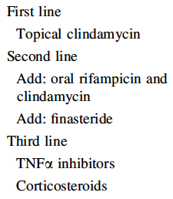
What are the current treatments for hidradenitis suppurativa in children?
No therapeutic trials have been published in pediatric hidradenitis suppurativa. Treatment recommendations are based on case reports and extrapolation of therapies tested in adults.
Topical treatment (clindamycin 10mg/mL lotion twice daily for 3 months) is recommended for patients with mild or moderate disease.
Systemic therapy requires appropriate pediatric dosing (oral antibiotics-–e.g., clindamycin and rifampicin), antiandrogens (finasteride), and immunosuppresants (TNF blockers).
Medical therapy suggested for pediatric cases of hidradenitis suppurativa
Mikkelsen P, et al. Hidradenitis suppurativa in children and adolescents: a review of treatment options. Pediatric Drugs 2014 (16): 483-489.

Slide 14
What are the current treatments for hidradenitis suppurativa in children?
Pediatric patients with Hidradenitis suppurativa should be examined for possible endocrine co-morbidities (premature adrenarche or diabetes).
If obese, weight loss is beneficial.
In addition to topical and systemic therapies for lesions, surgery may be necessary for scarred lesions and may include de-roofing and excisions. Incision and drainage is generally not recommended.
Biologic therapies, like Adalimumab (a recombinant human IgGI anti-TNF monoclonal antibody), Anakinra (a recombinant IL-I receptor antagonist), and Ustekinumab (a human IgG1x monoclonal antibody) have shown promise but have not yielded definitive results.
Mikkelsen P, et al. Hidradenitis suppurativa in children and adolescents: a review of treatment options. Pediatric Drugs 2014 (16): 483-489.

Slide 15
What is Marjolin’s ulcer?
Squamous cell carcinoma (SCC) has been commonly reported by foot and ankle specialists.
Marjolin's ulcer is a malignancy that involves a posttraumatic scar or ulceration that can develop into SCC from chronic neuropathic pedal wounds, venous stasis, or decubitus ulcerations.
Most Marjolin's ulcers are found in the lower extremity, specifically the feet, and it is twice as common in females as males.
Biopsy of the tumor is the reference standard to diagnose SCC, and wide excision of SCC is the most common treatment option.
Tchanque-Fossuo CN, Millsop JW, Johnson MA, Dahle SE, Isseroff RR. Ulcerated Basal Cell Carcinomas Masquerading as Venous Leg Ulcers. Adv Skin Wound Care. 2018;31(3):130-134.

Slide 16
How to distinguish ulcerated basal cell carcinomas from venous ulcers?
Tchanque-Fossuo CN, Millsop JW, Johnson MA, Dahle SE, Isseroff RR. Ulcerated Basal Cell Carcinomas Masquerading as Venous Leg Ulcers. Adv Skin Wound Care. 2018;31(3):130-134.
.

Slide 17
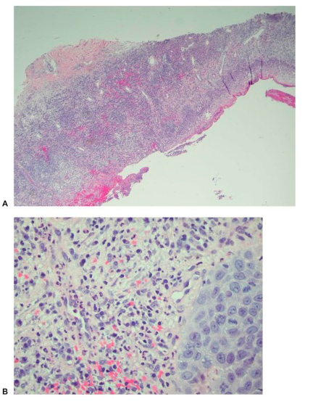
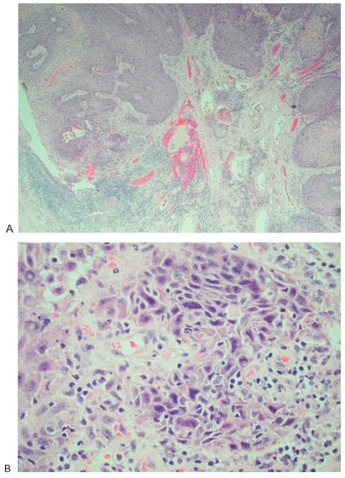
How to distinguish biopsies of ulcerated basal cell carcinomas from venous ulcers?
(A) Skin biopsy showing epidermal ulceration (original magnification × 40; hematoxylin and eosin stain) composed of (B) acute and chronic inflammatory cells and organizing granulation tissue, with reactive degenerative changes (original magnification × 400; hematoxylin and eosin stain).
(A) Well-differentiated, invasive squamous cell carcinoma showing ulceration (original magnification × 40; hematoxylin and eosin stain). (B) Nest of mild to moderate atypical cells showing abundant eosinophilic cytoplasm and large nuclei with vesicular chromatin (original magnification × 400; hematoxylin and eosin stain).
.
Cavaliere R, Mercado DM, Mani M. Squamous Cell Carcinoma From Marjolin's Ulcer of the Foot in a Diabetic Patient: Case Study. J Foot Ankle Surg. 2018;57(4):838-843.

Slide 18
How to treat Marjolin’s ulcer?
Preoperative clinical images showing the right posterior plantar heel with the tumor centrally located within the site of the pressure ulceration. The ulcer measured 3.0 cm long, 3.0 cm wide, and 1.5 cm deep.
Cavaliere R, Mercado DM, Mani M. Squamous Cell Carcinoma From Marjolin's Ulcer of the Foot in a Diabetic Patient: Case Study. J Foot Ankle Surg. 2018;57(4):838-843.
.

Slide 19
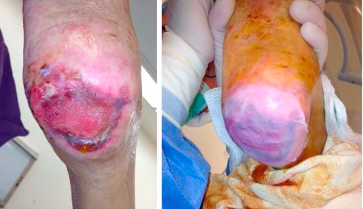
How to treat Marjolin’s ulcer?
Intraoperative application of Apligraf to the right heel ulceration. This was performed to assist in delayed primary closure in an effort to prevent recurrence.
Cavaliere R, Mercado DM, Mani M. Squamous Cell Carcinoma From Marjolin's Ulcer of the Foot in a Diabetic Patient: Case Study. J Foot Ankle Surg. 2018;57(4):838-843.
.

Slide 20
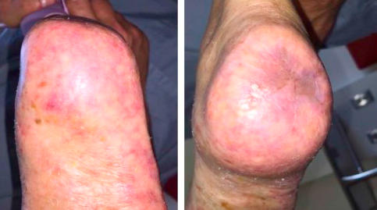
How to treat Marjolin’s ulcer?
View ~1 year postoperatively. The surgical site had healed with no open lesions or signs of recurrence at the site of resection.
Cavaliere R, Mercado DM, Mani M. Squamous Cell Carcinoma From Marjolin's Ulcer of the Foot in a Diabetic Patient: Case Study. J Foot Ankle Surg. 2018;57(4):838-843.
.

Slide 21
Nutrition and Chronic Wounds Dr. Michael Rothkopf

Slide 22
Case Report
45 yr old female with PMH of HTN, HFrEF on home milrinone, s/p ICD, right breast cancer s/p lumpectomy and chemo/radiation. Patient admitted for frequent AICD firing. Developed Cardiogenic Shock, s/p insertion of IABP; COVID-19 positive (4/17). Heart Mate 3 LVAD, protek RVAD inserted 6/1. Developed necrotic feet with multiple bulla and gangrene. Speech pathology recommended regular texture food and thin liquids. RVAD removed 7/1. Bilateral foot wounds extensively debrided on 7/1 by Dr. Granata. Metabolic input was requested to evaluate her nutritional status and requirements for wound healing.
Wound: Initially dry gangrene of toes of left foot, cyanosis of distal tips of right foot. Both feet and toes now responding to debridement.
Nutritional Parameters:
Height: 165 cm
Ideal Body Weight: 56.91 kg
Actual Weight: 81.36 kg
Percent Ideal Body Weight: 142.96 %
Body Mass Index: 30 kg/m2
Macronutrient Requirements: for wound healing, off vent, using 57 kgs IBW:
Energy: 1710 - 1995 kcals/d (30 - 35 kcals /kg IBW)
Protein: 80 - 86 g /d (1.4 - 1.5 g/kg IBW)
Not malnourished
At nutritional risk because of diminished intake in the face of increased requirements (stress, inflammation, wound healing)
Recommendations
a) Macronutrient support with ONS (calories and protein)
b) Counsel on protein content of foods
c) Consider appetite stimulation
d) Micronutrient support for wound healing – MVI, VC, zinc.
e) Check levels for deficiencies that may warrant correction – VA, VD, VK, VC, B1, B6, B9, B12, fe, cu, zn, se, mn, carnitine, creatine, others
Notes:
VC (collagen hydroxylation), B1, B6 (heme synthesis), B9, B12, fe, cu (lysyl oxidase – collagen cross-linking), zn (protein, immune system), se, mn (proline), carnitine, creatine, others

Slide 23
Concept of Protein Relative Value (RV)
William Rose (published 1948-57) proved that there are 9 essential amino acids: lysine, tryptophan, histidine, phenylalanine, leucine, isoleucine, threonine, methionine, valine.
Six others (arginine, cysteine, glycine, glutamine, proline, tyrosine) are considered conditionally essential. The body can make them, but their synthesis may be inadequate under certain pathophysiological conditions, such as severe catabolic stress.
Roughly 1/3 of dietary amino acids eventually appear in the urine as urea. These amino acids are utilized for fuel not protein synthesis (Glucogenic and Ketogenic AAs).
The remaining 2/3 are incorporated into body proteins by ribosomal protein synthesis
RV = the level of each essential amino acid in any given protein source compared to that found in whole egg
Most animal proteins have RVs that approach 1.0
Most plant proteins have RVs < 0.8

Slide 24
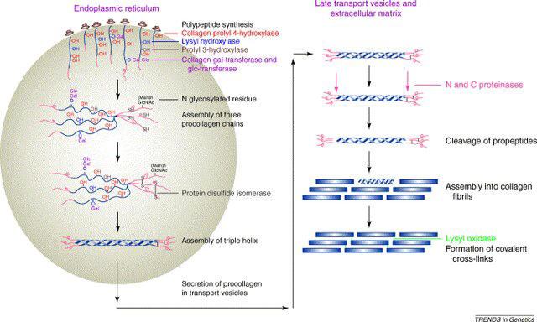
Collagen synthesis
Polypeptide chains are synthesized in ribosomes, secreted into the lumen of the ER, subjected to post-translational modification (hydroxylation of Pro and Lys and glycosylation). C-pro-peptides are assembled in as a triple helix and secreted in the extracellular space. N and C pro-peptides are cleaved, spontaneous self-assembly of collagen molecules into fibrils occurs, covalent crosslinks strengthens the structure
Notes:
Collagen synthesis: a) The polypeptide chains are synthesized in the ribosomes and secreted into the lumen of the endoplasmic reticulum, where they are subjected to different post-translational modification such as hydroxylation of Pro and Lys and glycosylation of other amino acidic residues. b) The C-pro-peptides are then assembled in the characteristic triple helix and secreted in the extracellular space. The subsequent steps are c) cleavage of the N and C pro-peptides, d) spontaneous self-assembly of the resulting collagen molecules into fibrils, and e) formation of covalent crosslinks. Figure from

Slide 25
What are the indications for hyperbaric oxygen therapy?
Two cases:
radiation injury, lung carcinoma
multisystem inflammatory syndrome in children

Slide 26
What is multisystem inflammatory syndrome (MIS-C) in children?
In late April 2020, clinicians in the United Kingdom reported a cluster of eight previously healthy children presenting with cardiovascular shock, fever, and hyperinflammation. On May 14, the CDC issued a national health advisory to report on cases meeting the criteria for MIS-C.
Many of the pediatric patients with this hyperinflammatory syndrome have had fever and mucocutaneous manifestations similar to those of Kawasaki’s disease.
Some patients have presented with features of toxic shock syndrome, secondary hemophagocytic lymphohistiocytosis, or macrophage activation syndrome.
Like Kawasaki’s disease, MIS-C is a syndrome with a range of clinical presentations and an absence of pathognomonic findings or diagnostic tests.
MIS-C has predominantly affects adolescents and children older than 5 years of age and is associated with more frequent cardiovascular involvement.
Feldstein LR, Rose EB, Horwitz SM, et al. Multisystem Inflammatory Syndrome in U.S. Children and Adolescents [published online ahead of print, 2020 Jun 29]. N Engl J Med. 2020;10.1056/NEJMoa2021680.

Slide 27
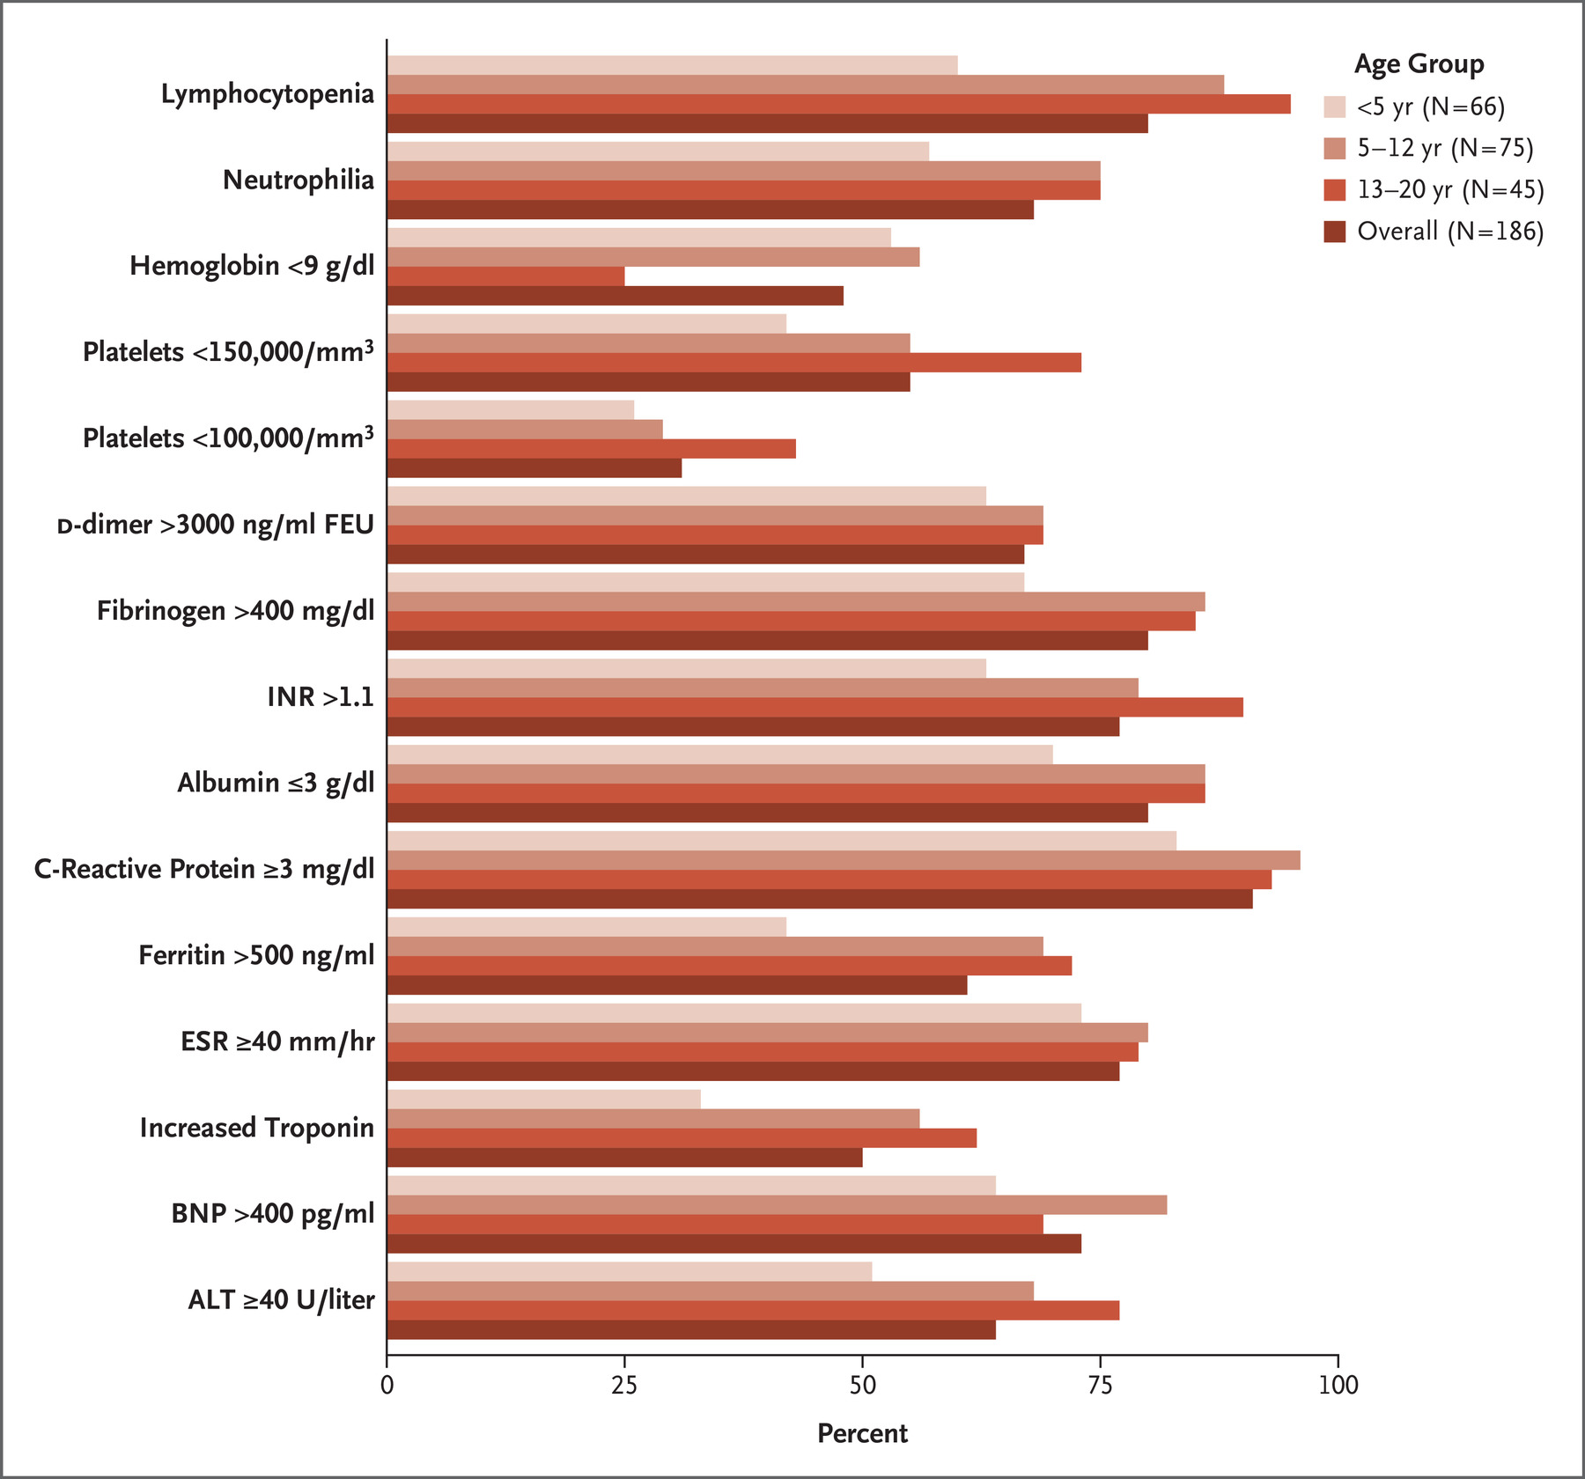
What are laboratory markers for MIS-C?
Feldstein LR, Rose EB, Horwitz SM, et al. Multisystem Inflammatory Syndrome in U.S. Children and Adolescents [published online ahead of print, 2020 Jun 29]. N Engl J Med. 2020;10.1056/NEJMoa2021680.

Slide 28
How to treat MIS-C?
Understanding the pathogenesis of MIS-C will be necessary to inform clinical management and prevention efforts. In a case series reported in NEJM, a majority of patients were treated with immunomodulatory drugs, most commonly intravenous immune globulin (77%) and systemic glucocorticoids (49%).
Most discharged patients survive.
The selection of treatment methods must be informed by whether organ damage is mediated by ongoing viral replication in the affected tissues, an exuberant host inflammatory response, or both.
Antiviral agents may be beneficial in the former situation, whereas immunomodulatory agents are generally preferred for immune dysregulation.
Feldstein LR, Rose EB, Horwitz SM, et al. Multisystem Inflammatory Syndrome in U.S. Children and Adolescents [published online ahead of print, 2020 Jun 29]. N Engl J Med. 2020;10.1056/NEJMoa2021680.

Slide 29
What are skin substitutes are commercially available ?
Apligraf | Organogenesis, Inc., Canton, MA, USA | Apligraf is a living, bilayered skin substitute. The lower dermal layer combines bovine type 1 collagen and human fibroblasts (dermal cells). The upper epidermal layer is formed by human keratinocytes (epidermal cells).
Cytal® wound matrix | Acell, Inc., Columbia, MD, USA | Cytal is composed of porcine urinary bladder matrix with an intact epithelial basement membrane.
Neox® Wound Allografts | Amniox Medical, Inc., Miami, FL, USA | Neox Wound Matrix is preserved human umbilical cord and amniotic membrane.
PuraPly® Antimicrobial (PuraPly AM) Wound Matrix (formally called FortaDerm) | Organogenesis, Inc. | PuraPly Antimicrobial Wound Matrix consists of a collagen sheet coated with 0.1% polyhex-methylenebiguanide hydrochloride.
Snyder D, Sullivan N, Margolis D, Schoelles K. Skin Substitutes for Treating Chronic Wounds. Rockville (MD): Agency for Healthcare Research and Quality (US); 2020.

Slide 30
What classification systems have been developed to categorize skin substitutes?
Some classification systems were based on the skin layers to be replaced and the source of material used in the product (human versus animal or synthetic) but did not distinguish between cellular and acellular products.
Cellularity the most important discriminator among skin substitutes since the presence of cells increases the rejection risk and manufacturing complexity. In this system, skin substitute products are divided first into acellular and cellular groups.
Acellular dermal substitutes made from natural biological materials are the most common commercially available skin substitute product for treating or managing chronic wounds (e.g., decellularized donated human dermis, human placental membranes, and animal tissue.
Snyder D, Sullivan N, Margolis D, Schoelles K. Skin Substitutes for Treating Chronic Wounds. Rockville (MD): Agency for Healthcare Research and Quality (US); 2020.
.

Slide 31
Apligraf Human Skin Equivalent (HSE)
Bi-layered living skin substitute suspended in a collagen matrix
HSE shown to be biologically active
15 growth factors/cytokine genes released from keratinocytes and fibroblasts
Improves the impaired reparative process of chronic wounds
Brem H, Young J, Tomic-Canic M, Isaacs C, Ehrlich HP. Clinical efficacy and mechanism of bilayered living human skin equivalent (HSE) in treatment of diabetic foot ulcers. Surg Technol Int. 2003;11:23-31.

Slide 32
Apligraf Wound Treatment
A
B
A: Saline applied to remove Apligraf from culture medium
B: Apligraf removed
C: Debrided non-healing sacral ulcer
D: Complete healing 4 weeks after Apligraf application
C
D
http://complexwoundhealing.org/

Slide 33
Apligraf Wound Treatment
A
B
A: Lateral metatarsal DFU, non-healing for 14 months. 1 week after Apligraf applied.
B: Complete healing after 4 weeks.
C: Dorsal hallux DFU
D: Complete healing 8 weeks after Apligraf application
C
D
Brem H, Young J, Tomic-Canic M, Isaacs C, Ehrlich HP. Clinical efficacy and mechanism of bilayered living human skin equivalent (HSE) in treatment of diabetic foot ulcers. Surg Technol Int. 2003;11:23-31.

Slide 34
How effective is porcine mesothelium matrix as a biomaterial for wound healing?
Porcine mesothelium is a tissue rich in connective tissue (CT, e.g. collagens types I and III, elastin, fibronectin) and basement membrane (BM, e.g. collagen type IV and laminin) proteins and growth factors (e.g. FGF-2, TGF-β, VEGF)
Growth factors retained within the porcine mesothelium matrix promote wound healing events, such as cell proliferation and angiogenesis in vivo. Such features clearly illustrate their potential in the wound healing scenario, where cell proliferation, re-epithelialization, and angiogenesis are desirable events to be promoted.
Despite all these advantages, commercially available porcine mesothelium grafts have only been used in breast, cartilage, and nasal reconstruction and as a tendon protector sheet.
Capella-Monsonís H, Tilbury MA, Wall JG, Zeugolis DI. Porcine mesothelium matrix as a biomaterial for wound healing applications. Mater Today Bio. 2020;7:100057. Published 2020 May 17.
.

Slide 35
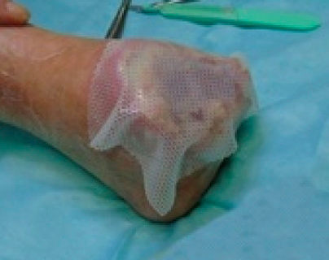
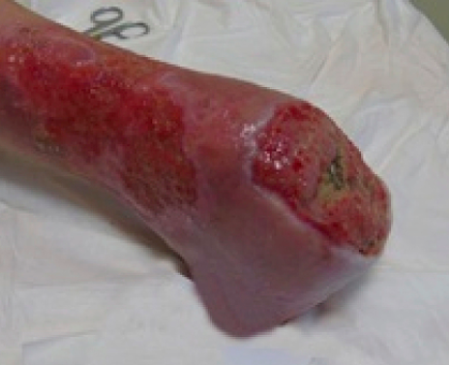
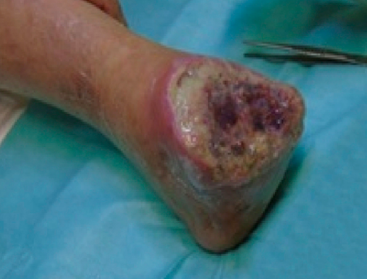
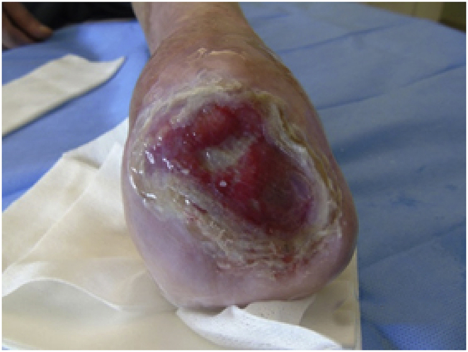
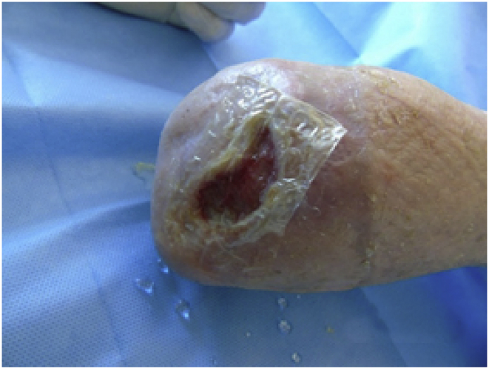
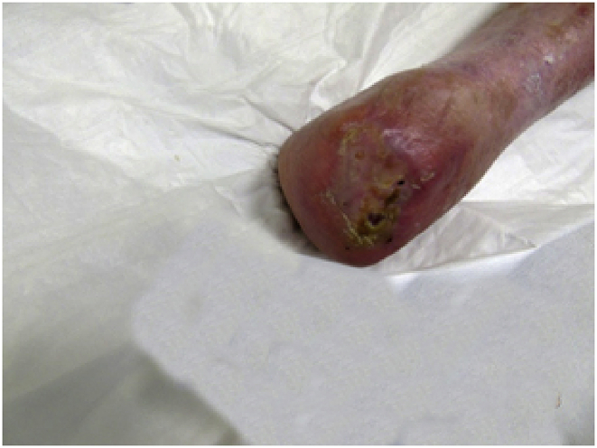
What is efficacy of human amniotic membrane (HAM) on diabetic foot ulcers?
“in vivo” and "in vitro" activity and efficacy of the HAM in subjects with chronic diabetic skin lesion. This clinical case showed that the HAM promote the wound healing of complex chronic skin lesion in a follow-up period of 6 months after the first graft.
First graft with HAM, measuring 10 × 12.5 cm
Application of Mepitel and coverage with sterile gauze and bandage.
After the lesion stopped healing, a second HAM (10 × 12.5 cm) was applied
new smaller HAM (6 × 6 cm).
HAM (3 × 3 cm)
complete healing
.
Chisari LM, Antonino G, Chisari G, Borzì AM, Chisari CG. Clinical bacteriological aspects of the Human Amniotic Membrane in the diabetic foot. A case report. Ann Med Surg (Lond). 2020;55:174-176. Published 2020 May 16. doi:10.1016/j.amsu.2020.04.020

Slide 36
What are self-assembled nanomaterials (e.g., PurAply)
Self-assembled nanomaterials are made of small building blocks (peptides or amphiphiles) that self-assemble to make larger complex structures, such as hydrogel scaffolds, and nanoparticles.
Self-assembly is generally driven by noncovalent interactions, but covalent crosslinking can be introduced to stabilize structures.
Self-assembled materials can serve as scaffolds that favor cell migration and proliferation, but also controlled release of bioactive peptides and antibiotics to the wound.
Self-assembled materials of different types may be combined to provide multiprong therapies that address multiple wound healing mechanisms.
Kang HJ, Chen N, Dash BC, Hsia HC, Berthiaume F. Self-Assembled Nanomaterials for Chronic Skin Wound Healing [published online ahead of print, 2020 Jun 2]. Adv Wound Care (New Rochelle).
.

Slide 37
What is Veraflo?
Although standard negative pressure wound therapy (NPWT) has been used to successfully manage both acute and chronic wounds since 1997, the benefits of regular wound cleansing between dressing changes have become more apparent in recent years to address healing impediments.
Instillation of a topical solution with removal via alternating negative pressure cycles is an important evolution of the NPWT concept.
During negative pressure wound therapy with instillation and dwell time (NPWTi‐d), a topical wound solution is instilled and allowed to dwell in the wound at set intervals to facilitate regular wound cleansing and wound bed preparation to help promote wound healing in certain complex wounds.
Kim PJ, Attinger CE, Constantine T, et al. Negative pressure wound therapy with instillation: International consensus guidelines update. Int Wound J. 2020;17(1):174-186.
.

Slide 38
How to use Veraflo?
In general, ROCF‐CC dressings with through holes were recommended over standard ROCF‐V dressings (without through holes) in wounds that contain areas of devitalised tissue.
Although the two dressings are suited for different wound environments, panel members recommended similar NPWTi‐d device settings for each of the dressings.
Panel members recommended instillation of saline with a dwell time of 10 minutes and a negative pressure time phase of 2.0 to 3.0 hours with ROCF‐V dressing and 2.0 to 2.5 hours with ROCF‐CC dressing at −125 mmHg for most wounds.
In the past 5 years, there has been a shift to normal saline as the first choice of instilled topical solution for most wounds vs topical antiseptic solutions, which were previously used more often as first‐line instilled topical solutions.
Kim PJ, Attinger CE, Constantine T, et al. Negative pressure wound therapy with instillation: International consensus guidelines update. Int Wound J. 2020;17(1):174-186.
.

Slide 39
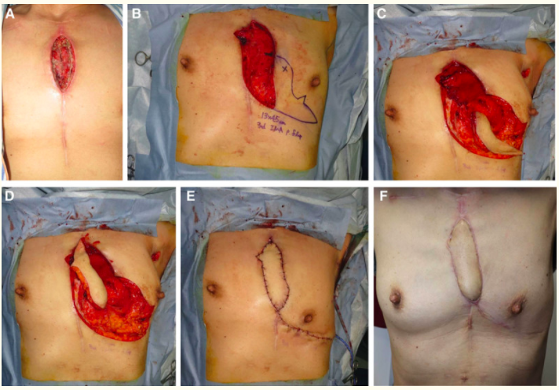
How to treat sternal wound infections?
Case 1: IMA perforator flap. A, The skin defect was 15 × 3 cm, and the sternum was exposed in the wound. B, A perforator pedicled propeller flap (with a 13 × 4.5 cm skin island) using the left internal mammary artery penetrating branch (left third intercostal) and a left pectoralis major musculocutaneous flap were planned. C, The flap was raised. D, The flap was rotated 180 degrees and moved to the defect. E, The flap color was good during the operation, and simple closure was used for the donor site. F, No recurrence was observed at 6 months after surgery.
Watanabe H, Uemura T, Yanai T, et al. Less Invasive Management of Tissue Deficits for Deep Sternal Wound Infections. Plast Reconstr Surg Glob Open. 2020;8(4):e2776.
.

Slide 40
What is mechanism of cardiac wound healing?
Cardiac fibroblasts undergo temporal pattern changes throughout the wound healing response.
•Resident fibroblasts work to maintain cardiac homeostasis, producing sufficient extracellular matrix (ECM) to coordinate normal turnover.
•Myocardial infarction (MI) day 1 fibroblasts are pro-inflammatory, day 3 fibroblasts are proliferative and pro-angiogenic, and day 7 fibroblasts are scar producing and anti-angiogenic.
•By MI day 28, fibroblasts have established a neohomeostasis, de-activating while continuing to produce sufficient ECM to coordinate the new kinetics of turnover.
Daseke MJ 2nd, Tenkorang MAA, Chalise U, Konfrst SR, Lindsey ML. Cardiac fibroblast activation during myocardial infarction wound healing: Fibroblast polarization after MI [published online ahead of print, 2020 May 21]. Matrix Biol. 2020;S0945-053X(20)30039-1.
.

Slide 41
What are the phases of cardiac wound healing?
Daseke MJ 2nd, Tenkorang MAA, Chalise U, Konfrst SR, Lindsey ML. Cardiac fibroblast activation during myocardial infarction wound healing: Fibroblast polarization after MI [published online ahead of print, 2020 May 21]. Matrix Biol. 2020;S0945-053X(20)30039-1.
.

Slide 42
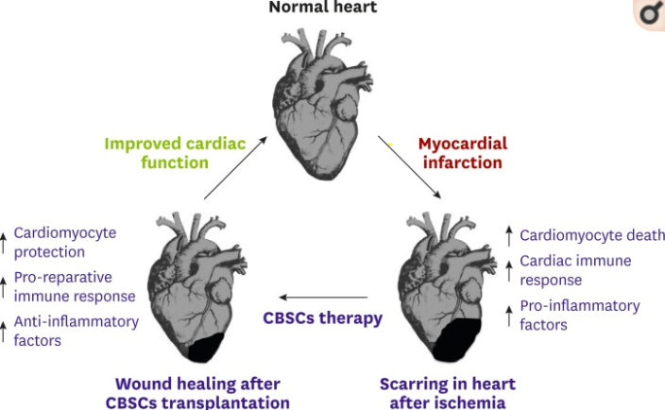
What role do stem cells play in cardiac wound healing after myocardial infarction?
The effects of cortical bone derived stem cells’ delivery showed improvement in structure and function of hearts post-MI
Mohsin S, Houser SR. Cortical Bone Derived Stem Cells for Cardiac Wound Healing. Korean Circ J. 2019;49(4):314-325.
.

Slide 43
What stem cell therapies are available for cardiac wounds?
Currently, cardiac treatment is primarily designed to be ‘damage-limiting’ modality, which is unable to prevent adverse remodeling and scar formation.
In contrast, adoptive transfer of reparative stem cells into an injured myocardium can improve cardiac pump function although the exact mechanisms remain debatable.
A variety of adult stem cell types that might repair the injured heart have been tested in animal models. These studies have shown that transplantation of autologous cardiac or bone marrow-derived stem cells induced pluripotent stem cells and direct reprogramming of endogenous non-stem cells into cardiogenic phenotypes have some capacity to improve cardiac function after injury.
Early stage clinical trials have largely focused on autologous (derived from the patient) stem cells due to their ease of isolation and lack of immunogenicity. These trials suggest that both bone marrow-and cardiac-derived cells offer modest functional benefits when transplanted after cardiac injury.
Mohsin S, Houser SR. Cortical Bone Derived Stem Cells for Cardiac Wound Healing. Korean Circ J. 2019;49(4):314-325.
.

