Slide 1
Wound Healing Outcomes Meeting
Division of Wound Healing and Regenerative Medicine
Department of Surgery
Newark Beth Israel Medical Center
June 30, 2020
Harold Brem, MD FACS
harold.brem@rwjbh.org
newjerseywoundhealing.org

Slide 2
Agenda
How protocols can:
Improve patient outcomes
Decrease amputations
Decrease length of stay
Decrease readmissions
Decrease mortality
What are the protocols?
Role of pathology
Treatment protocols for Necrotizing fasciitis and Fournier’s gangrene
Role of nutrition (Dr. Michael Rothkopf)
Role of hyperbaric oxygen (Dr. John Manicone)
Role of support surfaces
Data on Length of Stay, Readmissions, Amputation, and Safety
Wrap up
Q & A

Slide 3
What are the most common lower extremity ulcers?
Bonkemeyer MS. Venous Ulcers: Diagnosis and Treatment Am Fam Physician. 2019 Sep 01 100 (5): 298-305.

Slide 4
With across the system implementation, these evidence-based protocols can:
Improve patient outcomes
Decrease amputations
Decrease length of stay
Decrease readmissions
Decrease mortality

Slide 5
What do the protocols for the treatment of chronic ulcers have in common?
Physical exam and History
Diagnosis and understanding of underlying physiology
Treatment of infection
Debridement for diagnosis, infection, or not healing (pathology & deep culture)
Regenerative Medicine
Plastic Surgery
.

Slide 6
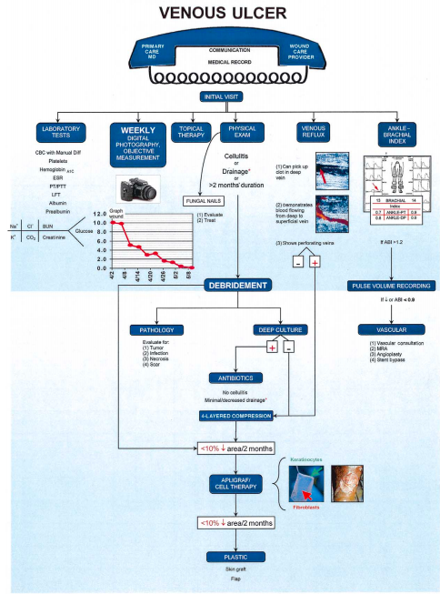
What are the protocols?
Brem H, Lyder C. Protocol for the successful treatment of pressure ulcers. Am J Surg. 2004;188(1A Suppl):9-17.
Brem H, Sheehan P, Boulton AJ. Protocol for treatment of diabetic foot ulcers. Am J Surg. 2004;187(5A):1S-10S.
Brem H, Kirsner RS, Falanga V. Protocol for the successful treatment of venous ulcers. Am J Surg. 2004;188(1A Suppl):1-8.

Slide 7
Pressure Ulcer Protocol
Brem H, Lyder C. Protocol for the successful treatment of pressure ulcers. Am J Surg. 2004;188(1A Suppl):9-17.

Slide 8
What physical exam is required for pressure ulcers?
Exact anatomical location of wound, e.g.:
Plantar or dorsal surface of toe 1,2,3,4,5)
If plantar, identify which metatarsal
Heel/ankle/calf, anterior tibia, lateral or medial
Daily assessment of the skin, particularly around the at-risk areas, including ischial, sacral, trochanteric, and heel areas
If patient has heel ulcer, do they have sacral, buttock, occiput, or hip ulcer?
Length, width, depth of wound
Fungal toenails (e.g., yes/no? which ones?)
Characterization of skin around wound (e.g., erythema, callus? pustules? dermatitis? hyperpigmentation?)
Pus
Tenderness
Drainage
Characterization of granulation tissue (e.g., discolored, well-vascularized?)
Undermining of wound edges (i.e., how many centimeters?)

Slide 9
What physical exam is required for pressure ulcers? (continued)
Warmth
Induration
Odor
Probes to bone (yes/no)
If patient has foot ulcer, peripheral sensory neuropathy (10 g Semes Weinst monofilament, 128 Hz tuning for, vibration perception threshold testing)
Biomechanical problems (assess by x-ray and ambulation exam)
Pulse exam
Absent or diminished (dorsalis pedis, posterior tibial)
Contralateral foot/leg (e.g., comment on ulceration, callus, dermatitis, hyperpigmentation, erythema, and edema)
perfusion and oxygenation; • poor nutritional status; and • increased skin moisture. (Strength of Evidence = C; Strength of Recommendation = Χ)

Slide 10
What laboratory tests are necessary for optimal assessment and treatment?
Erythrocyte sedimentation rate
Thyroid-stimulating hormone (TSH) thyroxine (T4) and triiodothyronine (T3)
Aspartate Aminotransferase (AST)
Alkaline phosphatase (ALP)
Gamma‐Glutamyl Transpeptidase (GGT)
Alanine aminotransferase (ALT)
Urine analysis
Urinary microalbumin
Procalcitonin
C-Reactive Protein
Hemoglobin A1c
Albumin, pre-albumin
Vitamin D level
Complete blood count with manual differential
Prothrombin time/partial thromboplastin time
Comprehensive metabolic panel
Lipid profile

Slide 11
What additional diagnostic tools are useful?
Plain radiography
Bone scan
Magnetic resonance imaging
Tissue or bone biopsy
For heel ulcers, all patients with diabetes and any patient with diminished pulse should have bilateral ankle brachial indices.

Slide 12
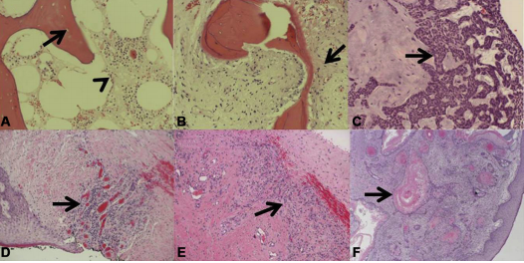
What is the Importance of Pathological Diagnosis After Debridement?
Pathology of deep specimens. (A) acute osteomyelitis with empty lacunae (arrow) and inflammatory cells in the marrow space (arrowhead). (B) chronic osteomyelitis with a mix of viable and nonviable bone, bone remodeling, and fibrosis (arrow). (C ) basal cell carcinoma with characteristic basal clue cells (arrow). (D) venous ulceration with granulation tissue (arrow). (E ) charcot arthopathy with inflamed dense fibrous connective tissue (arrow) and granulation tissue. (F) keratinizing squamous cell carcinoma with characteristic keratin pearls (arrow) in a bleeding exophytic back mass.
Howell RS, et al. Wound care center of excellence: guide to operative technique for chronic wounds. J Am Coll Surg 2018 (226)2: e7-e17.

Slide 13
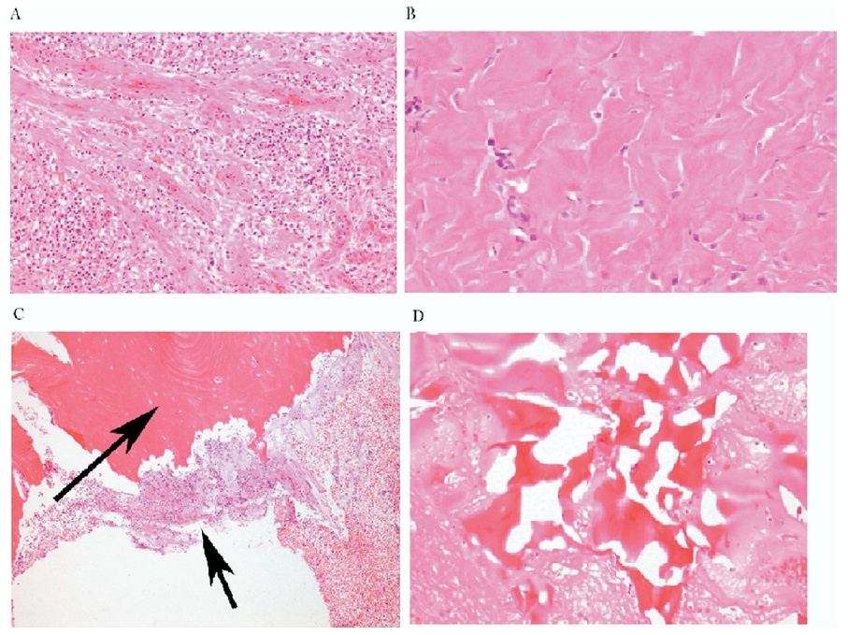
Pathological Importance of the Tissue Left Behind
A
B
Granulation tissue
Fibrosis
Osteomyelitis
Reactive bone
C
D
Golinko et al. Operative Debridement of Diabetic Foot Ulcers. J Am Coll Surg 2008; 207:e1-e6

Slide 14
Cutaneous Granulomatosis with Polyangiitis – Vasculitis. Perivascular inflammation with plasma cell infiltration. (40x)
White arrow: blood vessel
Yellow arrows: plasma cells
Turi GK, et al. Major Histopathologic Diagnoses of Chronic Wounds. Adv Skin Wound Care. 2016;29(8):E1.

Slide 15
What is histopathology of secondary-type vasculitis?
Turi GK, et al. Major Histopathologic Diagnoses of Chronic Wounds. Adv Skin Wound Care. 2016;29(8):E1.

Slide 16
What is histopathology of acute osteomyelitis?
Turi GK, et al. Major Histopathologic Diagnoses of Chronic Wounds. Adv Skin Wound Care. 2016;29(8):E1.

Slide 17
What is histopathology of osteomyelitis?
Turi GK, et al. Major Histopathologic Diagnoses of Chronic Wounds. Adv Skin Wound Care. 2016;29(8):E1.

Slide 18
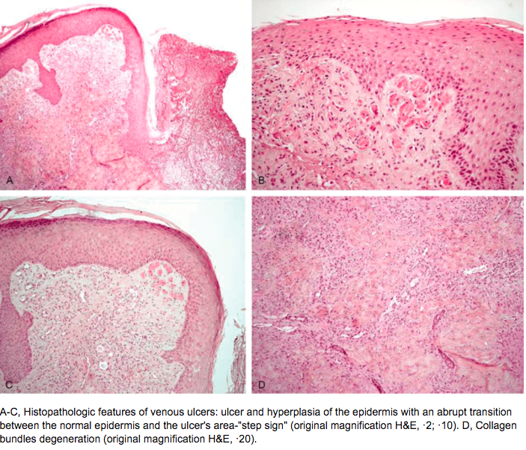
What is the histopathology of venous ulcers?
Misciali, Cosimo & Dika, Emi & Baraldi, Carlotta & Fanti, Pier & Mirelli, Michele & Stella, Andrea & Bertoncelli, Marco & Patrizi, Annalisa. (2014). Vascular Leg Ulcers: Histopathologic Study of 293 Patients. The American Journal of dermatopathology. 36.

Slide 19
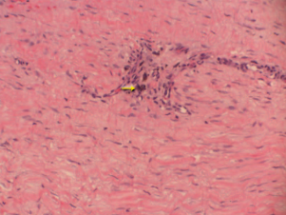
How to interpret pathology in venous ulcers?
Hematoxylin and eosin stain of debrided tissue from a venous ulcer depicting dense fibrous connective tissue with hemosiderin deposition (arrow).
Gould LJ, et al. Modalities to treat venous ulcers: compression, surgery, and bioengineered tissue. Plastic and Reconstructive Surgery. 2016 Sep; 138(3 Suppl): 199S-208S.

Slide 20
Diabetic Foot Ulcer Protocol
Brem H, Sheehan P, Boulton AJ. Protocol for treatment of diabetic foot ulcers. Am J Surg. 2004;187(5A):1S-10S.

Slide 21
What are the key components of the diabetic foot ulcer protocol?
History
Physical Exam
Wagner Classification
Laboratory Tests
Radiographic Testing
Indications for
Hospitalization
Surgical intervention (within 8 hours)
Surgical debridement
Treatment of Associated Comorbidities
Offloading

Slide 22
History
Duration of wound (e.g., time? new?)
Etiology (e.g., trauma, foreign body, spontaneous, recurrent?)
Previous physician/wound center (e.g., contact information and treatment plan?)
Past medical history
Autoimmune disease
Skin ulceration, abscesses
Stroke
Neuropathy
Gastropathy
Pain
Hospitalizations
Past surgical history
Venous disease
Arterial disease
Coronary artery disease
Stents
Myocardial infarction
Diabetes
Retinopathy
Obesity

Slide 23
What is role of Hemoglobin A1c on healing?
A1C levels ≥8% and fasting glucose levels ≥126 mg/dl are associated with increased likelihood of lower extremity amputation in patients with DFUs.
A purposively designed prospective study is needed to better understand the mechanisms underlying the association between hyperglycemia and lower extremity amputation.
Lane KL, et al. Glycemic control and diabetic foot ulcer outcomes: A systematic review and meta-analysis of observational studies [published online ahead of print, 2020 May 22]. J Diabetes Complications. 2020;107638.

Slide 24
How accurate is ABI in diagnosing PAD?
As clinical examination does not reliably exclude peripheral artery disease (PAD) in most persons with diabetes and a foot ulcer, evaluate pedal Doppler arterial waveforms in combination with ankle systolic pressure and systolic ankle brachial index (ABI) or toe systolic pressure and toe brachial index (TBI) measurement.
No single modality has been shown to be optimal and there is no definite threshold value above which PAD can reliably be excluded. However, PAD is a less likely diagnosis in the presence of ABI 0.9-1.3, toe brachial index ≥0.75 and triphasic pedal Doppler waveforms.
Hinchliffe RJ, et al. Guidelines on diagnosis, prognosis and management of peripheral artery disease in patients with foot ulcers and diabetes (IWGDF 2019 update). Diabetes Metab Res Rev. 2020;36(S1):e3276.

Slide 25
Surgical Debridement
Osteomyelitis
Substantial non-viable tissue
Joint involvement
Significant undermining
Infection
Non-healing
Drainage

Slide 26
Decreasing amputations
In a systematic regarding non-traumatic amputations of patients with diabetes mellitus and peripheral vascular disease, the 5-year mortality rate of patients after a below-the-knee amputation was 40 to 82%, and mortality after an above-the-knee amputation was 40 to 90%. Many of these complications are preventable by a thorough annual foot exam and routine foot care.
Endocrinology, diabetology, vascular surgery, podiatry, orthotics, prosthetics, wound care nursing, and educators are crucial to caring for the diabetic foot. Other specialties that may play roles in diabetic foot care depending on medical issues and infection include infectious disease, nephrology, cardiology, dermatology, and others. Goals should be to medically optimize comorbidities, prevent pedal issues, and treat pedal complications.
Song K, Chambers AR. Diabetic Foot Care. [Updated 2020 May 18]. In: StatPearls [Internet]. Treasure Island (FL): StatPearls Publishing; 2020 Jan-. Available from: https://www.ncbi.nlm.nih.gov/books/NBK553110/

Slide 27
Interdisciplinary teams and decreasing amputations
Diabetic foot care requires interprofessional care. The severity of amputation, length of stay, and mortality rates improved in patients receiving care from a team when compared to those who did not.
A systematic review showed that multidisciplinary teams reduced major amputations in 94% of studies. These teams specifically addressed four key tasks: 1) glycemic control; 2) local wound management, including surgical débridement and minor amputation; 3) diagnosis and management of vascular disease, including revascularization; 4) and diagnosis and management of infection
Musuuza J, et al. A systematic review of multidisciplinary teams to reduce major amputations for patients with diabetic foot ulcers. J Vasc Surg. 2020;71(4):1433-1446.e3.

Slide 28
Venous Ulcer Protocol
Brem H, Kirsner RS, Falanga V. Protocol for the successful treatment of venous ulcers. Am J Surg. 2004;188(1A Suppl):1-8.

Slide 29
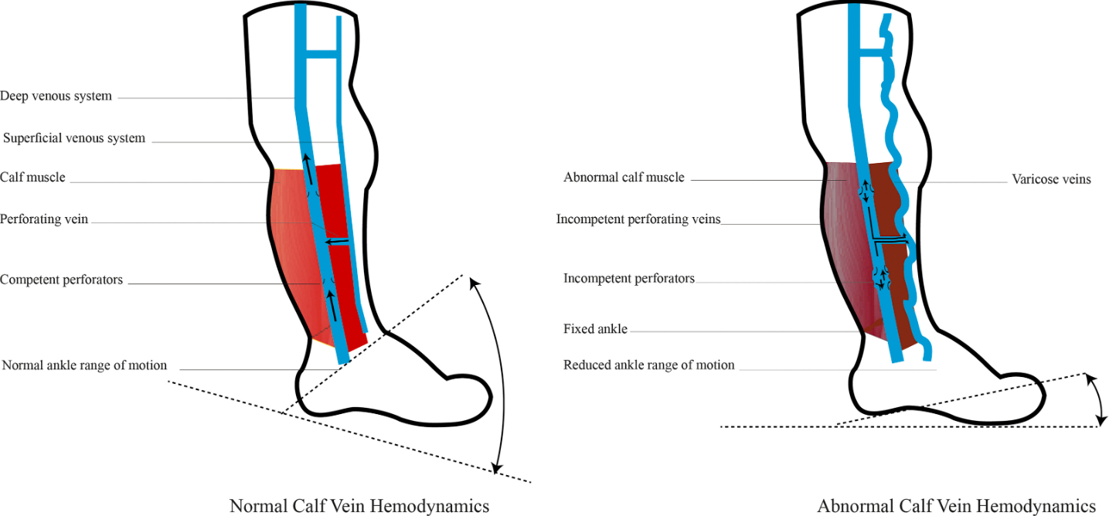
What is the pathophysiology of venous disease/venous ulcers?
Valve dysfunction, outflow obstruction, arteriovenous malformation, and calf muscle pump failure contribute to the pathogenesis of venous disease.
Alavi A, et al. What’s New: Management of venous leg ulcers: approach to venous leg ulcers. Journal of the American Academy of Dermatology. 2016;74(4):627-640.

Slide 30
Physical Exam
Exact anatomical location of wound, e.g.:
Plantar or dorsal surface of toe 1,2,3,4,5)
If plantar, identify which metatarsal
Heel/ankle/calf, anterior tibia, lateral or medial
If patient has heel ulcer, do they have sacral, buttock, occiput, or hip ulcer?
Length, width, depth of wound
Fungal toenails (e.g., yes/no? which ones?)
Characterization of skin around wound (e.g., erythema, callus? pustules? dermatitis? hyperpigmentation?)
Pus
Tenderness
Drainage
Characterization of granulation tissue (e.g., discolored, well-vascularized?)
Undermining of wound edges (i.e., how many centimeters?)
Warmth
Induration
Odor
Probes to bone (yes/no)
If patient has foot ulcer, peripheral sensory neuropathy (10 g Semes Weinst monofilament, 128 Hz tuning for, vibration perception threshold testing)
Biomechanical problems (assess by x-ray and ambulation exam)
Pulse exam
Absent or diminished (dorsalis pedis, posterior tibial)
Contralateral foot/leg (e.g., comment on ulceration, callus, dermatitis, hyperpigmentation, erythema, and edema)

Slide 31
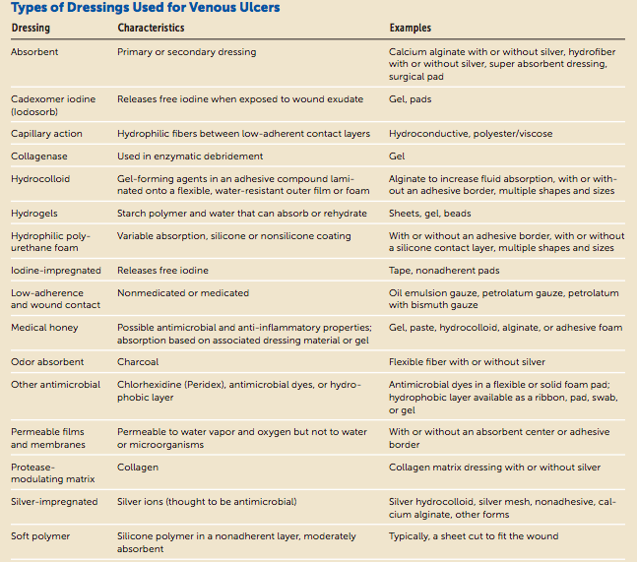
What types of dressings are available for venous ulcers?
.
Bonkemeyer MS. Venous Ulcers: Diagnosis and Treatment Am Fam Physician. 2019 Sep 01 100 (5): 298-305.

Slide 32
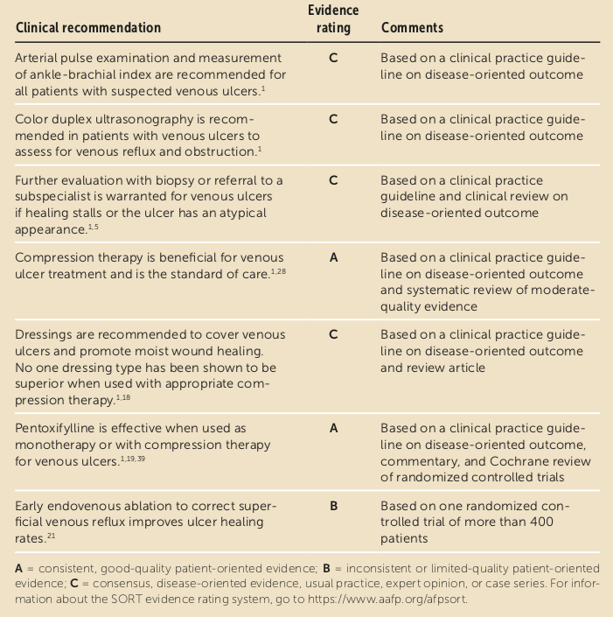
Venous Ulcers: What are key recommendations for practice?
Bonkemeyer MS. Venous Ulcers: Diagnosis and Treatment Am Fam Physician. 2019 Sep 01 100 (5): 298-305.

Slide 33
How effective is cellular therapy in treatment of venous leg ulcers?
(Left) This patient, an obese woman, presented with a cellulitic infected venous ulcer. (Right) This figure demonstrates healing after a combination of antibiotics, human skin equivalent, and compression therapy.
Brem H, et al. Protocol for the successful treatment of venous ulcers. American Journal of Surgery. 2004 (Suppl)188: 1S-8S.

Slide 34
What is histopathology of necrotizing fasciitis?
Tissue obtained from the operating room after debridement will usually show extensive superficial fascial necrosis. The majority of small and medium-size blood vessels will be thrombosed. Aggregates of neutrophils will be observed in the fascia and subcutaneous tissues. Small vessel vasculitis and extensive fat necrosis will also be evident. All the glands in the dermis and subcutaneous tissues will be necrotic as well. Gram stain will show clusters of various types of microorganisms.
Wallace HA, Perera TB. Necrotizing Fasciitis. In: StatPearls. Treasure Island (FL): StatPearls Publishing; 2020.

Slide 35
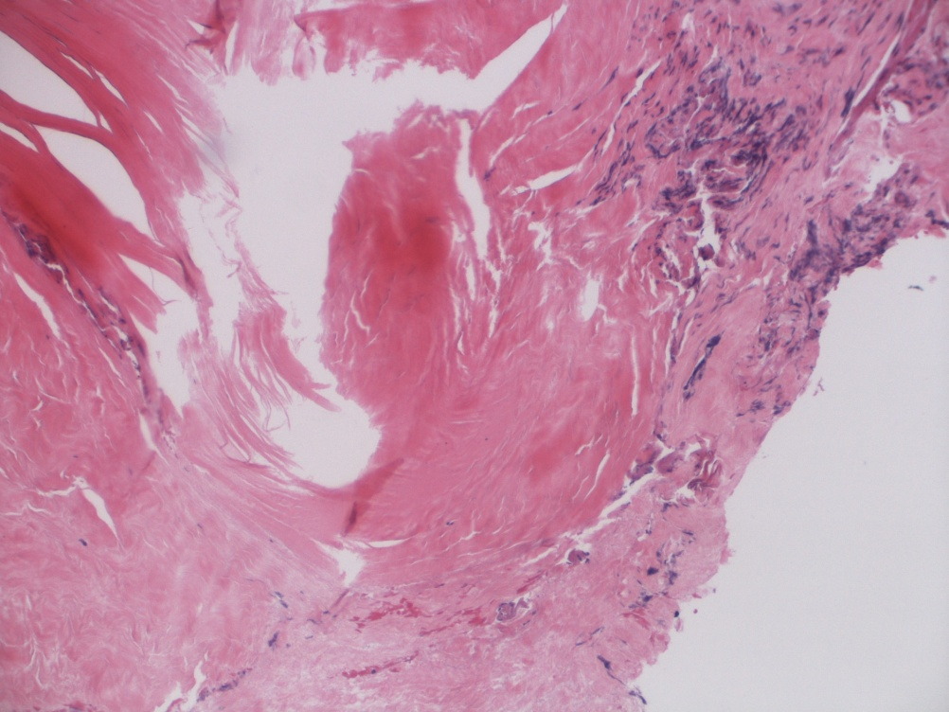
What is the pathology for Necrotizing Fasciitis?
Necrotic fascia
Crushed viable fascia
Necrotic fascia
Notes:
Fascia, left leg, exploration: - Necrotic fibroconnective tissue consistent with fascia.

Slide 36
How to evaluate for necrotizing fasciitis?
The Laboratory Risk Indicator for Necrotizing Infection (LRINEC) Score was developed in a 2004 report to distinguish NSTIs from other severe soft tissue infections. The scoring system is hinged on abnormalities in six independent variables:
C-reactive protein, mg/L
Less than 150 (0)
More than 150 (4)
Total white cell count (WBC), cells/mm
Less than 15 (0)
15 to 25 (1)
More than 25 (2)
Hemoglobin, g/dl
More than 13.5 (0)
11 to 13.5 (1)
Less than 11 (2)
Sodium, mmol/L
135 or greater (0)
Less than 135 (2)
Creatinine, mg/dL
1.6 or less (0)
More than 1.6 (2)
Glucose, mg/dL
180 or less (0)
More than 180 (1)
A score of six has a positive predictive value of 92% and a negative predictive value of 96%. A score of eight or greater represents a 75% risk of necrotizing infection.
Wallace HA, Perera TB. Necrotizing Fasciitis. In: StatPearls. Treasure Island (FL): StatPearls Publishing; 2020.

Slide 37
How to diagnose necrotizing fasciitis?
The diagnosis of NSTIs is still primarily a clinical one. Imaging may be useful in providing data when the diagnosis is uncertain. The most common plain film finding is similar to cellulitis with increased soft tissue thickness and opacity. Computed tomography (CT) has greater sensitivity than plain film in identifying necrotizing soft tissue infections. Plain x-rays have no value in the diagnosis. Sometimes under local anesthesia, one may probe the area with a finger for signs of necrotizing tissue. In most cases, the necrotic tissue can be penetrated with little resistance. Aspiration and gram stain can also be done.
The use of B mode color Doppler ultrasound can help in the early diagnosis of necrotizing fasciitis at the bedside. It should be understood that no lab or imaging test should delay surgical intervention.
Wallace HA, Perera TB. Necrotizing Fasciitis. In: StatPearls. Treasure Island (FL): StatPearls Publishing; 2020.

Slide 38
What are key treatments for necrotizing fasciitis?
Early diagnosis and differentiation between necrotizing and non-necrotizing SSTIs
The early launch of appropriate empiric antibacterial coverage (wide-spectrum)
Adequate control of infection sources such as aggressive surgical intervention for abscess drainage and debridement of necrotizing soft tissue infections (NSTIs)
Identification of infection-causing pathogen and applicable adjustment of antimicrobial coverage.
Antimicrobial therapy of necrotizing fasciitis is as follows:
Linezolid 600 mg twice per day, AND
Piperacillin/Tazobactam 4/0 to 5g LD infused in 30 min then 16/2 g QD by CI OR Daptomycin 6 mg/kg QD, AND
Piperacillin/Tazobactam 4/0 to 5g LD infused in 30 min then 16/2 g QD by CI AND Clindamycin 600 mg to 900 mg four times per day.
Wallace HA, Perera TB. Necrotizing Fasciitis. In: StatPearls. Treasure Island (FL): StatPearls Publishing; 2020.

Slide 39
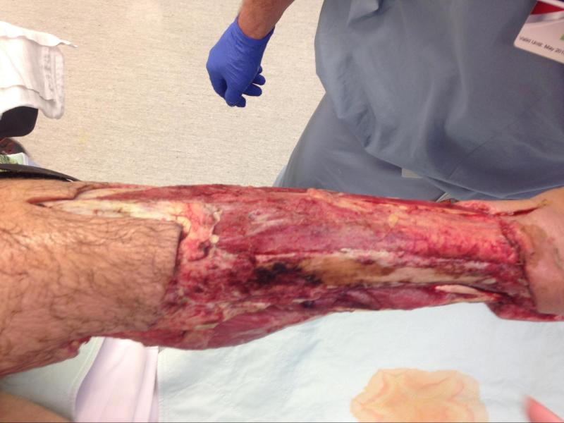
What are surgical options for necrotizing fasciitis?
The surgery requires extensive, wide debridement of all necrotic tissues. In some cases, a second-look surgery may also be required.
Early surgery may help minimize tissue loss and eliminate the need for amputation of a gangrenous extremity. With wide debridement, the wounds need to be left open and are packed with wet gauze. Daily dressing changes are mandatory.
A great deal of surgical judgment is required when faced with normal-appearing tissue which is not frankly necrotic. In most cases, if there is any doubt about viability, the tissues should be removed.
In most cases, hemodynamic stability is restored once the necrotic tissue and pus are removed. The patient should be kept intubated and monitored in a critical care unit. In some patients, daily surgical debridement may be required.
Appearance of lower leg after serial debridements of skin and fascia.
Wallace HA, Perera TB. Necrotizing Fasciitis. In: StatPearls. Treasure Island (FL): StatPearls Publishing; 2020.

Slide 40
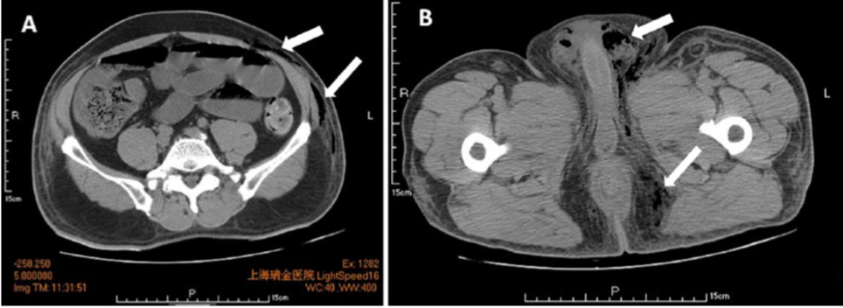
How to diagnose Fournier’s Gangrene
Diagnosis: Physical examination combined with CT, ultrasonography, and clinical findings
CT images can reveal perirectal abscesses and trace of fascial air along the perineum, scrotum, and lower abdomen.
Computed tomography (CT) image of the lower abdominal, scrotal, and perineal regions. The CT scan shows subcutaneous emphysema in addition to air in the lower abdomen, scrotum, and perianal fascia (arrows).
Zhou Z, et al. Fournier’s Gangrene With Septic Shock and Multiple Organ Dysfunction Syndrome. The International Journal of Lower Extremity Wounds 2019, 18(1): 94–96.

Slide 41
What are the treatment options for Fournier’s Gangrene?
Treatment includes wide-spectrum antibiotics and timely aggressive surgical debridement.
Early coverage of soft-tissue defects is an important part of treatment. Several reconstructive options are available and can be performed to achieve coverage with good functional and cosmetic results.
There is no consensus on the best method of reconstruction and the choice of reconstructive procedure should be based on individual characteristics of the defect, patient preference and surgeon experience.
Insua-Pereira I, Ferreira PC, Teixeira S, Barreiro D, Silva Á. Fournier's gangrene: a review of reconstructive options. Cent European J Urol. 2020;73(1):74-79.

Slide 42
What are the reconstructive options for Fournier’s Gangrene?
Skin grafting has multiple advantages: it is a simple one-stage procedure with short operative time, has low donor-site morbidity, can cover large areas and may have reasonable functional and cosmetic results.
Flap reconstruction has been described as an option best suitable for defects larger than half the area of the scrotum or extending beyond the scrotum
Scrotal flaps are a good reconstructive option for small to medium scrotal defects, providing durable good quality skin and good aesthetic results with a simple technique and low donor-site morbidity
Fasciocutaneous flaps have been described for scrotal and perineal reconstruction in Fournier’s gangrene, providing good coverage without the sacrifice of functioning muscles, often with superior durability and cosmetic results than split-thickness skin grafts.
The popularization of perforator-based flaps has broadened the range of reconstructive options. The perineum and upper thigh are anatomical areas rich on perforator vessels. Although dissection is often technically demanding, they provide thin and pliable tissue with direct closure of the donor site and minimal morbidity.
The transposition of testes and spermatic cords to a subcutaneous pouch created in the upper thigh may be employed in cases of scrotal defects, either permanently or as temporary testicular coverage until final reconstruction at a later stage.
Insua-Pereira I, Ferreira PC, Teixeira S, Barreiro D, Silva Á. Fournier's gangrene: a review of reconstructive options. Cent European J Urol. 2020;73(1):74-79.

Slide 43
How to Treat Fournier’s Gangrene With Septic Shock
Zhou Z, et al. Fournier’s Gangrene With Septic Shock and Multiple Organ Dysfunction Syndrome. The International Journal of Lower Extremity Wounds 2019, 18(1): 94–96.

Slide 44
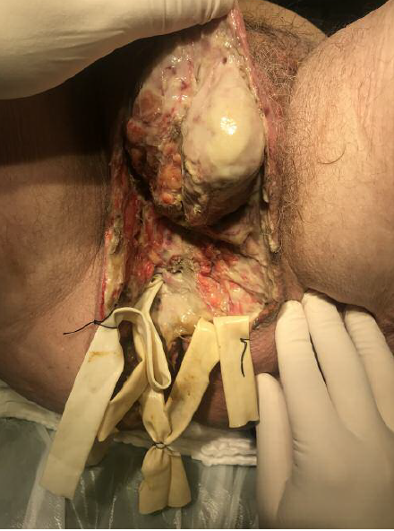
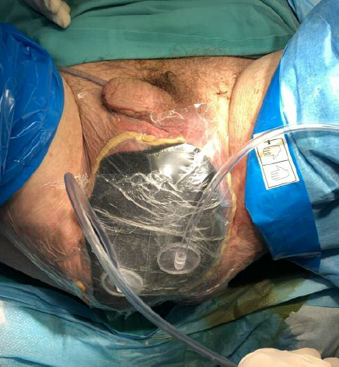
How to Treat Fournier’s Gangrene With VAC?
Wide radical surgical debridement with penrose placement
Vacuum-assisted closure therapy in the affected area.
Syllaios A, et al. Treatment of Fournier's Gangrene With Vacuum-assisted Closure Therapy as Enhanced Recovery Treatment Modality. In Vivo. 2020;34(3):1499-1502..

Slide 45
Nutrition and Chronic Wounds Dr. Michael Rothkopf

Slide 46
What does the literature say about nutrition and chronic wounds?
Nutritional status has a relevant influence on wound healing; therefore, the diagnosis, therapy, and prophylaxis of malnutrition are important elements of wound therapy
A sufficient and balanced supply of the necessary nutrients, including carbohydrates, proteins, fats, and micronutrients, such as vitamins, zinc, and magnesium is beneficial for wound healing,
The deficiency of micronutrients, especially vitamin D, vitamin C, zinc, and vitamin A, is common in diabetic patients with foot ulcers.
Knackstedt R, Oliver J, Gatherwright J. Evidence-Based Peri-Operative Nutrition Recommendations: Optimizing Results while Minimizing Risks [published online ahead of print, 2020 Jun 11]. Plast Reconstr Surg. 2020;10.1097

Slide 47
How to assess malnutrition?
Comprehensive evaluation of nutritional status should include patient history, complete physical exam, anthropometric measurements, and laboratory analyses.
Anthropometric measures used include height, weight, body mass index (BMI), and estimates of body fat and muscle mass. Recommended laboratory measurements include albumin, retinal-binding prealbumin, transferrin, complete blood count, serum folate, vitamin B12 , and cholesterol.
Neither the physical nor biochemical assessments have been found to correlate well with malnutrition and are time consuming, expensive, and often prone lack of reproducibility.
Haughey L, Barbul A. Nutrition and Lower Extremity Ulcers: Causality and/or Treatment. Int J Low Extrem Wounds. 2017;16(4):238-243.

Slide 48
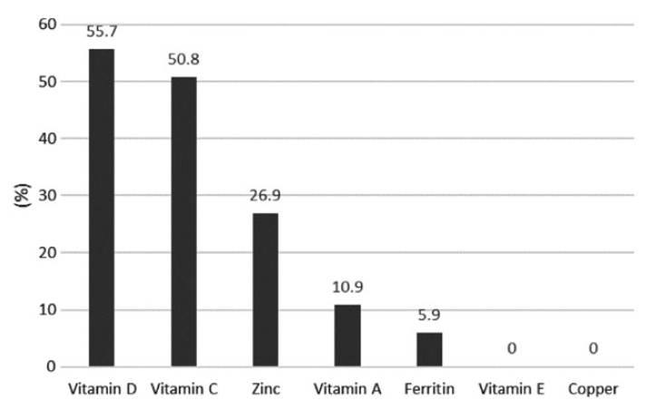
What are the nutritional deficiencies associated with diabetic foot ulcers?
Percentage of participants with vitamin and mineral deficiencies. (Prospective cohort study of diabetic patients with foot ulcers seen in multidisciplinary foot clinics)
Pena G, Kuang B, Cowled P, et al. Micronutrient Status in Diabetic Patients with Foot Ulcers. Adv Wound Care (New Rochelle). 2020;9(1):9-15. doi:10.1089/wound.2019.0973

Slide 49
What have does literature say about nutrition and diabetic foot ulcers?
Micronutrients also play a vital role in the form of trace elements and vitamins, which influence the course followed by the healing wound.
When supplementary micronutrients are administered, the risk of developing pressure wounds may be reduced.
A randomized control trial showed that giving nutritional supplement reduced the incidence of pressure ulcers in bedbound patients.
Healing involves both hypermetabolic and catabolic states. Catabolism may be reduced by nutrients, limiting its effects thereby leading to the anabolic state.
In the healing process, it beneficial to provide trace elements such as magnesium, zinc, iron and boron, vitamins A, C, D, E or herbal remedies.
Kulprachakarn K, et al. Micronutrients and Natural Compounds Status and Their Effects on Wound Healing in the Diabetic Foot Ulcer. Int J Low Extrem Wounds. 2017;16(4):244-250.

Slide 50
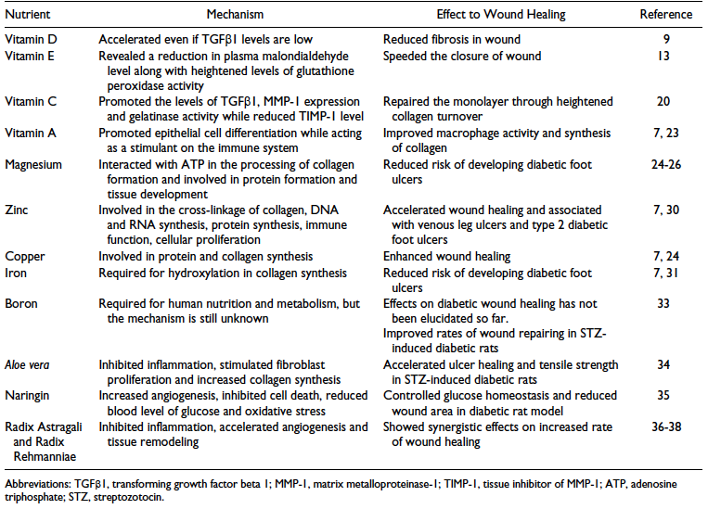
What is the effect of dietary nutrients on diabetic foot ulcers?
Summary of the Effect of Dietary Micronutrients and Natural Compounds Supplementation to Wound Healing in Diabetic Foot Ulcer
Kulprachakarn K, et al. Micronutrients and Natural Compounds Status and Their Effects on Wound Healing in the Diabetic Foot Ulcer. Int J Low Extrem Wounds. 2017;16(4):244-250.

Slide 51
What is the mechanism of Cellular Growth That Hyperbaric Induces In Patients With Diabetes?
Brem H, Tomic- Canic M . Cellular and molecular basis of wound healing in diabetes. J Clin Invest. 2007 (117)5: 1219-1222.

Slide 52
What are the indications for hyperbaric oxygen therapy?
Arterial Insufficiencies
Radiation-related wounds
Acute and chronic wounds (specifically diabetic foot ulcers)
Clostridial Myonecrosis (Gas Gangrene)
Necrotizing Soft Tissue Infections
Chronic Osteomyelitis
Severe Anemia
Insufficient evidence is available to support the routine use of patients with thermal burns, although it is a widely used adjunct therapy. Hyperbaric oxygen does have the potential to decrease healing time and fluid requirements, as well as increase the success of skin grafts, but more studies must be conducted to adopt this into routine practice.
Hanley ME, Hendriksen S, Cooper JS. Hyperbaric, Chronic Refractory Osteomyelitis. [Updated 2020 May 7]. In: StatPearls [Internet]. Treasure Island (FL): StatPearls Publishing; 2020 Jan-.

Slide 53
How effective in hyperbaric oxygen in treating diabetic foot ulcers?
A review of 12 randomized trials (577 participants) found that:
For diabetes-related foot ulcers, HBOT seemed to improve the chance of healing in the short term (up to six weeks), but not with longer term follow-up.
HBOT may reduce the number of major amputations in people with diabetes who have chronic foot ulcers.
For chronic wounds caused by disease to the veins of the leg, we found that HBOT may reduce the size of wounds.
For chronic wounds caused by lack of blood supply through the arteries or chronic pressure ulcers, we found no evidence to confirm or refute any eGects of HBOT.
Kranke P, Bennett MH, Martyn-St James M, Schnabel A, Debus SE, Weibel S. Hyperbaric oxygen therapy for chronic wounds. Cochrane Database Syst Rev. 2015;2015(6):CD004123. Published 2015 Jun 24.

Slide 54
How effective in hyperbaric oxygen in treating diabetic foot ulcers?
Hyperbaric oxygen therapy (HBOT) has been proposed as a useful adjunct in the complex treatment of DFUs with peripheral arterial occlusive disease (PAOD) because of the presence of local arterial insufficiency.
A systematic review of 11 studies and 729 patients that focuses specifically on patients with DFUs in combination with PAOD shows that HBOT as an adjunct to standard wound care in patients with DFU and PAOD leads to a decrease in major amputations, but no difference in minor amputation rates, mortality, or healing time.
Brouwer RJ, Lalieu RC, Hoencamp R, van Hulst RA, Ubbink DT. A systematic review and meta-analysis of hyperbaric oxygen therapy for diabetic foot ulcers with arterial insufficiency. J Vasc Surg. 2020;71(2):682-692.e1.

Slide 55
How effective in hyperbaric oxygen in treating diabetic foot ulcers?
Hyperbaric Oxygen therapy is an effective additional therapeutic component in the treatment of diabetic lower-extremity wounds and in non-diabetic arterial occlusive disease. Hyperbaric Oxygen therapy associated with standard aggressive therapeutic protocol can lead to a reduction in the number of complications and amputations in patients with diabetic angiopathy and arterial occlusive disease in non-diabetics.
The basic treatment should be started by a physician specializing in diagnosing, treating and monitoring the patient, and HBO therapy should be used in conjunction with early treatment, antibiotic therapy, medication and other therapeutic aspects involved in the process (anti aggregation drugs, statins, ACE inhibitors, etc.)
Begić A, Dilić M. Evaluation of the Occlusive Arterial Disease and Diabetic Angiopathy Treatment Effects by Hyperbaric Oxygenation. Med Arch. 2019;73(4):244-248..

Slide 56
What is known about support surfaces and pressure ulcer prevention?
The use of a static air mattress must be considered in preventing the development of pressure ulcers in a high-risk nursing home population.
The financial cost for static air mattress that prevents the development of pressure ulcer was lower than that for an alternating air pressure mattress.
The time to develop a pressure ulcer was significantly longer in the group who used a static air mattress compared to the group who used an alternating pressure air mattress.
Beeckmana D, et al. A multicentre prospective randomised controlled clinical trial comparing the effectiveness and cost of a static air mattress and alternating air pressure mattress to prevent pressure ulcers in nursing home residents. International Journal of Nursing Studies 97 (2019) 105–113.

Slide 57
What is known about support surfaces and pressure ulcer prevention?
The use of a static air mattress must be considered in preventing the development of pressure ulcers in a high-risk nursing home population.
The financial cost for static air mattress that prevents the development of pressure ulcer was lower than that for an alternating air pressure mattress.
The time to develop a pressure ulcer was significantly longer in the group who used a static air mattress compared to the group who used an alternating pressure air mattress.
Beeckmana D, et al. A multicentre prospective randomised controlled clinical trial comparing the effectiveness and cost of a static air mattress and alternating air pressure mattress to prevent pressure ulcers in nursing home residents. International Journal of Nursing Studies 97 (2019) 105–113.

Slide 58
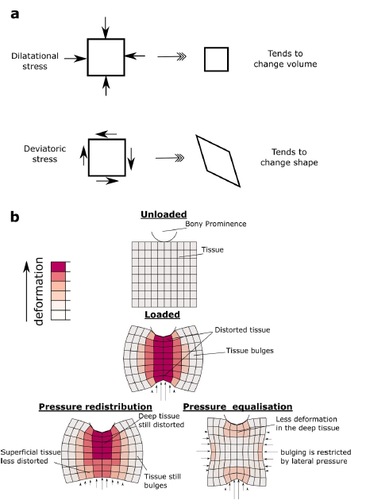
How does pressure redistribution work?
Deformations beneath a bony prominence. The stress in soft tissue has two components, dilatational and deviatoric (a). Soft tissue is much more resistant to dilatational stress than deviatoric stress. Under a bony prominence, the soft tissue is distorted due to the concentrated pressures at the bone and the support (b).
Redistributing the surface pressure has some effect on the outer (superficial) region, but not on the deep tissue. We hypothesise that by applying pressure laterally (termed pressure equalisation), bulging is reduced, and the tissue can bear the load in a moredilatational mode.
Boyle CJ, et al. Lateral pressure equalisation as a principle for designing support surfaces to prevent deep tissue pressure ulcers. PLoS ONE 2020 15(1): e0227064.

Slide 59
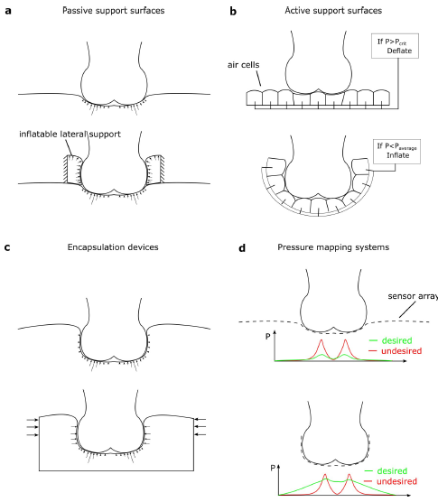
How does pressure equalization relate to device design?
For surfaces designed to reduce peak pressure passively (a), applying a lateral pressure device helps to avoid lateral bulging (top, showing current devices, bottom showing improved design).
Active devices based on individually controlled air cells (b) could be improved by surrounding the soft tissue and changing the control software to aim for equalized pressure, rather than reduce peak pressure.
Encapsulation devices achieve large contact areas, but the lateral pressures exerted may be limited (c). These could be improved by active compression or smart materials.
Pressure mapping systems (d) currently identify pressure peaks as undesirable. If they could measure pressure around the surface, then they could be repurposed to measure the level of pressure equalization.
Boyle CJ, et al. Lateral pressure equalisation as a principle for designing support surfaces to prevent deep tissue pressure ulcers. PLoS ONE 2020 15(1): e0227064.

Slide 60
What is known about the differences among support surfaces and pressure ulcer prevention?
Various types of support surfaces that prevent the development of pressure ulcer are available.
There is difference in the mechanism of pressure/shear reduction between an alternating air pressure mattress and static air mattress.
There is no evidence supporting the notion that alternating air pressure mattresses are more effective than other high-specification support mattresses in preventing pressure ulcer.
Beeckmana D, et al. A multicentre prospective randomised controlled clinical trial comparing the effectiveness and cost of a static air mattress and alternating air pressure mattress to prevent pressure ulcers in nursing home residents. International Journal of Nursing Studies 97 (2019) 105–113.

Slide 61
What are the guidelines for using support surfaces?
In 2014, the National Pressure Ulcer Advisory Panel, the European Pressure Ulcer Advisory Panel and the Pan Pacific Pressure Injury Alliance developed a clinical practice guideline for the prevention and management of pressure ulcers.
The key prevention strategies include risk assessment, use of support surfaces, systematic patient repositioning, skin care and nutritional care.
Patient repositioning (e.g. patient turning every 2 h) is defined as a change in position of the lying or seated individual to relieve or redistribute pressure and to enhance comfort
There is a lack of evidence regarding the comparative effectiveness between the commercially available support surfaces that prevent the development of pressure ulcer.
Beeckmana D, et al. A multicentre prospective randomised controlled clinical trial comparing the effectiveness and cost of a static air mattress and alternating air pressure mattress to prevent pressure ulcers in nursing home residents. International Journal of Nursing Studies 97 (2019) 105–113.

Slide 62
Is there a difference between alternating pressure and high specification foam?
One of the largest RCTs found insufficient evidence of a difference in pressure ulcer development in high risk patients using “high-tech” Alternating Pressure Mattress (APM) vs “low-tech” High Specification Foam (HSF)
Patients with existing category 1 and 2 pressure ulcers are most at risk of subsequent PUs of category ≥ 2 and require targeted secondary prevention.
Nixon J, et al. Pressure Relieving Support Surfaces for Pressure Ulcer Prevention (PRESSURE 2): Clinical and Health Economic Results of a Randomised Controlled Trial. EClinicalMedicine. 2019;14:42-52. Published 2019 Sep 3. doi:10.1016/j.eclinm.2019.07.018

Slide 63
What are LOS for relevant DRGs?
TABLE 5.—LIST OF MEDICARE SEVERITY DIAGNOSIS-RELATED GROUPS (MS-DRGS), RELATIVE WEIGHTING FACTORS, AND GEOMETRIC AND ARITHMETIC MEAN LENGTH OF STAY—FY 2020 Correction Notice
MS-DRG | FY 2020 FINAL Post-Acute DRG | FY 2020 FINAL Special Pay DRG | MDC | TYPE | MS-DRG Title | Weights | Geometric mean LOS | Arithmetic mean LOS
570 | Yes | No | 09 | SURG | SKIN DEBRIDEMENT W MCC | 2.8732 | 7.4 | 9.7
571 | Yes | No | 09 | SURG | SKIN DEBRIDEMENT W CC | 1.6723 | 5.0 | 6.3
572 | Yes | No | 09 | SURG | SKIN DEBRIDEMENT W/O CC/MCC | 1.1217 | 3.2 | 3.9
573 | Yes | No | 09 | SURG | SKIN GRAFT FOR SKIN ULCER OR CELLULITIS W MCC | 5.3153 | 10.4 | 15.2
574 | Yes | No | 09 | SURG | SKIN GRAFT FOR SKIN ULCER OR CELLULITIS W CC | 3.1218 | 7.3 | 9.8
575 | Yes | No | 09 | SURG | SKIN GRAFT FOR SKIN ULCER OR CELLULITIS W/O CC/MCC | 1.7570 | 4.3 | 5.4
576 | No | No | 09 | SURG | SKIN GRAFT EXC FOR SKIN ULCER OR CELLULITIS W MCC | 4.8492 | 8.5 | 12.3
577 | No | No | 09 | SURG | SKIN GRAFT EXC FOR SKIN ULCER OR CELLULITIS W CC | 2.4156 | 4.4 | 6.5
578 | No | No | 09 | SURG | SKIN GRAFT EXC FOR SKIN ULCER OR CELLULITIS W/O CC/MCC | 1.6274 | 2.8 | 3.8
592 | Yes | No | 09 | MED | SKIN ULCERS W MCC | 1.7843 | 5.5 | 7.4
593 | Yes | No | 09 | MED | SKIN ULCERS W CC | 1.1478 | 4.2 | 5.3
602 | Yes | No | 09 | MED | CELLULITIS W MCC | 1.4298 | 4.6 | 5.8
603 | Yes | No | 09 | MED | CELLULITIS W/O MCC | 0.8435 | 3.2 | 3.8
616 | Yes | No | 10 | SURG | AMPUTAT OF LOWER LIMB FOR ENDOCRINE, NUTRIT, & METABOL DIS W MCC | 4.0008 | 9.8 | 12.3
617 | Yes | No | 10 | SURG | AMPUTAT OF LOWER LIMB FOR ENDOCRINE, NUTRIT, & METABOL DIS W CC | 2.0513 | 5.9 | 7.0
618 | Yes | No | 10 | SURG | AMPUTAT OF LOWER LIMB FOR ENDOCRINE, NUTRIT, & METABOL DIS W/O CC/MCC | 1.2545 | 3.4 | 4.1

Slide 64
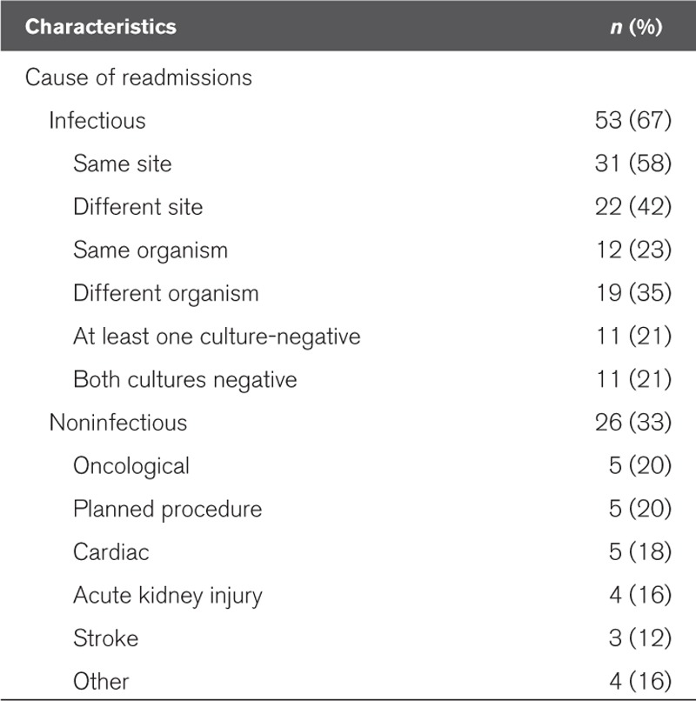
What are readmission rates due to sepsis?
Frequency and Cause of Hospital Readmissions in Sepsis Survivor Patients (n = 79)
Arshad A, Ayaz A, Haroon MA, Jamil B, Hussain E. Frequency and Cause of Readmissions in Sepsis Patients Presenting to a Tertiary Care Hospital in a Low Middle Income Country. Crit Care Explor. 2020;2(2):e0080. Published 2020 Feb 24. doi:10.1097/CCE.0000000000000080

Slide 65
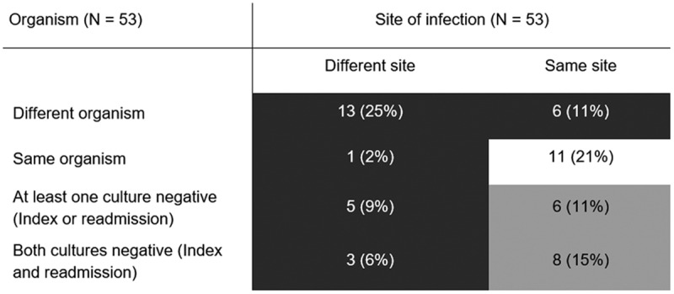
Sepsis readmissions by organism
Index admission-readmission dyads for organism and site causing sepsis. Dark gray cells represent dyads with new infection (n = 28, 53%); light gray cells represent dyads for whom infection may have been new or may have been a relapse or recurrent infection (n = 14, 26%); the white cell represents dyads with a relapsed or recurrent infection (n = 11, 21%).
Arshad A, Ayaz A, Haroon MA, Jamil B, Hussain E. Frequency and Cause of Readmissions in Sepsis Patients Presenting to a Tertiary Care Hospital in a Low Middle Income Country. Crit Care Explor. 2020;2(2):e0080. Published 2020 Feb 24. doi:10.1097/CCE.0000000000000080

Slide 66
What is 30-day readmission rate in patients with sepsis?
Study cohort included a total of 898,257 patients admitted with sepsis from 2013 and 2014 who survived to discharge and whose information was included in the Healthcare Cost and Utilization Project’s Nationwide Readmission Data.
Mean patient age was 66.8 ± 17.4 years with 60% of the study cohort ≥65 years. The primary outcome was 30-day readmission, and the causes for readmission were identified using the codes outlined in the International Classification of Diseases, Ninth Revision, Clinical Modification.
Of 898,257 patients, a total of 157,235 (17.5%) had a 30-day readmission, with a median time to readmission of 11 days. The most common cause for readmission was infectious etiology (42.16%, of which 22.86% due to sepsis), followed by gastrointestinal (9.6%), cardiovascular (8.73%), pulmonary (7.82%) and renal problems (4.99%).
Gadre SK, et al. Epidemiology and Predictors of 30-Day Readmission in Patients With Sepsis. Chest. 2019;155(3):483-490. doi:10.1016/j.chest.2018.12.008

Slide 67
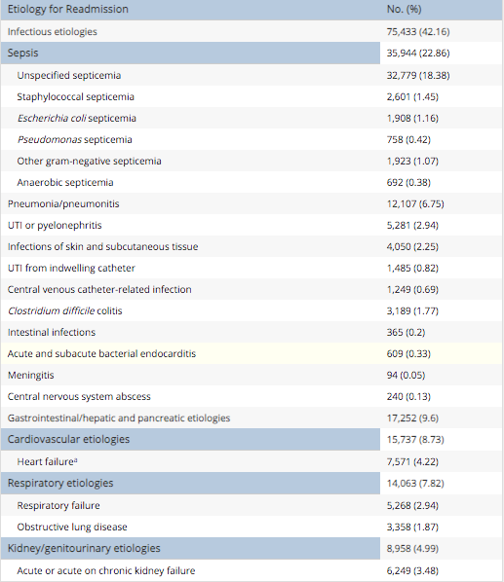
What are etiologies for 30-day readmission for Sepsis?
Gadre SK, et al. Epidemiology and Predictors of 30-Day Readmission in Patients With Sepsis. Chest. 2019;155(3):483-490. doi:10.1016/j.chest.2018.12.008

Slide 68
What is amputation rate for patients with diabetes and peripheral arterial disease?
Study cohort of 20 062 patients with diabetes, peripheral artery disease or both underwent 27 286 lower-limb amputations during the study period; 63.7% (12 786/20 062) of these patients underwent a major amputation.
The mean age was 68.7 years, and 32.4% were women. A total of 81.8% had diabetes, 93.8% had peripheral artery disease and 75.6% had both. The overall comorbidity burden was high, as indicated by a Charlson Comorbidity Index score of 2 or greater in 77.8% of patients.
Hypertension (81.1%), congestive heart failure (33.1%) and chronic obstructive pulmonary disease (32.5%) were the most frequent individual comorbidities, and all of these comorbidities were more prevalent in the major-amputation group.
Hussain MA, Al-Omran M, Salata K, et al. Population-based secular trends in lower-extremity amputation for diabetes and peripheral artery disease. CMAJ. 2019;191(35):E955-E961. doi:10.1503/cmaj.190134

Slide 69
What “patient harms” are captured in the AHRQ patient safety and adveres events composite?
www.qualityindicators.ahrq.gov/News/PSI90_Factsheet_FAQ_v1.pdf

Slide 70
How does Newark Beth Israel Score on Pressure Ulcers and Death from treatable serious complications?
Number of patients per 1,000 discharged with pressure ulcers
Number of surgical patients who died per 1,000 who had a serious treatable complication after surgery
www.hospitalsafetygrade.org/table-details/newark-beth-israel-medical-center

Slide 71
Patient Safety Indicator 03 (PSI 03) Pressure Ulcer Rate
Stage III or IV pressure ulcers or unstageable (secondary diagnosis) per 1,000 discharges among surgical or medical patients ages 18 years and older. Excludes stays less than 3 days; cases with a principal diagnosis of pressure ulcer; cases with a secondary diagnosis of Stage III or IV pressure ulcer or unstageable that is present on admission; obstetric cases; and transfers from another facility.
www.medicare.gov/HospitalCompare/Data/Serious-Complications.html

Slide 72
Patient Safety Indicator (PSI 04) Death Rate among Surgical Inpatients with Serious Treatable Complications
In-hospital deaths per 1,000 surgical discharges, among patients ages 18 through 89 years or obstetric patients, with serious treatable complications (pneumonia, pulmonary embolism/deep vein thrombosis, sepsis, shock/cardiac arrest or gastrointestinal hemorrhage/acute ulcer). Includes metrics for the number of discharges for each type of complication. Excludes cases transferred to an acute care facility
www.medicare.gov/HospitalCompare/Data/Serious-Complications.html

Slide 73
Patient Safety Indicator for surgical complications
Surgical complications – CMS recalibrated Patient Safety Indicators
Measures of serious complications are drawn from the CMS Patient Safety Indicators (PSIs). The overall score for serious complications is based on how often adult patients had certain serious, but potentially preventable, complications related to medical or surgical inpatient hospital care. This composite (or summary) measure – Patient Safety and Adverse Events Composite – is based on the following measures:
(PSI 3) Pressure sores (pressure ulcers)
(PSI 6) Collapsed lung that results from medical treatment (Iatrogenic pneumothorax)
(PSI 8) Broken hip from a fall after surgery (in-hospital fall with hip fracture)
(PSI 9) Bleeding or bruising during surgery (perioperative hemorrhage or hematoma)
(PSI 10) Kidney and diabetic complications after surgery (postoperative acute kidney injury requiring dialysis)
(PSI 11) Respiratory failure after surgery (postoperative respiratory failure)
(PSI 12) Blood clots, in the lung or a large vein, after surgery (perioperative pulmonary embolism or deep vein thrombosis)
(PSI 13) Blood stream infection after surgery (postoperative sepsis)
(PSI 14) A wound that splits open after surgery (postoperative wound dehiscence)
(PSI 15) Accidental cuts and tears (unrecognized abdominopelvic accidental puncture or laceration)
www.medicare.gov/HospitalCompare/Data/Serious-Complications.html

Slide 74
What “patient harms” are captured in the AHRQ patient safety and adveres events composite?
www.qualityindicators.ahrq.gov/News/PSI90_Factsheet_FAQ_v1.pdf

Slide 75
How does Newark Beth Israel Score on Pressure Ulcers and Death from treatable serious complications?
Number of patients per 1,000 discharged with pressure ulcers
Number of surgical patients who died per 1,000 who had a serious treatable complication after surgery
www.hospitalsafetygrade.org/table-details/newark-beth-israel-medical-center

Slide 76
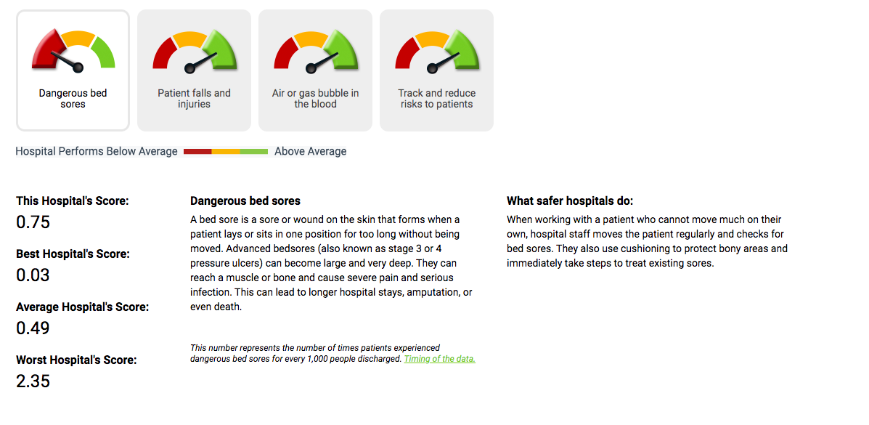
How does Newark Beth Israel Score on Pressure Ulcers?
www.hospitalsafetygrade.org/h/newark-beth-israel-medical-center?findBy=hospital&hospital=newark+beth&rPos=0&rSort=grade

Slide 77
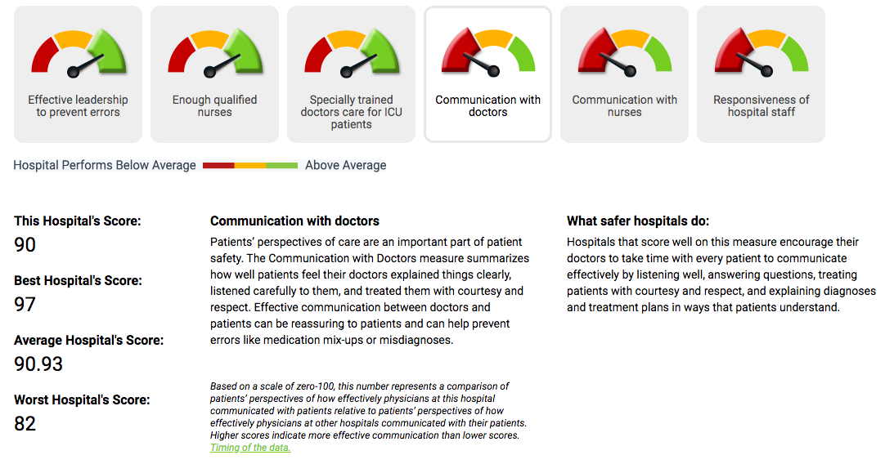
How does Newark Beth Israel Score on Doctor Communication with Patients?
www.hospitalsafetygrade.org/h/newark-beth-israel-medical-center?findBy=hospital&hospital=newark+beth&rPos=0&rSort=grade

Slide 78
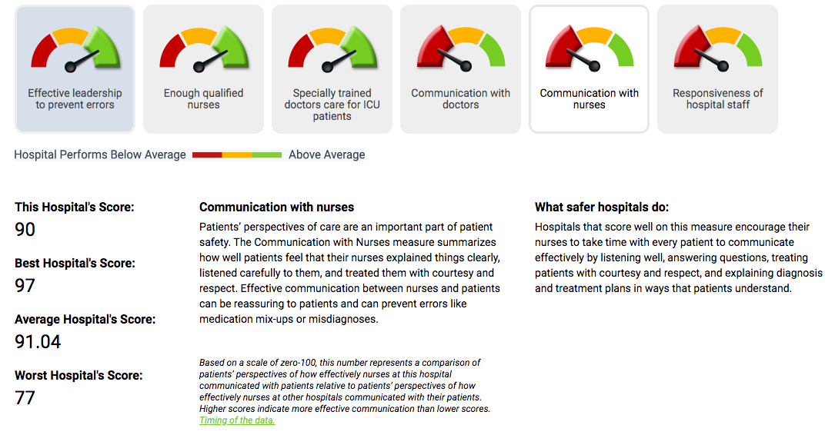
How does Newark Beth Israel Score on Nurse communication with patients?
www.hospitalsafetygrade.org/h/newark-beth-israel-medical-center?findBy=hospital&hospital=newark+beth&rPos=0&rSort=grade

Slide 79
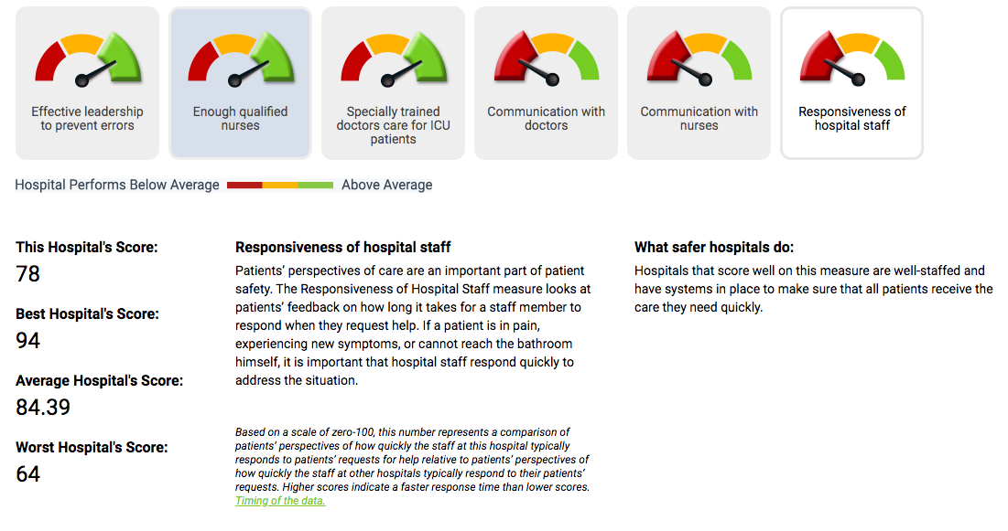
How does Newark Beth Israel Score on Nurse communication with patients?
www.hospitalsafetygrade.org/h/newark-beth-israel-medical-center?findBy=hospital&hospital=newark+beth&rPos=0&rSort=grade

Slide 80
CMS Star Ratings
The newest measure in this area is the Center for Medicare and Medicaid Services' (CMS) Hospital Compare Star rating system. This program uses complex methodology — based on a hospital's performance with mortality, safety, readmissions, patient experience, care effectiveness, care timeliness, and efficient use of medical imaging — to assign each hospital a Star rating ranging from 1 (lowest score) to 5 (highest score). The stated goal for this program is “To help millions of patients and their families learn about the quality of hospitals, compare facilities in their area side-by-side, and ask important questions about care quality when visiting a hospital or other health care provider (8).
www.medicare.gov/HospitalCompare/Data/Serious-Complications.html

Slide 81
How does Leapfrog measure hospital-acquired pressure ulcers?
Leapfrog evaluates two hospital-acquired injuries on the Leapfrog Hospital Survey: Hospital-Acquired Stage III & IV Pressure Ulcers and Hospital-Acquired Injuries.
Hospital-acquired pressure ulcers at stage III and IV are "bedsores" that are caused by remaining in one position for a long time, commonly in a bed or wheelchair, and can be prevented through known precautions. Stage III and IV pressure ulcers are very deep, serious sores that may reach muscle or bone. They cause severe pain and serious infection, and may prolong hospital stays or lead to amputation. Occasionally, a pressure ulcer may lead to death.
Hospital-acquired injuries are falls and other traumatic injuries (broken or dislocated bones, crushing injuries, or burns) that occur while a patient is in the hospital. Falls can happen when patients who really can’t walk on their own try getting out of bed, often to go to the restroom. Patient falls increase time in the hospital, require additional care, and can result in permanent disability or even death. Although some falls and injuries may occur when hospitals are providing quality care, many others can be avoided.
www.leapfroggroup.org/ratings/reports/hospitalacquiredinjuries

Slide 82
How are “never events” scored?
www.leapfroggroup.org/sites/default/files/Files/2019scoringAlgorithms_20190401_v8.0.pdf

Slide 83
What are the 9 principles for responding to “never events?”
In 2007, The Leapfrog Hospital Survey began asking hospitals about their process for handling serious reportable events. These principles are meant to ensure that patients and families, as well as caregivers, receive appropriate follow-up if a never event occurs. A hospital "fully meets standards" if they agree to all of the following if a Never Event occurs within their facility:
Apologize to the patient and family
Waive all costs directly related to the event
Report the event to an external agency
Conduct a root-cause analysis of how and why the event occurred
Interview patients and families, who are willing and able, to gather evidence for the root cause analysis
Inform the patient and family of the action(s) that the hospital will take to prevent future recurrences of similar events based on the findings from the root cause analysis
Have a protocol in place to provide support for caregivers involved in Never Events, and make that protocol known to all caregivers and affiliated clinicians
Perform an annual review to ensure compliance with each element of Leapfrog’s Never Events Policy for each never event that occurred
Make a copy of this policy available to patients upon request
/www.leapfroggroup.org/influencing/never-events

Slide 84
How does CMS score its quality measures?
Hospital Compare overall hospital rating
The Hospital Compare overall hospital rating summarizes a variety of measures across 7 areas of quality into a single star rating for each hospital. Once reporting thresholds are met, a hospital’s overall hospital rating is calculated using only those measures for which data are available. This may include as few as 9 or as many as 60 measures. The average is about 39 measures. Hospitals report data to the Centers for Medicare & Medicaid Services through the Hospital Inpatient Quality Reporting (IQR) Program and the Hospital Outpatient Quality Reporting (OQR) Program. Star ratings are not calculated for Veterans Health Administration (VHA) or Department of Defense (DoD) hospitals.
The methodology uses a statistical model known as a latent variable model. Seven different latent variable models are used to calculate scores for 7 groups of measures.
Mortality
Safety of Care
Readmission
Patient Experience
Effectiveness of Care
Timeliness of Care
Efficient Use of Medical Imaging
A hospital summary score is then calculated by taking the weighted average of these group scores. If a hospital is missing a measure category or group, the weights are redistributed amongst the qualifying measure categories or groups.
Finally, the overall hospital rating is calculated using the hospital summary score.

Slide 85
Wrap up
By understanding
The proper diagnostic techniques
The protocols for chronic wounds
Treatment of Necrotizing fasciitis and Fournier’s Gangrene
The role of Nutrition
The role of Hyperbaric oxygen
The role of appropriate support surfaces,
We can:
Improve patient outcomes
Decrease amputations
Decrease length of stay
Decrease readmissions
Decrease mortality

Slide 86
Q & A

