Slide 1
Preventing Readmissions Wednesday, October 9, 2024
Notes:
1

Slide 2
Agenda
Rates and predictors of readmission after minor lower extremity amputations
Ways to decrease readmission
Readmission rates
Readmission diagnoses
What is readmission rate by DRG?
What is the readmission rate by clinical classification?
What is readmission rate for any diagnosis in DM patients?
What is readmission rate for any diagnosis in chronic ulcer patients?
Incidence, risk factors, and causes for 30-day unplanned readmissions following 1° lower-extremity amputation in patients with DM
What are LOS for relevant DRGs?
Sepsis readmissions by organism
What are readmission rates due to sepsis?
What is 30-day readmission rate in patients with sepsis?
What are etiologies for 30-day readmission for sepsis?

Slide 3
Rates and predictors of readmission after minor lower extremity amputations
J Vasc Surg. 2015 Jul;62(1):101-5. doi: 10.1016/j.jvs.2015.02.021. Epub 2015 Mar 28.
2000-2012 retrospective chart review
717 patients → 100 (13.9%) readmitted
3.9% within 30 days
3.9% in 30-60 days
6.1% >60 days
95% of readmissions requiring re-amputation
Beaulieu et al., Rates and predictors of readmission after minor lower extremity amputations. J Vasc Surg. 2015 Jul;62(1):101-5.
Notes:
Multivariable analyses showed elective admission, PAD, CRI associated with readmission
Readmission due to infection 49%, ischemia and non healing wound
*suggest patients with known non-modifiable risk factors undergo higher amputation as primary sx to reduce readmission since majority of readm resulted in further amputations
abs

Slide 4
Ways to Decrease Readmission
Overall readmission rates: 8-26% (19-21% literature/database search)
6.6% due to pressure ulcers
Accounting for 28% of hospital days
Consider patient’s co-morbidities to tailor treatment and discharge planning
HTN, DM (HbA1c), CHF, asthma/COPD
Notes:
Reported rates anywhere from 8-38%. Avg reported on US databases 19-21%
6.6% readm due to PU, but they take up almost 30% of those readm hosp days

Slide 5
Ways to Decrease Readmission
Interventions to Reduce 30-Day Rehospitalization: A Systematic Review
Hansen L., et al. Ann Intern Med. 2011;155(8):520-528
19.6% readmission rate for Medicare fee-for-service patients
75% potentially avoidable → $12 billion savings
Hansen et al., Intervention to Reduce 30-Day Rehospitalization: A Systematic Review. Ann Intern Med. 2011; 155(8):520-528.

Slide 6
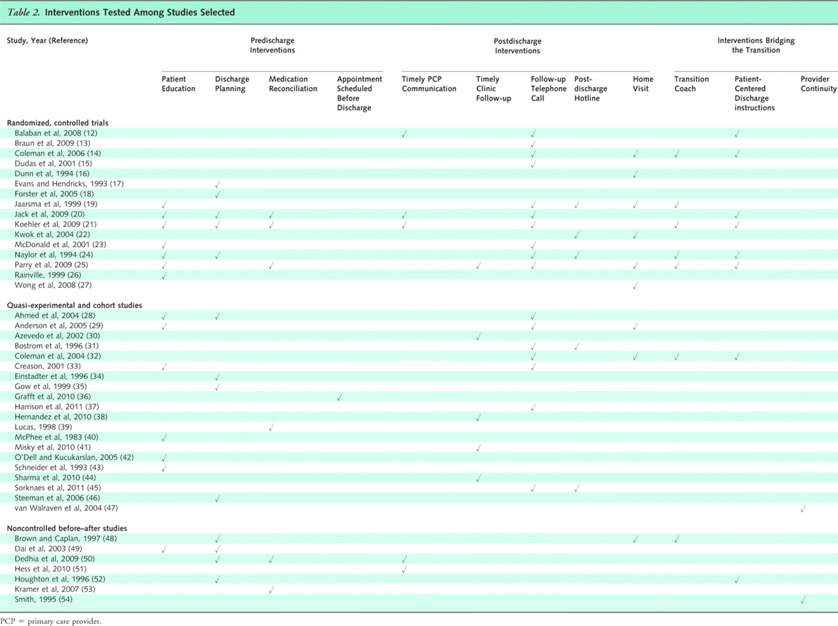
Hansen et al., Intervention to Reduce 30-Day Rehospitalization: A Systematic Review. Ann Intern Med. 2011; 155(8):520-528.

Slide 7
Ways to Decrease Readmission
Pre-discharge
Medication reconciliation
Dedicated discharge nurse
Set appointments/transportation
Patient education
Post-discharge
PMD/Clinic follow up
Phone calls, hotline
Home visit
Notes:
Reported rates anywhere from 8-38%. Avg reported on US databases 19-21%
6.6% readm due to PU, but they take up almost 30% of those readm hosp days

Slide 8
Readmission Rates
Rehospitalizations among Patients in the Medicare Fee-for-Service Program
Jencks F., et. al. N Engl J Med 2009; 360:1418-1428
Oct 2003 – Dec 2004
11,855,702 discharges
19.6% rehospitalized within 30 days
34.0% within 90 days
56.1% within 365 days
Jencks et al., Rehospitalizations among Patients in the Medicare Fee-for-Service Program. N Engl J Med 2009; 360:1418-1428.

Slide 9
Readmission Diagnoses
Jencks et al., Rehospitalizations among Patients in the Medicare Fee-for-Service Program. N Engl J Med 2009; 360:1418-1428.

Slide 10
What is the Readmission Rate by Diagnosis Related Group (DRG)?
MCC: major complications and comorbidities
CC: complications and comorbidities
Agency for Healthcare Research and Quality
http://hcupnet.ahrq.gov/HCUPnet.jsp
Notes:
MCC: major complications/comorbidities
CC: complications/comorbidities
Agency for Healthcare Research and Quality

Slide 11
What is the Readmission Rate by Clinical Classification?
Most common reasons for DM readmission
45% DM with complication
5% Septicemia
2.9% CHF
2.6% Renal failure
Agency for Healthcare Research and Quality
http://hcupnet.ahrq.gov/HCUPnet.jsp

Slide 12
What is the Readmission Rate for any Diagnosis in DM Patients?
In 2013
486,886 admissions with DM as principal diagnosis
9.2% readmitted in 30 days for same principal diagnosis
20.4% readmitted in 30 days for any cause
Agency for Healthcare Research and Quality. http://hcupnet.ahrq.gov/HCUPnet.jsp

Slide 13
What is the Readmission Rate for Any Diagnosis in Chronic Ulcer Patients?
In 2013
40,104 admissions with chronic skin ulcer as principal diagnosis
3.1% readmitted in 30 days for same principal diagnosis
20.0% readmitted in 30 days for any cause
Agency for Healthcare Research and Quality. http://hcupnet.ahrq.gov/HCUPnet.jsp
Notes:
From AHRQ

Slide 14
Incidence, risk factors, and causes for 30-day unplanned readmissions following 1° lower-extremity amputation in patients with DM
2002-2013 retrospective chart review
439 patients → 46 (10.5%) readmitted
4 groups of readmitted patients
Major surgical (37%) – i.e. re-operation
Minor surgical (28.3%) – i.e. pain, cellulitis
Major medical (28.3%) – i.e. CHF, renal failure
Psychiatric (6.5%) – requiring psych admission
Ries et al., Incidence, risk factors, and causes for 30-day unplanned readmissions following 1° lower-extremity amputation in patients with DM. J Bone Joint Surg Am. 2015;97(21):1774-80.
Notes:
Univariate analysis of co-morbidities and pt characteristics between the readmitted and non-readmitted groups
Multivariate logistic regression to identify independent risk factors to readmission
Also used chi-square, student t-test, analysis of variance
http://jbjs.org/content/97/21/1774.long

Slide 15
What are LOS for relevant DRGs?
TABLE 5.—LIST OF MEDICARE SEVERITY DIAGNOSIS-RELATED GROUPS (MS-DRGS), RELATIVE WEIGHTING FACTORS, AND GEOMETRIC AND ARITHMETIC MEAN LENGTH OF STAY—FY 2020 Correction Notice
MS-DRG | FY 2020 FINAL Post-Acute DRG | FY 2020 FINAL Special Pay DRG | MDC | TYPE | MS-DRG Title | Weights | Geometric mean LOS | Arithmetic mean LOS
570 | Yes | No | 09 | SURG | SKIN DEBRIDEMENT W MCC | 2.8732 | 7.4 | 9.7
571 | Yes | No | 09 | SURG | SKIN DEBRIDEMENT W CC | 1.6723 | 5.0 | 6.3
572 | Yes | No | 09 | SURG | SKIN DEBRIDEMENT W/O CC/MCC | 1.1217 | 3.2 | 3.9
573 | Yes | No | 09 | SURG | SKIN GRAFT FOR SKIN ULCER OR CELLULITIS W MCC | 5.3153 | 10.4 | 15.2
574 | Yes | No | 09 | SURG | SKIN GRAFT FOR SKIN ULCER OR CELLULITIS W CC | 3.1218 | 7.3 | 9.8
575 | Yes | No | 09 | SURG | SKIN GRAFT FOR SKIN ULCER OR CELLULITIS W/O CC/MCC | 1.7570 | 4.3 | 5.4
576 | No | No | 09 | SURG | SKIN GRAFT EXC FOR SKIN ULCER OR CELLULITIS W MCC | 4.8492 | 8.5 | 12.3
577 | No | No | 09 | SURG | SKIN GRAFT EXC FOR SKIN ULCER OR CELLULITIS W CC | 2.4156 | 4.4 | 6.5
578 | No | No | 09 | SURG | SKIN GRAFT EXC FOR SKIN ULCER OR CELLULITIS W/O CC/MCC | 1.6274 | 2.8 | 3.8
592 | Yes | No | 09 | MED | SKIN ULCERS W MCC | 1.7843 | 5.5 | 7.4
593 | Yes | No | 09 | MED | SKIN ULCERS W CC | 1.1478 | 4.2 | 5.3
602 | Yes | No | 09 | MED | CELLULITIS W MCC | 1.4298 | 4.6 | 5.8
603 | Yes | No | 09 | MED | CELLULITIS W/O MCC | 0.8435 | 3.2 | 3.8
616 | Yes | No | 10 | SURG | AMPUTAT OF LOWER LIMB FOR ENDOCRINE, NUTRIT, & METABOL DIS W MCC | 4.0008 | 9.8 | 12.3
617 | Yes | No | 10 | SURG | AMPUTAT OF LOWER LIMB FOR ENDOCRINE, NUTRIT, & METABOL DIS W CC | 2.0513 | 5.9 | 7.0
618 | Yes | No | 10 | SURG | AMPUTAT OF LOWER LIMB FOR ENDOCRINE, NUTRIT, & METABOL DIS W/O CC/MCC | 1.2545 | 3.4 | 4.1

Slide 16
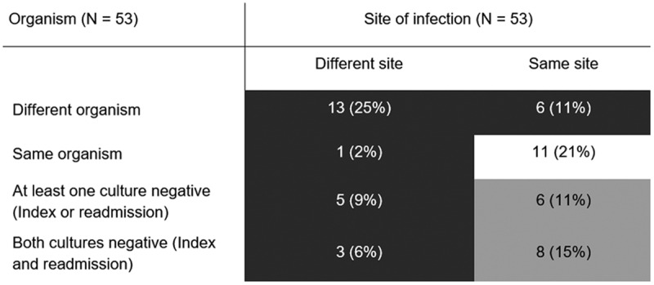
Sepsis readmissions by organism
Index admission-readmission dyads for organism and site causing sepsis. Dark gray cells represent dyads with new infection (n = 28, 53%); light gray cells represent dyads for whom infection may have been new or may have been a relapse or recurrent infection (n = 14, 26%); the white cell represents dyads with a relapsed or recurrent infection (n = 11, 21%).
Arshad A, Ayaz A, Haroon MA, Jamil B, Hussain E. Frequency and Cause of Readmissions in Sepsis Patients Presenting to a Tertiary Care Hospital in a Low Middle Income Country. Crit Care Explor. 2020;2(2):e0080. Published 2020 Feb 24. doi:10.1097/CCE.0000000000000080

Slide 17
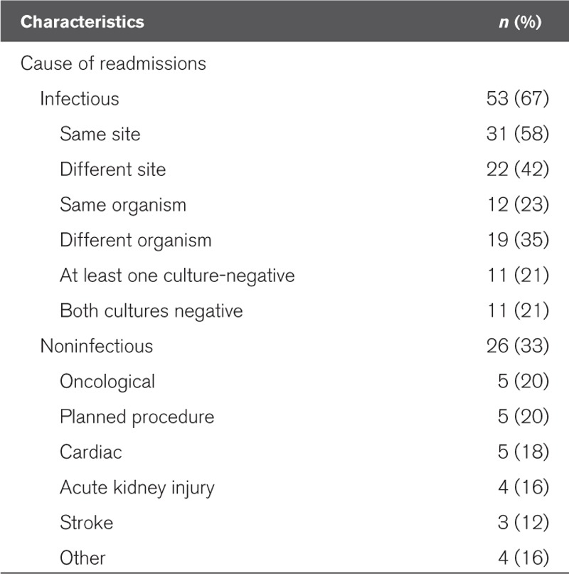
What are readmission rates due to sepsis?
Frequency and Cause of Hospital Readmissions in Sepsis Survivor Patients (n = 79)
Arshad A, Ayaz A, Haroon MA, Jamil B, Hussain E. Frequency and Cause of Readmissions in Sepsis Patients Presenting to a Tertiary Care Hospital in a Low Middle Income Country. Crit Care Explor. 2020;2(2):e0080. Published 2020 Feb 24. doi:10.1097/CCE.0000000000000080

Slide 18
What is 30-day readmission rate in patients with sepsis?
Study cohort included a total of 898,257 patients admitted with sepsis from 2013 and 2014 who survived to discharge and whose information was included in the Healthcare Cost and Utilization Project’s Nationwide Readmission Data.
Mean patient age was 66.8 ± 17.4 years with 60% of the study cohort ≥65 years. The primary outcome was 30-day readmission, and the causes for readmission were identified using the codes outlined in the International Classification of Diseases, Ninth Revision, Clinical Modification.
Of 898,257 patients, a total of 157,235 (17.5%) had a 30-day readmission, with a median time to readmission of 11 days. The most common cause for readmission was infectious etiology (42.16%, of which 22.86% due to sepsis), followed by gastrointestinal (9.6%), cardiovascular (8.73%), pulmonary (7.82%) and renal problems (4.99%).
Gadre SK, et al. Epidemiology and Predictors of 30-Day Readmission in Patients With Sepsis. Chest. 2019;155(3):483-490. doi:10.1016/j.chest.2018.12.008

Slide 19
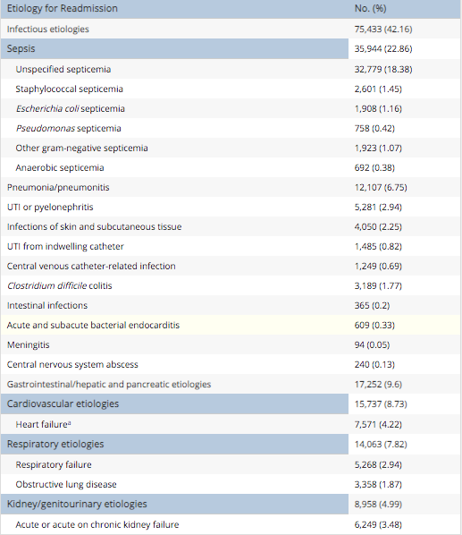
What are etiologies for 30-day readmission for Sepsis?
Gadre SK, et al. Epidemiology and Predictors of 30-Day Readmission in Patients With Sepsis. Chest. 2019;155(3):483-490. doi:10.1016/j.chest.2018.12.008

