Slide 1
Pre- and Post-op Wound Protocols Wednesday, October 2, 2024
Notes:
1

Slide 2
Agenda
What are the protocols?
What are required physical assessments?
What are required bacteriological assessments?
What are required diagnostic evaluations?
What are required vascular evaluations?
What are required radiographic evaluations?
How to use lidocaine?
What are required nutritional assessments?
What are required necrotizing fasciitis evaluations?
What are standard lengths of stay?
What are readmission rates?
What are amputation rates?
What are 30-day readmission rates?
What are key “Patient Safety Indicators” (PSIs)?
What is needed for informed consent?

Slide 3
What is required for patient history?
This information will help determine the causative factors and to help guide preventive and treatment strategies
Wound history
Timing and onset
Perceived causal factors
Qualitative changes such as size and drainage
Current wound care regimen
Previous treatments
Severity of pain
Prior wounds (location, characteristics, previous treatments)

Slide 4
What is required for patient history?
Medical history of conditions that may affect wound healing should be investigated. These include:
history of diabetes,
peripheral arterial disease,
venous insufficiency,
conditions that affect mobility (such as stroke, neurological conditions, and recent trauma),
recent weight loss,
smoking,
radiation,
immunosuppressive therapy and cancer.
Previous surgical history, especially as related to treatment of the wounds, such as wound debridement, skin grafting, arterial revascularization, and vein ablation procedures should be detailed.

Slide 5
What are required physical exams for pressure ulcers?
Exact anatomical location of wound, e.g.:
Plantar or dorsal surface of toe 1,2,3,4,5)
If plantar, identify which metatarsal
Heel/ankle/calf, anterior tibia, lateral or medial
Daily assessment of the skin, particularly around the at-risk areas, including ischial, sacral, trochanteric, and heel areas
If patient has heel ulcer, do they have sacral, buttock, occiput, or hip ulcer?
Length, width, depth of wound
Fungal toenails (e.g., yes/no? which ones?)
Characterization of skin around wound (e.g., erythema, callus? pustules? dermatitis? hyperpigmentation?)
Pus
Tenderness
Drainage
Characterization of granulation tissue (e.g., discolored, well-vascularized?)
Undermining of wound edges (i.e., how many centimeters?)

Slide 6
How to assess for infection?
Signs of infection
Increased blanching erythema in area surrounding the wound Induration surround the wound
Lymphangitis – red streaking proximally Wound drainage – especially thick, purulent, foul drainage
Foul odor
Increased tenderness
Increased warmth
Fever

Slide 7
What are required lab evaluations?
Procalcitonin
C-Reactive Protein
Hemoglobin A1c
Albumin, pre-albumin
Vitamin D level
Complete blood count with manual differential
Prothrombin time/partial thromboplastin time
Comprehensive metabolic panel
Lipid profile
Erythrocyte sedimentation rate
Thyroid-stimulating hormone (TSH) thyroxine (T4) and triiodothyronine (T3)
Aspartate Aminotransferase (AST)
Alkaline phosphatase (ALP)
Gamma‐Glutamyl Transpeptidase (GGT)
Alanine aminotransferase (ALT)
Urine analysis
Urinary microalbumin

Slide 8
What are required bacteriological evaluations?
Treat distant infections (e.g. urinary tract, cardiac valves, cranial sinuses) with appropriate antibiotics in pressure ulcer-prone patients or patients with established ulcers.
If infection is suspected in a debrided ulcer, or if contraction and epithelialization from the margin are not progressing within two weeks of debridement and relief of pressure, determine the type and level of infection in the debrided ulcer by tissue biopsy or by a validated quantitative swab technique.
Cultures should be performed to isolate both aerobic and anaerobic bacteria.

Slide 9
What are required bacteriological treatments?
If ≥ 106 CFU/g of tissue or any beta hemolytic streptococci, use topical antimicrobial (discontinue once in bacterial balance to minimize cytotoxicity and development of resistance).
Systemically administered antibiotics do not effectively decrease bacterial levels in granulating wounds; however, topically applied antimicrobials can be effective.
Obtain bacterial balance (< 105 CFU/g of tissue and no beta hemolytic streptococci) in the pressure ulcer prior to attempting surgical closure by skin graft, direct wound approximation, pedicled or free flap.
Obtain bone biopsy for culture and histology in cases of suspected osteomyelitis associated with a pressure ulcer.

Slide 10
What are required vascular assessments?
All patients with lower extremity ulcers should be assessed for arterial disease. Suspicion of arterial disease should prompt referral to a vascular specialist.
Criteria:
Decreased or absent palpable pedal pulses.
Delay in capillary refill response.
Delay of 10-15 seconds in returning of color when raising the leg to 45° for one minute, dependent rubor (Buerger’s test).
ABI ≤ 0.9 or > 1.2.
Transcutaneous oxygen pressure of < 40 mm Hg.
Doppler arterial waveform disparities.
Dampened pulse volume recordings. Pure arterial ulcers are unusual. Arterial insufficiency frequently contributes to poor healing in ulcers with another etiology (venous or diabetic).

Slide 11
What are required vascular assessments?
Leg elevation test (Buerger’s test) involves elevation of a leg with the patient in a supine position, and after the veins have completely drained, the leg is then placed in a dependent position. Elevation of the leg approximately 25 cm above the table will generate enough pressure to exceed the central venous pressure, allowing venous blood in the leg to drain centrally. The extremity is expected to remain pink and perfused in normal individuals. However, in patients with arterial insufficiency, the limb will become pale and ischemic. When the leg is subsequently placed in a dependent position, the veins should become dilated again within 20 seconds in normal individuals. If duration exceeds 20 seconds, arterial insufficiency may be present.

Slide 12
What are required vascular assessments?
Ankle-brachial index (ABI) is a simple test that can be performed at bedside. The ABI is the ratio of systolic blood pressure measured at the ankle over the systolic blood pressure measured at the arm, using a Doppler probe.
An ABI of >0.9 is suggestive of peripheral arterial disease. In patients with noncompressible vessels, such as patients with diabetes or advanced age, toe pressure and toe brachial index is used instead. This is usually done in the vascular lab and not at bedside.
In patients with clinical findings that are suspicious for peripheral arterial disease, additional arterial studies such as segmental pressure measurement and pulse volume recording measurement, or vascular imaging such as arterial duplex ultrasonography, computed tomography angiography, and digital subtraction angiography
https://www.facs.org/-/media/files/education/core-curriculum/nonhealing_wounds_go.ashx

Slide 13
What are required vascular assessments?
In patients with clinical findings that are suspicious for peripheral arterial disease, additional arterial studies may be indicated. In the segmental pressure study, systolic blood pressures are measured at the proximal thigh, distal thigh, below the knee, and ankle using a Doppler.
Pulse volume recording study detects volume changes sequentially down the extremity. A normal pulse volume wave form is characterized by sharp systolic upstroke, peak and prominent dicrotic notch. A loss of dicrotic notch or rounded waveform suggests diminished flow due to upstream occlusion.
Areas of arterial stenosis can be visualized on B-mode ultrasound imaging and can be demonstrated by Doppler as increased flow velocities.
Computed tomography angiography requires intravenous contrast timed specifically for arterial enhancement. It can provide three-dimensional imaging of the arterial system and is particularly useful for operative planning.
https://www.facs.org/-/media/files/education/core-curriculum/nonhealing_wounds_go.ashx

Slide 14
What are relevant diagnostic studies?
Plain radiography
Bone scan
Magnetic resonance imaging
Tissue or bone biopsy
For heel ulcers, all patients with diabetes and any patient with diminished pulse should have bilateral ankle brachial indices.

Slide 15
What are relevant diagnostic studies?
Laboratory tests Serum marker of inflammation such as white blood cell count (CRP), C-reactive protein, erythrocyte sedimentary rate (ESR) and procalcitonin (PCT) may be elevated in patients with active infection.
In patients with diabetic foot osteomyelitis, WBC and PCT may be normal, but ESR and C-reactive protein may be elevated. Elevated ESR together with evidence of ulcer connection to bone in diabetic patients should prompt additional imaging to evaluate for osteomyelitis.
Hemoglobin A1C (HbA1C) should be used as a marker for sustained diabetic control. Renal function tests should also be measured, as the presence of renal failure in patients with diabetes is associated with increased risk of diabetic foot ulcers or lower extremity amputations.
Patients with large wounds are often malnourished and are in persisted catabolic state. Nutritional assessment labs including prealbumin, albumin, and total lymphocyte counts should be considered.
https://www.facs.org/-/media/files/education/core-curriculum/nonhealing_wounds_go.ashx

Slide 16
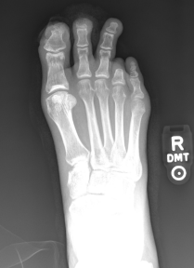
What are relevant imaging studies?
Plain radiographic evaluation of the extremity is indicated when osteomyelitis is suspected. Signs of osteomyelitis on plain radiographs are periosteal thickening, lytic lesions, endosteal scalloping, osteopenia, and loss of trabecular architecture
In general, osteomyelitis must extend at least 1 cm or compromise 30 to 50% of the bone mineral content to produce noticeable changes on conventional radiographs. This is about 2 to 3 weeks into the course of the infection
Radiograph demonstrates patient with bony destruction (osteopenia and bone loss) of the distal phalanges of the first and second digits, consistent with advanced osteomyelitis. Also present are soft tissue defects at the tip of the toes at the areas of chronic ulcerations. A previous 4th toe amputation is also evidenced on the radiograph.
https://www.facs.org/-/media/files/education/core-curriculum/nonhealing_wounds_go.ashx

Slide 17
What are relevant imaging studies?
Computed tomography shows changes earlier than conventional radiographs. However, the radiation exposure is higher with CT and it is not as sensitive as magnetic resonance imaging (MRI).
Magnetic resonance imaging is not only highly sensitive for detecting osteomyelitis, it also helps determine the extent of disease involvement. When used with gadolinium, sensitivity and specificity for osteomyelitis are 90% and 85% respectively.
Other imaging studies such as white blood cell labeled radionucleotide scan, hybrid 99mTc white blood cell labeled single-photon emission computed tomography/computed tomography (99mTc SPECT/CT), and hybrid positron emission tomography/computed tomography (PET/CT) have also been used for the diagnosis of osteomyelitis, especially when MRI is contraindicated.
https://www.facs.org/-/media/files/education/core-curriculum/nonhealing_wounds_go.ashx

Slide 18
What are the most common causative pathogens inducing necrotizing soft-tissue infection?
Gram-positive organisms such as group A Streptococcus, Enterococcus, Staphylococcus aureus, and Clostridium.
https://www.facs.org/-/media/files/education/core-curriculum/nonhealing_wounds_go.ashx

Slide 19
What are clinical manifestations of necrotizing fasciitis/soft-tissue infections?
Clinical sepsis
subcutaneous crepitus
SQ air on X-ray/CT
skin bullae
intense swelling and erythema
rapid progression of clinical signs.
Vayvada H, et al. Necrotising fasciitis in the central part of the body: diagnosis, management and review of the literature. Int Wound J. 2013 Aug; 10(4): 466-72.

Slide 20
What are the risk factors for necrotizing infection?
Diabetes mellitus
Obesity
Malnutrition
Steroid use
Autoimmune deficiencies
Myocardial ischemia
Covid-19 (not SARS-CoV-2)
Levophed

Slide 21
How to evaluate for necrotizing fasciitis?
The Laboratory Risk Indicator for Necrotizing Infection (LRINEC) Score was developed in a 2004 report to distinguish NSTIs from other severe soft tissue infections. The scoring system is hinged on abnormalities in six independent variables:
C-reactive protein, mg/L
Less than 150 (0)
More than 150 (4)
Total white cell count (WBC), cells/mm
Less than 15 (0)
15 to 25 (1)
More than 25 (2)
Hemoglobin, g/dl
More than 13.5 (0)
11 to 13.5 (1)
Less than 11 (2)
Sodium, mmol/L
135 or greater (0)
Less than 135 (2)
Creatinine, mg/dL
1.6 or less (0)
More than 1.6 (2)
Glucose, mg/dL
180 or less (0)
More than 180 (1)
A score of six has a positive predictive value of 92% and a negative predictive value of 96%. A score of eight or greater represents a 75% risk of necrotizing infection.
Wallace HA, Perera TB. Necrotizing Fasciitis. In: StatPearls. Treasure Island (FL): StatPearls Publishing; 2020.

Slide 22
What is checklist for surgical treatment of Necrotizing Fasciitis?
Rapidly diagnose NF based on the following signs and symptoms: extreme inflammation, ecchymosis, hemorrhagic bullae on the area involved, and pain out of proportion to the precipitating wound.
Consider a prompt incision for hemodynamically unstable patients and wide debridement for stable patients.
Use antibiotics empirically, and adjust the regimen later according to drug-sensitive testing.
Monitor NF patients closely for vital sign changes and send them to ICU if necessary.
Reconstructive surgery and nutritional and supportive therapy are important during the late period of NF treatment.
Liu Y, et al. Learning from clinical experience with necrotizing fasciitis: treatment and management. Advances in Skin & Wound Care. 2017 30(11):486-493.
Vayvada H, et al. Necrotising fasciitis in the central part of the body: diagnosis, management and review of the literature. Int Wound J. 2013 Aug; 10(4): 466-72.

Slide 23
What are required bacteriological treatments post-op?
If infection is suspected in a debrided ulcer, or if epithelialization from the margin is not progressing within two weeks of debridement and initiation of offloading therapy, determine type and level of infection in a debrided diabetic ulcer by tissue biopsy or by a validated quantitative swab technique. Cultures should be performed to isolate both aerobic and anaerobic bacteria.
If ≥106 CFU/g of tissue or any beta hemolytic streptococci, use topical antimicrobial (discontinue once in bacterial balance to minimize cytotoxicity and development of resistance).
Systemically administered antibiotics do not effectively decrease bacterial levels in granulating wounds; however, topically applied antimicrobials can be effective.

Slide 24
What are required bacteriological treatments post-op?
For acute diabetic foot infections not confined to the granulating wound, systemic antibiotics are effective.
Cellulitis (inflammation and infection of the skin and subcutaneous tissue most commonly due to streptococci or staphylococci) surrounding the ulcer should be treated with systemic gram positive bactericidal antibiotics.
If osteomyelitis is suspected, appropriate diagnostic measures include probing the wound with a sterile cotton-tipped applicator, serial X-rays, MRI, CT and radionuclide scan.
Osteomyelitis is best treated by removal of the infected bone, followed by two to four weeks of antibiotics. When not practical, it can be effectively treated with prolonged antibiotic therapy.
Minimize the tissue level of bacteria, preferably to ≤ 105 CFU/g of tissue with no beta hemolytic streptococci in the ulcer prior to attempting surgical closure by skin graft, skin equivalent, pedicled or free flap.

Slide 25
What are required nutritional assessments?
Perform nutritional assessment (weight, pre-albumin level and serum albumin level).
Encourage dietary intake or supplementation if malnourished and at risk for PU.
Ensure adequate dietary intake to prevent malnutrition (if compatible with individual’s wishes).
If still inadequate, use nutritional support (tube feeding) to place patient in positive nitrogen balance (30-35 cal/kg/day and 1.25-1.5g protein/kg/day).
Give vitamin and mineral supplements if deficiencies are confirmed or suspected.
A. Barbul et al. Clinical Treatment Guidelines, Wound Rep Reg. 2006; 14: 645-711.

Slide 26
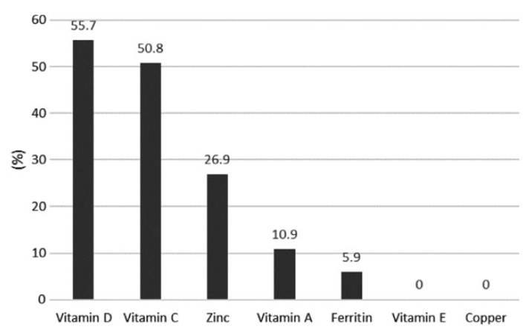
What are nutritional deficiencies associated with diabetic foot ulcers?
Percentage of participants with vitamin and mineral deficiencies. (Prospective cohort study of diabetic patients with foot ulcers seen in multidisciplinary foot clinics)
Pena G, Kuang B, Cowled P, et al. Micronutrient Status in Diabetic Patients with Foot Ulcers. Adv Wound Care (New Rochelle). 2020;9(1):9-15. doi:10.1089/wound.2019.0973

Slide 27
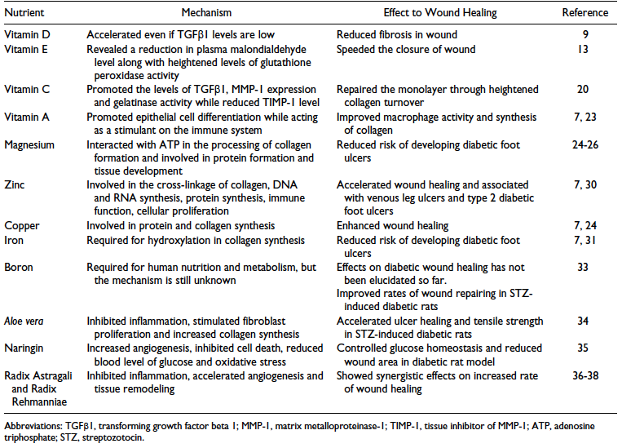
What are effects of nutritional deficiencies on diabetic foot ulcers?
Summary of the Effect of Dietary Micronutrients and Natural Compounds Supplementation to Wound Healing in Diabetic Foot Ulcer
Kulprachakarn K, et al. Micronutrients and Natural Compounds Status and Their Effects on Wound Healing in the Diabetic Foot Ulcer. Int J Low Extrem Wounds. 2017;16(4):244-250.

Slide 28
What is length of stay for relevant DRGs?
TABLE 5.—LIST OF MEDICARE SEVERITY DIAGNOSIS-RELATED GROUPS (MS-DRGS), RELATIVE WEIGHTING FACTORS, AND GEOMETRIC AND ARITHMETIC MEAN LENGTH OF STAY—FY 2020 Correction Notice
MS-DRG | FY 2020 FINAL Post-Acute DRG | FY 2020 FINAL Special Pay DRG | MDC | TYPE | MS-DRG Title | Weights | Geometric mean LOS | Arithmetic mean LOS
570 | Yes | No | 09 | SURG | SKIN DEBRIDEMENT W MCC | 2.8732 | 7.4 | 9.7
571 | Yes | No | 09 | SURG | SKIN DEBRIDEMENT W CC | 1.6723 | 5.0 | 6.3
572 | Yes | No | 09 | SURG | SKIN DEBRIDEMENT W/O CC/MCC | 1.1217 | 3.2 | 3.9
573 | Yes | No | 09 | SURG | SKIN GRAFT FOR SKIN ULCER OR CELLULITIS W MCC | 5.3153 | 10.4 | 15.2
574 | Yes | No | 09 | SURG | SKIN GRAFT FOR SKIN ULCER OR CELLULITIS W CC | 3.1218 | 7.3 | 9.8
575 | Yes | No | 09 | SURG | SKIN GRAFT FOR SKIN ULCER OR CELLULITIS W/O CC/MCC | 1.7570 | 4.3 | 5.4
576 | No | No | 09 | SURG | SKIN GRAFT EXC FOR SKIN ULCER OR CELLULITIS W MCC | 4.8492 | 8.5 | 12.3
577 | No | No | 09 | SURG | SKIN GRAFT EXC FOR SKIN ULCER OR CELLULITIS W CC | 2.4156 | 4.4 | 6.5
578 | No | No | 09 | SURG | SKIN GRAFT EXC FOR SKIN ULCER OR CELLULITIS W/O CC/MCC | 1.6274 | 2.8 | 3.8
592 | Yes | No | 09 | MED | SKIN ULCERS W MCC | 1.7843 | 5.5 | 7.4
593 | Yes | No | 09 | MED | SKIN ULCERS W CC | 1.1478 | 4.2 | 5.3
616 | Yes | No | 10 | SURG | AMPUTAT OF LOWER LIMB FOR ENDOCRINE, NUTRIT, & METABOL DIS W MCC | 4.0008 | 9.8 | 12.3
617 | Yes | No | 10 | SURG | AMPUTAT OF LOWER LIMB FOR ENDOCRINE, NUTRIT, & METABOL DIS W CC | 2.0513 | 5.9 | 7.0
618 | Yes | No | 10 | SURG | AMPUTAT OF LOWER LIMB FOR ENDOCRINE, NUTRIT, & METABOL DIS W/O CC/MCC | 1.2545 | 3.4 | 4.1
602 | Yes | No | 09 | MED | CELLULITIS W MCC | 1.4298 | 4.6 | 5.8
603 | Yes | No | 09 | MED | CELLULITIS W/O MCC | 0.8435 | 3.2 | 3.8

Slide 29
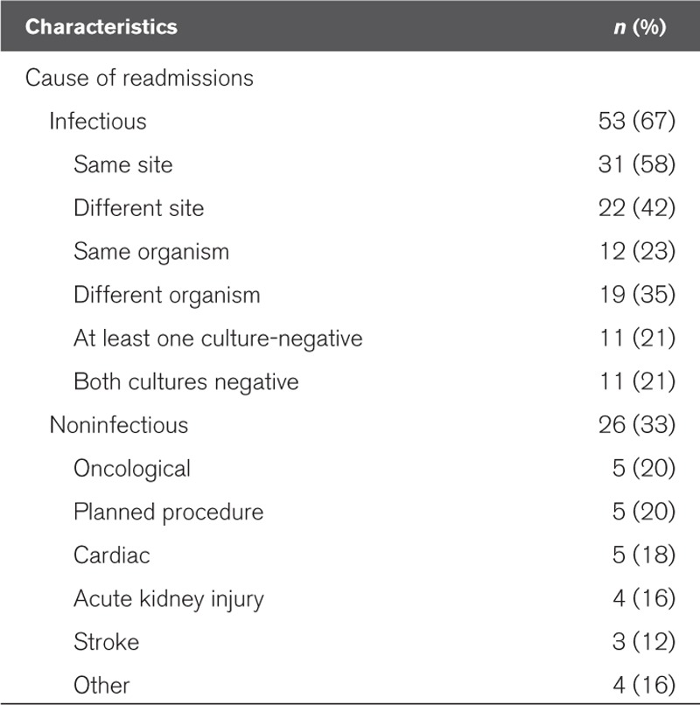
What are readmissions rates due to sepsis?
Frequency and Cause of Hospital Readmissions in Sepsis Survivor Patients (n = 79)
Arshad A, Ayaz A, Haroon MA, Jamil B, Hussain E. Frequency and Cause of Readmissions in Sepsis Patients Presenting to a Tertiary Care Hospital in a Low Middle Income Country. Crit Care Explor. 2020;2(2):e0080. Published 2020 Feb 24. doi:10.1097/CCE.0000000000000080

Slide 30
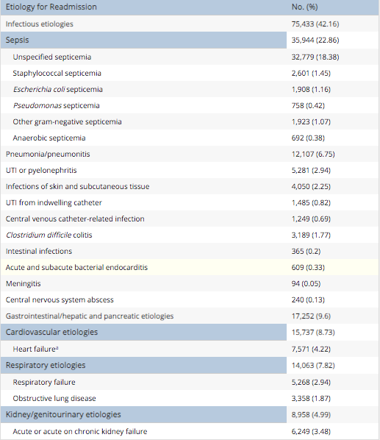
What are etiologies for 30-day readmission for sepsis?
Gadre SK, et al. Epidemiology and Predictors of 30-Day Readmission in Patients With Sepsis. Chest. 2019;155(3):483-490. doi:10.1016/j.chest.2018.12.008

Slide 31
What are key Patient Safety Indicators (PSIs)?
www.qualityindicators.ahrq.gov/News/PSI90_Factsheet_FAQ_v1.pdf

Slide 32
PSI 3: Pressure Ulcer Rate
Stage III or IV pressure ulcers or unstageable (secondary diagnosis) per 1,000 discharges among surgical or medical patients ages 18 years and older. Excludes stays less than 3 days; cases with a principal diagnosis of pressure ulcer; cases with a secondary diagnosis of Stage III or IV pressure ulcer or unstageable that is present on admission; obstetric cases; and transfers from another facility.
www.medicare.gov/HospitalCompare/Data/Serious-Complications.html

Slide 33
Patient Safety Indicator 03 (PSI 03) Pressure Ulcer Rate
with length of stay of less than 3 days
with a principal ICD-10-CM diagnosis code for pressure ulcer stage III or IV (or unstageable)
With all secondary ICD-10-CM diagnosis codes for pressure ulcer stage III or IV (or unstageable) present on admission
If more than one diagnosis of pressure ulcer is present, all diagnoses must be present on admission for the discharge to be excluded.
with any ICD-10-CM diagnosis code for severe burns (≥20% body surface area)
with any ICD-10-CM diagnosis code for exfoliative disorders of the skin (≥20% body surface area)
with a MDC code of 14 (pregnancy, childbirth, and puerperium)
with missing gender (SEX=missing), age (AGE=missing), quarter (DQTR=missing), year (YEAR=missing), or principal diagnosis (DX1=missing)
www.qualityindicators.ahrq.gov/Downloads/Modules/PSI/V2019/TechSpecs/PSI_03_Pressure_Ulcer_Rate.pdf

Slide 34
What is a “never event?”
According to the National Quality Forum (NQF), “never events” are errors in medical care that are clearly identifiable, preventable, and serious in their consequences for patients, and that indicate a real problem in the safety and credibility of a health care facility. Examples of “never events” include surgery on the wrong body part; foreign body left in a patient after surgery; mismatched blood transfusion; major medication error; severe “pressure ulcer” acquired in the hospital; and preventable post-operative deaths.
www.cms.gov/newsroom/fact-sheets/eliminating-serious-preventable-and-costly-medical-errors-never-events

Slide 35
How are never events scored?
www.leapfroggroup.org/sites/default/files/Files/2019scoringAlgorithms_20190401_v8.0.pdf

Slide 36
What are key surgical complications according to CMS?
Surgical complications – CMS recalibrated Patient Safety Indicators
Measures of serious complications are drawn from the CMS Patient Safety Indicators (PSIs). The overall score for serious complications is based on how often adult patients had certain serious, but potentially preventable, complications related to medical or surgical inpatient hospital care. This composite (or summary) measure – Patient Safety and Adverse Events Composite – is based on the following measures:
(PSI 3) Pressure sores (pressure ulcers)
(PSI 6) Collapsed lung that results from medical treatment (Iatrogenic pneumothorax)
(PSI 8) Broken hip from a fall after surgery (in-hospital fall with hip fracture)
(PSI 9) Bleeding or bruising during surgery (perioperative hemorrhage or hematoma)
(PSI 10) Kidney and diabetic complications after surgery (postoperative acute kidney injury requiring dialysis)
(PSI 11) Respiratory failure after surgery (postoperative respiratory failure)
(PSI 12) Blood clots, in the lung or a large vein, after surgery (perioperative pulmonary embolism or deep vein thrombosis)
(PSI 13) Blood stream infection after surgery (postoperative sepsis)
(PSI 14) A wound that splits open after surgery (postoperative wound dehiscence)
(PSI 15) Accidental cuts and tears (unrecognized abdominopelvic accidental puncture or laceration)
www.medicare.gov/HospitalCompare/Data/Serious-Complications.html

Slide 37
How does Leapfrog measure hospital-acquired pressure ulcers?
Leapfrog evaluates two hospital-acquired injuries on the Leapfrog Hospital Survey: Hospital-Acquired Stage III & IV Pressure Ulcers and Hospital-Acquired Injuries.
Hospital-acquired pressure ulcers at stage III and IV are "bedsores" that are caused by remaining in one position for a long time, commonly in a bed or wheelchair, and can be prevented through known precautions. Stage III and IV pressure ulcers are very deep, serious sores that may reach muscle or bone. They cause severe pain and serious infection, and may prolong hospital stays or lead to amputation. Occasionally, a pressure ulcer may lead to death.
Hospital-acquired injuries are falls and other traumatic injuries (broken or dislocated bones, crushing injuries, or burns) that occur while a patient is in the hospital. Falls can happen when patients who really can’t walk on their own try getting out of bed, often to go to the restroom. Patient falls increase time in the hospital, require additional care, and can result in permanent disability or even death. Although some falls and injuries may occur when hospitals are providing quality care, many others can be avoided.
www.leapfroggroup.org/ratings/reports/hospitalacquiredinjuries

Slide 38
What is needed for informed consent?
The right to make informed decisions regarding care presumes that the patient or the patient’s representative has been provided information about his/her health status, diagnosis, and prognosis. Furthermore, it includes the patient's or the patient’s representative’s participation in the development of his/her plan of care, including providing consent to, or refusal of, medical or surgical interventions, and in planning for care after discharge from the hospital.
The patient or the patient's representative should receive adequate information, provided in a manner that the patient or the patient's representative can understand, to assure that the patient or the patient’s representative can effectively exercise the right to make informed decisions.
It is essential that the MD discuss with the patient the details of of procedures.
https://www.cms.gov/Regulations-and-Guidance/Guidance/Manuals/downloads/som107ap_a_hospitals.pdf

Slide 39
What is needed for informed consent?
Informed consent process involves these elements:
Conducting the process in a manner and location that ensures participant privacy.
Giving adequate information about the study in a language understandable to potential subject.
Providing adequate opportunity for the potential subject to consider all options.
Responding to the potential subject’s questions and/or concerns.
Ensuring the potential subject comprehension of the information provided.
Obtaining the prospective subject’s voluntary agreement to participate.
Documenting the consent appropriately.
Providing copies of the consent documents to the subjects.
Continuing to provide information as the subject or research requires.
https://www.cms.gov/Regulations-and-Guidance/Guidance/Manuals/downloads/som107ap_a_hospitals.pdf

