Slide 1
Pelvic and Sacral Osteomyelitis Wednesday, October 2, 2024
Notes:
1

Slide 2
Agenda
What is definition of chronic osteomyelitis?
What are major criteria for chronic osteomyelitis?
How to diagnosis osteomyelitis: imaging/pathology?
How to diagnose pelvic osteomyelitis?
How to treat pelvic osteomyelitis?
What is microbiology of pressure-related pelvic osteomyelitis?
What is role of HBO in pelvic osteomyelitis?
How to diagnose sacral osteomyelitis?
Clinical presentations
What is importance of proximal bone biopsy?

Slide 3
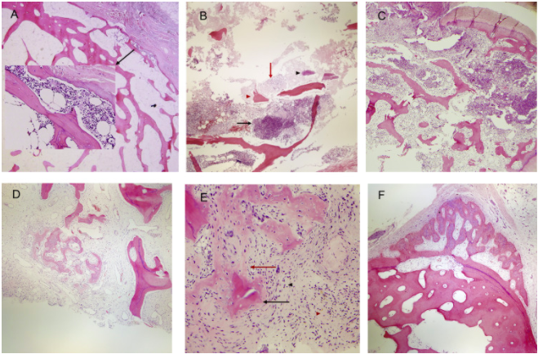
What is definition of chronic osteomyelitis?
Chronic osteomyelitis: histologically defined as bone tissue that has a significant amount of fibrosis surrounding devitalized tissue, accompanied by heavy infiltration of lymphocytes and plasma cells and few polymorphonuclear neutrophilic leukocytes.
Categories of osteomyelitis. (A) Acute osteomyelitis (early): small focus of neutrophils in the marrow space eroding the bone (magnification ×4 and ×20, hematoxylin-eosin [H&E] stain).
(B) Acute osteomyelitis: abscess formation (black arrow), fibrinoid necrosis (red arrow), bacteria (black arrowhead), necrotic bone (red arrowhead) and bone erosion (asterisk) (magnification ×4, H&E stain).
(C) Acute and chronic osteomyelitis: acute inflammation and abscess (right), draining fistula (top) with numerous sequestra and early fibroplasia with chronic inflammation (bottom left) (magnification ×4, H&E stain).
(D) Chronic osteomyelitis: involucrum and bony remodeling in a background of marrow fibrosis with plasmacytic inflammation and granulation tissue (red arrowhead) (magnification ×4, H&E stain).
(E) Chronic active osteomyelitis: Sequestrum (black arrow) and early involucrum (red arrow) in a background of dense marrow fibrosis with numerous plasma cells (black arrowhead) and a small aggregate of neutrophils (red arrowhead).
(F) Chronic inactive osteomyelitis: undulating, thick periosteal reaction with dense marrow fibrosis, scattered plasma cells and bone remodeling.
Sybenga A, et al. Diagnosing osteomyelitis: a histology guide for pathologists. J of Foot & Ankle Surg. 2019 (59)1: P75-85.

Slide 4
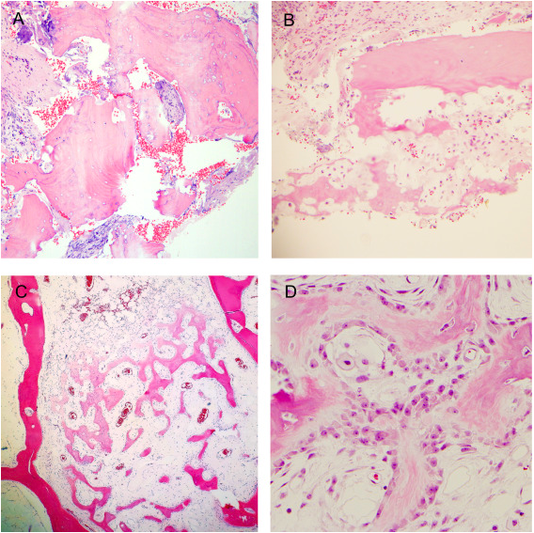
What are major criteria for chronic osteomyelitis?
Sequestrum: large fragment of necrotic bone with surrounding fibrosis and inflammation (magnification ×4, hematoxylin-eosin [H&E] stain). Note the empty lacunae.
Sequestrum: small fragments of necrotic bone with surrounding fibrosis and inflammation (magnification ×10, H&E stain).
Involucrum within the marrow space (magnification ×4, H&E stain).
Involucrum within the marrow space (magnification ×40, H&E stain).
Sybenga A, et al. Diagnosing osteomyelitis: a histology guide for pathologists. J of Foot & Ankle Surg. 2019 (59)1: P75-85.

Slide 5
How to diagnose osteomyelitis: imaging/pathology?
A diagnosis of osteomyelitis should be considered, unless proven otherwise, when there are signs of deep wounds in the sinus tract that probe to the bone, exposed bones or chronic nonhealing ulcers despite standard medical care. Further investigations, such as laboratory tests, diagnostic imaging (plain radiography, magnetic resonance imaging, WBC-labeled scintigraphy) and bone culture or biopsy can aid in the confirmation of osteomyelitis (strong; moderate).
In all patients suspected of having diabetic foot infection, plain film radiography of the foot is recommended to determine bone abnormalities (deformities, damage), soft tissue gases and foreign bodies (strong; moderate).
Plain film radiography is commonly used as first-line medical imaging in the assessment of the musculoskeletal structure of the lower extremities. Apart from being affordable, convenient and relatively fast, it also offers clinicians a bird’s eye view of any abnormalities in the bones and soft tissues (fractures, dislocations, malalignments, variant or accessory bones, the presence of foreign bodies, soft tissue gases) and allows them to dynamically monitor disease progression and the perioperative assessment of recovery, develop a roadmap with other medical imaging modalities and assess vascular calcification, neuropathic osteoarthropathy and bone deformities.
Wang A, Lv G, Cheng X, et al. Guidelines on multidisciplinary approaches for the prevention and management of diabetic foot disease (2020 edition). Burns Trauma. 2020;8:tkaa017. Published 2020 Jul 6. doi:10.1093/burnst/tkaa017

Slide 6
How to diagnose osteomyelitis: imaging/pathology?
MRI is the preferred and most advanced imaging method for aiding in the diagnosis of diabetic foot ostemyelitis. In active osteomyelitis, the bone marrow exhibits a hypointense signal on T1-weighted images and a hyperintense signal on T2-weighted images. In contrast, both the T1-weighted and T2-weighted images show reduced signal intensity during the chronic phase. The sensitivity of MRI is 90% (range, 77–100%), which is better than that of PR, technetium-99m bone scan or leukocyte scintigraphy.
Nuclear medicine scans may have some value in the diagnosis of DFO, especially when MRI is contraindicated. Direct scintigraphy and two-dimensional processed images can be used in combination with various radioisotopes and increase DFO diagnosis accuracy. Typical findings of hyperperfusion, hyperemia and bone resorption are suggestive of DFO. Nuclear medicine scans exhibit higher sensitivity but lower specificity and poor anatomical localization compared with MRI.
Bone biopsy and bone cultures should be considered the gold standard for the diagnosis of diabetic foot osteomyelitis (strong; high). Confirmation of the diagnosis of diabetic foot osteomyelitis is largely based on the isolation of bacteria in bone tissue, the discovery of osteonecrosis and histopathological findings of inflammatory cell infiltration. Bone biopsy is performed under surgical debridement or percutaneous puncture under fluoroscopy or computed tomography guidance and is considered the gold standard for the diagnosis of osteomyelitis. The sensitivity and specificity of bone biopsy can reach 95% and 90%, respectively. Bone biopsy has not only played a role in the diagnosis of osteomyelitis but also provided guidance in the identification of pathogenic bacteria and their antibiotic sensitivity.
Wang A, Lv G, Cheng X, et al. Guidelines on multidisciplinary approaches for the prevention and management of diabetic foot disease (2020 edition). Burns Trauma. 2020;8:tkaa017. Published 2020 Jul 6. doi:10.1093/burnst/tkaa017

Slide 7
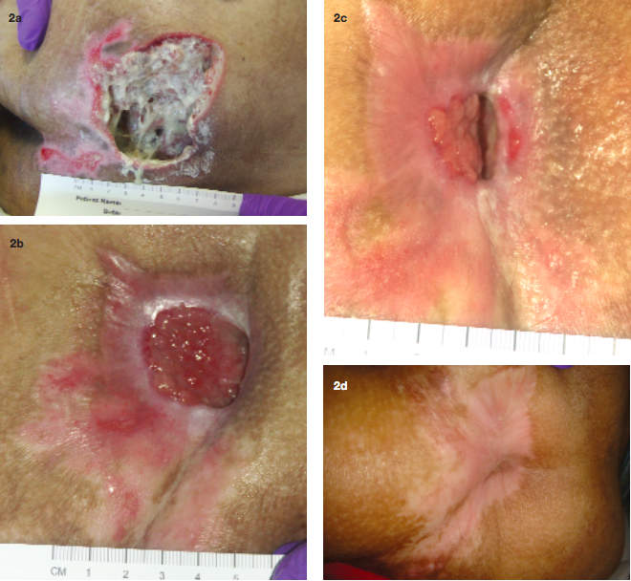
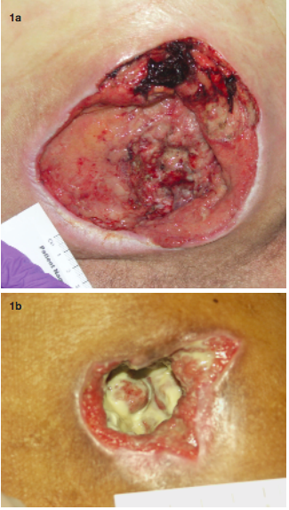
How to diagnose osteomyelitis: imaging/pathology?
Examples of patients with Stage IV pressure ulcers with underlying osteomyelitis: ischium (1a) and trochanteric (1b).
A 51-year-old woman with paralysis presented with gangrene and osteomyelitis (she grew MRSA from her bone) of her sacral ulcer (Figure 2a). The wound eventually healed after implementing the treatment protocol. (Figure 2b-d).
Rennert R, Golinko M, Yan A, Flattau A, Tomic-Canic M, Brem H. Developing and evaluating outcomes of an evidence-based protocol for the treatment of osteomyelitis in Stage IV pressure ulcers: a literature and wound electronic medical record database review. Ostomy Wound Manage. 2009;55(3):42-53.

Slide 8
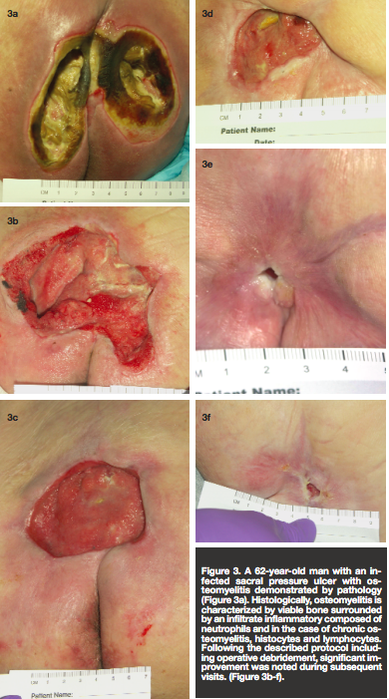
How to diagnose osteomyelitis: imaging/pathology?
A 62-year-old man with an infected sacral pressure ulcer with osteomyelitis demonstrated by pathology (Figure 3a). Histologically, osteomyelitis is characterized by viable bone surrounded by an infiltrate inflammatory composed of neutrophils and in the case of chronic osteomyelitis, histocytes and lymphocytes. Following the described protocol including operative debridement, significant improvement was noted during subsequent visits. (Figure 3b-f).
Rennert R, Golinko M, Yan A, Flattau A, Tomic-Canic M, Brem H. Developing and evaluating outcomes of an evidence-based protocol for the treatment of osteomyelitis in Stage IV pressure ulcers: a literature and wound electronic medical record database review. Ostomy Wound Manage. 2009;55(3):42-53.

Slide 9
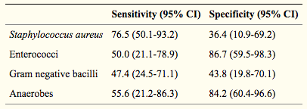
How to diagnose pelvic osteomyelitis?
Pressure ulcer-related pelvic osteomyelitis is a relatively under-studied entity in the field of bone infection.
Diagnosis itself can be difficult, and contrary to the widely held belief, exposed bone is not necessarily synonymous with histological evidence of osteomyelitis. Furthermore, the specificity of CT and MRI has been questioned when histology is considered the gold standard. The optimum duration of antimicrobial therapy has not been defined, nor the sub-group of patients who will derive benefit from surgical intervention.
Sensitivity and specificity of superficial wound swabs compared to deep bone samples
Russell CD, Tsang SJ, Simpson AHRW, Sutherland RK. Outcomes, Microbiology and Antimicrobial Usage in Pressure Ulcer-Related Pelvic Osteomyelitis: Messages for Clinical Practice. J Bone Jt Infect. 2020;5(2):67-75. Published 2020 Mar 26. doi:10.7150/jbji.41779

Slide 10
How to diagnose pelvic osteomyelitis?
Microbiological evaluation should involve deep bone sampling and not rely on superficial wound swabs. Antimicrobial duration is not associated with risk of treatment failure and shorter courses may be appropriate in some cases.
The role of antimicrobials may be secondary to optimizing the bio-psycho-social factors required for successful surgical intervention and subsequent wound healing.
Almost one quarter of patients died within one-year of their index episode and therefore anticipatory care planning should be considered.
A holistic approach to management is required, including dietetics, careful discharge planning, social care, tissue viability, infection specialists, plastic surgeons and orthopedic surgeons.
Russell CD, Tsang SJ, Simpson AHRW, Sutherland RK. Outcomes, Microbiology and Antimicrobial Usage in Pressure Ulcer-Related Pelvic Osteomyelitis: Messages for Clinical Practice. J Bone Jt Infect. 2020;5(2):67-75. Published 2020 Mar 26. doi:10.7150/jbji.41779

Slide 11
How to treat pelvic osteomyelitis?
Pressure ulcer-related pelvic osteomyelitis is a relatively under-studied entity in the field of bone infection.
Attempted soft tissue coverage after surgical debridement, ensuring appropriate support for personal care after discharge and nutritional optimisation could improve outcomes.
Superficial wound swabs are uninformative and deep bone sampling should be pursued. Long antimicrobial courses do not improve outcomes.
Clinicians should engage patients in anticipatory care planning.
Russell CD, Tsang SJ, Simpson AHRW, Sutherland RK. Outcomes, Microbiology and Antimicrobial Usage in Pressure Ulcer-Related Pelvic Osteomyelitis: Messages for Clinical Practice. J Bone Jt Infect. 2020;5(2):67-75. Published 2020 Mar 26. doi:10.7150/jbji.41779

Slide 12
How to treat pelvic osteomyelitis?
Identification of the sub-group of patients who will benefit from surgery remains an important goal to advance the management of this disease.
Formal personal care and nutrition are potentially modifiable factors associated with outcomes and should feature in strategies to optimize surgical outcomes.
Microbiological evaluation should involve deep bone sampling and not rely on superficial wound swabs.
Antimicrobial duration is not associated with risk of treatment failure and shorter courses may be appropriate in some cases.
Almost one quarter of patients died within one-year of their index episode and therefore anticipatory care planning should be considered.
Russell CD, Tsang SJ, Simpson AHRW, Sutherland RK. Outcomes, Microbiology and Antimicrobial Usage in Pressure Ulcer-Related Pelvic Osteomyelitis: Messages for Clinical Practice. J Bone Jt Infect. 2020;5(2):67-75. Published 2020 Mar 26. doi:10.7150/jbji.41779

Slide 13
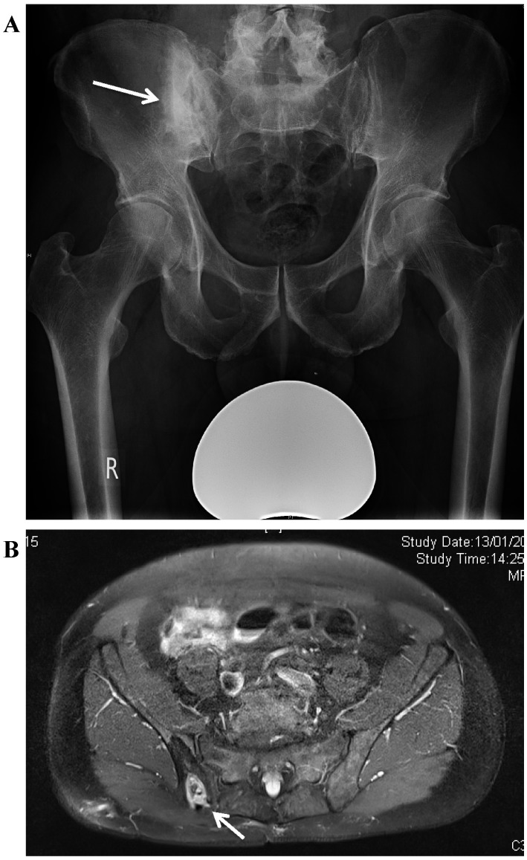
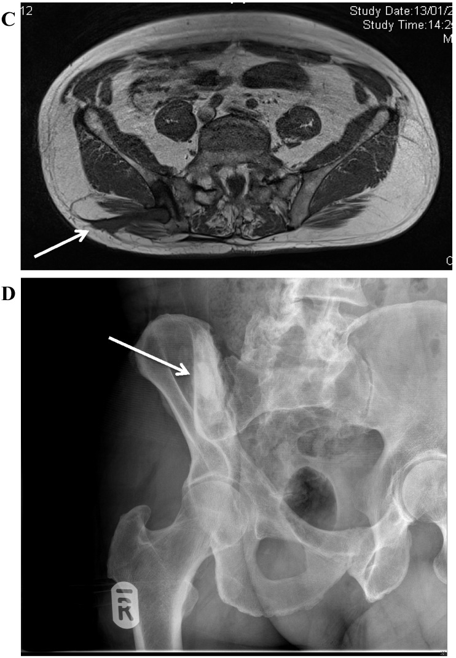
How to treat pelvic osteomyelitis?
A. Osteomyelitis of the right posterior ilium after a bone graft harvest for a spinal fusion. There is a central cavity with surrounding increased bone density (involucrum). B. MRI showing the bone destruction in the ilium, with a central area of dead bone. C. MRI demonstrating the bone involvement and sinus formation to the skin of the lateral buttock. D. Postoperative radiograph showing the area of resection. The bone defect has been filled with a bioabsorbable antibiotic carrier with Gentamicin
Dudareva M, Ferguson J, Riley N, Stubbs D, Atkins B, McNally M. Osteomyelitis of the Pelvic Bones: A Multidisciplinary Approach to Treatment. J Bone Jt Infect. 2017;2(4):184-193. Published 2017 Oct 9. doi:10.7150/jbji.21692

Slide 14
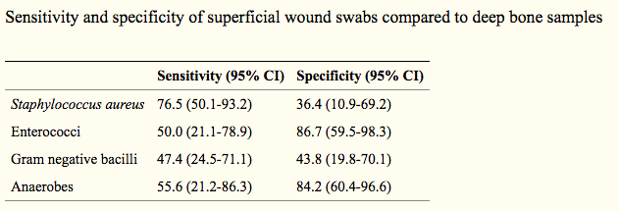
What is microbiology of pressure-related pelvic osteomyelitis?
Russell CD, Tsang SJ, Simpson AHRW, Sutherland RK. Outcomes, Microbiology and Antimicrobial Usage in Pressure Ulcer-Related Pelvic Osteomyelitis: Messages for Clinical Practice. J Bone Jt Infect. 2020;5(2):67-75. Published 2020 Mar 26. doi:10.7150/jbji.41779

Slide 15
What is microbiology of pressure-related pelvic osteomyelitis?
Chronic osteomyelitis of the pelvic bones is uncommon in adults but it is a very debilitating condition. Treatment of osteomyelitis affecting the pelvic bones is challenging due to the anatomic constraints of the pelvis and the high degree of comorbidity in affected patients. Several distinct aetiologies affect different groups of patients.
Pelvic osteomyelitis is commonly polymicrobial; in our cohort we applied a strict definition of positive diagnosis of osteomyelitis on microbiological culture, and it is likely that the definition of 'positive culture' used in the analysis underestimates the diversity of organisms causing infection in each patient.
It is important to involve infection specialists early in these complex cases.
Dudareva M, Ferguson J, Riley N, Stubbs D, Atkins B, McNally M. Osteomyelitis of the Pelvic Bones: A Multidisciplinary Approach to Treatment. J Bone Jt Infect. 2017;2(4):184-193. Published 2017 Oct 9. doi:10.7150/jbji.21692

Slide 16
What is the role of HBO in osteomyelitis of the pelvis?
Because efficient concentrations at the site of infection may be obtained for only a short period, antibiotic therapy may not always lead to long-term arrest of the disease. Delivery at the local level via various vehicles has been effective in the management of refractory cases. Nevertheless, failure of an antibiotic treatment is not uncommon.
Hyperbaric oxygen combined with other important therapeutic interventions, such as antibiotics and/or surgical debridement, was associated with high recovery rates of chronic osteomyelitis, especially when followed by a secure stabilization of the bone and removal of the infected implant. Nevertheless, quality data regarding this finding are scarce.
Savvidou OD, Kaspiris A, Bolia IK, et al. Effectiveness of Hyperbaric Oxygen Therapy for the Management of Chronic Osteomyelitis: A Systematic Review of the Literature. Orthopedics. 2018;41(4):193-199. doi:10.3928/01477447-20180628-02

Slide 17
What is the role of HBO in osteomyelitis of the pelvis?
The one retrospective study that included HBO treatment of osteomyelitis of the pelvis found:
Author, year, location | Type of study | participants | microorganism | Classification system | Intervention | Follow-up | Summary outcome
Eltoria et al 1984 USA | retrospective | Chronic osteomyelitis of the hip (n=28), Pelvis (n=6), lumbar spine (n=3), sacrum (n=5), knee joint (n=2), tibia (n=2), elbow (n=14), in pts with paraplegia (n=30), and tetraplegia (n=14), after spinal cord injury | Staphylococcus aureus, Streptococcus spp Escherichia coli Pseudomonas aeruginosa Enterococcus spp Klebsiella spp Serratia spp | Not reported | Surgical debridement, osteotomies, muscle grafts, antibiotic administration based on antibiogram HBOT | 6 to 108 months | No side effects of the treatment 30 pts considered cure Recurrence in 5 patients Amputation in 5 patients
Savvidou OD, Kaspiris A, Bolia IK, et al. Effectiveness of Hyperbaric Oxygen Therapy for the Management of Chronic Osteomyelitis: A Systematic Review of the Literature. Orthopedics. 2018;41(4):193-199. doi:10.3928/01477447-20180628-02

Slide 18
How to diagnose sacral osteomyelitis?
Most cases of sacral osteomyelitis arising in the setting of sacral pressure ulcers require minimal cortical debridement. When faced with advanced bony involvement, the surgeon is often unclear about how much can safely be resected. Unfamiliarity with sacral anatomy can lead to concerns of inadvertent entry into the dural space and compromise of future flap options.
The management of sacral osteomyelitis in the setting of sacral pressure sores is not without controversy. Most of the controversy resides in the treatment of confirmed or suspected sacral osteomyelitis. Traditionally, suspected osteomyelitis of the sacrum has been treated with wide debridement of all clinically affected bone and a prolonged course of intravenous antibiotics before definitive closure.
However, this approach has been viewed as impractical by those who cite the difficulty of targeted antibiotic therapy (bone cultures are often negative or indeterminate), the difficulty of determining the extent of involvement, the difficulty of confirming resolution, and the equivalent results obtained with conservative decortication and definitive closure at the time of diagnosis.
The presence of osteomyelitis tends to be overestimated by clinical assessment alone. Even with the use of imaging modalities, such as bone scanning and MRI, it is difficult to differentiate periostitis and pressure-induced changes, such as fibrosis, medullary edema, and reactive bone formation that accompany stage 4 sacral ulcers from true cortical bone involvement. An autopsy-based histopathologic study of sacral ulcers showed that only half of stage 4 ulcers contained histological evidence of sacral osteomyelitis, and that all of these cases involved the superficial subcortical bone (facies dorsalis) of the sacrum only.
Choo JH, Wilhelmi BJ. Landmarks for Sacral Debridement in Sacral Pressure Sores. Ann Plast Surg. 2016;76(3):361-363. doi:10.1097/SAP.0000000000000503

Slide 19
How to diagnose sacral osteomyelitis?
Using a line drawn connecting the posterior superior iliac spine to the tip of the coccyx, the approximate locations of the superior and inferior gluteal artery can be estimated. The ratio of the distance between the PSIS and the superior and inferior gluteal arteries and the PSIS to the tip of the coccyx is 0.23 and 0.49, respectively.
There are instances where sacral pressure ulcers extend beyond the superficial cortex of the sacrum and require consideration of possible CSF involvement, particularly when above the level of S2/S3. Conversely, sacral osteomyelitis limited to below this level would not be expected to have a high incidence of CSF involvement.
Debridement of the posterior table of the sacrum at or above the level of the Posterior superior SIS must be conservative and take into account the thickness of the posterior table of the sacrum at this level to avoid inadvertent entry into the dural space. The second implication is that when sacral ulcers involve bone above the level of the PSIS, the surgeon must be alert to the possibility of CSF communication and make every effort to identify and address the complication swiftly.
Choo JH, Wilhelmi BJ. Landmarks for Sacral Debridement in Sacral Pressure Sores. Ann Plast Surg. 2016;76(3):361-363. doi:10.1097/SAP.0000000000000503

Slide 20
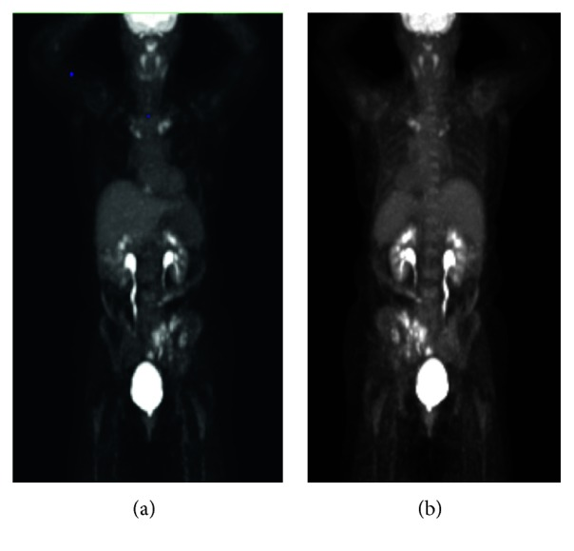
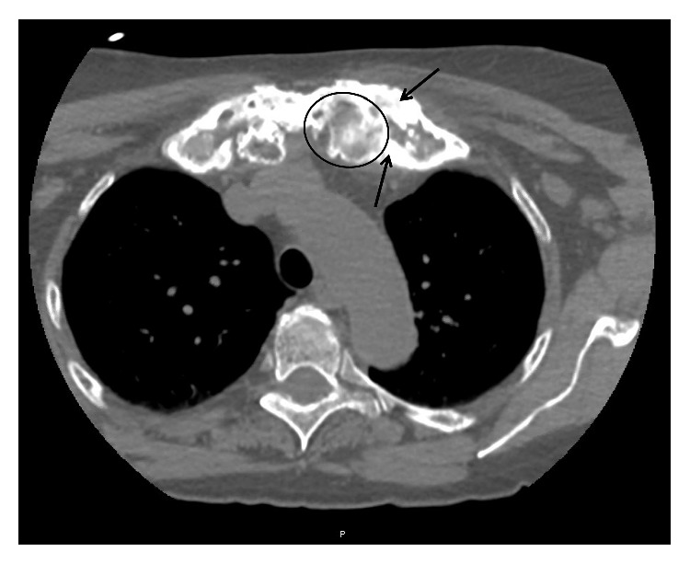
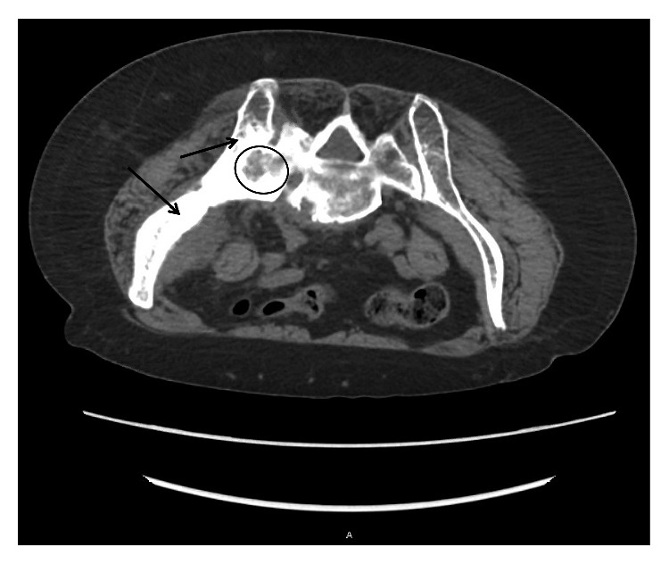
What is importance of proximal bone biopsy?
Chronic recurrent multifocal osteomyelitis (CRMO) is the most severe form of chronic nonbacterial osteomyelitis (CNO) and is a rare autoinflammatory bone disorder that mostly affects children and adolescents. CRMO is a diagnosis of exclusion, resulting in often-delayed diagnosis with over one year on average from onset of symptoms to time of diagnosis. Initial diagnosis is rare in adults.
CT biopsy imaging axial body view with slice thickness 5.00 demonstrating lytic (example inside circle) and sclerotic lesions (examples of thickened bone pointed to with arrows) of the left sacrum and left ileum. Also, notice fusion of the left sacro-iliac joint. For reference, the patient is prone in this image as it was taken during the time of biopsy; therefore, the left ileum/sacrum is on the left of the image.
CT biopsy imaging axial body view with a slice thickness of 2.00 demonstrating lytic (example inside circle) and sclerotic lesions (examples of thickened bone pointed to with arrows) of the left medial clavicle and left first rib.
PET scan whole body performed on 1/9/2019. (a) Anterior view and (b) posterior view with hypermetabolism of the left side of pelvis and ileum and bilateral medial clavicles
Mahady S, Ladani A. Clinical and Diagnostic Considerations for Atypical, Adult Onset Presentation of Chronic Recurrent Multifocal Osteomyelitis (CRMO). Case Rep Rheumatol. 2019;2019:8206892. Published 2019 Sep 29. doi:10.1155/2019/8206892

Slide 21
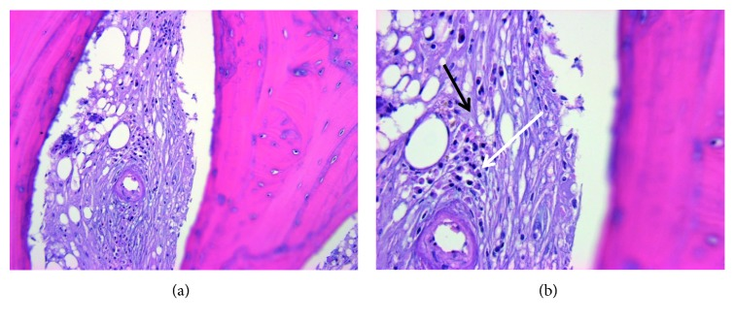
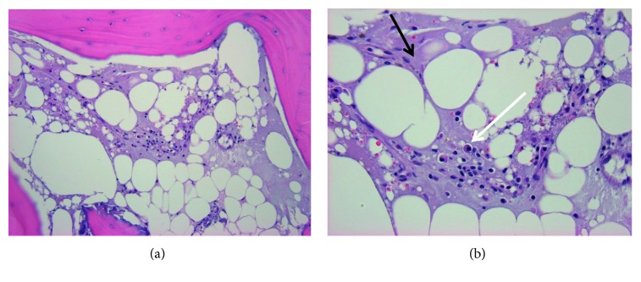
What is importance of proximal bone biopsy?
Chronic recurrent multifocal osteomyelitis (CRMO) is the most severe form of chronic nonbacterial osteomyelitis (CNO) and is a rare autoinflammatory bone disorder that mostly affects children and adolescents. CRMO is a diagnosis of exclusion, resulting in often-delayed diagnosis with over one year on average from onset of symptoms to time of diagnosis. Initial diagnosis is rare in adults.
Bone biopsy of the left medial clavicle performed on 1/21/2019. (a) H&E 200x marrow fibrosis with plasma cell infiltrate. (b) H&E 400x marrow fibrosis (lighter purple color throughout indicated by black arrow) in place of a fatty marrow background with plasma cell infiltrate that contains eccentric nuclei (area indicated by white arrow) representing changes indicative of chronic inflammation.
Bone biopsy of the left medial clavicle performed on 1/21/2019. (a) H&E 200x marrow fibrosis with plasma cell infiltrate. (b) H&E 400x marrow fibrosis (lighter purple color throughout indicated by black arrow) in place of a fatty marrow background with plasma cell infiltrate that contains eccentric nuclei (area indicated by white arrow) representing changes indicative of chronic inflammation.
Mahady S, Ladani A. Clinical and Diagnostic Considerations for Atypical, Adult Onset Presentation of Chronic Recurrent Multifocal Osteomyelitis (CRMO). Case Rep Rheumatol. 2019;2019:8206892. Published 2019 Sep 29. doi:10.1155/2019/8206892

Slide 22
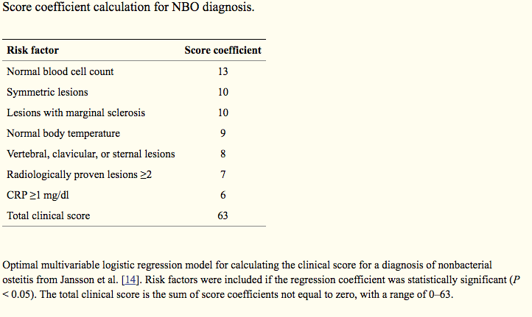
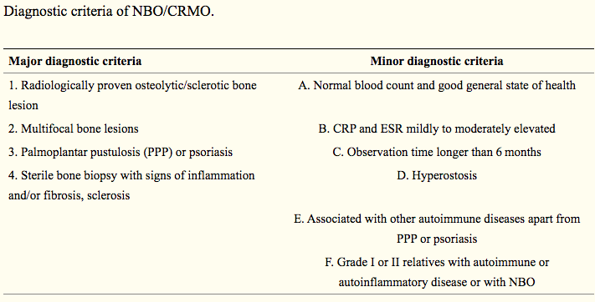
What is importance of proximal bone biopsy?
While the diagnosis of Chronic recurrent multifocal osteomyelitis (CRMO) is primarily based on exclusion of other differential diagnoses, history of recurrent bone pain, and the presence of sclerotic bone lesions, there do exist some diagnostic tools such as the diagnostic criteria and score coefficient calculation.
However, based on this necessity of exclusion of other differential diagnosis, bone biopsy remains mandatory in particular in adult patients. It is important to improve the clinical understanding of CRMO by the documentation of more cases, route of diagnosis, and treatment choices made in order to help develop clearer diagnostic and treatment guidelines.
Mahady S, Ladani A. Clinical and Diagnostic Considerations for Atypical, Adult Onset Presentation of Chronic Recurrent Multifocal Osteomyelitis (CRMO). Case Rep Rheumatol. 2019;2019:8206892. Published 2019 Sep 29. doi:10.1155/2019/8206892

Slide 23
Clinical Presentation: JL
Age: 40
Patient had surgery 6/26
White blood count: 10.6
Neutrophils 68%
History and present illness
THEN X-RAY FINDINGS

Slide 24
Clinical Presentation: JL
Pathology Report
2nd toe of right foot (amputation):
Skin and subcutis with acute suppurative inflammation and necrosis.
Bone resection margin in negative for osteomyelitis

Slide 25
Clinical Presentation: MW
Age: 33
Chest x-ray 1/2019 right lower lobe opacification
Admitted: 1/19- 3/19/20
Pneumonia refractory to Vancomycin and Menopenem
History of bilateral pleural infusions
Procedures:
in NBI ICU, patient received tracheostomy 1/25
Veno-Venous Extracorporeal Membrane Oxygenation cannulation on 1/25
Veno-Venous Extracorporeal Membrane Oxygenation decannulation on 2/5
PEG tube placement 2/8
R subclavian permacath placement 2/8
Telemetry on 2/12

Slide 26
Clinical Presentation: MW
Pathology
Sacral ulcer: skin, subcutis and muscle with ulceration and necrosis
Periosteum and bone of sacrum: Fibroadipose tissue and acute fibrinous exudate, as well as fragments of bone with few plasma cells, suggestive of chronic osteomyelitis.

Slide 27
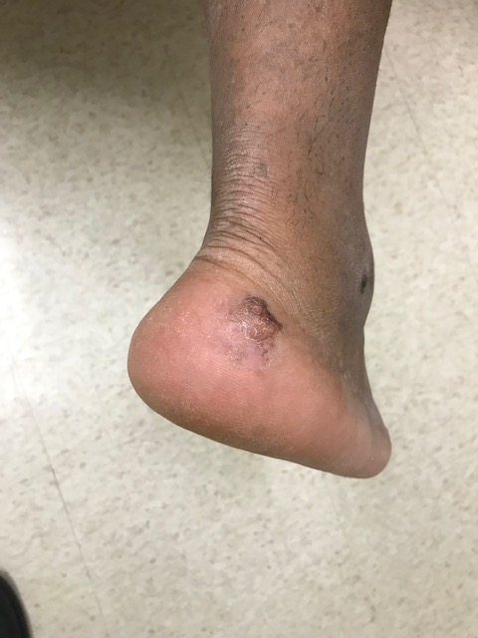
Clinical Presentation: MW

Slide 28
Clinical Presentation: MW (continued)
Culture reports
 | Serratia marcescens |  | Enterococcus faecalis
Drug | MIC Interp | MIC Dilutn | MIC Interp | MIC Dilutn
Ampicillin |  |  | S | <=2
Aztreonam | S | <=1
Cefazolin | R | >=64
Cefepime | S | <=1
Ceftazidime | S | <=1
Ceftriaxone | S | <=1
Gentamicin | S | <=1
Gentamicin Synergy |  |  | S | Syn-S
Levofloxacin | S | <=0.12
Menopenem | S | <=0.25
Streptomycin synergy |  |  | S | Syn-S
Tobramycin | S | <=1
Vancomycin |  |  | S | 1

Slide 29
Clinical Presentation: MW (continued)
Culture reports
 | Serratia marcescens
Drug | MIC Interp | MIC Dilutn
Aztreonam | S | <=1
Cefazolin | R | >=64
Cefepime | S | <=1
Ceftazidime | S | <=1
Ceftriaxone | S | <=1
Gentamicin | S | <=1
Levofloxacin | S | 0.25
Menopenem | S | <=0.25
Tobramycin | S | <=1

Slide 30
Clinical Presentation: AB
Age: 92
PMHx of LLL CA s/p (VATS left lower lobectomy in 2012), HTN, CAD, pacemaker insertion, osteoarthritis, and glaucoma who presents for evaluation of decreasing energy level and sores on backside. Patient is extremely drowsy. Decreased appetite. Lower back pain. Legs started swelling 2 weeks prior, and sores on buttocks and lower back noted by daughter.
Lung carcinoma
Left lower lobe lumpectomy
Severe vitamin B1, C & D deficiencies.
Supplements started.
Appetite stimulation started.

Slide 31
Clinical Presentation: AB (Nutrition)
Patient is a 92-year-old female with a significant history of lung cancer, hypertension, coronary artery disease, osteoarthritis and glaucoma who presented with confusion and an unstageable midline sacral decubitus with necrotic tissue to the bone and bilateral stage II ischial pressure ulcers. She was found to have osteomyelitis of the coccyx on CT imaging. She underwent extensive wound debridement by Dr. Brem. A metabolic consultation was requested to optimize her condition for wound healing.

Slide 32
Clinical Presentation: AB (Nutrition)
Patient was assessed as having moderate to severe protein calorie malnutrition based on a sub-optimal oral intake, weight loss with evidence of bitemporal and upper extremity muscle wasting and orbital fat depletion on physical examination. A metabolic laboratory evaluation revealed evidence of severe iron (fe=16), thiamine (B1 non-detectable), pyridoxine (B6 non-detectable), ascorbate (VC non-detectable) and ergocalciferol (VD=12) deficiencies. A three day calorie count recorded an average intake of 500 kcal per day, roughly 25% of her requirements. Micronutrient support was provided by intravenous and oral routes. Appetite stimulation therapy was initiated with mirtazapine. The patient gradually improved and was discharged to home.

Slide 33
Clinical Presentation: AB (continued)
Pathology report:
Sacral and bilateral buttock superficial wound (debridement): necrotic fibroadipose tissue with minute fragments of bone and focal acute inflammation
Right ischial bone (debridement): fragments of lamellar bone with osteonecrosis, focal marrow space fibrosis, neutrophil granulocytes and plasma cells compatible with acute / chronic osteomyelitis.
Right ischial bone (debridement): lamellar bone and attached fibrocartilage with acute osteomyelitis
7/19/20: little bacteroides distasonis.
Yeast

Slide 34
Clinical Presentation: AB (continued) Culture report
 | Candida albicans |  | Candida (Torulopsis) glabrata
Drug | MIC Interp | MIC Dilutn | MIC Interp | MIC Dilutn
Caspofungin | S | <=0.25 | S | <=0.25
Fluconazole | S | <=1 | S | 4
Voriconazole | S | <=0.12 | S | <=0.12
7/18/2020: Light growth of yeast
7/19/2020: Scant growth of Candida (Torulopsis) glabrata
Hospice care

Slide 35
Clinical Presentation: AD
Age: 53
History: SARS-2-CoV-2 pneumonia
type 2 Diabetes Mellitus
INPT: Hospital day #98
Sepsis from stage IV decubitus ulcer
sacral and bi-lateral buttock ulcer (12.5 x 11.5 x 4.0 cm)
Pathology: left ischial bone, chronic osteomyelitis

Slide 36
Clinical Presentation: AD (continued)
EEG results 5/18/20: Abnormal EEG with delta slowing over left hemisphere suggest underlying structural lesion which is potentially epileptogenic. Postictal effect can be the other differential. Later part tracing technically limited study, however, there was suggestion of delta range activity over both hemispheres. Neuroimaging and further video EEG as indicated. Clinical correlation advised.
Thrombosis seen in intramuscular calf veins of right lower extremity. Deep vein thrombosis seen of left lower extremity. Veins are dilated with intraluminal echolucent thrombus consistent with acute disease. No evidence of superficial vein thrombosis of the right or left lower extremity.
OR debridement: 6/15/2020

