Slide 1
Patient Safety & Quality Metrics
Wednesday, August 21, 2024

Slide 2
Agenda
What are the two main organizations that grade hospitals?
How does Leapfrog grade hospitals?
How does CMS grade hospitals?
What are the differences in grading methodologies between Leapfrog and CMS?
What are the key “patient safety indicators (PSIs?)
How does Leapfrog measure hospital-acquired pressure ulcers?
How are ”never events scored”?
What are the 9 principles for responding to “never events?”
What is Length of Stay for relevant DRGs?
What are readmission rates due to sepsis?
What are sepsis readmissions by organism?
What is 30-day readmission rate in patients with sepsis?
What are etiologies for 30-day readmission for Sepsis?
What is amputation rate for patients with diabetes and peripheral arterial disease?

Slide 3
What are the two main organizations that grade hospitals?
The two main organizations that grade hospitals are The Leapfrog Group and the Centers for Medicare & Medicaid Services (CMS).
Austin JM, D'Andrea G, Birkmeyer JD, Leape LL, Milstein A, Pronovost PJ, Romano PS, Singer SJ, Vogus TJ, Wachter RM. Safety in numbers: the development of Leapfrog's composite patient safety score for U.S. hospitals. J Patient Saf. 2014 Mar;10(1):64-71. doi: 10.1097/PTS.0b013e3182952644. PMID: 24080719.
Venkatesh AK, Bagshaw K, Gettel C, Suter L, Qin L, Herrin J, Lin Z, Grant S, Rothenberg E, Omotosho P. CMS Overall Hospital Quality Star Rating: July 2024 Updates and Specifications Report. Yale New Haven Health Services Corporation – Center for Outcomes Research and Evaluation (CORE); 2024 Jul.

Slide 4
How does Leapfrog grade hospitals?
Leapfrog grades hospitals using a composite patient safety score, which combines 26 measures of safety practices and outcomes. These measures are standardized and weighted based on their importance, impact, and room for improvement, resulting in a score that reflects the hospital's overall performance in patient safety. Hospitals are then assigned a letter grade from A to F, with A being the highest, to indicate their level of safety.
Austin JM, D'Andrea G, Birkmeyer JD, Leape LL, Milstein A, Pronovost PJ, Romano PS, Singer SJ, Vogus TJ, Wachter RM. Safety in numbers: the development of Leapfrog's composite patient safety score for U.S. hospitals. J Patient Saf. 2014 Mar;10(1):64-71. doi: 10.1097/PTS.0b013e3182952644. PMID: 24080719.
Leapfrog Group [Internet]. [cited 2024 Jun 6]. Available from: [Leapfrog Hospital Safety Grade image].

Slide 5
How does Leapfrog grade hospitals?
What are the sources of information?
The safety grade utilizes data primarily from the Centers for Medicare & Medicaid Services (CMS) and, for those hospitals that participate, from the annual Leapfrog Hospital Survey.
For hospitals that do not submit data to the Leapfrog Hospital Survey, publicly available data from secondary sources are used
Austin JM, D'Andrea G, Birkmeyer JD, Leape LL, Milstein A, Pronovost PJ, Romano PS, Singer SJ, Vogus TJ, Wachter RM. Safety in numbers: the development of Leapfrog's composite patient safety score for U.S. hospitals. J Patient Saf. 2014 Mar;10(1):64-71. doi: 10.1097/PTS.0b013e3182952644. PMID: 24080719.
What is The Leapfrog Hospital Safety Grade? [Internet]. hospitalsafetygrade.org. The Leapfrog Group; [cited 2024 Jun 4]. Available from: https://www.hospitalsafetygrade.org.
Leapfrog Group [Internet]. [cited 2024 Jun 6]. Available from: [Defining Moments from 20 Years image].

Slide 6
How does Leapfrog grade hospitals?
8. Safe Practice 17: Medication Reconciliation (Leapfrog Hospital Survey)
9. Safe Practice 19: Hand Hygiene (Leapfrog Hospital Survey)
10. Safe Practice 23: Care of the Ventilated Patient (Leapfrog Hospital Survey)
11. SCIP INF 1: Antibiotic within 1 Hour (CMS Hospital Compare)
12. SCIP INF 2: Antibiotic Selection (CMS Hospital Compare)
13. SCIP INF 3: Antibiotic Discontinued After 24 Hours (CMS Hospital Compare)
14. SCIP INF 9: Catheter Removal (CMS Hospital Compare)
26 Key Components of Leapfrog’s Grading Criteria
Patient Safety Measures:
1. Computerized Physician Order Entry (CPOE) (Leapfrog Hospital Survey, AHA Annual Survey)
2. ICU Physician Staffing (IPS) (Leapfrog Hospital Survey, AHA Annual Survey)
3. Safe Practice 1: Leadership Structures and Systems (Leapfrog Hospital Survey)
4. Safe Practice 2: Culture Measurement (Leapfrog Hospital Survey)
5. Safe Practice 3: Teamwork Training and Skill Building (Leapfrog Hospital Survey)
6. Safe Practice 4: Identification and Mitigation of Risks and Hazards (Leapfrog Hospital Survey)
7. Safe Practice 9: Nursing Workforce (Leapfrog Hospital Survey)
Austin JM, D'Andrea G, Birkmeyer JD, Leape LL, Milstein A, Pronovost PJ, Romano PS, Singer SJ, Vogus TJ, Wachter RM. Safety in numbers: the development of Leapfrog's composite patient safety score for U.S. hospitals. J Patient Saf. 2014 Mar;10(1):64-71. doi: 10.1097/PTS.0b013e3182952644. PMID: 24080719.
What is The Leapfrog Hospital Safety Grade? [Internet]. hospitalsafetygrade.org. The Leapfrog Group; [cited 2024 Jun 4]. Available from: https://www.hospitalsafetygrade.org.

Slide 7
How does Leapfrog grade hospitals?
26 Key Components of Leapfrog’s Grading Criteria
Outcome Measures
15. Foreign Object Retained after Surgery (CMS Hospital Compare)
16. Air Embolism (CMS Hospital Compare)
17. Blood Incompatibility (CMS Hospital Compare)
18. Pressure Ulcer Rate (AHRQ PSI)
19. Iatrogenic Pneumothorax Rate (AHRQ PSI)
20. Central Venous CatheterRelated Bloodstream Infection Rate (AHRQ PSI)
21. Postoperative Hip Fracture Rate (AHRQ PSI)
22. Perioperative Pulmonary Embolism or Deep Vein Thrombosis Rate (AHRQ PSI)
23. Postoperative Sepsis Rate (AHRQ PSI)
24. Postoperative Wound Dehiscence Rate (AHRQ PSI)
25. Accidental Puncture or Laceration Rate (AHRQ PSI)
26. Central Line Associated Bloodstream Infection (CLABSI) Rate (CMS Hospital Compare)
Austin JM, D'Andrea G, Birkmeyer JD, Leape LL, Milstein A, Pronovost PJ, Romano PS, Singer SJ, Vogus TJ, Wachter RM. Safety in numbers: the development of Leapfrog's composite patient safety score for U.S. hospitals. J Patient Saf. 2014 Mar;10(1):64-71. doi: 10.1097/PTS.0b013e3182952644. PMID: 24080719.
What is The Leapfrog Hospital Safety Grade? [Internet]. hospitalsafetygrade.org. The Leapfrog Group; [cited 2024 Jun 4]. Available from: https://www.hospitalsafetygrade.org.

Slide 8
How does Leapfrog grade hospitals?
Strength of Evidence: Higher weight for measures with stronger research support.
Opportunity for Improvement: Higher weight for measures with greater variation in hospital performance, indicating more room for improvement.
Impact: Measures affecting a larger percentage of patients and those associated with more severe harm or significant mortality reduction received higher weights.
Overall, the weight on the particular measurement in relation to the overall hospital score is determined by the strength of evidence available and potential opportunity for improvement as compared to other hospitals
Austin JM, D'Andrea G, Birkmeyer JD, Leape LL, Milstein A, Pronovost PJ, Romano PS, Singer SJ, Vogus TJ, Wachter RM. Safety in numbers: the development of Leapfrog's composite patient safety score for U.S. hospitals. J Patient Saf. 2014 Mar;10(1):64-71. doi: 10.1097/PTS.0b013e3182952644. PMID: 24080719.
What is The Leapfrog Hospital Safety Grade? [Internet]. hospitalsafetygrade.org. The Leapfrog Group; [cited 2024 Jun 4]. Available from: https://www.hospitalsafetygrade.org.

Slide 9
How does CMS grade hospitals?
What is the Overall Hospital Quality Star Rating?
The Overall Hospital Quality Star Rating is a system developed by the CMS to summarize hospital performance based on various quality measures. Hospitals receive a rating from one to five stars, with more stars indicating better performance.
Venkatesh AK, Bagshaw K, Gettel C, Suter L, Qin L, Herrin J, Lin Z, Grant S, Rothenberg E, Omotosho P. CMS Overall Hospital Quality Star Rating: July 2024 Updates and Specifications Report. Yale New Haven Health Services Corporation – Center for Outcomes Research and Evaluation (CORE); 2024 Jul.
Quality Measures Fact Sheet: CMS Patient Safety Indicators PSI 90 (NQF #0531). National Quality Strategy Domain: Patient Safety. CMS; 2019 Sep. Available from: https://www.qualityindicators.ahrq.gov/Downloads/Modules/PSI/V2018/TechSpecs/PSI_15_Accidental_Puncture_or_Laceration_Rate.pdf
Providence Saint John’s Health Center Earns CMS 5-star Quality and Safety Rating [Internet]. Saint John's Cancer Institute. 2024 [cited 2024 Jun 4]. Available from: https://www.providencehealthplan.com/about-providence/providence-news/cms-star-ratings

Slide 10
CMS Star Ratings
The newest measure in this area is the Center for Medicare and Medicaid Services' (CMS) Hospital Compare Star rating system. This program uses complex methodology — based on a hospital's performance with mortality, safety, readmissions, patient experience, care effectiveness, care timeliness, and efficient use of medical imaging — to assign each hospital a Star rating ranging from 1 (lowest score) to 5 (highest score). The stated goal for this program is “To help millions of patients and their families learn about the quality of hospitals, compare facilities in their area side-by-side, and ask important questions about care quality when visiting a hospital or other health care provider (8).
www.medicare.gov/HospitalCompare/Data/Serious-Complications.html

Slide 11
How does CMS grade hospitals?
How is the Overall Star Rating calculated?
The rating is calculated through a seven-step process:
1. Selection and Standardization of Measures: Selecting relevant measures and standardizing them.
2. Assignment of Measures to Groups: Grouping the measures into the five categories.
3. Calculation of Measure Group Scores: Calculating the average scores for each group.
4. Weighted Average of Measure Groups: Combining group scores using a weighted average.
5. Minimum Thresholds for Reporting: Applying minimum thresholds for a hospital to be eligible for a rating.
6. Peer Grouping: Grouping hospitals based on the number of measure groups they report.
7. Clustering Algorithm: Using a clustering algorithm to assign star ratings.
Venkatesh AK, Bagshaw K, Gettel C, Suter L, Qin L, Herrin J, Lin Z, Grant S, Rothenberg E, Omotosho P. CMS Overall Hospital Quality Star Rating: July 2024 Updates and Specifications Report. Yale New Haven Health Services Corporation – Center for Outcomes Research and Evaluation (CORE); 2024 Jul.
Quality Measures Fact Sheet: CMS Patient Safety Indicators PSI 90 (NQF #0531). National Quality Strategy Domain: Patient Safety. CMS; 2019 Sep. Available from: https://www.qualityindicators.ahrq.gov/Downloads/Modules/PSI/V2018/TechSpecs/PSI_15_Accidental_Puncture_or_Laceration_Rate.pdf
Providence Saint John’s Health Center Earns CMS 5-star Quality and Safety Rating [Internet]. Saint John's Cancer Institute. 2024 [cited 2024 Jun 4]. Available from: https://www.providencehealthplan.com/about-providence/providence-news/cms-star-ratings

Slide 12
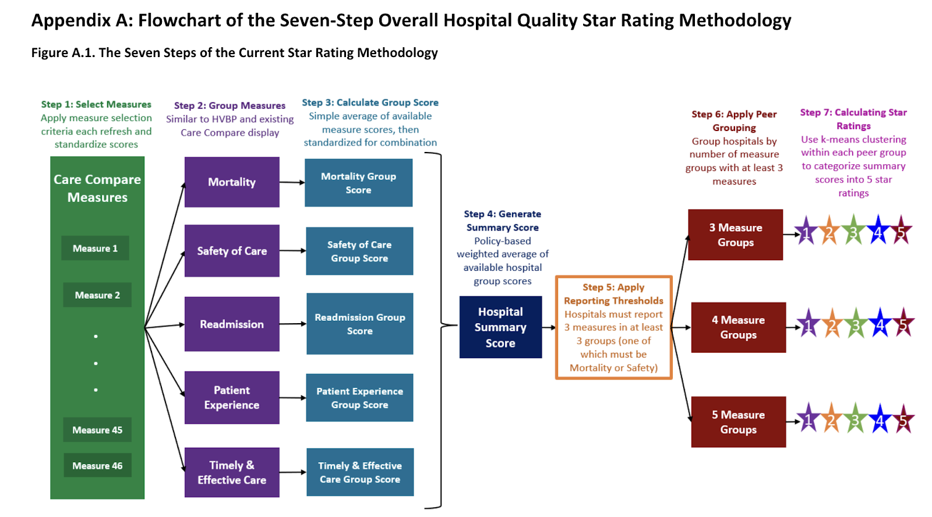
How does CMS grade hospitals?
Venkatesh AK, Bagshaw K, Gettel C, Suter L, Qin L, Herrin J, Lin Z, Grant S, Rothenberg E, Omotosho P. CMS Overall Hospital Quality Star Rating: July 2024 Updates and Specifications Report. Yale New Haven Health Services Corporation – Center for Outcomes Research and Evaluation (CORE); 2024 Jul.
Quality Measures Fact Sheet: CMS Patient Safety Indicators PSI 90 (NQF #0531). National Quality Strategy Domain: Patient Safety. CMS; 2019 Sep. Available from: https://www.qualityindicators.ahrq.gov/Downloads/Modules/PSI/V2018/TechSpecs/PSI_15_Accidental_Puncture_or_Laceration_Rate.pdf

Slide 13
How does CMS grade hospitals?
There are 5 categories used by CMS to grade hospitals
1. Mortality: Measures related to the death rates of patients in hospitals.
2. Safety of Care: Measures related to the safety and complications experienced by patients.
3. Readmission: Measures tracking the rate at which patients return to the hospital after discharge.
4. Patient Experience: Measures based on patient feedback about their hospital experience.
5. Timely and Effective Care: Measures related to the timeliness and effectiveness of the care provided.
Venkatesh AK, Bagshaw K, Gettel C, Suter L, Qin L, Herrin J, Lin Z, Grant S, Rothenberg E, Omotosho P. CMS Overall Hospital Quality Star Rating: July 2024 Updates and Specifications Report. Yale New Haven Health Services Corporation – Center for Outcomes Research and Evaluation (CORE); 2024 Jul.
Quality Measures Fact Sheet: CMS Patient Safety Indicators PSI 90 (NQF #0531). National Quality Strategy Domain: Patient Safety. CMS; 2019 Sep. Available from: https://www.qualityindicators.ahrq.gov/Downloads/Modules/PSI/V2018/TechSpecs/PSI_15_Accidental_Puncture_or_Laceration_Rate.pdf

Slide 14
How does CMS grade hospitals?
What are the weightings applied to each measure group in the final star rating calculation?
The weights for each measure group are as follows:
Mortality: 22%
Safety of Care: 22%
Readmission: 22%
Patient Experience: 22%
Timely and Effective Care: 12%
Venkatesh AK, Bagshaw K, Gettel C, Suter L, Qin L, Herrin J, Lin Z, Grant S, Rothenberg E, Omotosho P. CMS Overall Hospital Quality Star Rating: July 2024 Updates and Specifications Report. Yale New Haven Health Services Corporation – Center for Outcomes Research and Evaluation (CORE); 2024 Jul.
Quality Measures Fact Sheet: CMS Patient Safety Indicators PSI 90 (NQF #0531). National Quality Strategy Domain: Patient Safety. CMS; 2019 Sep. Available from: https://www.qualityindicators.ahrq.gov/Downloads/Modules/PSI/V2018/TechSpecs/PSI_15_Accidental_Puncture_or_Laceration_Rate.pdf

Slide 15
How does CMS grade hospitals?
Mortality
1. MORT30AMI: 30 day death rate for heart attack patients
2. MORT30CABG: Death rate for coronary artery bypass graft surgery patients
3. MORT30COPD: Death rate for chronic obstructive pulmonary disease (COPD) patients
4. MORT30HF: 30 day death rate for heart failure patients
5. MORT30PN: 30 day death rate for pneumonia patients
6. MORT30STK: Death rate for stroke patients
7. PSI 04: Death rate among surgical inpatients with serious treatable complications
Venkatesh AK, Bagshaw K, Gettel C, Suter L, Qin L, Herrin J, Lin Z, Grant S, Rothenberg E, Omotosho P. CMS Overall Hospital Quality Star Rating: July 2024 Updates and Specifications Report. Yale New Haven Health Services Corporation – Center for Outcomes Research and Evaluation (CORE); 2024 Jul.
Quality Measures Fact Sheet: CMS Patient Safety Indicators PSI 90 (NQF #0531). National Quality Strategy Domain: Patient Safety. CMS; 2019 Sep. Available from: https://www.qualityindicators.ahrq.gov/Downloads/Modules/PSI/V2018/TechSpecs/PSI_15_Accidental_Puncture_or_Laceration_Rate.pdf

Slide 16
How does CMS grade hospitals?
Safety of Care
1. COMPHIPKNEE: Rate of complications for hip and knee replacement patients
2. HAI1: Central line associated bloodstream infection (CLABSI)
3. HAI2: Catheter associated urinary tract infection (CAUTI)
4. HAI3: Surgical site infection from colon surgery (SSI: Colon)
5. HAI4: Surgical site infection from abdominal hysterectomy (SSIabdominal hysterectomy)
6. HAI5: Methicillin resistant Staphylococcus aureus (or MRSA) blood infections (Antibiotic resistant blood infections)
7. HAI6: Clostridioides difficile (or C.diff.) infections (Intestinal infections)
8. PSI 90: Patient Safety and Adverse Events Composite
Venkatesh AK, Bagshaw K, Gettel C, Suter L, Qin L, Herrin J, Lin Z, Grant S, Rothenberg E, Omotosho P. CMS Overall Hospital Quality Star Rating: July 2024 Updates and Specifications Report. Yale New Haven Health Services Corporation – Center for Outcomes Research and Evaluation (CORE); 2024 Jul.
Quality Measures Fact Sheet: CMS Patient Safety Indicators PSI 90 (NQF #0531). National Quality Strategy Domain: Patient Safety. CMS; 2019 Sep. Available from: https://www.qualityindicators.ahrq.gov/Downloads/Modules/PSI/V2018/TechSpecs/PSI_15_Accidental_Puncture_or_Laceration_Rate.pdf

Slide 17
How does CMS grade hospitals?
Readmission
1. EDAC30AMI: Acute myocardial infarction excess days in acute care (EDAC)
2. EDAC30HF: Heart failure excess days in acute care (EDAC)
3. EDAC30PN: Pneumonia excess days in acute care (EDAC)
4. READM30CABG: Rate of unplanned readmission after coronary artery bypass graft (CABG) surgery
5. READM30COPD: Rate of unplanned readmission for chronic obstructive pulmonary disease patient
6. READM30HipKnee: 30day rate of readmission for hip and knee replacement patients
7. READM30HOSPWIDE: Rate of readmission after discharge from hospital
8. OP32: Facility 7day risk standardized hospital visit rate after outpatient colonoscopy
9. OP35 ADM: Admissions visits for patients receiving outpatient chemotherapy
10. OP35 ED: Emergency department (ED) visits for patients receiving outpatient chemotherapy
11. OP36: Hospital visits after hospital outpatient surgery
Venkatesh AK, Bagshaw K, Gettel C, Suter L, Qin L, Herrin J, Lin Z, Grant S, Rothenberg E, Omotosho P. CMS Overall Hospital Quality Star Rating: July 2024 Updates and Specifications Report. Yale New Haven Health Services Corporation – Center for Outcomes Research and Evaluation (CORE); 2024 Jul.
Quality Measures Fact Sheet: CMS Patient Safety Indicators PSI 90 (NQF #0531). National Quality Strategy Domain: Patient Safety. CMS; 2019 Sep. Available from: https://www.qualityindicators.ahrq.gov/Downloads/Modules/PSI/V2018/TechSpecs/PSI_15_Accidental_Puncture_or_Laceration_Rate.pdf

Slide 18
How does CMS grade hospitals?
Patient Experience
1. HCOMP1: Communication with nurses
2. HCOMP2: Communication with doctors 23
3. HCOMP3: Responsiveness of hospital staff
4. HCOMP5: Communication about medicines
5. HCOMP6: Discharge information
6. HCOMP7: Care transition
7. HHSPRATING Hospital rating (Q21) + HRECMND: Willingness to recommend hospital (Q22) / 2
8. HCLEANHSP Cleanliness of hospital environment (Q8) + HQUIETHSP Quietness of hospital environment (Q9) / 2
Venkatesh AK, Bagshaw K, Gettel C, Suter L, Qin L, Herrin J, Lin Z, Grant S, Rothenberg E, Omotosho P. CMS Overall Hospital Quality Star Rating: July 2024 Updates and Specifications Report. Yale New Haven Health Services Corporation – Center for Outcomes Research and Evaluation (CORE); 2024 Jul.
Quality Measures Fact Sheet: CMS Patient Safety Indicators PSI 90 (NQF #0531). National Quality Strategy Domain: Patient Safety. CMS; 2019 Sep. Available from: https://www.qualityindicators.ahrq.gov/Downloads/Modules/PSI/V2018/TechSpecs/PSI_15_Accidental_Puncture_or_Laceration_Rate.pdf

Slide 19
How does CMS grade hospitals?
Timely and Effective Care
1. IMM3: Percent of healthcare workers vaccinated against Influenza
2. OP22: Percentage of patients who left the emergency department before being seen
3. OP23: Percentage of patients who came to the emergency department with stroke symptoms who received brain scan results within 45 minutes of arrival
4. OP29: Appropriate followup interval for normal colonoscopy in average risk patients
5. PC01: Percent of newborns whose deliveries were scheduled too early (13 weeks early), when a scheduled delivery was not medically necessary
6. SEP1: Percentage of patients who received appropriate care for severe sepsis and septic shock
7. OP3b: Average number of minutes before outpatients with chest pain or possible heart attack who needed specialized care were transferred to another hospital
8. OP18b: Average time patients spent in the emergency department before being sent home
9. OP8: Outpatients with low back pain who had an MRI without trying recommended treatments first, such as physical therapy
10. OP10: Outpatient CT scans of the abdomen that were “combination” (double) scans
11. OP13: Medicare patients who got cardiac imaging stress tests to screen for surgical risk before lowrisk outpatient surgery
12. HCP COVID19: COVID19 Vaccination Coverage Among HCPs
Venkatesh AK, Bagshaw K, Gettel C, Suter L, Qin L, Herrin J, Lin Z, Grant S, Rothenberg E, Omotosho P. CMS Overall Hospital Quality Star Rating: July 2024 Updates and Specifications Report. Yale New Haven Health Services Corporation – Center for Outcomes Research and Evaluation (CORE); 2024 Jul.
Quality Measures Fact Sheet: CMS Patient Safety Indicators PSI 90 (NQF #0531). National Quality Strategy Domain: Patient Safety. CMS; 2019 Sep. Available from: https://www.qualityindicators.ahrq.gov/Downloads/Modules/PSI/V2018/TechSpecs/PSI_15_Accidental_Puncture_or_Laceration_Rate.pdf

Slide 20
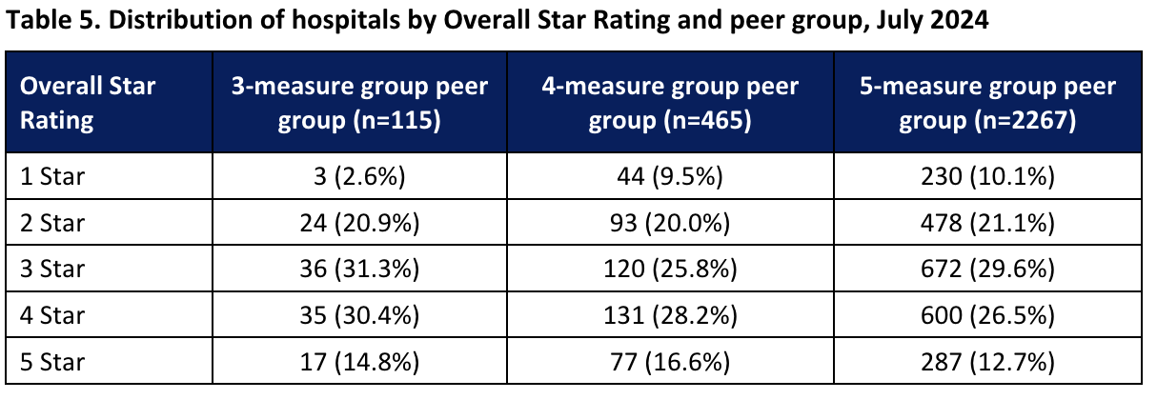
How does CMS grade hospitals?
Here are the national results of the CMS ranking
Some hospitals termed "3-measure group" or "4-measure group" are hospitals that were only graded on 3 or 4 out of the 5 metrics.
Venkatesh AK, Bagshaw K, Gettel C, Suter L, Qin L, Herrin J, Lin Z, Grant S, Rothenberg E, Omotosho P. CMS Overall Hospital Quality Star Rating: July 2024 Updates and Specifications Report. Yale New Haven Health Services Corporation – Center for Outcomes Research and Evaluation (CORE); 2024 Jul.
Quality Measures Fact Sheet: CMS Patient Safety Indicators PSI 90 (NQF #0531). National Quality Strategy Domain: Patient Safety. CMS; 2019 Sep. Available from: https://www.qualityindicators.ahrq.gov/Downloads/Modules/PSI/V2018/TechSpecs/PSI_15_Accidental_Puncture_or_Laceration_Rate.pdf

Slide 21
What are the differences in grading methodology between CMS and Leapfrog?
1. Objective and Scope:
Leapfrog: Focuses primarily on patient safety, aiming to provide a comprehensive composite score reflecting a hospital's safety efforts and outcomes.
CMS: Aims to provide an overall quality rating encompassing multiple dimensions of hospital performance, including safety, mortality, readmission, patient experience, and timely and effective care.
2. Selection of Measures:
Leapfrog:
Uses 26 measures divided equally between process/structural and outcome measures.
Measures are selected from publicly reported national sources, focusing specifically on patient safety.
CMS:
Uses 46 measures categorized into five groups: Mortality, Safety of Care, Readmission, Patient Experience, and Timely and Effective Care.
Measures are selected based on relevance, importance, and public reporting through CMS programs.
Venkatesh AK, Bagshaw K, Gettel C, Suter L, Qin L, Herrin J, Lin Z, Grant S, Rothenberg E, Omotosho P. CMS Overall Hospital Quality Star Rating: July 2024 Updates and Specifications Report. Yale New Haven Health Services Corporation – Center for Outcomes Research and Evaluation (CORE); 2024 Jul.
Quality Measures Fact Sheet: CMS Patient Safety Indicators PSI 90 (NQF #0531). National Quality Strategy Domain: Patient Safety. CMS; 2019 Sep. Available from: https://www.qualityindicators.ahrq.gov/Downloads/Modules/PSI/V2018/TechSpecs/PSI_15_Accidental_Puncture_or_Laceration_Rate.pdf
Austin JM, D'Andrea G, Birkmeyer JD, Leape LL, Milstein A, Pronovost PJ, Romano PS, Singer SJ, Vogus TJ, Wachter RM. Safety in numbers: the development of Leapfrog's composite patient safety score for U.S. hospitals. J Patient Saf. 2014 Mar;10(1):64-71. doi: 10.1097/PTS.0b013e3182952644. PMID: 24080719.

Slide 22
What are the differences in grading methodology between CMS and Leapfrog?
3. Measure Exclusion Criteria:
Leapfrog: Excludes measures not clear on safety, supported by weak evidence, or with better corresponding outcome measures.
CMS: Excludes measures with fewer than 100 hospitals reporting, structural measures not easily combined with other measures, nondirectional measures, measures not required for public reporting, and overlapping measures.
4. Weighting of Measures:
Leapfrog: Assigns weights based on strength of evidence, opportunity for improvement, and impact, with a specific formula to calculate weights.
CMS: Applies fixed weights to measure groups with heavier weights for outcome measures. The weights are: Mortality (22%), Safety of Care (22%), Readmission (22%), Patient Experience (22%), and Timely and Effective Care (12%).
5. Handling of Missing Data:
Leapfrog: Recalibrates weights for hospitals with missing data, excluding measures for which data are missing.
CMS: Reweights the remaining measure groups proportionally if one or more groups are missing, ensuring that hospitals with missing groups still receive a summary score.
Venkatesh AK, Bagshaw K, Gettel C, Suter L, Qin L, Herrin J, Lin Z, Grant S, Rothenberg E, Omotosho P. CMS Overall Hospital Quality Star Rating: July 2024 Updates and Specifications Report. Yale New Haven Health Services Corporation – Center for Outcomes Research and Evaluation (CORE); 2024 Jul.
Quality Measures Fact Sheet: CMS Patient Safety Indicators PSI 90 (NQF #0531). National Quality Strategy Domain: Patient Safety. CMS; 2019 Sep. Available from: https://www.qualityindicators.ahrq.gov/Downloads/Modules/PSI/V2018/TechSpecs/PSI_15_Accidental_Puncture_or_Laceration_Rate.pdf
Austin JM, D'Andrea G, Birkmeyer JD, Leape LL, Milstein A, Pronovost PJ, Romano PS, Singer SJ, Vogus TJ, Wachter RM. Safety in numbers: the development of Leapfrog's composite patient safety score for U.S. hospitals. J Patient Saf. 2014 Mar;10(1):64-71. doi: 10.1097/PTS.0b013e3182952644. PMID: 24080719.

Slide 23
What are the differences in grading methodology between CMS and Leapfrog?
Outcome Focus:
Leapfrog: Equally weighs process/structural and outcome measures.
CMS: Places heavier weight on outcome measure groups to reflect their higher impact on overall quality.
These differences highlight how Leapfrog focuses more narrowly on patient safety with a composite score approach, while CMS aims for a broader assessment of hospital quality across multiple dimensions using a star rating system.
Venkatesh AK, Bagshaw K, Gettel C, Suter L, Qin L, Herrin J, Lin Z, Grant S, Rothenberg E, Omotosho P. CMS Overall Hospital Quality Star Rating: July 2024 Updates and Specifications Report. Yale New Haven Health Services Corporation – Center for Outcomes Research and Evaluation (CORE); 2024 Jul.
Quality Measures Fact Sheet: CMS Patient Safety Indicators PSI 90 (NQF #0531). National Quality Strategy Domain: Patient Safety. CMS; 2019 Sep. Available from: https://www.qualityindicators.ahrq.gov/Downloads/Modules/PSI/V2018/TechSpecs/PSI_15_Accidental_Puncture_or_Laceration_Rate.pdf
Austin JM, D'Andrea G, Birkmeyer JD, Leape LL, Milstein A, Pronovost PJ, Romano PS, Singer SJ, Vogus TJ, Wachter RM. Safety in numbers: the development of Leapfrog's composite patient safety score for U.S. hospitals. J Patient Saf. 2014 Mar;10(1):64-71. doi: 10.1097/PTS.0b013e3182952644. PMID: 24080719.

Slide 24
Patient Safety Indicator 03 (PSI 03) Pressure Ulcer Rate
Stage III or IV pressure ulcers or unstageable (secondary diagnosis) per 1,000 discharges among surgical or medical patients ages 18 years and older. Excludes stays less than 3 days; cases with a principal diagnosis of pressure ulcer; cases with a secondary diagnosis of Stage III or IV pressure ulcer or unstageable that is present on admission; obstetric cases; and transfers from another facility.
https://qualityindicators.ahrq.gov/Downloads/Modules/PSI/V2023/TechSpecs/PSI_03_Pressure_Ulcer_Rate.pdf
www.medicare.gov/HospitalCompare/Data/Serious-Complications.html

Slide 25
Patient Safety Indicator (PSI 04) Death Rate among Surgical Inpatients with Serious Treatable Complications
In-hospital deaths per 1,000 surgical discharges, among patients ages 18 through 89 years or obstetric patients, with serious treatable complications (pneumonia, pulmonary embolism/deep vein thrombosis, sepsis, shock/cardiac arrest or gastrointestinal hemorrhage/acute ulcer). Includes metrics for the number of discharges for each type of complication. Excludes cases transferred to an acute care facility
https://qualityindicators.ahrq.gov/Downloads/Modules/PSI/V60-ICD09/TechSpecs/PSI_04_Death_Rate_among_Surgical_Inpatients_with_Serious_Treatable_Complications.pdf
www.medicare.gov/HospitalCompare/Data/Serious-Complications.html

Slide 26
Patient Safety Indicator for surgical complications
Surgical complications – CMS recalibrated Patient Safety Indicators
Measures of serious complications are drawn from the CMS Patient Safety Indicators (PSIs). The overall score for serious complications is based on how often adult patients had certain serious, but potentially preventable, complications related to medical or surgical inpatient hospital care. This composite (or summary) measure – Patient Safety and Adverse Events Composite – is based on the following measures:
(PSI 3) Pressure sores (pressure ulcers)
(PSI 6) Collapsed lung that results from medical treatment (Iatrogenic pneumothorax)
(PSI 8) Broken hip from a fall after surgery (in-hospital fall with hip fracture)
(PSI 9) Bleeding or bruising during surgery (perioperative hemorrhage or hematoma)
(PSI 10) Kidney and diabetic complications after surgery (postoperative acute kidney injury requiring dialysis)
(PSI 11) Respiratory failure after surgery (postoperative respiratory failure)
(PSI 12) Blood clots, in the lung or a large vein, after surgery (perioperative pulmonary embolism or deep vein thrombosis)
(PSI 13) Blood stream infection after surgery (postoperative sepsis)
(PSI 14) A wound that splits open after surgery (postoperative wound dehiscence)
(PSI 15) Accidental cuts and tears (unrecognized abdominopelvic accidental puncture or laceration)
www.medicare.gov/HospitalCompare/Data/Serious-Complications.html

Slide 27
What “patient harms” are captured in the patient safety and adverse events composite?
www.qualityindicators.ahrq.gov/News/PSI90_Factsheet_FAQ_v1.pdf

Slide 28
How does Leapfrog measure hospital-acquired pressure ulcers?
Leapfrog evaluates two hospital-acquired injuries on the Leapfrog Hospital Survey: Hospital-Acquired Stage III & IV Pressure Ulcers and Hospital-Acquired Injuries.
Hospital-acquired pressure ulcers at stage III and IV are "bedsores" that are caused by remaining in one position for a long time, commonly in a bed or wheelchair, and can be prevented through known precautions. Stage III and IV pressure ulcers are very deep, serious sores that may reach muscle or bone. They cause severe pain and serious infection, and may prolong hospital stays or lead to amputation. Occasionally, a pressure ulcer may lead to death.
Hospital-acquired injuries are falls and other traumatic injuries (broken or dislocated bones, crushing injuries, or burns) that occur while a patient is in the hospital. Falls can happen when patients who really can’t walk on their own try getting out of bed, often to go to the restroom. Patient falls increase time in the hospital, require additional care, and can result in permanent disability or even death. Although some falls and injuries may occur when hospitals are providing quality care, many others can be avoided.
www.leapfroggroup.org/ratings/reports/hospitalacquiredinjuries

Slide 29
How are “never events” scored?
www.leapfroggroup.org/sites/default/files/Files/2019scoringAlgorithms_20190401_v8.0.pdf

Slide 30
What are the 9 principles for responding to “never events?”
In 2007, The Leapfrog Hospital Survey began asking hospitals about their process for handling serious reportable events. These principles are meant to ensure that patients and families, as well as caregivers, receive appropriate follow-up if a never event occurs. A hospital "fully meets standards" if they agree to all of the following if a Never Event occurs within their facility:
Apologize to the patient and family
Waive all costs directly related to the event
Report the event to an external agency
Conduct a root-cause analysis of how and why the event occurred
Interview patients and families, who are willing and able, to gather evidence for the root cause analysis
Inform the patient and family of the action(s) that the hospital will take to prevent future recurrences of similar events based on the findings from the root cause analysis
Have a protocol in place to provide support for caregivers involved in Never Events, and make that protocol known to all caregivers and affiliated clinicians
Perform an annual review to ensure compliance with each element of Leapfrog’s Never Events Policy for each never event that occurred
Make a copy of this policy available to patients upon request
/www.leapfroggroup.org/influencing/never-events

Slide 31
What is Length of Stay for relevant DRGs?
TABLE 5.—LIST OF MEDICARE SEVERITY DIAGNOSIS-RELATED GROUPS (MS-DRGS), RELATIVE WEIGHTING FACTORS, AND GEOMETRIC AND ARITHMETIC MEAN LENGTH OF STAY—FY 2020 Correction Notice
MS-DRG | FY 2020 FINAL Post-Acute DRG | FY 2020 FINAL Special Pay DRG | MDC | TYPE | MS-DRG Title | Weights | Geometric mean LOS | Arithmetic mean LOS
570 | Yes | No | 09 | SURG | SKIN DEBRIDEMENT W MCC | 2.8732 | 7.4 | 9.7
571 | Yes | No | 09 | SURG | SKIN DEBRIDEMENT W CC | 1.6723 | 5.0 | 6.3
572 | Yes | No | 09 | SURG | SKIN DEBRIDEMENT W/O CC/MCC | 1.1217 | 3.2 | 3.9
573 | Yes | No | 09 | SURG | SKIN GRAFT FOR SKIN ULCER OR CELLULITIS W MCC | 5.3153 | 10.4 | 15.2
574 | Yes | No | 09 | SURG | SKIN GRAFT FOR SKIN ULCER OR CELLULITIS W CC | 3.1218 | 7.3 | 9.8
575 | Yes | No | 09 | SURG | SKIN GRAFT FOR SKIN ULCER OR CELLULITIS W/O CC/MCC | 1.7570 | 4.3 | 5.4
576 | No | No | 09 | SURG | SKIN GRAFT EXC FOR SKIN ULCER OR CELLULITIS W MCC | 4.8492 | 8.5 | 12.3
577 | No | No | 09 | SURG | SKIN GRAFT EXC FOR SKIN ULCER OR CELLULITIS W CC | 2.4156 | 4.4 | 6.5
578 | No | No | 09 | SURG | SKIN GRAFT EXC FOR SKIN ULCER OR CELLULITIS W/O CC/MCC | 1.6274 | 2.8 | 3.8
592 | Yes | No | 09 | MED | SKIN ULCERS W MCC | 1.7843 | 5.5 | 7.4
593 | Yes | No | 09 | MED | SKIN ULCERS W CC | 1.1478 | 4.2 | 5.3
602 | Yes | No | 09 | MED | CELLULITIS W MCC | 1.4298 | 4.6 | 5.8
603 | Yes | No | 09 | MED | CELLULITIS W/O MCC | 0.8435 | 3.2 | 3.8
616 | Yes | No | 10 | SURG | AMPUTAT OF LOWER LIMB FOR ENDOCRINE, NUTRIT, & METABOL DIS W MCC | 4.0008 | 9.8 | 12.3
617 | Yes | No | 10 | SURG | AMPUTAT OF LOWER LIMB FOR ENDOCRINE, NUTRIT, & METABOL DIS W CC | 2.0513 | 5.9 | 7.0
618 | Yes | No | 10 | SURG | AMPUTAT OF LOWER LIMB FOR ENDOCRINE, NUTRIT, & METABOL DIS W/O CC/MCC | 1.2545 | 3.4 | 4.1
https://www.cms.gov/medicaremedicare-fee-service-paymentacuteinpatientppsacute-inpatient-files-download/files-fy-2020-final-rule-and-correction-notice

Slide 32
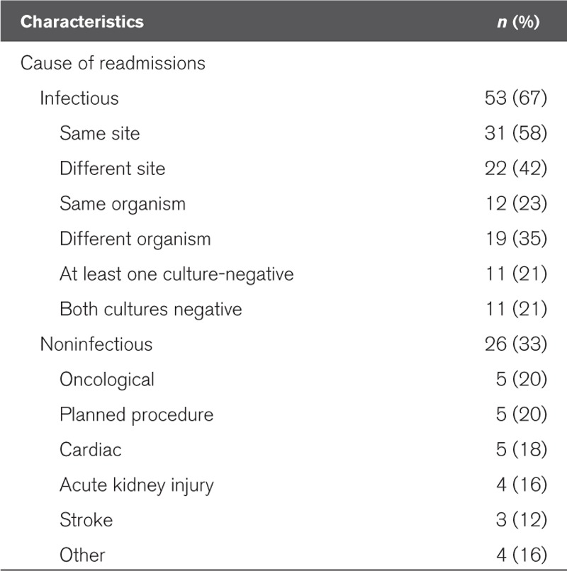
What are readmission rates due to sepsis?
Frequency and Cause of Hospital Readmissions in Sepsis Survivor Patients (n = 79)
Arshad A, Ayaz A, Haroon MA, Jamil B, Hussain E. Frequency and Cause of Readmissions in Sepsis Patients Presenting to a Tertiary Care Hospital in a Low Middle Income Country. Crit Care Explor. 2020;2(2):e0080. Published 2020 Feb 24. doi:10.1097/CCE.0000000000000080

Slide 33
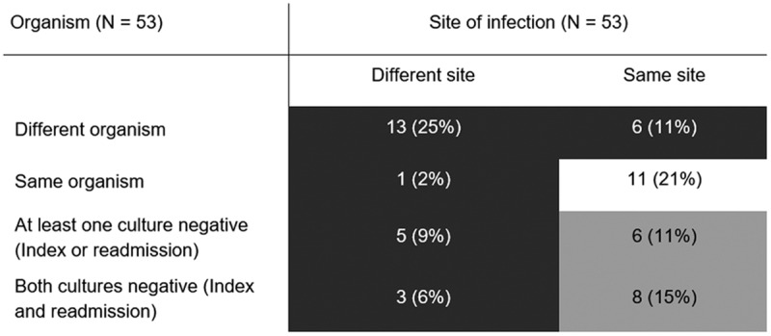
What are sepsis readmissions by organism?
Index admission-readmission dyads for organism and site causing sepsis. Dark gray cells represent dyads with new infection (n = 28, 53%); light gray cells represent dyads for whom infection may have been new or may have been a relapse or recurrent infection (n = 14, 26%); the white cell represents dyads with a relapsed or recurrent infection (n = 11, 21%).
Arshad A, Ayaz A, Haroon MA, Jamil B, Hussain E. Frequency and Cause of Readmissions in Sepsis Patients Presenting to a Tertiary Care Hospital in a Low Middle Income Country. Crit Care Explor. 2020;2(2):e0080. Published 2020 Feb 24. doi:10.1097/CCE.0000000000000080

Slide 34
What is 30-day readmission rate in patients with sepsis?
Study cohort included a total of 898,257 patients admitted with sepsis from 2013 and 2014 who survived to discharge and whose information was included in the Healthcare Cost and Utilization Project’s Nationwide Readmission Data.
Mean patient age was 66.8 ± 17.4 years with 60% of the study cohort ≥65 years. The primary outcome was 30-day readmission, and the causes for readmission were identified using the codes outlined in the International Classification of Diseases, Ninth Revision, Clinical Modification.
Of 898,257 patients, a total of 157,235 (17.5%) had a 30-day readmission, with a median time to readmission of 11 days. The most common cause for readmission was infectious etiology (42.16%, of which 22.86% due to sepsis), followed by gastrointestinal (9.6%), cardiovascular (8.73%), pulmonary (7.82%) and renal problems (4.99%).
Gadre SK, et al. Epidemiology and Predictors of 30-Day Readmission in Patients With Sepsis. Chest. 2019;155(3):483-490. doi:10.1016/j.chest.2018.12.008

Slide 35
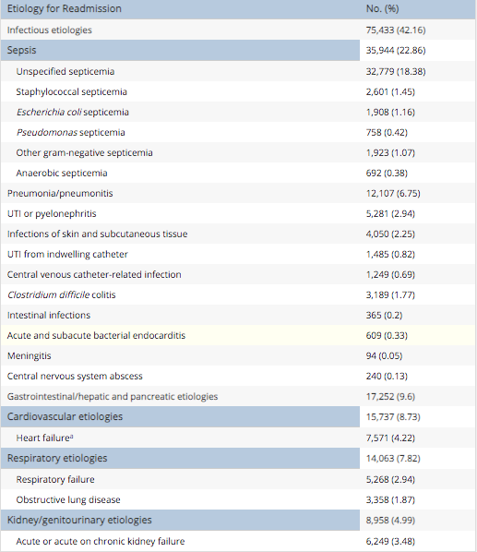
What are etiologies for 30-day readmission for Sepsis?
Gadre SK, et al. Epidemiology and Predictors of 30-Day Readmission in Patients With Sepsis. Chest. 2019;155(3):483-490. doi:10.1016/j.chest.2018.12.008

Slide 36
What is amputation rate for patients with diabetes and peripheral arterial disease?
Study cohort of 20 062 patients with diabetes, peripheral artery disease or both underwent 27 286 lower-limb amputations during the study period; 63.7% (12 786/20 062) of these patients underwent a major amputation.
The mean age was 68.7 years, and 32.4% were women. A total of 81.8% had diabetes, 93.8% had peripheral artery disease and 75.6% had both. The overall comorbidity burden was high, as indicated by a Charlson Comorbidity Index score of 2 or greater in 77.8% of patients.
Hypertension (81.1%), congestive heart failure (33.1%) and chronic obstructive pulmonary disease (32.5%) were the most frequent individual comorbidities, and all of these comorbidities were more prevalent in the major-amputation group.
Hussain MA, Al-Omran M, Salata K, et al. Population-based secular trends in lower-extremity amputation for diabetes and peripheral artery disease. CMAJ. 2019;191(35):E955-E961. doi:10.1503/cmaj.190134

