Slide 1
Offloading for Patients with Pressure Ulcers
Wednesday, September 25, 2024

Slide 2
Agenda
How does pressure redistribution work?
How does pressure equalization relate to device design?
What types of support surfaces are available?
What is known about the differernces among support surfaces and pressure ulcer prevention?
What are guidelines for using support surfaces?
What are alternating air mattresses?
How do alternating air mattresses work?
What’s the difference between standard foam mattress and alternating pressure surfaces?
What are differences between alternative foam mattresses, low air-loss mattresses, and sheepskin overlays?
Is there a difference between alternating pressure and high specification foam?
What is air fluidized therapy?
How does fluid immersion simulation work?
How does multi podus boot work?
How to use multi podus boot?
What are guidelines for turning patients?
What are support surfaces for home health care?
What are protocols for offloading?

Slide 3
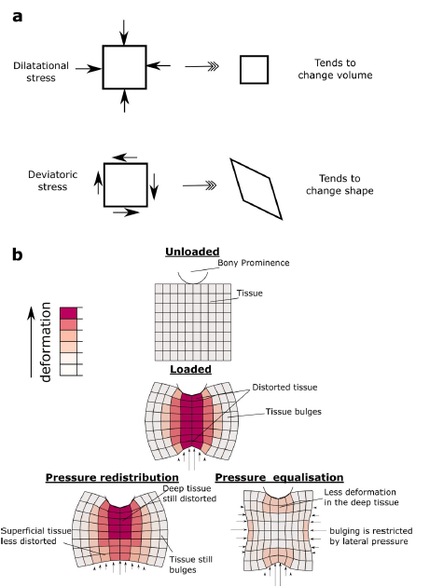
How does pressure redistribution work?
Deformations beneath a bony prominence. The stress in soft tissue has two components, dilatational and deviatoric (a). Soft tissue is much more resistant to dilatational stress than deviatoric stress. Under a bony prominence, the soft tissue is distorted due to the concentrated pressures at the bone and the support (b).
Redistributing the surface pressure has some effect on the outer (superficial) region, but not on the deep tissue. We hypothesise that by applying pressure laterally (termed pressure equalisation), bulging is reduced, and the tissue can bear the load in a moredilatational mode.
Boyle CJ, et al. Lateral pressure equalisation as a principle for designing support surfaces to prevent deep tissue pressure ulcers. PLoS ONE 2020 15(1): e0227064.

Slide 4
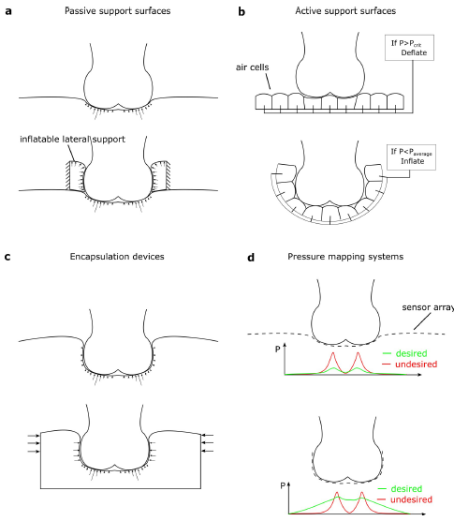
How does pressure equalization relate to device design?
For surfaces designed to reduce peak pressure passively (a), applying a lateral pressure device helps to avoid lateral bulging (top, showing current devices, bottom showing improved design).
Active devices based on individually controlled air cells (b) could be improved by surrounding the soft tissue and changing the control software to aim for equalized pressure, rather than reduce peak pressure.
Encapsulation devices achieve large contact areas, but the lateral pressures exerted may be limited (c). These could be improved by active compression or smart materials.
Pressure mapping systems (d) currently identify pressure peaks as undesirable. If they could measure pressure around the surface, then they could be repurposed to measure the level of pressure equalization.
Boyle CJ, et al. Lateral pressure equalisation as a principle for designing support surfaces to prevent deep tissue pressure ulcers. PLoS ONE 2020 15(1): e0227064.

Slide 5
What offloading measures should be taken?
Offload sites of high pressure (callus, surgical wound) with pedorthic device to redistribute pressure
In the presence of heel ulcers, multipodus boot or specialized heel boot

Slide 6
What types of support surfaces are available?
Various types of support surfaces have been developed with different mechanisms for pressure and shear relief including
(1) redistributing the weight over the maximum body surface area;
(2) mechanically alternating the pressure beneath body to reduce the duration of the applied pressure; or
(3) redistributing pressure by a combination of the above, allowing health care professionals to change the mode according to a person’s needs.
Support surfaces are made from a variety of construction materials (e.g. foam) and have different functional features (e.g. low-air-loss). Identification of the optimum support surface from the diverse options available requires evidence on their relative effectiveness in terms of how well they prevent the incidence of new pressure ulcers
Shi C, Dumville JC, Cullum N. Support surfaces for pressure ulcer prevention: A network meta-analysis. PLoS One. 2018;13(2):e0192707. Published 2018 Feb 23. doi:10.1371/journal.pone.0192707

Slide 7
What types of support surfaces are available?
Types of support surface include, but are not limited to, integrated bed systems, mattresses and overlays.
The National Pressure Ulcer Injury Advisory Council (NPIAP) Support Surface Standards Initiative system can be used to classify types of support surface (NPIAP S3I 2007). According to this system support surfaces may:
Be powered (i.e.require electrical power to function) or non- powered;
Passively redistribute body weight (i.e. reactive pressure redistribution), or mechanically alternate the pressure on the body to reduce the duration of pressure (i.e. active pressure redistribution);
Be made of a range of materials, including but not limited to: air cells, foam materials, fiber materials, gel materials, sheepskin for medical use, and water-bags; and
Be constructed of air-filled cells that have small holes on the surface for blowing out air to dry skin (i.e. low air-loss feature) or have fluid-like characteristics via forcing filtered air through ceramic beads (i.e. air-fluidized feature), or have neither of these features.
Shi C, Dumville JC, Cullum N, Rhodes S, McInnes E. Foam surfaces for preventing pressure ulcers (Protocol). Cochrane Database of Systematic Reviews 2020, Issue 5. Art. No.: CD013621. DOI: 10.1002/14651858.CD013621.

Slide 8
What types of support surfaces are available?
Air-fluidized supports | Membranes that cover a layer of particles that are fluidised by having air forced through them. The airflow can be turned off, which makes the surface solid again, to allow the person to be moved. People find it difficult to get in and out of these beds independently; therefore, they are usually reserved for people who spend most of the day in bed.
Alternating-pressure surfaces | Mattresses or overlays made of one or two layers of parallel air sacs. Alternate sacs are inflated and deflated, which provides alternating pressure and release for each area of skin.
Low- or high-tech constant-low-pressure supports | Mattresses, overlays, and cushions made of high-density or contoured foam or filled with fibre, gel, water, beads, or air. They increase the area of contact between the person and the support surface and thus reduce the pressure at the interface. See also air-fluidised supports, low-air-loss beds, and low-air-loss hydrotherapy beds.
Low-air-loss beds | Mattresses that consist of inflatable upright sacs of semipermeable fabric. Inflation of the sacs increases the area of contact between the individual and the support surface and reduces the pressure on the skin. People find it difficult to get in and out of these beds independently; therefore, they are usually reserved for people who spend most of the day in bed.
Low-air-loss hydrotherapy beds | A mattress that consists of cushions covered by a permeable, fast-drying filter sheet, through which air is circulated. The bed also contains a urine-collecting device.
Cullum N, Petherick E. Pressure ulcers. BMJ Clin Evid. 2008;2008:1901. Published 2008 Mar 19.
Notes:
Creates large fluid-absorption capacity. Silver kills bacteria. Silvadene – limited application to 2 weeks (Burns, skin grafts, incisions, leg ulcers).
Can hamper concentration of fibroblasts.

Slide 9
What is known about the differences among support surfaces and pressure ulcer prevention?
Various types of support surfaces that prevent the development of pressure ulcer are available.
There are differences in the mechanism of pressure/shear reduction between an alternating air pressure mattress and static air mattress.
There is no evidence supporting the notion that alternating air pressure mattresses are more effective than other high-specification support mattresses in preventing pressure ulcer.
Beeckmana D, et al. A multicentre prospective randomised controlled clinical trial comparing the effectiveness and cost of a static air mattress and alternating air pressure mattress to prevent pressure ulcers in nursing home residents. International Journal of Nursing Studies 97 (2019) 105–113.

Slide 10
What is known about support surfaces and pressure ulcer prevention?
The use of a static air mattress must be considered in preventing the development of pressure ulcers in a high-risk nursing home population.
The financial cost for static air mattress that prevents the development of pressure ulcer was lower than that for an alternating air pressure mattress.
The time to develop a pressure ulcer was significantly longer in the group who used a static air mattress compared to the group who used an alternating pressure air mattress.
Beeckmana D, et al. A multicentre prospective randomised controlled clinical trial comparing the effectiveness and cost of a static air mattress and alternating air pressure mattress to prevent pressure ulcers in nursing home residents. International Journal of Nursing Studies 97 (2019) 105–113.

Slide 11
What is known about support surfaces and pressure ulcer prevention?
People lying on ordinary foam mattresses are more likely to get pressure ulcers than those lying on a higher-specification foam mattress.
In addition the review also found that people who used sheepskin overlays on their mattress developed fewer pressure ulcers.
While alternating-pressure mattresses may be more cost eIective than alternating-pressure overlays, the evidence base regarding the merits of higher-specification constant low-pressure and alternating-pressure support surfaces for preventing pressure ulcers is unclear.
McInnes E, Jammali-Blasi A, Bell-Syer SE, Leung V. Support surfaces for treating pressure ulcers. Cochrane Database Syst Rev. 2018;10(10):CD009490. Published 2018 Oct 11. doi:10.1002/14651858.CD009490.pub2

Slide 12
What are the guidelines for using support surfaces?
In 2014, the National Pressure Ulcer Advisory Panel, the European Pressure Ulcer Advisory Panel and the Pan Pacific Pressure Injury Alliance developed a clinical practice guideline for the prevention and management of pressure ulcers.
The key prevention strategies include risk assessment, use of support surfaces, systematic patient repositioning, skin care and nutritional care.
Patient repositioning (e.g. patient turning every 2 h) is defined as a change in position of the lying or seated individual to relieve or redistribute pressure and to enhance comfort
There is a lack of evidence regarding the comparative effectiveness between the commercially available support surfaces that prevent the development of pressure ulcer.
Beeckmana D, et al. A multicentre prospective randomised controlled clinical trial comparing the effectiveness and cost of a static air mattress and alternating air pressure mattress to prevent pressure ulcers in nursing home residents. International Journal of Nursing Studies 97 (2019) 105–113.

Slide 13
Alternative Air Mattresses
Powered active air-surfaces probably reduce pressure ulcer incidence, but are probably less comfortable than standard hospital surfaces.
analysis results suggest that powered hybrid low-air-loss air surfaces have the highest probability of being the most effective intervention
There is moderate certainty evidence that powered active air surfaces and powered hybrid air surfaces probably reduce the incidence of pressure ulcers compared with standard hospital surfaces
Shi C, Dumville JC, Cullum N. Support surfaces for pressure ulcer prevention: A network meta-analysis. PLoS One. 2018;13(2):e0192707. Published 2018 Feb 23. doi:10.1371/journal.pone.0192707
Notes:
Creates large fluid-absorption capacity. Silver kills bacteria. Silvadene – limited application to 2 weeks (Burns, skin grafts, incisions, leg ulcers).
Can hamper concentration of fibroblasts.

Slide 14
How do alternating support surfaces work?
The surfaces achieve alternating support and relief utilizing independent rows of small comfort nodes. The alternating rows inflate and deflate. The inflated nodes support the body and the deflated nodes result in pressure relief. The pattern then reverses at a preprogrammed interval.
Notes:
Composites (primary or secondary dressing, autolytic debridement, exchange of moisture vapor – Island dressing, bandaid, tegaderm).
Contact layer (Protection layer from trauma, prevent dressing from sticking to tissue).
Change 1x/weekly – can stay on between secondary changes (mepitel). Used with wound vacs.

Slide 15
What is the difference between standard foam mattresses and alternating pressure surfaces?
Compared with standard foam mattress: Alternating pressure surfaces may be more effective ( very low-quality evidence ).
Compared with constant-low-pressure supports: We don’t know whether alternating pressure surfaces are more effective than constant-low-pressure supports such as viscoelastic foam (very low-quality evidence).
Compared with each other: We don’t know whether one alternating pressure surface is more effective than the others ( low-quality evidence ).
Cullum N, Petherick E. Pressure ulcers. BMJ Clin Evid. 2008;2008:1901. Published 2008 Mar 19.

Slide 16
What is the difference between foam alternatives versus standard foam mattresses to prevent pressure ulcers?
Foam alternatives may be more effective at 10–14 days at reducing the incidence of pressure ulcers in people at high risk of developing pressure ulcers ( low-quality evidence ).
Compared with each other: Foam and fiber replacement mattresses consisting of five sections may be more effective than a 4-inch thick dimpled foam mattress at reducing the risk of pressure ulcers (low-quality evidence).
Foam alternatives or standard mattress plus different repositioning frequencies compared with standard care: Combination of a viscoelastic foam mattress and 4-hourly repositioning may be more effective at reducing the incidence of pressure ulcers ( very low-quality evidence ).
Cullum N, Petherick E. Pressure ulcers. BMJ Clin Evid. 2008;2008:1901. Published 2008 Mar 19.

Slide 17
What are the differences among alternative foam mattresses, low air-loss, and medical sheepskin overlays?
Alternative Foam Mattresses (such as viscoelastic foam) reduce the incidence of pressure ulcers in people at risk compared with standard hospital foam mattresses, although we don't know which is the best alternative to use.
Low air-loss may reduce the risk of pressure ulcers compared with standard intensive-care beds, but we don't know whether pressure-releiving overlays on operating tables are also beneficial compared with other pressure-relieving surfaces.
Medical sheepskin overlays may reduce the risk of pressure ulcers compared with standard care.
Cullum N, Petherick E. Pressure ulcers. BMJ Clin Evid. 2008;2008:1901. Published 2008 Mar 19.
Notes:
Creates large fluid-absorption capacity. Silver kills bacteria. Silvadene – limited application to 2 weeks (Burns, skin grafts, incisions, leg ulcers).
Can hamper concentration of fibroblasts.

Slide 18
Is there a difference between alternating pressure and high specification foam?
One of the largest randomized clinical trials found insufficient evidence of a difference in pressure ulcer development in high risk patients using “high-tech” Alternating Pressure Mattress (APM) vs “low-tech” High Specification Foam (HSF)
Patients with existing category 1 and 2 pressure ulcers are most at risk of subsequent PUs of category ≥ 2 and require targeted secondary prevention.
Nixon J, et al. Pressure Relieving Support Surfaces for Pressure Ulcer Prevention (PRESSURE 2): Clinical and Health Economic Results of a Randomised Controlled Trial. EClinicalMedicine. 2019;14:42-52. Published 2019 Sep 3. doi:10.1016/j.eclinm.2019.07.018

Slide 19
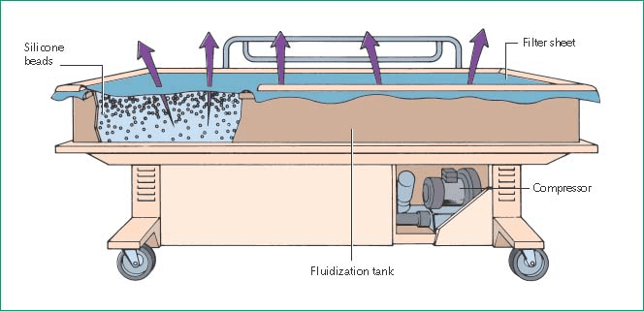
What Is Air Fluidized Therapy?
The most common support surface utilized after surgery was the air-fluidized bed in attempts to minimize interface pressure on the surgical area; however, there are many drawbacks to using this support surface including dehydration, patient care, and handling.
Health care providers express difficulty with daily hygiene, bowel routine, and surgical site inspection. The air-fluidized surface is also the most costly support surface to rent.
Spear M, Thurman K. Real-Time Pressure Assessment and Monitoring With a Fluid Immersion Simulation Support Surface Show Clinical and Financial Benefits for Flap Management. Plast Surg Nurs. 2017 Jan/Mar;37(1):39-44. doi: 10.1097/PSN.0000000000000175. PMID: 28244964.
Notes:
Creates large fluid-absorption capacity. Silver kills bacteria. Silvadene – limited application to 2 weeks (Burns, skin grafts, incisions, leg ulcers).
Can hamper concentration of fibroblasts.

Slide 20
What Is Air Fluidized Therapy?
Air-fluidized therapy is a feature of a support surface that provides pressure redistribution via a fluid-like medium created by forcing air through beads as characterized by immersion and envelopment.
Through millions of sand-like silicone beads, the patient immerses into the surface and is enveloped, allowing pressure to be redistributed over a larger surface area, decreasing the amount of pressure on any one body area. This creates greater equalization of pressure across the weight-bearing surfaces of the body and a claimed reduction in shearing.
The head o fbed is maintained at 30° except for meals beginning the following day. Patients remain in the hospital for 5–7 days after their operation and are then transitioned to either home or a long-term care/skilled nursing facility prefer- ably on the air-fluidized therapy. Occasionally, discharge planning can be prolonged for multiple reasons, including insurance, lack of family resources, or criteria for facility placement.
Fleck CA, Rappl LM, Simman R, et al. Use of alternatives to air-fluidized support surfaces in the care of complex wounds in postflap and postgraft patients. J Am Col Certif Wound Spec. 2010;2(1):4-8. Published 2010 Mar 21. doi:10.1016/j.jcws.2010.02.002
Notes:
Creates large fluid-absorption capacity. Silver kills bacteria. Silvadene – limited application to 2 weeks (Burns, skin grafts, incisions, leg ulcers).
Can hamper concentration of fibroblasts.

Slide 21
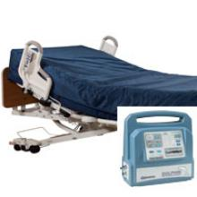
How does fluid immersion simulation work?
Minimizes soft tissue deformation and maintains near normal blood flow
Automatically adjusts to each patient's weight, surface area and repositioning
Fits existing bed frames, including ICU, medical/surgical and bariatric
Keeps the patient in a simulated fluid environment. This system helps to maintain blood f low and tissue perfusion and evenly redistributes pressure, thereby eliminating high pressure points, reducing tissue deformation, and improving wound healing
Fletcher J. Case series evaluating the use of the Dolphin Fluid Immersion Simulation® mattress
Wounds UK. 2015 11(3):34-37. doi: 10.1097/PSN.0000000000000175. PMID: 28244964.
Notes:
Wet-to-dry is not selective; often removes healthy tissues, causing re-injury. Can also be painful. Can be used only temporarily, 2-3 days to protect/cover.
Use NS when removing! Used for packing of dead space within a wound.
Available in different sizes, shapes, thickness. Fluff, don’t Stuff!

Slide 22
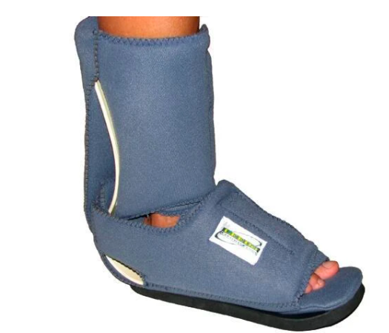
How does the multi podus boot work?
Multi-podis boots are often used after foot or ankle surgery, or when the foot or ankle should not be moved.
The multi-podis boot keeps the foot in a flexed position. This is important because it helps prevent the foot from getting stuck in a dropped position (called foot drop).
The boot can also help keep pressure off the heel to prevent heel ulcers or relieve pressure if ulcers start to appear.

Slide 23
How to use the multi podus boot?
Before the patient goes home from the hospital they should:
Know how to safely put on and remove multi-podis boot.
Check skin to make sure that his/her boot fits well.
Understand that all equipment should be worn at all times other than during skin checks and hygiene.
Review restrictions with their nurse. Patient should know how much weight they can bear (stand), how much they can move his/her foot (range of motion), and how active they can be.
Demonstrate how to use the boot “kick stand” to help keep the foot in alignment. When patient is home from the hospital they should:
Make sure their foot fits snuggly into the boot.
Check to make sure that their foot “floats” above the heel bar.
Remove the boot at least every 4 hours for skin checks and hygiene. Some patients wear the boot on a schedule set by their doctor (such as two hours on and two hours off). Ask doctor how long to wear the boot

Slide 24
What are guidelines for turning patients?
Patients from the ICU are more likely to be exposed to these factors, including but not limited to reduced activity and mobility or even being bedridden, loss of sensory perception as a result of medication such as anesthetics, sedatives, and analgesics that are commonly used in ICU patients, and maceration of skin due to sweating, incontinence, or leaking wounds.
These factors are present among patients from other departments in the hospital, while they are mostly presented at a higher level of severity or a combination of more than two factors among ICU patients. The likely worldwide prevalence range of pressure injuries in acute care settings is between 6% and 54%, and the incidence of pressure injuries is between 3% and 29%. Coyer et al. found that patients from the ICU were 3.8 times more likely to develop pressure injuries than those from nonintensive departments.
Traditional two-hour turning prevents pressure injuries by shortening the constant duration of comprehensive and shearing forces. However, it mainly depends on human resources, which is generally one of the most intensive resources in hospitals. A study in an intensive care unit suggested that only 36.8% of the patients who should be manually turned were actually repositioned
Bai DL, Liu TW, Chou HL, Hsu YL. Relationship between a pressure redistributing foam mattress and pressure injuries: An observational prospective cohort study. PLoS One. 2020;15(11):e0241276. Published 2020 Nov 9. doi:10.1371/journal.pone.0241276
Notes:
Creates large fluid-absorption capacity. Silver kills bacteria. Silvadene – limited application to 2 weeks (Burns, skin grafts, incisions, leg ulcers).
Can hamper concentration of fibroblasts.

Slide 25
What are guidelines for turning patients?
Repositioning for patients should be an individualized plan as many different factors need to be considered. The condition of the skin and patient comfort are particularly important, as is the broader objective of their care.
While 2-hourly turning appears to still be common practice, it is not always in the patient’s best interests and it should be considered as only one element of their care in preventing pressure ulcers. Repositioning should be a 24-hour consideration, not simply something that happens when the patient is in bed.
Fletcher J. Reposition patients effectively to prevent pressure ulcers Wounds International. 2017;8(1): 7-9.
Notes:
Creates large fluid-absorption capacity. Silver kills bacteria. Silvadene – limited application to 2 weeks (Burns, skin grafts, incisions, leg ulcers).
Can hamper concentration of fibroblasts.

Slide 26
Support surfaces for home health care
Since PU prevention in the home health setting is dependent on the patient and caregiver, education is a key element of care. This teaching is commonly oral, and can be augmented by written materials tailored to the educational background of the patient and caregiver.
Appropriate use of pressure redistribution surfaces in home health care is sometimes limited by Medicare guidelines regulating coverage. When a patient meets Medicare criteria for a surface, home health staff contact the physician and work to obtain the bed and/or chair surface that Medicare will cover most or part of the cost.
For patients with private primary or secondary insurance, home health care staff work with the physician, patient, and family to obtain the pressure redistribution surface covered by the policy. If the cost is not covered by third party reimbursement, patients are asked to purchase the bed or chair surface as an out-of-pocket expense. If the individual cannot afford this purchase, home health staff collaborate with health care vendors or charity organizations to obtain a donated device. Some nonprofit home health care agencies will provide the redistribution surface for selected patients without cost.
Bergquist-Beringer S, Daley CM. Adapting pressure ulcer prevention for use in home health care. J Wound Ostomy Continence Nurs. 2011 Mar-Apr;38(2):145-54. doi: 10.1097/WON.0b013e31820ad115. PMID: 21326116.
Notes:
Creates large fluid-absorption capacity. Silver kills bacteria. Silvadene – limited application to 2 weeks (Burns, skin grafts, incisions, leg ulcers).
Can hamper concentration of fibroblasts.

Slide 27
Support surfaces for home health care
The professional staff-patient and caregiver partnership is essential for continuity of care during the time staff are not in the home and fundamental to the goals of home health service that include maximizing patient and caregiver independence in caregiving.
Nevertheless, the division of responsibilities between these partners for PU prevention requires clarification. Consensus surrounding when professional home health staff should inspect the skin rather than complete the assessment by monitoring the patient or caregiver report of skin integrity is needed.
Bergquist-Beringer S, Daley CM. Adapting pressure ulcer prevention for use in home health care. J Wound Ostomy Continence Nurs. 2011 Mar-Apr;38(2):145-54. doi: 10.1097/WON.0b013e31820ad115. PMID: 21326116.
Notes:
Creates large fluid-absorption capacity. Silver kills bacteria. Silvadene – limited application to 2 weeks (Burns, skin grafts, incisions, leg ulcers).
Can hamper concentration of fibroblasts.

Slide 28
Support surfaces for home health care
While the hospital or nursing home is financially responsible for acquiring and supplying the appropriate device, home health care patients with Medicare must meet established criteria for need before this cost is covered by Medicare Part B or a private insurance provider.
In addition, the home health care agency is not responsible for supplying the appropriate product if the patient does not qualify for insurance coverage.
Home health care staff often must encourage patients to pay for the device themselves or collaborate with health care vendors or other community resources to donate needed supplies. Since the use of a pressure redistribution surface is an essential component of pressure ulcer prevention, we recommend that Medicare broaden Part B coverage to include home health patients deemed at risk.
Bergquist-Beringer S, Daley CM. Adapting pressure ulcer prevention for use in home health care. J Wound Ostomy Continence Nurs. 2011 Mar-Apr;38(2):145-54. doi: 10.1097/WON.0b013e31820ad115. PMID: 21326116.
Notes:
Creates large fluid-absorption capacity. Silver kills bacteria. Silvadene – limited application to 2 weeks (Burns, skin grafts, incisions, leg ulcers).
Can hamper concentration of fibroblasts.

Slide 29
Mattresses for Home Health Care
Data suggest that risk factors are more prevalent in patients living at home than in a community setting or hospital, particularly among older people
Data on patients discharged from hospital and receiving hospital care at home are scarce.
Meaume S, Marty M. Pressure ulcer prevention and healing using alternating pressure mattress at home: the PARESTRY project. J Wound Care. 2015 Aug;24(8):359-65. doi: 10.12968/jowc.2015.24.8.359. PMID: 26562378.
Notes:
Creates large fluid-absorption capacity. Silver kills bacteria. Silvadene – limited application to 2 weeks (Burns, skin grafts, incisions, leg ulcers).
Can hamper concentration of fibroblasts.

