Slide 1
Nutrition and Wound Healing Wednesday, October 2, 2024
Notes:
1

Slide 2
Agenda
What does the literature say about nutrition and chronic wounds?
How to assess malnutrition?
What are the nutritional deficiencies associated with diabetic foot ulcers?
What is the effect of dietary nutrients on diabetic foot ulcers?
Case report
Concept of Protein Relative Value (RV)
Collagen synthesis
Nutrition: Macronutrients
Nutrition: Micronutrients

Slide 3
What does the literature say about nutrition and chronic wounds?
Nutritional status has a relevant influence on wound healing; therefore, the diagnosis, therapy, and prophylaxis of malnutrition are important elements of wound therapy
A sufficient and balanced supply of the necessary nutrients, including carbohydrates, proteins, fats, and micronutrients, such as vitamins, zinc, and magnesium is beneficial for wound healing,
The deficiency of micronutrients, especially vitamin D, vitamin C, zinc, and vitamin A, is common in diabetic patients with foot ulcers.
Knackstedt R, Oliver J, Gatherwright J. Evidence-Based Peri-Operative Nutrition Recommendations: Optimizing Results while Minimizing Risks [published online ahead of print, 2020 Jun 11]. Plast Reconstr Surg. 2020;10.1097

Slide 4
How to assess malnutrition?
Comprehensive evaluation of nutritional status should include patient history, complete physical exam, anthropometric measurements, and laboratory analyses.
Anthropometric measures used include height, weight, body mass index (BMI), and estimates of body fat and muscle mass. Recommended laboratory measurements include albumin, retinal-binding prealbumin, transferrin, complete blood count, serum folate, vitamin B12 , and cholesterol.
Neither the physical nor biochemical assessments have been found to correlate well with malnutrition and are time consuming, expensive, and often prone lack of reproducibility.
Haughey L, Barbul A. Nutrition and Lower Extremity Ulcers: Causality and/or Treatment. Int J Low Extrem Wounds. 2017;16(4):238-243.

Slide 5
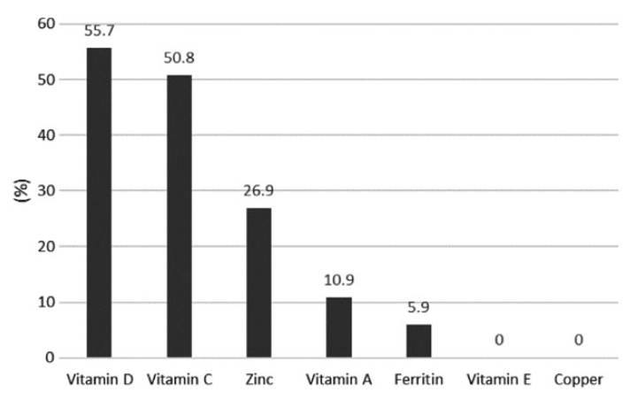
What are the nutritional deficiencies associated with diabetic foot ulcers?
Percentage of participants with vitamin and mineral deficiencies. (Prospective cohort study of diabetic patients with foot ulcers seen in multidisciplinary foot clinics)
Pena G, Kuang B, Cowled P, et al. Micronutrient Status in Diabetic Patients with Foot Ulcers. Adv Wound Care (New Rochelle). 2020;9(1):9-15. doi:10.1089/wound.2019.0973

Slide 6
What are the nutritional deficiencies associated with diabetic foot ulcers?
Micronutrients also play a vital role in the form of trace elements and vitamins, which influence the course followed by the healing wound.
When supplementary micronutrients are administered, the risk of developing pressure wounds may be reduced.
A randomized control trial showed that giving nutritional supplement reduced the incidence of pressure ulcers in bedbound patients.
Healing involves both hypermetabolic and catabolic states. Catabolism may be reduced by nutrients, limiting its effects thereby leading to the anabolic state.
In the healing process, it beneficial to provide trace elements such as magnesium, zinc, iron and boron, vitamins A, C, D, E or herbal remedies.
Kulprachakarn K, et al. Micronutrients and Natural Compounds Status and Their Effects on Wound Healing in the Diabetic Foot Ulcer. Int J Low Extrem Wounds. 2017;16(4):244-250.

Slide 7
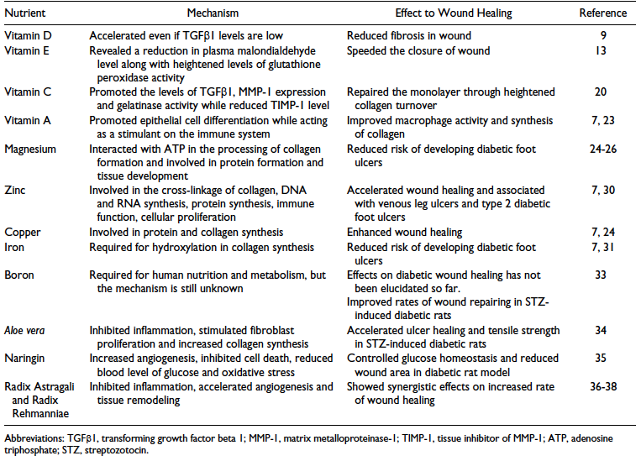
What is the effect of dietary nutrients on diabetic foot ulcers?
Summary of the Effect of Dietary Micronutrients and Natural Compounds Supplementation to Wound Healing in Diabetic Foot Ulcer
Kulprachakarn K, et al. Micronutrients and Natural Compounds Status and Their Effects on Wound Healing in the Diabetic Foot Ulcer. Int J Low Extrem Wounds. 2017;16(4):244-250.

Slide 8
Case Report
45 yr old female with PMH of HTN, HFrEF on home milrinone, s/p ICD, right breast cancer s/p lumpectomy and chemo/radiation. Patient admitted for frequent AICD firing. Developed Cardiogenic Shock, s/p insertion of IABP; COVID-19 positive (4/17). Heart Mate 3 LVAD, protek RVAD inserted 6/1. Developed necrotic feet with multiple bulla and gangrene. Speech pathology recommended regular texture food and thin liquids. RVAD removed 7/1. Bilateral foot wounds extensively debrided on 7/1 by Dr. Granata. Metabolic input was requested to evaluate her nutritional status and requirements for wound healing.
Wound: Initially dry gangrene of toes of left foot, cyanosis of distal tips of right foot. Both feet and toes now responding to debridement.
Nutritional Parameters:
Height: 165 cm
Ideal Body Weight: 56.91 kg
Actual Weight: 81.36 kg
Percent Ideal Body Weight: 142.96 %
Body Mass Index: 30 kg/m2
Macronutrient Requirements: for wound healing, off vent, using 57 kgs IBW:
Energy: 1710 - 1995 kcals/d (30 - 35 kcals /kg IBW)
Protein: 80 - 86 g /d (1.4 - 1.5 g/kg IBW)
Not malnourished
At nutritional risk because of diminished intake in the face of increased requirements (stress, inflammation, wound healing)
Recommendations
a) Macronutrient support with ONS (calories and protein)
b) Counsel on protein content of foods
c) Consider appetite stimulation
d) Micronutrient support for wound healing – MVI, VC, zinc.
e) Check levels for deficiencies that may warrant correction – VA, VD, VK, VC, B1, B6, B9, B12, fe, cu, zn, se, mn, carnitine, creatine, others
Notes:
VC (collagen hydroxylation), B1, B6 (heme synthesis), B9, B12, fe, cu (lysyl oxidase – collagen cross-linking), zn (protein, immune system), se, mn (proline), carnitine, creatine, others

Slide 9
Concept of Protein Relative Value (RV)
William Rose (published 1948-57) proved that there are 9 essential amino acids: lysine, tryptophan, histidine, phenylalanine, leucine, isoleucine, threonine, methionine, valine.
Six others (arginine, cysteine, glycine, glutamine, proline, tyrosine) are considered conditionally essential. The body can make them, but their synthesis may be inadequate under certain pathophysiological conditions, such as severe catabolic stress.
Roughly 1/3 of dietary amino acids eventually appear in the urine as urea. These amino acids are utilized for fuel not protein synthesis (Glucogenic and Ketogenic AAs).
The remaining 2/3 are incorporated into body proteins by ribosomal protein synthesis
RV = the level of each essential amino acid in any given protein source compared to that found in whole egg
Most animal proteins have RVs that approach 1.0
Most plant proteins have RVs < 0.8

Slide 10
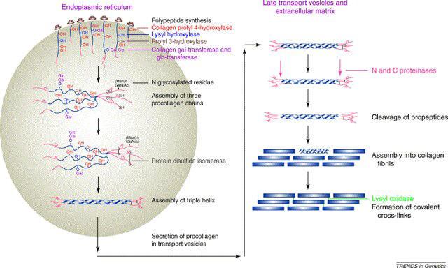
Collagen synthesis
Polypeptide chains are synthesized in ribosomes, secreted into the lumen of the ER, subjected to post-translational modification (hydroxylation of Pro and Lys and glycosylation). C-pro-peptides are assembled in as a triple helix and secreted in the extracellular space. N and C pro-peptides are cleaved, spontaneous self-assembly of collagen molecules into fibrils occurs, covalent crosslinks strengthens the structure
Notes:
Collagen synthesis: a) The polypeptide chains are synthesized in the ribosomes and secreted into the lumen of the endoplasmic reticulum, where they are subjected to different post-translational modification such as hydroxylation of Pro and Lys and glycosylation of other amino acidic residues. b) The C-pro-peptides are then assembled in the characteristic triple helix and secreted in the extracellular space. The subsequent steps are c) cleavage of the N and C pro-peptides, d) spontaneous self-assembly of the resulting collagen molecules into fibrils, and e) formation of covalent crosslinks. Figure from

Slide 11
Nutrition: Macronutrients
Carbohydrates, fats, proteins, and fluids. Overall, nutrition in wound healing must provide adequate support for an increased energy demand during the wound healing process. Caloric needs during wound healing are estimated at 30-35 kcal/kg, or up to 40 kcal/kg if the patient is underweight, but may need to be individualized based on age, comorbidities, body weight, activity level, stage of the healing process, and the severity, size, and number of wounds. Also, the composition of the calories needs to be evaluated with carbohydrates, proteins, and fats, as each play a role in the wound healing process.
Protein-calorie malnutrition (PCM) is a form of malnutrition with decreased calories and decreased protein content of diet, leading to deficient lean body mass (LBM). It is sometimes found in critically ill patients due to hypermetabolic/hypercatabolic responses, but it can also be found in nonhospitalized patients due to behavioral eating habits.
The hypermetabolic response results in glycogen depletion with cortisol production resulting in protein catabolism, amino acid mobilization, and the production of hepatic glucose. Additionally, inflammatory and immune responses are activated with increased production of interleukins 1 through 6; tumor necrosis factor alpha (TNFα); C-reactive protein, fibrinogen, and protein S; and decreased production of albumin and prealbumin.
Quain AM, Khardori NM. Nutrition in Wound Care Management: A Comprehensive Overview. Wounds. 2015 Dec;27(12):327-35. PMID: 27447105.

Slide 12
Nutrition: Macronutrients
Carbohydrates. Carbohydrates stimulate insulin production, which is helpful in the anabolic processes of wound healing, particularly during the proliferative phase. However, hyperglycemia can reduce granulocyte function and increase infectious complications.
Also, diabetic neuropathy can propagate wound formation if the patient does not take care to protect the wound in the area of reduced pain sensation.
Apart from diabetes mellitus, steroid use, antibiotics, fluid supplementation with dextrose, and physiologic stress with increased cortisol production can also contribute to hyperglycemia.
Quain AM, Khardori NM. Nutrition in Wound Care Management: A Comprehensive Overview. Wounds. 2015 Dec;27(12):327-35. PMID: 27447105.

Slide 13
Nutrition: Macronutrients
Fats. Adequate fat intake in the patient with an acute or chronic wound can supply additional energy to the wound healing process, as well as structural functions including axonal myelination and lipid bilayers in cell and organelle membranes during tissue growth. Dietary fats can produce ATP via beta-oxidation, thereby addressing other energy-requiring processes to spare protein for wound healing. Fat intake is also important in the role of absorbing fat-soluble micronutrients, including vitamin A, omega-3, and omega-6 fatty acids. Omega-6 fatty acids are an important precursor to production of prostaglandins, thromboxane, and leukotrienes in the inflammatory response, resulting in platelet aggregation and inflammatory vasoconstriction.
Omega-3 fatty acids, on the other hand, dampen inflammatory responses and result in vasodilation through cytokine release. Omega-3 fatty acid supplementation was shown to have a detrimental effect on wound healing with decreased wound tensile strength²⁰; however, it was also shown to decrease progression of pressure ulcers when supplemented in combination with omega-6 fatty acids in fish oil. Though the overall effect of essential fatty acids on wound healing is still unclear, supplements during the inflammatory phase in a 1:1 ratio of omega-6 to omega-3 have been proposed as beneficial. More information is needed on when to supplement fatty acids, what types of fatty acids are needed and in what ratio, as many trials thus far have been confounded due to a multisupplement approach.
Quain AM, Khardori NM. Nutrition in Wound Care Management: A Comprehensive Overview. Wounds. 2015 Dec;27(12):327-35. PMID: 27447105.

Slide 14
Nutrition: Macronutrients
Protein. Protein plays an essential role in all stages of wound healing. Protein supplies are essential to collagen synthesis, angiogenesis, fibroblast proliferation, immune function, tissue remodeling, wound contraction, and skin structural proteins. Leukocytes, monocytes, lymphocytes, and macrophages require protein for their formation and function in mounting an immune response. Protein deficiency results in impaired fibroblast proliferation and collagen synthesis during the proliferative phase of healing. One key role of protein is the maintenance of oncotic pressure, particularly in venous insufficiency wounds, where excess extraluminal pressure due to peripheral edema will exacerbate wound formation and slow wound healing. Also, as mentioned with fat intake, overall protein and calorie malnutrition may shunt protein reserves away from wound healing processes into other required functions, thereby slowing wound healing. The presence of a wound increases protein demand by up to 250% and caloric demand by up to 50% to maintain adequate LBM stores. Additionally, large quantities of protein can be lost through wound exudate. Depletion of 10% of LBM is associated with impaired immunity and risk of infection, losses of 20% of LBM decreases the rate of wound closure with thinning of the skin, and losses of 30% of LBM will halt healing and predispose the patient to new wound formation. Greater losses often result in death. Ensuring adequate protein stores and protein intake is vital; however, oversupplementation may not promote additional protein synthesis with the risk of increased oncotic pressure resulting in dehydration
Quain AM, Khardori NM. Nutrition in Wound Care Management: A Comprehensive Overview. Wounds. 2015 Dec;27(12):327-35. PMID: 27447105.

Slide 15
Nutrition: Macronutrients
Fluids. Apart from calories, another factor of malnutrition to consider in wound healing is fluid intake. The function of fluid in wound healing is to maintain skin turgor and promote tissue perfusion and oxygenation. Water serves as a diluent for glucose, waste removal, and micronutrients; to this end, risk factors for dehydration should be evaluated in the wound patient including fever, diarrhea, vomiting, diuresis, fistulae, wound drainage, and poor intake.
The goal for fluid intake in patients with wounds is approximately 1ml/kcal/day, but should be adjusted for insensible losses or comorbid renal or cardiac disease.
It is also important to encourage intake of water vs other fluids: one common social factor that can often lead to malnutrition and alter physiologic demand is alcohol abuse. Chronic alcohol consumption impairs the antioxidant defense and induces chronic oxidative stress. The micronutrient zinc was noted to be decreased in male alcoholics with decreased plasma levels and increased urinary excretion. Alcohol abuse can also propagate zinc deficiency, whereby zinc levels in the liver and serum have been found to be depleted in alcoholic cirrhotic patients. Selenium was also noted to be affected by alcohol consumption, as the liver is the primary storage site for this micronutrient, and plasma selenium concentrations were significantly lower in patients with alcoholic cirrhosis. Of note, selenium levels improved in these patients following supplementation. Also, narcotic use (prescription or recreational) often results in constipation, nausea, and anorexia, which can discourage oral intake and thus exacerbate nutritional deficiencies
Quain AM, Khardori NM. Nutrition in Wound Care Management: A Comprehensive Overview. Wounds. 2015 Dec;27(12):327-35. PMID: 27447105.

Slide 16
Nutrition: Micronutrients
Amino acids. Micronutrients must also be considered in the evaluation of the wound care patient including amino acids, vitamins, and minerals. Amino acids have also been implicated in the role of wound healing, in particular arginine and glutamine. Arginine is a conditionally essential amino acid, normally synthesized in the kidney and liver from citrulline. Supplementation of arginine may be required in states of increased demand, including patients with sepsis, trauma, and wounds. The role of arginine in wound healing is diverse. Arginine is a precursor for nitric oxide, which is essential in the inflammatory process of wound healing, but it is also used in the production of collagen. Arginine is also a precursor of proline, which is necessary for the synthesis of collagen. Arginine supplementation was observed to increase collagen deposition in wounds. Additionally, arginine supplementation was observed to increase lymphocyte mitogenesis. Together with ornithine, arginine also stimulates production of growth hormone and activation of T cells. The recommendations for supplementation of arginine in patients with pressure wounds or stasis wounds was found to be 4.5 g/day, but this can only be followed in the setting of adequate protein intake; otherwise, supplementation is of no value
Quain AM, Khardori NM. Nutrition in Wound Care Management: A Comprehensive Overview. Wounds. 2015 Dec;27(12):327-35. PMID: 27447105.

Slide 17
Nutrition: Micronutrients
Vitamin C (ascorbic acid) deficiency brings to mind images of scurvy and loose-toothed sailors; however, vitamin C deficiency may not be readily apparent in the wound-healing patient. The role of vitamin C in wound healing is believed to be due to an influence on collagen formation, immunomodulation, and antioxidant functions. Deficiency results in impaired immune response during the inflammatory phase with increased capillary fragility and reduced collagen tensile strength and synthesis during the proliferative and remodeling phases, with risk of wound dehiscence. Supplementation in the deficient patient is clearly beneficial; however, the evidence supporting the use of vitamin C alone in the nondeficient patient has been inconclusive. A review of multiple trials looking at the impact of supplementation on wound healing noted, “convincing evidence only exists for a protein and energy rich ONS (oral nutrient supplement) providing at least 500 mg of vitamin C, 17 mg of zinc, and 3gm of L-arginine in pressure ulcer therapy.” However, recommendations exist for 500-1,000 mg of vitamin C daily in divided doses for wound healing, and up to 1-2 g/day in severe wounds, such as extensive burns.
Quain AM, Khardori NM. Nutrition in Wound Care Management: A Comprehensive Overview. Wounds. 2015 Dec;27(12):327-35. PMID: 27447105.

Slide 18
Nutrition: Micronutrients
Vitamin D is a fairly new player to join the wound care supplementation repertoire; however, vitamin D deficiency has been shown to have increased incidence in patients with venous ulcers and pressure ulcers, and recent studies have identified vitamin D receptors in a variety of tissues where their presence was previously unknown.
Cathelicidin, an antimicrobial peptide induced by vitamin D, promotes wound healing. These researchers concluded that vitamin D and its receptor signaling regulates structural integrity and transport functions of epithelial barriers with implications for wound healing.
Quain AM, Khardori NM. Nutrition in Wound Care Management: A Comprehensive Overview. Wounds. 2015 Dec;27(12):327-35. PMID: 27447105.

Slide 19
Nutrition: Micronutrients
Minerals. Along with vitamins, minerals represent another essential micronutrient in the role of enzyme structural factors and metalloenzymes. Zinc, selenium, and iron have been postulated as beneficial in wound healing, and more than 200 zinc-containing enzymes, including superoxide dismutase, are involved in wound healing. They function as antioxidants and modulate cell replication, nucleic acid metabolism, tissue repair, and growth. Decreased zinc levels result in decreased cytotoxicity of natural killer cells, impaired phagocytosis in macrophages and neutrophils, and decreased number of granulocytes. Also with zinc deficiency, B-cell precursors and mature B-cells are reduced. Zinc deficiency affects all phases of wound healing. In the inflammatory phase, there is decreased immunity and increased susceptibility to infections. In the proliferative phase, there is impaired collagen synthesis and tensile strength. Finally, in the remodeling phase, there is a dampening of fibroblast proliferation, collagen synthesis, and epithelialization. However, excess zinc supplementation can interfere with the absorption of other cations, specifically iron and copper. Therefore, supplementation should be avoided unless deficiency is present. The most common causes of zinc deficiency include diarrhea, malabsorption, and hypermetabolic states including stress, sepsis, and burns. Topical zinc applied to surgical wounds consistently augments wound healing. Recommendations for zinc supplementation in the zinc-deficient patient range from 40 mg/day up to 220 mg 2 times per day for 10-14 days.
Quain AM, Khardori NM. Nutrition in Wound Care Management: A Comprehensive Overview. Wounds. 2015 Dec;27(12):327-35. PMID: 27447105.

