Slide 1
Wound Healing Outcomes
Division of Wound Healing and Regenerative Medicine
Department of Surgery
Newark Beth Israel Medical Center
July 14, 2020
njwoundhealing.org

Slide 2
Agenda
HS: Necrotizing fasciitis
WB: sacral pressure ulcer, necrotizing fasciitis? (Dr. Manicone)
GF: right ischium, osteomyelitis by culture not pathology (Dr. Brem)
What is necrotizing fasciitis and how to make the diagnosis?
What is the pathology of necrotizing fasciitis?
What are antibiotic options for necrotizing fasciitis?
How to treat osteomyelitis of the pelvis?
What is microbiology of osteomyelitis of the pelvis?
What is the role of hyperbaric oxygen in chronic osteomyelitis of the pelvis?
How to treat incidental vocal polyp? (Dr. Kaye)
How to differentiate deep tissue injuries?
What is the criteria for hospice?

Slide 3
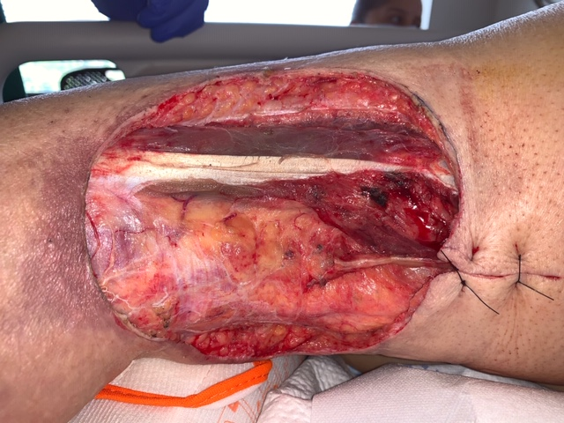
HS: Necrotizing fasciitis

Slide 4
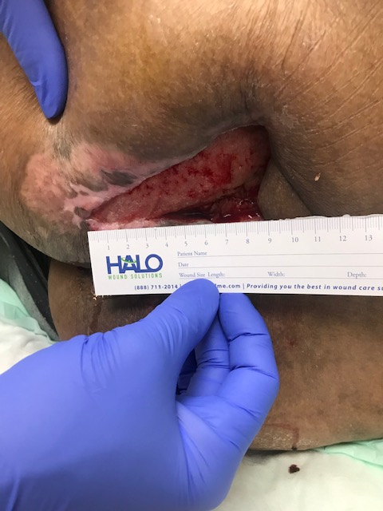
GF (7/13/20) patient with left ischial osteomyelitis

Slide 5
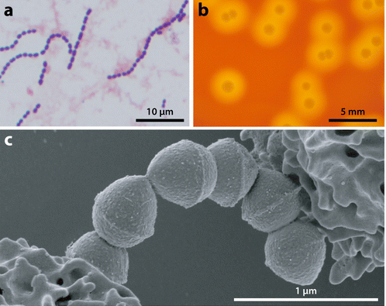
What is necrotizing fasciitis and how to make the diagnosis?
Morphology of group A Streptococcus (GAS).
A: micrograph of GAS isolated from the blood of human patient. GAS are gram-positive cocci that grow in pairs and chains.
B: photograph of GAS grown of solid agar media supplemented with sheep blood. GAS forms small, gray-colored, smoothly contoured, round colonies with a distinct zone of beta hemolysis (area of complete clearing around each colony).
C: scanning electron micrograph of GAS organisms interacting with human neutrophils). Pathogen-host interactions and immune evasion are important themes in necrotizing fasciitis pathogenesis.
Olsen RJ, Musser JM. Molecular pathogenesis of necrotizing fasciitis. Annu Rev Pathol. 2010;5:1-31. doi:10.1146/annurev-pathol-121808-102135

Slide 6
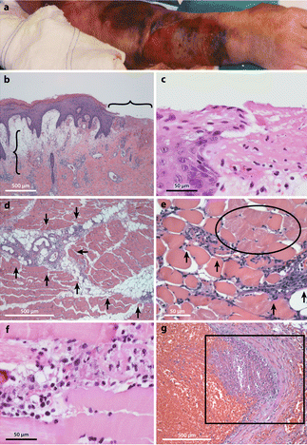
What is pathology of necrotizing fasciitis?
Histopathology features of human necrotizing fasciitis.
A: The arm of this patient infected with group A Streptococcusis very swollen and bruised. A large ulcer is developing on the dorsal forearm. However, the visual appearance still greatly underestimates the true severity of the underlying infection. B: Microscopic evaluation of the skin shows an erosion of the epidermis (horizontal bracket), edematous thickening of the dermis (vertical bracket), and sparse inflammatory cell infiltrate (original magnification 2×). C: These histopathological features of the ulcer and dermal-epidermal junction are better seen at high magnification. D: In the infected deep soft tissue, there are marked necrosis, acute inflammatory cell infiltration, and bacterial organisms that are primarily concentrated along the major fascial planes (arrows). E: The necrosis is observed to extend beyond the fascial planes to also infiltrate along individual muscle fibers (arrows). Numerous nonviable muscle cells are present alongside the advancing infection (circled region). F: At high magnification, four severely damaged muscle fibers are seen. G A characteristic feature of human necrotizing fasciitis is vascular thrombosis (boxed region) and hemorrhage.
Olsen RJ, Musser JM. Molecular pathogenesis of necrotizing fasciitis. Annu Rev Pathol. 2010;5:1-31. doi:10.1146/annurev-pathol-121808-102135

Slide 7
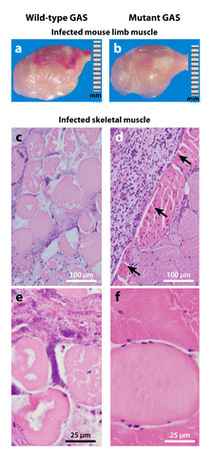
What is pathology of necrotizing fasciitis?
Animal models of group A Streptococcus(GAS) necrotizing fasciitis. To investigate a particular gene of interest, animals are infected intramuscularly with either the wild-type or the isogenic mutant strain, and parameters of disease severity are compared.
(a, b) Photographs of infected mouse limbs demonstrate that the wild-type GAS strain (panel a) causes larger, more hemorrhagic lesions compared to the mutant strain (panel b).
(c, d) Micrographs of infected nonhuman primate limb muscle excised from the inoculation site show that the wild-type GAS strain causes much more severe, widespread fascial and myocyte necrosis (panel c) compared to the confined lesion (arrows) caused by the mutant strain (panel d). (e, f) These features are better seen at high magnification (panel ecompared to panel f).
Olsen RJ, Musser JM. Molecular pathogenesis of necrotizing fasciitis. Annu Rev Pathol. 2010;5:1-31. doi:10.1146/annurev-pathol-121808-102135

Slide 8
What are antibiotic options for necrotizing fasciitis?
Menichetti F, Giuliano S, Fortunato S. Are there any reasons to change our behavior in necrotizing fasciitis with the advent of new antibiotics?. Curr Opin Infect Dis. 2017;30(2):172-179.

Slide 9
What are antibiotic options for necrotizing fasciitis?
Menichetti F, Giuliano S, Fortunato S. Are there any reasons to change our behavior in necrotizing fasciitis with the advent of new antibiotics?. Curr Opin Infect Dis. 2017;30(2):172-179.

Slide 10
How to treat osteomyelitis of the pelvis?
Pressure ulcer-related pelvic osteomyelitis is a relatively under-studied entity in the field of bone infection.
Attempted soft tissue coverage after surgical debridement, ensuring appropriate support for personal care after discharge and nutritional optimisation could improve outcomes.
Superficial wound swabs are uninformative and deep bone sampling should be pursued. Long antimicrobial courses do not improve outcomes.
Clinicians should engage patients in anticipatory care planning.
Russell CD, Tsang SJ, Simpson AHRW, Sutherland RK. Outcomes, Microbiology and Antimicrobial Usage in Pressure Ulcer-Related Pelvic Osteomyelitis: Messages for Clinical Practice. J Bone Jt Infect. 2020;5(2):67-75. Published 2020 Mar 26. doi:10.7150/jbji.41779

Slide 11
How to treat osteomyelitis of the pelvis?
Identification of the sub-group of patients who will benefit from surgery remains an important goal to advance the management of this disease.
Formal personal care and nutrition are potentially modifiable factors associated with outcomes and should feature in strategies to optimize surgical outcomes.
Microbiological evaluation should involve deep bone sampling and not rely on superficial wound swabs.
Antimicrobial duration is not associated with risk of treatment failure and shorter courses may be appropriate in some cases.
Almost one quarter of patients died within one-year of their index episode and therefore anticipatory care planning should be considered.
Russell CD, Tsang SJ, Simpson AHRW, Sutherland RK. Outcomes, Microbiology and Antimicrobial Usage in Pressure Ulcer-Related Pelvic Osteomyelitis: Messages for Clinical Practice. J Bone Jt Infect. 2020;5(2):67-75. Published 2020 Mar 26. doi:10.7150/jbji.41779

Slide 12
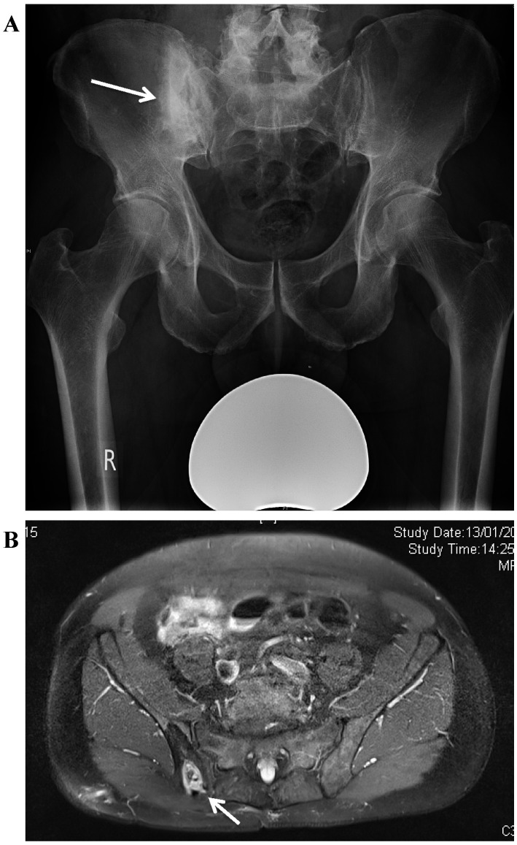
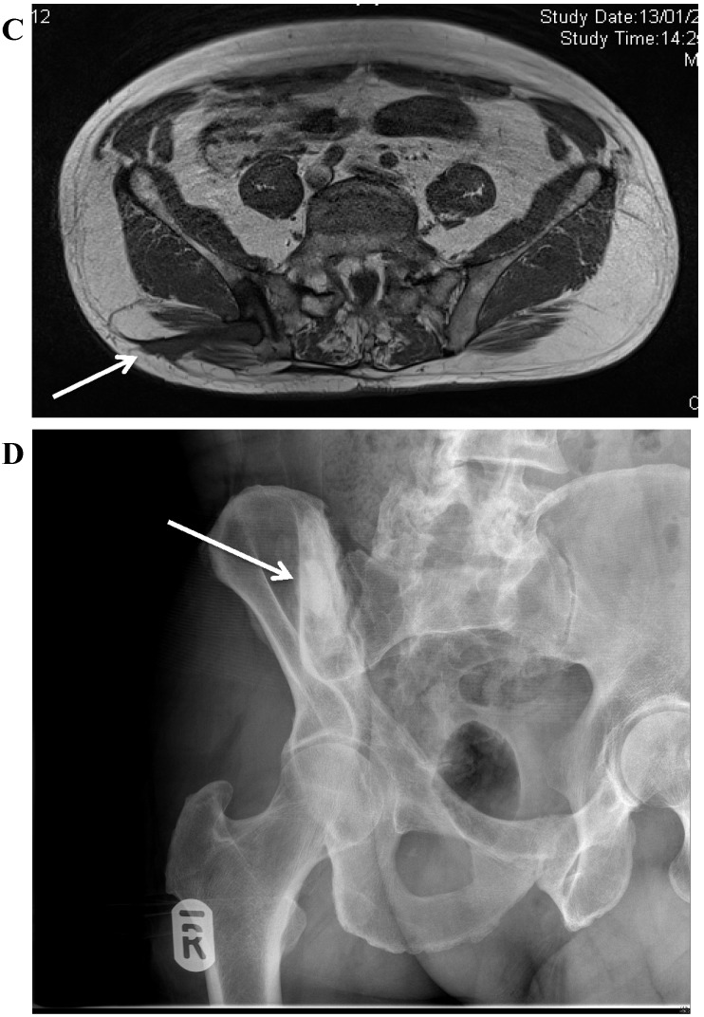
How to treat osteomyelitis of the pelvis?
A. Osteomyelitis of the right posterior ilium after a bone graft harvest for a spinal fusion. There is a central cavity with surrounding increased bone density (involucrum). B. MRI showing the bone destruction in the ilium, with a central area of dead bone. C. MRI demonstrating the bone involvement and sinus formation to the skin of the lateral buttock. D. Postoperative radiograph showing the area of resection. The bone defect has been filled with a bioabsorbable antibiotic carrier with Gentamicin
Dudareva M, Ferguson J, Riley N, Stubbs D, Atkins B, McNally M. Osteomyelitis of the Pelvic Bones: A Multidisciplinary Approach to Treatment. J Bone Jt Infect. 2017;2(4):184-193. Published 2017 Oct 9. doi:10.7150/jbji.21692

Slide 13
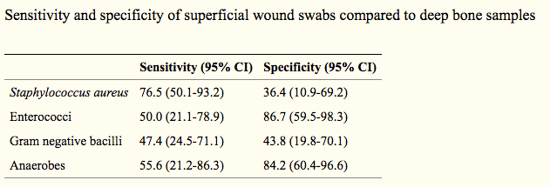
What is microbiology of pressure-related pelvic osteomyelitis?
Russell CD, Tsang SJ, Simpson AHRW, Sutherland RK. Outcomes, Microbiology and Antimicrobial Usage in Pressure Ulcer-Related Pelvic Osteomyelitis: Messages for Clinical Practice. J Bone Jt Infect. 2020;5(2):67-75. Published 2020 Mar 26. doi:10.7150/jbji.41779

Slide 14
What is microbiology of pressure-related pelvic osteomyelitis?
Chronic osteomyelitis of the pelvic bones is uncommon in adults but it is a very debilitating condition. Treatment of osteomyelitis affecting the pelvic bones is challenging due to the anatomic constraints of the pelvis and the high degree of comorbidity in affected patients. Several distinct aetiologies affect different groups of patients.
Pelvic osteomyelitis is commonly polymicrobial; in our cohort we applied a strict definition of positive diagnosis of osteomyelitis on microbiological culture, and it is likely that the definition of 'positive culture' used in the analysis underestimates the diversity of organisms causing infection in each patient.
It is important to involve infection specialists early in these complex cases.
Dudareva M, Ferguson J, Riley N, Stubbs D, Atkins B, McNally M. Osteomyelitis of the Pelvic Bones: A Multidisciplinary Approach to Treatment. J Bone Jt Infect. 2017;2(4):184-193. Published 2017 Oct 9. doi:10.7150/jbji.21692

Slide 15
What is the role of HBO in osteomyelitis of the pelvis?
Because efficient concentrations at the site of infection may be obtained for only a short period, antibiotic therapy may not always lead to long-term arrest of the disease. Delivery at the local level via various vehicles has been effective in the management of refractory cases. Nevertheless, failure of an antibiotic treatment is not uncommon.
Hyperbaric oxygen combined with other important therapeutic interventions, such as antibiotics and/or surgical debridement, was associated with high recovery rates of chronic osteomyelitis, especially when followed by a secure stabilization of the bone and removal of the infected implant. Nevertheless, quality data regarding this finding are scarce.
Savvidou OD, Kaspiris A, Bolia IK, et al. Effectiveness of Hyperbaric Oxygen Therapy for the Management of Chronic Osteomyelitis: A Systematic Review of the Literature. Orthopedics. 2018;41(4):193-199. doi:10.3928/01477447-20180628-02

Slide 16
What is the role of HBO in osteomyelitis of the pelvis?
The one retrospective study that included HBO treatment of osteomyelitis of the pelvis found:
Author, year, location | Type of study | participants | microorganism | Classification system | Intervention | Follow-up | Summary outcome
Eltoria et al 1984 USA | retrospective | Chronic osteomyelitis of the hip (n=28), Pelvis (n=6), lumbar spine (n=3), sacrum (n=5), knee joint (n=2), tibia (n=2), elbow (n=14), in pts with paraplegia (n=30), and tetraplegia (n=14), after spinal cord injury | Staphylococcus aureus, Streptococcus spp Escherichia coli Pseudomonas aeruginosa Enterococcus spp Klebsiella spp Serratia spp | Not reported | Surgical debridement, osteotomies, muscle grafts, antibiotic administration based on antibiogram HBOT | 6 to 108 months | No side effects of the treatment 30 pts considered cure Recurrence in 5 patients Amputation in 5 patients
Savvidou OD, Kaspiris A, Bolia IK, et al. Effectiveness of Hyperbaric Oxygen Therapy for the Management of Chronic Osteomyelitis: A Systematic Review of the Literature. Orthopedics. 2018;41(4):193-199. doi:10.3928/01477447-20180628-02

Slide 17
How to treat incidental vocal polyp?
Vocal cord leukoplakia is characterized by great pathological differences and a certain tendency of malignant transformation.
Narrow band imaging (NBI) endoscopy can identify malignant lesions on the mucosal surface by observing the morphology of intraepithelial papillary capillary loop (IPCL).
In recent years, NBI endoscopy has been gradually applied to the diagnosis of laryngeal lesions.
Lin C, Zhang S, Lu L, Wang M, Qian X. Diagnostic Value and Pathological Correlation of Narrow Band Imaging Classification in Laryngeal Lesions [published online ahead of print, 2020 May 8]. Ear Nose Throat J. 2020.

Slide 18
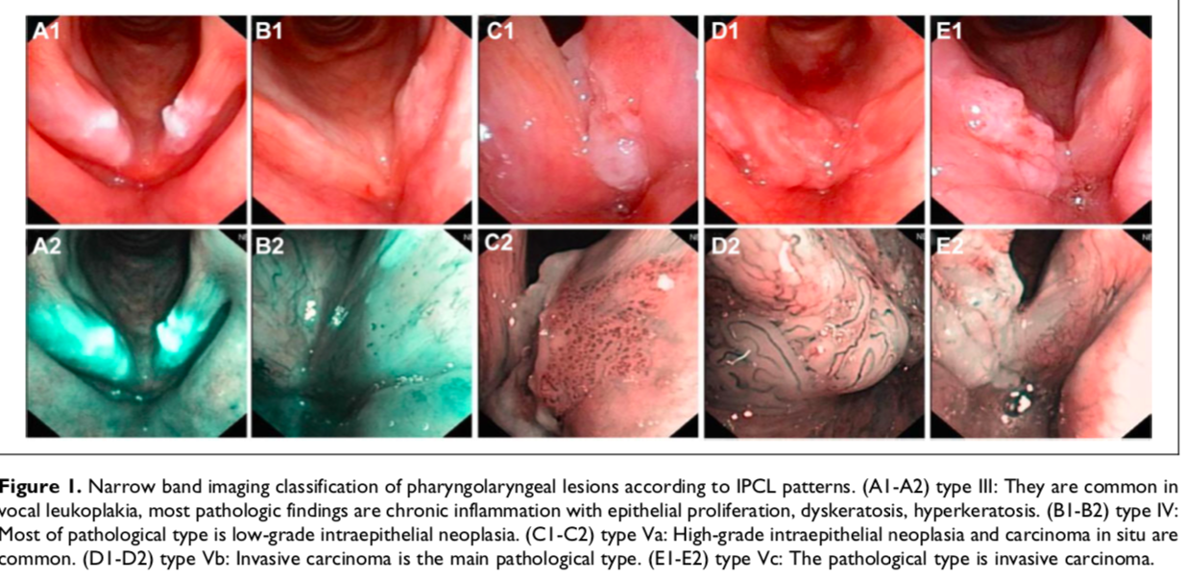
How to treat incidental vocal polyp?
Lin C, Zhang S, Lu L, Wang M, Qian X. Diagnostic Value and Pathological Correlation of Narrow Band Imaging Classification in Laryngeal Lesions [published online ahead of print, 2020 May 8]. Ear Nose Throat J. 2020.

Slide 19
How to differentiate deep tissue injuries?
Necrotising fasciitis is a rapidly progressive inflammatory infection of the fascia, with secondary necrosis of the subcutaneous tissues.
Patients with necrotising soft tissue infections, including necrotising fasciitis may or may not have a history of skin injury.
These patients often report severe pain in the tissues and are quickly septic. Ischaemia is created in the tissues by bacteria such as Streptococcus and Clostridia ; however, many organisms are present in the wound cultures.
The skin may look pale at first, but quickly becomes red or bronze and warm to the touch, and sometimes becomes swollen. Later, the skin turns violet, often with the development of large fluid‐filled blisters.
Drainage from these blisters is brown, watery and sometimes foul‐smelling. Areas of gangrene develop and the patient becomes septic.
Black JM, Brindle CT, Honaker JS. Differential diagnosis of suspected deep tissue injury. Int Wound J. 2016;13(4):531-539.

Slide 20
What is criteria for hospice?
These are the criteria for receiving hospice care, according to CMS:
Your hospice doctor and your regular doctor (if you have one) certify that you’re terminally ill (with a life expectancy of 6 months or less).
You accept palliative care (for comfort) instead of care to cure your illness.
You sign a statement choosing hospice care instead of other Medicare-covered benefits to treat your terminal illness and related conditions
Medicare has established guidelines for hospice admissions for most major terminal illnesses. These guidelines are not necessarily accurate in predicting death within six months.
Careful documentation of the medicare hospice criteria as pertaining to that patient is a convenient way to demonstrate the severity of the illness for patients, family and for colleagues as you all work together to develop appropriate goals of care.
www.medicare.gov/coverage/hospice-care

Slide 21
What is criteria for hospice?
Writing a note in the patient’s chart (either inpatient or outpatient) that documents the eligibility for hospice care based on the CMS guidelines can assist the hospice in making a prompt determination of eligibility and would help if there was every a regulatory question of a patients eligibility.
For patients who have a longer than expected survival, reevaluation at time of re-certification will document that the patient is still eligible for home hospice care. In rare situations were patients have unanticipated recovery, they may be discharged from hospice but readmitted later without penalty, if there is decline in health status.
www.medicare.gov/coverage/hospice-care

