Slide 1
Necrotizing Fasciitis Wednesday, October 9, 2024
Notes:
1

Slide 2
Agenda
Necrotizing fasciitis: overview
What is necrotizing fasciitis?
Clinical appearance of necrotizing fasciitis
How to evaluate for necrotizing fasciitis?
How to diagnose necrotizing fasciitis?
What is pathology of necrotizing fasciitis?
What is role of imaging?
How to differentiate deep tissue injuries?
What are antibiotic options for necrotizing fasciitis?
How to manage infection?
What are treatment options?
What are surgical options?
How to debride?
Is it rapid bacterial progression or lack of early recognition of the infection
Case studies

Slide 3
Necrotizing Fasciitis: Overview
500 to 1500 cases per year in U.S.
A retrospective single-center review showed 35% of cases were initially misdiagnosed as simple cellulitis or severe, non-necrotizing skin infection
Mortality rates between 25 and 35%
Sarani B, Strong M, Pascual J, et al. Necrotizing fasciitis: current concepts and review of the literature. J Am Coll Surg 2009;208(2):279–88.
Anaya DA, McMahon K, Nathens AB, et al. Predictors of mortality and limb loss in necrotizing soft tissue infections. Arch Surg 2005;140(2):151–7.
Haywood CT, McGeer A, Low DE. Clinical experience with 20 cases of group A streptococcus necrotizing fasciitis and myonecrosis: 1995 to 1997. Plast Reconstr Surg 1999;103(6):1567–73.
Anaya DA, Dellinger EP. Necrotizing soft-tissue infection. In: Jong EC, Stevens DL, editors. Netter’s infectious disease. 1st edition. Philadelphia: Saunders; 2012. p. 273–8.

Slide 4
Necrotizing Fasciitis: Overview
1984 NEJM Retrospective review
Early emphasis placed on the utility of frozen section for definitive diagnosis
Current literature, 2012-present
Although local findings may be subtle and non-specific, a high index of clinical suspicion should dictate operative debridement
Haywood CT, McGeer A, Low DE. Clinical experience with 20 cases of group A streptococcus necrotizing fasciitis and myonecrosis: 1995 to 1997. Plast Reconstr Surg 1999;103(6):1567–73.
Anaya DA, Dellinger EP. Necrotizing soft-tissue infection. In: Jong EC, Stevens DL, editors. Netter’s infectious disease. 1st edition. Philadelphia: Saunders; 2012. p. 273–8.
Stamenkovic I, Lew PD. Early recognition of potentially fatal necrotizing fasciitis. The use of frozen-section biopsy. N Engl J Med. 1984;310(26):1689-93.

Slide 5
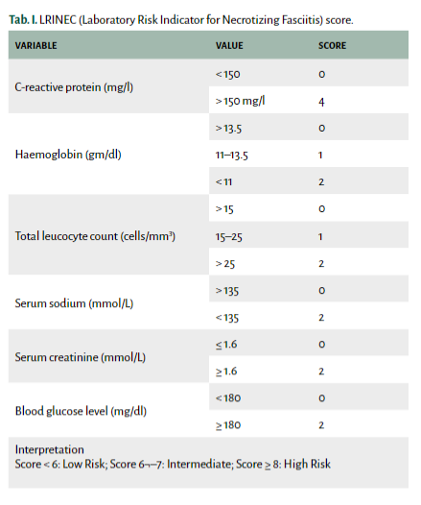
What is necrotizing fasciitis?
Necrotizing fasciitis is an uncommon, rapidly progressive, often aggressive bacterial infection that causes extensive necrosis of the subcutaneous tissue and fascia, relatively sparing the muscle and skin tissues.
Rapid diagnosis of the disease is mandatory because the delay in initiation of aggressive treatment negatively influences the outcome. Specific clinical signs may not be always present, which makes an accurate and timely diagnosis difficult.
Diagnosis of NF can be difficult and a high level of suspicion should be maintained by the clinician.
Chen LL, Fasolka B, Treacy C. Necrotizing fasciitis: A comprehensive review. Nursing. 2020 Sep;50(9):34-40. doi: 10.1097/01.NURSE.0000694752.85118.62. PMID: 32826674; PMCID: PMC8828282.

Slide 6
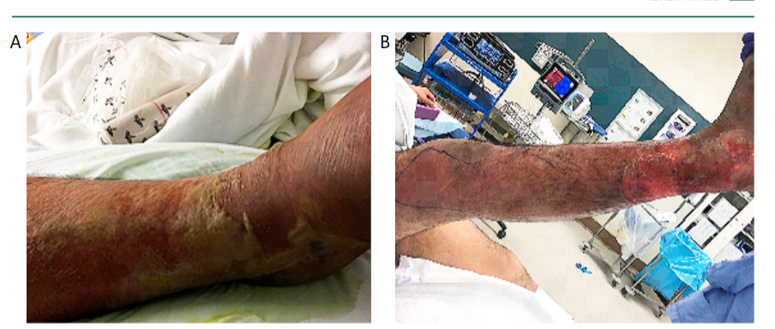
What is clinical appearance of necrotizing fasciitis?
Necrotizing fasciitis of the right lower limb. (A) Day 4 of symptoms with erythema, edema and blisters. (B): Day 5 of symptoms with skin peeling off.
Chen LL, Fasolka B, Treacy C. Necrotizing fasciitis: A comprehensive review. Nursing. 2020 Sep;50(9):34-40. doi: 10.1097/01.NURSE.0000694752.85118.62. PMID: 32826674; PMCID: PMC8828282.

Slide 7
How to evaluate for necrotizing fasciitis?
The Laboratory Risk Indicator for Necrotizing Infection (LRINEC) Score was developed in a 2004 report to distinguish NSTIs from other severe soft tissue infections. The scoring system is hinged on abnormalities in six independent variables:
C-reactive protein, mg/L
Less than 150 (0)
More than 150 (4)
Total white cell count (WBC), cells/mm
Less than 15 (0)
15 to 25 (1)
More than 25 (2)
Hemoglobin, g/dl
More than 13.5 (0)
11 to 13.5 (1)
Less than 11 (2)
Sodium, mmol/L
135 or greater (0)
Less than 135 (2)
Creatinine, mg/dL
1.6 or less (0)
More than 1.6 (2)
Glucose, mg/dL
180 or less (0)
More than 180 (1)
A score of six has a positive predictive value of 92% and a negative predictive value of 96%. A score of eight or greater represents a 75% risk of necrotizing infection.
Wallace HA, Perera TB. Necrotizing Fasciitis. In: StatPearls. Treasure Island (FL): StatPearls Publishing; 2020.

Slide 8
How to diagnose necrotizing fasciitis?
The diagnosis of necrotizing soft tissue infections is still primarily a clinical one. Imaging may be useful in providing data when the diagnosis is uncertain. The most common plain film finding is similar to cellulitis with increased soft tissue thickness and opacity. Computed tomography (CT) has greater sensitivity than plain film in identifying necrotizing soft tissue infections. Z
Plain x-rays have no value in the diagnosis. Sometimes under local anesthesia, one may probe the area with a finger for signs of necrotizing tissue. In most cases, the necrotic tissue can be penetrated with little resistance. Aspiration and gram stain can also be done.
The use of B mode color Doppler ultrasound can help in the early diagnosis of necrotizing fasciitis at the bedside. It should be understood that no lab or imaging test should delay surgical intervention.
Wallace HA, Perera TB. Necrotizing Fasciitis. In: StatPearls. Treasure Island (FL): StatPearls Publishing; 2020.

Slide 9
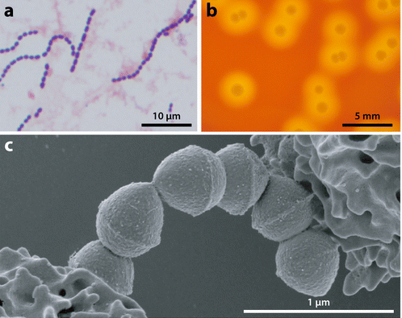
How to make the diagnosis?
Morphology of group A Streptococcus (GAS).
A: micrograph of GAS isolated from the blood of human patient. GAS are gram-positive cocci that grow in pairs and chains.
B: photograph of GAS grown of solid agar media supplemented with sheep blood. GAS forms small, gray-colored, smoothly contoured, round colonies with a distinct zone of beta hemolysis (area of complete clearing around each colony).
C: scanning electron micrograph of GAS organisms interacting with human neutrophils). Pathogen-host interactions and immune evasion are important themes in necrotizing fasciitis pathogenesis.
Olsen RJ, Musser JM. Molecular pathogenesis of necrotizing fasciitis. Annu Rev Pathol. 2010;5:1-31. doi:10.1146/annurev-pathol-121808-102135

Slide 10
Necrotizing Fasciitis
Hussein QA, Anaya DA. Necrotizing soft tissue infections. Crit Care Clin. 2013;29(4):795-806.

Slide 11
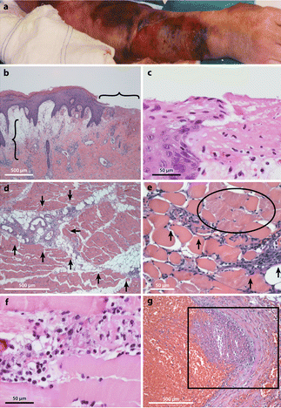
What is pathology of necrotizing fasciitis?
Histopathology features of human necrotizing fasciitis.
A: The arm of this patient infected with group A Streptococcusis very swollen and bruised. A large ulcer is developing on the dorsal forearm. However, the visual appearance still greatly underestimates the true severity of the underlying infection. B: Microscopic evaluation of the skin shows an erosion of the epidermis (horizontal bracket), edematous thickening of the dermis (vertical bracket), and sparse inflammatory cell infiltrate (original magnification 2×). C: These histopathological features of the ulcer and dermal-epidermal junction are better seen at high magnification. D: In the infected deep soft tissue, there are marked necrosis, acute inflammatory cell infiltration, and bacterial organisms that are primarily concentrated along the major fascial planes (arrows). E: The necrosis is observed to extend beyond the fascial planes to also infiltrate along individual muscle fibers (arrows). Numerous nonviable muscle cells are present alongside the advancing infection (circled region). F: At high magnification, four severely damaged muscle fibers are seen. G A characteristic feature of human necrotizing fasciitis is vascular thrombosis (boxed region) and hemorrhage.
Olsen RJ, Musser JM. Molecular pathogenesis of necrotizing fasciitis. Annu Rev Pathol. 2010;5:1-31. doi:10.1146/annurev-pathol-121808-102135

Slide 12
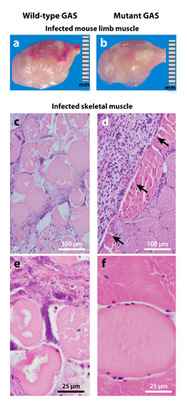
What is pathology of necrotizing fasciitis?
Animal models of group A Streptococcus(GAS) necrotizing fasciitis. To investigate a particular gene of interest, animals are infected intramuscularly with either the wild-type or the isogenic mutant strain, and parameters of disease severity are compared.
(a, b) Photographs of infected mouse limbs demonstrate that the wild-type GAS strain (panel a) causes larger, more hemorrhagic lesions compared to the mutant strain (panel b).
(c, d) Micrographs of infected nonhuman primate limb muscle excised from the inoculation site show that the wild-type GAS strain causes much more severe, widespread fascial and myocyte necrosis (panel c) compared to the confined lesion (arrows) caused by the mutant strain (panel d). (e, f) These features are better seen at high magnification (panel ecompared to panel f).
Olsen RJ, Musser JM. Molecular pathogenesis of necrotizing fasciitis. Annu Rev Pathol. 2010;5:1-31. doi:10.1146/annurev-pathol-121808-102135

Slide 13
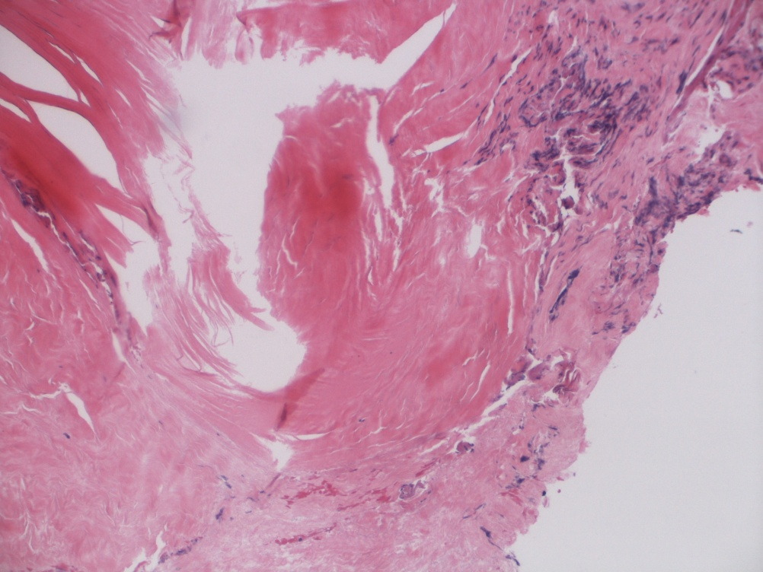
What is the pathology for Necrotizing Fasciitis?
Necrotic fascia
Crushed viable fascia
Necrotic fascia
Turi GK, Donovan V, DiGregorio J, et al. Major Histopathologic Diagnoses of Chronic Wounds. Adv Skin Wound Care. 2016;29(8):376-382. doi:10.1097/01.ASW.0000484665.45022.b3
Notes:
Fascia, left leg, exploration: - Necrotic fibroconnective tissue consistent with fascia.

Slide 14
What is role of Imaging in Necrotizing Fasciitis?
Imaging should play an ancillary role and must never delay surgical treatment (gold standard)
Plain XR: More useful in later stages of disease to identify subcutaneous gas. Limited utility.
CT and MRI: detect fascial thickening, fat infiltration, focal fluid collection, soft-tissue gas, muscle involvement and intra-abdominal extension
Arslan A, Pierre-Jerome C, Borthne A. Necrotizing fasciitis: unreliable MRI findings in the preoperative diagnosis. Eur J Radiol 2000;36(3):139–43.
Wysoki MG, Santora TA, Shah RM, et al. Necrotizing fasciitis: CT characteristics. Radiology 1997;203(3):859–63.
Levenson RB, Singh AK, Novelline RA. Fournier gangrene: role of imaging. Radiographics 2008;28:519–28.

Slide 15
What is role of Imaging in Necrotizing Fasciitis
CT:
Sensitivity: 50-100%
Specificity: 80-81%
PPV: 63-76%
MRI:
Sensitivity: 89-100%
Specificity: 46-86%
PPV: 94%
Note: values are lower in early disease
Hopkins KL, Li KC, Bergman G. Gadolinium-DTPA-enhanced magnetic resonance imaging of musculoskeletal infectious processes. Skeletal Radiol. 1995;24(5):325-30.
Schmid MR, Kossmann T, Duewell S. Differentiation of necrotizing fasciitis and cellulitis using MR imaging. AJR Am J Roentgenol. 998;170(3):615-20.
AJR Am J Roentgenol. 1998 Mar;170(3):615-20. Radiology. 2011 Jun;259(3):816-24. PMID: 9490940.
Zacharias N, Velmahos GC, Salama A, Alam HB, de Moya M, King DR, et al. Diagnosis of necrotizing soft tissue infections by computed tomography. Arch Surg. 2010;145(5):452-5.

Slide 16
MR: Necrotizing Fasciitis on CT Pelvis
Scrotal infection
Perineal infection

Slide 17
MR: Necrotizing Fasciitis on CT Pelvis
Muscle
Skin
Femur
Air from infection
Subcutaneous
Fat
Notes:
Martin Rivera 80361143

Slide 18
How to differentiate deep tissue injuries?
Necrotising fasciitis is a rapidly progressive inflammatory infection of the fascia, with secondary necrosis of the subcutaneous tissues.
Patients with necrotising soft tissue infections, including necrotising fasciitis may or may not have a history of skin injury.
These patients often report severe pain in the tissues and are quickly septic. Ischaemia is created in the tissues by bacteria such as Streptococcus and Clostridia ; however, many organisms are present in the wound cultures.
The skin may look pale at first, but quickly becomes red or bronze and warm to the touch, and sometimes becomes swollen. Later, the skin turns violet, often with the development of large fluid‐filled blisters.
Drainage from these blisters is brown, watery and sometimes foul‐smelling. Areas of gangrene develop and the patient becomes septic.
Black JM, Brindle CT, Honaker JS. Differential diagnosis of suspected deep tissue injury. Int Wound J. 2016;13(4):531-539.

Slide 19
How to differentiate deep tissue injuries?
Black JM, Brindle CT, Honaker JS. Differential diagnosis of suspected deep tissue injury. Int Wound J. 2016;13(4):531-539.

Slide 20
What are antibiotic options for necrotizing fasciitis?
Menichetti F, Giuliano S, Fortunato S. Are there any reasons to change our behavior in necrotizing fasciitis with the advent of new antibiotics?. Curr Opin Infect Dis. 2017;30(2):172-179.

Slide 21
What are antibiotic options for necrotizing fasciitis?
Menichetti F, Giuliano S, Fortunato S. Are there any reasons to change our behavior in necrotizing fasciitis with the advent of new antibiotics?. Curr Opin Infect Dis. 2017;30(2):172-179.

Slide 22
How to manage infection?
Infection. A nonhealing wound, as measured by change in area, is often a sign of occult infection. Use of an informatics system such as the WEMR in the emergency room or clinic setting would allow clinicians to determine if the wound is not healing as compared to previous visits.
Patients with chronic wounds may not present with classic signs of soft tissue infection, such as redness, warmth, swelling, and pain, particularly if they have impaired immune response from aging or impaired local vasodilatation linked to neuropathy. Hence, absence of these classic signs does not rule out a wound infection; the clinician should be aware of the atypical signs of a chronic wound infection and devise a treatment plan. In any person with diabetes and wound pain, even a small ulcer may harbor an infection. Increased drainage in a chronic wound is often a sign of persistent infection. Although the drainage may not be purulent, discoloration or an increase in drainage may be a sign of persistent infection that requires treatment.
Golinko MS, Clark S, Rennert R, Flattau A, Boulton AJ, Brem H. Wound emergencies: the importance of assessment, documentation, and early treatment using a wound electronic medical record. Ostomy Wound Manage. 2009 May 1;55(5):54-61. PMID: 19471049.

Slide 23
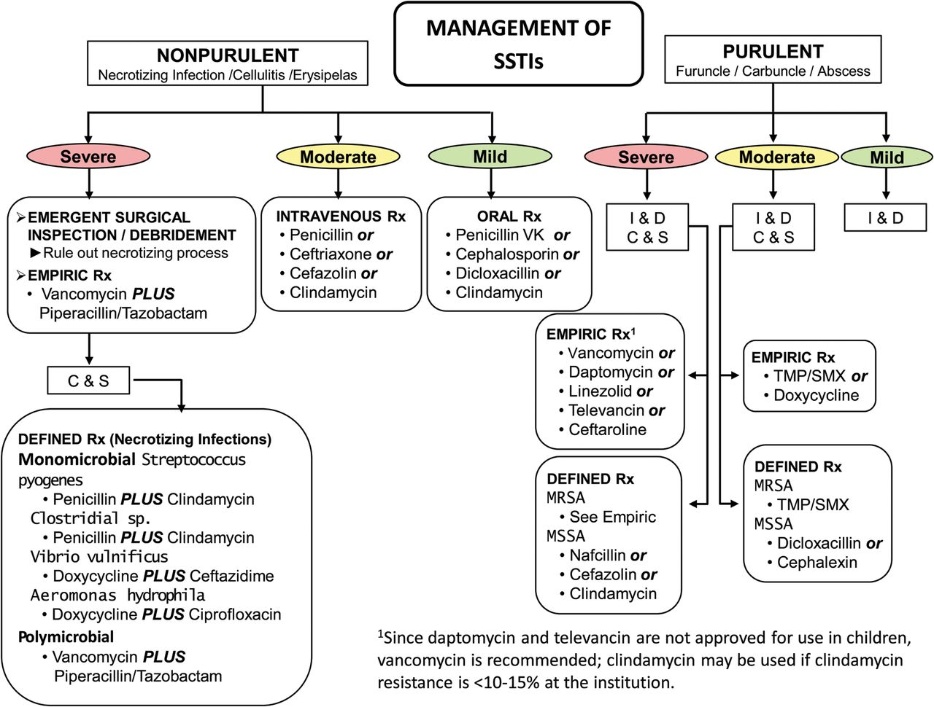
How to manage infection?
Dennis L. Stevens, Alan L. Bisno, Henry F. Chambers, E. Patchen Dellinger, Ellie J. C. Goldstein, Sherwood L. Gorbach, Jan V. Hirschmann, Sheldon L. Kaplan, Jose G. Montoya, James C. Wade, Practice Guidelines for the Diagnosis and Management of Skin and Soft Tissue Infections: 2014 Update by the Infectious Diseases Society of America, Clinical Infectious Diseases, Volume 59, Issue 2, 15 July 2014, Pages e10–e52

Slide 24
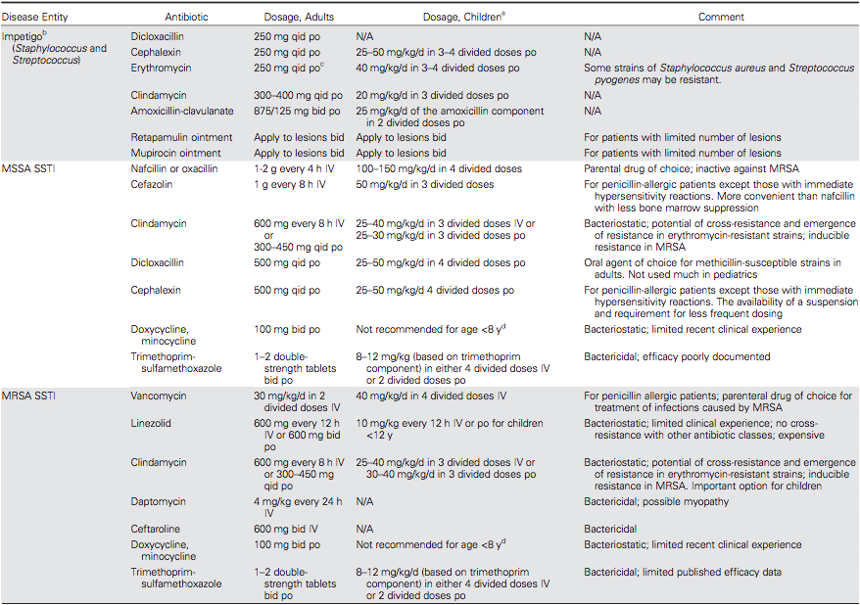
How to manage infection?
Antimicrobial Therapy for Staphylococcal and Streptococcal Skin and Soft Tissue Infections
Dennis L. Stevens, Alan L. Bisno, Henry F. Chambers, E. Patchen Dellinger, Ellie J. C. Goldstein, Sherwood L. Gorbach, Jan V. Hirschmann, Sheldon L. Kaplan, Jose G. Montoya, James C. Wade, Practice Guidelines for the Diagnosis and Management of Skin and Soft Tissue Infections: 2014 Update by the Infectious Diseases Society of America, Clinical Infectious Diseases, Volume 59, Issue 2, 15 July 2014, Pages e10–e52

Slide 25
How to manage infection?
Antimicrobial Therapy for Staphylococcal and Streptococcal Skin and Soft Tissue Infections
Dennis L. Stevens, Alan L. Bisno, Henry F. Chambers, E. Patchen Dellinger, Ellie J. C. Goldstein, Sherwood L. Gorbach, Jan V. Hirschmann, Sheldon L. Kaplan, Jose G. Montoya, James C. Wade, Practice Guidelines for the Diagnosis and Management of Skin and Soft Tissue Infections: 2014 Update by the Infectious Diseases Society of America, Clinical Infectious Diseases, Volume 59, Issue 2, 15 July 2014, Pages e10–e52

Slide 26
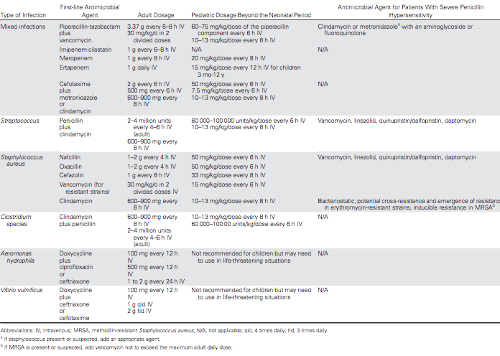
How to manage infection?
Treatment of Necrotizing Infections of the Skin, Fascia, and Muscle
Dennis L. Stevens, Alan L. Bisno, Henry F. Chambers, E. Patchen Dellinger, Ellie J. C. Goldstein, Sherwood L. Gorbach, Jan V. Hirschmann, Sheldon L. Kaplan, Jose G. Montoya, James C. Wade, Practice Guidelines for the Diagnosis and Management of Skin and Soft Tissue Infections: 2014 Update by the Infectious Diseases Society of America, Clinical Infectious Diseases, Volume 59, Issue 2, 15 July 2014, Pages e10–e52

Slide 27
What are treatment options?
Early diagnosis and differentiation between necrotizing and non-necrotizing SSTIs
The early launch of appropriate empiric antibacterial coverage (wide-spectrum)
Adequate control of infection sources such as aggressive surgical intervention for abscess drainage and debridement of necrotizing soft tissue infections (NSTIs)
Identification of infection-causing pathogen and applicable adjustment of antimicrobial coverage.
Antimicrobial therapy of necrotizing fasciitis is as follows:
Linezolid 600 mg twice per day, AND
Piperacillin/Tazobactam 4/0 to 5g LD infused in 30 min then 16/2 g QD by CI OR Daptomycin 6 mg/kg QD, AND
Piperacillin/Tazobactam 4/0 to 5g LD infused in 30 min then 16/2 g QD by CI AND Clindamycin 600 mg to 900 mg four times per day.
Wallace HA, Perera TB. Necrotizing Fasciitis. In: StatPearls. Treasure Island (FL): StatPearls Publishing; 2020.

Slide 28
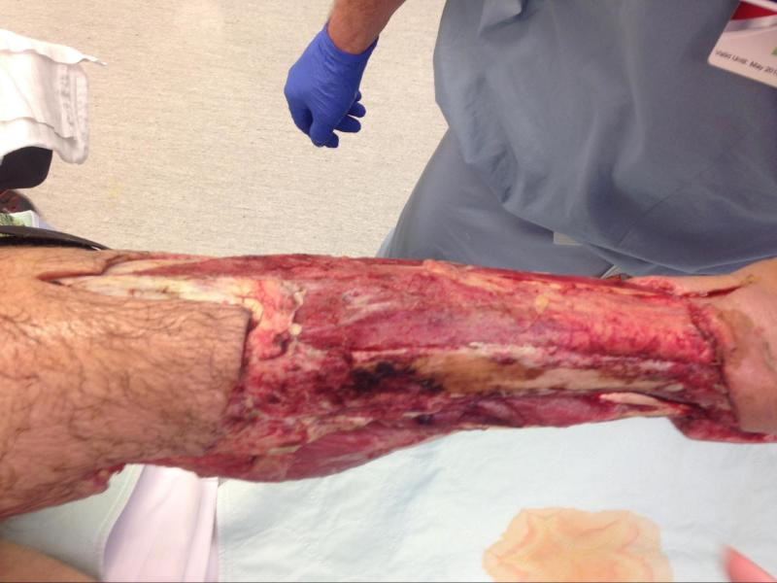
What are surgical options for necrotizing fasciitis?
The surgery requires extensive, wide debridement of all necrotic tissues. In some cases, a second-look surgery may also be required.
Early surgery may help minimize tissue loss and eliminate the need for amputation of a gangrenous extremity. With wide debridement, the wounds need to be left open and are packed with wet gauze. Daily dressing changes are mandatory.
A great deal of surgical judgment is required when faced with normal-appearing tissue which is not frankly necrotic. In most cases, if there is any doubt about viability, the tissues should be removed.
In most cases, hemodynamic stability is restored once the necrotic tissue and pus are removed. The patient should be kept intubated and monitored in a critical care unit. In some patients, daily surgical debridement may be required.
Appearance of lower leg after serial debridements of skin and fascia.
Wallace HA, Perera TB. Necrotizing Fasciitis. In: StatPearls. Treasure Island (FL): StatPearls Publishing; 2020.

Slide 29
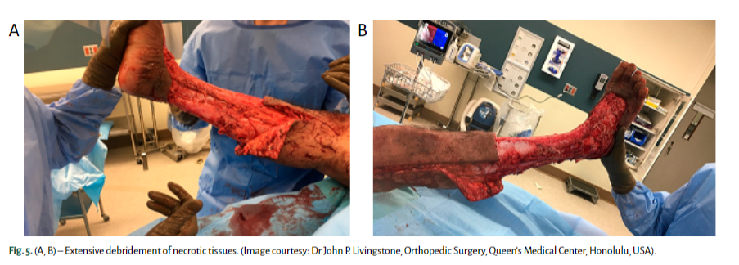
How to debride?
Early and aggressive surgical debridement of necrotic tissue is the cornerstone of management. It reduces the infection burden, minimizes ultimate tissue loss, reduces the need for amputation and thereby, decreases mortality.
Debridement should be extensive and all the necrotic and poorly perfused tissues that can be easily elevated off the fascia with gentle pressure should be excised
Chen LL, Fasolka B, Treacy C. Necrotizing fasciitis: A comprehensive review. Nursing. 2020 Sep;50(9):34-40. doi: 10.1097/01.NURSE.0000694752.85118.62. PMID: 32826674; PMCID: PMC8828282.

Slide 30
Is it Rapid Bacterial Progression or Lack of Early Recognition of the Infection ?
Necrotizing Infection at Fascial and Muscle Layers

Slide 31
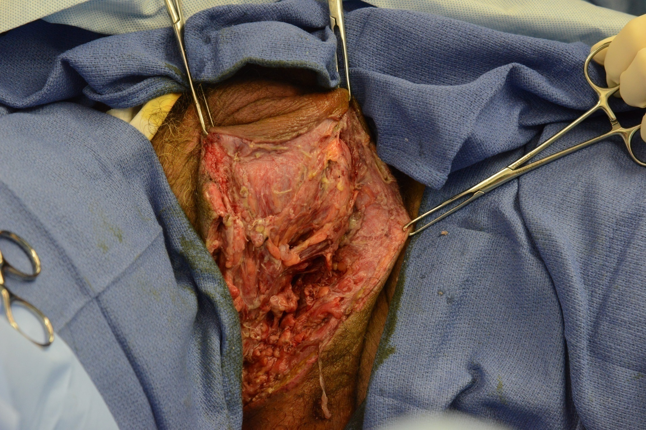
MR

Slide 32
MR: 11/25/14
Notes:
11/22/14
11/23
11/25
11/26 colostomy
12/1
12/3

Slide 33
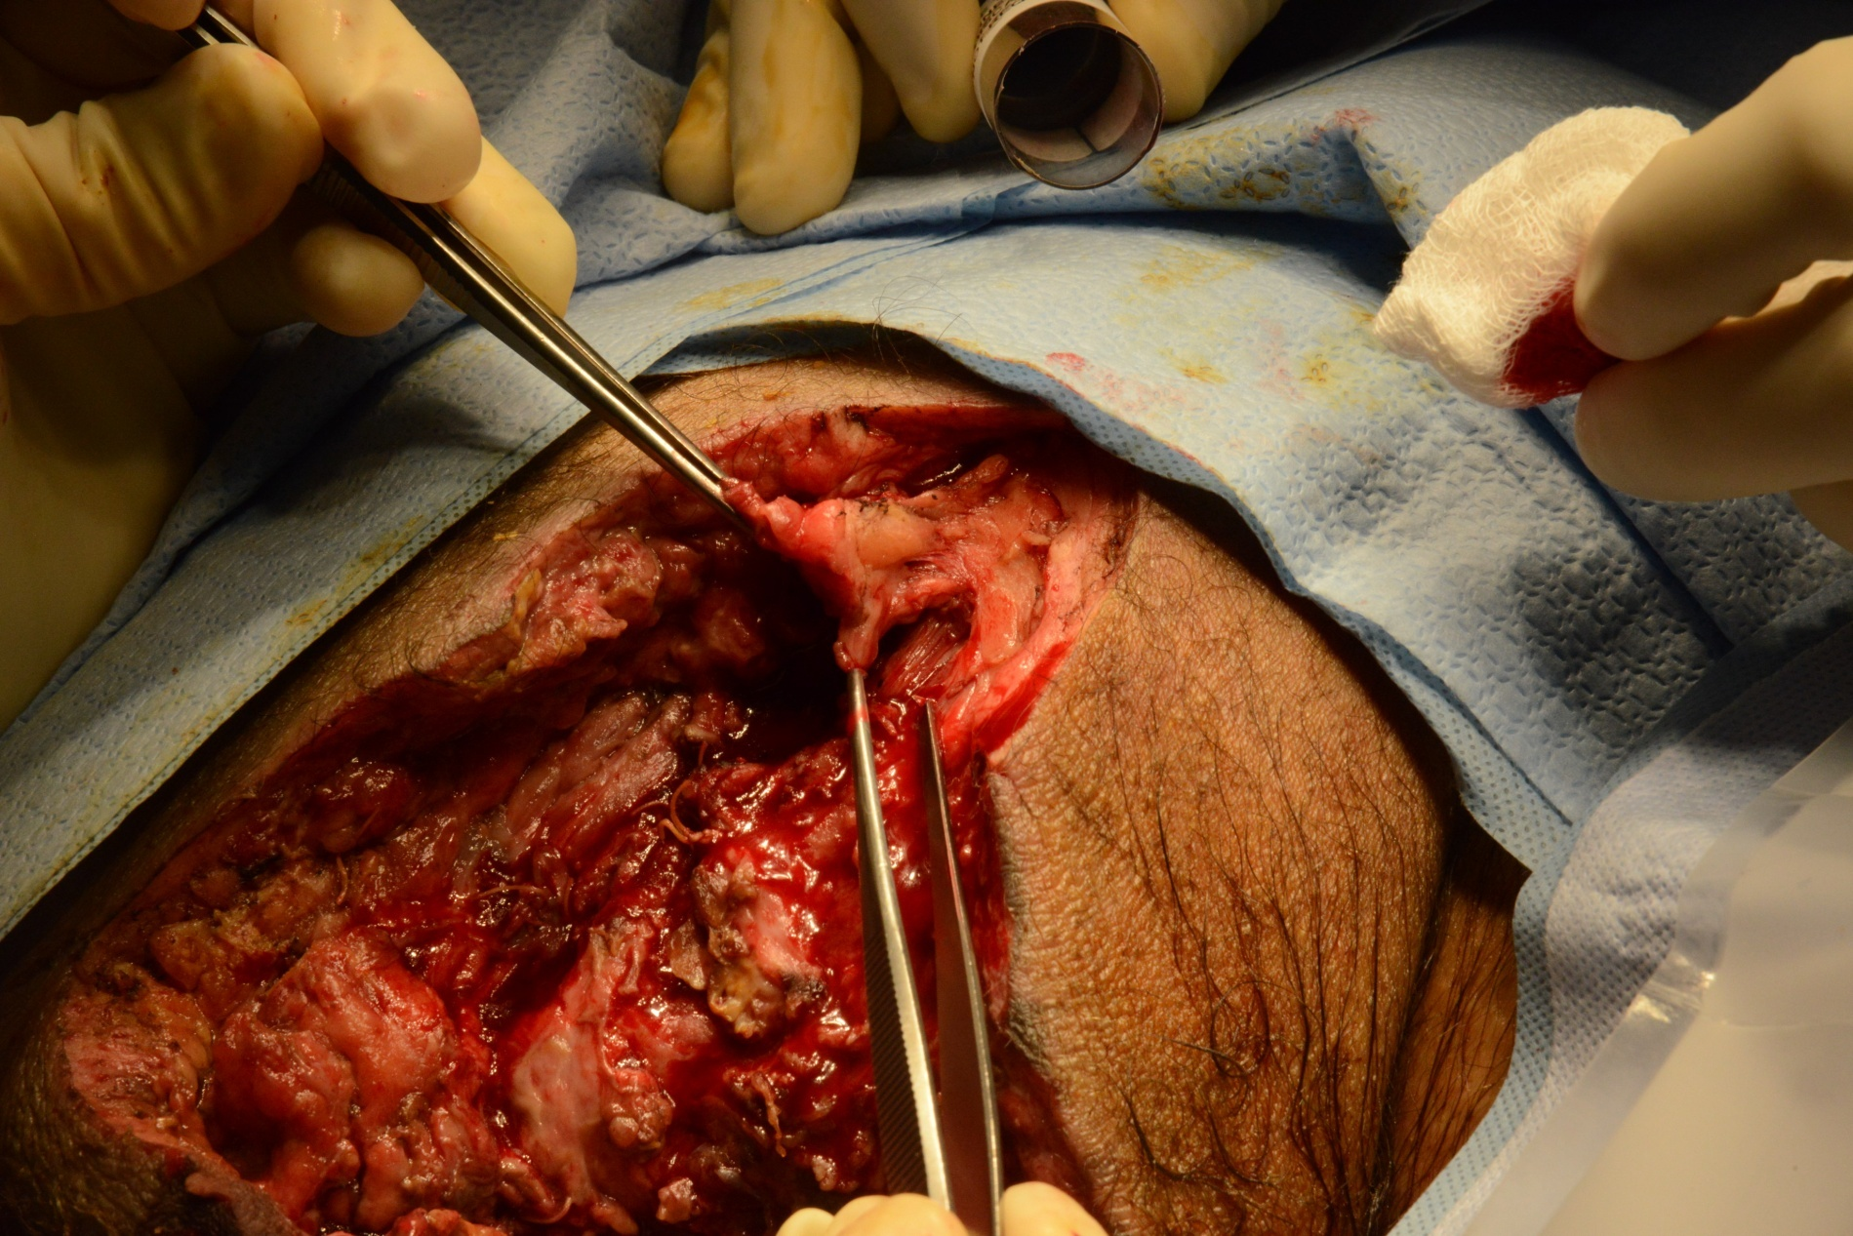
MR

Slide 34
MR
Necrotic skin
Healthy undermined skin

Slide 35
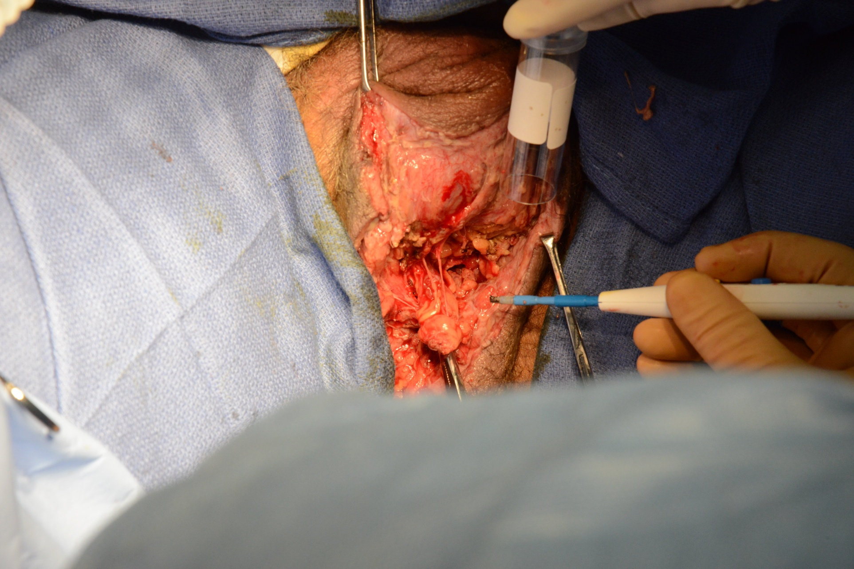
MR

Slide 36
Findings
Gram Stain: WBCs, gram pos cocci in pairs, chains and clusters, gram neg rods, gram pos rods
Culture: coagulase neg staphylococcus, actinomyces, peptostreptococcus prevotii, peptostreptococcus asaccharolyticus

Slide 37
Findings
Pathology:
R buttock
Skin and subcutaneous tissue with marked necrotizing acute panniculitis, extensive throughout deep adipose tissue
Microabscess formation within deep subcutaneous adipose tissue is identified
Necrotic deep fascia with acute inflammation is identified, suggestive of necrotizing fasciitis

Slide 38
Findings
Pathology:
Scrotum:
Fragments of soft tissue with acute inflammation, necrosis, and necrotic adipose tissue with inflammation
Large nerve structures surrounding acute inflammatory exudate are identified
Blood vessels with secondary type vasculitis are identified
Deep soft tissue necrotizing acute inflammation

Slide 39
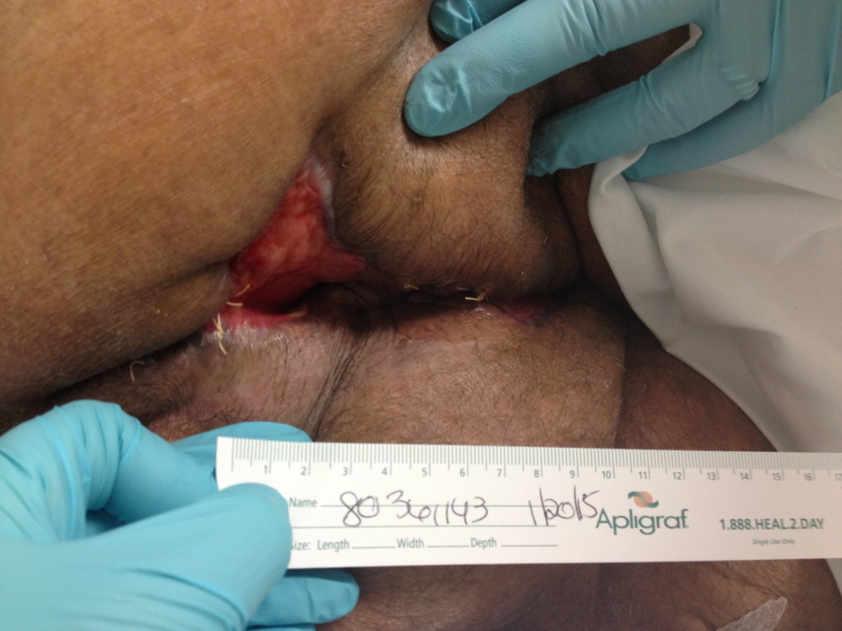
MR 1/20/15
2 months post-op

Slide 40
MR 4/7/15
5 months post-op

Slide 41
Is it Rapid Bacterial Progression or Lack of Early Recognition of the Infection ?
Necrotizing Infection at Fascial and Muscle Layers

