Slide 1
Necrotizing Fasciitis of Hand and Forearm and Neuromas Wednesday, October 2, 2024
Notes:
1

Slide 2
Agenda
Clinical presentation
Pathology report
Microbiology
What is significance of early recognition of necrotizing fasciitis of hand and wrist?
What tests are useful in diagnosis of necrotizing fasciitis of hand and wrist?
How are necrotizing infections classified?
What is underlying pathology of necrotizing infections?
What are treatment options for necrotizing infections?
What are pitfalls in diagnosis and treatment?
”Traumatic” neuroma of sacral nerve
How to treat neuromas?
How to treat neuropathic pain
What are reported clinical outcomes?
How to treat neuromas?: Summary

Slide 3
Clinical Presentation: Necrotizing fascitiis of the hand and forearm
Age: 53
Previous bilateral below knee amputation from diabetic foot ulcers
Previous surgery of knee and patella (HB) with complete healing
Presented with necrotizing fasciitiis or hand and forearm
Necrotizing fasciiitis of hand and forearm
Extensive Poly
Dorsal on the forearm
Origin is the middle third of posterior surface of ulna, interosseous membrane.
Distal phalynx

Slide 4
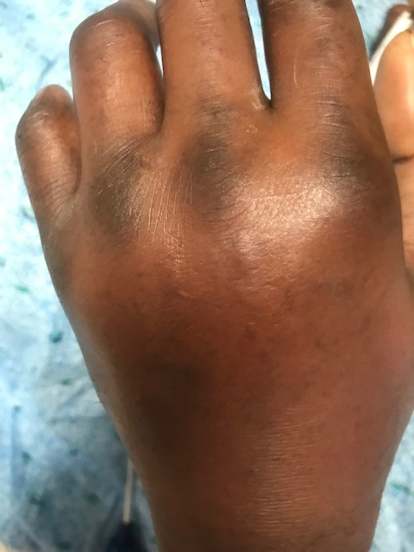
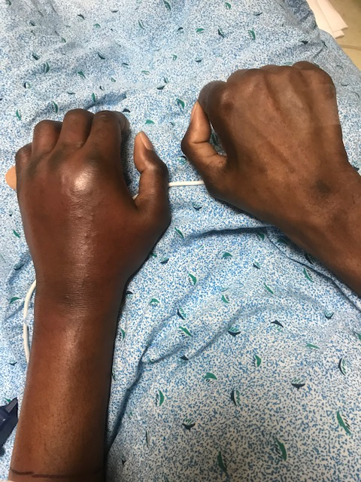
Clinical Presentation: Necrotizing fascitiis of the hand and forearm

Slide 5
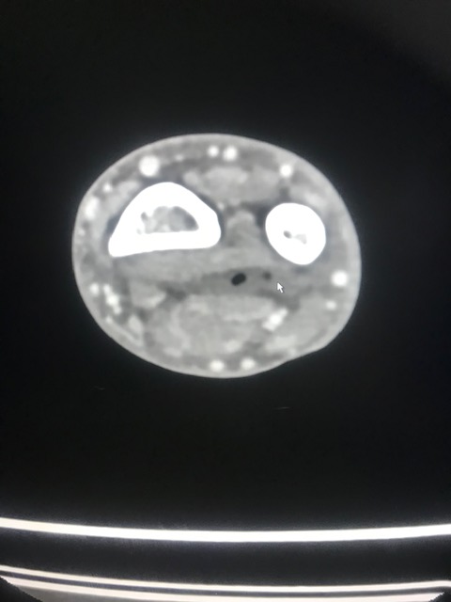
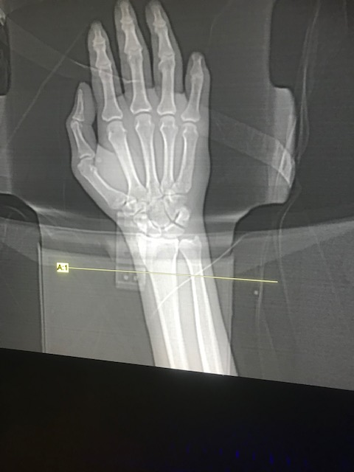
Clinical Presentation: Necrotizing fascitiis of the hand and forearm

Slide 6
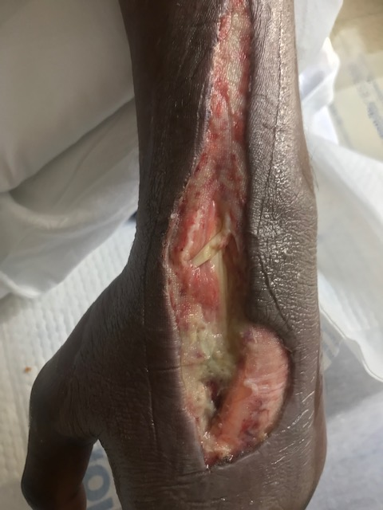
Necrotizing fascitiis of the hand and forearm
Note extension of P longus tendon in middle

Slide 7
Necrotizing fascitiis of the hand and forearm
A. Fascia of wrist: left hand.
Fragment of fibroconnective tissue and scant adipose tissue showing acute and chronic inflammation with focal necrosis and fibrinous exudate.
B. Skin of left hand:
Segment of skin and subcutaneous showing: focal acute and chronic inflammation, necrosis, and venous thrombosi with organization and recanalization.

Slide 8
Pathology report
A. Bone and marrow space showing changes with chronic osteomyelitis.
Bundles of nerve tissue suggestive of traumatic neuroma
B. Right sacral bone: Bone and marrow space showing changes with osteomyelitis.
C. Superficial sacral and buttock wound: Dense fibrous tissue and granulation tissue with mild acute chronic inflammation, edematous.
Small fragments of bone.

Slide 9
Microbiology
Positive for methicillin-susceptible Staphylococcus aureus by Verigent nucleic acid test.

Slide 10
Microbiology
Pitfalls: patients with diabetes cannot rely solely on the cultures as pathological organisms are routinely present and not cultured.
Endpoint to narrow antibiotics in cases of severe infection in patients with diabetes should be a normal white count and a final culture report.

Slide 11
What is significance of early recognition of necrotizing fasciitis of hand and wrist?
Necrotizing infections of the hand and wrist are important clinical entities because of their rapidly progressive and potentially lethal nature.
If the brief prodromal period of these infections goes unrecognized, a local area of devitalized tissue can evolve into fulminant infection, multiorgan failure, and potentially death.
Early recognition and treatment including administration of broad-spectrum antibiotics and surgical debridement are paramount to improving patient outcomes.
Choueka, Jack MD; De Tolla, Jadie E. MD Necrotizing Infections of the Hand and Wrist: Diagnosis and Treatment Options, Journal of the American Academy of Orthopaedic Surgeons: January 15, 2020 - Volume 28 - Issue 2 - p e55-e63 doi: 10.5435/JAAOS-D-17-00716

Slide 12
What is significance of early recognition of necrotizing fasciitis of hand and wrist?
The clinical diagnosis of necrotizing soft tissue infections (NSTI) of the upper extremity can be challenging secondary to the complexity and density of anatomic structures in this region. Although NSTI commonly occurs after local trauma, the trauma can be benign or remote. The early stages of NSTI are characterized by nonspecific findings such as localized edema and erythema. These subtle findings can be difficult to differentiate from indolent soft-tissue infections of the hand and wrist such as cellulitis or abscess. In apparent indolent soft-tissue infections, careful monitoring is warranted to identify cases demonstrating the potential for rapid deterioration into a more fulminant condition.
The diagnosis of NSTI is generally made clinically and later corroborated with intraoperative findings and frozen section. Laboratory and radiologic studies can aid in confirming the clinical diagnosis and providing important diagnostic and prognostic information, however should never delay early treatment of this life-threatening disease
Choueka, Jack MD; De Tolla, Jadie E. MD Necrotizing Infections of the Hand and Wrist: Diagnosis and Treatment Options, Journal of the American Academy of Orthopaedic Surgeons: January 15, 2020 - Volume 28 - Issue 2 - p e55-e63 doi: 10.5435/JAAOS-D-17-00716

Slide 13
What tests are useful in diagnosis of necrotizing fasciitis of hand and wrist?
Imaging studies can assist in the diagnosis of NSTI of the hand and wrist in equivocal cases. However, surgical intervention should never be delayed when waiting for advanced imaging if one has a high clinical suspicion of NSTI. Ultrasonography is preferred because of its accessibility. On ultrasonography, hypoechoic fluid between the muscle and subcutaneous tissue and hyperechoic gas adjacent to the fascia can indicate fascial necrosis.
In addition to imaging, a bedside cut-down or "finger test" may be used in patients with signs and symptoms suspicious for early NSTI before definitive surgery. This procedure is performed under local anesthesia. The finger test has historically been described as a 2-cm incision made in the area of interest down to the deep fascia followed by gentle probing with a finger. In the hand and wrist, the authors recommend making a 1-cm incision and passing a blunt hemostat. Findings that correlate with NSTI include the presence of "dishwater" fluid (which is a product of polymorphic cell lysis), lack of resistance to blunt dissection, and absence of bleeding tissue. Rapid frozen-section biopsy following the bedside cut-down test as well as culture and gram stain should be performed.
Choueka, Jack MD; De Tolla, Jadie E. MD Necrotizing Infections of the Hand and Wrist: Diagnosis and Treatment Options, Journal of the American Academy of Orthopaedic Surgeons: January 15, 2020 - Volume 28 - Issue 2 - p e55-e63 doi: 10.5435/JAAOS-D-17-00716

Slide 14
What tests are useful in diagnosis of necrotizing fasciitis of hand and wrist?
Intraoperative examination and histopathology are the benchmark for confirming the diagnosis of NSTI. Histology of the affected tissue reveals infiltration of the fascia and dermis by polymorphic nuclear cells, thrombosis and necrosis of the arteries and veins, and the presence of microorganisms within the necrotic fascia and dermis. These histologic findings are present even in early stages of NSTI
Early clinical signs and symptoms of NSTI are often confused with cellulitis. Standard laboratory tests, bedside cut-downs, and imaging can assist in the early differential diagnosis of NSTI and cellulitis as discussed. Practitioners should also be aware of other mimickers of NSTIs to provide appropriate treatment and avoid unnecessary and invasive surgery. Pyoderma gangrenosum is a dermatologic condition that is often associated with ulcerative colitis and can easily be mistaken for infectious conditions such as NSTI. Clinically, this condition has four main variants with the ulcerative form being the most common. This condition begins with the presence of a papule or nodule, which progresses rapidly to painful ulcerated lesions with central necrosis. Treatment includes local wound care, steroids, and immunosuppressant medications. Surgical excision is contraindicated because it may exacerbate the disease and result in extension of necrosis
Choueka, Jack MD; De Tolla, Jadie E. MD Necrotizing Infections of the Hand and Wrist: Diagnosis and Treatment Options, Journal of the American Academy of Orthopaedic Surgeons: January 15, 2020 - Volume 28 - Issue 2 - p e55-e63 doi: 10.5435/JAAOS-D-17-00716

Slide 15
How necrotizing infections classified?
NSTIs can be classified based on anatomic location, depth of involvement, or microbial pathogen. These classification systems provide context for typical presentations and affected cohorts, however do little to dictate clinical management or predict morbidity and mortality. Four microbial subtypes of NSTI have been described.
Type I infections, which represent 70% to 80% of cases, are polymicrobial involving both aerobic and anaerobic organisms and are often synergistic. They occur in older patients with underlying medical comorbidities and are more commonly found in the trunk and perineum. These infections tend to be more indolent in nature with the exception of clostridial infections. Clostridium perfringens is now a rare cause of NSTI secondary to improvements in sanitation and hygiene.
Type II infections are monomicrobial and comprise approximately 20% to 30% of cases. They are caused by group A beta-hemolytic streptococci (GAS) either alone or in association with Staphylococcus aureus. Unlike type I infections, type II infections occur in any age group and often occur in persons without medical comorbidities. These infections classically occur in the extremities, and patients often have a history of trauma, surgery, or IV drug abuse. Associated group A streptococcal toxic shock syndrome contributes to the aggressive clinical course of these infection.
Type III infections comprised gram-negative marine bacteria, most commonly V vulnificus. These infections are associated with marine injury and moderate to severe liver disease. They occur more commonly in coastal communities, particularly in Asia. Similar to type II infections with associated toxic shock syndrome, V vulnificus NSTI has a fulminant course with early signs of septic shock and a mortality rate of 30% to 40%.
Type IV fungal infections are rare and primarily affect immunocompromised patients. These infections often have a high mortality rate and aggressive clinical course with rapid extension of involved areas.
Choueka, Jack MD; De Tolla, Jadie E. MD Necrotizing Infections of the Hand and Wrist: Diagnosis and Treatment Options, Journal of the American Academy of Orthopaedic Surgeons: January 15, 2020 - Volume 28 - Issue 2 - p e55-e63 doi: 10.5435/JAAOS-D-17-00716

Slide 16
What is underlying pathology of necrotizing infections?
NSTIs are believed to be caused by a breakdown in tissue integrity; however, many infections arise spontaneously in subcutaneous tissues without an apparent wound or lesion. These infections occur through either direct or hematogenous spread. Microbial introduction is followed by subcutaneous tracking of bacteria along fascial planes. Bacteria produce toxins that cause vessel thrombosis, tissue ischemia, and liquefactive necrosis. The thrombosis of perforating vessels to the skin promotes further dissemination of infection and eventually skin necrosis.
Although the underlying pathophysiology is analogous in all types of NSTIs, the rate of progression and presence of systemic toxicity varies depending on the causative organism or organisms. For instance, clostridial and GAS NSTI usually progress within a few hours after initial inoculation.
The lethal nature of clostridial infections can be attributed to its alpha and theta exotoxins. The alpha-toxin causes platelet aggregation and thrombus formation, leading to tissue ischemia and necrosis. This condition creates an environment primed for bacterial proliferation. Systemically, the alpha and theta toxins impede phagocyte function, cause intravascular hemolysis, increase endothelial permeability, and decrease vascular tone, leading to cardiovascular collapse. In addition, the alpha-toxin produced by the Clostridium species causes extensive muscle necrosis and is responsible for clostridial myonecrosis, which is often referred to as gas gangrene. The distinguishing feature of clostridial myonecrosis is its almost uniform involvement of muscle, which is usually spared in other forms of NSTI
Choueka, Jack MD; De Tolla, Jadie E. MD Necrotizing Infections of the Hand and Wrist: Diagnosis and Treatment Options, Journal of the American Academy of Orthopaedic Surgeons: January 15, 2020 - Volume 28 - Issue 2 - p e55-e63 doi: 10.5435/JAAOS-D-17-00716

Slide 17
What are treatment options for necrotizing infections?
The treatment of choice for necrotizing fasciitis includes urgent and aggressive surgical debridement combined with intravenous antibiotics. In order to achieve adequate debridement, longitudinal incisions along the extremity must be performed followed by excision of all necrotic tissues.
Repeated debridements every 24 to 48 hours may be required in order to control the infection. Survival rate for upper-extremity necrotizing fasciitis is reported to be more than 90% if early and adequate debridement and broad-spectrum antibiotics administration is undertaken.
The outcome is not optimal in patients older than 50 years, those with chronic illnesses or diabetes mellitus, and those with involvement of the trunk.
Flevas DA, Syngouna S, Fandridis E, Tsiodras S, Mavrogenis AF. Infections of the hand: an overview. EFORT Open Rev. 2019;4(5):183-193. Published 2019 May 10. doi:10.1302/2058-5241.4.180082

Slide 18
What are pitfalls in diagnosis and treatment?
Pitfalls: patients with diabetes cannot rely solely on the cultures as pathological organisms are routinely present and not cultured.
Endpoint is to narrow antibiotics in cases of severe infection in patients with diabetes should be a normal white count and a final culture report.

Slide 19
“Traumatic” neuroma of sacral nerve
Age: 62
Patient presented with fever chills and sepsis.
Failed myocutaneous flap, other institution
History of paraplegia status post trauma x 10 years. Neurostomy and colostomy and remote past

Slide 20
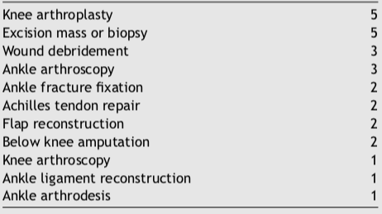
How to treat neuromas?
Surgical cause of neuroma (n=27)
The outcomes for neuroma excision and implantation alone are modest. Contemporary treatments for neuroma such as allograft reconstruction, targeted muscle reinnervation , or regenerative peripheral nerve interface have demonstrated improved pain compared with conventional techniques, especially in amputees.
Surgical techniques that “actively” address the nerve end may further improve the treatment outcomes of surgery for lower extremity neuroma.
Further prospective study is required to determine the effectiveness of newer, active techniques for lower extremity neuroma management, such as allograft reconstruction, targeted muscle reinnervation , and regenerative peripheral nerve interface.
Surgical cause of neuroma (n=27)
Anantavorasakul N, Lans J, Macken AA, Sood RF, Chen NC, Eberlin KR. Surgery for lower extremity symptomatic neuroma: Long-term outcomes. J Plast Reconstr Aesthet Surg. 2020;73(8):1456-1464. doi:10.1016/j.bjps.2020.01.034

Slide 21
How to treat neuromas?
Peripheral neuroma caused by injuries and surgical procedures can result in traumatic neuropathic pain, functional impairment and psychological distress, severely decreasing the quality of life.
A traumatic neuroma is a tangle of neural fibers and connective tissue that develops following nerve injury. It usually presents as a firm, oval, whitish, slowly growing, palpable and painful nodule, not larger than 2 cm. It may be associated with paresthesia over the injured area.
Painful hypersensitivity to normal light tactile stimuli (dysesthesia) or a neuralgic pain with the presence of a typical trigger point in the area of a neuroma may be a prominent feature. Traumatic neuropathic pain can cause the patient to feel burning, stabbing, raw, gnawing or sickening sensations.
Numerous techniques for neuroma prevention and treatment have been proposed, including therapeutic massage, electrical stimulation, lipofilling, transposition of the proximal stump into the muscle, bone or vein, and neural capping with synthetic or biological materials. The diversity of treatment modalities in use reflects the currently frustrating clinical prognosis and high failure rates.
Currently, the treatment of traumatic neuroma is challenging with varied symptoms among patients, some of which are usually resistant to common analgesics, and a standardized management is highly demanded in clinical practice.
Yao C, Zhou X, Zhao B, Sun C, Poonit K, Yan H. Treatments of traumatic neuropathic pain: a systematic review. Oncotarget. 2017;8(34):57670-57679. Published 2017 Apr 7. doi:10.18632/oncotarget.16917

Slide 22
How to treat neuromas?
Medication should be doctors’ first choice for patients who develop traumatic neuropathic pain for the first time, it also should be advised for prevention postoperatively.
For patients who undergo intractable traumatic neuropathic pain, which is refractory to medication, surgical procedure is advised. As for which kind of surgery should be performed, it depends on which particular nerve is injured. For example, neuroma of palmar cutaneous branch (PCB) of the median nerve can be transpositioned into the pronator quadratus, while the traumatic neuropathic pain in an amputated finger is suggested to be treated with interdigital neurorrhaphy.
In general, resection of the existing neuroma is strongly advised for all the patients with traumatic neuropathic pain. Transposition and relocation of the nerve stump into a biological tunnel away from partial compression, for instance, muscles, bones and veins are necessary to assure long term efficacy.
Artificial conduits can be used under the circumstances that no suitable biological tunnel can be found. Soft tissues treatment, for instance, flaps and lippofilling can provide better prognosis for those patients with large scale of tissue defect and deep soft tissue injury.
For patients with intractable traumatic neuropathic pain refractory to medication and refuse any surgical treatment or have little satisfaction with surgery, physiotherapy as electrostimulation and massage may also be good choices.
Yao C, Zhou X, Zhao B, Sun C, Poonit K, Yan H. Treatments of traumatic neuropathic pain: a systematic review. Oncotarget. 2017;8(34):57670-57679. Published 2017 Apr 7. doi:10.18632/oncotarget.16917

Slide 23
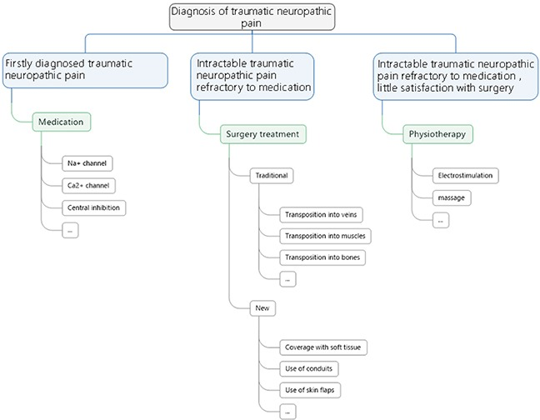
How to treat neuropathic pain?
A flowchart of treatment principles for neuropathic pain
Yao C, Zhou X, Zhao B, Sun C, Poonit K, Yan H. Treatments of traumatic neuropathic pain: a systematic review. Oncotarget. 2017;8(34):57670-57679. Published 2017 Apr 7. doi:10.18632/oncotarget.16917

Slide 24
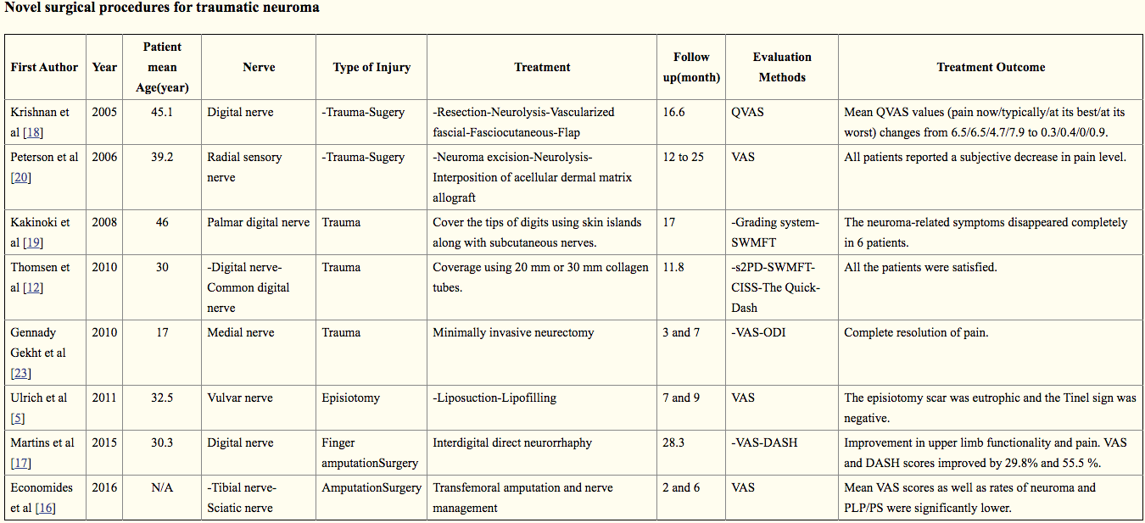
What are reported clinical outcomes?
Yao C, Zhou X, Zhao B, Sun C, Poonit K, Yan H. Treatments of traumatic neuropathic pain: a systematic review. Oncotarget. 2017;8(34):57670-57679. Published 2017 Apr 7. doi:10.18632/oncotarget.16917

Slide 25
How to treat neuromas?: Summary
A practical and standardized treatment modality is desirable, as it would allow a better comparison of results from different studies. However, there are great differences in published treatments, especially between choices of surgical procedures and medicines.
Several of these treatments are better regarding to a specific aspect of prevention and efficacy. Considering the different injured nerves and different kind of symptoms, it is unlikely that a single treatment modality could be of reference for all.
The expression of alpha smooth muscle actin (α-SMA) may contribute to neuroma-associated pain either as a direct cause of pain or an indirect marker of existence of local mechanical stimuli. The potential role of α-SMA in the pathobiology of traumatic neuropathic pain might be considered as a treatment option in clinical practice.
Due to the great differences in all aspects of the different treatment modalities (nerves, types of injury and evaluation methods), it is not possible to statistically compare the reviewed studies and their results; thus, evidence-based indications for the standardization of neuroma treatment modalities are not easily extrapolated.
Yao C, Zhou X, Zhao B, Sun C, Poonit K, Yan H. Treatments of traumatic neuropathic pain: a systematic review. Oncotarget. 2017;8(34):57670-57679. Published 2017 Apr 7. doi:10.18632/oncotarget.16917

