Slide 1
Leapfrog, Diabetes, and Limb Salvage Wednesday, August 7, 2024
Notes:
1

Slide 2
Agenda
Goals
Media reporting on the problem
What is Leapfrog?
Leapfrog Diabetes Recognition Program
What are requirements for Leapfrog recognition?
How does Leapfrog weigh its quality measures?
What is the rationale for the program?
What is the protocol for patients with diabetes at risk for limb loss?
What is protocol for patient history.
Laboratory tests.
Radiographic tests
What are antibiotic recommendations based on severity of infection?
What is relevance of Hemoglobin A1c on healing?
What is importance of Ankle brachial index?
What are reported readmission rates?
What is action plan to prevent amputations upon admission?

Slide 3
Goals
0% amputation rate for any patient with diabetes and lower extremity ulcers.
Our hypothesis: by following protocol and recognizing early warning signs, all amputations can be prevented.

Slide 4
Media reporting on the problem
https://www.nytimes.com/2024/01/16/us/diabetes-san-antonio-texas-amputations.html
https://www.nytimes.com/2023/11/27/opinion/peripheral-artery-disease.html

Slide 5
What is Leapfrog?
Founded in 2000 by large employers and other purchasers, The Leapfrog Group is a national nonprofit organization driving a movement for giant leaps for patient safety. The Leapfrog Hospital Safety Grade, Leapfrog's other main initiative, assigns letter grades to hospitals based on their record of patient safety, helping consumers protect themselves and their families from errors, injuries, accidents, and infections.
Rahway hospital is one of a select few hospitals in New Jersey that receives a consistent yearly “A” grade.

Slide 6
What is the Leapfrog Diabetes Recognition Program (aka “Recognized Leader in Caring for People Living with Diabetes”?
The Leapfrog Group and the American Diabetes Association (ADA) partnered to launch an inpatient diabetes recognition program called Recognized Leader in Caring for People Living with Diabetes
It is the first-ever national recognition program that will recognize hospitals providing safe and high-quality health care for people living with diabetes.
Adult and general acute hospitals and specialty hospitals that care for adult inpatients and have submitted a 2023 Leapfrog Hospital Survey are eligible to apply for the designation. A badge will be given to only the top performers and displayed on Leapfrog’s public reporting website. Hospitals that do not meet the criteria will not be identified.
https://www.leapfroggroup.org/recognized-leader-diabetes/about-the-program#:~:text=Recognized%20Leader%20in%20Caring%20for%20People%20Living%20with%20Diabetes%20is,for%20patients%20living%20with%20diabetes.

Slide 7
What are requirements for Leapfrog recognition?
Structures to Support Patient-Centered Care
Diabetes Self-Management: Facilitating self-management of using insulin pumps and glucose monitors.
Hypoglycemia Protocol: Following a specified hypoglycemia protocol to allow rapid treatment in emergency situations.
Data Collection on Amputations: Collecting data on amputations and/or participating in registries collect data on amputations.
https://www.leapfroggroup.org/recognized-leader-diabetes/key-indicators-recognition

Slide 8
What are requirements for Leapfrog recognition?
Surgical Patients
Preparation for Scheduled Inpatient Surgeries: Ensuring that patients with diabetes have appropriate preparation for a scheduled surgery, including a preoperative assessment, medication management, and monitoring during the procedure.
https://www.leapfroggroup.org/recognized-leader-diabetes/key-indicators-recognition

Slide 9
What are requirements for Leapfrog recognition?
All Hospitalized Patients
HbA1c Testing: Conducting an HbA1c test on admission for patients with diabetes, unless a recent test has been documented.
Meals and Insulin Regimen: Ensuring the appropriate administration of insulin based on meals and monitoring carbohydrates.
https://www.leapfroggroup.org/recognized-leader-diabetes/key-indicators-recognition

Slide 10
What are requirements for Leapfrog recognition?
High-Risk Patients
Specialized Care Teams and Patient Education: Deploying a specialized team to care for and educate high-risk patients with diabetes.
Discharge Planning: Implementing a comprehensive discharge process for high-risk patients with diabetes, that includes post-discharge care coordination, medication management, patients education, and more.
https://www.leapfroggroup.org/recognized-leader-diabetes/key-indicators-recognition

Slide 11
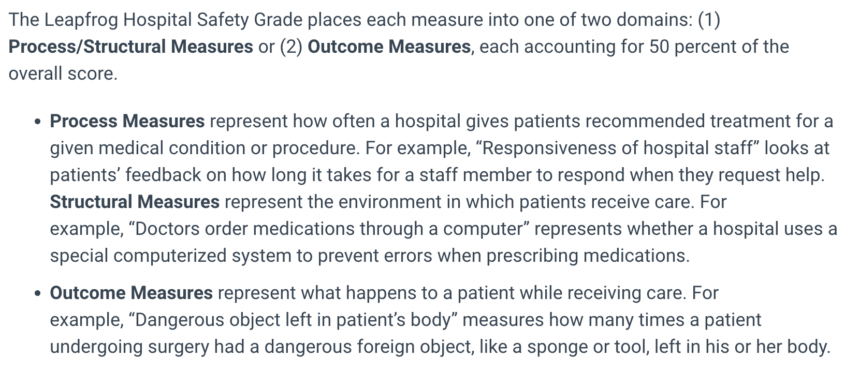
How does Leapfrog weigh its quality measures?
https://www.hospitalsafetygrade.org/your-hospitals-safety-grade/about-the-grade

Slide 12
What are the 12 “process/structural” measures?
Computerized Physician Order Entry (CPOE)
Bar Code Medication Administration (BCMA)
CU Physician Staffing (IPS)
Safe Practice 1: Culture of Leadership Structures and Systems
Safe Practice 2: Culture Measurement, Feedback & Intervention
Total Nursing Care Hours per Patient Day
Hand Hygiene
Nurse Communication
Doctor Communication
Staff Responsiveness
Communication about Medicines
Discharge Information

Slide 13
What are the 10 “outcome” measures?
Foreign Object Retained
Air Embolism
Falls and Trauma
CLABSI
CAUTI
SSI: Colon
MRSA
C. Diff.
CMS PSI 4: Death rate among surgical inpatients with serious treatable conditions
CMS Medicare PSI 90: Patient safety and adverse events composite

Slide 14
What is PSI 4?
Patient Safety Indicator 04 (PSI 04) Death Rate among Surgical Inpatients with Serious Treatable Complications. This includes:
deep vein thrombosis or pulmonary embolism,
pneumonia,
sepsis,
shock or cardiac arrest,
gastrointestinal hemorrhage or acute ulcer
https://qualityindicators.ahrq.gov/Downloads/Modules/PSI/V60-ICD09/TechSpecs/PSI_04_Death_Rate_among_Surgical_Inpatients_with_Serious_Treatable_Complications.pdf

Slide 15
What is PSI 90?
Patient Safety and Adverse Events Composite (PSI 90). This composite score includes:
PSI 03 Pressure Ulcer Rate
PSI 06 Iatrogenic Pneumothorax Rate
PSI 08 In-Hospital Fall With Hip Fracture Rate
PSI 09 Perioperative Hemorrhage or Hematoma Rate
PSI 10 Postoperative Acute Kidney Injury Rate
PSI 11 Postoperative Respiratory Failure Rate
PSI 12 Perioperative Pulmonary Embolism (PE) or Deep Vein Thrombosis (DVT) Rate
PSI 13 Postoperative Sepsis Rate
PSI 14 Postoperative Wound Dehiscence Rate
PSI 15 Unrecognized Abdominopelvic Accidental Puncture/Laceration Rate
https://qualityindicators.ahrq.gov/news/psi90_factsheet_faq.pdf

Slide 16
What is rationale for this program?
The program combines the American Diabetes Association’s (ADA) breadth of resources and reach among the diabetes community with Leapfrog’s expertise in measurement, public reporting, and engaging purchasers and the public to use ratings to incentivize excellence.
Of the 37 million people in the U.S. who are living with diabetes, 8 million are admitted to the hospital each year with related complications. Like all patients, people living with diabetes face serious risk of harm—or even death—from preventable medical errors. These patient safety breakdowns are all too common: One in four inpatients are harmed during their stay, and an estimated 250,000 people die from a preventable error annually, making patient safety problems a leading cause of death in the U.S. Inequity makes those risks even greater for some patients. Black and Indigenous people with diabetes are twice as likely as white people with diabetes to undergo amputation.
Diabetes compounds the risk all inpatients already face from medical errors, injuries, and infections that are all too common in hospitals. Studies estimate that more than 200,000 people die every year from preventable harm in hospitals, making patient safety breakdowns a leading cause of death in America. There are many programs in place nationally to advance patient safety in hospitals, but there are few, if any, that target patients living with diabetes during a hospitalization.
https://www.leapfroggroup.org/recognized-leader-diabetes/about-the-program#:~:text=Recognized%20Leader%20in%20Caring%20for%20People%20Living%20with%20Diabetes%20is,for%20patients%20living%20with%20diabetes.

Slide 17
According to the ADA:
People with diabetes can face major health risks while visiting a hospital, with studies suggesting that more than 200,000 people die every year from preventable errors, accidents, or infections. The estimated 40% of hospitalized people living with diabetes face increased safety risks including amputation and other complications like coma and death if mistakes are made in their daily care. Black and Indigenous people are twice as likely and Latinos are 50% more likely to undergo amputation than non-Hispanic white Americans.
During a hospital stay, people living with diabetes require care coordination that starts at admission and continues through to their discharge. During admission, hospitals need to evaluate a person’s blood glucose (blood sugar), diet, and devices. Throughout the stay, hospitals should provide diabetes experts and additional monitoring. Serious health complications arise when people do not receive continued blood glucose monitoring and timely administration of insulin and other medications. After discharge, hospitals should coordinate follow-up care to ensure people with diabetes are able to manage their post-stay care.
https://www2.diabetes.org/newsroom/press-releases/2023/american-diabetes-association-leapfrog-group-launch-new-patient-safety-partnership-recognize-hospitals-leadership-caring-people-living-with-diabetes

Slide 18
What are the key components of the protocol for patients with diabetes at risk for limb loss?
History (including hyperlipidemia, coronary artery disease, hypertension, GI dysfunction, urinary dysfunction, erectile dysfunction, previous ulcers)
Physical Exam (epix picture of all feet to include plantar aspect and toe nails)
Wagner Classification
Laboratory Tests (ED vs. Wound center)
Radiographic Testing (X-rays of lower extremities and feet)
Indications for
Hospitalization
Surgical debridement
Vascular status (ankle brachial indices)
Treatment of Associated Comorbidities
Offloading

Slide 19
Protocol for patient history
Duration of wound (e.g., time? new?)
Previous physician (e.g., contact information and treatment plan)
Previous history (pathology, microbiology, vascular intervention, type of offloading?)
Past medical history
Autoimmune disease
Skin ulceration, abscesses
Stroke
Neuropathy
Gastropathy
Pain
Hospitalizations
Past surgical history
Venous disease
Arterial disease
Coronary artery disease
Stents
Myocardial infarction
Retinopathy
Obesity

Slide 20
Laboratory Tests
Procalcitonin
C-Reactive Protein
Hemoglobin A1c
Albumin, pre-albumin
Vitamin D level
Complete blood count with manual differential
Prothrombin time/partial thromboplastin time
Comprehensive metabolic panel
Lipid profile
Erythrocyte sedimentation rate
Thyroid-stimulating hormone (TSH) thyroxine (T4) and triodothyronine (T3)
Aspartate Aminotransferase (AST)
Alkaline phosphatase (ALP)
Gamma‐Glutamyl Transpeptidase (GGT)
Alanine aminotransferase (ALT)
Urine analysis
Urinary microalbumin

Slide 21
Radiographic Testing
x-ray (e.g., foot, tibia, fibula).
All patients with diabetes and any patient with a diminished pulse should have bilateral ankle brachial indices.
Unless a pulse is clearly palpable, noninvasive vascular ankle-brachial index testing, and all patients with diabetes over 50 should be screened with an ankle-brachial index, whether or not they have an ulcer.

Slide 22
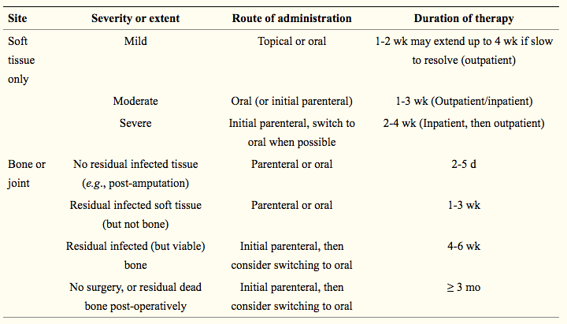
What are antibiotic recommendations based on severity of infection?
Kavitha KV, Tiwari S, Purandare VB, Khedkar S, Bhosale SS, Unnikrishnan AG. Choice of wound care in diabetic foot ulcer: A practical approach. World J Diabetes. 2014;5(4):546-556. doi:10.4239/wjd.v5.i4.546

Slide 23
What is relevance of Hemoglobin A1c on healing?
A1C levels ≥8% and fasting glucose levels ≥126 mg/dl are associated with increased likelihood of lower extremity amputation in patients with DFUs.
Lane KL, et al. Glycemic control and diabetic foot ulcer outcomes: A systematic review and meta-analysis of observational studies [published online ahead of print, 2020 May 22]. J Diabetes Complications. 2020;107638.

Slide 24
What is importance of Ankle brachial index?
As clinical examination does not reliably exclude peripheral artery disease (PAD) in most persons with diabetes and a foot ulcer, evaluate pedal Doppler arterial waveforms in combination with ankle systolic pressure and systolic ankle brachial index (ABI) or toe systolic pressure and toe brachial index (TBI) measurement.
PAD is a less likely diagnosis in the presence of ABI 0.9-1.3, toe brachial index ≥0.75 and triphasic pedal Doppler waveforms.
Hinchliffe RJ, et al. Guidelines on diagnosis, prognosis and management of peripheral artery disease in patients with foot ulcers and diabetes (IWGDF 2019 update). Diabetes Metab Res Rev. 2020;36(S1):e3276.

Slide 25
What are reported readmission rates?
Currently, it is estimated that 25% of all hospitalized patients have DM\, but data on 30-day readmission rates for patients with DM is only just emerging. Direct medical costs due to DM were $176 billion in 2012, of which 43% was generated via inpatient care.
Compared to patients without DM, patients with DM were more likely to be readmitted with other comorbid conditions such as heart failure, myocardial infarction, and cardiac surgery
In recent studies, the 30-day readmission rate for hospitalized patients with DM is estimated to be 14.4–22.7%, much higher than the rate for all hospitalized patients (8.5–13.5%).
Ostling, S., Wyckoff, J., Ciarkowski, S.L. et al. The relationship between diabetes mellitus and 30-day readmission rates. Clin Diabetes Endocrinol 3, 3 (2017). https://doi.org/10.1186/s40842-016-0040-x
Adult patients with diabetes mellitus (DM) represent 10% to 25% of all 30-day unplanned hospital readmissions
Soh JGS, Wong WP, Mukhopadhyay A, Quek SC, Tai BC. Predictors of 30-day unplanned hospital readmission among adult patients with diabetes mellitus: a systematic review with meta-analysis. BMJ Open Diabetes Res Care. 2020 Aug;8(1):e001227. doi: 10.1136/bmjdrc-2020-001227. PMID: 32784248; PMCID: PMC7418689.

Slide 26
Action plan to prevent amputations upon admission
Labs for pts lipid profile
Take photographs of bottom of feet and nail bed for patients with known diabetes
Photographs of all ulcers
Chest x-ray for all patients with diabetic ulcers
Take culture of wound
Identify source of infection
Ankle brachial indices
Post all data on WEMR
Start treatment on underlying infection (e.g. Iodosorb or Silvadene)
Creation of follow up plan
Follow up in wound center
Follow up with medical primary for diabetes control
Provide Rahway’s patient instruction manual
Weekly group meeting
Identify any obstacles for treatment (e.g. patient anxiety about adverse effects, poor health literacy and/or aversion to health care) Get consensus on protocol
Identify team leaders

Slide 27
Action plan to prevent amputations upon admission
Each patient who presents with a lower extremity ulcer will be placed into the protocol
Follow up in the wound center
Labs checked the next day and patient called back

Slide 28
Standard orders in the ED
Pictures in epic of all feet with people in ED
Collect data
Weekly Meeting to educate

