Slide 1
Inpatient care of the emergent patient with oral and maxillofacial pathology Wednesday, October 9, 2024
Notes:
1

Slide 2
Agenda
Which patients require hospitalization for oral and maxillofacial surgery?
Who to call for an admission for a hospitalized patient after oral or maxillofacial surgery?
Preoperative evaluation: Which laboratory tests?
What is role of nutrition in wound healing after maxillofacial surgery?
What are antibiotic choices for oral and maxillofacial emergency surgery?
When to provide hemodialysis for emergency oral and maxillofacial surgery?
Risk factors: why they are relevant
What is the relationship between safety and hospital ratings?
How is platelet rich plasma used in these patients?
Acell and Oral and Maxillofacial Surgery
Platelet derived growth factor in Oral and Maxillofacial surgery
CelTx=Apligraf in place of a free gingival graft
Puraply AM and NuShield
Hidradenitis Suppurativa Face
What are appropriate anesthesia practices?
What is protocol for psychopharmacologic treatments?
What is role of histopathology in diagnosis?

Slide 3
Which patients require hospitalization for oral and maxillofacial surgery?
Trauma
Osteomyelitis
Abscess
Major cancer resection
Hidradenitis Suppurativa

Slide 4
Who to call for an admission for a hospitalized patient after oral or maxillofacial surgery?
Hospitalist on call with cell of admitter (201 452 4511)
Intensive Care Unit fellow (973 803 3965)

Slide 5
Preoperative evaluation: Which laboratory tests?
CBC
Platelets
CMP
Hemoglobin A1c
Albumin, prealbumin, iron profile, vitamin D
Liver function test
Thyroid function test

Slide 6
What is role of nutrition in wound healing after maxillofacial surgery?
Best resources:
Dr. Michael Rothkopf
Dr. Omar Bey
Dr. Donna Chrisanderson
Dr. Nudrat Ayub
Vitamins, especially A, B, E, and CoQ₁₀, as well as vitamin combinations, could exert positive attributes on the periodontal outcomes in adjunct to surgical or nonsurgical periodontal therapy.
Fawzy El-Sayed KM, Cosgarea R, Sculean A, Doerfer C. Can vitamins improve periodontal wound healing/regeneration? Periodontol 2000. 2023 Aug 17. doi: 10.1111/prd.12513. Epub ahead of print. PMID: 37592831.

Slide 7
What are antibiotic choices for oral and maxillofacial emergency surgery?
Vancomycin/Zosyn is a safe broad spectrum to start until your cultures return.

Slide 8
When to provide hemodialysis for emergency oral and maxillofacial surgery?
Preferably the day before surgery.

Slide 9
Risk factors: why they are relevant
Best resource: Kevin Klebba, MD DDS
Obesity: BMI Greater than 31
Anxiety/depression: medication
Hypertension
Coronary artery disease or limb ischemia: see a cardiologist

Slide 10
What is the relationship between safety and hospital ratings?
There are five criteria the Centers for Medicaid and Medicare Services uses to assess safety: mortality, safety of care, readmission, patient experience, and timely and effective care. Here is an overview of each of how each of these indicators directly apply to the care we provide.
https://data.cms.gov/provider-data/topics/hospitals/overall-hospital-quality-star-rating

Slide 11
Mortality (22% of overall rating)
CMS lists pressure ulcers as the first “patient safety indicator” (PSI) associated with “serious complications” resulting in “deaths among patients with serious treatable complications after surgery.” By eliminating hospital acquired pressure ulcers and ensuring optimal treatment for any patient with a chronic wound we can not only reducing deaths among patients with serious treatable complications after surgery, we will also contribute to higher CMS ratings.
https://data.cms.gov/provider-data/topics/hospitals/overall-hospital-quality-star-rating
https://qualityindicators.ahrq.gov/Downloads/Modules/PSI/V2022/TechSpecs/PSI_0Death_Rate_among_Surgical_Inpatients_with_Serious_Treatable_Complications.pdf

Slide 12
Safety of Care (22% of overall rating)
The CMS identifies “Methicillin-resistant Staphylococcus aureus (MRSA) Blood Laboratory-identified Events (Bloodstream infections)” as another area of avoidable “serious complications.” By employing our evidence-based protocols, which require early treatment and taking initial deep culture and pathology, we do reduce healthcare-acquired MRSA infection and ensure that at-risk patients are treated promptly and comprehensively for any potential infection. This will also reduce the morbidity and mortality associated with post-op sepsis while contributing to the hospital’s overall rating.
https://data.cms.gov/provider-data/topics/hospitals/overall-hospital-quality-star-rating

Slide 13
Readmission (22% of overall rating)
The CMS defines readmission as “admission to an acute care hospital within 30 days of discharge” or “unplanned visits after hospital outpatient surgery.” Because readmissions are costly as well as preventable, reducing readmissions through definitive debridements with a comprehensive treatment plan upon first examination of the patient can directly address this key criterion.
https://data.cms.gov/provider-data/topics/hospitals/overall-hospital-quality-star-rating

Slide 14
Patient experience (22% of overall rating)
Because quality of care ratings now determine government reimbursement, and patient satisfaction surveys now significantly decide assessment of care, patient satisfaction is of critical importance to every practice. CMS identifies “communication” as the core element of patient satisfaction, including communication with nurses, doctors, and staff. Two other key metrics are “Patients who reported that they were given information about what to do during their recovery at home” and “Patients who understood their care when they left the hospital.”
Communication is at the core of our care. Not only are patients able to contact our caregivers 24/7 to discuss concerns about their wounds, we maintain a continuously updated website (newjerseywoundhealing.com) that contains a range of educational material for patients with questions about their wound or wound care.
https://data.cms.gov/provider-data/topics/hospitals/overall-hospital-quality-star-rating

Slide 15
Timely and effective care (12% of overall rating)
The CMS includes in this category “percentage of patients who received appropriate care for severe sepsis and septic shock” and “percentage of outpatients who got cardiac imaging stress tests before low-risk outpatient surgery.” These are two areas in which our team excels as they are already part of our routine standard of care.
Although we may not be included in the hospital acquired condition reduction program, we can help serve as partners to Medicare as national leaders in reducing wound- related and sepsis-related readmissions because we have already established with publications with the former director of Medicare. We have already identified multiple etiologies for readmission in our wound patients here at NBI.
https://data.cms.gov/provider-data/topics/hospitals/overall-hospital-quality-star-rating

Slide 16
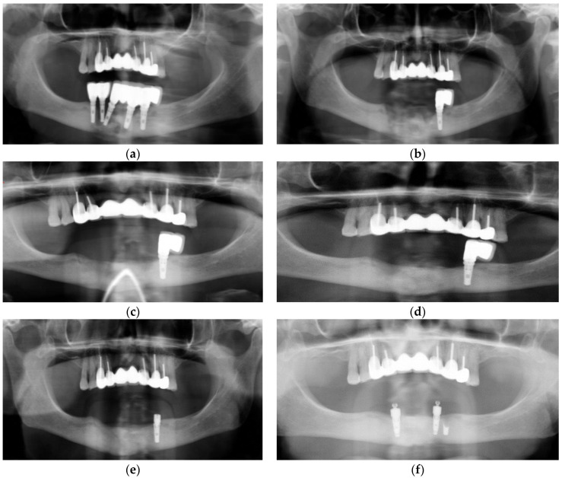
How is platelet rich plasma used in these patients?
DuVal M, Alkhraisat MH. Adjunctive Plasma Rich in Growth Factors in the Treatment of Osteomyelitis and Large Odontogenic Cysts Prior to Successful Implant Rehabilitation: Case Report. Dent J (Basel). 2023 Jul 31;11(8):184. doi: 10.3390/dj11080184. PMID: 37623280; PMCID: PMC10453440.
Case 1: (a) Extensive osteolysis of implants 45,44,43, and 32 extending to the inferior border of the mandible; (b) Immediate post-operative panorex following curettage and debridement with removal of sequestrae. Note that extensive corticotomy and saucerization were not performed; (c) The 10-week post-operative panoramic radiograph. Note that bone regeneration with no apparent loss of osseous height compared to pre-operative panoramic radiograph was observed; (d) The 26-week follow-up panoramic radiograph showing bone consolidation; (e) Fractured implant 34; (f) At 52 weeks after debridement—Implant placement for conservative over denture rehabilitation.

Slide 17
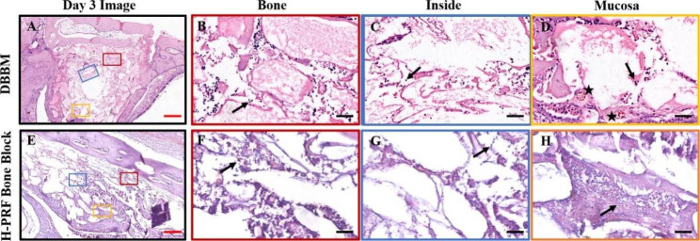
How is platelet rich plasma used in these patients?
Yu S, Bd YT, Bd YW, Bd MF, BMed SL, BMed GT, BMed ZY, Miron RJ, Zhang Y, Yang Z, Wang Y. Early tissue and healing responses after maxillary sinus augmentation using horizontal platelet rich fibrin bone blocks. BMC Oral Health. 2023 Aug 24;23(1):589. doi: 10.1186/s12903-023-03228-z. PMID: 37620826; PMCID: PMC10463479.
H-PRF bone blocks led to early infiltration of immune cells as early as 3 days post-surgery, leading towards an accelerated formation of new blood vessels and bone remodeling.
Photomicrographs of hematoxylin and eosin (H&E) staining sections of bioptic samples derived three days post-surgery. Three different areas were chosen for comparison: Bone (area close to the antrostomy); Inside (in the center of the material); Mucosa (area nera the Schneiderian membrane); Black arrows: the inflammatory cells appear as dark blue dots; Asterisks: blood vessels. Scale bar in A,E = 2 mm; B,C,D,F,G,H = 50 μm

Slide 18
How is platelet rich plasma used in these patients?
Straub A, Utz C, Stapf M, Vollmer A, Kasper S, Kübler AC, Brands RC, Hartmann S, Lâm TT. Investigation of three common centrifugation protocols for platelet-rich fibrin (PRF) as a bio-carrier for ampicillin/sulbactam: a prospective trial. Clin Oral Investig. 2023 Aug 21. doi: 10.1007/s00784-023-05212-x. Epub ahead of print. PMID: 37603167.
Straub et al provide valuable information on how PRF can be enriched with antibiotics, notably ampicillin/sulbactam (SAM). We demonstrate especially that a single dose of SAM is sufficient to reach high concentrations within PRF when the sampled blood is obtained no longer than 15 min after infusion of SAM. These results are clinically relevant and have the potential to expand the field of PRF application. .

Slide 19
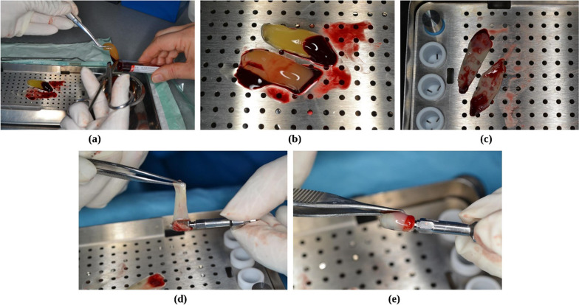
How is platelet rich plasma used in these patients?
Naeimi Darestani M, Asl Roosta H, Mosaddad SA, Yaghoubee S. The effect of leukocyte- and platelet-rich fibrin on the bone loss and primary stability of implants placed in posterior maxilla: a randomized clinical trial. Int J Implant Dent. 2023 Aug 9;9(1):23. doi: 10.1186/s40729-023-00487-x. PMID: 37555894; PMCID: PMC10412516.
L-PRF preparation. a L-PRF removed from the tube, b transferred to the PRF box, c ready to apply after 5 min, d, e L-PRF membrane wrapped around dental implants before insertion
In light of the present study's shortcomings, it could be stated that compared to the control group, applying L-PRF did not improve the RFA outcomes in the posterior maxilla three months after implant insertion. Changes in the ISQ values over time were similar in the two groups, and the interaction was not affected by using L-PRF. Besides, the rate of marginal bone loss around the implant was not significantly affected by L-PRF.

Slide 20
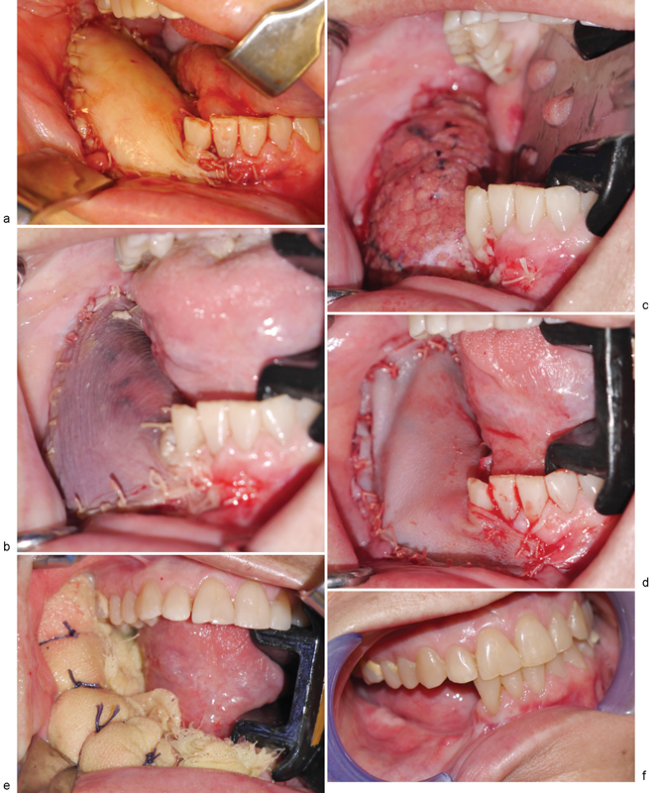
Acell and Oral and Maxillofacial Surgery
Shanti et al establish a novel application of a commercially available porcine urinary bladder extracellular matrix, MatriStem (ACell, Inc., Columbia, MD), in the salvage of partial loss of the skin paddle of a fibula osteoseptocutaneous free flap that was utilized for mandibular reconstruction.
Clinical photographs. ( a ) Fibula free flap skin paddle immediately after inset and microvascular anastomosis. ( b ) Congested skin paddle on postoperative day 7. ( c ) Remaining portion of skin paddle following debridement of clinically apparent congested tissues. ( d ) Urinary bladder matrix (UBM) construct sutured in place. ( e ) Xeroform bolster in place to maintain intimate contact between UBM construct and underlying soft
Shanti RM, Smart RJ, Meram A, Kim D. Porcine Urinary Bladder Extracellular Matrix for the Salvage of Fibula Free Flap Skin Paddle: Technical Note and Description of a Case. Craniomaxillofac Trauma Reconstr. 2017 Dec;10(4):318-322. doi: 10.1055/s-0036-1593473. Epub 2016 Dec 14. PMID: 29109844; PMCID: PMC5669992.

Slide 21
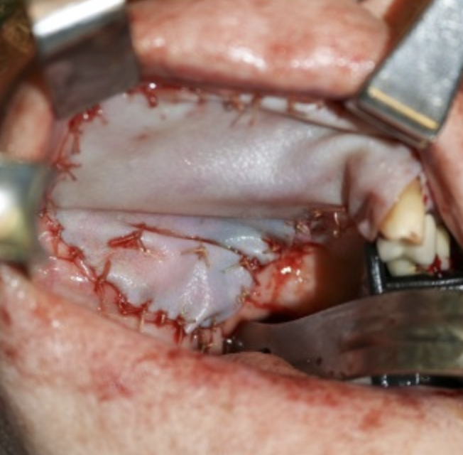
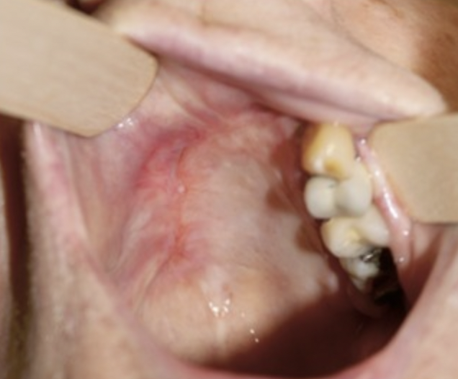
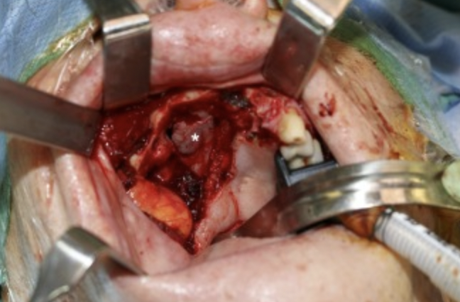
Acell and Oral and Maxillofacial Surgery
Graillon, Le, Chang, & Shanti highlight the utility of MatriStem Surgical Matrix Thick UBM™, a decellularised urinary bladder extracellular matrix in the reconstruction of a post-oncological maxillectomy defect. In utilizing this biological construct to serve as a biological dressing, their patient underwent complete mucosalisation of his surgical site without the development of an oroantral fistula and with adequate maxillary vestibule to allow for definitive oral rehabilitation with a removable partial denture.
Fig. 1. Intraoperative clinical photograph of the resection bed with identification of the nasal mucosa
Fig. 2. Intraoperative clinical photograph following the inset of Gentrix®.
Fig. 3. Complete mucosalisation of maxillectomy defect without exposed bone or oroantral fistula six months postoperatively.
Graillon N, Le AD, Chang BM, Shanti RM. Utility of decellularised urinary bladder extracellular matrix in full mucosalisation of a post-oncological maxillectomy defect. Br J Oral Maxillofac Surg. 2020 Dec;58(10):e323-e325. doi: 10.1016/j.bjoms.2020.08.093. Epub 2020 Aug 25. PMID: 32917425.

Slide 22
Platelet derived growth factor in Oral and Maxillofacial surgery
The combination of rhPDGF-BB with various xenogeneic bone substitutes is a safe and effective matrix that leads to favorable long-term clinical and radiographic outcomes for treating severe intrabony periodontal defects. In men, it seems that androgens play a subordinate role in HS. Antiandrogenic therapy is a good option according to the available data for female patients. The clinical response in HS of spironolactone and finasteride ranged from approximately 40% to 85%.
Batra C, Goel A, Daneshparvar N, Hamada Y. Clinical Evaluation of the Combination of rhPDGF-BB and Xenogeneic Bone Substitutes for Treatment of Severe Periodontal Intrabony Defects: A Case Series. Int J Periodontics Restorative Dent. 2023 Mar, Apr;43(2):192-200. doi: 10.11607/prd.6313. PMID: 37232681.

Slide 23
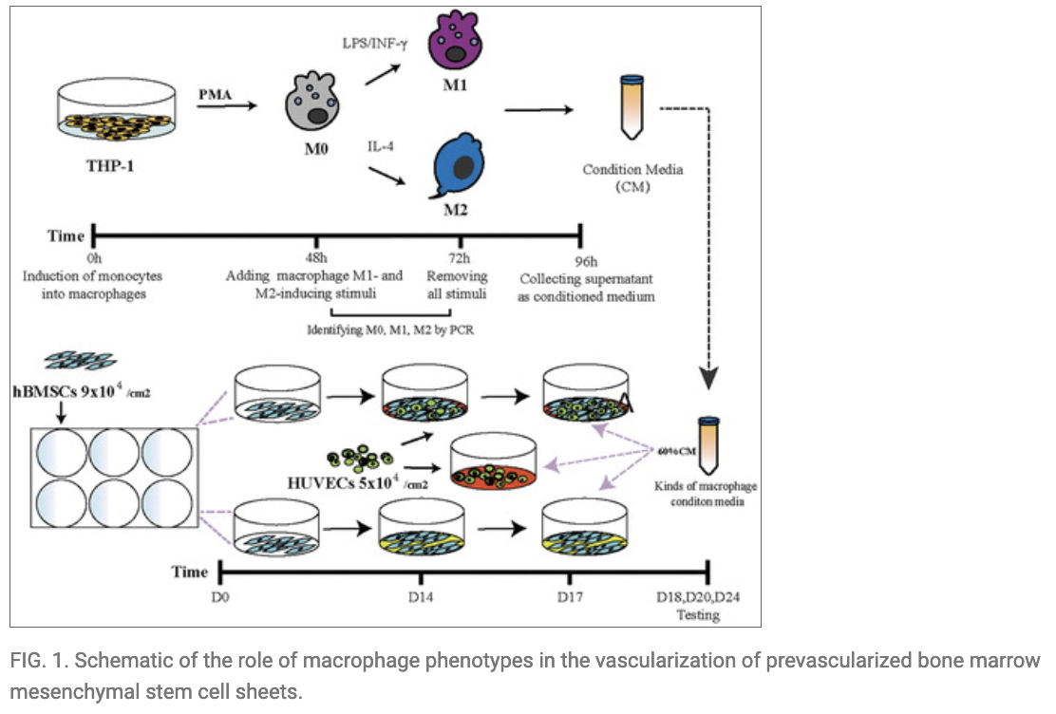
Platelet derived growth factor in Oral and Maxillofacial surgery
This study indicates that macrophages with different phenotypes can regulate vascularization in prevascularized cell sheets by sequentially secreting various types of cytokines during different stages; for example, M1 macrophages can induce angiogenesis by secreting high levels of TNF-α, and M2 macrophages play an important role during vessel maturation. These results further confirm the importance of immune regulation in tissue engineering and that the phenotypic plasticity of macrophages may play a significant role in tissue engineering graft survival and effective physiological roles.
Chen R, Long S, Ren L, Xu S, Liu X, Shi J, Liu J, Ma D, Zhou P, Ren L. The Role of Macrophage Phenotype in the Vascularization of Prevascularized Human Bone Marrow Mesenchymal Stem Cell Sheets. Stem Cells Dev. 2023 Aug;32(15-16):504-514. doi: 10.1089/scd.2022.0268. Epub 2023 Jun 1. PMID: 37119121.

Slide 24
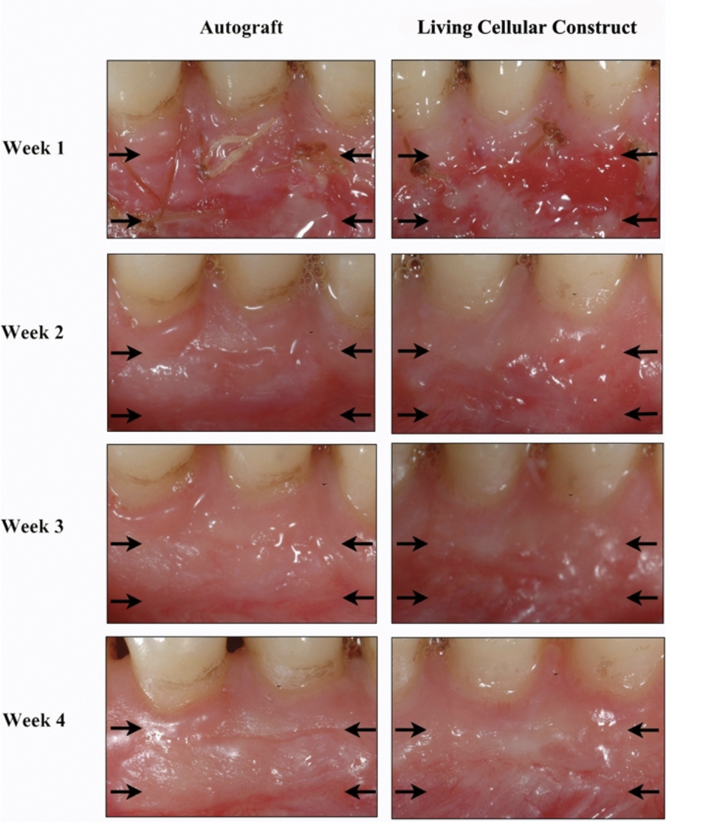
CelTx=Apligraf in place of a free gingival graft
This is keratinocytes and fibroblasts on type 1 collagen
Wound fluid collection at the borders of the wound during the 4 wks post-operatively for both autograft and living cellular construct. 156 x 179 mm (300 x 300 DPI).
Morelli, T et al. “Angiogenic biomarkers and healing of living cellular constructs.” Journal of dental research vol. 90,4 (2011): 456-62. doi:10.1177/0022034510389334

Slide 25
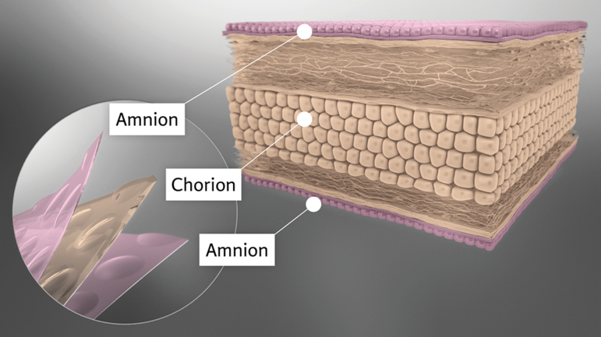
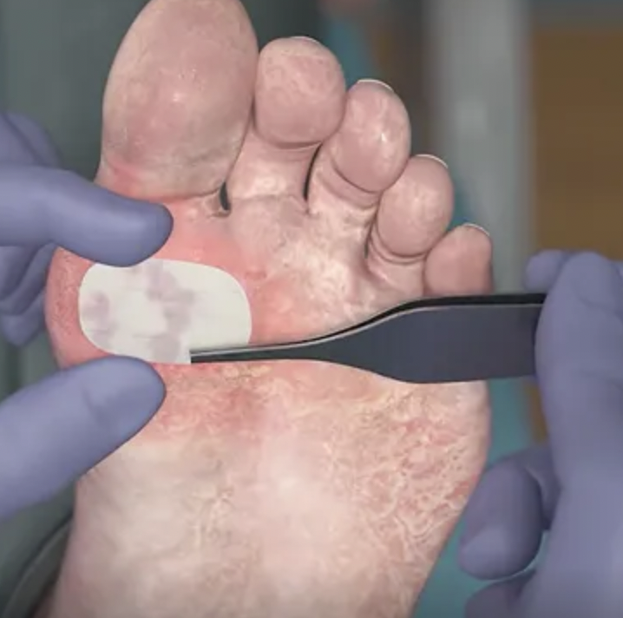
Puraply AM and NuShield
Puraply is purified native collagen matrix embedded with the antimicrobial [PHMB], a broad spectrum antimicrobia
NuShield (dehydrated placental allograft)

Slide 26
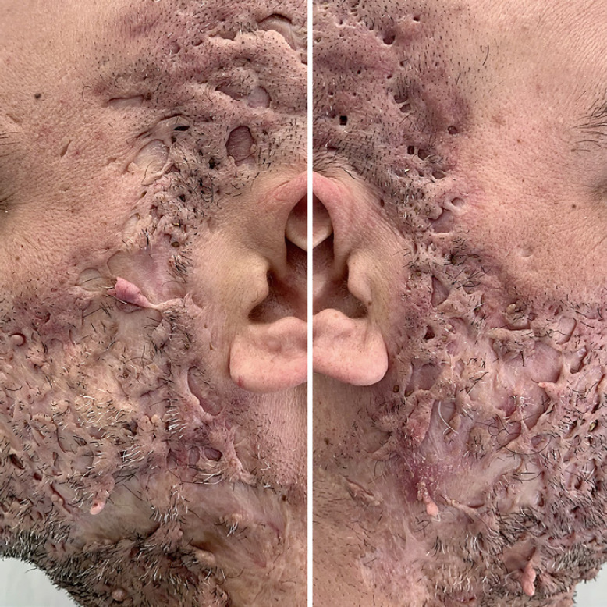
Hidradenitis Suppurativa Face
It is important to differentiate hidradenitis suppurativa (HS) scarring from acne scarring for proper diagnosis and management of atypical HS presentations.
New therapies for HS scarring are emerging, including novel combinations with intralesional steroids and fractional CO₂ laser.
Massive, bridged scarring on the cheeks and temporal area.
Capasso G, Fabbrocini G, Marasca C. Disfiguring Hidradenitis Suppurativa of the Face. Skin Appendage Disord. 2022 Jan;8(1):70-72. doi: 10.1159/000518433. Epub 2021 Aug 26. PMID: 35118134; PMCID: PMC8787590.

Slide 27
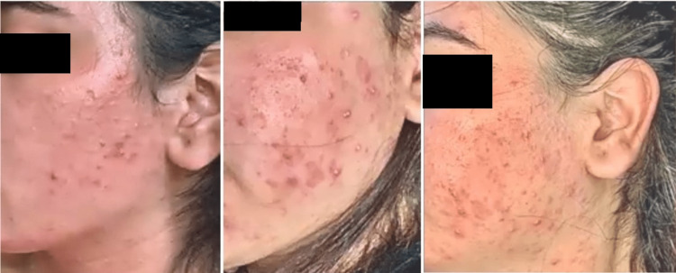
Hidradenitis Suppurativa Face
Multiple severe cystic eruptions, papules, nodules, and comedones with some sinus tracts and scarring.
Chaudhari D, Vohra RR, Abdefatah Ali M, Nadeem H, Tarimci B, Garg T, Sharari RA, Joseph A, Khan A. A Rare Phenomenon of Lithium-Associated Acne Inversa: A Case Series and Literature Review. Cureus. 2023 Mar 12;15(3):e36051. doi: 10.7759/cureus.36051. PMID: 37056525; PMCID: PMC10089641.

Slide 28
What are appropriate anesthesia practices?
O'Neill DK, Robins B, Ayello EA, Cuff G, Linton P, Brem H. Regional anaesthesia with sedation protocol to safely debride sacral pressure ulcers. Int Wound J. 2012 Oct;9(5):525-43. doi: 10.1111/j.1742-481X.2011.00912.x. Epub 2012 Apr 20. PMID: 22520149; PMCID: PMC7950615.
O'Neill DK, Tsui SM, Ayello EA, Cuff G, Brem H. Anesthesia protocol for heel pressure ulcer debridement. Adv Skin Wound Care. 2012 May;25(5):209-19. doi: 10.1097/01.ASW.0000414704.48514.fb. PMID: 22517227.
McMeeking A, Kim I, Ross F, Ayello EA, Brem H, Linton P, O'Neill DK. Wounds in patients with HIV. Adv Skin Wound Care. 2014 Sep;27(9):396-9. doi: 10.1097/01.ASW.0000453268.62015.3c. PMID: 25133341.

Slide 29
What is protocol for psychopharmacologic treatments?
Pinkhasov A, Singh D, Kashan B, DiGregorio J, Criscitelli TM, Gorenstein S, Brem H. Protocol for Psychopharmacologic Management of Behavioral Health Comorbidity in Adult Patients with Diabetes and Soft Tissue Infections in a Tertiary Care Hospital Setting. Adv Skin Wound Care. 2016 Nov;29(11):518-526. doi: 10.1097/01.ASW.0000499601.57987.48. PMID: 27755051.

Slide 30
What is role of histopathology in diagnosis?
Turi GK, Donovan V, DiGregorio J, Criscitelli TM, Kashan B, Barrientos S, Balingcongan JR, Gorenstein S, Brem H. Major Histopathologic Diagnoses of Chronic Wounds. Adv Skin Wound Care. 2016 Aug;29(8):376-82. doi: 10.1097/01.ASW.0000484665.45022.b3. PMID: 27429243.

