Slide 1
Wound Healing Outcomes
Division of Wound Healing and Regenerative Medicine
Department of Surgery
Newark Beth Israel Medical Center
August 11, 2020
NJwoundhealing.org

Slide 2
Agenda
Incidental polyp of vocal cords found upon intubation
Incidental epiglottic mass Infected abdominal wall mesh and ventral hernia
Necrotizing fasciitis of hand and forearm
“Traumatic” neuroma of sacral nerve
Chronic osteomyelitis of the pelvis
Next week’s agenda

Slide 3
Clinical Presentation:
Age: 44, female
Obesity
Hydratinitis x 9 sites

Slide 4
How to diagnose incidental vocal polyp?
Vocal cord leukoplakia is characterized by great pathological differences and a certain tendency of malignant transformation.
Narrow band imaging (NBI) endoscopy can identify malignant lesions on the mucosal surface by observing the morphology of intraepithelial papillary capillary loop (IPCL).
In recent years, NBI endoscopy has been gradually applied to the diagnosis of laryngeal lesions.
Lin C, Zhang S, Lu L, Wang M, Qian X. Diagnostic Value and Pathological Correlation of Narrow Band Imaging Classification in Laryngeal Lesions [published online ahead of print, 2020 May 8]. Ear Nose Throat J. 2020.

Slide 5
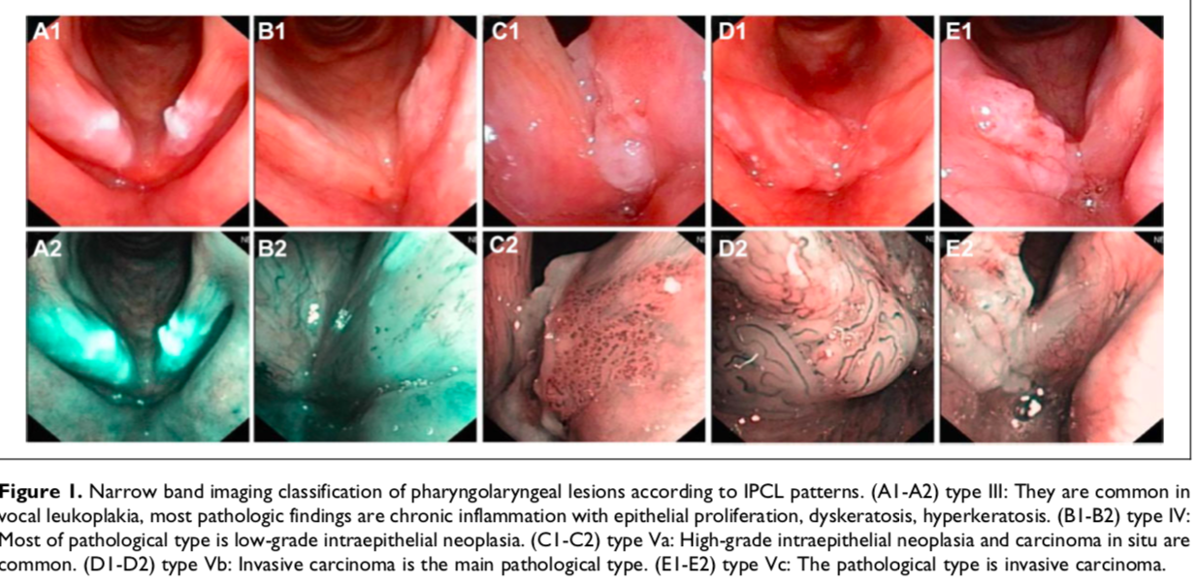
How to diagnose incidental vocal polyp?
Lin C, Zhang S, Lu L, Wang M, Qian X. Diagnostic Value and Pathological Correlation of Narrow Band Imaging Classification in Laryngeal Lesions [published online ahead of print, 2020 May 8]. Ear Nose Throat J. 2020.

Slide 6
Clinical Presentation: Incidental epiglottic mass
Age: 61
Hydratinitis x 6 sites

Slide 7
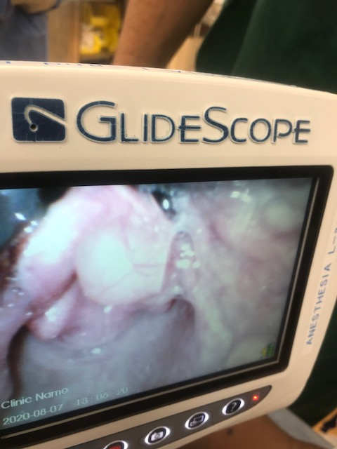
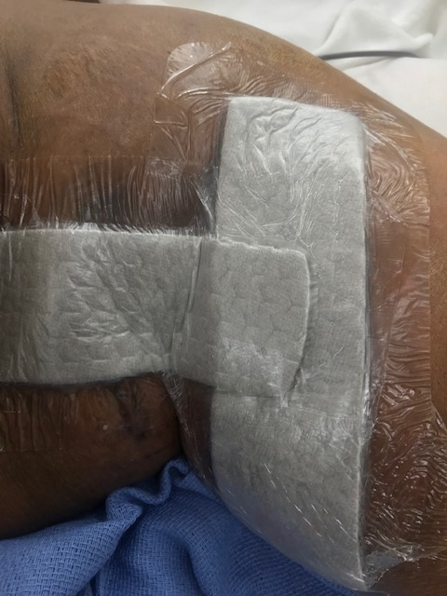
Clinical Presentation: Incidental epiglottic mass

Slide 8
How to diagnose epiglottic masses?
Masses of the epiglottis may be cystic, granulomatous, infectious, neoplastic, or manifestations of a systemic disease.¹ The radiologist may greatly contribute to patient care by being able to narrow the differential diagnosis.
Benign neoplastic and non-neoplastic proliferations can present as an epiglottic mass. Benign squamous papillomas are noninvasive and slow-growing epithelial tumors that tend to form fine papillary, well-defined masses that may be pedunculated.
Laryngeal cysts comprise 5% of all benign laryngeal lesions, and the majority of ductal cysts arise from the epiglottis.
Granulomatous diseases that may cause an epiglottis mass include tuberculosis, sarcoidosis, and Wegener’s granulomatosis. When sarcoidosis involves the larynx, it most often involves the epiglottis and manifests with erythema, edema, punctate nodules, and mass lesions.
Epiglottic masses are more often seen clinically by the otolaryngologist than by the radiologist on CT or MRI, as most patients will not undergo imaging of benign-appearing epiglottic masses. Nevertheless, the radiologist must be vigilant for their presence and aware of the differential diagnosis, as epiglottic masses may simply be incidental findings without symptoms, as in our patient, or they may present with airway obstruction.
Tresley J, Saraf-Lavi E, Kryvenko ON, Sargi Z. Epiglottic masses identified on CT imaging: A case report and review of the broad differential diagnosis [published correction appears in Neuroradiol J. 2015 Oct;28(5):NP1. Kryvenko, Oleksandr [corrected to Kryvenko, Oleksandr N]]. Neuroradiol J. 2015;28(3):347-353. doi:10.1177/1971400915594517

Slide 9
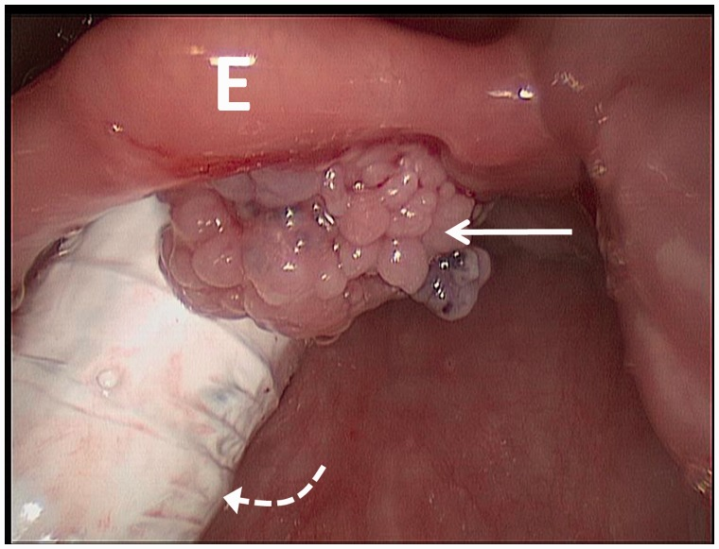
How to diagnose epiglottic masses?
Intra-operative photograph from laryngoscopy reveals an approximately 1 cm exophytic, pedunculated, papillomatous lesion (arrow) on the laryngeal surface of the suprahyoid epiglottis (E), close to midline, without apparent involvement of the underlying cartilage. The endotracheal tube is seen posteriorly (curved dotted arrow).
Tresley J, Saraf-Lavi E, Kryvenko ON, Sargi Z. Epiglottic masses identified on CT imaging: A case report and review of the broad differential diagnosis [published correction appears in Neuroradiol J. 2015 Oct;28(5):NP1. Kryvenko, Oleksandr [corrected to Kryvenko, Oleksandr N]]. Neuroradiol J. 2015;28(3):347-353. doi:10.1177/1971400915594517

Slide 10
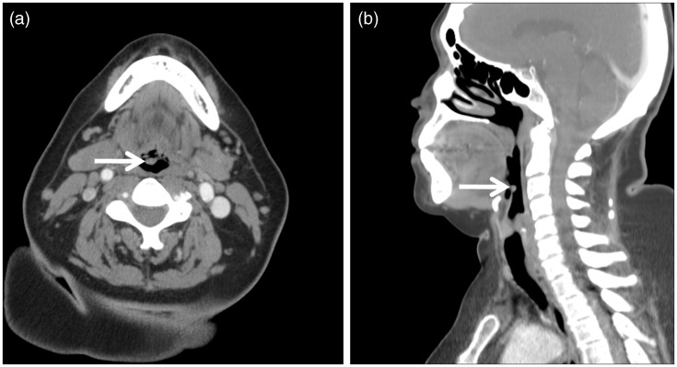
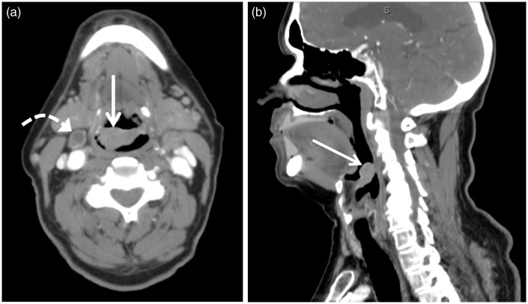
How to diagnose epiglottic masses?
Axial (a) and sagittal (b) contrast-enhanced computed tomography (CT) images of our 65-year-old female patient revealed a 0.7 cm × 0.5 cm × 0.5 cm (transverse × anterior-posterior × craniocaudal) circumscribed structure (arrow) of approximately 50 Hounsfield units, inseparable from the posterior (laryngeal) surface of the right parasagittal epiglottis. The epiglottis was not thickened, and the remainder of the larynx appeared normal.
Axial (a) and sagittal (b) contrast-enhanced computed tomography (CT) images of a 73-year-old male patient with foreign body sensation revealed a 2.6 cm × 1.5 cm × 2.0 cm (transverse × anterior-posterior × craniocaudal) epiglottic mass (arrow) of approximately 70 Hounsfield units biopsy proven squamous cell carcinoma. A necrotic lymph node was also identified (curved arrow).
Tresley J, Saraf-Lavi E, Kryvenko ON, Sargi Z. Epiglottic masses identified on CT imaging: A case report and review of the broad differential diagnosis [published correction appears in Neuroradiol J. 2015 Oct;28(5):NP1. Kryvenko, Oleksandr [corrected to Kryvenko, Oleksandr N]]. Neuroradiol J. 2015;28(3):347-353. doi:10.1177/1971400915594517

Slide 11
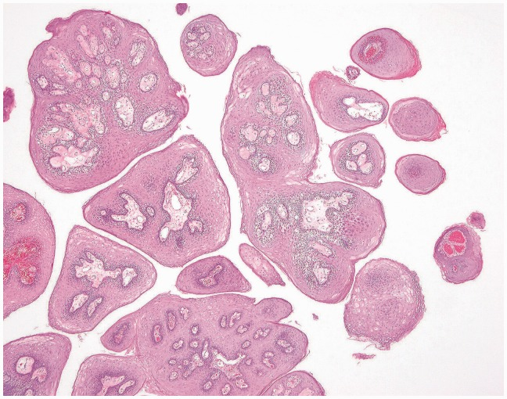
How to diagnose epiglottic masses?
Low-power magnification showing central fibrovascular cores covered by benign keratinizing squamous epithelium.
Tresley J, Saraf-Lavi E, Kryvenko ON, Sargi Z. Epiglottic masses identified on CT imaging: A case report and review of the broad differential diagnosis [published correction appears in Neuroradiol J. 2015 Oct;28(5):NP1. Kryvenko, Oleksandr [corrected to Kryvenko, Oleksandr N]]. Neuroradiol J. 2015;28(3):347-353. doi:10.1177/1971400915594517

Slide 12
Clinical Presentation: Infected abdominal wall mesh and ventral hernia
Age: 51
Infected abdominal wall mesh and ventral hernia status post ventral hernia after a caesarian section that was repaired with mesh.
Fistula between mesh and skin
Surgery 7/22/2020 for explantation of the mesh (picture from text)
Culture: fluid from the fistula
20 x 25 cm phasix mesh
intra-peritoneal mesh placement: fully resorbable monofilament scaffold

Slide 13
Clinical Presentation: Infected abdominal wall mesh and ventral hernia
Age: 51
Infected abdominal wall mesh and ventral hernia status post ventral hernia after a C-section that was repaired with mesh.
Since the ventral hernia repair with mesh placement, the mesh has frequently become infected and developed a fistulous tract between mesh and skin.
Surgery 7/22/2020 for explantation of the mesh
Abdominal wall and infected mesh, removal and repair:
Akin with subcutaneous acute and chronic inflammation and foreign body giant cell reaction.
Adherent dense fibrous tissue, fibroadipose tissue and skeletal muscle, consistent with abdominal wall, with acute and chronic inflammation, granulation tissue, and foreign body giant cell reaction
Culture: fluid from the fistula
20 x 25 cm phasix mesh
intra-peritoneal mesh placement: fully resorbable monofilament scaffold

Slide 14
Pathology report
7/25/2020
Few growth resembles skin flora
No strict anaerobic organisms isolated
Köckerling F, Alam NN, Antoniou SA, et al. What is the evidence for the use of biologic or biosynthetic meshes in abdominal wall reconstruction?. Hernia. 2018;22(2):249-269. doi:10.1007/s10029-018-1735-y

Slide 15
What is evidence for use of abdominal wall mesh?
These products are divided into two groups: synthetic and biologic meshes.
Synthetic meshes can be either permanent or absorbable. The development of absorbable and biologic meshes was triggered by the complications of using permanent meshes. Contamination of the surgical field poses a dilemma as the use of permanent synthetic material is historically considered contraindicated given the risk of postoperative infective complications and need for mesh removal.
The introduction of biologic or absorbable synthetic meshes has provided an alternative. Derived from biologic (human, bovine, or porcine) sources or absorbable synthetic material, these meshes theoretically incorporate into native tissue and possess the ability to resist infection.
Although none of the biologic meshes have US Food and Drug Administration approval for use in an infected field and even though there is a paucity of controlled data, they have become the method of choice in many institutions across Europe and the United States over the past several years
Köckerling F, Alam NN, Antoniou SA, et al. What is the evidence for the use of biologic or biosynthetic meshes in abdominal wall reconstruction?. Hernia. 2018;22(2):249-269. doi:10.1007/s10029-018-1735-y

Slide 16
What is evidence for use of abdominal wall mesh?
The cumulative data regarding biologic and biosynthetic mesh use in ventral hernia repair under contaminated conditions do not support the claim that it is better than synthetic mesh used under the same conditions. The available evidence is limited in quantity and quality, but it does not support the superiority of biologic over synthetic non-absorbable meshes in contaminated fields (level of evidence according to the GRADE system [LoE GRADE]: moderate).
Biologic mesh use should be avoided when bridging is needed in ventral hernia repairs due to the very high risk of a recurrence (LoE GRADE: moderate).
There is no evidence supporting the use of biologic or biosynthetic meshes for the prevention of incisional hernia when closing a laparotomy in high-risk patients or in stoma reversal wounds. There is no evidence to support the use of biosynthetic meshes in preference to permanent synthetic meshes in clean or clean-contaminated surgery (LoE GRADE: low).
Köckerling F, Alam NN, Antoniou SA, et al. What is the evidence for the use of biologic or biosynthetic meshes in abdominal wall reconstruction?. Hernia. 2018;22(2):249-269.

Slide 17
What is evidence for use of abdominal wall mesh?
The quality of data does not support a significant risk reduction of parastomal hernia development by biologic mesh reinforcement of a permanent stoma at the primary operation. The use of biologic meshes for prophylaxis of a parastomal hernia should not be performed outside clinical studies (LoE GRADE: low).
The use of biologic and biosynthetic meshes is an option in contaminated or dirty fields of incarcerated and/or strangulated abdominal wall hernia repair when defect closure is possible (LoE GRADE: very low).
Biologic meshes do not provide a superior alternative to synthetic meshes for parastomal hernia repair, while at the same time being less cost-effective for this indication. Biologic meshes cannot be considered an alternative to synthetic meshes for elective parastomal hernia repair (LoE GRADE: very low).
It is recommended not to use a biologic mesh for bridging in replacement of an infected synthetic mesh due to the high risk of recurrence. Either a synthetic (onlay) or biologic mesh seems to work as a replacement of an infected synthetic mesh if the fascia defect can be closed in ventral and incisional hernia (LoE GRADE: very low).
Köckerling F, Alam NN, Antoniou SA, et al. What is the evidence for the use of biologic or biosynthetic meshes in abdominal wall reconstruction?. Hernia. 2018;22(2):249-269.

Slide 18
What is evidence for use of abdominal wall mesh?
International guidelines do not recommend routine use of biologic or biosynthetic meshes in early closure of the open abdomen. Alternative strategies are recommended. Concerning short-term outcome, it seems safe to use either a biologic or biosynthetic or synthetic mesh, if fascial closure can be achieved. Negative wound pressure treatment can be recommended to reduce wound morbidity and shorten wound healing (LoE GRADE: very low).
In case of enterocutaneous fistula, the use of biologic mesh allows a one-stage repair, if possible without bridging, with acceptable outcomes. A high wound morbidity, risk for refistulisation, and recurrence rate have to be expected (LoE grade: very low).
Component separation technique reinforced with biologic meshes has no significantly higher recurrence rate compared with synthetic meshes in clean field operations and patients with higher infection risks. However, the number of major SSO/SSI including need for reoperation does not seem to be decreased substantially by the use of biologic versus synthetic meshes. In the subgroup of patients with contaminated surgical field, there might be a place for the use of biologic mesh due to potentional higher salvage rate in case of mesh infection. Further high-quality comparative studies are needed (LoE GRADE: low).
The critical review of the cumulative data regarding biologic and biosynthetic mesh use under contaminated conditions does not support the claim of better results than synthetic meshes. Biologic and biosynthetic mesh should not be used in a bridging situation. There seems to be no clear advantages of biologic and biosynthetic meshes in inguinal hernia repair. There is no evidence for the use of biologic or biosynthetic meshes in the prevention of incisional and parastomal hernias. In complex abdominal wall hernia repairs (incarcerated hernia, parastomal hernia, infected mesh, open abdomen, entero-cutaneous fistula, and component separation technique), biologic and biosynthetic meshes do not provide a superior alternative to synthetic meshes.
Köckerling F, Alam NN, Antoniou SA, et al. What is the evidence for the use of biologic or biosynthetic meshes in abdominal wall reconstruction?. Hernia. 2018;22(2):249-269. doi:10.1007/s10029-018-1735-y

Slide 19
What is evidence for use of abdominal wall mesh?
Complex Abdominal Wall Reconstruction (CAWR) is a demanding procedure, which requires appropriate surgeon training, correct timing of the procedure, accurate placement, and the correct choice of prosthesis.
Synthetic meshes, which are considered the gold standard for abdominal wall repair, are strong and are designed to have a non-adherent side facing the viscera.
Their major disadvantages include inflammation with consequent stiffness and abdominal pain, a high infection rate, adhesion to the viscera, and enterocutaneous fistulae.
Even though the introduction of synthetic meshes in hernia repair drastically reduced the recurrence rate, it is still estimated at around 24% after three years.
In the last decade, meshes of biological origin have been studied as possible alternatives to synthetic materials. Biological meshes have shown many advantages, including a milder immune response, a decreased incidence of fistulae, and reduced fibrosis. However, there are some concerns with the use of biological materials such as their supposedly inferior mechanical strength and higher cost of production.
Costa A, Adamo S, Gossetti F, et al. Biological Scaffolds for Abdominal Wall Repair: Future in Clinical Application?. Materials (Basel). 2019;12(15):2375. Published 2019 Jul 25. doi:10.3390/ma12152375

Slide 20
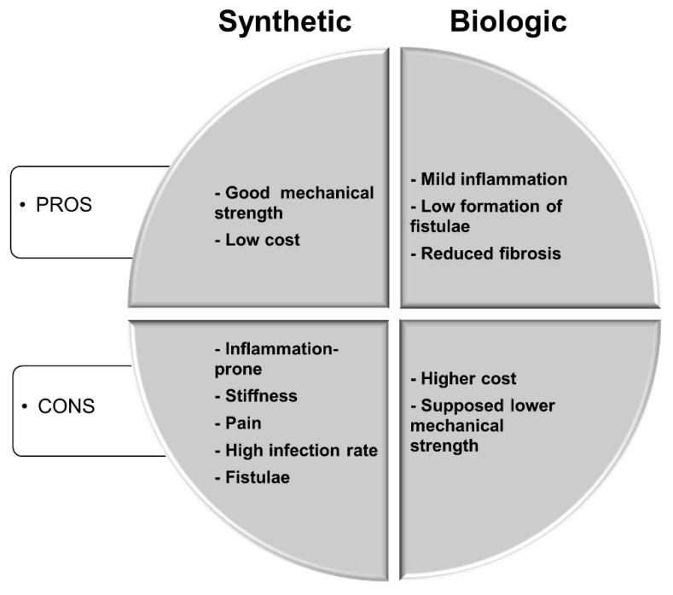
What is evidence for use of abdominal wall mesh?
Schematic representation of pros and cons of synthetic versus biologic meshes in hernia repair.
Costa A, Adamo S, Gossetti F, et al. Biological Scaffolds for Abdominal Wall Repair: Future in Clinical Application?. Materials (Basel). 2019;12(15):2375. Published 2019 Jul 25. doi:10.3390/ma12152375

Slide 21
What is evidence for use of abdominal wall mesh?
In order to overcome the issues related to the application of synthetic meshes (i.e., polyester and polypropylene meshes), second-generation composite surgical meshes for hernia repair were developed.
Composite meshes have a synthetic layer facing the dermis, which provides mechanical strength and promotes collagen accumulation and ingrowth, and an internal layer coated with a naturally degradable biomaterial, facing the peritoneum, whose primary role is to avoid adhesion to the viscera. The natural layer of such meshes is usually degraded within one to eight months
After the first pro-inflammatory phase due to injury, the shift toward an anti-inflammatory environment promotes constructive tissue remodeling (i.e., the differentiation of progenitor/stem cells, the formation of a mature vasculature, and the secretion of a new extracellular matrix), while a persisting pro-inflammatory scenario leads to tissue repair failure.
Extracellular matrix biomaterials are obtained by decellularization, i.e., the removal of the cellular component from tissues and organs.
Together with growth factors (GFs), ECM degradation products released during remodelling are thought to be responsible for ECM bioactivity. In addition to the mentioned advantages offered by ECM biomaterials, the antibacterial action of such biomaterials has been demonstrated.
The observed high recurrence for extracellular matrix biomaterial meshes is commonly ascribed to the degradable nature of the extracellular matrix and the consequent mechanical weakness when compared with synthetic mesh. However, the degradation rate of the ECM during tissue remodeling is also influenced by the deposition of new extracellular matrices by the cells that colonize the implanted biomaterials. Thus, extracellular matrix degradation is also strictly dependent upon the ability of the ECM itself to recruit stem/progenitor cells, to modulate the inflammatory response, and to respond to mechanical stimuli.
Costa A, Adamo S, Gossetti F, et al. Biological Scaffolds for Abdominal Wall Repair: Future in Clinical Application?. Materials (Basel). 2019;12(15):2375. Published 2019 Jul 25. doi:10.3390/ma12152375

Slide 22
Clinical Presentation: Necrotizing fascitiis of the hand and forearm
Age: 53
Previous bilateral below knee amputation from diabetic foot ulcers
Previous surgery of knee and patella (HB) with complete healing
Presented with necrotizing fasciitiis or hand and forearm
Necrotizing fasciiitis of hand and forearm
Extensive Poly
Dorsal on the forearm
Origin is the middle third of posterior surface of ulna, interosseous membrane.
Distal phalynx

Slide 23
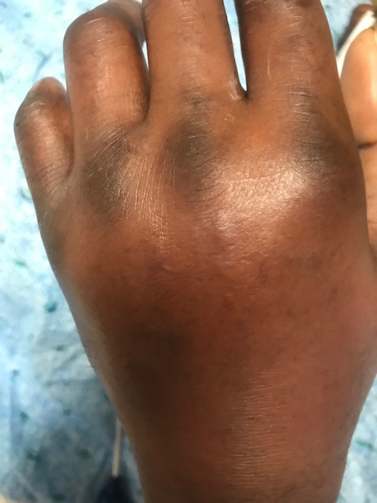
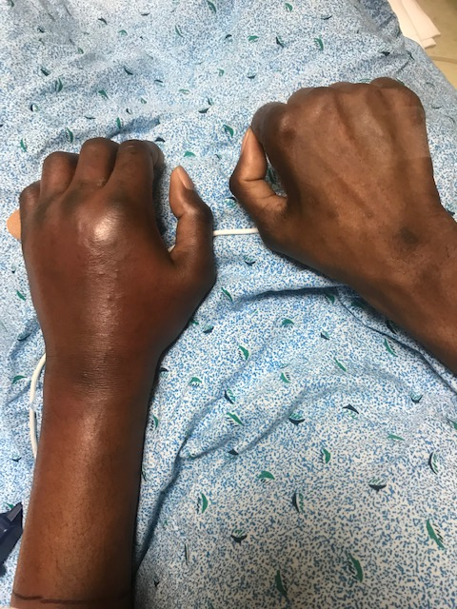
Clinical Presentation: Necrotizing fascitiis of the hand and forearm

Slide 24
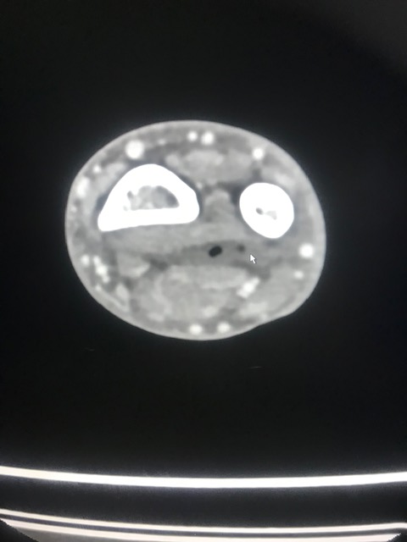
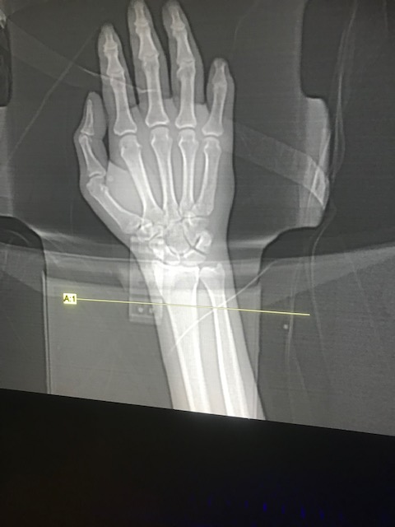
Clinical Presentation: Necrotizing fascitiis of the hand and forearm

Slide 25
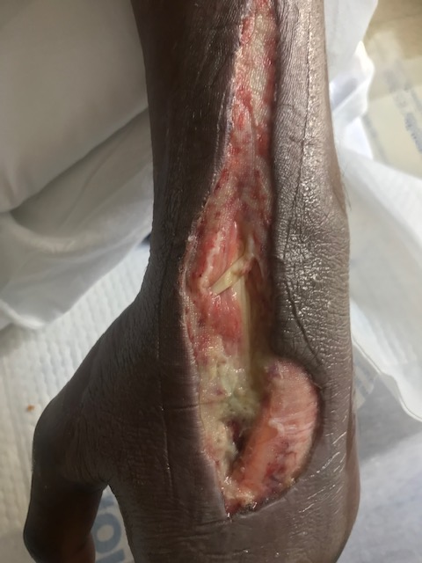
Necrotizing fascitiis of the hand and forearm
Note extension of P longus tendon in middle

Slide 26
Necrotizing fascitiis of the hand and forearm
A. Fascia of wrist: left hand.
Fragment of fibroconnective tissue and scant adipose tissue showing acute and chronic inflammation with focal necrosis and fibrinous exudate.
B. Skin of left hand:
Segment of skin and subcutaneous showing: focal acute and chronic inflammation, necrosis, and venous thrombosi with organization and recanalization.

Slide 27
Pathology report
A. Bone and marrow space showing changes with chronic osteomyelitis.
Bundles of nerve tissue suggestive of traumatic neuroma
B. Right sacral bone: Bone and marrow space showing changes with osteomyelitis.
C. Superficial sacral and buttock wound: Dense fibrous tissue and granulation tissue with mild acute chronic inflammation, edematous.
Small fragments of bone.

Slide 28
Microbiology
Positive for methicillin-susceptible Staphylococcus aureus by Verigent nucleic acid test.

Slide 29
Microbiology
Pitfalls: patients with diabetes cannot rely solely on the cultures as pathological organisms are routinely present and not cultured.
Endpoint to narrow antibiotics in cases of severe infection in patients with diabetes should be a normal white count and a final culture report.

Slide 30
Microbiology
 | Methicillin-Sensitive Staphe aureus
Drug | MIC interp | MIC Dilutn
CIprolfalxin | 5 | <=0.05
Clindaycin | 5 | 0.25
Doxycycline | 5 | <=0.25
Erthyromycin | S | <=0.25
Gentamicn | S | <=0.5
Inducible Clincamycin Resistance | Neg | Neg
Levofloxacin | S | 0.25
Moxifloxacin | S | <=0.25
Oxacillin | S | <=0.25
Rifampin | S | <=0.5
Tetracycline | S | <=1
Trimethoprim/Sulfa | S | <=10
Vancyomycin | S | 1

Slide 31
What is evidence for treatment of necrotizing fasciitis of hand and wrist?
Necrotizing infections of the hand and wrist are important clinical entities because of their rapidly progressive and potentially lethal nature.
If the brief prodromal period of these infections goes unrecognized, a local area of devitalized tissue can evolve into fulminant infection, multiorgan failure, and potentially death.
Early recognition and treatment including administration of broad-spectrum antibiotics and surgical debridement are paramount to improving patient outcomes.
Choueka, Jack MD; De Tolla, Jadie E. MD Necrotizing Infections of the Hand and Wrist: Diagnosis and Treatment Options, Journal of the American Academy of Orthopaedic Surgeons: January 15, 2020 - Volume 28 - Issue 2 - p e55-e63 doi: 10.5435/JAAOS-D-17-00716

Slide 32
What is evidence for treatment of necrotizing fasciitis of hand and wrist?
The clinical diagnosis of necrotizing soft tissue infections (NSTI) of the upper extremity can be challenging secondary to the complexity and density of anatomic structures in this region. Although NSTI commonly occurs after local trauma, the trauma can be benign or remote. The early stages of NSTI are characterized by nonspecific findings such as localized edema and erythema. These subtle findings can be difficult to differentiate from indolent soft-tissue infections of the hand and wrist such as cellulitis or abscess. In apparent indolent soft-tissue infections, careful monitoring is warranted to identify cases demonstrating the potential for rapid deterioration into a more fulminant condition.
The diagnosis of NSTI is generally made clinically and later corroborated with intraoperative findings and frozen section. Laboratory and radiologic studies can aid in confirming the clinical diagnosis and providing important diagnostic and prognostic information, however should never delay early treatment of this life-threatening disease
Choueka, Jack MD; De Tolla, Jadie E. MD Necrotizing Infections of the Hand and Wrist: Diagnosis and Treatment Options, Journal of the American Academy of Orthopaedic Surgeons: January 15, 2020 - Volume 28 - Issue 2 - p e55-e63 doi: 10.5435/JAAOS-D-17-00716

Slide 33
What is evidence for treatment of necrotizing fasciitis of hand and wrist?
Imaging studies can assist in the diagnosis of NSTI of the hand and wrist in equivocal cases. However, surgical intervention should never be delayed when waiting for advanced imaging if one has a high clinical suspicion of NSTI. Ultrasonography is preferred because of its accessibility. On ultrasonography, hypoechoic fluid between the muscle and subcutaneous tissue and hyperechoic gas adjacent to the fascia can indicate fascial necrosis.
In addition to imaging, a bedside cut-down or "finger test" may be used in patients with signs and symptoms suspicious for early NSTI before definitive surgery. This procedure is performed under local anesthesia. The finger test has historically been described as a 2-cm incision made in the area of interest down to the deep fascia followed by gentle probing with a finger. In the hand and wrist, the authors recommend making a 1-cm incision and passing a blunt hemostat. Findings that correlate with NSTI include the presence of "dishwater" fluid (which is a product of polymorphic cell lysis), lack of resistance to blunt dissection, and absence of bleeding tissue. Rapid frozen-section biopsy following the bedside cut-down test as well as culture and gram stain should be performed.
Choueka, Jack MD; De Tolla, Jadie E. MD Necrotizing Infections of the Hand and Wrist: Diagnosis and Treatment Options, Journal of the American Academy of Orthopaedic Surgeons: January 15, 2020 - Volume 28 - Issue 2 - p e55-e63 doi: 10.5435/JAAOS-D-17-00716

Slide 34
What is evidence for treatment of necrotizing fasciitis of hand and wrist?
Intraoperative examination and histopathology are the benchmark for confirming the diagnosis of NSTI. Histology of the affected tissue reveals infiltration of the fascia and dermis by polymorphic nuclear cells, thrombosis and necrosis of the arteries and veins, and the presence of microorganisms within the necrotic fascia and dermis. These histologic findings are present even in early stages of NSTI
Early clinical signs and symptoms of NSTI are often confused with cellulitis. Standard laboratory tests, bedside cut-downs, and imaging can assist in the early differential diagnosis of NSTI and cellulitis as discussed. Practitioners should also be aware of other mimickers of NSTIs to provide appropriate treatment and avoid unnecessary and invasive surgery. Pyoderma gangrenosum is a dermatologic condition that is often associated with ulcerative colitis and can easily be mistaken for infectious conditions such as NSTI. Clinically, this condition has four main variants with the ulcerative form being the most common. This condition begins with the presence of a papule or nodule, which progresses rapidly to painful ulcerated lesions with central necrosis. Treatment includes local wound care, steroids, and immunosuppressant medications. Surgical excision is contraindicated because it may exacerbate the disease and result in extension of necrosis
Choueka, Jack MD; De Tolla, Jadie E. MD Necrotizing Infections of the Hand and Wrist: Diagnosis and Treatment Options, Journal of the American Academy of Orthopaedic Surgeons: January 15, 2020 - Volume 28 - Issue 2 - p e55-e63 doi: 10.5435/JAAOS-D-17-00716

Slide 35
What is evidence for treatment of necrotizing fasciitis of hand and wrist?
NSTIs can be classified based on anatomic location, depth of involvement, or microbial pathogen. These classification systems provide context for typical presentations and affected cohorts, however do little to dictate clinical management or predict morbidity and mortality. Four microbial subtypes of NSTI have been described.
Type I infections, which represent 70% to 80% of cases, are polymicrobial involving both aerobic and anaerobic organisms and are often synergistic. They occur in older patients with underlying medical comorbidities and are more commonly found in the trunk and perineum. These infections tend to be more indolent in nature with the exception of clostridial infections. Clostridium perfringens is now a rare cause of NSTI secondary to improvements in sanitation and hygiene.
Type II infections are monomicrobial and comprise approximately 20% to 30% of cases. They are caused by group A beta-hemolytic streptococci (GAS) either alone or in association with Staphylococcus aureus. Unlike type I infections, type II infections occur in any age group and often occur in persons without medical comorbidities. These infections classically occur in the extremities, and patients often have a history of trauma, surgery, or IV drug abuse. Associated group A streptococcal toxic shock syndrome contributes to the aggressive clinical course of these infection.
Type III infections comprised gram-negative marine bacteria, most commonly V vulnificus. These infections are associated with marine injury and moderate to severe liver disease. They occur more commonly in coastal communities, particularly in Asia. Similar to type II infections with associated toxic shock syndrome, V vulnificus NSTI has a fulminant course with early signs of septic shock and a mortality rate of 30% to 40%.
Type IV fungal infections are rare and primarily affect immunocompromised patients. These infections often have a high mortality rate and aggressive clinical course with rapid extension of involved areas.
Choueka, Jack MD; De Tolla, Jadie E. MD Necrotizing Infections of the Hand and Wrist: Diagnosis and Treatment Options, Journal of the American Academy of Orthopaedic Surgeons: January 15, 2020 - Volume 28 - Issue 2 - p e55-e63 doi: 10.5435/JAAOS-D-17-00716

Slide 36
What is evidence for treatment of necrotizing fasciitis of hand and wrist?
NSTIs are believed to be caused by a breakdown in tissue integrity; however, many infections arise spontaneously in subcutaneous tissues without an apparent wound or lesion. These infections occur through either direct or hematogenous spread. Microbial introduction is followed by subcutaneous tracking of bacteria along fascial planes. Bacteria produce toxins that cause vessel thrombosis, tissue ischemia, and liquefactive necrosis. The thrombosis of perforating vessels to the skin promotes further dissemination of infection and eventually skin necrosis.
Although the underlying pathophysiology is analogous in all types of NSTIs, the rate of progression and presence of systemic toxicity varies depending on the causative organism or organisms. For instance, clostridial and GAS NSTI usually progress within a few hours after initial inoculation.
The lethal nature of clostridial infections can be attributed to its alpha and theta exotoxins. The alpha-toxin causes platelet aggregation and thrombus formation, leading to tissue ischemia and necrosis. This condition creates an environment primed for bacterial proliferation.4 Systemically, the alpha and theta toxins impede phagocyte function, cause intravascular hemolysis, increase endothelial permeability, and decrease vascular tone, leading to cardiovascular collapse. In addition, the alpha-toxin produced by the Clostridium species causes extensive muscle necrosis and is responsible for clostridial myonecrosis, which is often referred to as gas gangrene. The distinguishing feature of clostridial myonecrosis is its almost uniform involvement of muscle, which is usually spared in other forms of NSTI
Choueka, Jack MD; De Tolla, Jadie E. MD Necrotizing Infections of the Hand and Wrist: Diagnosis and Treatment Options, Journal of the American Academy of Orthopaedic Surgeons: January 15, 2020 - Volume 28 - Issue 2 - p e55-e63 doi: 10.5435/JAAOS-D-17-00716

Slide 37
What is evidence for treatment of necrotizing fasciitis of hand and wrist?
The treatment of choice for necrotizing fasciitis includes urgent and aggressive surgical debridement combined with intravenous antibiotics. In order to achieve adequate debridement, longitudinal incisions along the extremity must be performed followed by excision of all necrotic tissues.
Repeated debridements every 24 to 48 hours may be required in order to control the infection. Survival rate for upper-extremity necrotizing fasciitis is reported to be more than 90% if early and adequate debridement and broad-spectrum antibiotics administration is undertaken.
The outcome is not optimal in patients older than 50 years, those with chronic illnesses or diabetes mellitus, and those with involvement of the trunk.
Flevas DA, Syngouna S, Fandridis E, Tsiodras S, Mavrogenis AF. Infections of the hand: an overview. EFORT Open Rev. 2019;4(5):183-193. Published 2019 May 10. doi:10.1302/2058-5241.4.180082

Slide 38
What is evidence for treatment of necrotizing fasciitis of hand and wrist?
Pitfalls: patients with diabetes cannot rely solely on the cultures as pathological organisms are routinely present and not cultured.
Endpoint is to narrow antibiotics in cases of severe infection in patients with diabetes should be a normal white count and a final culture report.

Slide 39
“Traumatic” neuroma of sacral nerve
Age: 62
Patient presented with fever chills and sepsis.
Failed myocutaneous flap, other institution
History of paraplegia status post trauma x 10 years. Neurostomy and colostomy and remote past

Slide 40
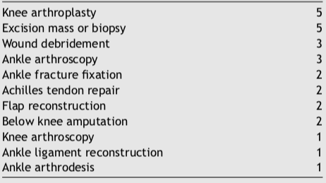
How to treat neuromas?
Surgical cause of neuroma (n=27)
The outcomes for neuroma excision and implantation alone are modest. Contemporary treatments for neuroma such as allograft reconstruction, targeted muscle reinnervation , or regenerative peripheral nerve interface have demonstrated improved pain compared with conventional techniques, especially in amputees.
Surgical techniques that “actively” address the nerve end may further improve the treatment outcomes of surgery for lower extremity neuroma.
Further prospective study is required to determine the effectiveness of newer, active techniques for lower extremity neuroma management, such as allograft reconstruction, targeted muscle reinnervation , and regenerative peripheral nerve interface.
Surgical cause of neuroma (n=27)
Anantavorasakul N, Lans J, Macken AA, Sood RF, Chen NC, Eberlin KR. Surgery for lower extremity symptomatic neuroma: Long-term outcomes. J Plast Reconstr Aesthet Surg. 2020;73(8):1456-1464. doi:10.1016/j.bjps.2020.01.034

Slide 41
How to treat neuromas?
Peripheral neuroma caused by injuries and surgical procedures can result in traumatic neuropathic pain, functional impairment and psychological distress, severely decreasing the quality of life.
A traumatic neuroma is a tangle of neural fibers and connective tissue that develops following nerve injury. It usually presents as a firm, oval, whitish, slowly growing, palpable and painful nodule, not larger than 2 cm. It may be associated with paresthesia over the injured area.
Painful hypersensitivity to normal light tactile stimuli (dysesthesia) or a neuralgic pain with the presence of a typical trigger point in the area of a neuroma may be a prominent feature. Traumatic neuropathic pain can cause the patient to feel burning, stabbing, raw, gnawing or sickening sensations.
Numerous techniques for neuroma prevention and treatment have been proposed, including therapeutic massage, electrical stimulation, lipofilling, transposition of the proximal stump into the muscle, bone or vein, and neural capping with synthetic or biological materials. The diversity of treatment modalities in use reflects the currently frustrating clinical prognosis and high failure rates.
Currently, the treatment of traumatic neuroma is challenging with varied symptoms among patients, some of which are usually resistant to common analgesics, and a standardized management is highly demanded in clinical practice.
Yao C, Zhou X, Zhao B, Sun C, Poonit K, Yan H. Treatments of traumatic neuropathic pain: a systematic review. Oncotarget. 2017;8(34):57670-57679. Published 2017 Apr 7. doi:10.18632/oncotarget.16917

Slide 42
How to treat neuromas?
Medication should be doctors’ first choice for patients who develop traumatic neuropathic pain for the first time, it also should be advised for prevention postoperatively.
For patients who undergo intractable traumatic neuropathic pain, which is refractory to medication, surgical procedure is advised. As for which kind of surgery should be performed, it depends on which particular nerve is injured. For example, neuroma of palmar cutaneous branch (PCB) of the median nerve can be transpositioned into the pronator quadratus, while the traumatic neuropathic pain in an amputated finger is suggested to be treated with interdigital neurorrhaphy.
In general, resection of the existing neuroma is strongly advised for all the patients with traumatic neuropathic pain. Transposition and relocation of the nerve stump into a biological tunnel away from partial compression, for instance, muscles, bones and veins are necessary to assure long term efficacy.
Artificial conduits can be used under the circumstances that no suitable biological tunnel can be found. Soft tissues treatment, for instance, flaps and lippofilling can provide better prognosis for those patients with large scale of tissue defect and deep soft tissue injury.
For patients with intractable traumatic neuropathic pain refractory to medication and refuse any surgical treatment or have little satisfaction with surgery, physiotherapy as electrostimulation and massage may also be good choices.
Yao C, Zhou X, Zhao B, Sun C, Poonit K, Yan H. Treatments of traumatic neuropathic pain: a systematic review. Oncotarget. 2017;8(34):57670-57679. Published 2017 Apr 7. doi:10.18632/oncotarget.16917

Slide 43
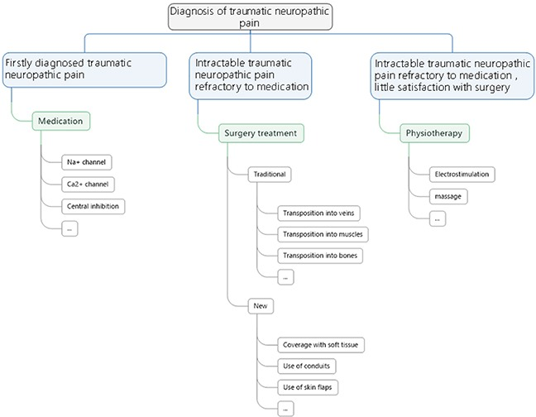
How to treat neuromas?
A flowchart of treatment principles for neuropathic pain
Yao C, Zhou X, Zhao B, Sun C, Poonit K, Yan H. Treatments of traumatic neuropathic pain: a systematic review. Oncotarget. 2017;8(34):57670-57679. Published 2017 Apr 7. doi:10.18632/oncotarget.16917

Slide 44
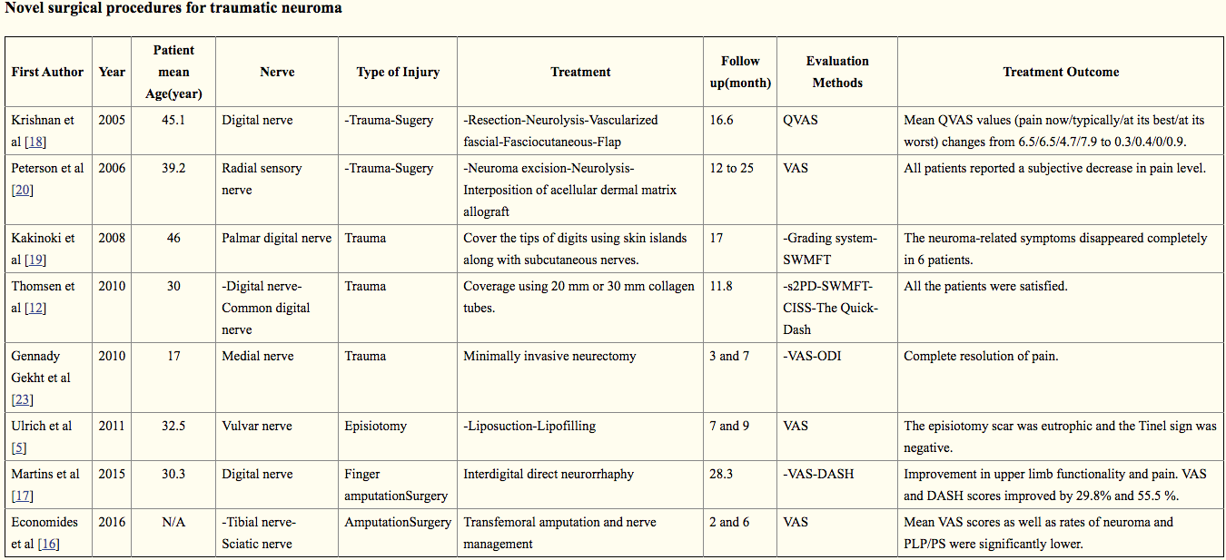
How to treat neuromas?
Yao C, Zhou X, Zhao B, Sun C, Poonit K, Yan H. Treatments of traumatic neuropathic pain: a systematic review. Oncotarget. 2017;8(34):57670-57679. Published 2017 Apr 7. doi:10.18632/oncotarget.16917

Slide 45
How to treat neuromas?
A practical and standardized treatment modality is desirable, as it would allow a better comparison of results from different studies. However, there are great differences in published treatments, especially between choices of surgical procedures and medicines.
Several of these treatments are better regarding to a specific aspect of prevention and efficacy. Considering the different injured nerves and different kind of symptoms, it is unlikely that a single treatment modality could be of reference for all.
The expression of alpha smooth muscle actin (α-SMA) may contribute to neuroma-associated pain either as a direct cause of pain or an indirect marker of existence of local mechanical stimuli. The potential role of α-SMA in the pathobiology of traumatic neuropathic pain might be considered as a treatment option in clinical practice.
Due to the great differences in all aspects of the different treatment modalities (nerves, types of injury and evaluation methods), it is not possible to statistically compare the reviewed studies and their results; thus, evidence-based indications for the standardization of neuroma treatment modalities are not easily extrapolated.
Yao C, Zhou X, Zhao B, Sun C, Poonit K, Yan H. Treatments of traumatic neuropathic pain: a systematic review. Oncotarget. 2017;8(34):57670-57679. Published 2017 Apr 7. doi:10.18632/oncotarget.16917

Slide 46
Next week’s agenda
Protocols/no pathology for:
Vasculitis
Diabetic foot ulcers
Venous ulcers
Abdominal mesh wounds
Necrotizing fasciitis
Decubiti ulcers
Hydratinitis wounds
Arterial ulcers

