Slide 1
How to treat wounds in immunocompromised patients Wednesday, August 28, 2024
Notes:
1

Slide 2
Agenda
Hot to treat wounds colonized by multidrug resistant organisms in immune-compromised patients?
How to treat wounds in patients with HIV?

Slide 3
How to treat wounds colonized by multidrug resistant organisms in immune-compromised patients?
Critically ill and immune-compromised patients incur a high risk of surgical wound infection and dehiscence. The underlying disease and comorbidities such as foreign bodies (abdominal mesh, suture material), serous collections and devitalized tissues, all contribute to the risk of infection.
In particular, bacterial infections contribute to the increased morbidity and mortality of patients who have undergone organ transplantation and are treated with immunosuppressive drugs and steroids.
Pignatti M, Gerunda GE, Rompianesi G, De Ruvo N, Di Benedetto F, Codeluppi M, Bonucchi D, Pacchioni L, Loschi P, Malaventura C, De Santis G. Treatment of wounds colonized by multidrug resistant organisms in immune-compromised patients: a retrospective case series. Patient Saf Surg. 2013 Sep 3;7(1):28. doi: 10.1186/1754-9493-7-28. PMID: 24139428; PMCID: PMC3847491.

Slide 4
How to treat wounds colonized by multidrug resistant organisms in immune-compromised patients?
Similarly to other contaminated or infected wounds, mechanical debridement, that removes the non-viable tissue, is essential in reducing the bacterial load and eradicating the wound biofilm.
Leaving contaminated wounds to heal spontaneously by secondary intention has been demonstrated to be safe, but it requires a long healing time and frequent and time-consuming changing of wound dressings.
Moreover, an open wound could become further infected and create severe problems of metabolic balance in already severely ill patients. Direct closure of such wounds presents therefore several advantages.
Pignatti M, Gerunda GE, Rompianesi G, De Ruvo N, Di Benedetto F, Codeluppi M, Bonucchi D, Pacchioni L, Loschi P, Malaventura C, De Santis G. Treatment of wounds colonized by multidrug resistant organisms in immune-compromised patients: a retrospective case series. Patient Saf Surg. 2013 Sep 3;7(1):28. doi: 10.1186/1754-9493-7-28. PMID: 24139428; PMCID: PMC3847491.

Slide 5
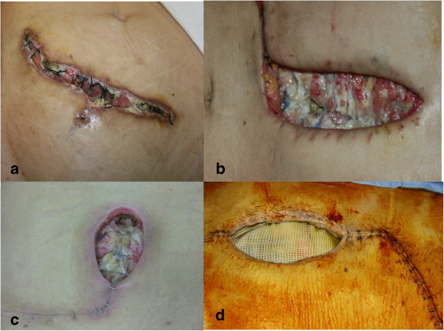
How to treat wounds colonized by multidrug resistant organisms in immune-compromised patients?
Examples of dehiscent abdominal wounds. (a) Dehiscent abdominal wound colonized by Acinetobacter baumannii after kidney transplantation. (b) Dehiscent abdominal wound colonized by Acinetobacter baumannii after liver re-transplantation (due to Hepatitis B virus). (c) Dehiscent abdominal wound colonized by Enterococcus faecium after liver transplantation. (d) Dehiscent abdominal wound colonized by Enterococcus faecium after liver transplantation. The Prolene mesh (Prolene ™. Ethicon Inc., U.S.A.), used to bridge a missing part of the muscular wall is clearly visible.
Pignatti M, Gerunda GE, Rompianesi G, De Ruvo N, Di Benedetto F, Codeluppi M, Bonucchi D, Pacchioni L, Loschi P, Malaventura C, De Santis G. Treatment of wounds colonized by multidrug resistant organisms in immune-compromised patients: a retrospective case series. Patient Saf Surg. 2013 Sep 3;7(1):28. doi: 10.1186/1754-9493-7-28. PMID: 24139428; PMCID: PMC3847491.

Slide 6
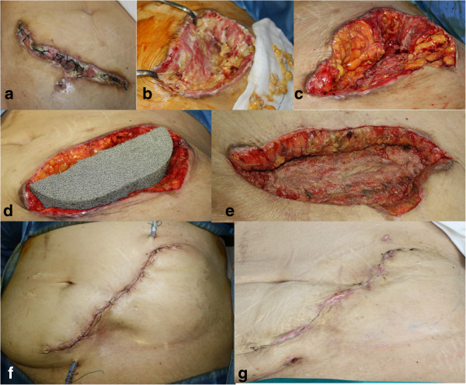
How to treat wounds colonized by multidrug resistant organisms in immune-compromised patients?
Phases of surgical treatment. Patient presenting with a dehiscent abdominal wound colonized by Acinetobacter baumannii after kidney transplant (a). Serial wound debridements (b, c). Negative pressure dressing (V.A.C. GranuFoam Silver®) positioned (d). Clinically satisfactory appearance, with healthy granulating tissue despite still positive microbiological cultures (e). Primary closure, 2 days post-operatively (f), and 2 weeks post-operatively (g).
Pignatti M, Gerunda GE, Rompianesi G, De Ruvo N, Di Benedetto F, Codeluppi M, Bonucchi D, Pacchioni L, Loschi P, Malaventura C, De Santis G. Treatment of wounds colonized by multidrug resistant organisms in immune-compromised patients: a retrospective case series. Patient Saf Surg. 2013 Sep 3;7(1):28. doi: 10.1186/1754-9493-7-28. PMID: 24139428; PMCID: PMC3847491.

Slide 7
How to treat wounds in patients with HIV?
Patients with HIV/AIDS are experiencing prolonged life expectancy because of advancements in antiretroviral therapy. Consequently, they are also developing morbidities associated with aging and immobility, such as chronic wound formation. The vast majority of wounds are typically venous, diabetic neuropathic, or PrUs.
In the United States, more than 36% of the HIV/AIDS cases can be attributed directly or indirectly to injected drug use, including 9% of newly diagnosed cases in 2009.
McMeeking A, Kim I, Ross F, Ayello EA, Brem H, Linton P, O'Neill DK. Wounds in patients with HIV. Adv Skin Wound Care. 2014 Sep;27(9):396-9. doi: 10.1097/01.ASW.0000453268.62015.3c. PMID: 25133341.

Slide 8
How to treat wounds in patients with HIV?
Because injection sites are commonly in the lower extremities, repeated use can lead to chronic vein trauma, infections, deep vein thrombosis, and collapse of veins as well as nerve and muscle damage.
These changes enhance the risk of developing chronic venous insufficiency and impact the range of motion of the ankle. Loss of range of motion causes ankle impairment of the calf muscle pump function, which results inincreased venous pressure and damage to veins, leading to venous reflux.
McMeeking A, Kim I, Ross F, Ayello EA, Brem H, Linton P, O'Neill DK. Wounds in patients with HIV. Adv Skin Wound Care. 2014 Sep;27(9):396-9. doi: 10.1097/01.ASW.0000453268.62015.3c. PMID: 25133341.

