Slide 1
How to treat Marjolin’s Ulcer Wednesday, October 2, 2024
Notes:
1

Slide 2
Agenda
What is Marjolin’s ulcer?
What is definition of Marjolin’s ulcer?
How to distinguish ulcerated basal cell carcinomas from venous ulcers?
How to treat Marjolin’s ulcer?

Slide 3
What is Marjolin’s ulcer?
Squamous cell carcinoma (SCC) has been commonly reported by foot and ankle specialists.
Marjolin's ulcer is a malignancy that involves a posttraumatic scar or ulceration that can develop into SCC from chronic neuropathic pedal wounds, venous stasis, or decubitus ulcerations.
Most Marjolin's ulcers are found in the lower extremity, specifically the feet, and it is twice as common in females as males.
Biopsy of the tumor is the reference standard to diagnose SCC, and wide excision of SCC is the most common treatment option.
Tchanque-Fossuo CN, Millsop JW, Johnson MA, Dahle SE, Isseroff RR. Ulcerated Basal Cell Carcinomas Masquerading as Venous Leg Ulcers. Adv Skin Wound Care. 2018;31(3):130-134.

Slide 4
What is definition of Marjolin’s ulcer?
De novo SCC is a particularly aggressive variant of SCC which lacks a precursor and will thus arise independently on skin which has been chronically injured or diseased. It is not correlated with sun exposure, nor will it show any evidence of previous actinic lesions or SCCS.
Generally, de novo SCC will emerge in the setting of long-standing ulcers, burn scars, or osteomyelitis. It can also be seen in chronic inflammatory conditions such as discoid lupus erythematosus and dystrophic epidermolysis bullosa. The tendency for malignancies to develop in burn scars was first described by Marjolin in 1827, and accordingly, are referred to today as Marjolin's ulcers.
Unlike conventional SCCs, which tend to occur on the face, neck, hands, and other sun-damage prone areas, de novo SCCs are most commonly found on the lower extremities, where burn scars are more prevalent.
Although females on average sustain a greater number of burn injuries than males, there is a predilection for malignant scar development in men, and de novo SCCs are significantly more likely to be found in males than in females. They usually emerge 20 to 40 years after the original trauma occurred, and will present clinically as nonhealing, exophytic growths or indurated ulcers which have recently became painful and may have a foul smelling discharge
Yanofsky VR, Mercer SE, Phelps RG. Histopathological variants of cutaneous squamous cell carcinoma: a review. J Skin Cancer. 2011;2011:210813. doi:10.1155/2011/210813

Slide 5
What is definition of Marjolin’s ulcer?
Frequency of histopathologic diagnoses
Pathologic diagnosis | Frequency NO. (%)
Well differentiated SCC | 32 (38.6%)
SCC, differentiation not reported | 20(24.1%)
Moderately Differentiated SCC | 11(13.2%)
BCC | 8(9.6%)
Poorly Differentiatd SCC | 5(6.0%)
Melanoma | 2(2.4%)
Verrucous carcinoma | 2(2.4%)
MFH | 1(1.2%)
Mucoepidermoid carcinoma | 1(1.2%)
Leiomyosarcoma | 1(1.2%)
Sadegh Fazeli M, Lebaschi AH, Hajirostam M, Keramati MR. Marjolin's ulcer: clinical and pathologic features of 83 cases and review of literature. Med J Islam Repub Iran. 2013;27(4):215-224.

Slide 6
How to distinguish ulcerated basal cell carcinomas from venous ulcers?
Tchanque-Fossuo CN, Millsop JW, Johnson MA, Dahle SE, Isseroff RR. Ulcerated Basal Cell Carcinomas Masquerading as Venous Leg Ulcers. Adv Skin Wound Care. 2018;31(3):130-134.
.

Slide 7
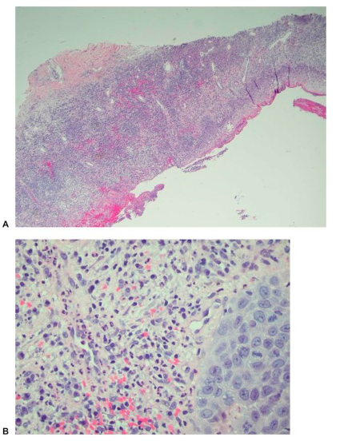
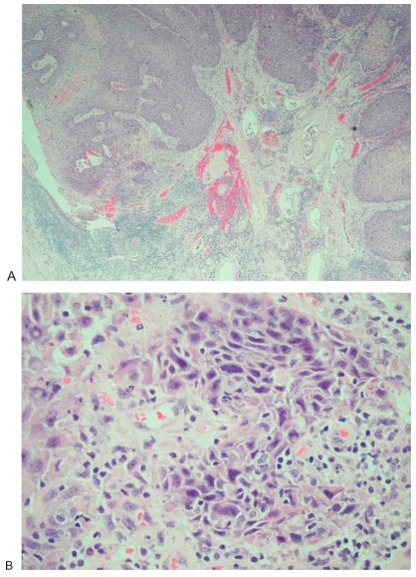
How to distinguish biopsies of ulcerated basal cell carcinomas from venous ulcers?
(A) Skin biopsy showing epidermal ulceration (original magnification × 40; hematoxylin and eosin stain) composed of (B) acute and chronic inflammatory cells and organizing granulation tissue, with reactive degenerative changes (original magnification × 400; hematoxylin and eosin stain).
(A) Well-differentiated, invasive squamous cell carcinoma showing ulceration (original magnification × 40; hematoxylin and eosin stain). (B) Nest of mild to moderate atypical cells showing abundant eosinophilic cytoplasm and large nuclei with vesicular chromatin (original magnification × 400; hematoxylin and eosin stain).
.
Cavaliere R, Mercado DM, Mani M. Squamous Cell Carcinoma From Marjolin's Ulcer of the Foot in a Diabetic Patient: Case Study. J Foot Ankle Surg. 2018;57(4):838-843.

Slide 8
How to treat Marjolin’s ulcer?
Preoperative clinical images showing the right posterior plantar heel with the tumor centrally located within the site of the pressure ulceration. The ulcer measured 3.0 cm long, 3.0 cm wide, and 1.5 cm deep.
Cavaliere R, Mercado DM, Mani M. Squamous Cell Carcinoma From Marjolin's Ulcer of the Foot in a Diabetic Patient: Case Study. J Foot Ankle Surg. 2018;57(4):838-843.
.

Slide 9
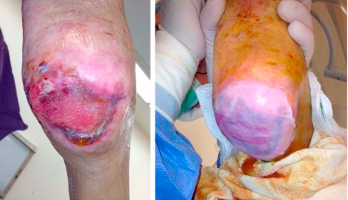
How to treat Marjolin’s ulcer?
Intraoperative application of Apligraf to the right heel ulceration. This was performed to assist in delayed primary closure in an effort to prevent recurrence.
Cavaliere R, Mercado DM, Mani M. Squamous Cell Carcinoma From Marjolin's Ulcer of the Foot in a Diabetic Patient: Case Study. J Foot Ankle Surg. 2018;57(4):838-843.
.

Slide 10
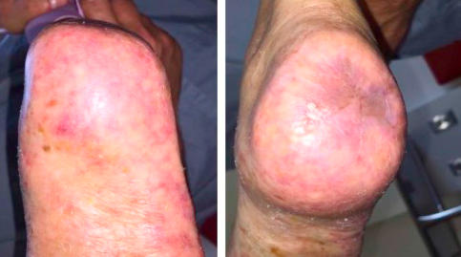
How to treat Marjolin’s ulcer?
View ~1 year postoperatively. The surgical site had healed with no open lesions or signs of recurrence at the site of resection.
Cavaliere R, Mercado DM, Mani M. Squamous Cell Carcinoma From Marjolin's Ulcer of the Foot in a Diabetic Patient: Case Study. J Foot Ankle Surg. 2018;57(4):838-843.
.

