Slide 1
Hospital Metabolic Services
Wednesday, October 2, 2024
Michael M. Rothkopf, MD, FACP, FACN
Founding Director, Physician Nutrition E-learning Platform
Immediate Past President, National Board of Physician Nutrition Specialists
Clinical Associate Professor of Medicine, Thomas Jefferson University, Philadelphia, Pa
Adjunct Associate Professor of Medicine, Eastern Virginia Medical School, Norfolk, Va
Notes:
1

Slide 2
Agenda
The role of a physician specialist—the “Metabolist”
Primary diseases of nutrition
Nutritional options for the management of chronic diseases
Nutritional disease prevention
Malnutrition: an older adult crisis
NOURISH: Nutrition effect on Unplanned Readmissions and Survival in Hospitalization
Nutrition and Mortality
Potential economic impact of NOURISH
EFFORT study

Slide 3
The Role of a Physician Nutrition Specialist – The "Metabolist"
Expert knowledge of clinical biochemistry
Specialized clinical tools
Nutrition Focused Physical Exam (NFPE) in malnutrition
Nutrition Focused Physical Exam (NFPE) in adiposity
Metabolic cart
Body Composition
Nitrogen balance
Micronutrient levels
Defined scope of practice
Primary diseases of nutrition
Nutritional disease management
Nutritional approaches for disease prevention

Slide 4
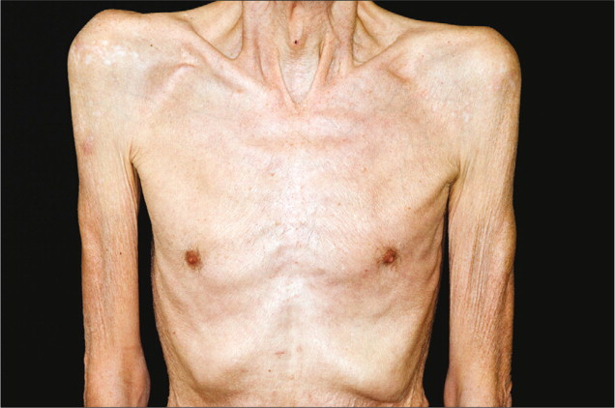
Primary Diseases of Nutrition
Undernutrition
Protein-calorie malnutrition
Marasmus/Kwashiorkor
Cachexia
Anorexia
Sarcopenia
Stress metabolism
Mineral/electrolyte deficiencies
Micronutrient deficiencies
Overnutrition
Metabolic syndrome
Adiposity
Obesity
NAFLD
Mineral/electrolyte overload/toxicity
Micronutrient overload/toxicity
Inborn errors of metabolism
Classic syndromes of childhood, adult survivors
Partial metabolic errors with unique presentations

Slide 5
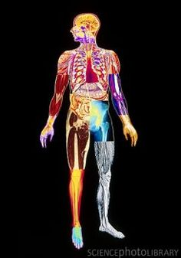
Nutritional Options for the Management of Chronic Diseases*
CNS: epilepsy (ketogenic), dementia (ketogenic, MCT oil, copper restriction), multiple sclerosis (omega 3), neuropathy (B1, B12, copper)
CVS: atherosclerosis (Mediterranean, omega 3), AF (Mediterranean), cardiac cachexia (carnitine, creatine, coQ10, B1, B2, B3)
Pulmonary: COPD, CF (high fat, low carb, omega 3)
GI: food allergy (elimination diets, FODMAP), IBD (elemental diets, omega 3)
Liver: NAFLD (Mediterranean), hyperammonemia (plant protein, vitamin support)
GU: CRI (protein modulation), HD (nutritional support), nephrolithiasis (calcium, oxalate, urate modulation)
Gyn: PCOS, infertility
Skeletomuscular: osteoporosis (calcium, magnesium, vitamin D),
myositis (carnitine, creatine, coQ10, B1, B2, B3), arthritis (omega 3)
Derm: psoriasis (vitamin D, omega 3)
Endocrine: metabolic syndrome, DM mgmt (Mediterranean, low carb), DM resolution (pharmacosurgery)
Cancer: prevention (numerous), adjunctive (during therapy), cachexia (nutritional support), others
*Partial List

Slide 6
Nutritional Disease Prevention*
Diabetes
Heart Disease
Liver Disease
Cancer
Alzheimer's
Hospital Malnutrition Screening
NOURISH - Nutrition effect on Unplanned Readmissions and Survival with Hospitalization
EFFORT - Effect of early nutritional support on Frailty, Functional Outcomes, and Recovery Trial
Perioperative Nutrition
ERAS - Enhanced Recovery After Surgery
*Partial List​

Slide 9
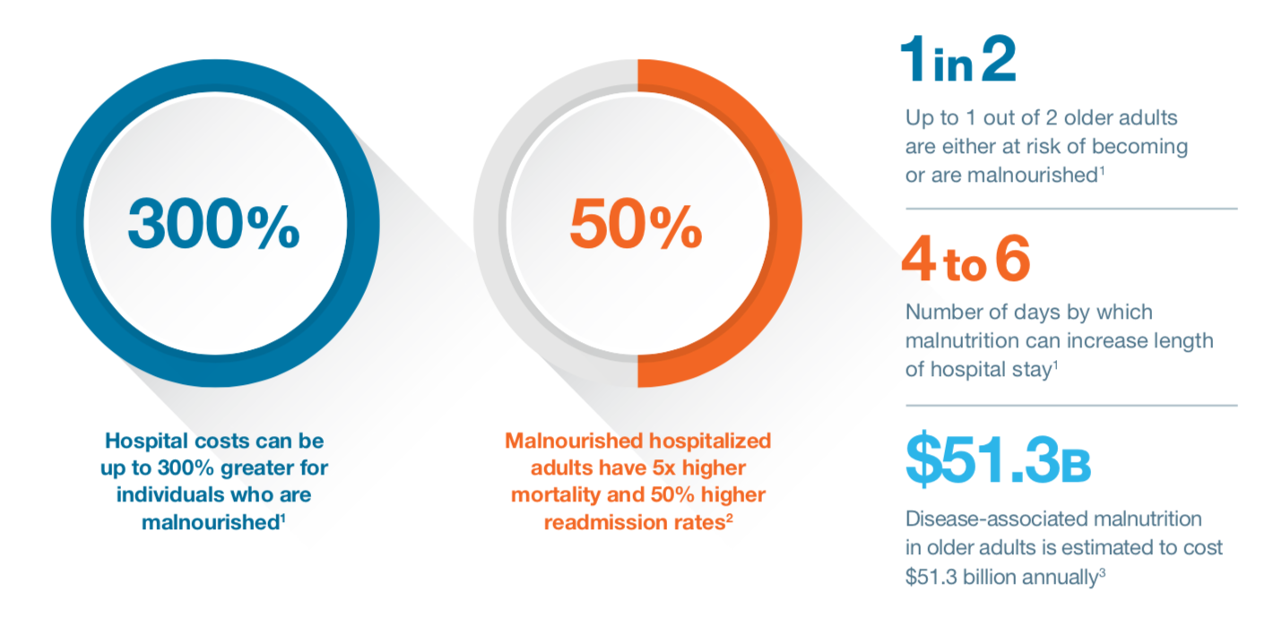

Slide 10
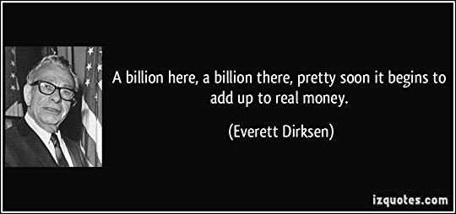
Everett McKinley Dirksen (1896-1969)
Illinois Representative (1930-50)
Illinois Senator (1950-69)
Fiscal conservative
Civil rights proponent.

Slide 11
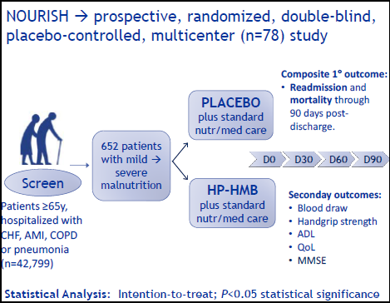
NOURISH: Nutrition effect on Unplanned Readmissions and Survival in Hospitalization
Deutz et al., Clin Nutr 2016;35:18‐26

Slide 12
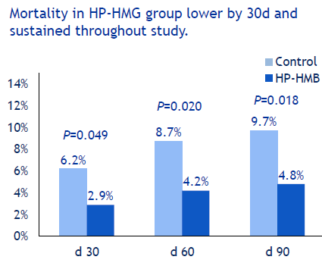
Deutz et al., Clin Nutr 2016;35:18‐26

Slide 13
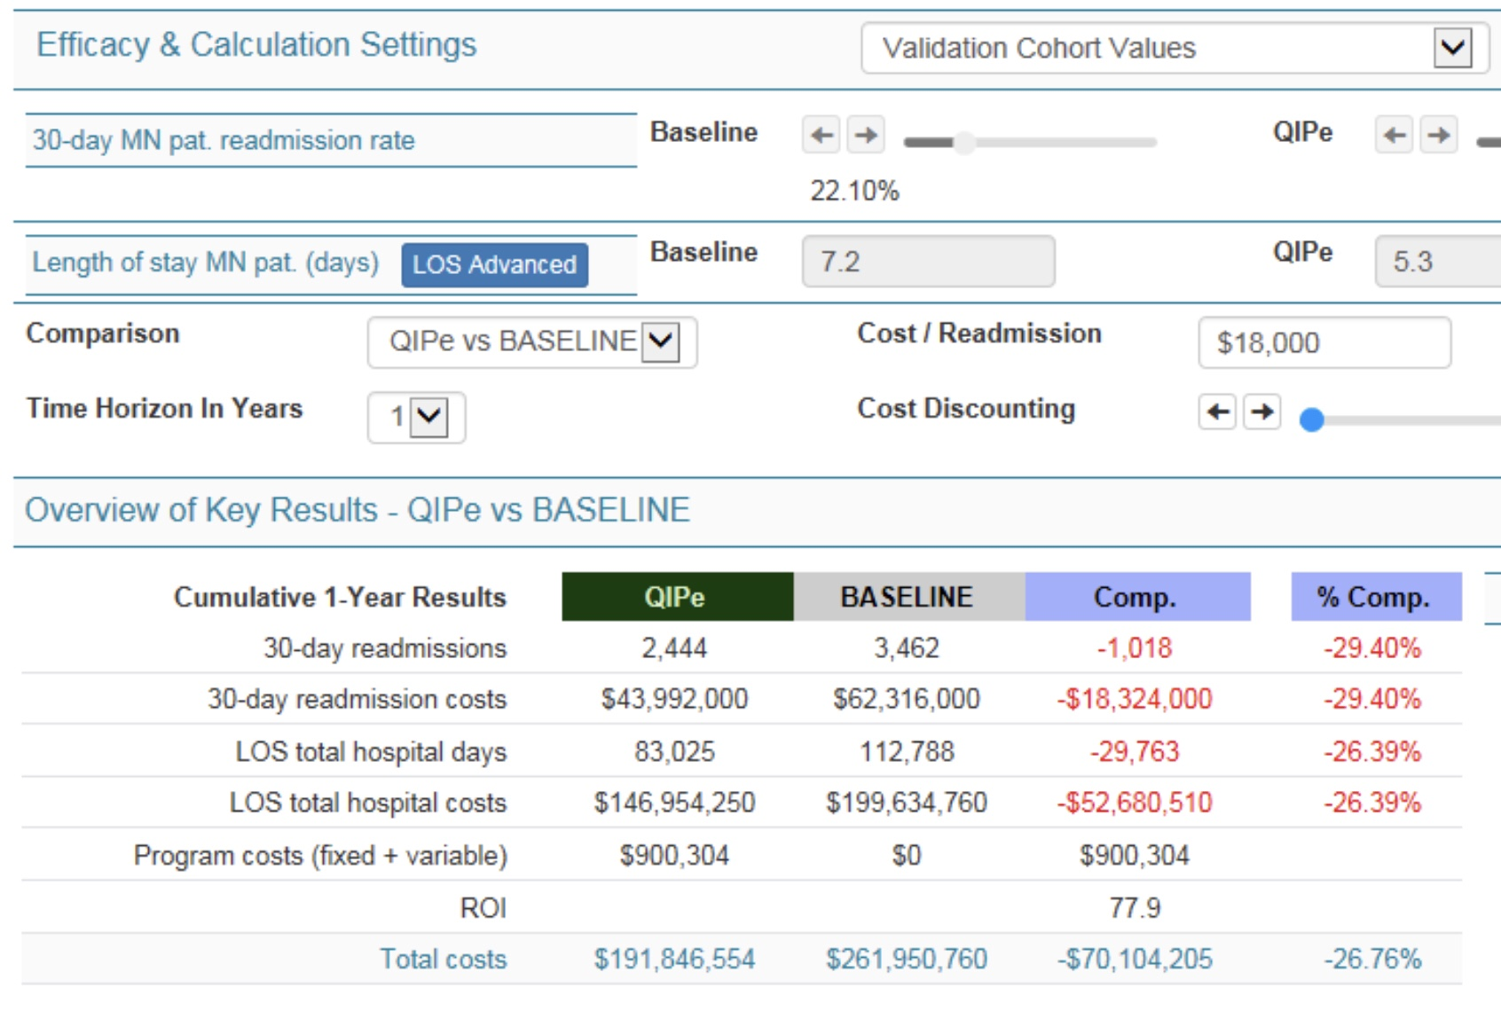
Potential Economic Impact of NOURISH – Single Suburban Hospital Example

Slide 14
EFFORT Study - 2019
Effect of early nutritional support on frailty, functional outcomes, and recovery of malnourished medical inpatients
5015 patients screened, 2088 recruited, 8 hospitals
1050 assigned to intervention (Int), 1038 to control (C)
At 30 days, 232 (23%) Int vs 272 (27%) C experienced adverse clinical outcome (adjusted odds ratio [OR] 0·79
By day 30, 73 [7%] Int vs 100 [10%] C died (adjusted OR 0·65)
Lancet 2019; 393: 2312–21

Slide 15
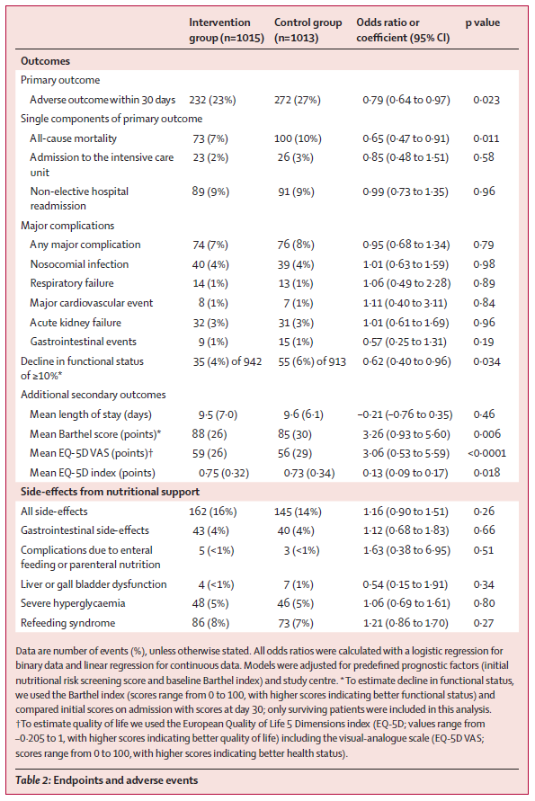
Lancet 2019; 393: 2312–21

Slide 16
http://nbpns.org/

