Slide 1
What are criteria for Hospice? Wednesday, October 2, 2024
Notes:
1

Slide 2
Agenda
Can patients with stage IV pressure ulcers and multiple comorbidities heal?
What are criteria for hospice?
What are criteria for hospice for dementia?

Slide 3
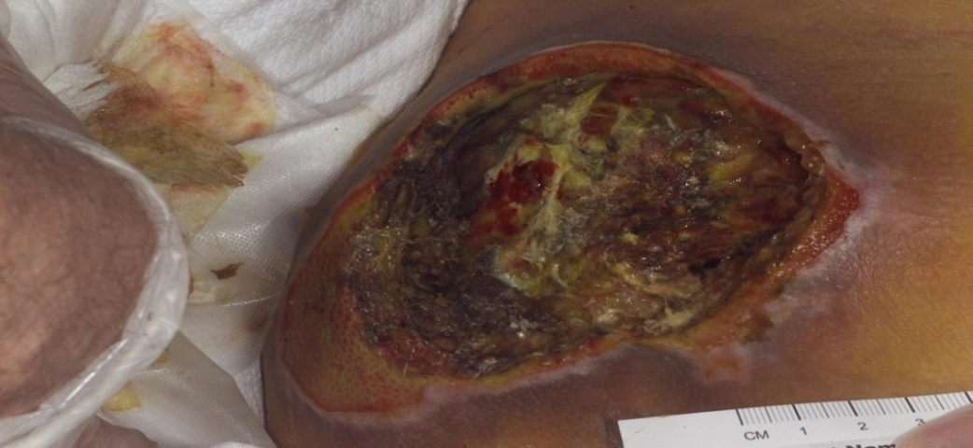
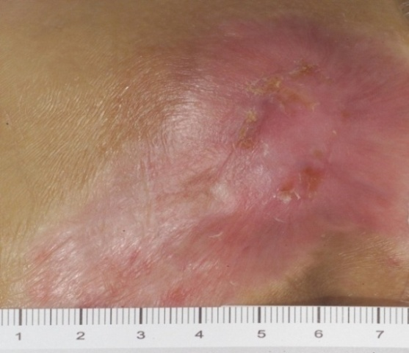
Can Patients with Stage IV Pressure Ulcers and Multiple Comorbidities Heal? Hospice or Healing Should be Initial Conversation in the Older Adult
Schiffman et al., Operative debridement of pressure ulcers using the Wound
Electronic Medical Record. World J Surg 2009; 33:1396-1402.

Slide 4
What are criteria for hospice?
These are the criteria for receiving hospice care, according to CMS:
Your hospice doctor and your regular doctor (if you have one) certify that you’re terminally ill (with a life expectancy of 6 months or less).
You accept palliative care (for comfort) instead of care to cure your illness.
You sign a statement choosing hospice care instead of other Medicare-covered benefits to treat your terminal illness and related conditions
Medicare has established guidelines for hospice admissions for most major terminal illnesses. These guidelines are not necessarily accurate in predicting death within six months.
Careful documentation of the medicare hospice criteria as pertaining to that patient is a convenient way to demonstrate the severity of the illness for patients, family and for colleagues as you all work together to develop appropriate goals of care.
www.medicare.gov/coverage/hospice-care

Slide 5
What are criteria for hospice?
Writing a note in the patient’s chart (either inpatient or outpatient) that documents the eligibility for hospice care based on the CMS guidelines can assist the hospice in making a prompt determination of eligibility and would help if there was every a regulatory question of a patients eligibility.
For patients who have a longer than expected survival, reevaluation at time of re-certification will document that the patient is still eligible for home hospice care. In rare situations were patients have unanticipated recovery, they may be discharged from hospice but readmitted later without penalty, if there is decline in health status.
www.medicare.gov/coverage/hospice-care

Slide 6
What are criteria for hospice?
An abridged version of the currently outlined assessment criteria for the progression of diseases and non-disease baseline guidelines as obtained from the Centers of Medicare and Medicaid Services
Part 1: Decline in a patient's clinical status guidelines
A. Progression of disease via worsening status, symptoms, signs, laboratory results: Clinical Status:
Refractory or recurring infections
Progressive inanition which is documented by several measures such as 10% body weight loss, decreased albumin, dysphagia leading to aspiration, among others
Symptoms: Include a number of symptoms including nausea and vomiting, dyspnea, persisting cough, diarrhea, and progressive pain
Signs: Include a number of clinical signs including hypotension, edema, ascites, progressive weakness, new altered mental status, among others
Laboratory Results:
Include a number of laboratory findings including worsening pCO2/pO2/SaO2 values, worsening liver function tests, worsening tumor markers, and volatile sodium and potassium, among others
Teoli D, Bhardwaj A. Hospice Appropriate Diagnoses. [Updated 2019 Feb 9]. In: StatPearls [Internet]. Treasure Island (FL): StatPearls Publishing; 2020 Jan

Slide 7
What are criteria for hospice?
B. Progressive disease leading to worsened Karnofsky Performance Status or Palliative Performance Score
C. Worsened Functional Assessment Staging of diagnosed dementia.
D. Requiring assistance with additional ADL's
E. Worsening refractory stage 3 to stage 4 pressure ulcers despite wound care
F. Increasing healthcare utilization in the form of emergency visits, hospital admissions, and physician appointments related to the primary hospice diagnosis before seeking hospice benefit
Teoli D, Bhardwaj A. Hospice Appropriate Diagnoses. [Updated 2019 Feb 9]. In: StatPearls [Internet]. Treasure Island (FL): StatPearls Publishing; 2020 Jan

Slide 8
What are criteria for hospice?
Part 2. Non-disease specific baseline guidelines (both points A and B must be satisfied).
A. Physiologic impairment of functional status as interpreted via the Karnofsky Performance Status or Palliative Performance Score of less than 70 percent
B. Individual needs assistance for greater than or equal to 2 ADL's: Ambulation; Transfer; Dressing; Feeding; Continence; Bathing.
C. Co-morbidities: when the condition is not the designated primary hospice diagnosis, the presence of significant disease thought to contribute to a prognosis of 6 months or less survival should be considered, such as:COPD, CHF, Ischemic heart disease, Diabetes mellitus, Neurologic disease (CVA, ALS, MS, Parkinson's), Renal failure, Liver Disease, Neoplasia, Acquired immune deficiency syndrome/HIV, Dementia, Refractory severe autoimmune disease (e.g., lupus or rheumatoid arthritis)
Teoli D, Bhardwaj A. Hospice Appropriate Diagnoses. [Updated 2019 Feb 9]. In: StatPearls [Internet]. Treasure Island (FL): StatPearls Publishing; 2020 Jan

Slide 9
What are criteria for hospice for dementia?
Stage 7C or beyond according to FAST Scale
AND one or more in the past 12 months:
Aspiration pneumonia
Pyelonephritis
Septicemia
multiple pressure ulcers (stage 3-4)
Recurrent fever
Inability to maintain sufficient fluid and calorie intake in past 6 months (10% weight loss or albumin <2.5)
Other significant condition that suggests limited prognosis
www.medicare.gov/coverage/hospice-care

