Slide 1





Hidradenitis Suppurativa
Wednesday, October 9, 2024
Notes:
1

Slide 2
Agenda
What is Hidradenitis Suppurativa?

Slide 3
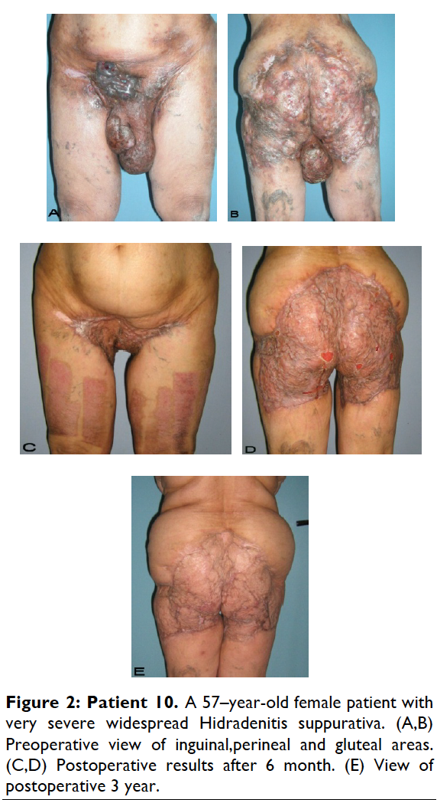
What is Hidradenitis Suppurativa?
Hidradenitis suppurativa (HS) is a common dermatologic condition that frequently presents in emergency and inpatient settings.
Anemia, leukocytosis, neutrophilia, an elevated erythrocyte sedimentation rate, and an elevated C-reactive protein level are common markers of chronic inflammation in HS patients and might not signify infection.
Acute management of HS should focus on anti-inflammatory and antibiotic regimens, with increasing severity dictating the need for more aggressive therapy.
Longitudinal outpatient care coordination with a dermatologist and primary care physician is imperative for limiting emergency department and inpatient care utilization.
Charrow, A., Savage, K. T., Flood, K., & Kimball, A. B. (2019). Hidradenitis suppurativa for the dermatologic hospitalist. Cutis, 104(5), 276–280.
Gierek, M., Ochała-Gierek, G., Kitala, D., Łabuś, W., & Bergler-Czop, B. (2022). Surgical management of hidradenitis suppurativa. Postepy dermatologii i alergologii, 39(6), 1015–1020. https://doi.org/10.5114/ada.2022.115323

Slide 4
Hidradenitis Suppurativa
Infundibular hyperkeratosis, hyperplasia of the follicular epithelium and perifolliculitis are major histopathological characteristics of hidradenitis suppurativa/acne inversa.
These apparently precede rupture of the follicle.
In particular, hyperplasia of the follicular epithelium probably marks the beginning of sinus formation, which usually spreads horizontally.
Psoriasiform hyperplasia of the interfollicular epidermis with subepidermal inflammatory infiltrate might be interpreted as an inflammation‐driven process basically identical to that which is evident at the terminal follicle.
However, it does not lead to harmful and progressive sequelae like those (rupture, sinus tracts) seen at the terminal follicles.
von Laffert M, Stadie V, Wohlrab J, Marsch WC. Hidradenitis suppurativa/acne inversa: bilocated epithelial hyperplasia with very different sequelae. Br J Dermatol. 2011;164(2):367-371.

Slide 5
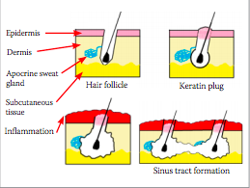
What is definition of Hidradenitis suppurativa?
Schematic representation of the pathophysiology of HS. Follicles adjacent to the apocrine glands become occluded leading to inflammation, rupture and sinus formation
Ferris A, Harding K. Hidradenitis suppurativa: a clinical summary. Wounds UK. 2019; 15(1): 53-57.

Slide 6
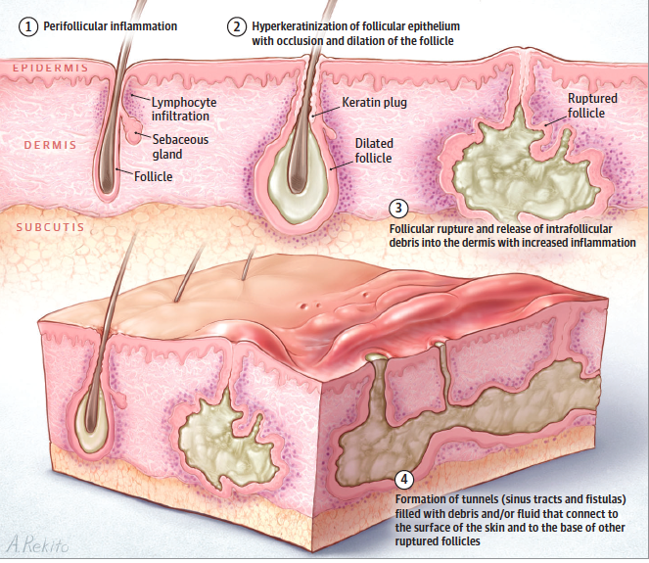
Pathology: What is hidradenitis suppurativa?
Hidradenitis suppurativa is a chronic, inflammatory, recurring, debilitating skin disease of the hair follicles that usually presents after puberty with painful, deep-seated, inflamed lesions in the apocrine gland-bearing areas of the body (most commonly the axillae, inguinal, and anogenital regions).
Although it occurs in about 0.05 and 4% of the general population, its incidence in pediatric populations is unknown.
Early recognition and treatment is crucial in order to minimize subsequent life-course effects of this disease.
Lindenhardt Saunte DM, et al. Hidradenitis suppurativa: Advances in diagnosis and treatment. JAMA 2017 (318)20: 2019-2032.

Slide 7
What are the inflammatory pathways for hidradenitis suppurativa?
Maarouf M, Clark AK, Lee DE, Shi VY. Targeted treatments for hidradenitis suppurativa: a review of the current literature and ongoing clinical trials. J Dermatolog Treat. 2018;29(5):441-449.

Slide 8
What is the pathophysiology of hidradenitis suppurativa?
As the follicle dilates, it eventually ruptures and affects adjacent apocrine ducts. Spillage of adnexal contents results in lympho-histiocytic inflammation, secondary bacterial infection, and biofilm formation, further amplifying the immune response.
This, together with extension of suppurative material to adjacent tissue, causes ulceration, fibrosis, and sinus tract formation
Maarouf M, Clark AK, Lee DE, Shi VY. Targeted treatments for hidradenitis suppurativa: a review of the current literature and ongoing clinical trials. J Dermatolog Treat. 2018;29(5):441-449.

Slide 9
What are the treatment options hidradenitis suppurativa?
The multifactorial pathogenesis of HS presents a variety of options for treatment. As we enter the dawn of targeted therapies for HS, the use of biologic treatments has the potential to dampen disease severity at multiple inflammatory points.
Although the only FDA-approved medication for HS is adalimumab, several other biologics have demonstrated potential in targeting inflammatory cytokines involved in HS, including TNF-α (etanercept, infliximab), IL-1 (anakinra), IL-17A (secukinumab), IL-12/23 (ustekinumab), and PDE4 (apremilast).
Agents that block other inflammatory mediators detected in HS patients may lead to the development of new targeted therapies.
Maarouf M, Clark AK, Lee DE, Shi VY. Targeted treatments for hidradenitis suppurativa: a review of the current literature and ongoing clinical trials. J Dermatolog Treat. 2018;29(5):441-449.

Slide 10
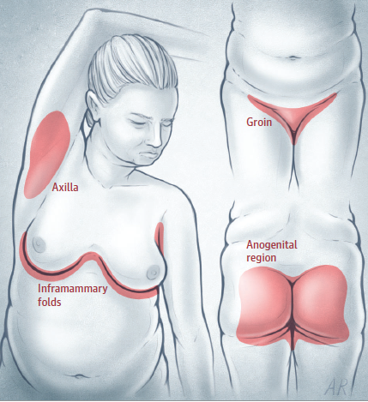
What are the current treatments for hidradenitis suppurativa in children
Typical hidradenitis suppuration distribution
Pediatric patients with Hidradenitis suppurativa should be examined for possible endocrine co-morbidities (premature adrenarche or diabetes).
If obese, weight loss is beneficial.
In addition to topical and systemic therapies for lesions, surgery may be necessary for scarred lesions and may include de-roofing and excisions. Incision and drainage is generally not recommended.
Lindenhardt Saunte DM, et al. Hidradenitis suppurativa: Advances in diagnosis and treatment. JAMA 2017 (318)20: 2019-2032.

Slide 11
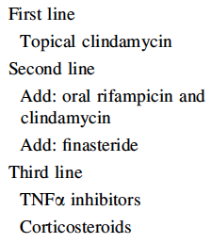
What are the current treatments for hidradenitis suppurativa in children?
No therapeutic trials have been published in pediatric hidradenitis suppurativa. Treatment recommendations are based on case reports and extrapolation of therapies tested in adults.
Topical treatment (clindamycin 10mg/mL lotion twice daily for 3 months) is recommended for patients with mild or moderate disease.
Systemic therapy requires appropriate pediatric dosing (oral antibiotics-–e.g., clindamycin and rifampicin), antiandrogens (finasteride), and immunosuppresants (TNF blockers).
Medical therapy suggested for pediatric cases of hidradenitis suppurativa
Mikkelsen P, et al. Hidradenitis suppurativa in children and adolescents: a review of treatment options. Pediatric Drugs 2014 (16): 483-489.

Slide 12
What are the current treatments for hidradenitis suppurativa in children?
Pediatric patients with Hidradenitis suppurativa should be examined for possible endocrine co-morbidities (premature adrenarche or diabetes).
If obese, weight loss is beneficial.
In addition to topical and systemic therapies for lesions, surgery may be necessary for scarred lesions and may include de-roofing and excisions. Incision and drainage is generally not recommended.
Biologic therapies, like Adalimumab (a recombinant human IgGI anti-TNF monoclonal antibody), Anakinra (a recombinant IL-I receptor antagonist), and Ustekinumab (a human IgG1x monoclonal antibody) have shown promise but have not yielded definitive results.
Mikkelsen P, et al. Hidradenitis suppurativa in children and adolescents: a review of treatment options. Pediatric Drugs 2014 (16): 483-489.

Slide 13
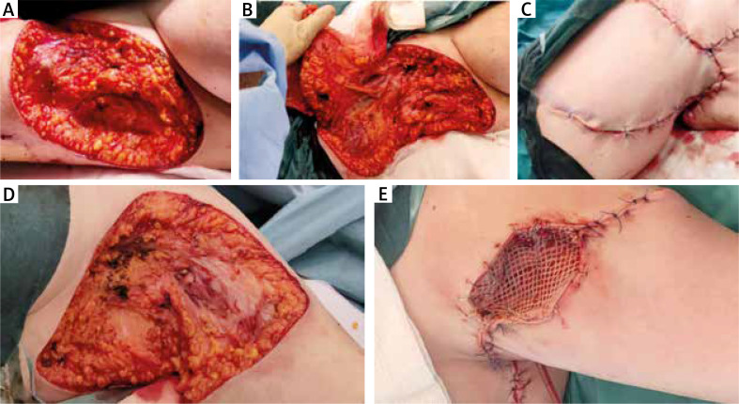
Hidradenitis Suppurativa
Figure A – Wide resection of the right axilla.
Figure B – Flap preparation.
Figure C – Successful wound closure with rotatory local flap.
Figure D – Wide excision of the left axilla.
Figure E – Successful reconstruction with local flap and skin graft (mixed technique)
Gierek, M., Ochała-Gierek, G., Kitala, D., Łabuś, W., & Bergler-Czop, B. (2022). Surgical management of hidradenitis suppurativa. Postepy dermatologii i alergologii, 39(6), 1015–1020. https://doi.org/10.5114/ada.2022.115323

Slide 14
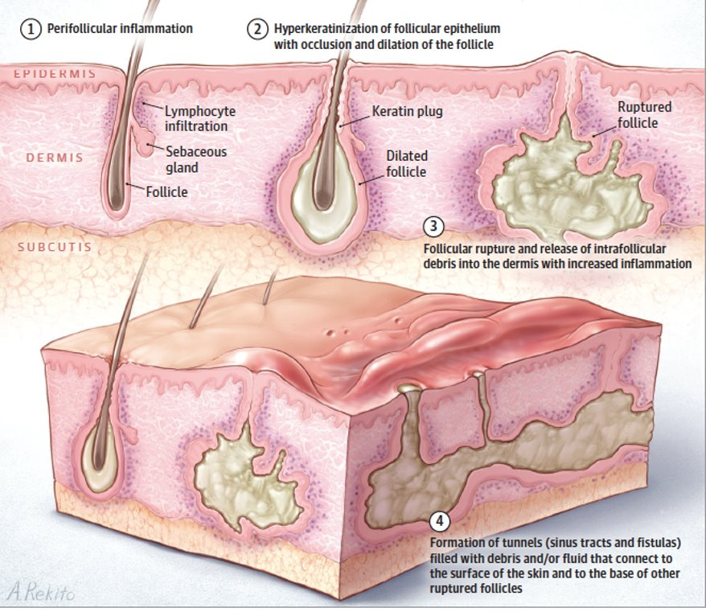
What is Hidradenitis suppurativa?
Hidradenitis suppurativa is a chronic, inflammatory, recurring, debilitating skin disease of the hair follicles that usually presents after puberty with painful, deep-seated, inflamed lesions in the apocrine gland-bearing areas of the body (most commonly the axillae, inguinal, and anogenital regions). ​
Early recognition and treatment is crucial in order to minimize subsequent life-course effects of this disease.​
Lindenhardt Saunte DM, et al. Hidradenitis suppurativa: Advances in diagnosis and treatment. JAMA 2017 (318)20: 2019-2032. ​

Slide 15
At what age does Hidradenitis Suppurativa present itself in pediatric population?
It usually presents after puberty with painful, deep-seated, inflamed lesions in the apocrine gland bearing areas of the body, such as the axillae, inguinal folds, and perianal area. Earlier studies reported that the mean age of onset of HS was between 20 to 24 years.
More recently, it has been shown that HS has a bimodal age of onset, with the first peak in the late teens and a second peak in the mid 40s, and that for classic HS the mean age at diagnosis is later in in male than female patients (19.7 years vs 16.8 years, respectively).
Liy-Wong C, Kim M, Kirkorian AY, et al. Hidradenitis Suppurativa in the Pediatric Population: An International, Multicenter, Retrospective, Cross-sectional Study of 481 Pediatric Patients. JAMA Dermatol. 2021;157(4):385–391.

Slide 16
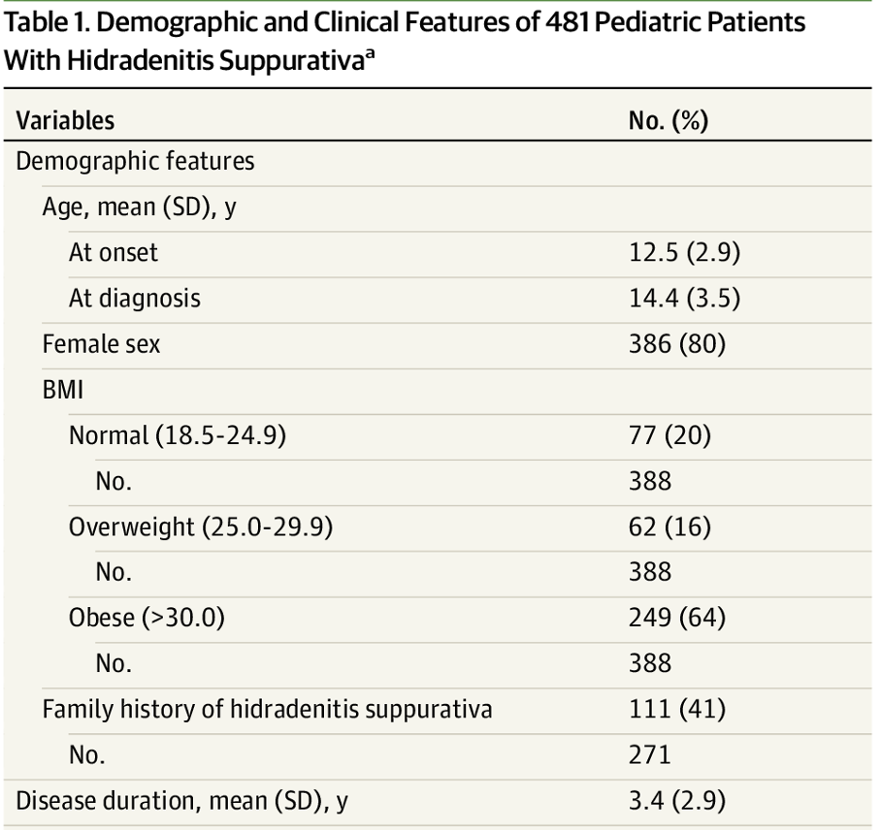
At what age does Hidradenitis Suppurativa present itself in pediatric population?
Liy-Wong C, Kim M, Kirkorian AY, et al. Hidradenitis Suppurativa in the Pediatric Population: An International, Multicenter, Retrospective, Cross-sectional Study of 481 Pediatric Patients. JAMA Dermatol. 2021;157(4):385–391.

Slide 17
What is the prevalence of HS in pediatric population?
The exact prevalence of HS globally has been difficult to estimate because of misdiagnosis and diagnostic delay, though recent studies show rates between 0.1% and 2%.7,12 In the United States, the overall estimated point prevalence is 0.098%, with the highest prevalence of 0.17% in those aged 30 to 39 years.¹
The prevalence of pedHS is estimated at 0.03%, but the point prevalence varies with age (0.11% in 15–17 year olds, 0.03% in 10–14 year olds, and 0.002% in those younger than 9 years). By far the highest prevalence is observed among female adolescents aged 15 to 17 years who are African American or biracial (0.53% and 0.25%, respectively).¹
Women are more frequently affected than men (female:male ratio, 3:1) and appear to be more likely to have genitofemoral lesions. The condition most commonly develops in persons in their early 20s, although the onset has been described in prepubertal children and in postmenopausal women as well. The prevalence of the disease appears to decline at an age of more than 50 years.²
About one third of patients with hidradenitis suppurativa report a family history of the disease, and affected families with an autosomal dominant mode of inheritance have been identified. In a small number of cases in which hidradenitis suppurativa is accompanied by severe acne and perifolliculitis capitis, the disease has been linked to chromosome 1p21.1–1q25.3 and mutations of the γ-secretase complex. Studies have not shown associations between HLA antigens and hidradenitis suppurativa.²
It is estimated that 7% of patients with HS develop symptoms before 13 years old and 2% before 11 years old.¹
¹Cotton CH, Chen SX, Hussain SH, Lara-Corrales I, Zaenglein AL. Hidradenitis Suppurativa in Pediatric Patients. Pediatrics. 2023 May 1;151(5).
²Jemec G. Hidradenitis Suppurativa. N Engl J Med 2012; 366:158-164

Slide 18
What is the pathogenesis of Hidradenitis Suppurativa?
Although the exact pathophysiology of the condition is unknown, it likely involves a host of hormonal, microbial, and immunological factors. Laboratory abnormalities, including leukocytosis, thrombophilia, an elevated erythrocyte sedimentation rate, as well as an elevated C-reactive protein level, are common in HS patients and generally represent a chronic inflammatory state rather than overt infection.
HS is thought to begin with follicular occlusion with downstream inflammation mediating neutrophilic activity and scarring. Hyperplasia of the infundibular epithelium is observed on histology, and the resulting occlusion, contained keratin, and follicular rupture initiate robust downstream inflammation.
Follicular occlusion might be initially androgen mediated or might occur in combination with friction and genetic or acquired factors involving Notch signaling. Although HS characteristically presents in areas of high apocrine density, apocrine glands are not thought to be the primary mediator of disease activity.¹
HS is associated with an inflammatory response characterized by dysregulation of the immune system as a result of tumor necrosis factor (TNF)-α, interleukin (IL)−1β, IL-10, IL-23/ T helper (Th) 17, and IL-12/Th1 pathways.²
¹Charrow A, Savage KT, Flood K, Kimball AB. Hidradenitis suppurativa for the dermatologic hospitalist. Cutis. 2019 Nov;104(5):276-280.
²Sachdeva M, Kim P, Mufti A, Maliyar K, Sibbald C, Alavi A. Biologic Use in Pediatric Patients With Hidradenitis Suppurativa: A Systematic Review. J Cutan Med Surg. 2022 Mar-Apr;26(2):176-180.

Slide 19
What is the pathogenesis of Hidradenitis Suppurativa?
Dermal tunnels in chronic HS may be sources of inflammation, leading to increased expression of proinflammatory cytokines and chemokines like C-X-C motif chemokine ligand 1 (CXCL1) and CXCL8 that drive local and systemic neutrophilic infiltration.
Additionally, imbalances in matrix metalloproteinases and tissue inhibitors of metalloproteinase increase profibrotic factors, including tissue growth factor-b 1, 2, and 3.24 This contributes to scarring and tunnel formation, hallmarks of HS.
Although HS is not a primary infection, the microbiome plays a role and superinfection is controversial. The microbiome in lesional and nonlesional skin of patients with HS differs significantly from healthy controls. Bacterial spread within intertriginous skin may boost immune activation. Distinct microbiological profiles have been identified in HS lesions depending on lesion type and severity.
An intriguing new concept proposes that HS could be considered “autoinfectious” because of strictly cutaneous immune dysregulation led by the host microbiome.
Sex hormones, particularly androgens, have been linked to the pathogenesis of HS. Support for hormonal involvement in disease pathophysiology includes the observations that females are predominantly affected and may experience premenstrual flares. HS also tends to improve during pregnancy, flare postpartum, and is often exacerbated by oral contraceptives with a low estrogen to progesterone ratio. Additionally, HS is rare before puberty or postmenopause, and can be the presenting feature of premature adrenarche.
Cotton CH, Chen SX, Hussain SH, Lara-Corrales I, Zaenglein AL. Hidradenitis Suppurativa in Pediatric Patients. Pediatrics. 2023 May 1;151(5).

Slide 20
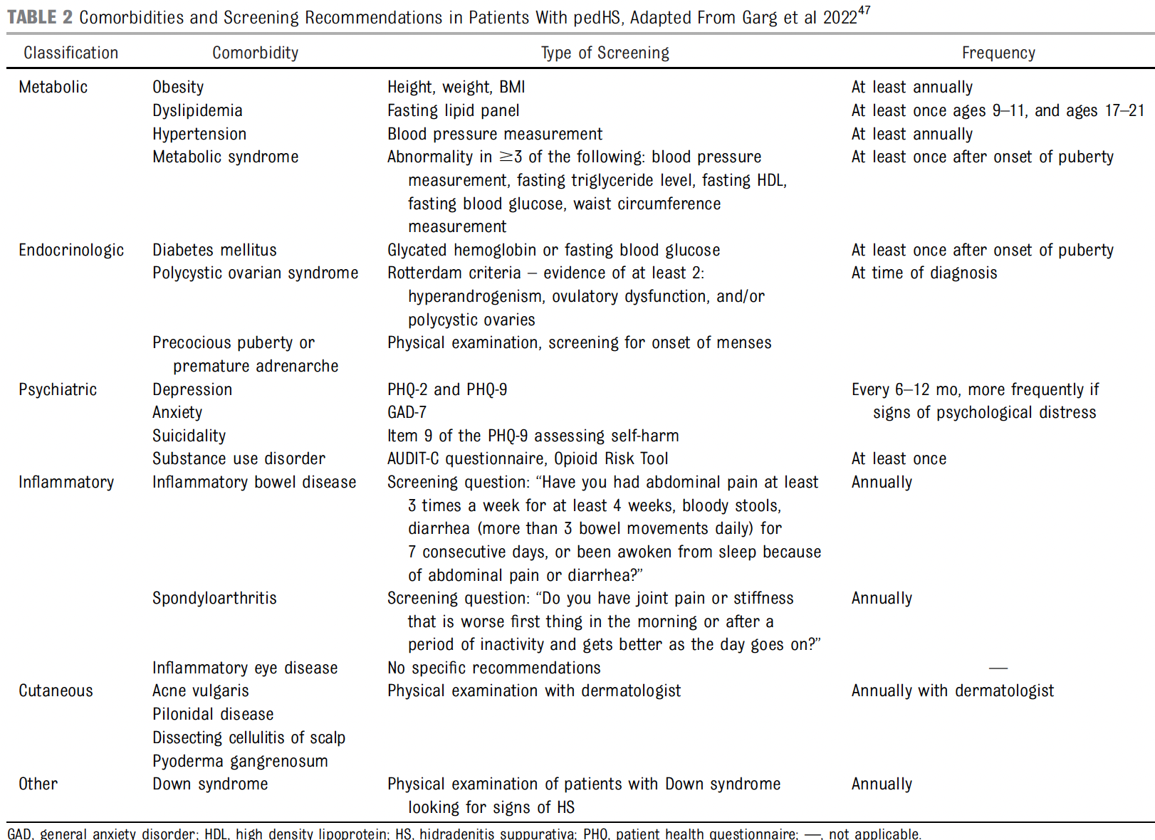
What are comorbidities and screening recommendations?
¹Cotton CH, Chen SX, Hussain SH, Lara-Corrales I, Zaenglein AL. Hidradenitis Suppurativa in Pediatric Patients. Pediatrics. 2023 May 1;151(5).

Slide 21
What are antibiotic treatment options?
Topical Antimicrobial Agents
Benzoyl peroxide, chlorhexidine, and zinc pyrithione washes are commonly used daily to cleanse affected areas of HS to decrease microbial colonization. Potential irritation and bleaching of fabrics are common benzoyl peroxide side effects.
Clindamycin 1% solution applied once or twice daily is used first-line for mild-to-moderate HS. It is often combined with benzoyl peroxide wash to minimize bacterial resistance. Alternately, resorcinol 15% cream daily may be employed for its antiseptic and keratolytic properties. Irritation and burning are possible side effects.
Topical dapsone gel is supported by expert opinion only as clinical data are lacking.
Cotton CH, Chen SX, Hussain SH, Lara-Corrales I, Zaenglein AL. Hidradenitis Suppurativa in Pediatric Patients. Pediatrics. 2023 May 1;151(5).

Slide 22
What are antibiotic treatment options?
Oral Antibiotics
For flares of HS, systemic antibiotic therapy is indicated. Tetracycline class antibiotics are used first-line because of their broad antibacterial coverage and anti-inflammatory action. Doxycycline is commonly used for mild-to-moderate HS over a 12-week course or as long-term maintenance if needed. Patients should be counseled on common side effects of photosensitivity, gastrointestinal upset, and rare hepatotoxicity. Alternately, minocycline can be employed in children 12 years and older. Potential side effects include dizziness, blue discoloration of skin or gums, and rare hepatotoxicity or drug hypersensitivity reactions.
Rifampin in combination with clindamycin systemically for 8 to 12 weeks is recommended for patients unresponsive to systemic tetracyclines. Fifteen percent of patients experienced nonspecific gastrointestinal upset; however, the risk of Clostridium difficile colitis should be considered. Systemic dapsone, a sulfone with anti-inflammatory properties, has been used second-line for refractory adult HS, with retrospective case series reporting 60% of patients achieving clinical improvement.
Intravenous Antibiotics
Based on limited case series, ertapenem, a broad-spectrum carbapenem antibiotic, is effective for severe flares in adult patients with HS.
Cotton CH, Chen SX, Hussain SH, Lara-Corrales I, Zaenglein AL. Hidradenitis Suppurativa in Pediatric Patients. Pediatrics. 2023 May 1;151(5).

Slide 23
What organism is most common?
A clear pattern of cutaneous dysbiosis develops in HS lesions which highlights the presence of anaerobic bacteria and a possibly virulent Staphylococcus species.
Bacteria identified as elevated in HS lesions are the anerobic Gram-negative bacilli Prevotella, Porphyromonas, and Fusibacterium, the Gram-positive bacilli Corynebacterium, and the Gram-positive cocci Staphylococcus, Streptococcus and Parvimonas.
In terms of elucidating pathologic mechanism of disease in HS, the most promising group of organisms identified thus far in both culture-based and NGS studies are the Gram-negative anaerobes. This group of organisms is a common inhabitant of the oral and gut microbiome but as evidenced by the studies above is present in scant quantities as a member of healthy skin microbiota.
Is the microbiological dysbiosis causing the progression of HS, does it exacerbate and perpetuate the disease or is the dysbiosis simply a bystander effect of the newly formed sinus tract environments? This situation is similar to the ongoing debate regarding the pathogenesis of Atopic Dermatitis where a strong link to S. aureus has been established. It is unclear whether the microbiome influences cutaneous inflammation or if cutaneous inflammation alters the microbiome.
Williams, Samuel C et al. “A systematic review and critical appraisal of metagenomic and culture studies in hidradenitis suppurativa.” Experimental dermatology vol. 30,10 (2021): 1388-1397.

Slide 24
How to time immune therapies relative to surgical interventions?
Patients with severe Hurley stage III disease (i.e., diffuse involvement of the axilla with deep-seated, inflamed nodules; interconnecting skin tunnels; purulent drainage; and rope-like scars) are often excluded from clinical trials of biologic agents because of concerns that initiating immunosuppressive therapy without surgical intervention carries the risk of disseminating infection. Studies show that wide local excision surgery is often the most effective way to rapidly improve the quality of life for patients with Hurley stage III disease.
However, a series of recent studies suggest that patients treated with adjuvant biologic therapy after radical resection of HS demonstrated lower rates of recurrence and disease progression, as well as longer disease-free interval.
Data from the Wound Etiology and Healing-Hidradenitis Suppurativa (WE-HEAL-HS) study has shown that combining biologic immunosuppression therapy with wide local excision surgeries is more effective than either intervention alone, and data suggests that timing of biologic therapy relative to surgery does not alter the synergistic impact of these interventions
Shanmugam VK, Zaman NM, McNish S, Hant FN. Review of Current Immunologic Therapies for Hidradenitis Suppurativa. Int J Rheumatol. 2017;2017:8018192.

Slide 25
What biologic therapies are used?
A systematic review of biologic use in pedHS found that the mean duration of disease before initiating biologic treatment was 3.5 (±2.9) years.91 Most patients were Hurley stage 2. In the pooled analysis of 26 pedHS cases treated with biologics, 23.1% experienced complete resolution, 73.1% had partial response, and 3.8% had no improvement.
Adalimumab (Humira) is a TNF-α inhibitor approved for use in patients aged 12 years and older with moderate-tosevere HS. Approval in the adolescent age group was based on adult studies without additional clinical trial data. Dosing is based on body weight. Other TNF-α inhibitors may be employed for refractory pedHS, including infliximab, a chimeric monoclonal antibody infusion. However, data on use of etanercept in HS are mostly nonsupportive.
Side effects of TNF-α inhibitors include increased risk of opportunistic infections and reactivation of tuberculosis and hepatitis B. There is a small increased risk of malignancy, particularly lymphomas, made worse by concomitant use of immunosuppressants. Patients on TNF-α inhibitors (especially adalimumab) are at risk for autoimmunity with antidrug antibody formation and lupus-like reactions. Paradoxical exacerbation of HS has been reported with TNF-a inhibitor use.
All patients should be tested for tuberculosis and hepatitis B before starting a biologic agent. All age appropriate vaccines should be given 1 month before starting a biologic, and live vaccines should not be given to children on biologic therapy.
Cotton CH, Chen SX, Hussain SH, Lara-Corrales I, Zaenglein AL. Hidradenitis Suppurativa in Pediatric Patients. Pediatrics. 2023 May 1;151(5).

Slide 26
What is drug survival for biologics?
In a nationwide cohort study of 241 Danish patients with HS, drug survival was comparable between adalimumab, infliximab, and ustekinumab, but significantly lower for etanercept. There were no differences in drug survival among biologic therapy–naive and nonnaive patients.
Drug survival in patients with HS appears to be considerably lower than seen for other inflammatory diseases, such as psoriasis, thus suggesting the complex role of proinflammatory cytokines in the pathogenesis of HS.
Ring HC, Maul JT, Yao Y, Wu JJ, Thyssen JP, Thomsen SF, Egeberg A. Drug Survival of Biologics in Patients With Hidradenitis Suppurativa. JAMA Dermatol. 2022 Feb 1;158(2):184-188.

Slide 27
When to give Adalimumab (Humira)?
Adalimumab, a TNF-α inhibitor, is the only biologic approved by the Food and Drug Administration for moderate-to-severe HS treatment.¹
Results from the latest trials of adalimumab and HS have shown that, just as in IBD, higher induction and maintenance doses than those used in psoriasis are needed to achieve better disease control; the proposed regimen is 160 mg at week 0, 80 mg at week 2, and 40 mg a week from week 4 onwards. These higher doses are justified by the higher levels of TNF- α found in lesional skin in HS compared with Psoriasis.²
Adalimumab was efficacious in patients with HS, with no need to interrupt treatment prior to surgery.
¹Sachdeva M, Kim P, Mufti A, Maliyar K, Sibbald C, Alavi A. Biologic Use in Pediatric Patients With Hidradenitis Suppurativa: A Systematic Review. J Cutan Med Surg. 2022 Mar-Apr;26(2):176-180.
²Martorell A, García FJ, Jiménez-Gallo D, Pascual JC, Pereyra-Rodríguez J, Salgado L, Villarrasa E. Update on Hidradenitis Suppurative (Part II): Treatment. Actas Dermosifiliogr. 2015 Nov;106(9):716-24.

Slide 28
What is role of hormonal control?
The role of hormones in HS seems to be complex due to many hormonal feedbacks. Data on sex hormones in HS are controversial, suggesting that androgens are involved in pathogenesis of female HS patients. It is interesting to note that, in female HS patients, genes controlled by androgens are upregulated.
In men, it seems that androgens play a subordinate role in HS. Antiandrogenic therapy is a good option according to the available data for female patients. The clinical response in HS of spironolactone and finasteride ranged from approximately 40% to 85%.
Overall, both drugs are tolerated and few side effects have been reported. Antiandrogenic therapy should not be used in male patients as there is little experience, and it could have more severe side effects. Estrogen does not seem to play a role in pathogenesis of HS [13]. There are hardly any data available on sex hormone progesterone in HS. As some patients demonstrate a link between HS and pregnancy, further investigation of progesterone levels during pregnancy and after pregnancy might be useful. Peripubertal onset of HS, premenstrual deterioration, and postpartum deterioration supported the role of sex hormones in HS. However, this connection has not yet been proven.
Abu Rached N, Gambichler T, Dietrich JW, Ocker L, Seifert C, Stockfleth E, Bechara FG. The Role of Hormones in Hidradenitis Suppurativa: A Systematic Review. Int J Mol Sci. 2022 Dec 3;23(23):15250.

Slide 29
What is role of hormonal therapy?
Hormonal therapies are used with increasing frequency in adolescents with HS; however, data are limited. Combined oral contraceptive pills are employed as adjunctive therapy in female patients with HS. Progestins with greater antiandrogenic activity (ie, norgestimate, drospirenone) are recommended. Data suggest that patients with perimenstrual flares of HS and those on concomitant treatments respond better than patients without cyclical flares or on combined oral contraceptive monotherapy. Before starting a combined oral contraceptive, patients should be appropriately screened for blood clot and stroke risk, hypertension, migraine with aura, and liver tumor. Note that rifampin will decrease the efficacy of combined oral contraceptives.
Spironolactone, an antiandrogen and potassium-sparing diuretic, may be used alone or in combination with combined oral contraceptives in postmenarchal females with HS. Side effects include menstrual irregularity and breast tenderness. Hyperkalemia may result, primarily in those with renal dysfunction; however, serum potassium monitoring is not required for otherwise healthy patients.
Finasteride, a systemic 5a-reductase inhibitor, has been used in adults and children with HS unresponsive to or intolerant of other antiandrogens.105 Potential side effects include headache, dizziness, nausea, breast tenderness, gynecomastia, and menstrual irregularity. Metformin decreases hepatic glucose production and is an antiandrogen. It is an adjunctive therapy predominantly used in patients with HS and associated hyperinsulinemia. Potential side effects include gastrointestinal upset, decreased absorption of vitamin B12, and lactic acidosis.
Cotton CH, Chen SX, Hussain SH, Lara-Corrales I, Zaenglein AL. Hidradenitis Suppurativa in Pediatric Patients. Pediatrics. 2023 May 1;151(5).

Slide 30
What are surgical management options?
When the recurrent lesions of HS form scars and sinus tracts, surgical intervention may be required. Incision and drainage should only be performed for painful, acute disease with grossly purulent abscesses. It is not recommended as definitive therapy because of high recurrence rates.
Other surgical techniques, like punch debridement (for small nodules) or a tissue sparing deroofing procedure (for epithelialized tracts), can be performed in both the acute and chronic setting with careful attention to pain control.
Larger areas of severe, chronic disease may require wide local excision with the potential need for skin grafts or flaps. Depending on the patient’s age and extent of the surgical procedure chosen, these may be done under local or general anesthesia.
Cotton CH, Chen SX, Hussain SH, Lara-Corrales I, Zaenglein AL. Hidradenitis Suppurativa in Pediatric Patients. Pediatrics. 2023 May 1;151(5).

Slide 31
Skin graft or flap or none?
The surgery of the HS would be indicated for all those symptomatic sequelae secondary to the chronic inflammation. The hypertrophic scars resulting from chronic inflammation are superinfected, and this situation favors repetitive suppurative episodes despite a well-controlled inflammatory activity.
One of the basic principles in HS surgery is a wide and complete three-dimensional resection of the affected area. The second basic principle is stable coverage and “like-with-like” reconstruction.
Fasciocutaneous flap offers a stable coverage and better aesthetic results. The axillary is a common area for HS, and it is not uncommon to expose the axillary vessels and brachial plexus after a complete resection. Is not safe to cover the axillary vessels and brachial plexus with a mesh split-thickness skin graft.
Sugio Y, Tomita K, Hosokawa K. Reconstruction after Excision of Hidradenitis Suppurativa: Are Skin Grafts Better than Flaps? Plast Reconstr Surg Glob Open. 2016 Nov 10;4(11).

Slide 32
Skin graft or flap or none?
Both split thickness skin grafts and para-scapular flaps are safe and useful techniques for reconstruction of debrided sites in chronic hidradenitis suppurativa of the axillary region.
It is essential that tissue coverage be used for moderate to severe chronic hidradenitis suppurativa. Antibiotics and other modalities are usually used before surgical reconstructions.
It is recommended that skin grafts, flaps and secondary healing are three potential surgical modalities to reconstruct the axilla after wide debridement and multiple irrigations. However, none of these modalities are superior to others. Secondary healing seems to have less pain that grafting.
Afsharfard, Abolfazl et al. “Comparison of Split Thickness Skin Grafts and Flaps in Bilateral Chronic Axillary Hidradenitis Suppurativa.” World journal of plastic surgery vol. 9,1 (2020): 55-61.

Slide 33
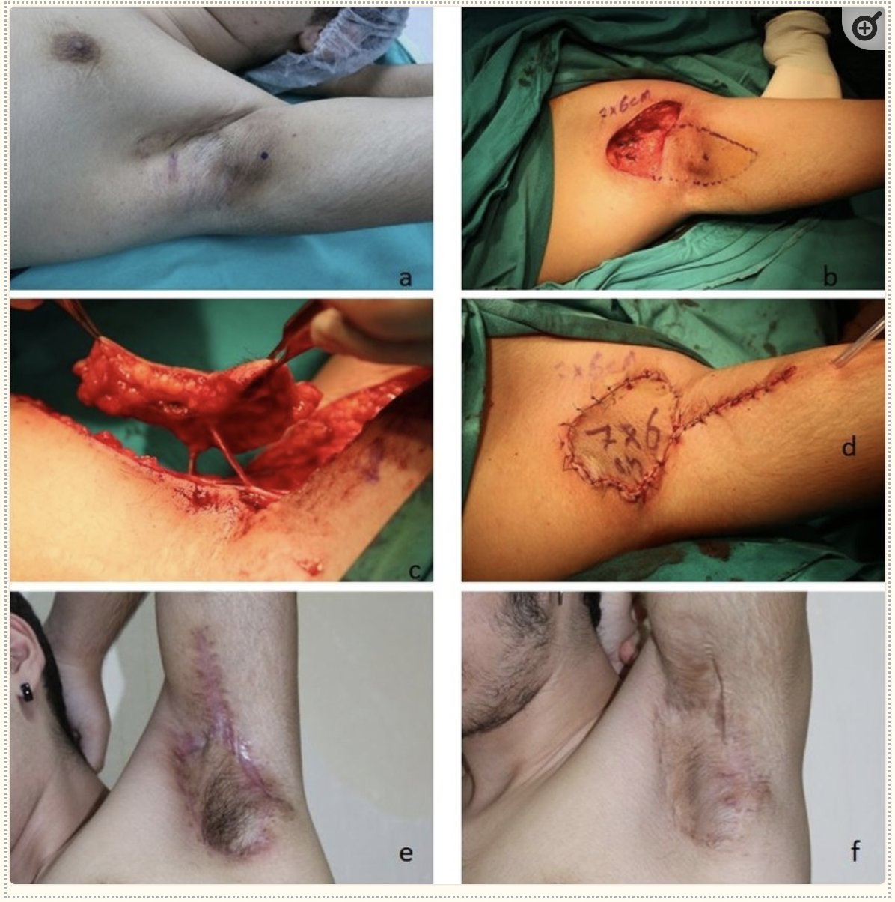
What is an example of flap surgery?
A 16-year-old male patient with HS in the left axillary area for 2 years. The defect formed after excision was reconstructed using a PAPF island flap with a size of 7 × 6 cm
Preoperative, perioperative, and postoperative third month and 14th month appearance of patient number 2. The localization of the pedicle has been marked as blue dot in A and B.
Sirvan, Selami Serhat et al. “Posterior Arm Perforator Flap for Axillary Reconstruction After Hidradenitis Suppurativa Excision.” Plastic surgery (Oakville, Ont.) vol. 27,3 (2019): 204-210.

Slide 34
What is the role of weight control?
The association between HS and obesity has been well established, with numerous studies demonstrating greater disease severity with increasing body mass index (BMI). A retrospective study of 249 patients with obesity due to undergo bariatric surgery showed a point prevalence for HS of 18.1%.
Several mechanisms may explain the association of obesity with HS including larger skin folds contributing to increased mechanical friction, humid microenvironments encouraging bacterial proliferation, and obesity contributing a systemic inflammatory state.
HS patients may benefit from restriction of dairy and brewer’s yeast, as well as supplementation with zinc, vitamin D, and riboflavin. These studied interventions show promise; however, all studies in our review were observational, hence prospective RCTs are required to strengthen findings. Clinicians may consider incorporating weight loss and the elimination of potential dietary triggers, as lower risk adjunct interventions, into the management plan. Healthy eating should be discussed with HS patients as part of routine care.
Sivanand A, Gulliver WP, Josan CK, Alhusayen R, Fleming PJ. Weight Loss and Dietary Interventions for Hidradenitis Suppurativa: A Systematic Review. Journal of Cutaneous Medicine and Surgery. 2020;24(1):64-72.

Slide 35
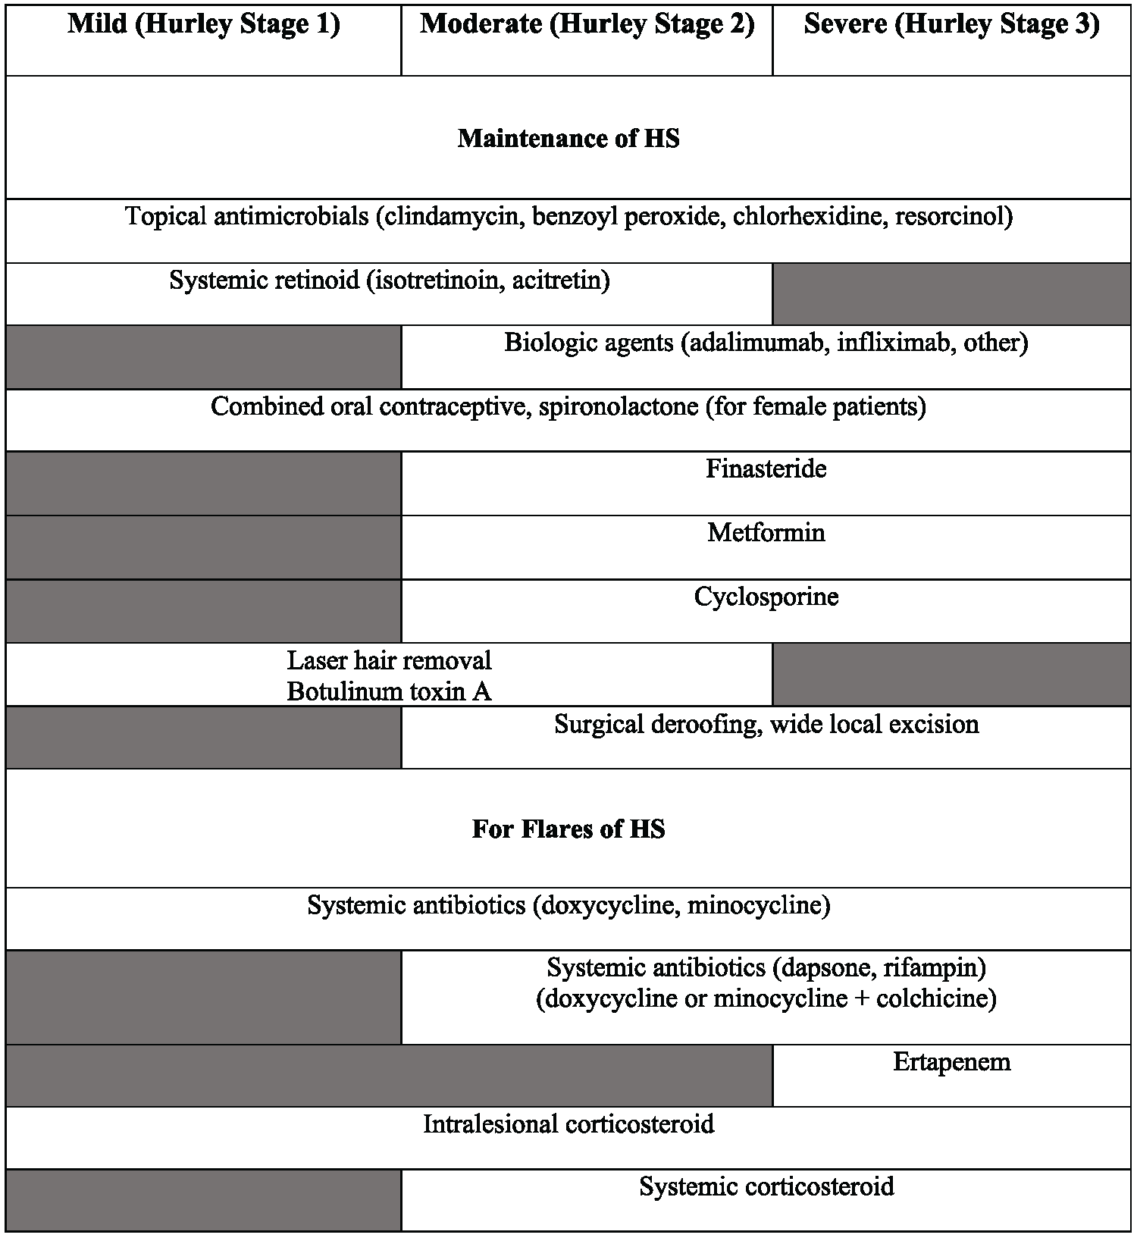
Summary of treatments for pediatric Hidradenitis Suppurativa
Cotton CH, Chen SX, Hussain SH, Lara-Corrales I, Zaenglein AL. Hidradenitis Suppurativa in Pediatric Patients. Pediatrics. 2023 May 1;151(5).

Slide 36
What are costs of Hidradenitis Suppurativa?
HS has higher utilization of inpatient care and emergency department visits compared to patients with other chronic inflammatory conditions such as psoriasis.
One study described clinical factors associated with the hospitalization of patients suffering from HS using a nationally representative dataset including over 7 million patient records. It analyzed data from the Nationwide Inpatient Sample (NIS) from 2016. Administered by the Healthcare Cost and Utilization Project (HCUP), the NIS data represents a stratified sample of approximately 20% of all inpatient hospitalizations within the United States
A total of 7,135,090 discharges were captured in the NIS 2016 database, of which 812 had a primary diagnosis of HS, equal to ∼4062 discharges nationally after weighting.
HS admissions were most common in age groups 18–39 and 40–59 years and less common in those over 60 years or under the age of 18 years.
Patients admitted with a diagnosis of HS were more likely to be black than white, with no significant differences noted between other races.
HS admissions were more likely in teaching hospitals, and the length of stay was significantly greater for patients with a diagnosis of HS as compared to patients without (5.96 days ± 0.36 versus 4.62 ± 0.02 days).
HS patients admitted incurred total charges of $49 million, with an average cost of $12,089 ± 629 per HS patient.
In contrast, the average cost associated with non-HS patients was $11,728 ± 106, although this difference was not significant. Of note, patients admitted with HS were less likely to be female.
Khanna R, Whang KA, Huang AH, Williams KA, Khanna R, Byrd AS, Okoye GA, Kwatra SG. Inpatient burden of hidradenitis suppurativa in the United States: analysis of the 2016 National Inpatient Sample. J Dermatolog Treat. 2022 Mar;33(2):1150-1152.

Slide 37
Works Cited (manuscripts available upon request)
Abu Rached N, Gambichler T, Dietrich JW, Ocker L, Seifert C, Stockfleth E, Bechara FG. The Role of Hormones in Hidradenitis Suppurativa: A Systematic Review. Int J Mol Sci. 2022 Dec 3;23(23):15250.
Afsharfard, Abolfazl et al. “Comparison of Split Thickness Skin Grafts and Flaps in Bilateral Chronic Axillary Hidradenitis Suppurativa.” World journal of plastic surgery vol. 9,1 (2020): 55-61.
Charrow A, Savage KT, Flood K, Kimball AB. Hidradenitis suppurativa for the dermatologic hospitalist. Cutis. 2019 Nov;104(5):276-280.
Cotton CH, Chen SX, Hussain SH, Lara-Corrales I, Zaenglein AL. Hidradenitis Suppurativa in Pediatric Patients. Pediatrics. 2023 May 1;151(5).
Jemec G. Hidradenitis Suppurativa. N Engl J Med 2012; 366:158-164
Khanna R, Whang KA, Huang AH, Williams KA, Khanna R, Byrd AS, Okoye GA, Kwatra SG. Inpatient burden of hidradenitis suppurativa in the United States: analysis of the 2016 National Inpatient Sample. J Dermatolog Treat. 2022 Mar;33(2):1150-1152.
Lindenhardt Saunte DM, et al. Hidradenitis suppurativa: Advances in diagnosis and treatment. JAMA 2017 (318)20: 2019-2032. ​
Liy-Wong C, Kim M, Kirkorian AY, et al. Hidradenitis Suppurativa in the Pediatric Population: An International, Multicenter, Retrospective, Cross-sectional Study of 481 Pediatric Patients. JAMA Dermatol. 2021;157(4):385–391.
Martorell A, García FJ, Jiménez-Gallo D, Pascual JC, Pereyra-Rodríguez J, Salgado L, Villarrasa E. Update on Hidradenitis Suppurative (Part II): Treatment. Actas Dermosifiliogr. 2015 Nov;106(9):716-24.
Ring HC, Maul JT, Yao Y, Wu JJ, Thyssen JP, Thomsen SF, Egeberg A. Drug Survival of Biologics in Patients With Hidradenitis Suppurativa. JAMA Dermatol. 2022 Feb 1;158(2):184-188.
Sachdeva M, Kim P, Mufti A, Maliyar K, Sibbald C, Alavi A. Biologic Use in Pediatric Patients With Hidradenitis Suppurativa: A Systematic Review. J Cutan Med Surg. 2022 Mar-Apr;26(2):176-180.
Shanmugam VK, Zaman NM, McNish S, Hant FN. Review of Current Immunologic Therapies for Hidradenitis Suppurativa. Int J Rheumatol. 2017;2017:8018192.
Sirvan, Selami Serhat et al. “Posterior Arm Perforator Flap for Axillary Reconstruction After Hidradenitis Suppurativa Excision.” Plastic surgery (Oakville, Ont.) vol. 27,3 (2019): 204-210.
Sugio Y, Tomita K, Hosokawa K. Reconstruction after Excision of Hidradenitis Suppurativa: Are Skin Grafts Better than Flaps? Plast Reconstr Surg Glob Open. 2016 Nov 10;4(11).
Williams, Samuel C et al. “A systematic review and critical appraisal of metagenomic and culture studies in hidradenitis suppurativa.” Experimental dermatology vol. 30,10 (2021): 1388-1397.

