Slide 1





Genomic Approach to Study Bioengineered Living Cell Construct in Venous Leg Ulcers
Wednesday, October 9, 2024
Notes:
1

Slide 2
Agenda
Hypothesis
Methodology
Bioengineered living cell construct (BLCC) normalizes sub-optimally regulated ulcer genes to acute wound levels
BLCC recovers acute wound inflammatory signals absent in standard-of-care treated ulcers
BLCC-treated venous leg ulcers recapitulate acute inflammatory wound healing
Venous leg ulcer bed shows hallmarks of a fibrotic disease
BLCC promotes remodeling of the fibrotic ulcer bed

Slide 3
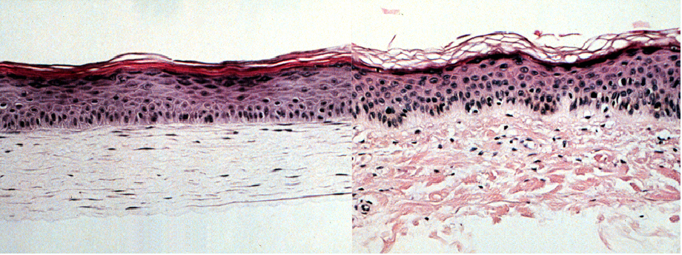
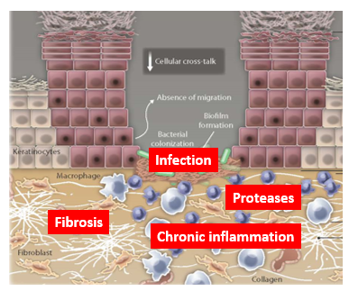
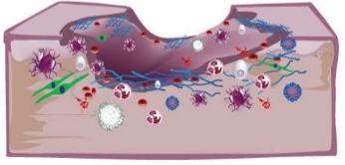
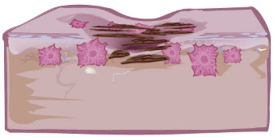
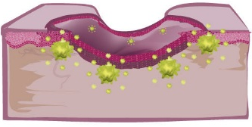
Hypothesis
BLCC
CHRONIC
WOUND
INERT
RESPONSIVE
ACUTE
WOUND
INFLAMMATION
REMODELING
REEPITHELIALIZATION

Slide 4
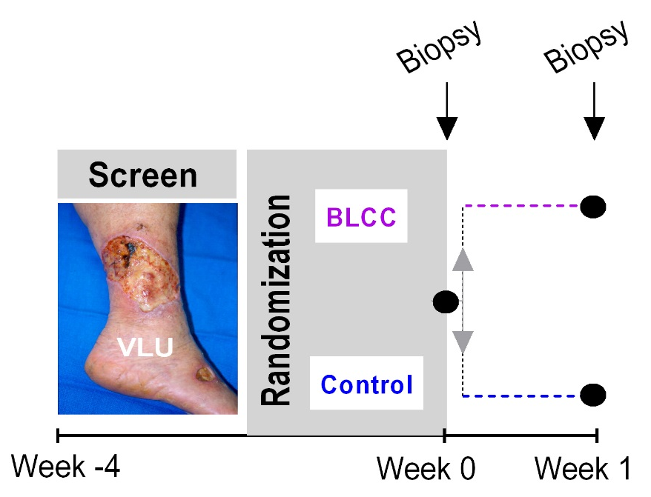
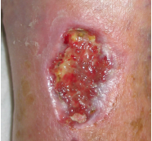
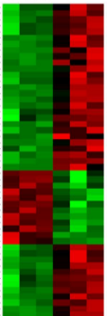
Genomic Approach to Study bioengineered living cell construct (BLCC) mechanism of action:
ClinicalTrials.gov NCT01327937
Identify VLU not predicted to heal
Treat with compression therapy +/- BLCC
Biopsy ulcer edge and ulcer bed
Examine cellular transcriptomes after treatment
Histology and
Genotyping
EDGE
Microarray
>30,000 genes
BED
Stone, Stojadinovic et al, Science Translational Medicine 2017 4;9(371). pii: eaaf8611
Notes:
We designed a clinical trial
Since BLCC shows greatest efficacy in the most difficult-to-heal VLUs, we began by prescreening… for 4 weeks….during which standard-care compression therapy was provided. If VLU did not close by at least 40%, qualified for randomization. This 40% mark is an accepted surrogate endpoint of healing at 12 and 24 months.
We took biopsies at Week 0 baseline, then randomized to control (std care) or BLCC + std care
1 week later, re-biopsied.
Biopsies were taken from ulcer edge and bed and subjected to transcriptome analysis via microarray
Also underwent histologic validation as well as genotypic validation to confirm that cells being arrayed were not BLCC cells
In this talk I will focus on the BLCC effects that we identified at the ulcer bed- SEE POSTER for further details

Slide 5
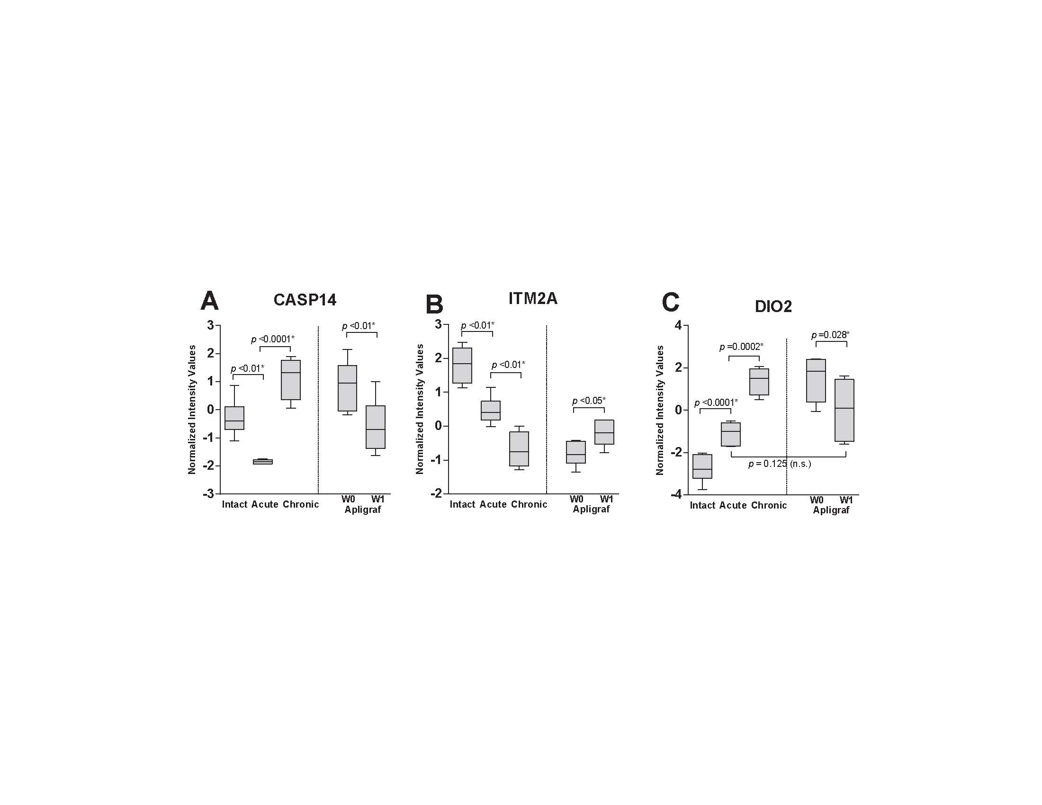
BLCC normalizes sub-optimally regulated ulcer genes to acute wound levels
CASP14
Caspase 14
DIO2
Thyroid deiodinase
ITM2A
Integral transmembrane
protein
Shift from differentiation to acute healing keratinocyte
Regulates thyroid hormone action on target tissues at the intracellular/nuclear level
Fine tuning of adaptive immune response
Stone, Stojadinovic et al, Science Translational Medicine 2017 4;9(371). pii: eaaf8611

Slide 6
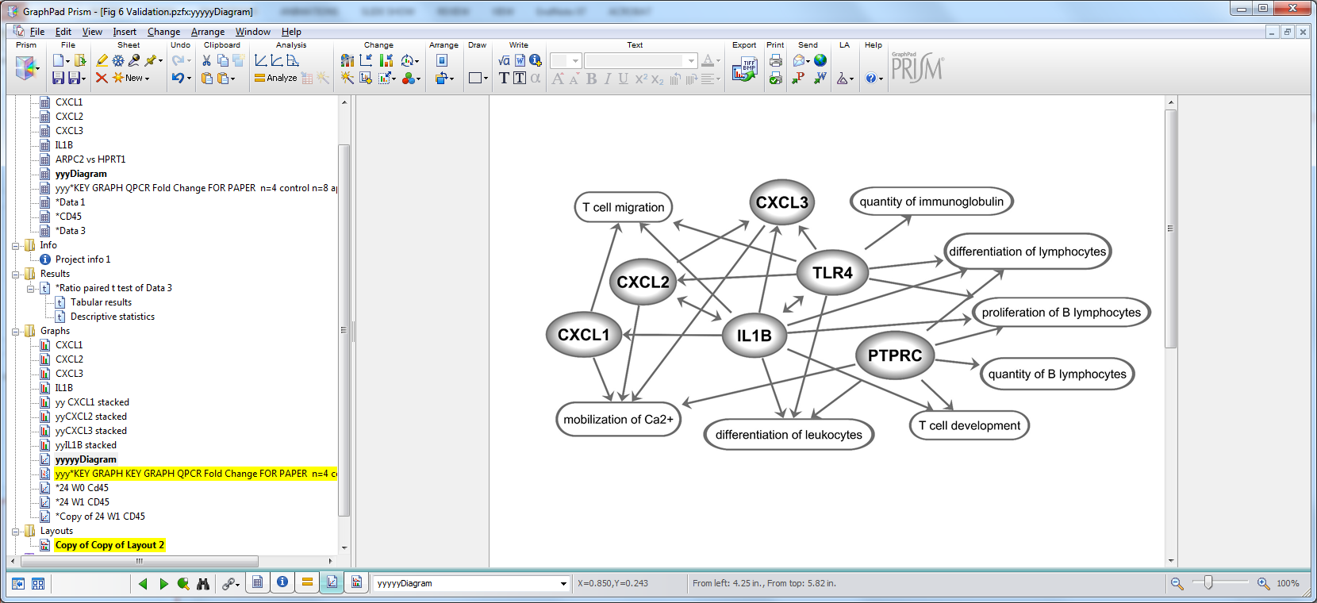
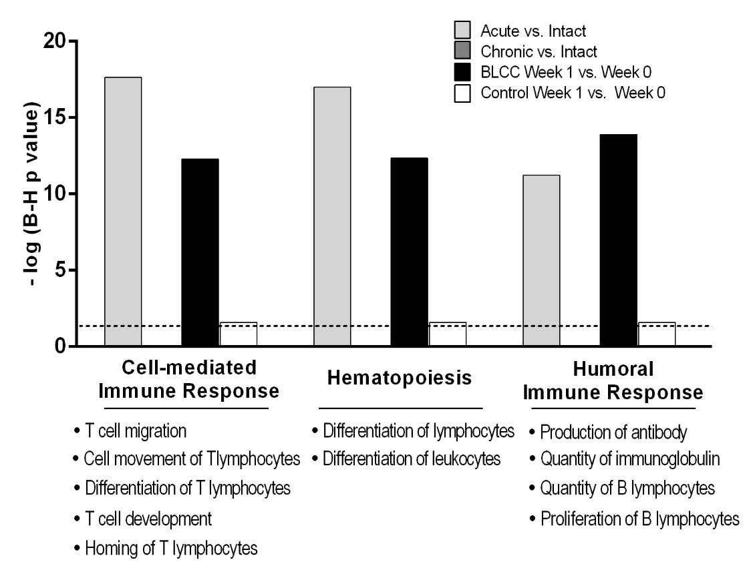
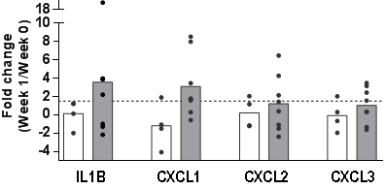
BLCC recovers acute wound inflammatory
signals absent in standard-of-care-treated ulcers
TLR4
Stone, Stojadinovic et al, Science Translational Medicine 2017 4;9(371). pii: eaaf8611

Slide 7
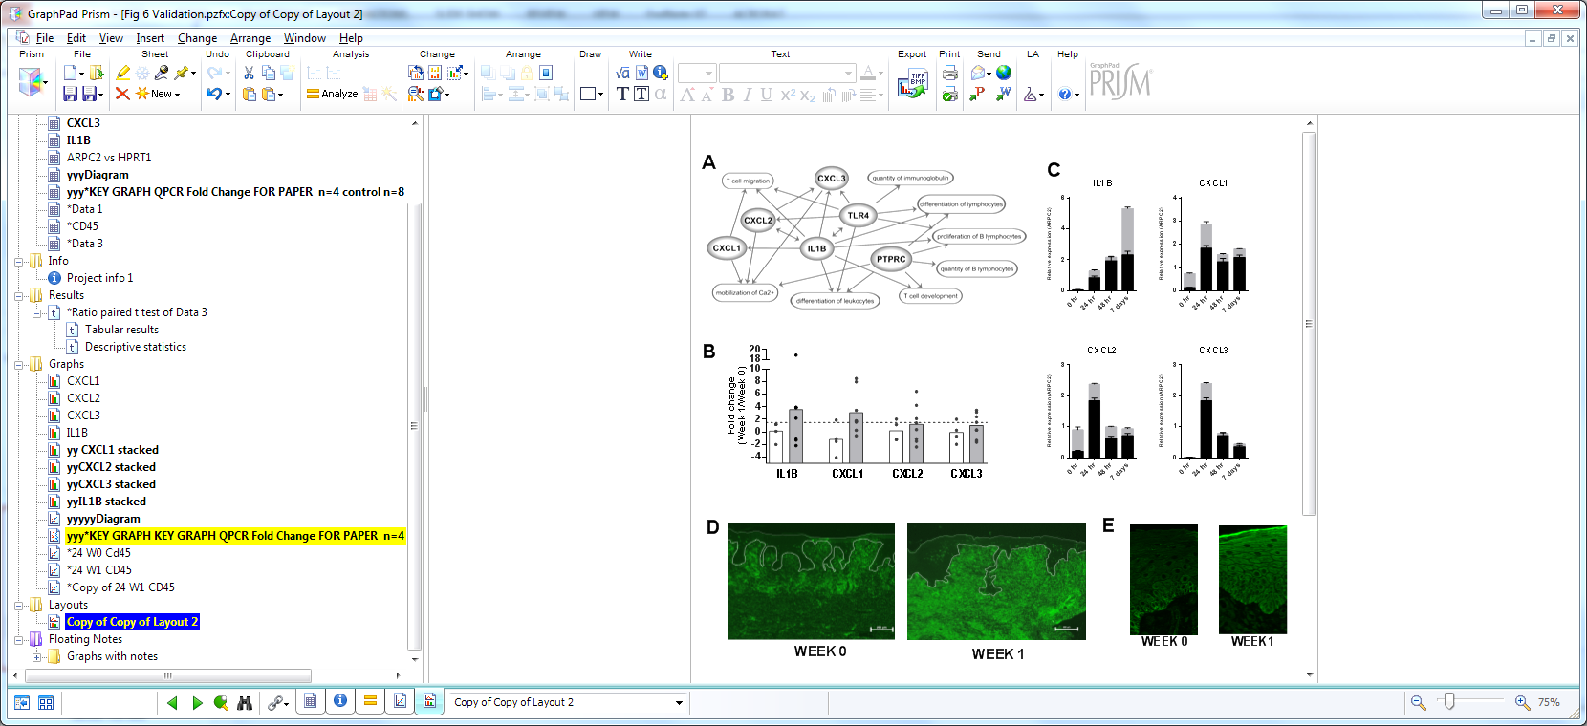
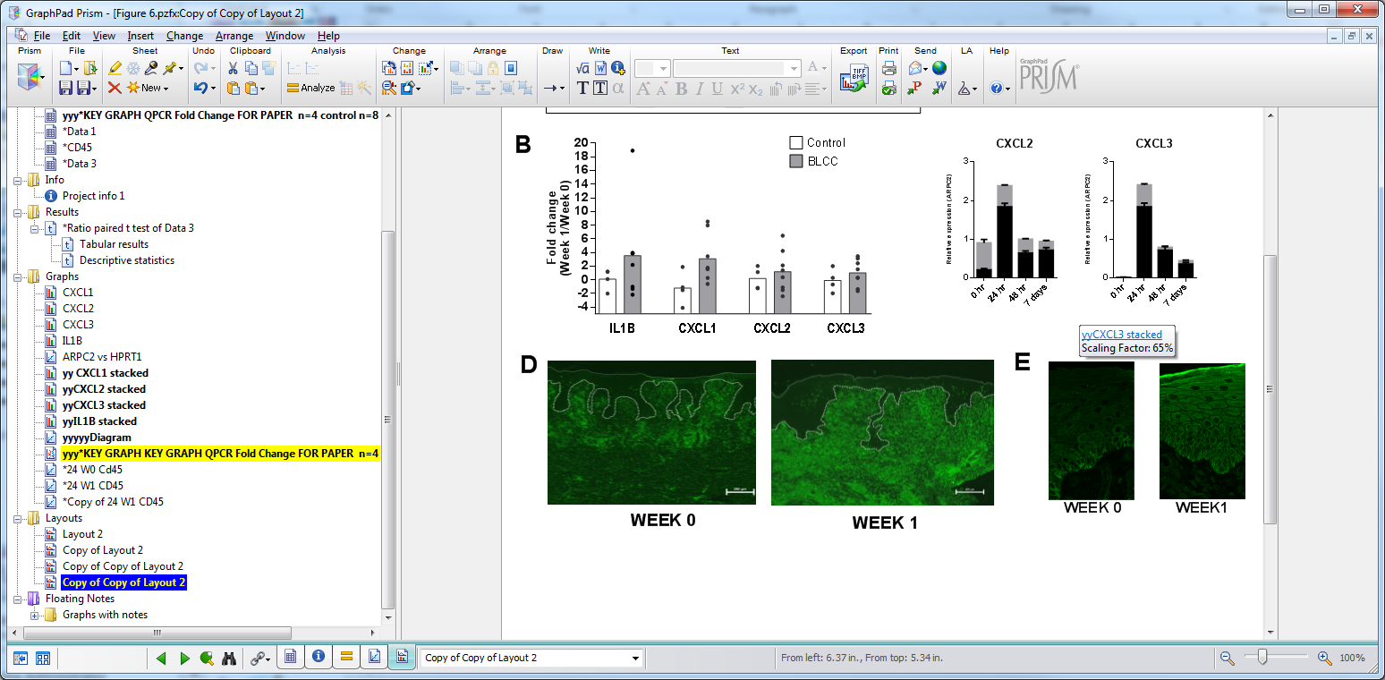
BLCC-treated VLU recapitulate
acute inflammatory wound healing
TLR4
Protein tyrosine phosphatase C PTPRC (CD45)
Stone, Stojadinovic et al, Science Translational Medicine 2017, Jan 4;9(371). pii: eaaf8611

Slide 8
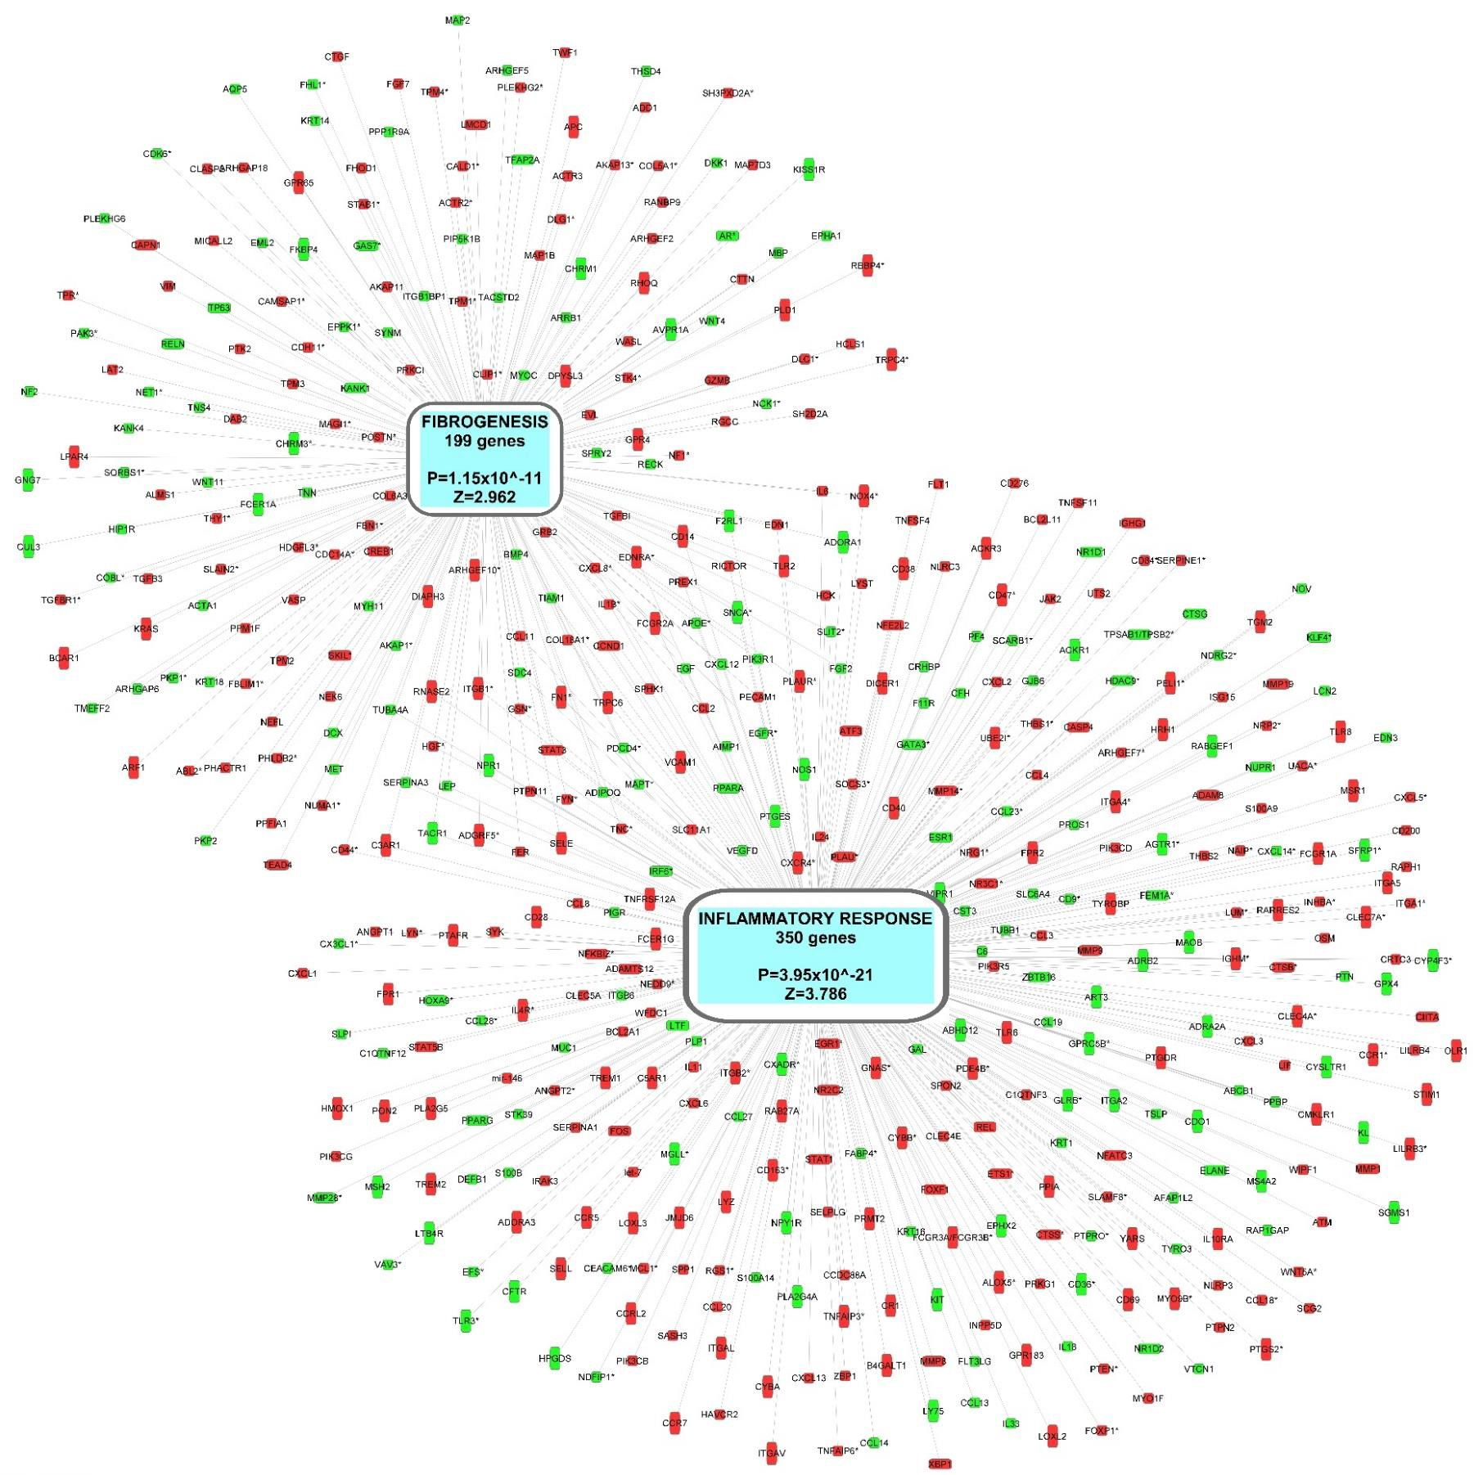
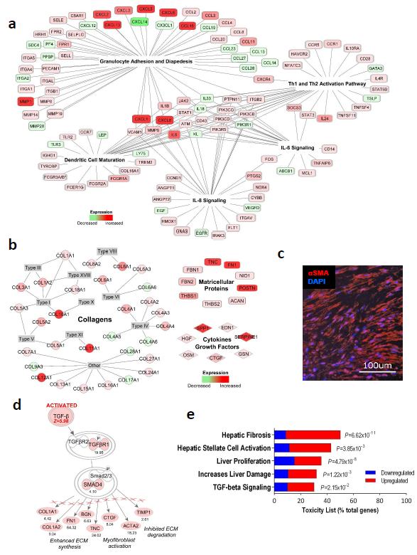
VLU bed shows hallmarks of a fibrotic disease
Stone RC et al, Wound Repair Regen. 2019 Epub ahead of print

Slide 9
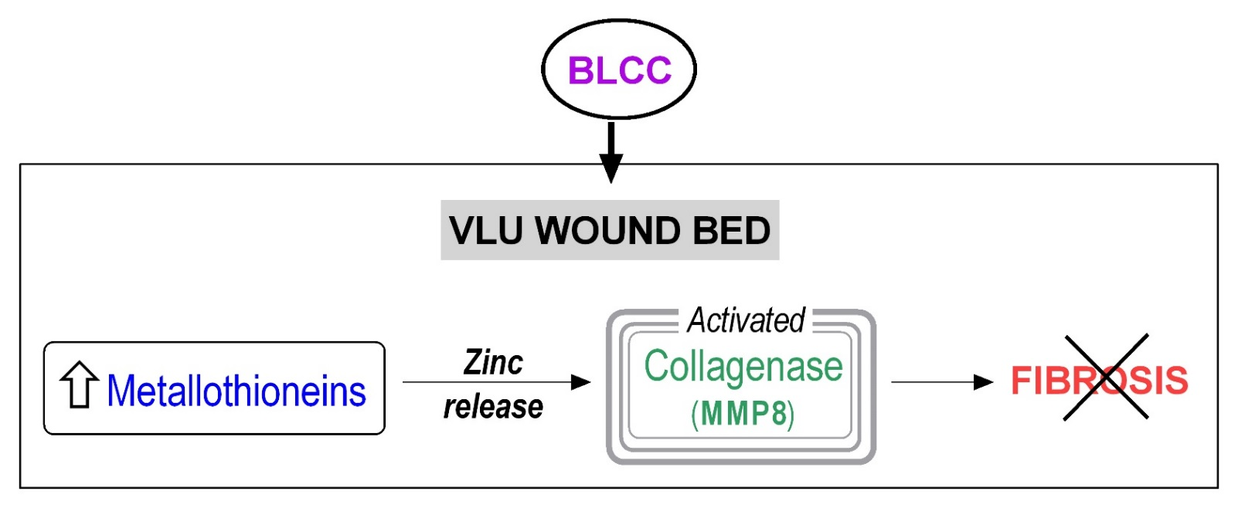
BLCC promotes remodeling of
the fibrotic ulcer bed
Metallothioneins
Role in tissue repair: regulates zinc availability
↓MT’s → keloids (fibroproliferation)
MT gene therapy resolves murine liver fibrosis
VLU fibrosis
Dense fibrosis and ↑collagen independently predict non-healing outcome
MMP8
Zinc-dependent collagenase
Remodeling enzyme in acute wounds
Mmp8-/- mice: delayed healing
Reverses fibrosis, ECM accumulation
Stone RC et al, Wound Repair Regen. 2019 Epub ahead of print

Slide 10
Ulcer bed and ulcer edge have profound but different biological response to cell therapy that work in synergy to achieve tissue reprogramming from non-healing to acutely healing wound and restore healing.
Stone RC, Stojadinovic O, et al Sci Transl Med. 2017 Jan 4;9(371). pii: eaaf8611
Stone RC et al, Wound Repair Regen. 2019 Epub ahead of print

