Slide 1
Wound Healing Outcomes
Division of Wound Healing and Regenerative Medicine
Department of Surgery
Newark Beth Israel Medical Center
August 4, 2020
NJwoundhealing.org

Slide 2
Agenda
Clinical presentation: JM
Pathology
How to identify a tumor masquerading as a wound—not Marjolin’s ulcer?
What is role of systemic T-cell vs. localized T-cell lymphoma for treatment?
What is role of radiation therapy in lymphoma?
Clinical presentation: PF
Chronic limb ischemia
Hyperbaric oxygen and acute limb ischemia: Harold
Clinical presentation: EA
Pathology:
How to diagnose sacral osteomyelitis?
Clinical presentation: JL
Pathology
What is importance of proximal bone biopsy?
Next week’s agenda

Slide 3
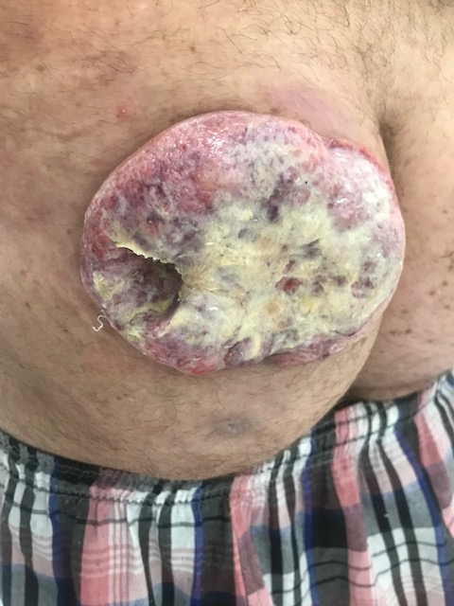
Clinical Presentation: JM

Slide 4
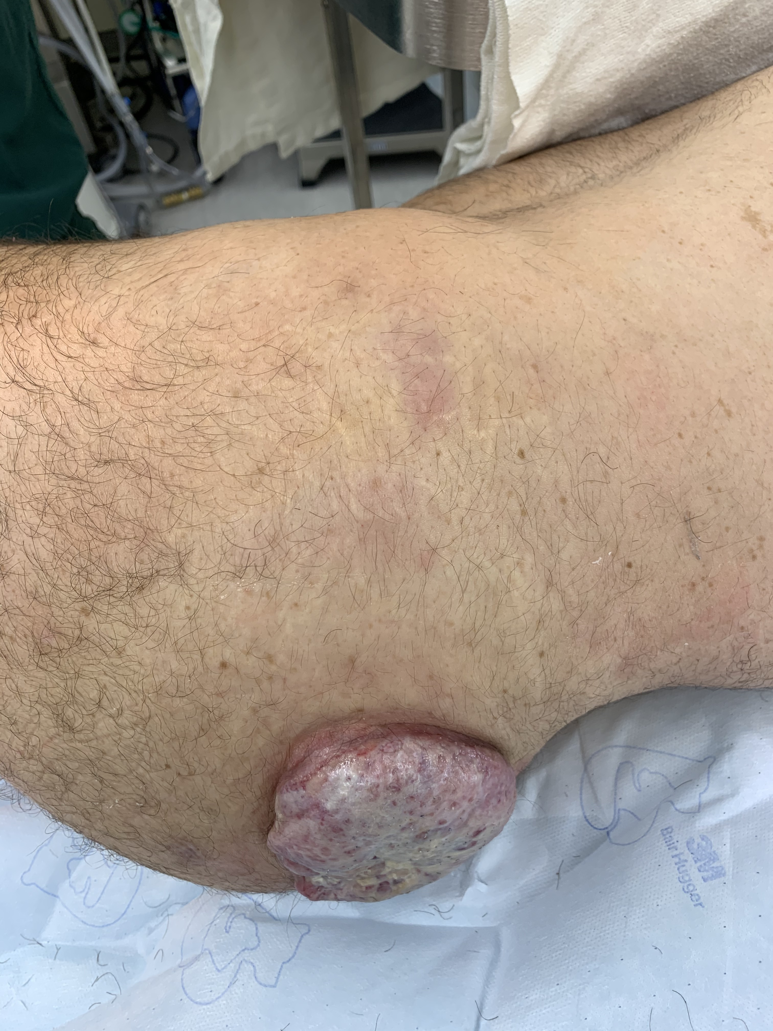
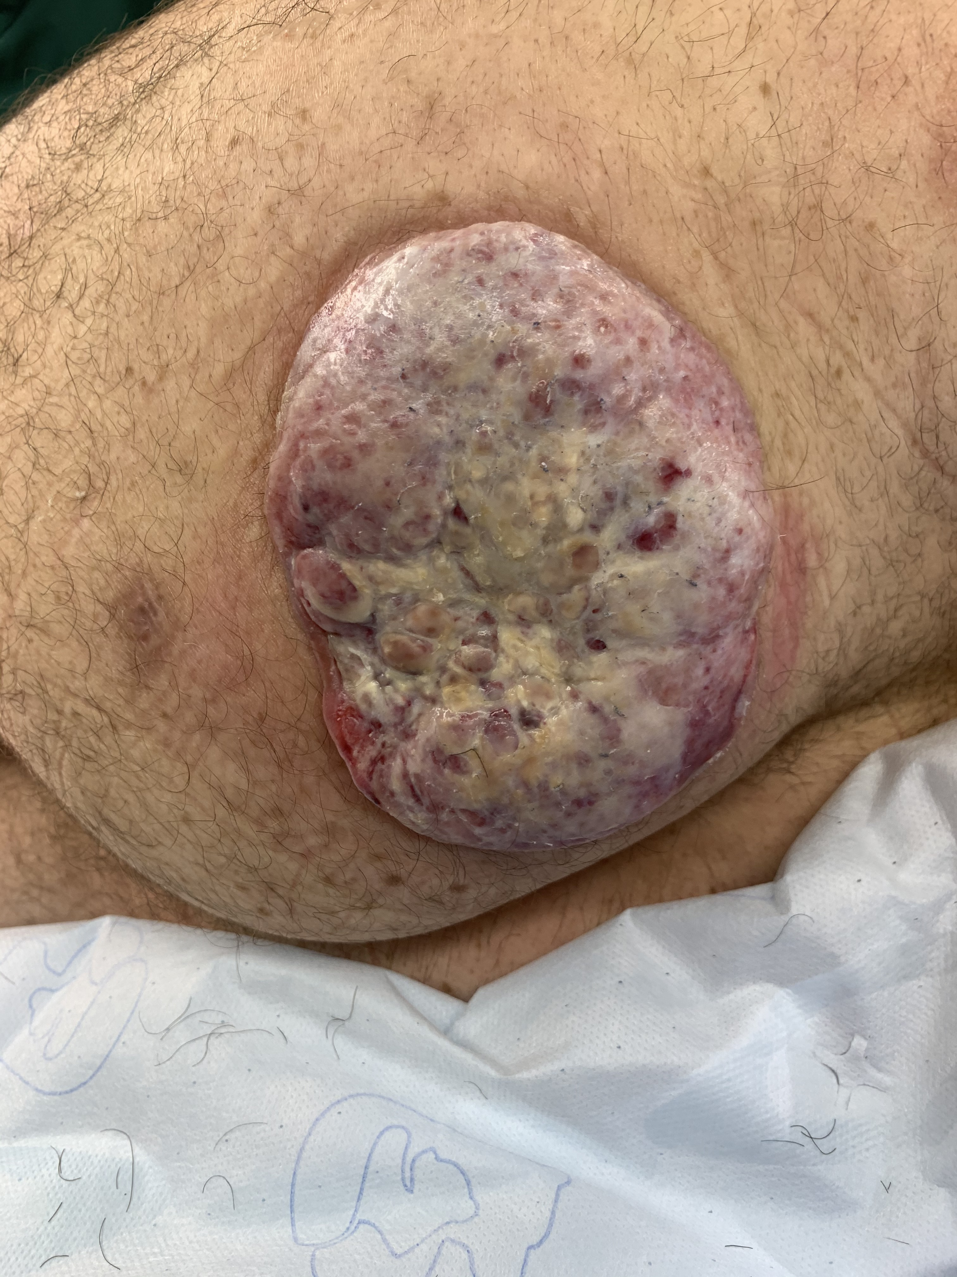
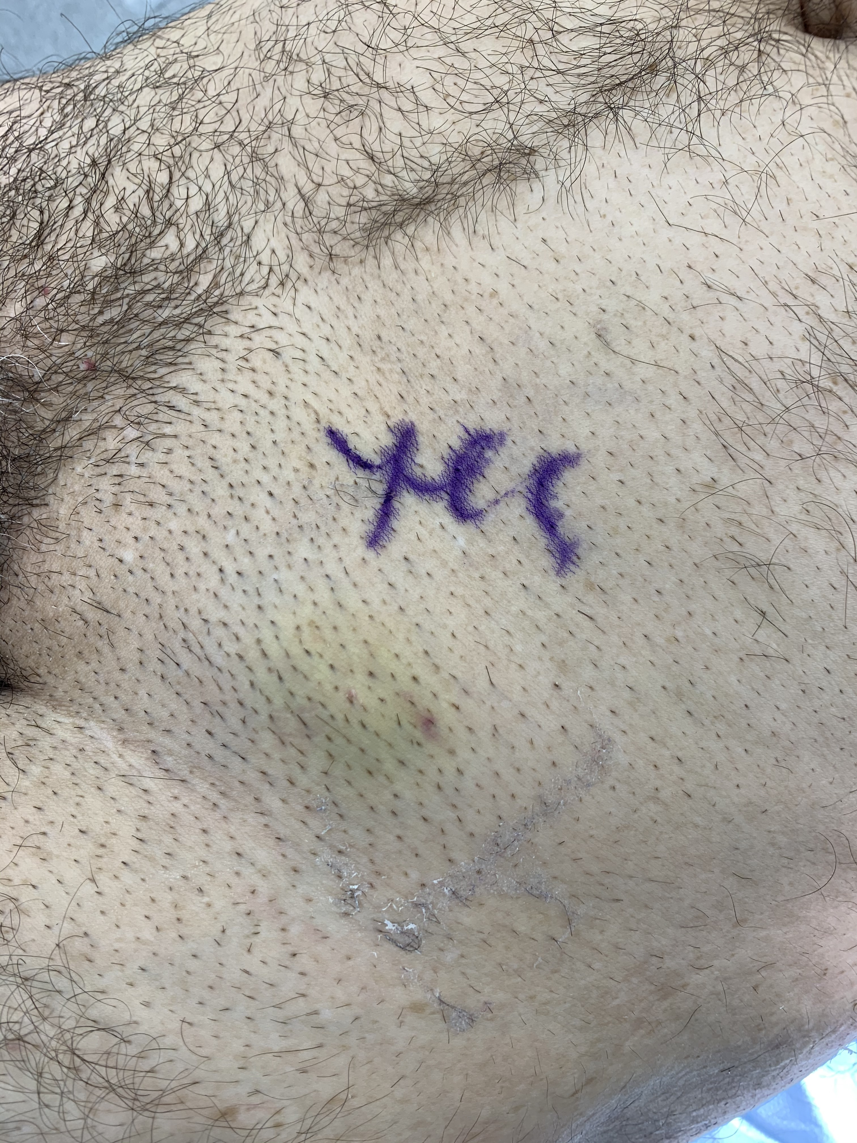
Procedures
Excision of left inguinal necrotic lymph node, incisional biopsy of left gluteal mass and left posterior hip soft tissue mass

Slide 5
Clinical Presentation: JM
Age: 51
The mass began as a pimple 9/2019 and has increased in size. I performed a biopsy on 5/22 showing no clear evidence of malignancy. Admitted patient for biopsy and secondary infection and he signed out AMA. He states the mass has become painful. BMI 26.4
ROS: denies weight loss, back pain, nausea, vomiting, night sweats, dysuria, diarrhea, constipation
Fam Hx: mother died of cancer at 53yo
Physical Exam:
Gen: no acute distress, AAOx3
Cardiac: NSR
Pulm: non-labored respirations
Abdomen: soft, non-tender, non-distended
Skin exam: left gluteal mass measuring 9cmx5cm, fixed left inguinal node lymphadenopathy 4x4cm, non-tender, no ulceration

Slide 6
JM: Hospital Day 1-3
Pathology 5/22
Fragments of fibroconnective tissue showing acute and chronic inflammation, granulation tissue, focal lymphoid aggregates and necrosis
CT chest, abdomen, pelvis 5/22
Increased cutaneous thickening and nodularity in the left gluteal region, with increasing nodules in the left lateral aspect of the buttocks
Mass extending to left gluteus maximus muscle with attenuated, but intact fat plane
Necrotic left inguinal lymph node/abscess
Left inguinal lymph node FNA
Predominantly necrotic tissue with findings most compatible with a lymphoproliferative disorder

Slide 7
JM: Labs
G6PD pending
B2-microglobulin 1.95
CRP <0.29, ESR 12
HIV non-reactive
LDH 431
Hep B non-reactive
12.4
142
108
20
7.7
257
98
4.1
33
0.98
36.5

Slide 9
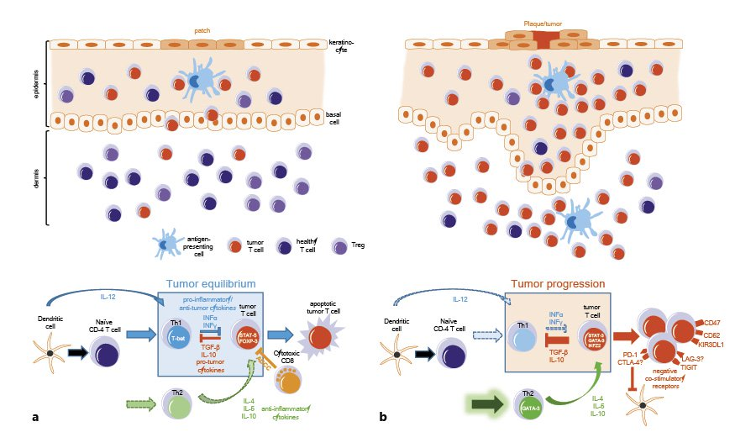
What is role of systemic T-cell vs localized T-cell lymphoma for treatment?
Immune responses in early- and advanced-stage Cutaneous T-Cell Lymphoma (CTCL).
a Early-stage CTCL. Upper panel: schematic illustration of the cellular composition in patch-stage disease. Small populations of tumor T cells are present mostly in the epidermis and are held in check by surrounding healthy T cells and regulatory T cells.
Lower panel: immunosurveillance mechanisms are partially intact, the antitumor Th1 immune response can control tumor progression, leading to a tumor equilibrium.
b Advanced-stage CTCL. Upper panel: schematic illustration of the cellular composition in plaque/tumor stage disease. The number of infiltrating tumor T cells is largely increased and present now also in the dermis, while the number of healthy T cells and T regulatory cells is decreased. Lower panel: immunosurveillance of the tumor is largely defective. A skewed Th1 immune response and an increased Th2 response, among other mechanisms, lead to immune escape of tumor cells and allow tumor progression.
Bobrowicz M, Fassnacht C, Ignatova D, Chang YT, Dimitriou F, Guenova E. Pathogenesis and Therapy of Primary Cutaneous T-Cell Lymphoma: Collegium Internationale Allergologicum (CIA) Update 2020 [published online ahead of print, 2020 Jul 20]. Int Arch Allergy Immunol. 2020;1-13. doi:10.1159/000509281

Slide 10
What is role of systemic T-cell vs localized T-cell lymphoma for treatment?
Treatment of Cutaneous T-Cell Lymphoma depends on the stage of the disease and the general condition of the patient.
Early disease stages of MF (IA-IIA) can be controlled with skin – directed therapy, such as topical steroids, light treatment and radiation.
Systemic treatments, such as retinoids and IFN-α have been recommended as second-line treatment of MF stages IA, IB and IIA. The 5-year survival for these patients is around 90%, significantly better compared with 30%–50% for advanced disease (IIB–IVB).
Chemotherapy agents, such as monochemotherapy (gemcitabine, pegylated liposomal doxorubicine) and polychemotherapy, as well as newer systemic agents (brentuximab-vedotin and mogamulizumab) are recommended in advanced disease stage. Large cell transformation in histology, expression of CD30 and folliculotropic subtype of MF have been reported to have a more aggressive course and poorer prognosis. Although rare cases of CD4⁻ CD8⁺ , CD4⁻ CD8⁻ , or CD4⁺CD8⁺ immunophenotypes have been described in MF, these differences in phenotype do not affected the prognosis of the disease. However, a phenotypic switch from CD4⁺ to CD4⁻ in the lesion has been suggested a portend of poor outcome
Bobrowicz M, Fassnacht C, Ignatova D, Chang YT, Dimitriou F, Guenova E. Pathogenesis and Therapy of Primary Cutaneous T-Cell Lymphoma: Collegium Internationale Allergologicum (CIA) Update 2020 [published online ahead of print, 2020 Jul 20]. Int Arch Allergy Immunol. 2020;1-13. doi:10.1159/000509281

Slide 11
What is role of radiation therapy in lymphoma?
Cutaneous T-cell lymphoma (CTCL) is a rare non-Hodgkin lymphoma that originates from skin-homing T lymphocytes. Although most patients present with early-stage disease (stage IAIIA) and are likely to experience a favorable prognosis, advanced stage disease (stage IIB-IVB) has been associated with inferior outcomes and a median survival of 2 to 5 years.
Total skin electron beam is a well-established treatment modality for advanced CTCL and has been associated with a near 100% response rate in the skin, with most achieving a complete response when delivered at conventional doses.
Total skin electron beam can be used as an individual regimen or as part of a conditioning regimen in total body irradiation for allogeneic hematopoietic stem cell transplantation.
Kudelka MR, Switchenko JM, Lechowicz MJ, et al. Maintenance Therapy for Cutaneous T-cell Lymphoma After Total Skin Electron Irradiation: Evidence for Improved Overall Survival With Ultraviolet Therapy [published online ahead of print, 2020 Jun 30]. Clin Lymphoma Myeloma Leuk. 2020;S2152-2650(20)30318-9. doi:10.1016/j.clml.2020.06.020

Slide 12
What is role of radiation therapy in lymphoma?
A single-center retrospective analysis of 101 patients with cutaneous T-cell lymphoma (CTCL) who had received total skin electron beam therapy from 1998 to 2018 at the Winship Cancer Institute of Emory University compared the overall survival and progression-free survival for patients had received maintenance therapy, including retinoids, interferon, ultraviolet therapy, nitrogen mustard, and extracorporeal photopheresis compared with those who had not.
They found that all-comer maintenance therapy after total skin electron beam therapy was associated with prolonged progression-free survival and that the specific maintenance regimen of UV therapy was associated with improved overall survival.
Maintenance therapy improved progression-free survival for patients with all stages of CTCL.
UV-based maintenance improved progression-free survival and overall surival in a subset of patients with CTCL.
More multicenter and prospective studies are needed to fully evaluate UV-based maintenance therapies after total skin electron beam therapy for CTCL.
Kudelka MR, Switchenko JM, Lechowicz MJ, et al. Maintenance Therapy for Cutaneous T-cell Lymphoma After Total Skin Electron Irradiation: Evidence for Improved Overall Survival With Ultraviolet Therapy [published online ahead of print, 2020 Jun 30]. Clin Lymphoma Myeloma Leuk. 2020;S2152-2650(20)30318-9. doi:10.1016/j.clml.2020.06.020

Slide 13
How to identify a tumor masquerading as a wound—not Marjolin’s ulcer?
In 1986, Harold F. Dvorak, Professor of Pathology at Harvard Medical School Boston, published an essay in the New England Journal of Medicine entitled "Tumors: Wounds that do not heal" that pointed out the similarities exist between tumor stroma generation and wound healing. Cancers share many features in common with tissue regeneration, including immune response, cell proliferation, cell migration, tissue remodeling, and cell death.
Based on the then recent discovery of vascular permeability factor (VPF)/VEGF, Dvorak suggested that tumors behaved as wounds that do not heal. More particularly, he proposed that tumors co-opted the wound-healing response to induce the stroma they required for maintenance and growth. Work over the past few decades has supported this hypothesis and has put it on a firmer molecular basis.
VPF/VEGF initiates a sequence of events in both tumors and wounds that includes the following: increased vascular permeability; extravasation of plasma, fibrinogen and other plasma proteins; activation of the clotting system outside the vascular system; deposition of an extravascular fibrin gel that serves as a provisional stroma and a favorable matrix for cell migration; induction of angiogenesis and arterio-venogenesis; subsequent degradation of fibrin and its replacement by "granulation tissue" (highly vascular connective tissue); and, finally, vascular resorption and collagen synthesis, resulting in the formation of dense fibrous connective tissue (called "scar tissue" in wounds and "desmoplasia" in cancer). A similar sequence of events also takes place in a variety of important inflammatory diseases that involve cellular immunity.
Dvorak HF. Tumors: wounds that do not heal. Similarities between tumor stroma generation and wound healing. N Engl J Med. 1986;315(26):1650-1659.
Dvorak HF. Tumors: wounds that do not heal-redux. Cancer Immunol Res. 2015;3(1):1-11.

Slide 14
Clinical Presentation: PF
73 yr old female admitted for left foot/toe pain for about 1 month.
PMHx: Hypertension, Diabetes mellitus, End stage renal disease on hemodialysis (right arm arterial venous fistula), Peripheral arterial disease (s/p multiple bypasses in the right and left superficial femoral artery stent)
Exam: palpable left femoral, no left popliteal/pedal pulses. Motor/sensory intact, decreased capillary refill at toes, discolored toes.
Notes:
Acute vs chronic…. How do we decide? How should we think about this patient.

Slide 15
Chronic limb ischemia

Slide 16
Notes:
PAD is more prevalent than cancer or stroke and alzheimers together. The five year mortality rate for PAD is higher than stroke, coronary artery disease, or breast cancer. It is time to bring this number down!
Note: CHF = congestive heart failure

Slide 17
Chronic Limb Threatening Ischemia (CLTI)
CLTI is a clinical syndrome defined by the presence of peripheral arterial disease (PAD) in combination with rest pain, gangrene, or a lower limb ulceration >2 weeks duration. Venous, traumatic, embolic, and nonatherosclerotic etiologies are excluded.
Previously known as Critical Limb Ischemia (CLI)
Notes:
Acute vs chronic…. How do we decide? How should we think about this patient.

Slide 18
Natural History
CLTI – 6 Months

Slide 19
Classification of CLTI

Slide 20
Management
Heparin gtt (drops per ML)
Vascular non-invasive studies
Intervention
Endovascular
Open
Hybrid

Slide 21
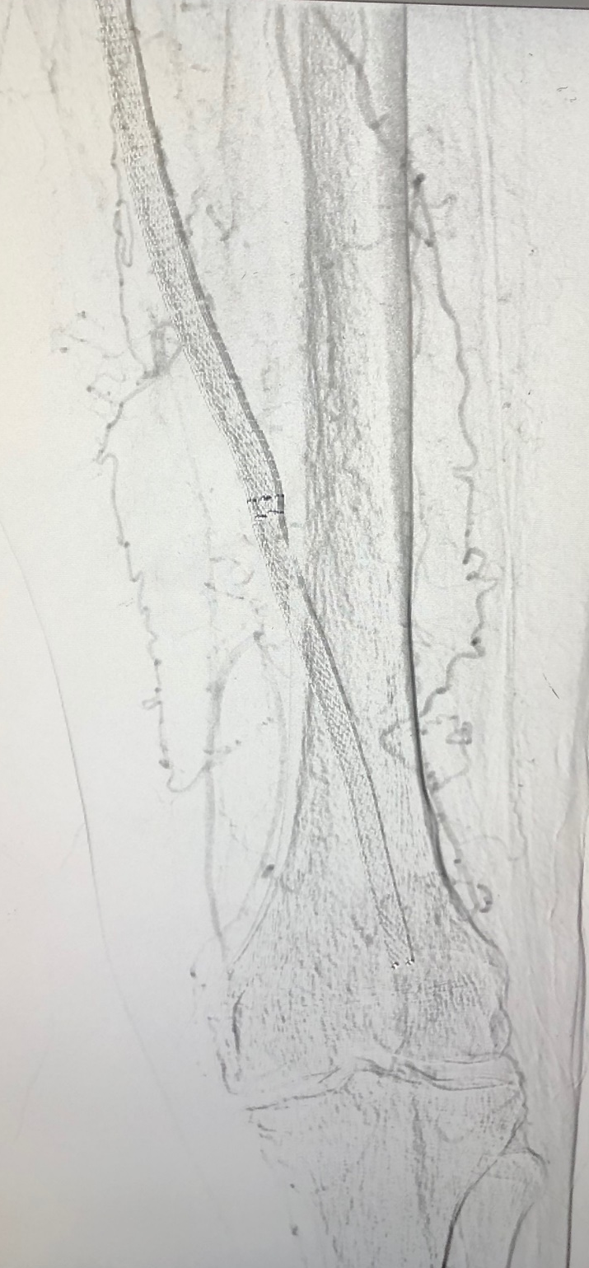
Initial
SFA stent occlusion

Slide 22
Final
Atherectomy with balloon angioplasty

Slide 23
Hyperbaric oxygen and acute limb ischemia: Dr. Brem

Slide 24
What is role of hyperbaric in acute limb ischemia?
The documentation of significant beneficial biocellular and clinical effects have established hyperbaric oxygen as useful adjuvant therapy in the management osteoradionecrosis, clostridial myonecrosis, crush injury, radiation-induced soft-tissue injury, certain problem wounds, and compromised skin grafts and reconstructive flaps.
Using an objective and reproducible measurement (trancutaneous oxygen measurements, or TCOM, which evaluates degree of hypoxia in ischemic tissue) and a corresponding limit (> 10 torr) statistical significance regarding healing can be predicted.
Patients with TCOM values of <10 torr are unlikely to benefit from HBO therapy.
Grolman RE, Wilkerson DK, Taylor J, Allinson P, Zatina MA. Transcutaneous oxygen measurements predict a beneficial response to hyperbaric oxygen therapy in patients with nonhealing wounds and critical limb ischemia. Am Surg. 2001;67(11):1072-1080.

Slide 25
Clinical Presentation: EA
Age: 67
Temperature: 100.7
Respiratory rate: 21
Heart rate: 110
WBC: 16.3
DUN: 47
Creatinine: 148
Patient presented
Surgery: July 22, 2020
Presented to ER with maggots
Right heel deep tissue injury
Left thigh

Slide 26
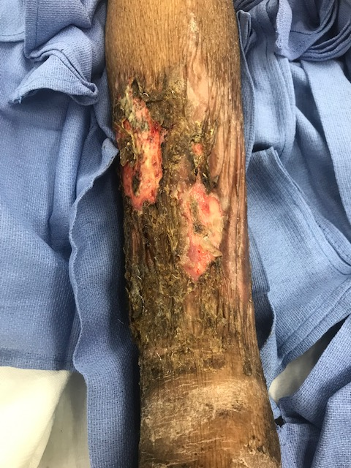
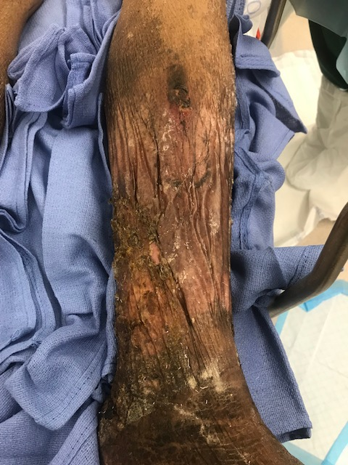
Clinical Presentation: EA

Slide 27
Clinical Presentation: EA
Pathology Report
A. Left knee skin edge: Segment of the partly epidermis denuded skin showing fibrosis with nuclear debris.
B. Right leg ulcer superficial: Fragment of fibrofatty tissue showing acute and chronic inflammation with focal granulation tissue and necrosis.
C. Sacral, bilateral buttock superficial ulcers: Fragments of fibrofatty tissue and striated muscle showing acute and chronic inflammation and necrosis.
D. Left buttock deep tissue: Fragments of fibrofatty tissue and striated muscle showing acute and chronic inflammation and necrosis.
E. Sacral bone: Acute and chronic osteomyelitis.

Slide 28
How to diagnose sacral osteomyelitis?
Most cases of sacral osteomyelitis arising in the setting of sacral pressure ulcers require minimal cortical debridement. When faced with advanced bony involvement, the surgeon is often unclear about how much can safely be resected. Unfamiliarity with sacral anatomy can lead to concerns of inadvertent entry into the dural space and compromise of future flap options.
The management of sacral osteomyelitis in the setting of sacral pressure sores is not without controversy. Most of the controversy resides in the treatment of confirmed or suspected sacral osteomyelitis. Traditionally, suspected osteomyelitis of the sacrum has been treated with wide debridement of all clinically affected bone and a prolonged course of intravenous antibiotics before definitive closure.
However, this approach has been viewed as impractical by those who cite the difficulty of targeted antibiotic therapy (bone cultures are often negative or indeterminate), the difficulty of determining the extent of involvement, the difficulty of confirming resolution, and the equivalent results obtained with conservative decortication and definitive closure at the time of diagnosis.
The presence of osteomyelitis tends to be overestimated by clinical assessment alone. Even with the use of imaging modalities, such as bone scanning and MRI, it is difficult to differentiate periostitis and pressure-induced changes, such as fibrosis, medullary edema, and reactive bone formation that accompany stage 4 sacral ulcers from true cortical bone involvement. An autopsy-based histopathologic study of sacral ulcers showed that only half of stage 4 ulcers contained histological evidence of sacral osteomyelitis, and that all of these cases involved the superficial subcortical bone (facies dorsalis) of the sacrum only.
Choo JH, Wilhelmi BJ. Landmarks for Sacral Debridement in Sacral Pressure Sores. Ann Plast Surg. 2016;76(3):361-363. doi:10.1097/SAP.0000000000000503

Slide 29
How to diagnose sacral osteomyelitis?
Using a line drawn connecting the posterior superior iliac spine to the tip of the coccyx, the approximate locations of the superior and inferior gluteal artery can be estimated. The ratio of the distance between the PSIS and the superior and inferior gluteal arteries and the PSIS to the tip of the coccyx is 0.23 and 0.49, respectively.
There are instances where sacral pressure ulcers extend beyond the superficial cortex of the sacrum and require consideration of possible CSF involvement, particularly when above the level of S2/S3. Conversely, sacral osteomyelitis limited to below this level would not be expected to have a high incidence of CSF involvement.
Debridement of the posterior table of the sacrum at or above the level of the Posterior superior SIS must be conservative and take into account the thickness of the posterior table of the sacrum at this level to avoid inadvertent entry into the dural space. The second implication is that when sacral ulcers involve bone above the level of the PSIS, the surgeon must be alert to the possibility of CSF communication and make every effort to identify and address the complication swiftly.
Choo JH, Wilhelmi BJ. Landmarks for Sacral Debridement in Sacral Pressure Sores. Ann Plast Surg. 2016;76(3):361-363. doi:10.1097/SAP.0000000000000503

Slide 30
Clinical Presentation: JL
Age: 40
Patient had surgery 6/26
White blood count: 10.6
Neutrophils 68%
History and present illness
THEN X-RAY FINDINGS

Slide 31
Clinical Presentation: JL
Pathology Report
2nd toe of right foot (amputation):
Skin and subcutis with acute suppurative inflammation and necrosis.
Bone resection margin in negative for osteomyelitis

Slide 32
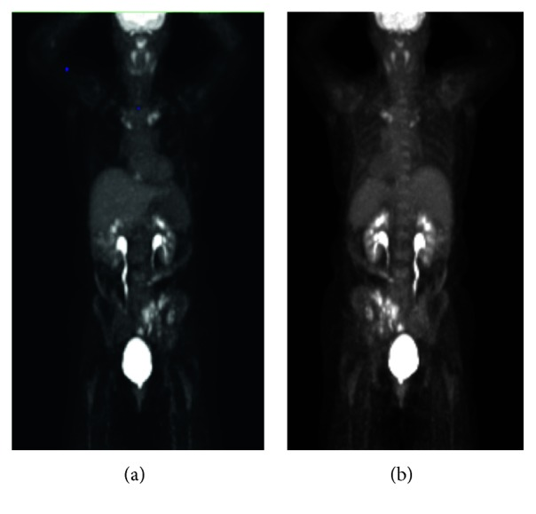
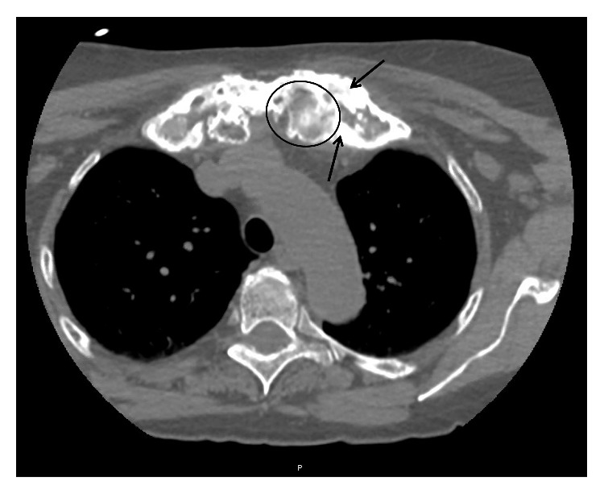
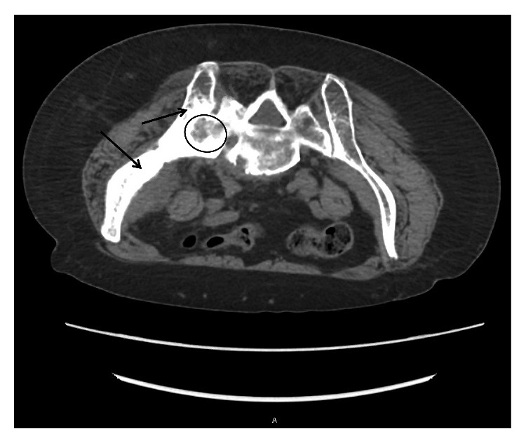
What is importance of proximal bone biopsy?
Chronic recurrent multifocal osteomyelitis (CRMO) is the most severe form of chronic nonbacterial osteomyelitis (CNO) and is a rare autoinflammatory bone disorder that mostly affects children and adolescents. CRMO is a diagnosis of exclusion, resulting in often-delayed diagnosis with over one year on average from onset of symptoms to time of diagnosis. Initial diagnosis is rare in adults.
CT biopsy imaging axial body view with slice thickness 5.00 demonstrating lytic (example inside circle) and sclerotic lesions (examples of thickened bone pointed to with arrows) of the left sacrum and left ileum. Also, notice fusion of the left sacro-iliac joint. For reference, the patient is prone in this image as it was taken during the time of biopsy; therefore, the left ileum/sacrum is on the left of the image.
CT biopsy imaging axial body view with a slice thickness of 2.00 demonstrating lytic (example inside circle) and sclerotic lesions (examples of thickened bone pointed to with arrows) of the left medial clavicle and left first rib.
PET scan whole body performed on 1/9/2019. (a) Anterior view and (b) posterior view with hypermetabolism of the left side of pelvis and ileum and bilateral medial clavicles
Mahady S, Ladani A. Clinical and Diagnostic Considerations for Atypical, Adult Onset Presentation of Chronic Recurrent Multifocal Osteomyelitis (CRMO). Case Rep Rheumatol. 2019;2019:8206892. Published 2019 Sep 29. doi:10.1155/2019/8206892

Slide 33
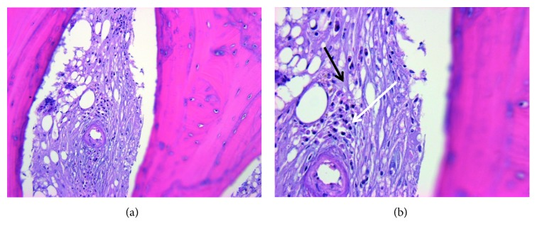
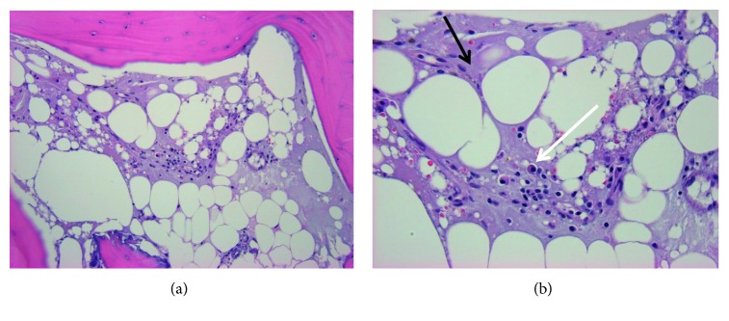
What is importance of proximal bone biopsy?
Chronic recurrent multifocal osteomyelitis (CRMO) is the most severe form of chronic nonbacterial osteomyelitis (CNO) and is a rare autoinflammatory bone disorder that mostly affects children and adolescents. CRMO is a diagnosis of exclusion, resulting in often-delayed diagnosis with over one year on average from onset of symptoms to time of diagnosis. Initial diagnosis is rare in adults.
Bone biopsy of the left medial clavicle performed on 1/21/2019. (a) H&E 200x marrow fibrosis with plasma cell infiltrate. (b) H&E 400x marrow fibrosis (lighter purple color throughout indicated by black arrow) in place of a fatty marrow background with plasma cell infiltrate that contains eccentric nuclei (area indicated by white arrow) representing changes indicative of chronic inflammation.
Bone biopsy of the left medial clavicle performed on 1/21/2019. (a) H&E 200x marrow fibrosis with plasma cell infiltrate. (b) H&E 400x marrow fibrosis (lighter purple color throughout indicated by black arrow) in place of a fatty marrow background with plasma cell infiltrate that contains eccentric nuclei (area indicated by white arrow) representing changes indicative of chronic inflammation.
Mahady S, Ladani A. Clinical and Diagnostic Considerations for Atypical, Adult Onset Presentation of Chronic Recurrent Multifocal Osteomyelitis (CRMO). Case Rep Rheumatol. 2019;2019:8206892. Published 2019 Sep 29. doi:10.1155/2019/8206892

Slide 34
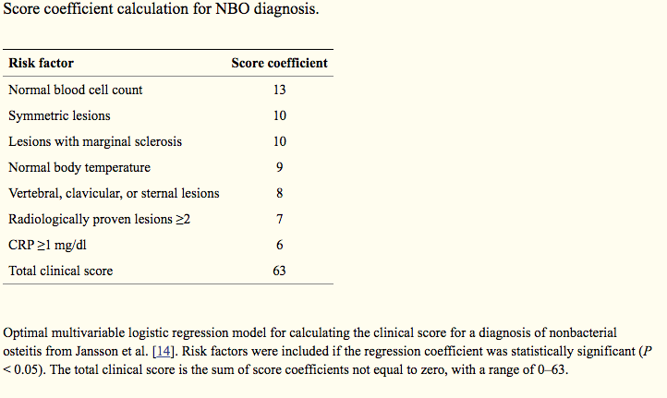
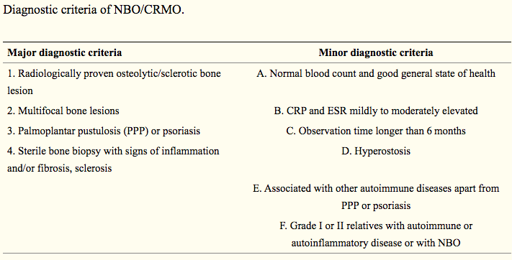
What is importance of proximal bone biopsy?
While the diagnosis of Chronic recurrent multifocal osteomyelitis (CRMO) is primarily based on exclusion of other differential diagnoses, history of recurrent bone pain, and the presence of sclerotic bone lesions, there do exist some diagnostic tools such as the diagnostic criteria and score coefficient calculation.
However, based on this necessity of exclusion of other differential diagnosis, bone biopsy remains mandatory in particular in adult patients. It is important to improve the clinical understanding of CRMO by the documentation of more cases, route of diagnosis, and treatment choices made in order to help develop clearer diagnostic and treatment guidelines.
Mahady S, Ladani A. Clinical and Diagnostic Considerations for Atypical, Adult Onset Presentation of Chronic Recurrent Multifocal Osteomyelitis (CRMO). Case Rep Rheumatol. 2019;2019:8206892. Published 2019 Sep 29. doi:10.1155/2019/8206892

Slide 35
Next week’s agenda
Infected abdominal wall mesh and ventral hernia
Necrotizing fasciitis of hand and forearm
“Traumatic” neuroma of sacral nerve
Chronic ostemyelitis of pelvis

