Slide 1





Dressing Changes
Wednesday, October 2, 2024
Notes:
1

Slide 2
Agenda
Overview of Wound Dressings
Details on Specific Dressings
  Iodosorb
  Collagenase
  Silvadene
  Triple Antibiotic Ointment
  Dakin’s Solution
  Interdry
  Avylene
  Medihoney
  Vac white foam

Slide 3
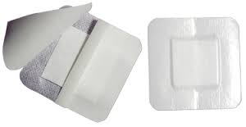
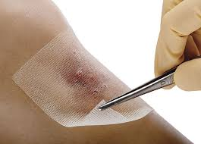
Composites
Two or more products manufactured as a single dressing providing multiple functions.
Aquacel for example. NOT MEDICATED!!
Indications:
Minimal to heavy exudate,
granulation tissue or necrotic tissue.
Contact Layers
Thin, mesh like non adherent sheets placed directly on an open wound bed to protect the wound tissue from direct contact with other agents. They are porous to allow drainage. Vaseline Gauze.
Indications:
  fragile wound tissue, grafts, pain at dressing change, secondary dressing adhering to wound bed
Notes:
Composites (primary or secondary dressing, autolytic debridement, exchange of moisture vapor – Island dressing, bandaid, tegaderm).
Contact layer (Protection layer from trauma, prevent dressing from sticking to tissue).
Change 1x/weekly – can stay on between secondary changes (mepitel). Used with wound vacs.

Slide 4
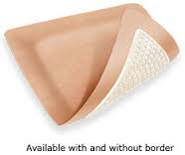
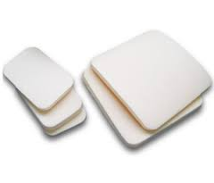
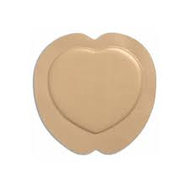
Foam
Provides a thermal insulator and has longer wear time than gauze. Change daily with physical exam.
Indications
  moderate to heavily exudating wounds
  Contraindications
  Do not use with dry eschar, nor sinus tracts.
  *Dressing should be one inch larger than wound, some have adhesive border, some require secondary adhesive to hold in place
Notes:
Sponge-like. Semi-permeable. Capable of holding fluids and pulling moisture away from wound bed.
Adhesive or non-adhesive border; Available as pads, sheets, pillows (cavity) dressing in various shapes and sizes.
May be used under compression dressings to assist with weeping wounds.

Slide 5
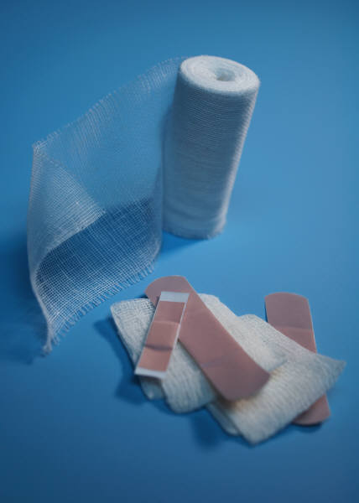
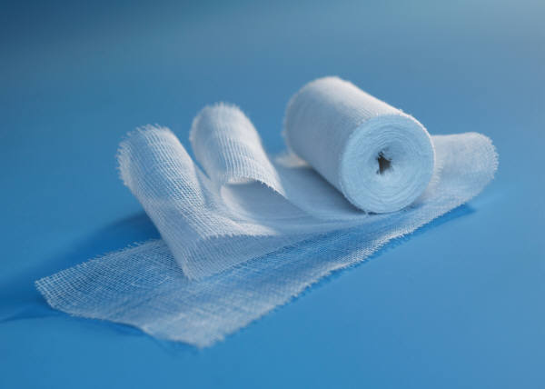
Gauze
Wet to dry dressing is sub-par treatment. Just say N☺!!!!!!!
Wrapping gauzes:
  Kerlix: FLUFFY- used as primary dressing, providing fast wicking action and excellent absorbency as secondary dressing. Ideal for bandaging heads, limbs and difficult to dress wounds
  Kling: similar to kerlix but more elastic.
Notes:
Wet-to-dry is not selective; often removes healthy tissues, causing re-injury. Can also be painful. Can be used only temporarily, 2-3 days to protect/cover.
Use NS when removing! Used for packing of dead space within a wound.
Available in different sizes, shapes, thickness. Fluff, don’t Stuff!

Slide 6
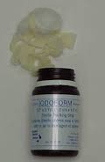
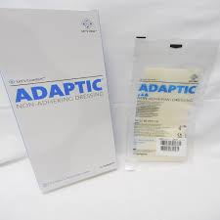
Impregnated gauze
  Iodoform: iodine impregnated gauze packing strips
  Adaptic: Vaseline Gauze.
  Patients Love this dressing. Ideal for most light exudating wounds, coated with light oil to prevent dressing adherence while soaking up exudate

Slide 7
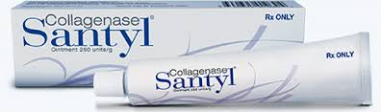
Topical Applications
Collagenase Santyl:
sterile enzymatic debridement with ability to digest collagen in necrotic tissue. Cover edge to edge nickel thickness. Daily treatment.
Bacitracin:
Topical antibiotic, has a wide spectrum for gram positives and negatives
Notes:
Santyl (debriding chronic ulcers, severely burned areas). Daily application, cleanse area first.
Antiseptics only used for limited time periods, reassess after 7 days.
Betadine, kills everything.

Slide 8
Cleansers
Wound Wash/Normal Saline: Most commonly used wound cleanser. Be sure to irrigate and scrub, not just pat.
Dakin solution: Effective against bacteria. Effective in killing all micro organisms in burns. Recommended use BID to QID
Acetic acid: bacteriocidal against many gram positive and negative organisms especially pseudomonas aeruginosa. Recommended use TID
Notes:
Dakin's (Pharmacy can mix, used to irrigate. includes bleach – is cytotoxic.) Use short-term, 2 weeks.
BID – VFO must be in place or caregiver trained to do.
Acetic acid (vinegar; TID).

Slide 9
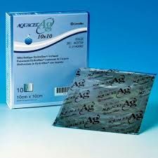
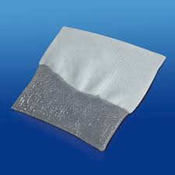
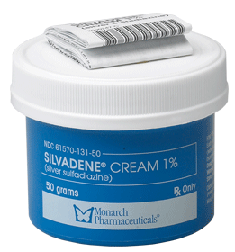
Topical Antibacterial agents
Aquacel AG: silver fibers gel on contact with the wound locking exudate wicking bacteria away from wound
Silver: (silvadene) can impede fibroblast activity. Use on eschars, scabs, infected wounds.
Notes:
Creates large fluid-absorption capacity. Silver kills bacteria. Silvadene – limited application to 2 weeks (Burns, skin grafts, incisions, leg ulcers).
Can hamper concentration of fibroblasts.

Slide 10
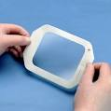
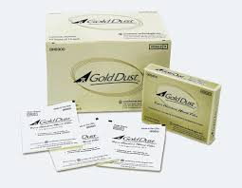
Transparent Films
  When to use: wounds without depth, intact skin as protector, useful as second dressing. NOT on limbs
  Do NOT use on moderate to heavily exudating wounds
Wound Fillers: agents in a variety of forms, including pastes, granules, powders, and gels to fill wound. We love avitene microfibrillar collagen
Use: to fill dead space, absorptive, provides moist wound healing
Indications: wounds that require packing and have depth.
Change every one to three days
Notes:
Films (skin tears; IV);

Slide 11
Wound Packing
Packing a wound is necessary to fill dead space
LIGHTLY…NOT TIGHTLY
FLUFF...DON’T STUFF
Over packing increases pressure, decreases circulation, prevents communication between walls of tissue
Document what you put in and what you take out.
https://www.youtube.com/watch?v=HTvNND0S9IQ

Slide 12
Tips
When securing a dressing be attentive to areas that are high risk for friction and shear.
Tape should extend one inch beyond the dressing border.
Remove tape “low and slow”, in direction of hair growth keeping close to the skin surface and pulled back over itself. Shaving is a nice thing to do, e,g., on the scalp.
Use saline to soften dressing and promote easier removal.
Notes:
Skin prep! Tape for sensitive skin. Mefix.

Slide 13
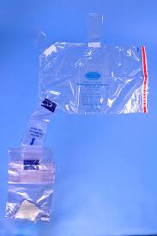
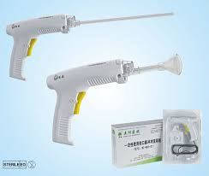
Closed Pulse Irrigation
CPI: a safe pulse irrigation system performed on open wounds under the protection of a contained wound irrigation bag.
Purpose- to remove biofilm from wound surface in order to optimize wound healing. It washes away the bacteria from the entire wound surface, without damaging healthy or granulating tissue.
Indications- acute or chronic non-healing wounds, infected wounds (MRSA, MDR), high bio-burden, slough.
Contraindications-exposed bone, organs
Notes:
Pulse lavage
Enable hydro-wound debridement to be performed at the bedside in a way that safely contains all bacteria and contaminants, eliminates the possibility of splash back.
http://www.pulsecaremedical.com/

Slide 14
Pulse Irrigation
Typical order reads as follows:
  You can schedule a surgery!! ) sort :).. But you can recommend surgery.
  3000 ml bags of NS. The Operating Room team here at the Beth is AMAZING!!!!!.
  https://www.youtube.com/watch?v=ZBWvwAvdMks
Notes:
Dr. Patrick Marasco
YouTube at 2:35 seconds – 4:30 seconds
Show demo / supplies with Video.
May add lidocaine to bag prior to treatment to reduce pain.
Order batteries every 8-10 treatments, or new ‘water gun’.

Slide 15
Dressings: An Overview
Type of Dressing | Dressing Name & Company | About this Dressing | Type of Wound Dressing Used For
Hydrocolloid | Tegasorb, Tegaderm Hydrocolloid (3M), Duoderm (Convatec) | Cost effective—can be worn up to 7 days (Duoderm, 3-5) Promotes a moist wound environment Promotes autolytic debridement Protects from friction and shear Waterproof and occlusive, which prevents bacterial contamination | Low exudating Pressure ulcer Venous leg ulcer First/Second degree burn Donor site Dry Superficial
Hydrogel (Secondary dressing is required) | DuoDerm Gel; Intrasite Gel (Smith & Nephew); Tegaderm hydrogel wound filler (3M) | Easily removed from wound by irrigation with normal saline/sterile water Increases moisture, preventing eschar formation In dry wounds, can be mixed with Iodosorb and Flagyl Promotes autolytic debridement without damaging fragile granulating tissue | Pressure ulcer Surgical Venous leg ulcer Burn Malignant Dry Partial thickness Laceration Necrotic Can be used with infections
Antimicrobial Dressings/Topical Antimicrobial Preparations | Acticoat, Iodosorb, Flmazine (Smith & Nephew); Tegasorb Silver; Tegaderm Ag Mesh dsg with silver; Alginate Ag Silver (3M); Actisorb Silver (Johnson & Johnson); Mepilex Ag; Mesalt (Molnlycke); Medihoney (Derma Science); Plymem Silver | Acticoat remains effective for up to 3 days; use with sterile water not normal saline; can be remoistened Actisorb Silver contains charcoal which absorbs odor and bacterial toxins Iodosorb’s antimicrobial activity is sustained for 3 days; goes on brown—change when cream colored Medihone Calcium alginate for wet wounds & honeycolloid for dry wounds and debriding; quickly reduces odor and useful in all phases of wound healing Mesalt is impregnated with sodium chloride (hypertonic solution); use on wet wounds only and change q 24 hours Mepilex Border Ag is an antimicrobial all-in-one foam dressing that effectively absorbs and retains exudate and maintains a moist wound environment; change q 7 days. | Moderate/High exudating Pressure ulcer Surgical Venous leg ulcer Diabetic ulcer Burn Infected Sloughy or infected wounds Fungating exogenous tumors (commonly from late stage breast cancer) Cellulitis

Slide 16
Dressings: An Overview
Type of Dressing | Dressing Name & Company | About this Dressing | Type of Wound Dressing Used For
Self Adherent Absorbent Dressing (Works well as secondary dsg covering wounds with gel) | Alldress (Molnlycke); Island Dressing such as Medipore and Tegaderm (3M) | Provides a moist wound environment Absorbs exudate Primary dressing for clean wounds where a barrier is needed All in one sterile dressings to be used as a primary or secondary dressing A combination of a non-adherent pad covered with a waterproof, transparent backing on a soft cloth conformable cover | Low exudating Pressure ulcer Venous leg ulcer First/second degree burn Donor site Dry Superficial Infected wound

Slide 17
Dressings: An Overview
Type of Dressing | Dressing Name & Company | About this Dressing | Type of Wound Dressing Used For
Foam Dressing | Allevyn (Smith & Nephew), Biatain (Coloplast), Mepilex/Meplix Border (Molnlycke), Tegaderm foam, | Cost effective (Can be left in place for up to 7 days) Promotes a moist wound environment Highly absorbent Can be used with topical agents Domes in a variety of shapes and sizes Does NOT provide ‘padding’ for skin Mepilex/Mepilex border – Silicone layer keeps exudate off the wound and periwound, skin surface reducing maceration | Heavily exudating Pressure Ulcer Surgical Venous leg ulcer Neuropathic/Diabetic ulcer Burn Donor site Fungating/Malignant
Calcium Alginate and Hydrofiber | Aquacel/Ribbon, Kaltostat (ConvaTec); Tegaderm Alginate, Versiva XC (SM); Aquacel Ag Surgical-Hydrocolloid with Hydrofiber | Can be left on until saturated, which depends on wound drainage Promotes a moist wound environment Interacts with exudate to form a gel Useful for packing wounds Always requires a secondary dressing Contours with wound | Moderate/Heavy Exudating Wound Pressure Ulcer Surgical

Slide 18
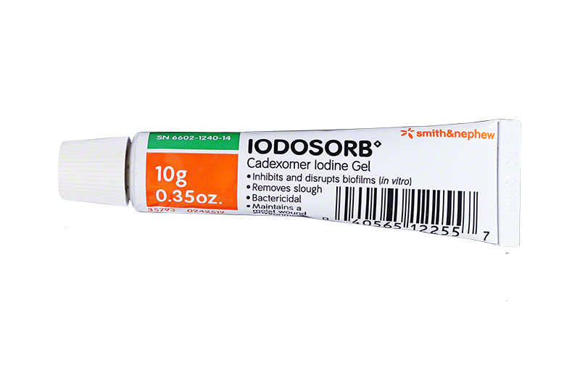
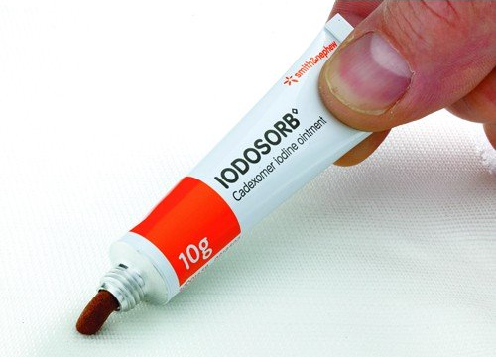
What Is Iodosorb (Cadexomer Iodine)?
Cadexomer iodine is a hydrophilic starch polymer bead, containing 0.9% w/w iodine.
When in contact with wound exudates, it releases free iodine (an antiseptic), which reduces the bacterial count.
It also absorbs fluid, removes pus and debris, and facilitates desloughing.
In addition, cadexomer iodine maintains a moist environment to promote the healing of chronic skin ulcers.
Ormiston MC, et al. Controlled trial of Iodosorb in chronic venous ulcers. Br Med J 1985 (291)6491: 308-310.

Slide 19
How Does Iodosorb Work?
Cadexomer iodine consists of spherical microbeads with a three-dimensional network of modified starch. The microbeads contain iodine within its matrix. When applied to the wound, the highly hydrophilic microbeads absorb exudate from the wound surface, swelling to form a gel, and progressively release iodine at the wound surface.
One gram of powder can absorb as much as 7 mL of fluid. Cadexomer iodine promotes an acid pH that favors the antimicrobial activity of the iodine.

Slide 20
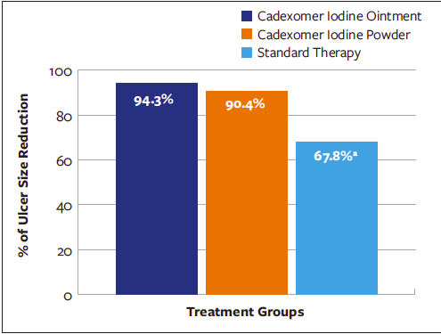
How Does Iodosorb Work?
Percentage of reduction in ulcer size from baseline to 12 weeks
Cadexomer iodine (both ointment and powder), in comparison with standard care alone, increases the percentage of reduction in ulcer size and promotes complete wound healing in chronic ulcers.
Raju R, et al. Efficacy of cadexomer iodine in the treatment of chronic ulcers: a randomized, multicenter, controlled trial. Wounds 2019 (31)3: 85-90.

Slide 21
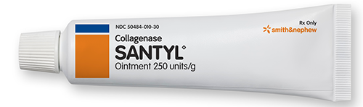
What Is Collagenase?
Collagenase Santyl is a sterile enzymatic debriding ointment It possesses the unique ability to digest collagen in necrotic tissue. It is an adjunct to surgery.
Never use it with an eschar or prior to debridement. Nor if their is an elevated WBC that could be coming from the wound or if patient has a left shift (high neutrophils).
Collagenase is a healing agent that degrades basement membrane and facilitates new blood vessel growth (angiogenesis), and new skin (epithelialization).

Slide 22
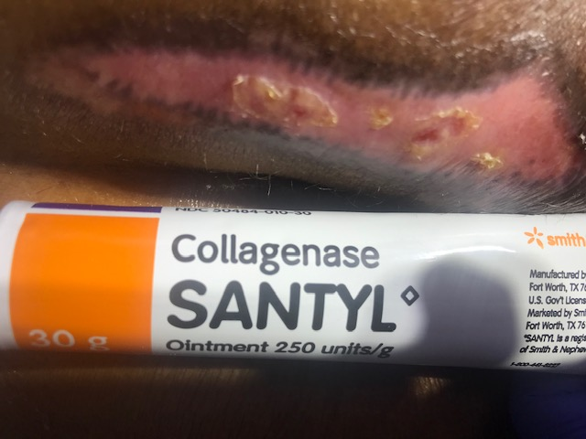
How to Apply Collagenase?
Collagenase ointment should be applied at least twice a day. (or more frequently if the dressing becomes soiled, as from incontinence).

Slide 23
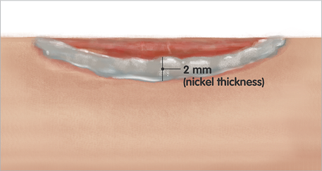
How to Apply Collagenase?
Collagenase should be applied in the following manner:
prior to application the wound should be cleansed of debris and digested material by gently rubbing with a gauze pad saturated with normal saline solution, or with the desired cleansing agent compatible with Collagenase, followed by a normal saline solution or Dakin solution scrub.
Tongue blades or q tips or sterile gloves.
D:( not apply on gauze.

Slide 24
What Are Pros/Cons of Collagenase?
There is a lack of RCTs with adequate methodological quality.
Collagenase appears beneficial for wound healing and for its ability to remove necrotic or devitalized tissues in pressure ulcers, diabetic foot ulcers, and in burns with topical antibiotics.
Patients treated with collagenase may have an increased risk of adverse events (e.g., cellulitis) compared to alternative treatments.
Patry J, et al. Enzymatic debridement with collagenase in wounds and ulcers: a systematic review and meta-analysis. International Wound Journal 2017 (14)6: 1055-1065.

Slide 25
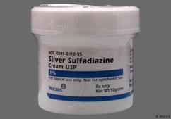
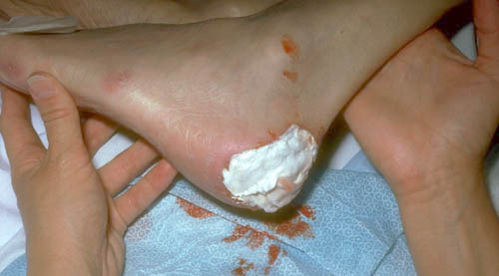
What Is Silvadene
(Silver sulfadiazine [SSD])?
Silver sulfadiazine (SSD) is one of the best topical antibacterial agents to control wound infection. SSD possesses a broad spectrum of activity against gram-positive and gram-negative bacteria as well as fungi.
The ability of SSD to reduce early invasive wound sepsis at low concentration has made it a drug of choice for chronic wounds and burns injuries.
However, usage of silver based creams in large wounds results in toxicity due to systemic absorption of silver ions and currently available formulations lack the ability to control the release of SSD to prevent serum silver concentration to reach toxic levels.
Banerjee J, Seetharaman S, Wrice NL, Christy RJ, Natesan S. Delivery of silver sulfadiazine and adipose derived stem cells using fibrin hydrogel improves infected burn wound regeneration. PLoS One. 2019;14(6):e0217965. Published 2019 Jun 13. doi:10.1371/journal.pone.0217965

Slide 26
How to Apply Silvadene?
Silvadene is an excellent antibacterial cream to apply to a wound after debridement.
One must insure that an 1/8 inch to 1/4 inch coat is applied to help insure that the dressing doesn't absorb all the cream and allow the wound subsequently dry out. usually 2 to 3 times daily.
The wound should be covered with the cream at all times. Dressings may be applied over the cream, but only if needed. If some of the cream rubs off the wound, reapply it immediately. The cream should also be reapplied immediately after hydrotherapy.

Slide 27
What Are Pros/Cons of Silvadene?
Due to its strong antimicrobial activity, silver is commonly used as an adjunct in wound care.
Silver is beneficial for the first few days/weeks, after which nonsilver dressings should be used.
Silver-containing dressings, especially nanocrystalline silver, are most useful in infected wounds.
Khansa I, et al. Silver in wound care—friend or foe? Plast Reconstr Surg Glob Open 2019 (7)8: e2390. doi: .

Slide 28
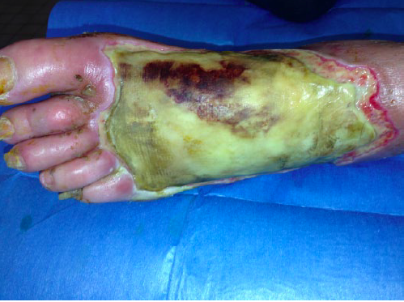
Silvadene (silver sulfadiazene)
Eschar formation on left dorsum of left foot after use of silver sulfadiazene and cerium nitrate.
Vitse J. Silver Sulfadiazine and Cerium Nitrate in ischemic skin necrosis of the leg and foot: results of a prospective randomized controlled study. International Journal of Lower Extremity Wounds 2018 (17)3: 151-160.

Slide 29
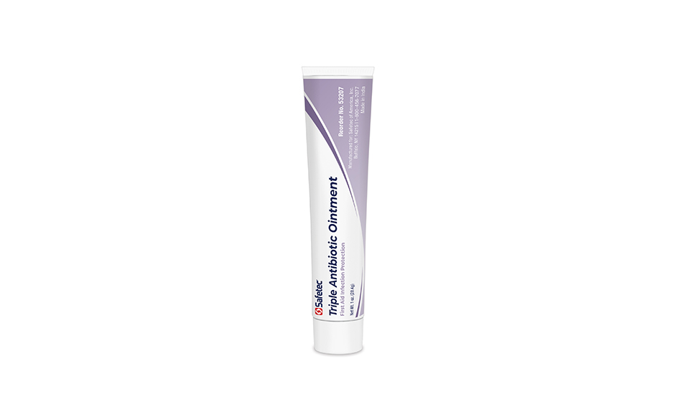
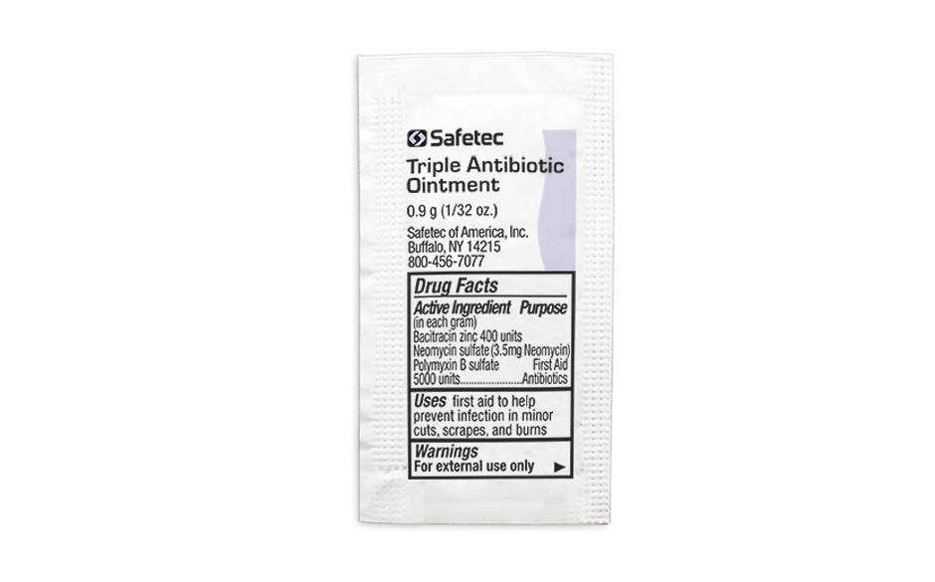
What Is Triple Antibiotic Ointment?
This product contains neomycin, bacitracin, and polymyxin, antibiotics that work by stopping the growth of bacteria. This medication prevents/treats only bacterial skin infections.
It will not work for other types of skin infections (e.g., infections caused by fungi, viruses). Unnecessary use or misuse of any antibiotic can lead to its decreased effectiveness.

Slide 30
How to Apply Triple Antibiotic Ointment?
Clean and dry the affected skin area. Then apply a small amount of medication (no more than can fit on your finger tip) in a thin layer on the skin and rub in gently, usually 1 to 3 times a day.

Slide 31
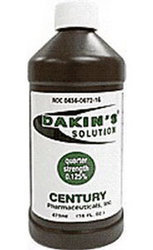
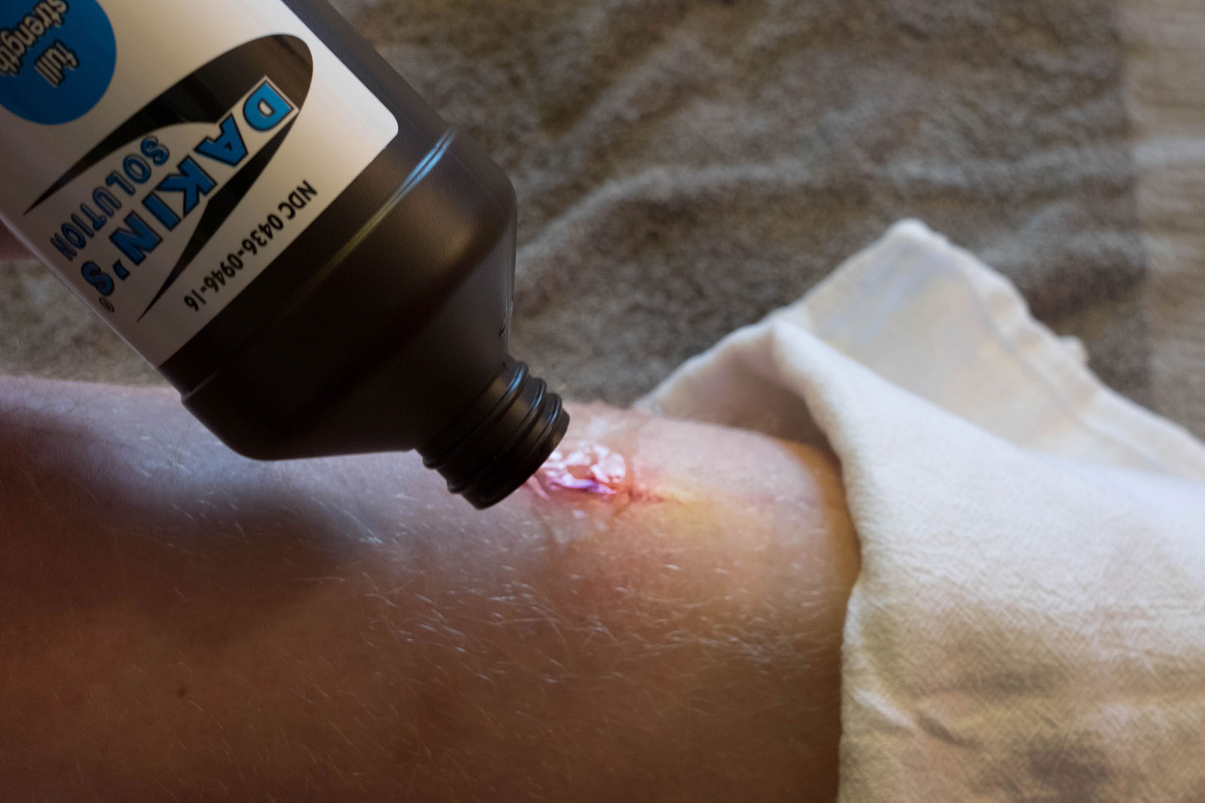
What Is Dakin Solution (chlorhexidine)?
Dakin solution, also called Dakin fluid or Carrel-Dakin fluid, is a dilute sodium hypochlorite (NaClO) solution that is commonly known as bleach.
The mixture of sodium peroxide (NaO) and hydrochloric acid (HCl) produces sodium hypochlorite. The main active agent in the Dakin solution is created when the chlorine in the solution reacts with water in the environment to form hypochlorous acid (HClO). This hypochlorous acid produces the potent antibacterial effect in tissues.
In fact, neutrophils of the human immune system produce small amounts of hypochlorous acid inside phagosomes, which are used to digest bacteria and viruses. Unlike stronger germicidal solutions that contain carbolic acid or iodine, Dakin does not damage living cells or lose potency in the presence of blood serum. It has a solvent action on dead cells that hastens the separation of dead tissue from living tissue.

Slide 32
What Is Dakin Solution (chlorhexidine)?
Chlorhexidine is produced in two forms: a 0.05% dilution for wound cleansing and a 4% solution for use as a surgical skin preparation.
Chlorhexidine 0.05% is of particular use to irrigate wounds requiring cleansing, particularly those healing by secondary infection.
Although it is commonly believed that the 0.05% can decrease bacterial load, it has been proposed that it is the physical action of cleansing that removes debris or exudate rather than the product used.
Much of the existing evidence on chlorhexidine 0.05% dates from the 1990s; up-to-date studies are required.
Main RC. Should chlorhexidine gluconate be used in wound cleansing? Journal of Wound Care 2008 (17)3: 112-114.

Slide 33
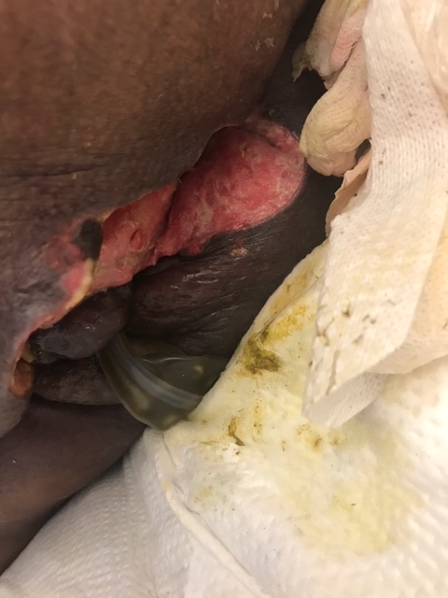
How to Apply Dakin’s Solution?
Due to its properties as an acid-based compound, the Dakin’s solution can be corrosive to healthy tissue, especially at higher concentrations. An oil-based ointment such as petroleum jelly can be applied to surrounding healthy tissue to reduce skin irritation and prevent debridement of viable tissue.
Dakin’s solution also loses its antiseptic properties rapidly after application due to the instability of the compound. Therefore, gauze sponges soaked with Dakin that are used to pack necrotic wounds need to be frequently changed.
McCullough M, Carlson GW. Dakin's solution: historical perspective and current practice. Ann Plast Surg. 2014 Sep;73(3):254-6.

Slide 34
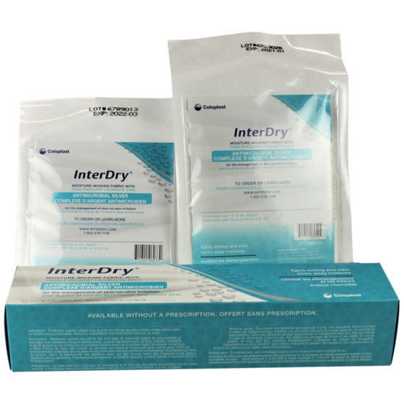
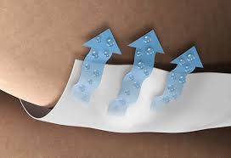
What Is InterDry?
InterDry is a moisture-wicking fabric that contains antimicrobial silver. Use InterDry dressing to alleviate symptoms of intertrigo (aka intertriginous dermatitis).
Commonly affecting skin fold areas like the armpits, abdominal area and underneath the breasts, intertrigo can cause redness, itching, burning and skin erosion. Advanced cases may develop bacterial, viral or fungal infections.
Infused with antimicrobial silver, fabric sheets of InterDry wick away moisture and inhibit infections while forming a physical barrier to reduce friction and help alleviate the symptoms of intertrigo.

Slide 35
How to Apply InterDry?
Step 1: Wash skin and gently pat dry.
Step 2: Measure and cut. Cut the size needed using clean scissors. Make sure to cut enough fabric to have about 2 inches sticking out from the bare skin. This allows for the best moisture loss.
Step 3: Apply and secure o Lay a single layer of the fabric in the skin fold. Place one edge of the fabric into the base of the fold. Gently smooth the rest of the fabric over the skin. Try to keep the fabric flat. Make sure to leave at least 2 inches of the fabric sticking out from the bare skin. Secure the fabric in one of the following ways; with the skin fold, with a small amount of tape, or tucked under clothing.
How to remove InterDry: Remove the fabric before bathing. Gently separate the skin fold and lift away the fabric. Be careful not to harm the skin. The fabric can be reused after bathing. Each piece of fabric can be used for up to 5 days. Do not use with creams or ointments.

Slide 36
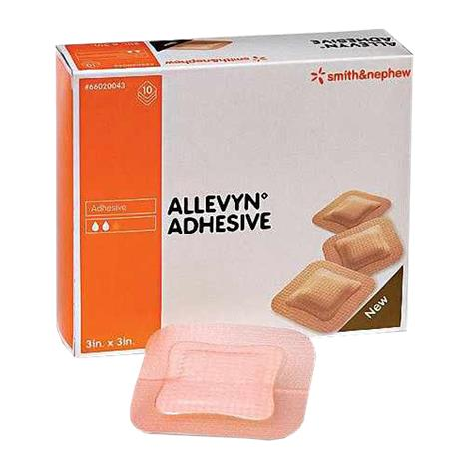
What Is Allevyn?
ALLEVYN Adhesive, is designed to achieve this combination to ensure optimal fluid handling to support moist wound healing.
The triple action technology helps to maintain an optimal balance in fluid creating a moist wound environment for healing.
The low allergy adhesive helps to keep the dressing securely in place without adhering to the wound.
The breathable top film helps to minimize the risk of maceration to the wound and peri-wound.
Provides an effective barrier function to exogenous bacteria as well as helping to prevent fluid and bacterial strikethrough⁸
Easy to apply and remove.
Conforms to body contours and is very comfortable for patients.
Sacral sizes available which combine the high-absorbency and secure self-adhesion in an anatomically-shaped dressing.

Slide 37
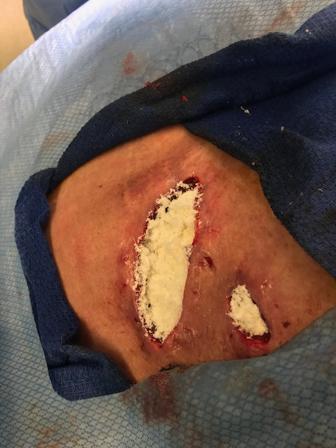
How to Apply Allevyn?
Cleanse wound in accordance with local clinical protocol.
Select an appropriate dressing size. Allevyn Adhesive can be cut to dress wounds on the heel, elbows and other awkward areas.
Prepare and clean the skin surrounding the wound area and remove excess moisture. Any excess hair should be clipped to ensure close approximation to the wound.
Remove one of the protector films from Allevyn Adhesive and anchor the adhesive side of the dressing to the skin.
Remove the remaining protector film and smooth the dressing over the remainder of the wound without stretching, ensuring there are no creases. The pad area of the dressing must be adhered across the entire surface of the wound.
If the dressing has been cut ensure any exposed foam areas are covered with an appropriate film dressing taking care not to cover the entire dressing.
When positioning Allevyn Adhesive on the sacrum, place the narrow end of the dressing a minimum of 2cm (3/4in.) above the anal sphincter, then smooth the dressing over the sacrum.

Slide 38
How to Remove Allevyn?
To remove Allevyn Adhesive, lift one edge of the dressing and slowly peel back until completely removed from the wound. Sacral dressings should be removed from the top edge and down towards the anus to minimize the potential for fecal contamination.

Slide 39
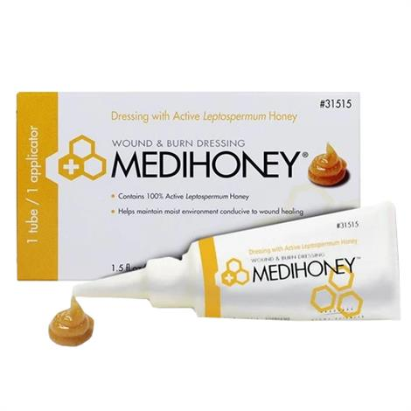
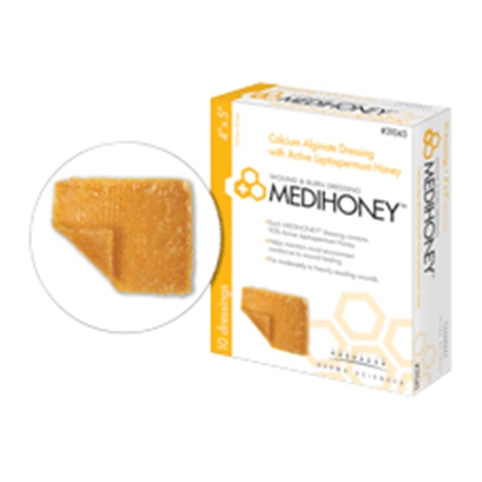
What Is Medihoney?
Medical honey is hygroscopic, meaning it draws moisture out of the environment and thus dehydrates bacteria. The enzyme glucose oxidase, produces gluconic acid and minute amounts of hydrogen peroxide when in contact with the wound surface.
The pH level of honey is low (mean 4.4). Bacterial colonization or infection and recalcitrant wound healing situations are often accompanied by high pH values in wound exudates and lowering the pH speeds healing.
The Active Leptospermum has antimicrobial properties and combats drug resistant infections, such as MRSA.

Slide 40
How to Apply Medihoney?
Prior to application of MediHoney cleanse the wound
Apply MediHoney either directly to the wound bed, or onto a suitable primary dressing such as alginate, gauze pad, or island dressing.
Cover with an appropriate secondary dressing.
Moisten with sterile saline if the wound bed appears dry before removal of the dressing.
Remove the secondary dressing from the wound bed gently.
Cleanse the wound bed prior to application of new dressing.

Slide 41
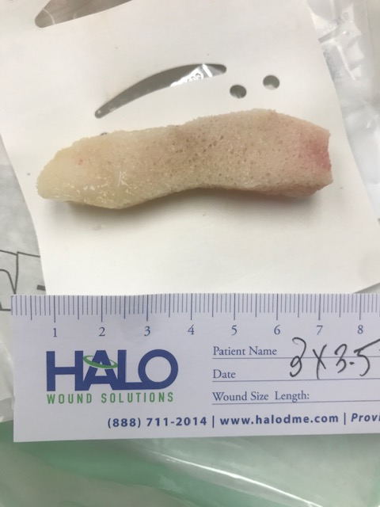
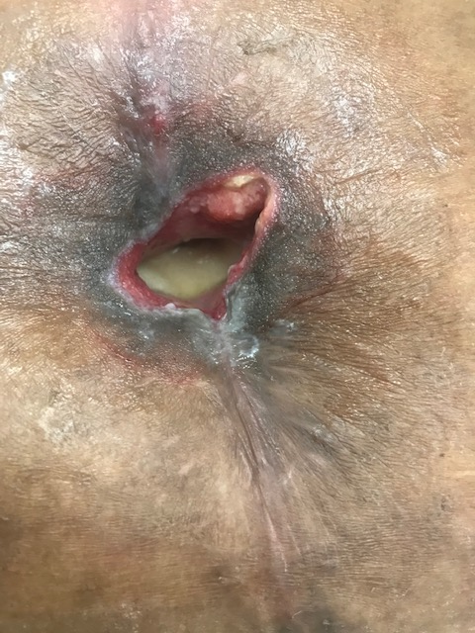
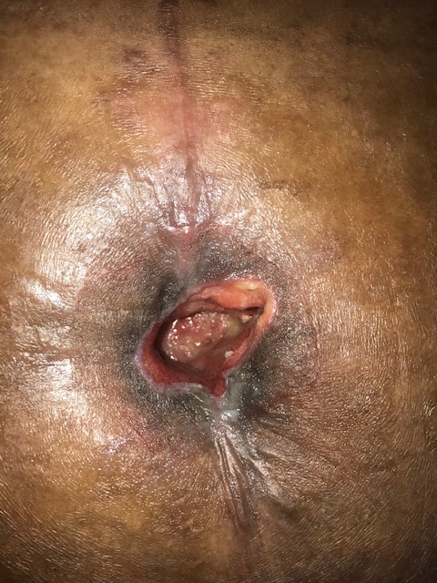
How to Apply Vac White Foam?
The foam cut to size.
The foam in place in the wound.
The wound after foam has been removed.

