Slide 1
Diagnosing and Treating Chronic Wounds in an Acute Care Setting Wednesday, October 9, 2024
Notes:
1

Slide 2
Agenda
What are the most commonly-seen wounds?
Diabetic foot ulcers
Sickle cell ulcers
Pressure ulcers
Pressure ulcers
Hidradenitis Suppurativa
How are these wounds diagnosed?
Medical history
Laboratory tests
What is the role of Procalcitonin?
What are required vascular assessments?
What are relevant imaging studies?
Radiographic tests
How to diagnose infection?
How to treat infection?
When is debridement indicated?
What are indications for debridement?
What are general principles of debridement?
What is pathological importance of tissue left behind?
What are regenerative medicine options?
What are dressing options?
What are the research possibilities?

Slide 3
What are the most commonly-seen types of wounds?

Slide 4
Diabetic foot ulcers
Associated with neuropathy
Located on plantar aspect of foot, extensive callus formation, superficial to deep
Wagner Classification
If patient has diabetic foot ulcer, what is Wagner Classification?
Grade 0: no open lesions; may have deformity or cellulitis
Grade 1: superficial diabetic ulcers (partial or full thickness)
Grade 2: ulcer extension to ligament, tendon, joint capsule or deep fascia without abscess or osteomyelitis
Grade 3: deep ulcer with abscess, osteomyelitis, or joint sepsis
Grade 4: gangrene localized to portion of forefoot or heel
Grade 5: extensive gangrenous involvement of the entire foot
Assessments
Ankle-brachial index
Bone scan if concern for osteomyelitis
Lower extremity duplex ultrasonagraphy
MRI if concern for osteomyelitis
Radiography
Transcutaneous oximetry
Wound culture

Slide 5
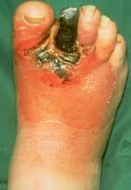
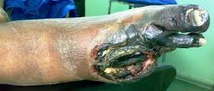
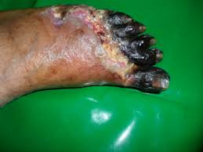
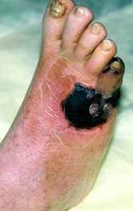
Diabetic foot ulcers: Progression of Simple Diabetic Foot Ulcer to Gangrene

Slide 6
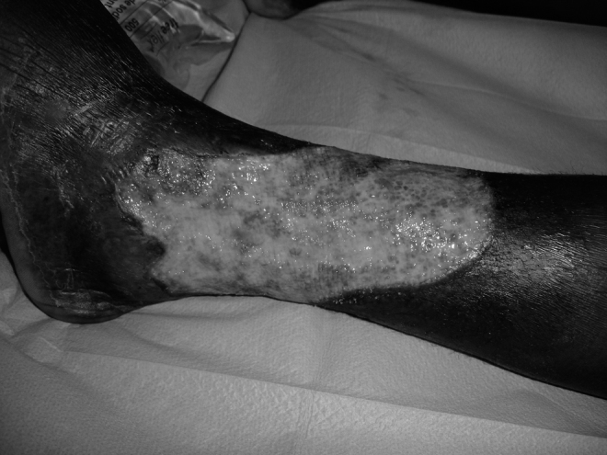
Sickle cell ulcers
Lower extremity
Often confused with venous reflux ulcers
Sickle Cell Leg Ulcers are a severe complication of sickle-cell disease and are associated with an increased risk of death.
They have a significant impact on quality of life. There are no official recommendations for their treatment.
Treatment must include pain relief, dressings, and sometimes systemic treatment for severe cases.

Slide 7
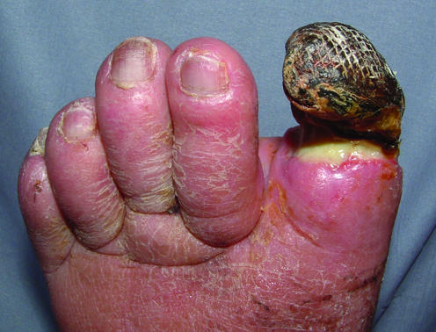
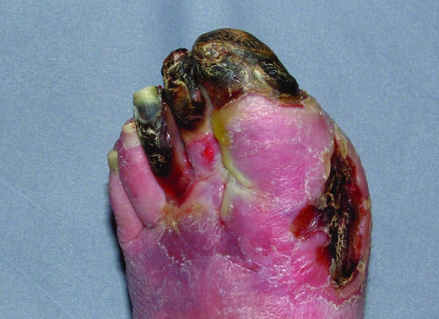
Arterial ulcers
Arterial ulceration typically occurs over the toes, heels, and bony prominences of the foot.
ulcer appears “punched out,” with well demarcated edges and a pale, non-granulating, often necrotic base.
surrounding skin may exhibit dusky erythema and may be cool to touch, hairless, thin, and brittle, with a shiny texture.
toenails thicken and become opaque and may be lost.
Gangrene of the extremities may also occur.
Examination of the arterial system may show a decreased or absent pulse in the dorsalis pedis and posterior tibial arteries.
There may be bruits in the proximal leg arteries, indicating the presence of atherosclerosis.
Top: Dry gangrene of great toe in a patient with peripheral vascular disease with line of demarcation covered with slough. Bottom: Wet gangrene of forefoot and toes in a patient with arterial disease, with soft tissue swelling due to infection.
Grey, J. E., Harding, K. G., & Enoch, S. (2006). Venous and arterial leg ulcers. BMJ (Clinical research ed.), 332(7537), 347–350. https://doi.org/10.1136/bmj.332.7537.347

Slide 8
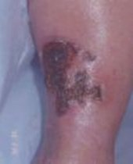
Arterial ulcers: assessment
Palpate pulses
Assess macrocirculation:
Angiography
Ankle-brachial index or toe-brachial index
Lower extremity arterial duplex ultrasonography
Pulse volume recording
Segmental limb pressure
Assess microcirculation:
Skin perfusion pressure
Transcutaneous oximetry

Slide 9
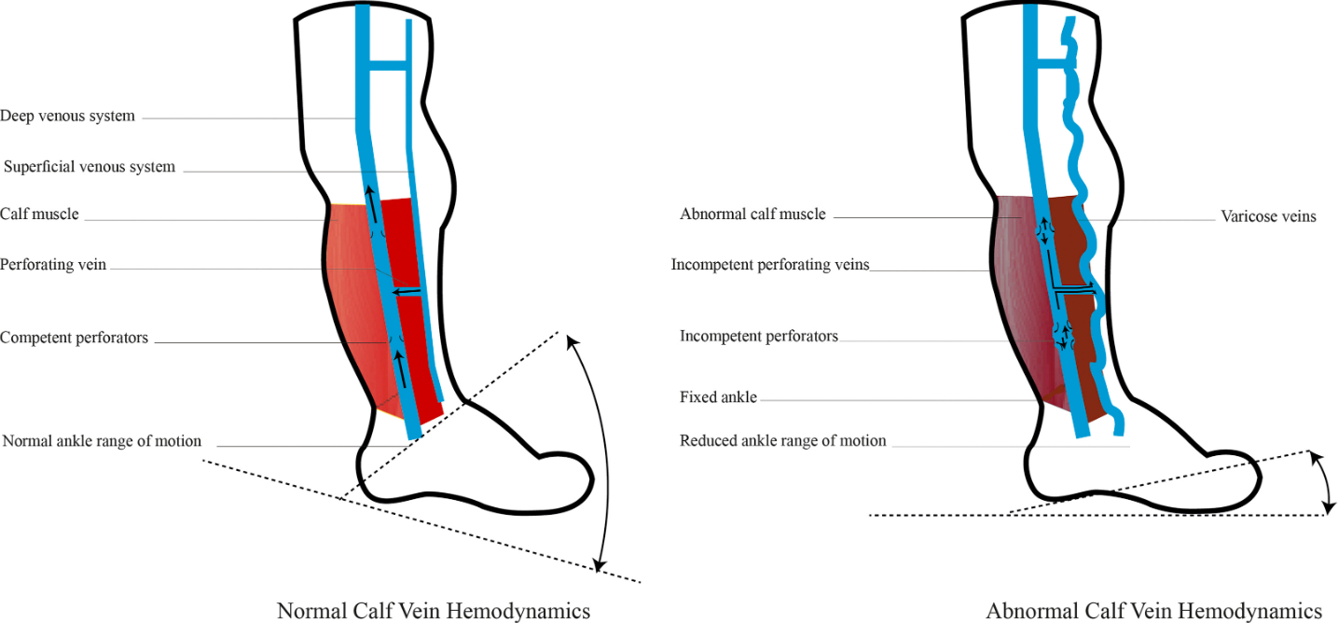
What is the pathophysiology of venous disease/venous ulcers?
Valve dysfunction, outflow obstruction, areteriovenous malformation, and calf muscle pump failure contribute to the pathogenesis of venous disease.
Alavi A, et al. What’s New: Management of venous leg ulcers: approach to venous leg ulcers. Journal of the American Academy of Dermatology. 2016;74(4):627-640.

Slide 10
How are Pressure Ulcers staged?
The most widely accepted classification system is the National Pressure Ulcer Advisory Panel (NPUAP) system. It uses ulcer depth as a way to classify these ulcers.
Stage I: The skin is intact with the presence of non-blanchable erythema.
Stage II: There is partial-thickness skin loss involving the epidermis and dermis.
Stage III: There is a full-thickness loss of skin that extends to the subcutaneous tissue but does not cross the fascia beneath it. The lesion may be foul-smelling.
Stage IV: There is full-thickness skin loss extending through the fascia with considerable tissue loss. There might be possible involvement of the muscle, bone, tendon, or joint.
Most common pressure ulcer sites:
Supine: Occipital areas, sacrum, scapula(e) and heels
Prone: Chest, anterior superior iliac crests, symphysis, pubis, patella, anterior tibial regions
Sitting: Ischium, coccyx, elbow, trochanter
Side-lying: Trochanter, lateral foot, ankle, knee, ear
Bansal C, Scott R, Stewart D, Cockerell CJ. Decubitus ulcers: a review of the literature. Int J Dermatol. 2005 Oct;44(10):805-10

Slide 11
Physical exams for pressure ulcers
Exact anatomical location of wound, e.g.:
Plantar or dorsal surface of toe 1,2,3,4,5)
If plantar, identify which metatarsal
Heel/ankle/calf, anterior tibia, lateral or medial
Daily assessment of the skin, particularly around the at-risk areas, including ischial, sacral, trochanteric, and heel areas
If patient has heel ulcer, do they have sacral, buttock, occiput, or hip ulcer?
Length, width, depth of wound
Fungal toenails (e.g., yes/no? which ones?)
Characterization of skin around wound (e.g., erythema, callus? pustules? dermatitis? hyperpigmentation?)
Pus
Tenderness
Drainage
Characterization of granulation tissue (e.g., discolored, well-vascularized?)
Undermining of wound edges (i.e., how many centimeters?)

Slide 12
What are the current treatments for Hidradenitis Suppurativa?
Management should be guided by disease severity.
For stage I, characterized by mild, nonscarring disease, limited clinical trial data support the efficacy of topical clindamycin; although data are lacking to support the use of intralesional triamcinolone, clinical experience suggests that it may be useful for some isolated lesions.
Case series suggest that scarred lesions are best treated with wide excision or evaporation with the use of a carbon dioxide laser.
More extensive and severe disease requires systemic treatment. For stage II disease, antibiotic therapy (clindamycin and rifampin, 300 mg twice daily for 6 months).
Involvement of the Genitalia in a Woman with Hurley Stage III Disease. Genitofemoral lesions are common in patients with hidradenitis suppurativa, especially in women
Jemec GB. Hidradenitis suppurativa. N Engl J Med 2012;366:158-164.

Slide 13
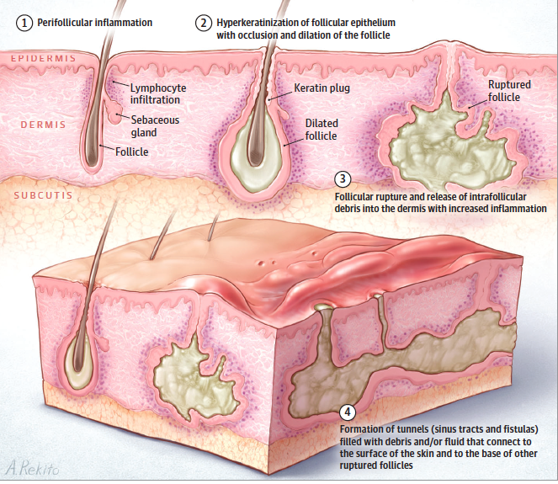
What are the current treatments for hidradenitis suppurativa?
Hidradenitis suppurativa is a chronic, inflammatory, recurring, debilitating skin disease of the hair follicles that usually presents after puberty with painful, deep-seated, inflamed lesions in the apocrine gland-bearing areas of the body (most commonly the axillae, inguinal, and anogenital regions).
Early recognition and treatment is crucial in order to minimize subsequent life-course effects of this disease.
Lindenhardt Saunte DM, et al. Hidradenitis suppurativa: Advances in diagnosis and treatment. JAMA 2017 (318)20: 2019-2032.

Slide 14
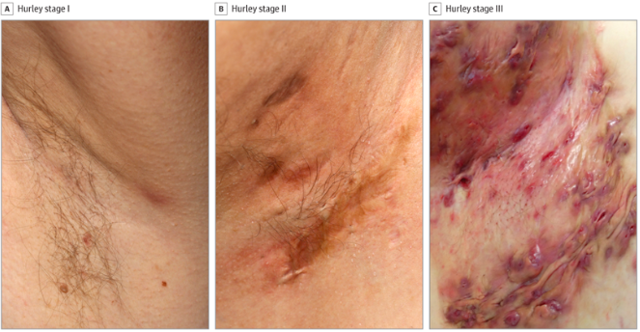
What are the current treatments for Hidradenitis Suppurativa?
The diagnosis of HS is made by lesion morphology (nodules, abscesses, tunnels, and scars), location (axillae, inframammary folds, groin, perigenital, or perineal), and lesion progression (2 recurrences within 6 months or chronic or persistent lesions for ≥3 months).
Antibiotic treatment with combinations of clindamycin and rifampicin, or ertapenem followed by combination rifampicin, moxifloxacin, and metronidazole for 6 months is effective. Adalimumab is effective in a significant proportion of patients and treatment with IL-1 and IL-12 receptor subunit beta 1 (Rb1) antibodies may also be useful.
Tissue-sparing surgical techniques and carbon dioxide laser treatments also are available, but the evidence on clinical outcomes with these approaches is limited.
Typical Hidradenitis Suppuration (Hurley Stage I, II, and III)
The 3 different Hurley stages in the axillae region. Hurley stage I (inflamed lesion without scarring); Hurley stage II (tunnels, scars, and inflamed nodules separated by clinically unaffected skin); and Hurley Stage III (coalescent lesions [inflamed tunnels, nodules, scars]).
Saunte DML, et al. Hidradenitis suppurativa: Advances in diagnosis and treatment. JAMA 2017 (318)20: 2019-2032.

Slide 15
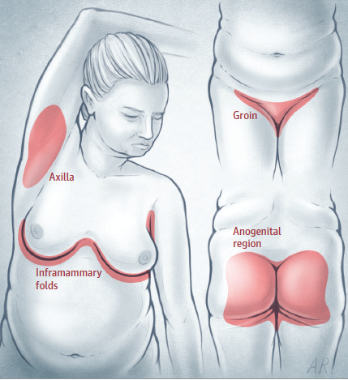
What are the current treatments for hidradenitis suppurativa
Typical hidradenitis suppuration distribution
If obese, weight loss is beneficial.
In addition to topical and systemic therapies for lesions, surgery may be necessary for scarred lesions and may include de-roofing and excisions. Incision and drainage is generally not recommended.
Lindenhardt Saunte DM, et al. Hidradenitis suppurativa: Advances in diagnosis and treatment. JAMA 2017 (318)20: 2019-2032.

Slide 16
How are these wounds diagnosed?

Slide 17
Medical history
Medical history of conditions that may affect wound healing should be investigated. These include:
history of diabetes,
peripheral arterial disease,
venous insufficiency,
conditions that affect mobility (such as stroke, neurological conditions, and recent trauma),
recent weight loss,
smoking,
radiation,
immunosuppressive therapy and cancer.
Previous surgical history, especially as related to treatment of the wounds, such as wound debridement, skin grafting, arterial revascularization, and vein ablation procedures should be detailed.

Slide 18
Laboratory Tests
Procalcitonin
C-Reactive Protein
Hemoglobin A1c
Albumin, pre-albumin
Vitamin D level
Complete blood count with manual differential
Prothrombin time/partial thromboplastin time
Comprehensive metabolic panel
Lipid profile
(ALP)
Gamma‐Erythrocyte sedimentation rate
Thyroid-stimulating hormone (TSH) thyroxine (T4) and triiodothyronine (T3)
Aspartate Aminotransferase (AST)
Alkaline phosphatase Glutamyl Transpeptidase (GGT)
Alanine aminotransferase (ALT)
Urine analysis
Urinary microalbumin

Slide 19
What is the role of Procalcitonin?
Procalcitonin (PCT) is widely regarded as a highly sensitive biomarker of bacterial infection, offering acute care surgeons a key tool in the management of surgical infections. Antibiotics (AB) can be lifesaving when treating bacterial infections but are often used inappropriately, specifically when unnecessary or when administered for excessive durations, and it has been reported that up to 30–50% of the AB given to hospitalized patients may be unnecessary

Slide 20
What are required vascular assessments?
All patients with lower extremity ulcers should be assessed for arterial disease. Suspicion of arterial disease should prompt referral to a vascular specialist.
Criteria:
Decreased or absent palpable pedal pulses.
Delay in capillary refill response.
Delay of 10-15 seconds in returning of color when raising the leg to 45° for one minute, dependent rubor (Buerger’s test).
ABI ≤ 0.9 or > 1.2.
Transcutaneous oxygen pressure of < 40 mm Hg.
Doppler arterial waveform disparities.
Dampened pulse volume recordings. Pure arterial ulcers are unusual. Arterial insufficiency frequently contributes to poor healing in ulcers with another etiology (venous or diabetic).

Slide 21
What are required vascular assessments?
Ankle-brachial index (ABI) is a simple test that can be performed at bedside. The ABI is the ratio of systolic blood pressure measured at the ankle over the systolic blood pressure measured at the arm, using a Doppler probe.
An ABI of >0.9 is suggestive of peripheral arterial disease. In patients with noncompressible vessels, such as patients with diabetes or advanced age, toe pressure and toe brachial index is used instead. This is usually done in the vascular lab and not at bedside.
In patients with clinical findings that are suspicious for peripheral arterial disease, additional arterial studies such as segmental pressure measurement and pulse volume recording measurement, or vascular imaging such as arterial duplex ultrasonography, computed tomography angiography, and digital subtraction angiography
https://www.facs.org/-/media/files/education/core-curriculum/nonhealing_wounds_go.ashx

Slide 22
What are required vascular assessments?
In patients with clinical findings that are suspicious for peripheral arterial disease, additional arterial studies may be indicated. In the segmental pressure study, systolic blood pressures are measured at the proximal thigh, distal thigh, below the knee, and ankle using a Doppler.
Pulse volume recording study detects volume changes sequentially down the extremity. A normal pulse volume wave form is characterized by sharp systolic upstroke, peak and prominent dicrotic notch. A loss of dicrotic notch or rounded waveform suggests diminished flow due to upstream occlusion.
Areas of arterial stenosis can be visualized on B-mode ultrasound imaging and can be demonstrated by Doppler as increased flow velocities.
Computed tomography angiography requires intravenous contrast timed specifically for arterial enhancement. It can provide three-dimensional imaging of the arterial system and is particularly useful for operative planning.
https://www.facs.org/-/media/files/education/core-curriculum/nonhealing_wounds_go.ashx

Slide 23
Radiographic Tests
Imaging modalities | Application in chronic wound imaging | Spatial resolution | Safety | Real time | Time consuming | Cost | Penetration depth
CT | Assessment of bone and joint pathology around wounded region. | High | Ionizing radiation | No | Medium | Medium | High
SPECT/CT | Assessment of regional microvascular perfusion in lower extremities. | High | Ionizing radiation | No | High | High | High
MRI | Soft tissue and bone pathology evaluation. | Low | General safe | Sometimes | High | High | High
Ultrasound imaging | Dermatology, assessment of wound structure and speed of flowing blood. | High | Safe | Yes | Low | Low | Low
THz spectroscopy | Assessment of burn wound | Medium | Safe | Sometimes | Low | Low | Medium
A comparison of five different imaging modalities for chronic wound diagnosis
Li, S., Mohamedi, A. H., Senkowsky, J., Nair, A., & Tang, L. (2020). Imaging in Chronic Wound Diagnostics. Advances in wound care, 9(5), 245–263. https://doi.org/10.1089/wound.2019.0967

Slide 24
Radiographic tests
x-ray (e.g., foot, tibia, fibula)
MRI
CT
Bone scan, but not if diagnosis already made (e.g., wound probes to bone or patient is scheduled for surgery)
All patients with diabetes and any patient with a diminished pulse should have bilateral ankle brachial indices. (an ABI of <0.9 indicates significant arterial insufficiency.
Unless a pulse is clearly palpable, noninvasive vascular ankle-brachial index testing, and all patients with diabetes over 50 should be screened with an ankle-brachial index, whether or not they have an ulcer.
Duplex ultrasonography is useful for determining the presence of venous insufficiency.
Ultrasonography is useful for diagnosing deep vein thrombosis.

Slide 25
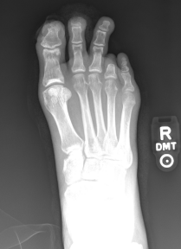
What are relevant imaging studies?
Plain radiographic evaluation of the extremity is indicated when osteomyelitis is suspected. Signs of osteomyelitis on plain radiographs are periosteal thickening, lytic lesions, endosteal scalloping, osteopenia, and loss of trabecular architecture
In general, osteomyelitis must extend at least 1 cm or compromise 30 to 50% of the bone mineral content to produce noticeable changes on conventional radiographs. This is about 2 to 3 weeks into the course of the infection
Radiograph demonstrates patient with bony destruction (osteopenia and bone loss) of the distal phalanges of the first and second digits, consistent with advanced osteomyelitis. Also present are soft tissue defects at the tip of the toes at the areas of chronic ulcerations. A previous 4th toe amputation is also evidenced on the radiograph.
https://www.facs.org/-/media/files/education/core-curriculum/nonhealing_wounds_go.ashx

Slide 26
What are relevant imaging studies?
Computed tomography shows changes earlier than conventional radiographs. However, the radiation exposure is higher with CT and it is not as sensitive as magnetic resonance imaging (MRI).
Magnetic resonance imaging is not only highly sensitive for detecting osteomyelitis, it also helps determine the extent of disease involvement. When used with gadolinium, sensitivity and specificity for osteomyelitis are 90% and 85% respectively.
Other imaging studies such as white blood cell labeled radionucleotide scan, hybrid 99mTc white blood cell labeled single-photon emission computed tomography/computed tomography (99mTc SPECT/CT), and hybrid positron emission tomography/computed tomography (PET/CT) have also been used for the diagnosis of osteomyelitis, especially when MRI is contraindicated.
https://www.facs.org/-/media/files/education/core-curriculum/nonhealing_wounds_go.ashx

Slide 27
What are relevant diagnostic studies?
Laboratory tests Serum marker of inflammation such as white blood cell count (CRP), C-reactive protein, erythrocyte sedimentary rate (ESR) and procalcitonin (PCT) may be elevated in patients with active infection.
In patients with diabetic foot osteomyelitis, WBC and PCT may be normal, but ESR and C-reactive protein may be elevated. Elevated ESR together with evidence of ulcer connection to bone in diabetic patients should prompt additional imaging to evaluate for osteomyelitis.
Hemoglobin A1C (HbA1C) should be used as a marker for sustained diabetic control. Renal function tests should also be measured, as the presence of renal failure in patients with diabetes is associated with increased risk of diabetic foot ulcers or lower extremity amputations.
Patients with large wounds are often malnourished and are in persisted catabolic state. Nutritional assessment labs including prealbumin, albumin, and total lymphocyte counts should be considered.
https://www.facs.org/-/media/files/education/core-curriculum/nonhealing_wounds_go.ashx

Slide 28
How to diagnose infection?
Signs of infection
Increased blanching erythema in area surrounding the wound Induration surround the wound
Lymphangitis – red streaking proximally Wound drainage – especially thick, purulent, foul drainage
Foul odor
Increased tenderness
Increased warmth
Fever

Slide 29
What are required bacteriological evaluations?
Treat distant infections (e.g. urinary tract, cardiac valves, cranial sinuses) with appropriate antibiotics in pressure ulcer-prone patients or patients with established ulcers.
If infection is suspected in a debrided ulcer, or if contraction and epithelialization from the margin are not progressing within two weeks of debridement and relief of pressure, determine the type and level of infection in the debrided ulcer by tissue biopsy or by a validated quantitative swab technique.
Cultures should be performed to isolate both aerobic and anaerobic bacteria.

Slide 30
How to treat infection?
Wounds that have been clinically diagnosed as infected could be treated with a topical antimicrobial that is appropriate for the clinical indications (e.g. exudate and odour management) as well as safe for and acceptable to the patient.
Systemic antibiotics should be considered and used cautiously and in consultation with a specialist member of the multidisciplinary team.
A multidisciplinary approach, coupled with a treatment pathway that enables timely referral to specialists, is important for optimal outcomes.
Thorough, ongoing assessment should be employed to evaluate the progression of the wound (according to the treatment goals) and the effect of treatment on meeting treatment goals.
Schultz G, Bjarnsholt T, James GA, Leaper DJ, McBain AJ, Malone M, Stoodley P, Swanson T, Tachi M, Wolcott RD; Global Wound Biofilm Expert Panel. Consensus guidelines for the identification and treatment of biofilms in chronic nonhealing wounds. Wound Repair Regen. 2017 Sep;25(5):744-757.

Slide 31
What are indications for debridement?
Osteomyelitis
Substantial non-viable tissue
Joint involvement
Significant undermining
Infection
Non-healing, drainage
If a pressure ulcer, repeat debridement until culture is negative.
MRI if osteomyelitis is suspected.
Pressure relief based on decreasing pressure, increasing blood flow, maximizing comfort. (“Off-loading”)

Slide 32
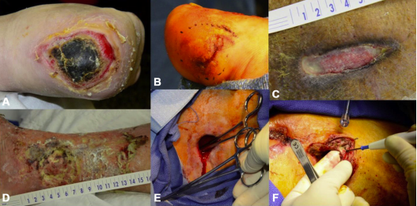
What are the general principles of debridement?
General principles of debridement. Wounds exhibiting features necessitating debridement: A: nonviable/ necrotic tissue; B: callus; C: nonmigratory heaped or rolled skin edges; D: exudate; E: tunneling; F: undermining
Howell RS, et al. Wound care center of excellence: guide to operative technique for chronic wounds. J Am Coll Surg 2018 (226)2: e7-e17.
Howell RS, Brem H. Wound care center of excellence: guide to operative technique for chronic wounds. J Am Coll Surg 2018 (226)2: e7-e17.

Slide 33
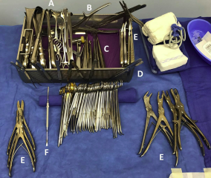
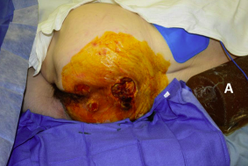
What are the general principles of debridement?
Patient positioning. The patient is in a right lateral decubitus position with a pillow between the lower extremities for cushioning and a safety belt (not seen). A flat-bottom gel roll (A) is placed behind patient’s back for added support.
Instrument tray. The wound tray that we have developed includes: (A) retractors, (B) bone cutters, (C) curettes, (D) forceps, (E) rongeurs, and (F) elevators.
Howell RS, Brem H. Wound care center of excellence: guide to operative technique for chronic wounds. J Am Coll Surg 2018 (226)2: e7-e17.

Slide 34
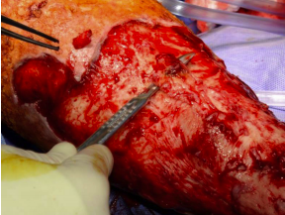
What are the general principles of debridement?
Debridement of venous ulcer. Venous wounds are vigorously scrubbed with a surgical chlorhexidine brush to remove biofilm, coupled with tangential shaving of the ulcer down to a layer of viable-appearing tissue.
Howell RS, Brem H. Wound care center of excellence: guide to operative technique for chronic wounds. J Am Coll Surg 2018 (226)2: e7-e17.

Slide 35
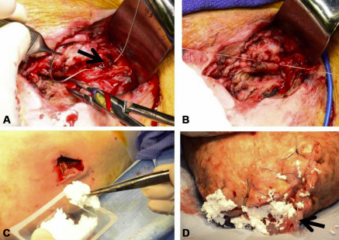
What are the general principles of debridement?
Intraoperative hemostasis. (A, B) an actively bleeding vessel (arrow) is sutured. (C ) fibrillar collagen is applied to a pressure wound. (D) fibrin sealant is applied to a surgical amputation site, followed by fibrillar collagen.
Howell RS, Brem H. Wound care center of excellence: guide to operative technique for chronic wounds. J Am Coll Surg 2018 (226)2: e7-e17.

Slide 36
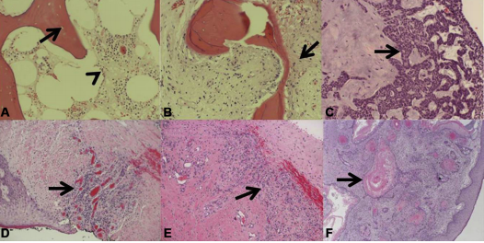
What are the general principles of debridement?
Pathology of deep specimens. (A) acute osteomyelitis with empty lacunae (arrow) and inflammatory cells in the marrow space (arrowhead). (B) chronic osteomyelitis with a mix of viable and nonviable bone, bone remodeling, and fibrosis (arrow). (C ) basal cell carcinoma with characteristic basal clue cells (arrow). (D) venous ulceration with granulation tissue (arrow). (E ) charcot arthopathy with inflamed dense fibrous connective tissue (arrow) and granulation tissue. (F) keratinizing squamous cell carcinoma with characteristic keratin pearls (arrow) in a bleeding exophytic back mass.
Howell RS, Brem H. Wound care center of excellence: guide to operative technique for chronic wounds. J Am Coll Surg 2018 (226)2: e7-e17.

Slide 37
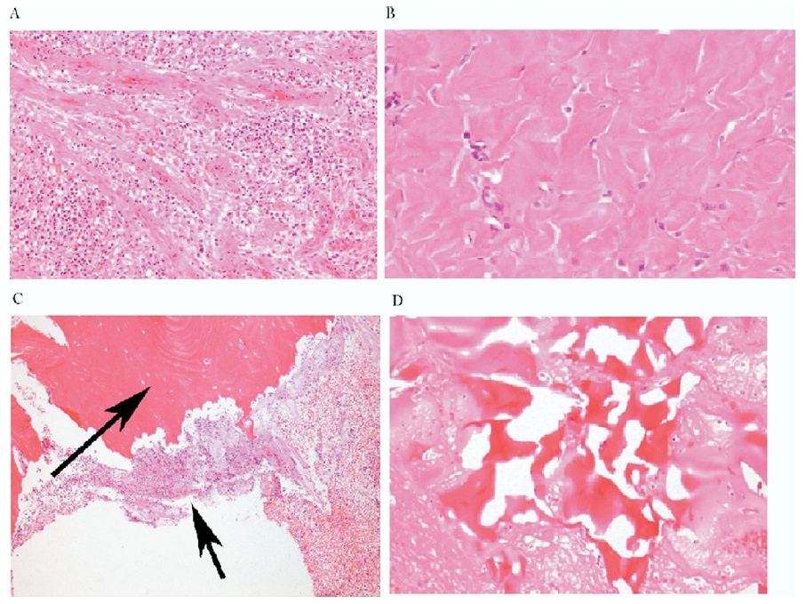
Pathological Importance of the Tissue Left Behind
A
B
Granulation tissue
Fibrosis
Osteomyelitis
Reactive bone
C
D
Golinko M, Brem H, et al. Operative Debridement of Diabetic Foot Ulcers. J Am Coll Surg 2008; 207:e1-e6

Slide 38
What are regenerative medicine options?
Although there are a multitude of therapeutic options available, chronic wound healing has met with modest success in the clinic. The treatment options are even narrower for patients with underlying complications (e.g., advanced age, diabetes, vascular/arterial insufficiency) for whom surgical intervention is less tolerable.
For patients like these, regenerative medicine is a field that holds tremendous promise. Regenerative medicine is the process of creating living, functional tissues to repair or replace tissues damaged due to age, disease, or congenital defects.

Slide 39
What are regenerative medicine options?
Intraoperative regenerative medicine. (A, B) Application of bilayered bioengineered living skin substitute to diabetic foot ulcers and (C) application after meshing to a lower-extremity venous ulcer. (D) Injection of granulocyte-macrophage colony-stimulating factor into a diabetic foot ulcer.
Howell R, Brem H, Wound Care Center of Excellence: Guide to Operative Technique for Chronic Wounds Journal of American College of Surgery. 2018 Feb; 226(2): 7-8.

Slide 40
Porcine Urinary Bladder Matrix= Acell | Lyophilized sheet of intact basement membrane and subadjacent lamina propria of the porcine urinary ECM | Guides wound healing response by providing a complex molecular architecture that aids in biologic tissue repair
GRANULOCYTE-MACROPHAGE COLONY-STIMULATING FACTOR= LEUKINE | Cytokine | Promotes proliferation and differentiation of bone marrow-derived monocyte precursors into macrophages
Cryopreserved placental membrane | Source of MSCa, collagen matrix, growth factors (preserved structural and cellular integrity) | Anti-inflammatory, anti-microbial, angiogenic activities Create a moist environment
APLIGRAF | Type 1 bovine collagen dermal layer fibroblasts with overlying epidermal layer keratinocytes | Produces a great number of cytokines and growth factors that stimulate differentiation and proliferation in the nonhealing wound bed
Acellular matrix scaffold | Porcine small intestine submucosa ECM | Contains collagen, elastin, glycosaminoglycans, proteoglycans, and growth factors. Number cell types attach and migrate into the matrix Reduces level of MMPs
Dehydrated human amnion/chorion membrane allograft | Dehydrated human amnion/chorion membrane allograft | Provides matrix, nonimmunogenic, reduces inflammation/scar tissue/pain, antibacterial, contains GF and cytokines
Bilayered cross-linked type 1 bovine tendon collagen combined with chondroitin-6-sulfate and a semi-permeable silicone membrane | Bilayered cross-linked type 1 bovine tendon collagen combined with chondroitin-6-sulfate and a semi-permeable silicone membrane | Guides growth of the neo-dermis with silicone as a temporary epidermal barrier
Purified type 1 collagen with polyhexamethylenebiguanide | Purified type 1 collagen with polyhexamethylenebiguanide | Selectively binds and condenses bacterial DNA chromosomes

Slide 41
Dressings: An Overview
Type of Dressing | Dressing Name & Company | About this Dressing | Type of Wound Dressing Used For
Self Adherent Absorbent Dressing (Works well as secondary dsg covering wounds with gel) | Alldress (Molnlycke); Island Dressing such as Medipore and Tegaderm (3M) | Provides a moist wound environment Absorbs exudate Primary dressing for clean wounds where a barrier is needed All in one sterile dressings to be used as a primary or secondary dressing A combination of a non-adherent pad covered with a waterproof, transparent backing on a soft cloth conformable cover | Low exudating Pressure ulcer Venous leg ulcer First/second degree burn Donor site Dry Superficial Infected wound

Slide 42
Dressings: An Overview
Type of Dressing | Dressing Name & Company | About this Dressing | Type of Wound Dressing Used For
Foam Dressing | Allevyn (Smith & Nephew), Biatain (Coloplast), Mepilex/Meplix Border (Molnlycke), Tegaderm foam, | Cost effective (Can be left in place for up to 7 days) Promotes a moist wound environment Highly absorbent Can be used with topical agents Domes in a variety of shapes and sizes Does NOT provide ‘padding’ for skin Mepilex/Mepilex border – Silicone layer keeps exudate off the wound and periwound, skin surface reducing maceration | Heavily exudating Pressure Ulcer Surgical Venous leg ulcer Neuropathic/Diabetic ulcer Burn Donor site Fungating/Malignant
Calcium Alginate and Hydrofiber | Aquacel/Ribbon, Kaltostat (ConvaTec); Tegaderm Alginate, Versiva XC (SM); Aquacel Ag Surgical-Hydrocolloid with Hydrofiber | Can be left on until saturated, which depends on wound drainage Promotes a moist wound environment Interacts with exudate to form a gel Useful for packing wounds Always requires a secondary dressing Contours with wound | Moderate/Heavy Exudating Wound Pressure Ulcer Surgical

Slide 43
Dressings: An Overview
Type of Dressing | Dressing Name & Company | About this Dressing | Type of Wound Dressing Used For
Hydrocolloid | Tegasorb, Tegaderm Hydrocolloid (3M), Duoderm (Convatec) | Cost effective—can be worn up to 7 days (Duoderm, 3-5) Promotes a moist wound environment Promotes autolytic debridement Protects from friction and shear Waterproof and occlusive, which prevents bacterial contamination | Low exudating Pressure ulcer Venous leg ulcer First/Second degree burn Donor site Dry Superficial
Hydrogel (Secondary dressing is required) | DuoDerm Gel; Intrasite Gel (Smith & Nephew); Tegaderm hydrogel wound filler (3M) | Easily removed from wound by irrigation with normal saline/sterile water Increases moisture, preventing eschar formation In dry wounds, can be mixed with Iodosorb and Flagyl Promotes autolytic debridement without damaging fragile granulating tissue | Pressure ulcer Surgical Venous leg ulcer Burn Malignant Dry Partial thickness Laceration Necrotic Can be used with infections
Antimicrobial Dressings/Topical Antimicrobial Preparations | Acticoat, Iodosorb, Flmazine (Smith & Nephew); Tegasorb Silver; Tegaderm Ag Mesh dsg with silver; Alginate Ag Silver (3M); Actisorb Silver (Johnson & Johnson); Mepilex Ag; Mesalt (Molnlycke); Medihoney (Derma Science); Plymem Silver | Acticoat remains effective for up to 3 days; use with sterile water not normal saline; can be remoistened Actisorb Silver contains charcoal which absorbs odor and bacterial toxins Iodosorb’s antimicrobial activity is sustained for 3 days; goes on brown—change when cream colored Medihone Calcium alginate for wet wounds & honeycolloid for dry wounds and debriding; quickly reduces odor and useful in all phases of wound healing Mesalt is impregnated with sodium chloride (hypertonic solution); use on wet wounds only and change q 24 hours Mepilex Border Ag is an antimicrobial all-in-one foam dressing that effectively absorbs and retains exudate and maintains a moist wound environment; change q 7 days. | Moderate/High exudating Pressure ulcer Surgical Venous leg ulcer Diabetic ulcer Burn Infected Sloughy or infected wounds Fungating exogenous tumors (commonly from late stage breast cancer) Cellulitis

Slide 44
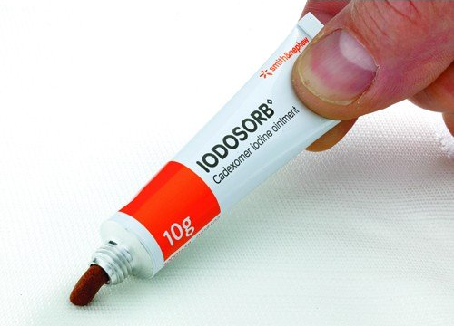
What Is Iodosorb (Cadexomer Iodine)?
Cadexomer iodine is a hydrophilic starch polymer bead, containing 0.9% w/w iodine.
When in contact with wound exudates, it releases free iodine (an antiseptic), which reduces the bacterial count.
It also absorbs fluid, removes pus and debris, and facilitates desloughing.
In addition, cadexomer iodine maintains a moist environment to promote the healing of chronic skin ulcers.
Ormiston MC, et al. Controlled trial of Iodosorb in chronic venous ulcers. Br Med J 1985 (291)6491: 308-310.

Slide 45
How Does Iodosorb Work?
Cadexomer iodine consists of spherical microbeads with a three-dimensional network of modified starch. The microbeads contain iodine within its matrix. When applied to the wound, the highly hydrophilic microbeads absorb exudate from the wound surface, swelling to form a gel, and progressively release iodine at the wound surface.
One gram of powder can absorb as much as 7 mL of fluid. Cadexomer iodine promotes an acid pH that favors the antimicrobial activity of the iodine.

Slide 46
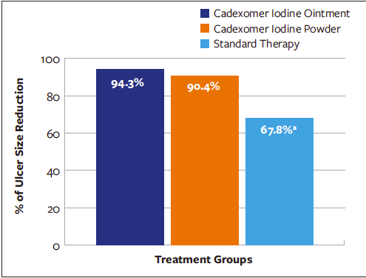
How Does Iodosorb Work?
Percentage of reduction in ulcer size from baseline to 12 weeks
Cadexomer iodine (both ointment and powder), in comparison with standard care alone, increases the percentage of reduction in ulcer size and promotes complete wound healing in chronic ulcers.
Raju R, et al. Efficacy of cadexomer iodine in the treatment of chronic ulcers: a randomized, multicenter, controlled trial. Wounds 2019 (31)3: 85-90.

Slide 47
What Is Collagenase?
Collagenase Santyl is a sterile enzymatic debriding ointment It possesses the unique ability to digest collagen in necrotic tissue. It is an adjunct to surgery.
Never use it with an eschar or prior to debridement. Nor if their is an elevated WBC that could be coming from the wound or if patient has a left shift (high neutrophils).
Collagenase is a healing agent that degrades basement membrane and facilitates new blood vessel growth (angiogenesis), and new skin (epithelialization).

Slide 48
What Are Pros/Cons of Collagenase?
There is a lack of RCTs with adequate methodological quality.
Collagenase appears beneficial for wound healing and for its ability to remove necrotic or devitalized tissues in pressure ulcers, diabetic foot ulcers, and in burns with topical antibiotics.
Patients treated with collagenase may have an increased risk of adverse events (e.g., cellulitis) compared to alternative treatments.
Patry J, et al. Enzymatic debridement with collagenase in wounds and ulcers: a systematic review and meta-analysis. International Wound Journal 2017 (14)6: 1055-1065.

Slide 49
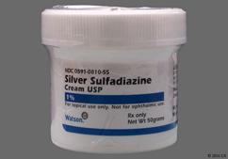
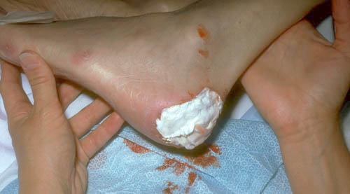
What Is Silvadene (Silver sulfadiazine [SSD])?
Silver sulfadiazine (SSD) is one of the best topical antibacterial agents to control wound infection. SSD possesses a broad spectrum of activity against gram-positive and gram-negative bacteria as well as fungi.
The ability of SSD to reduce early invasive wound sepsis at low concentration has made it a drug of choice for chronic wounds and burns injuries.
However, usage of silver based creams in large wounds results in toxicity due to systemic absorption of silver ions and currently available formulations lack the ability to control the release of SSD to prevent serum silver concentration to reach toxic levels.
Banerjee J, Seetharaman S, Wrice NL, Christy RJ, Natesan S. Delivery of silver sulfadiazine and adipose derived stem cells using fibrin hydrogel improves infected burn wound regeneration. PLoS One. 2019;14(6):e0217965. Published 2019 Jun 13. doi:10.1371/journal.pone.0217965

Slide 50
What Are Pros/Cons of Silvadene?
Due to its strong antimicrobial activity, silver is commonly used as an adjunct in wound care.
Silver is beneficial for the first few days/weeks, after which nonsilver dressings should be used.
Silver-containing dressings, especially nanocrystalline silver, are most useful in infected wounds.
Khansa I, et al. Silver in wound care—friend or foe? Plast Reconstr Surg Glob Open 2019 (7)8

Slide 51
Silvadene
Eschar formation on left dorsum of left foot after use of silver sulfadiazene and cerium nitrate.
Vitse J. Silver Sulfadiazine and Cerium Nitrate in ischemic skin necrosis of the leg and foot: results of a prospective randomized controlled study. International Journal of Lower Extremity Wounds 2018 (17)3: 151-160.

Slide 52
What are the research possibilities?

Slide 53
Current NIH-funded research:
Developing Strategies for Effective Debridement in Patients for Venous Leg Ulcers National Institute of Arthritis and Musculoskeletal and Skin Diseases (NIAMS) The goal of this project is to use genomic profiling, candidate genes and proteins to develop guided surgical debridement to improve healing in chronic non-healing venous leg ulcers (VLUs) and to test the efficacy of this approach.
Previous NIH-funded research:
Understanding the biology of chronic ulcers: histological and molecular basis of healing (NIAMS), 2007
Clinical research center to decrease limb amputation rate in people with diabetes (NIDDK), 2013
Diabetic foot and pressure ulcer databank, (NLM), 2007
Local angiogenic therapy for diabetic ulcers (NIDDK), 2004

Slide 54
What is needed for informed consent?
The right to make informed decisions regarding care presumes that the patient or the patient’s representative has been provided information about his/her health status, diagnosis, and prognosis. Furthermore, it includes the patient's or the patient’s representative’s participation in the development of his/her plan of care, including providing consent to, or refusal of, medical or surgical interventions, and in planning for care after discharge from the hospital.
The patient or the patient's representative should receive adequate information, provided in a manner that the patient or the patient's representative can understand, to assure that the patient or the patient’s representative can effectively exercise the right to make informed decisions.
It is essential that the MD discuss with the patient the details of of procedures.
https://www.cms.gov/Regulations-and-Guidance/Guidance/Manuals/downloads/som107ap_a_hospitals.pdf

