Slide 1
Diabetes and Limb Salvage Wednesday, October 2, 2024
Notes:
1

Slide 2
Agenda
Diabetes and limb salvage
Diabetic foot ulcer protocol?
What are the key components of the DFU protocol?
What history is taken?
Radiographic testing
What is role of Hemoglobin A1c on healing?
How accurate is ABI in diagnosing PAD?
What is molecular basis of debridement?
When to debride?
What are antibiotic recommendations?
What does Society for Vascular Surgery say?
Hot to treat chronic limb threatening ischemia?
Diagnosis & treatment for lower extremity ulcers
Clinical characteristics of a wound emergency
How to decrease amputations?
Does diabetes and aging result in impaired healing?
From a research perspective, can wounds be standardized?
Should infrapopliteal atherosclerotic disease be vascularized in the elderly?
What is the endpoint of PAD?
How to classify PAD?
Progression of simple DFU to gangrene
Pedal access vascular interventions
Lower extremity vasculature
Anterior tibial artery case
Outcomes: what data is collected?
Hospital cost of non-healing wounds
What is pathological importance of tissue left behind?
Pathology of necrotizing fasciitis
Goals of outcomes-based research for older adults with wounds
WEMR and when to amputate?
Necrosis of leg: venous ulcer vs. pyoderma gangrenosum
What does the underlying tissue look like?
Is it osteomyelitis?
Diagnosis of diabetic peripheral neuropathy in patients with lower extremity wounds
What’s New in the Field of Wound Photography and Quantification

Slide 3
Diabetes and Limb Salvage
29.1 million people or 9.3% of the population have diabetes
Diabetes is the seventh leading cause of death in the United States
US total estimated diabetes costs = $245 Billion
68,000 hospital discharges for non-traumatic lower extremity amputations in patients with diabetes
http://www.cdc.gov/diabetes/statistics/lea/fig7.htm
Notes:
2012-2014: diabetes and limb salvage article; better data; new england journal

Slide 4
Diabetic Foot Ulcer Protocol
Brem H, Sheehan P, Boulton AJ. Protocol for treatment of diabetic foot ulcers. Am J Surg. 2004;187(5A):1S-10S.

Slide 5
What are the key components of the diabetic foot ulcer protocol?
History
Physical Exam
Wagner Classification
Laboratory Tests
Radiographic Testing
Indications for
Hospitalization
Surgical intervention (within 8 hours)
Surgical debridement
Treatment of Associated Comorbidities
Offloading

Slide 6
History
Duration of wound (e.g., time? new?)
Etiology (e.g., trauma, foreign body, spontaneous, recurrent?)
Previous physician/wound center (e.g., contact information and treatment plan?)
Past medical history
Autoimmune disease
Skin ulceration, abscesses
Stroke
Neuropathy
Gastropathy
Pain
Hospitalizations
Past surgical history
Venous disease
Arterial disease
Coronary artery disease
Stents
Myocardial infarction
Diabetes
Retinopathy
Obesity

Slide 7
Radiographic Testing
x-ray (e.g., foot, tibia, fibula).
All patients with diabetes and any patient with a diminished pulse should have bilateral ankle brachial indices.
Unless a pulse is clearly palpable, noninvasive vascular ankle-brachial index testing, and all patients with diabetes over 50 should be screened with an ankle-brachial index, whether or not they have an ulcer.

Slide 8
Whaat is role of Hemoglobin A1c on healing?
A1C levels ≥8% and fasting glucose levels ≥126 mg/dl are associated with increased likelihood of lower extremity amputation in patients with DFUs.
A purposively designed prospective study is needed to better understand the mechanisms underlying the association between hyperglycemia and lower extremity amputation.
Lane KL, et al. Glycemic control and diabetic foot ulcer outcomes: A systematic review and meta-analysis of observational studies [published online ahead of print, 2020 May 22]. J Diabetes Complications. 2020;107638.

Slide 9
How accurate is ABI in diagnosing PAD?
As clinical examination does not reliably exclude peripheral artery disease (PAD) in most persons with diabetes and a foot ulcer, evaluate pedal Doppler arterial waveforms in combination with ankle systolic pressure and systolic ankle brachial index (ABI) or toe systolic pressure and toe brachial index (TBI) measurement.
No single modality has been shown to be optimal and there is no definite threshold value above which PAD can reliably be excluded. However, PAD is a less likely diagnosis in the presence of ABI 0.9-1.3, toe brachial index ≥0.75 and triphasic pedal Doppler waveforms.
Hinchliffe RJ, et al. Guidelines on diagnosis, prognosis and management of peripheral artery disease in patients with foot ulcers and diabetes (IWGDF 2019 update). Diabetes Metab Res Rev. 2020;36(S1):e3276.

Slide 10
What is the molecular basis of debridement?
Top: A typical foot ulcer in a patient with diabetes.
(i) The nonhealing edge (callus) containing cells with molecular markers indicative of healing impairment.
(ii) Phenotypically normal but physiologically impaired cells, which can be stimulated to heal. Despite a wound’s appearance after debridement. It may not be healing and may need to be evaluated for the presence of molecular markers of inhibition and/or hyperkeratotic tissue.
Once a wound is debrided, pathology analyses along with immunohistochemistry determine whether debridement was sufficient. If not (see lower left), cells positive for c-myc (green) and nuclear β-catenin (purple) will be found, indicating presence of ulcerogenic cells and successful debridement.
Brem H, Tomic-Canic M. Cellular and molecular basis of wound healing in diabetes. J Clin Invest. 2007 (117)5: 1219-1222.

Slide 11
When to debride?
Osteomyelitis
Substantial non-viable tissue
Joint involvement
Significant undermining
Infection
Non-healing
Drainage

Slide 12
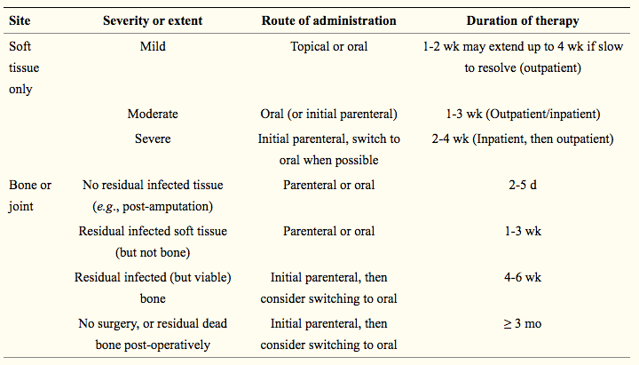
What are antibiotic recommendations based on severity of infection?
Kavitha KV, Tiwari S, Purandare VB, Khedkar S, Bhosale SS, Unnikrishnan AG. Choice of wound care in diabetic foot ulcer: A practical approach. World J Diabetes. 2014;5(4):546-556. doi:10.4239/wjd.v5.i4.546

Slide 13
Probability of healing a diabetic foot ulcer: Society for Vascular Surgery
Mills JL Sr, Conte MS, Armstrong DG, et al. The Society for Vascular Surgery Lower Extremity Threatened Limb Classification System: risk stratification based on wound, ischemia, and foot infection (WIfI). J Vasc Surg. 2014;59(1):220-34.e342. doi:10.1016/j.jvs.2013.08.003

Slide 14
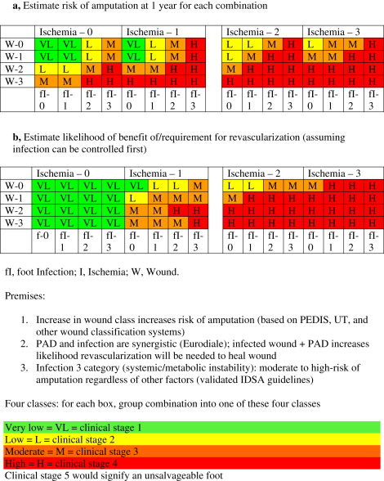
Risk/benefit: Clinical stages by expert consensus: Society for Vascular Surgery
Mills JL Sr, Conte MS, Armstrong DG, et al. The Society for Vascular Surgery Lower Extremity Threatened Limb Classification System: risk stratification based on wound, ischemia, and foot infection (WIfI). J Vasc Surg. 2014;59(1):220-34.e342. doi:10.1016/j.jvs.2013.08.003

Slide 15
Patients with arterial wounds: Society for Vascular Surgery
Vascular physical exam
palpable pedal pulses?
If present
objectify exam with non-invasive vascular study (pvr/segmentals (waveforms to the metatarsals and digits) plus TBI. If normal, usually no need for revascularization.
If absent :
• PVR/segmentals (waveforms to the metatarsals and digits) plus TBI.
• Classify patient within WiFi score.
• Assess patient for revascularization candidate based on WiFi score, ambulatory status, co-morbidities.
a. If revascularization candidate à need further imaging of anatomy (arterial duplex, CTA, MRA, vein mapping angiogram) based on: (often physician preference)
i. proximal pulse exam (fem/pop pulses)
ii. presence of ckd – difficult to get CTA/MRA (contrast induced nephropathy)
iii. pace makers, defibrillators, presence of iliac stents – excludes MRA
b. Revascularization options:
i. Endovascular revascularization
ii. Hybrid revascularization
iii. Open revascularization
Hingorani A, LaMuraglia GM, Henke P, et al. The management of diabetic foot: A clinical practice guideline by the Society for Vascular Surgery in collaboration with the American Podiatric Medical Association and the Society for Vascular Medicine. J Vasc Surg. 2016;63(2 Suppl):3S-21S. doi:10.1016/j.jvs.2015.10.003

Slide 16
Patients with arterial wounds: Society for Vascular Surgery
General concepts:
ABI in isolation, especially in patients with dm and ckd is not accurate. ABI is a good test to rule in PAD if abnormal but not necessarily to rule out PAD.
Should not revascularize patients if wound is so extensive that foot is not salvageable (unless revascularization is necessary to heal proximal amputation).
Should not deem patient not a revascularization candidate without complete angiogram including images of the foot.
Patients all need medical therapy – antiplatelet therapy, statins, smoking cessation, optimization of co-morbities.
Hingorani A, LaMuraglia GM, Henke P, et al. The management of diabetic foot: A clinical practice guideline by the Society for Vascular Surgery in collaboration with the American Podiatric Medical Association and the Society for Vascular Medicine. J Vasc Surg. 2016;63(2 Suppl):3S-21S. doi:10.1016/j.jvs.2015.10.003

Slide 17
Society for Vascular Surgery Lower Extremity Guidelines: WIfI Classification System
An improved understanding of the underlying disease and advances in therapy, particularly endovascular procedures, has rendered existing classification schemes obsolete while simultaneously highlighting the need for a more comprehensive system. The concept of a single dichotomous hemodynamic cutoff point for CLI no longer applies to the majority of patients encountered in current clinical practice; various degrees of ischemia may prove “critical” depending on the overall status of the limb.
Ischemia, while of fundamental importance, is but one component among a triad of major factors that place a limb at risk for amputation.
The proposed SVS Lower Extremity Threatened Limb Classification System is based simply on grading each of the three major factors (Wound, Ischemia, and foot Infection [WIfI]).
This classification system is hereinafter referred to as SVS WIfI. It is based on a scale from 0 to 3, where 0 represents none, 1 mild, 2 moderate, and 3 severe.
This classification represents a synthesis of multiple previously published classification schemes that merges systems focused on diabetic foot ulcers and pure ischemia models.
Mills JL Sr, Conte MS, Armstrong DG, et al. The Society for Vascular Surgery Lower Extremity Threatened Limb Classification System: risk stratification based on wound, ischemia, and foot infection (WIfI). J Vasc Surg. 2014;59(1):220-34.e342. doi:10.1016/j.jvs.2013.08.003

Slide 18
Society for Vascular Surgery Lower Extremity Guidelines: WIFI Classification System
In 2014, The Society for Vascular Surgery Lower Extremity Guidelines Committee published a classification system for threatened lower limbs, categorizing and grading (0–3) the three major risk factors leading to amputation: wound, ischemia and foot infection (WIfI). The WIfI system merges existing classification systems, including the Infectious Diseases Society of America (IDSA) classification for diabetic foot infections, into a single concise system. After grading each category, one can then clinically stage the affected limb to estimate risk of amputation at one year.
Not only does WIfI predict amputation risk, it is the only system that can standardize outcome comparisons for accurate analysis of the increasing number of available therapies. The WIfI classification has the capability to improve guideline-based management of these complex and resource-intensive patients.
The Society for Vascular Surgery WIfI system is intended for any patient with a diabetic foot ulcer, non-healing foot ulcer present for two or more weeks, foot/lower extremity gangrene, or ischemic rest pain. It is not meant for patients with acute ischemia, emboli, trauma, non-atherosclerotic diseases such as vasospastic disorders, or pure venous ulcers.
Mills JL Sr, Conte MS, Armstrong DG, et al. The Society for Vascular Surgery Lower Extremity Threatened Limb Classification System: risk stratification based on wound, ischemia, and foot infection (WIfI). J Vasc Surg. 2014;59(1):220-34.e342. doi:10.1016/j.jvs.2013.08.003

Slide 19
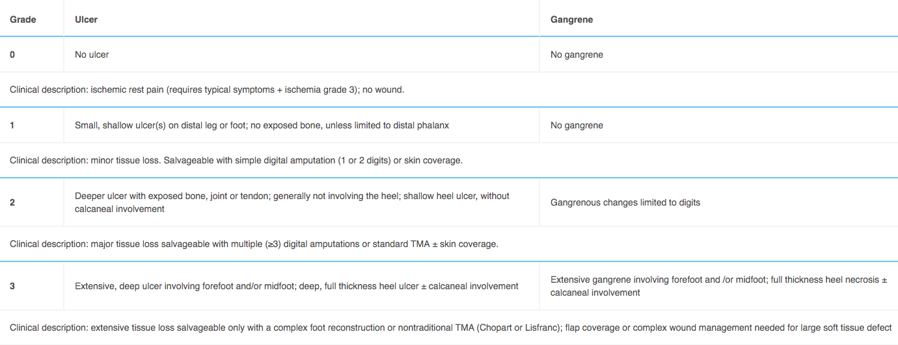
Society for Vascular Surgery Lower Extremity Guidelines: WIFI Classification System
Wound (“W”)
Mills JL Sr, Conte MS, Armstrong DG, et al. The Society for Vascular Surgery Lower Extremity Threatened Limb Classification System: risk stratification based on wound, ischemia, and foot infection (WIfI). J Vasc Surg. 2014;59(1):220-34.e342. doi:10.1016/j.jvs.2013.08.003

Slide 20
Society for Vascular Surgery Lower Extremity Guidelines: WIFI Classification System
Ischemia (“I”)
Mills JL Sr, Conte MS, Armstrong DG, et al. The Society for Vascular Surgery Lower Extremity Threatened Limb Classification System: risk stratification based on wound, ischemia, and foot infection (WIfI). J Vasc Surg. 2014;59(1):220-34.e342. doi:10.1016/j.jvs.2013.08.003

Slide 21
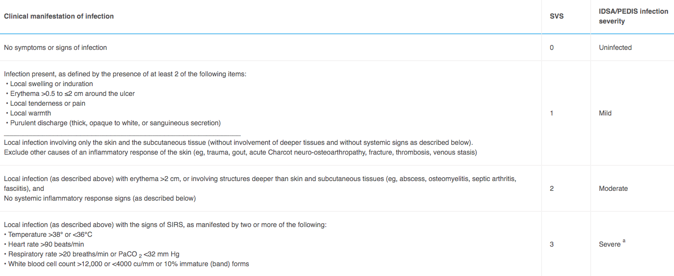
Society for Vascular Surgery Lower Extremity Guidelines: WIFI Classification System
Foot Infection (“FI”)
Mills JL Sr, Conte MS, Armstrong DG, et al. The Society for Vascular Surgery Lower Extremity Threatened Limb Classification System: risk stratification based on wound, ischemia, and foot infection (WIfI). J Vasc Surg. 2014;59(1):220-34.e342. doi:10.1016/j.jvs.2013.08.003

Slide 22
Society for Vascular Surgery Lower Extremity Guidelines: WIFI Classification System
Key summary points for use of Society for Vascular Surgery Lower Extremity Threatened Limb SVS Wifi classification system:
The full WiFI system, is to be used for initial, baseline classification of all patients with ischemic rest pain or wounds within the spectrum of chronic lower limb ischemia when reporting outcomes, regardless of form of therapy. The system is not to be employed for patients with vasospastic and collagen vascular disease, vasculitis, Buerger's disease, acute limb ischemia, or acute trauma (mangled extremity).Patients with and without diabetes mellitus should be differentiated into separate categories for subsequent outcomes analysis.
Presence of neuropathy (+) should be noted when possible in patients with diabetes in long-term studies of wound healing, ulcer recurrence, and amputation, since the presence of neuropathy (loss of protective sensation and motor neuropathic deformity) influences recurrence rate.
In the Wound (W) classification, depth takes priority over size. Although we recommend that a wound, if present, be measured, a shallow, 8-cm ² ulcer with no exposed tendon or bone would be classified as grade 1.
If a study of wound healing vs Wound (W) grade were performed, wounds would be classified by depth, and could also be categorized by size: small (<5 cm ²), medium (5-10 cm ²), and large (>10 cm ²)
TPs are preferred for classification of ischemia (I) in patients with diabetes mellitus, since ABI is often falsely elevated. TcPO ₂, SPP, and flat forefoot PVRs are also acceptable alternatives if TP is unavailable. All reports of outcomes with or without revascularization therapy require measurement and classification of baseline perfusion.
In reporting the outcomes of revascularization procedures, patients should be restaged after control of infection, if present, and/or after any debridement, if performed, prior to revascularization. (see risk/benefit table)
Group a patients: no infection within 30 days, or simple infection controlled with antibiotics alone
Group b patients: had infection that required incision and drainage or debridement/partial amputation to control
Mills JL Sr, Conte MS, Armstrong DG, et al. The Society for Vascular Surgery Lower Extremity Threatened Limb Classification System: risk stratification based on wound, ischemia, and foot infection (WIfI). J Vasc Surg. 2014;59(1):220-34.e342. doi:10.1016/j.jvs.2013.08.003

Slide 23
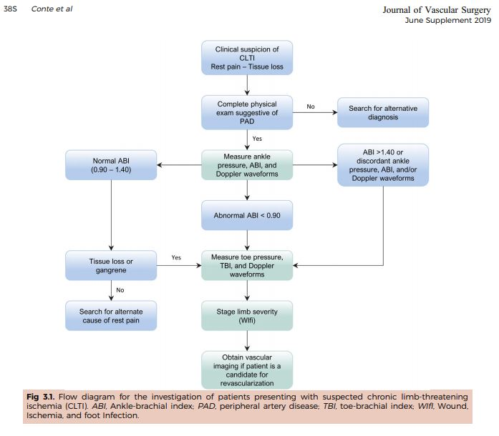
How to treat chronic limb threating ischemia?
Global Vascular Guidelines on Management of Chronic Limb threatening Ischemia. European Journal of Vascular and Endovascular Surgery2019;58(1): S1-S109

Slide 24
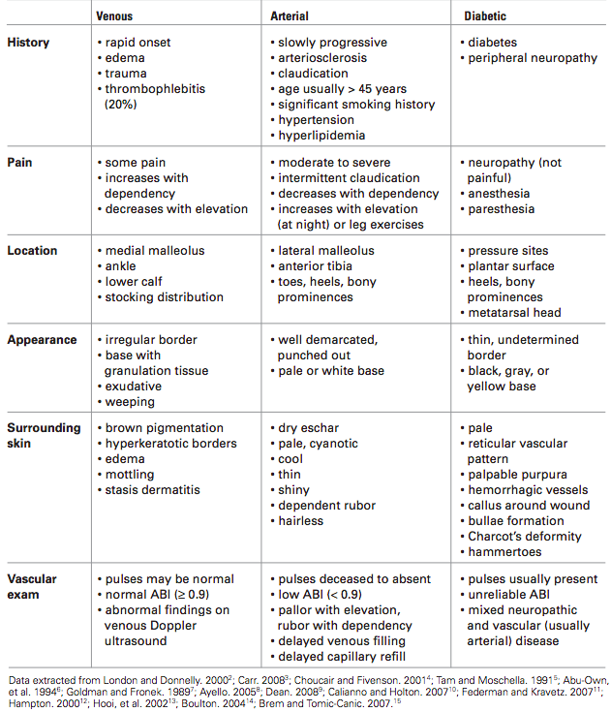
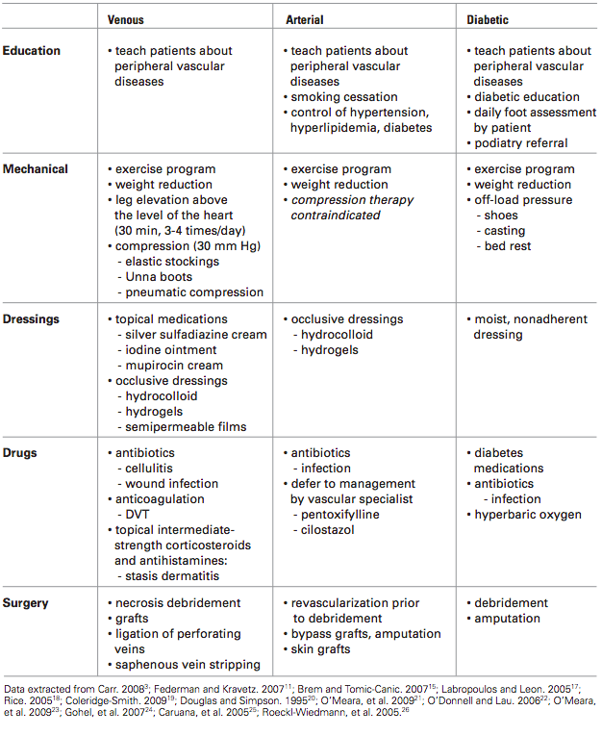
Treatment options for lower extremity ulcers
Differential diagnosis of lower extremity ulcers
Aydin A, Shenbagamurthi S, Brem H. Lower extremity ulcers: venous, arterial, or diabetic? Emergency Medicine. 2009 August;41(8):18-24

Slide 25
Clinical characteristics of a wound emergency
Wound characteristic | Clinical point | Treatment rationale | Treatment point
New or increasing pain | Palpate for tenderness in areas adjacent to the wound | May indicate that the infection has spread beyond visible boundaries of wound | Explore wound and surrounding structures for nonviable and infected tissue Treat with antibiotics tailored to the organisms. Perform sharp debridement
New or increasing cellulitis | Skin may appear taut and shiny as well as warm and erythematous. | May indicate a new soft tissue infection or infection with resistant or multiple pathogens. | Culture the wound bed before starting new antibiotics. Deep culture/pathology of the viable wound base after sharp debridement should guide antibiotic therapy.
New or increasing nonpurulent drainage | Ask patient about frequency of dressing changes and examine dressing for nature of fluid – i.e. discoloration, odor | May indicate a new soft tissue infection or infection with resistant or multiple pathogens | Culture wound fluid before starting new antibiotics Culture/pathology analysis of tissue left behind after sharp debridement should guide therapy
Significant undermining | Use a soft cotton swab to explore wound below the level of skin. Note: skin over undermined areas may appear normal | Indicates compromised subcutaneous tissue usually secondary to deeper infection; removing areas of undermining provides access to entire wound bed for debridement, topical therapy, and dressings | Excise undermined skin in triangular fashion to expose entire wound bed and minimize loss of normal tissue Send a portion of noninfected, viable-appearing tissue at the base of the wound for culture and pathology
Golinko MS, Clark S, Rennert R, Flattau A, Boulton AJ, Brem H. Wound emergencies: the importance of assessment, documentation, and early treatment using a wound electronic medical record. Ostomy Wound Manage. 2009;55(5):54-61.

Slide 26
Decreasing amputations
In a systematic regarding non-traumatic amputations of patients with diabetes mellitus and peripheral vascular disease, the 5-year mortality rate of patients after a below-the-knee amputation was 40 to 82%, and mortality after an above-the-knee amputation was 40 to 90%. Many of these complications are preventable by a thorough annual foot exam and routine foot care.
Endocrinology, diabetology, vascular surgery, podiatry, orthotics, prosthetics, wound care nursing, and educators are crucial to caring for the diabetic foot. Other specialties that may play roles in diabetic foot care depending on medical issues and infection include infectious disease, nephrology, cardiology, dermatology, and others. Goals should be to medically optimize comorbidities, prevent pedal issues, and treat pedal complications.
Song K, Chambers AR. Diabetic Foot Care. [Updated 2020 May 18]. In: StatPearls [Internet]. Treasure Island (FL): StatPearls Publishing; 2020 Jan-. Available from: https://www.ncbi.nlm.nih.gov/books/NBK553110/

Slide 27
Interdisciplinary teams and decreasing amputations
Diabetic foot care requires interprofessional care. The severity of amputation, length of stay, and mortality rates improved in patients receiving care from a team when compared to those who did not.
A systematic review showed that multidisciplinary teams reduced major amputations in 94% of studies. These teams specifically addressed four key tasks: 1) glycemic control; 2) local wound management, including surgical débridement and minor amputation; 3) diagnosis and management of vascular disease, including revascularization; 4) and diagnosis and management of infection
Musuuza J, et al. A systematic review of multidisciplinary teams to reduce major amputations for patients with diabetic foot ulcers. J Vasc Surg. 2020;71(4):1433-1446.e3.

Slide 28
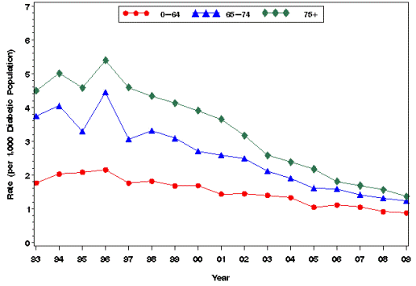
Diabetic Population Below-Knee Amputation Rate by Age
http://www.cdc.gov/diabetes/statistics/lealevel/table9_bknee.htm
Notes:
Hospital Discharge Rates for Non-traumatic Lower Extremity Amputation (LEA) per 1,000 Diabetic Population, Below Knee Amputation by Age, United States, 1993–2009

Slide 29
Does Diabetes and Aging Result in a Synergistic Impairment in Healing?
Breaking Strength (N)
Aged Diabetic
Glucose < 100
Aged Diabetic
Glucose < 400 HgA1C>6.5
Aged
Non diabetic
Young Diabetic
Controls
Brem H et al, The synergism of age and db/db genotype impairs wound healing, Exp. Gerontol. 2007; 42:523-31.

Slide 30
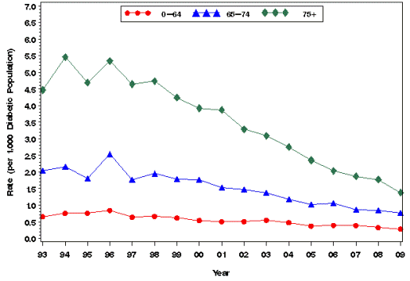
Diabetic Population Above-Knee Amputation Rate by Age
http://www.cdc.gov/diabetes/statistics/lealevel/table9_aknee.htm
Notes:
Hospital Discharge Rates for Nontraumatic Lower Extremity Amputation (LEA) per 1,000 Diabetic Population, Above Knee Amputation by Age, United States, 1993–2009

Slide 31
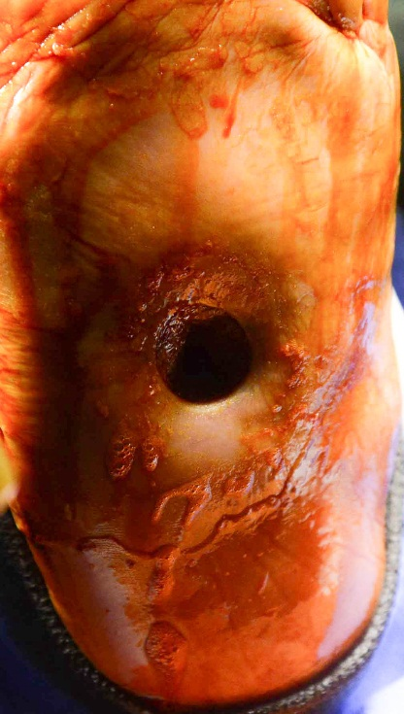
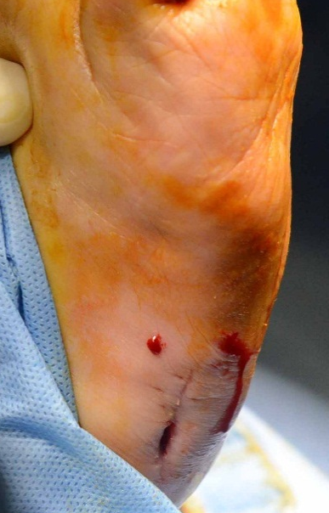
From a research perspective can these wounds be standardized?
A
B
68 yo female with diabetic foot ulcer.
Soft tissue, bone and right lateral surgical wounds all
grew pseudomonas and MRSA.
C
D

Slide 32
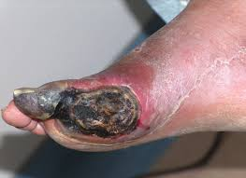
Should Infrapopliteal Atherosclerotic Disease be Vascularized in the Elderly?
Ischemic Ulcers
Secondary to
Peripheral
Arterial
Disease
Notes:
Ischemic Ulcers in Older Patients Require Answers to Multiple Specific Research Questions Including: Is It Necessary to Vascularize Infrapopliteal Atherosclerotic Disease? Use of Stem Cells?

Slide 33
What is the Endpoint of PAD: Pain or Wound Healing?
Decreased Healing

Slide 34
How to Classify PAD
http://www.coronarie.it/_ecoronarie/emf_PeripheralArterialDisease.html

Slide 35
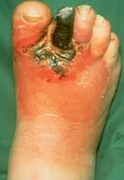
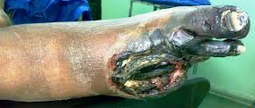
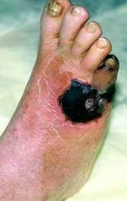
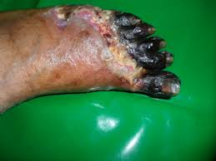
Progression of Simple Diabetic Foot Ulcer to Gangrene
Slide Courtesy of Dr. Toufic Safa, AAA Vascular Care, Medical Director

Slide 36
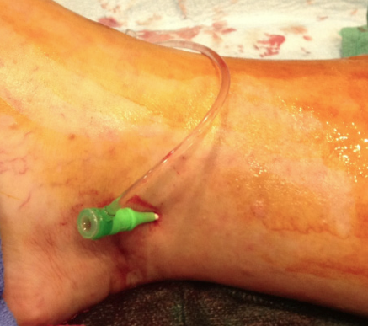
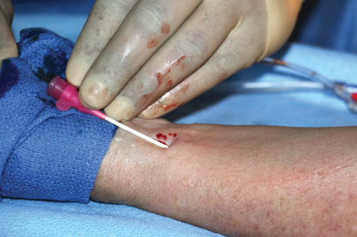
Pedal Access Vascular Interventions
US-guided percutaneous microvascular access
Balloon angioplasty with/without plaque atherectomy
Posterior tibial (PT) artery access
Anterior tibial (AT) artery access
Slide Courtesy of Dr. Toufic Safa, AAA Vascular Care, Medical Director

Slide 37
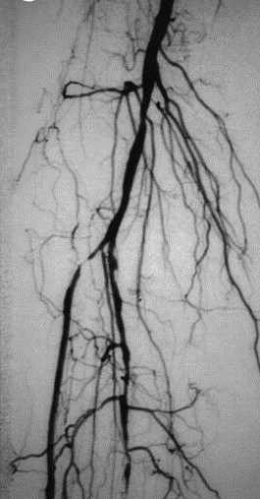
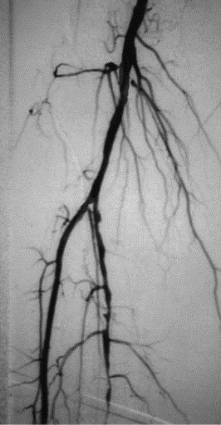
Pedal Access Vascular Interventions
Posterior Tibial
Artery Intervention
Anterior Tibial (AT)
Artery intervention
Popliteal Artery
Popliteal Artery
AT
Tibial-Peroneal Trunk
AT
Peroneal Artery
PT
PT
BEFORE
AFTER
BEFORE
AFTER
Slide Courtesy of Dr. Toufic Safa, AAA Vascular Care, Medical Director

Slide 38
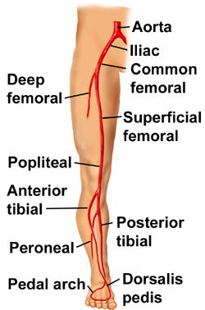
Lower Extremity Vasculature
http://yoursurgery.com/ProcedureDetails.cfm?BR=5&Proc=33 © J. Norah

Slide 39
Anterior Tibial Artery Case
62 yo male, DM, CAD, PAD, renal insufficiency presented s/p L hallux amputation, refusing BKA
Slide Courtesy of Dr. Toufic Safa, AAA Vascular Care, Medical Director

Slide 40
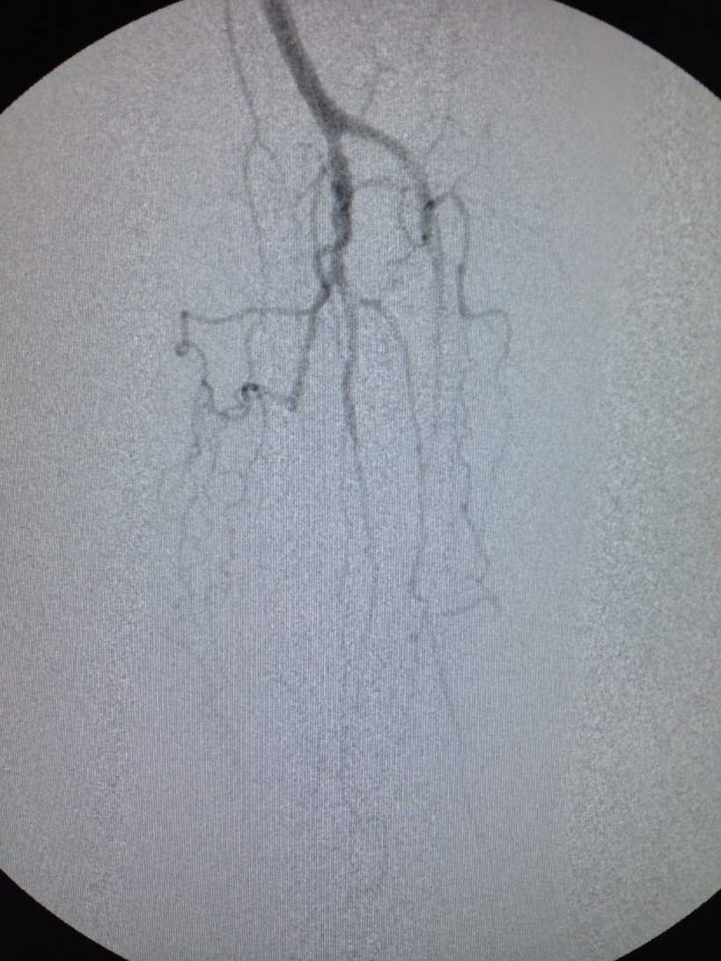
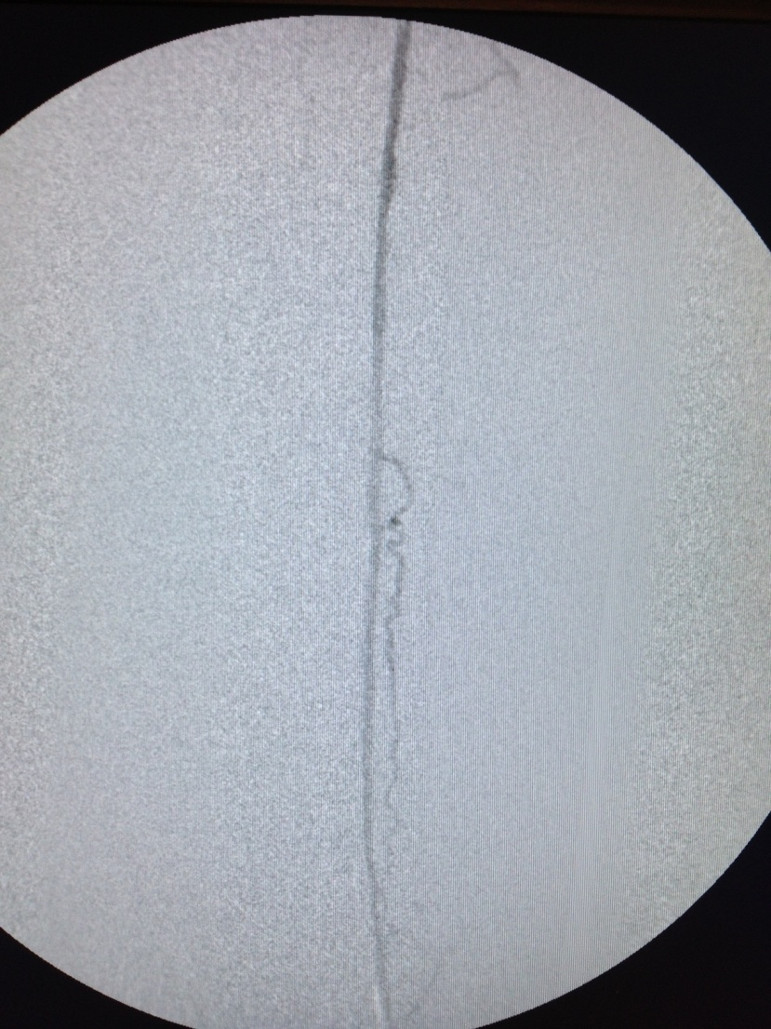
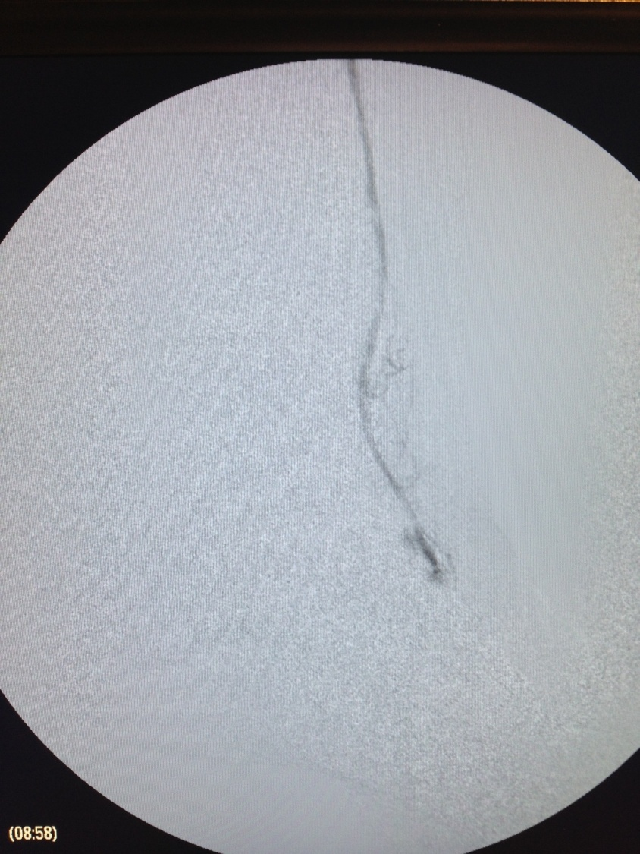
Anterior Tibial Artery Case
Popliteal Artery
AT
AT
DP
Initial angiogram
AT open after angioplasty and atherectomy
DP: Dorsalis pedis artery
accessed for final angiogram
Slide Courtesy of Dr. Toufic Safa, AAA Vascular Care, Medical Director

Slide 41
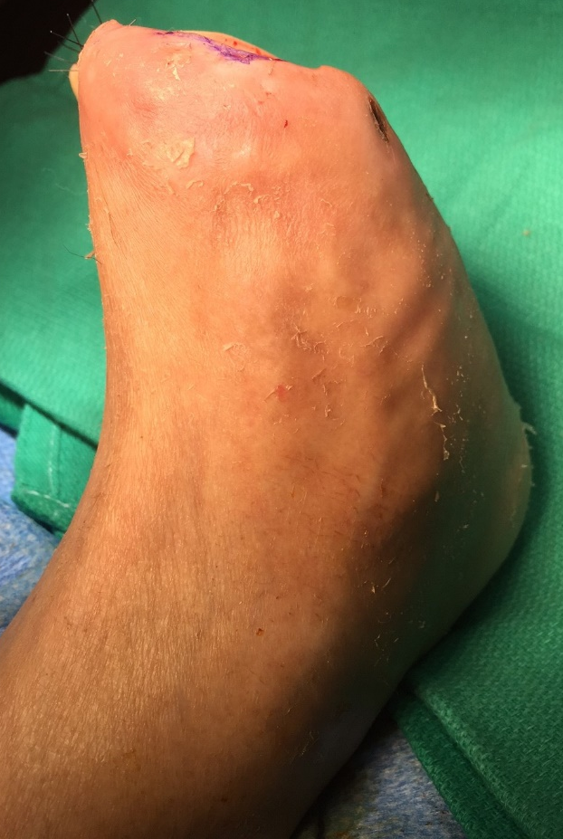
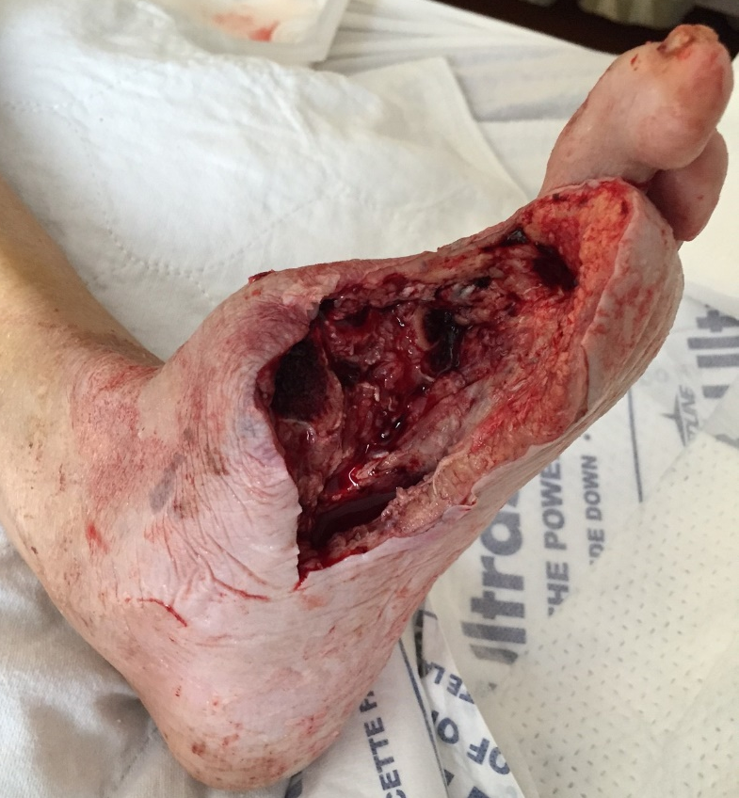
Anterior Tibial Artery Case
3 WEEKS LATER: REST OF TOES REMOVED
GANGRENOUS PORTION WIDELY EXCISED DAY AFTER ANGIOPLASTY
9 WEEKS LATER: STSG TO STUMP
Slide Courtesy of Dr. Toufic Safa, AAA Vascular Care, Medical Director

Slide 42
Outcomes: What Data is Collected?
1) Incidence and healing rate of pressure ulcer (PU)
2) Time to healing
3) Admission and readmission rate
4) Morbidity
5) Unplanned Mortality
6) Unplanned minor & major amputations
Visit Date | Number of Wounds | PU total | PU I | PU II | PU III | PU IV | DF | VSU | Art | Surg | Other | Non-Healing Wound | Percentage of HEALING
July 1 | 155 | 31 | 1 | 10 | 7 | 13 | 21 | 74 | 25 | 2 | 2 | 6 | 96.10%
July 8 | 139 | 24 | 1 | 3 | 1 | 19 | 7 | 83 | 18 | 3 | 4 | 8 | 94.20%
July 15 | 134 | 23 | 1 | 4 | 1 | 17 | 12 | 69 | 16 | 3 | 11 | 10 | 92.50%
July 22 | 128 | 12 | 0 | 1 | 2 | 9 | 5 | 80 | 20 | 4 | 7 | 11 | 91.40%
July 29 | 147 | 28 | 0 | 4 | 3 | 21 | 12 | 76 | 21 | 4 | 6 | 8 | 94.60%
JULY TOTALS | 703 | 118 | 3 | 22 | 14 | 79 | 57 | 382 | 100 | 16 | 30 | 43 | 93.90%

Slide 43
Hospital Cost of Non-Healing Wounds in the Elderly due to Morbidity of Ulcers
Brem et al., High cost of stage IV pressure ulcers. Amer J Surg 2010; 200:476-477.

Slide 44
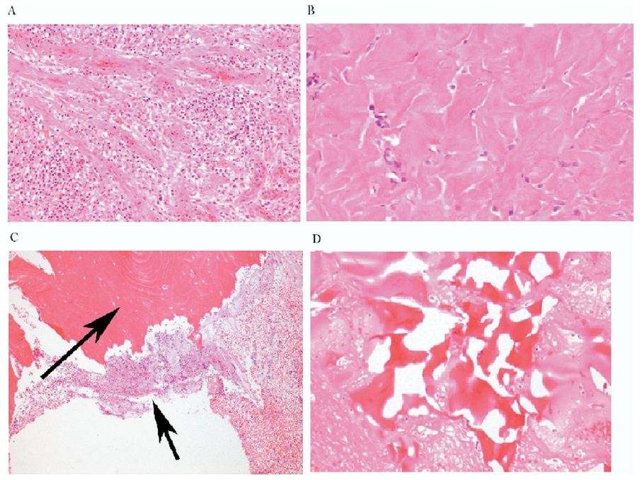
What Is Pathological Importance of the Tissue Left Behind?
A
B
Granulation tissue
Fibrosis
Osteomyelitis
Reactive bone
C
D
Golinko et al. Operative Debridement of Diabetic Foot Ulcers. J Am Coll Surg 2008; 207:e1-e6

Slide 45
Cutaneous Granulomatosis with Polyangiitis – Vasculitis. Perivascular inflammation with plasma cell infiltration. (40x)
Blue arrow: blood vessel
Yellow arrows: plasma cells

Slide 46
Ulcer bed, secondary-type vasculitis involving all small blood vessels (100x)

Slide 47
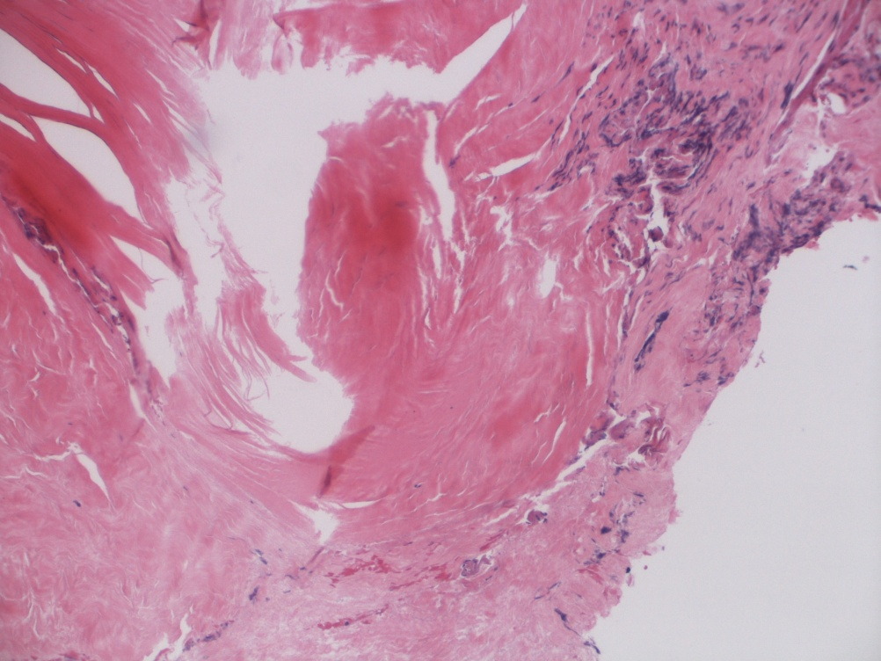
Pathology: Necrotizing Fasciitis
Necrotic fascia
Crushed viable fascia
Necrotic fascia
Notes:
Fascia, left leg, exploration: - Necrotic fibroconnective tissue consistent with fascia.

Slide 48
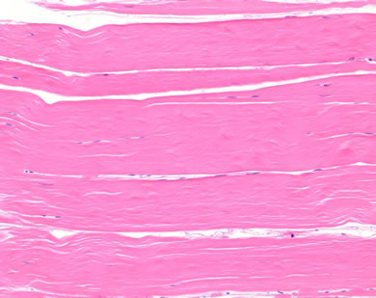
Healthy Fascia
http://www.premierlab.com/slides/he6.htm. Accessed July 2015

Slide 49
Goals of Outcome-Based Research for Older Adults With Wounds
Defining hospital-based wound healing in the elderly:
Pain, quality of life, readmission, mortality, management of co-morbidities
Sepsis treatment
Prevent amputation and mortality
Minimally invasive revascularization
Hospice versus Healing
Treatment of osteomyelitis and ischemia
Use of Clinical Decision Support for patients and clinicians
Regenerative Medicine
Multi-center clinical trials in real time
Brem et. al. 2015. Chronic wound repair and healing in older adults: current status and future research. J Am Geriatr Soc. 63(3): 427-38.
Notes:
49

Slide 50
WEMR and When To Amputate?
If a patient is refractory (no decrease in wound area <2 weeks) to simultaneous treatment (IV antibiotics, deep tissue debridement, offloading and biological therapy), early amputation is indicated
Use of the WEMR resulted in an amputation rate of 13% for persons with diabetic foot ulcers in a tertiary referral practice
Although major amputations are thought to be primarily due to arterial inflow and minor due to bone infection, we observed a similar percentage of osteomyelitis in the wounds that preceded a minor or a major amputation
Patients with fewer visits were more likely to be amputated
Further use of the WEMR may decrease both minor and major amputations
Preliminary Development of a Diabetic Foot Ulcer Database from a Wound Electronic Medical Record: A Tool to Decrease Limb Amputations. Michael S. Golinko, David J. Margolis, Adit Tal, Ole Hoffstad, Andrew J. M. Boulton, Harold Brem. Wound Repair and Regeneration,Sept–Oct 2009.; 17(5): 657-665.

Slide 51
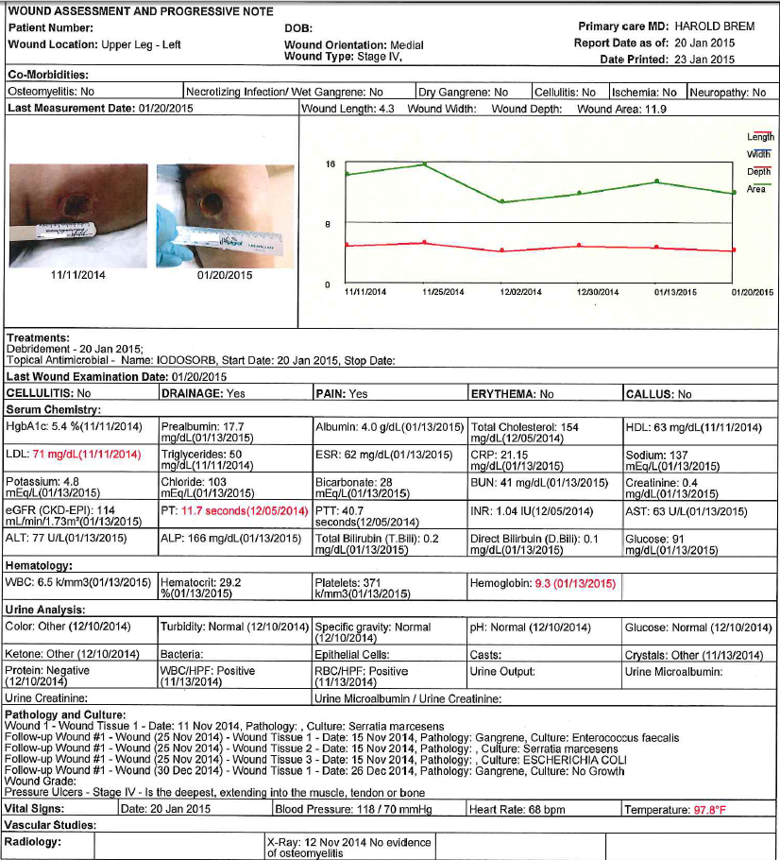
CDS/WEMR
Clinical Decision Support/ Wound Electronic Medical Record.

Slide 52
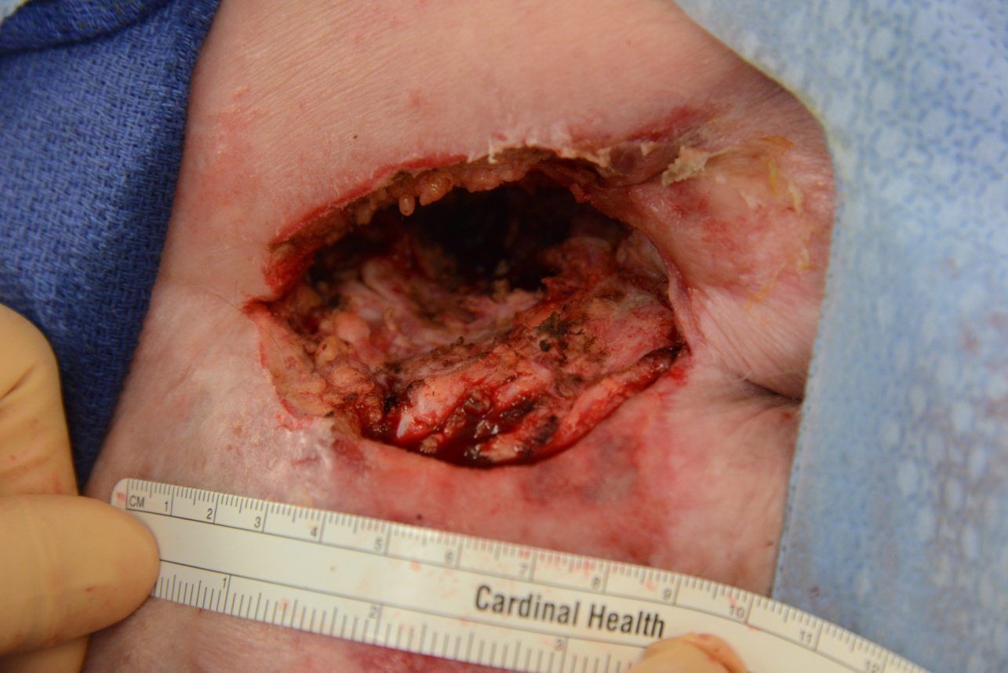
FW – When To Amputate On 90 y/o Male?
Notes:
Frank Winchell 101298831

Slide 53
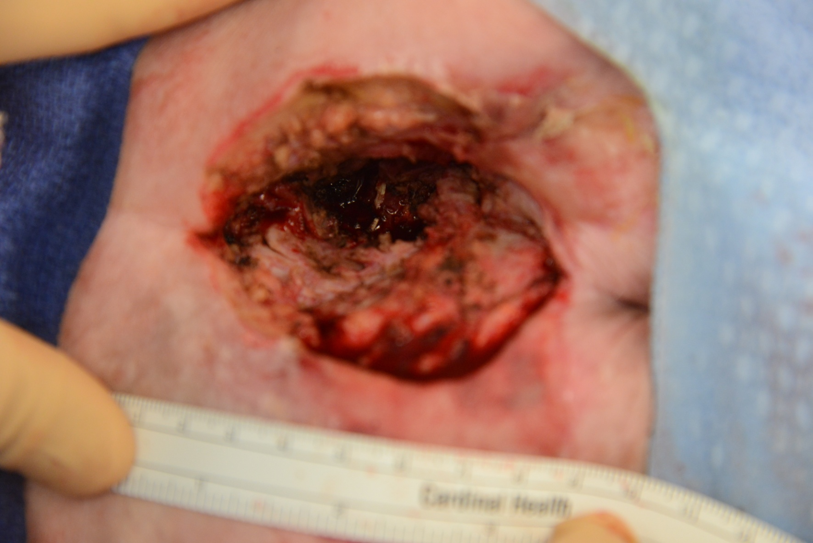
FW

Slide 54
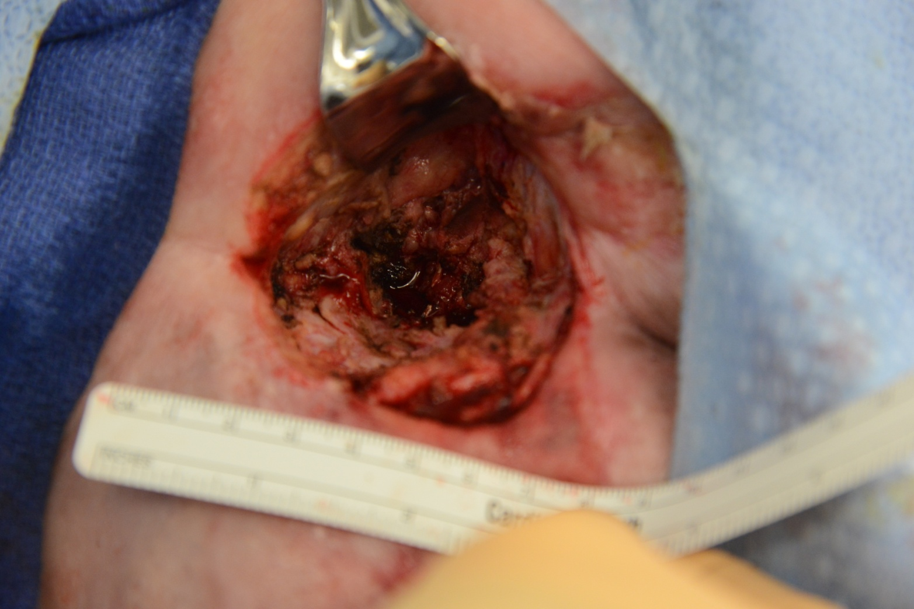
FW

Slide 55
Findings
Gram Stain: E. coli
Pathology:
Superficial: Necrotic skin and subcutaneous tissue with acute inflammation, consistent with gangrene. Necrosis and inflammation extend to the deep margin
Deep: Fibroadipose tissue with fibrosis, mild acute inflammation, and focal ischemic necrosis of adipose tissue

Slide 56
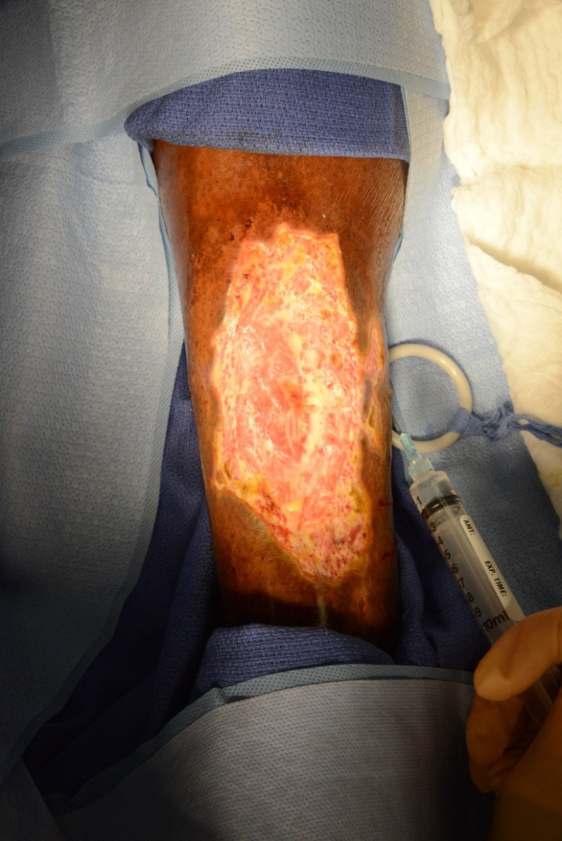
GB – Necrosis of Leg, Venous Ulcer Vs. Pyoderma Gangrenosum
Notes:
George Brown 80095968

Slide 57
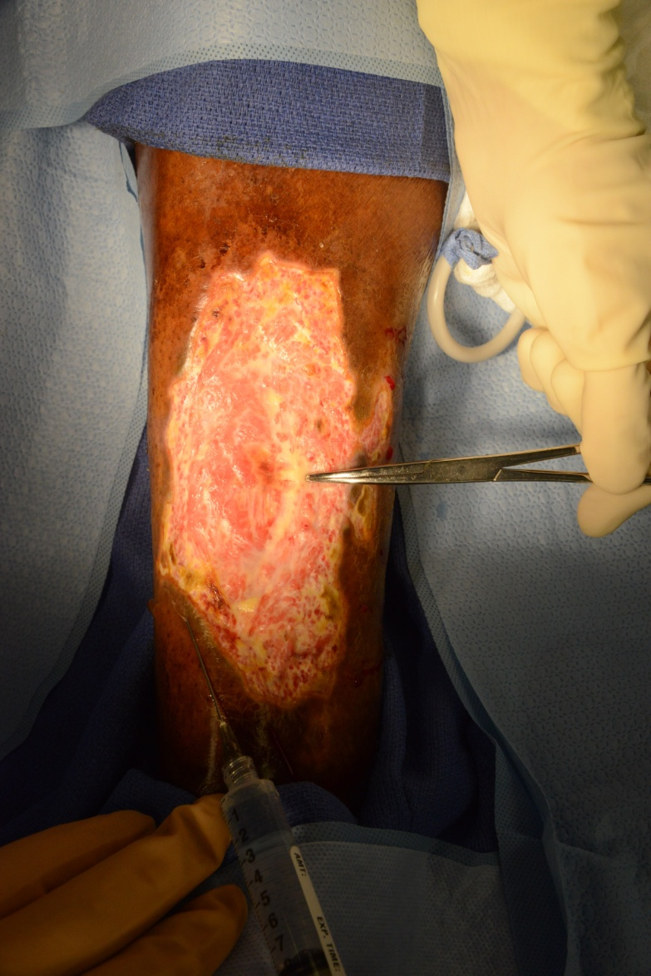
GB

Slide 58
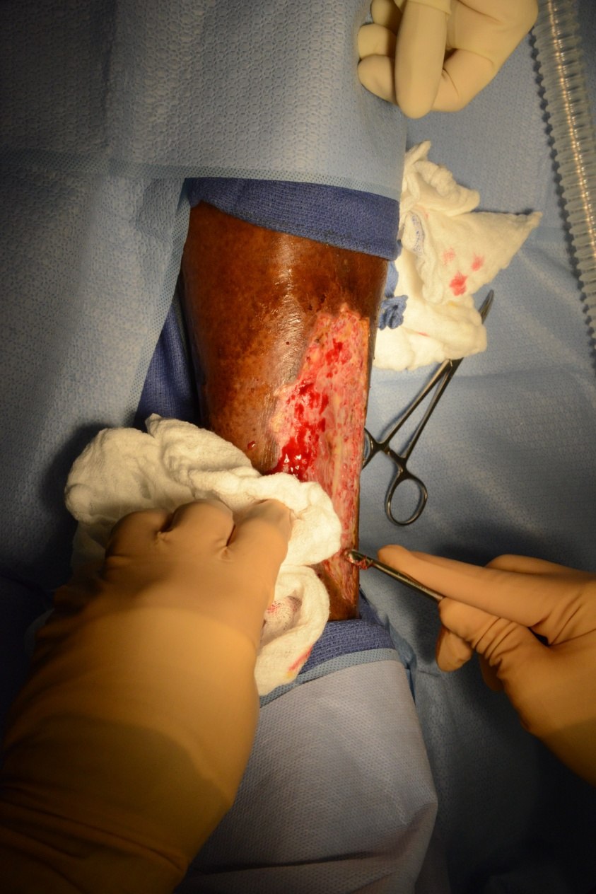
GB

Slide 59
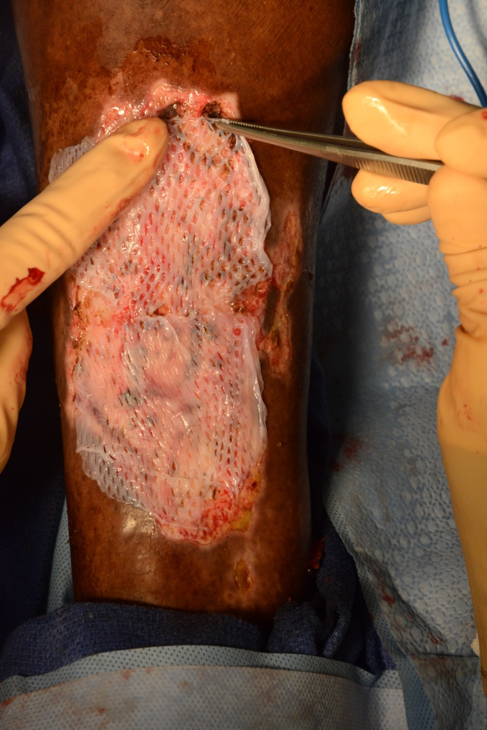
GB

Slide 60
Findings
Gram Stain: WBCs, Gram positive cocci in pairs
Culture: Candida albicans, VRE
Pathology:
Gangrenous skin, dense fibrous connective tissue and adipose tissue with acute necrotizing inflammation, fragments of ulcerated acute and chronically inflamed granulation tissue with fibrinoid necrosis of vascular walls, and focal calcifications
Fungal organisms with morphological features suggestive of Candida sp identified

Slide 61
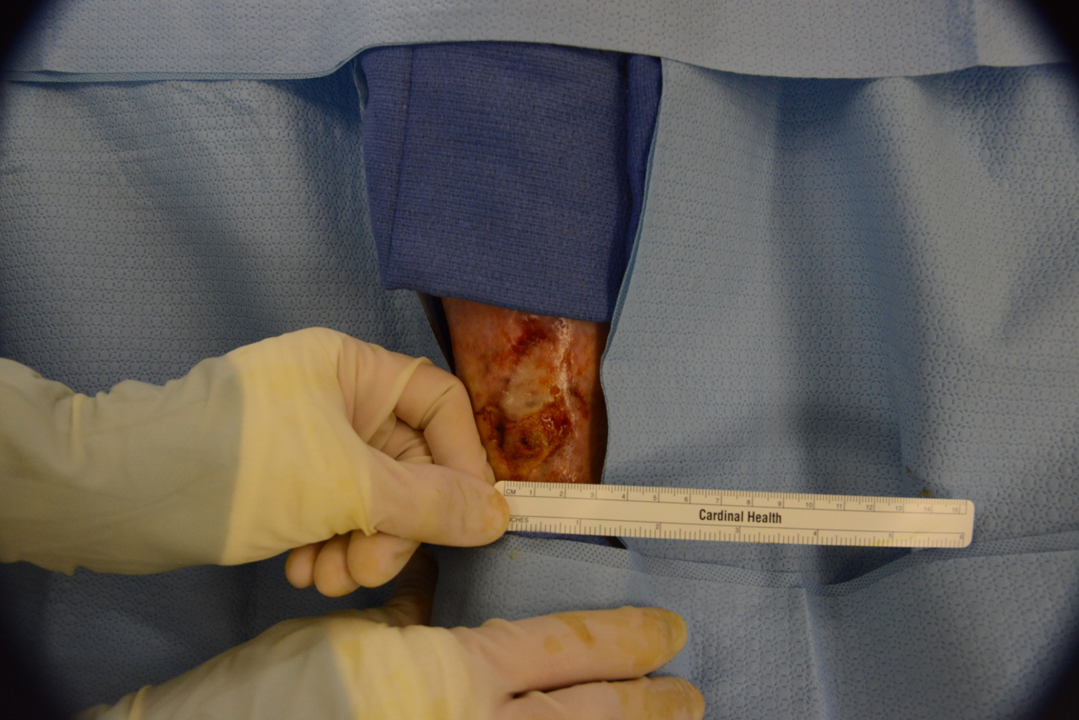
FC – What Does The Underlying Tissue Look Like?
Notes:
Frank Caliendo 80057130

Slide 62
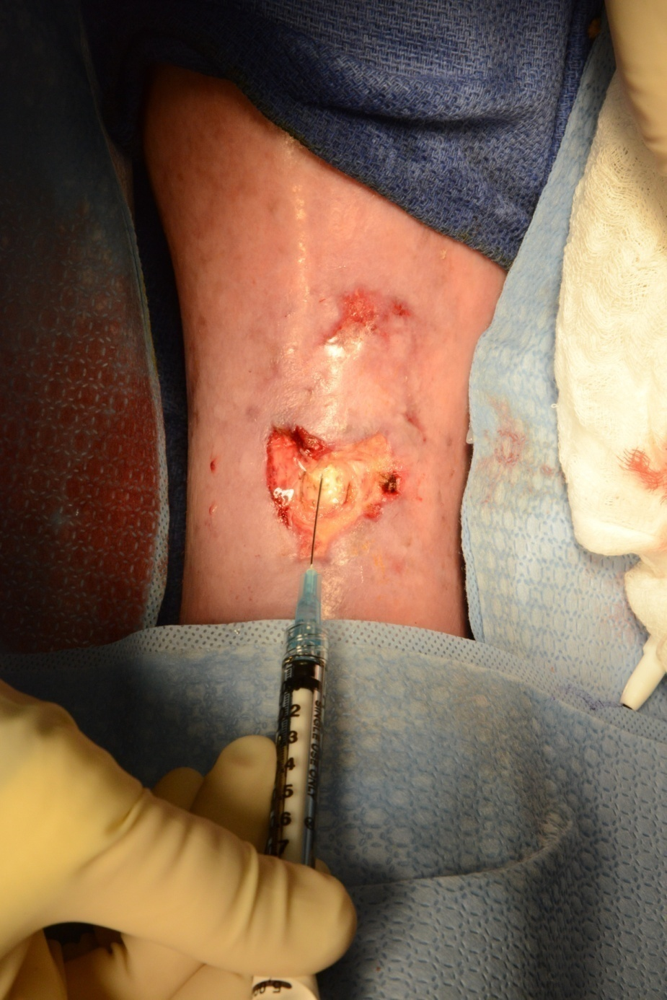
FC

Slide 63
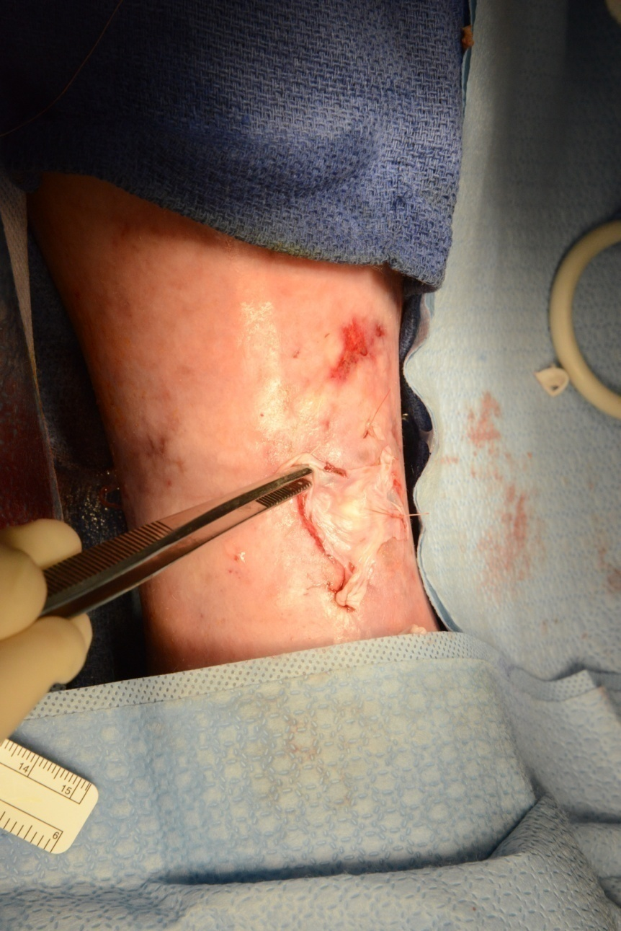
FC

Slide 64
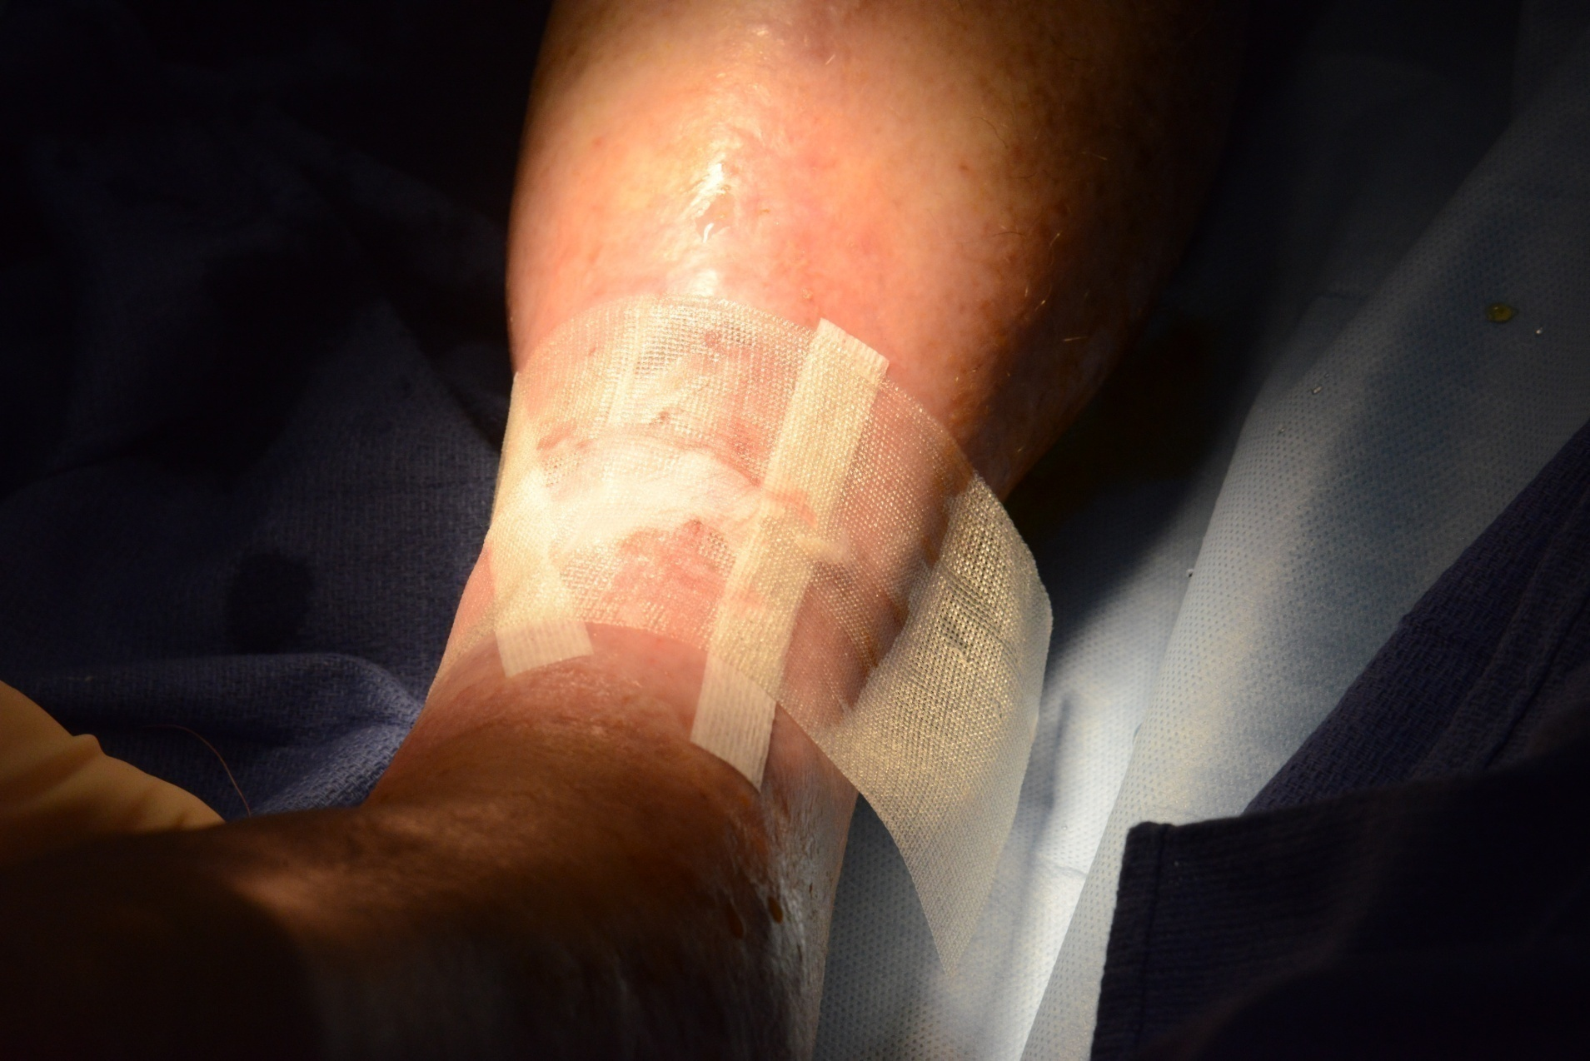
FC

Slide 65
Findings
Gram stain: WBC’s
Culture: negative
Pathology:
Necrotic tendon tissue
Inflammation is not identified

Slide 66
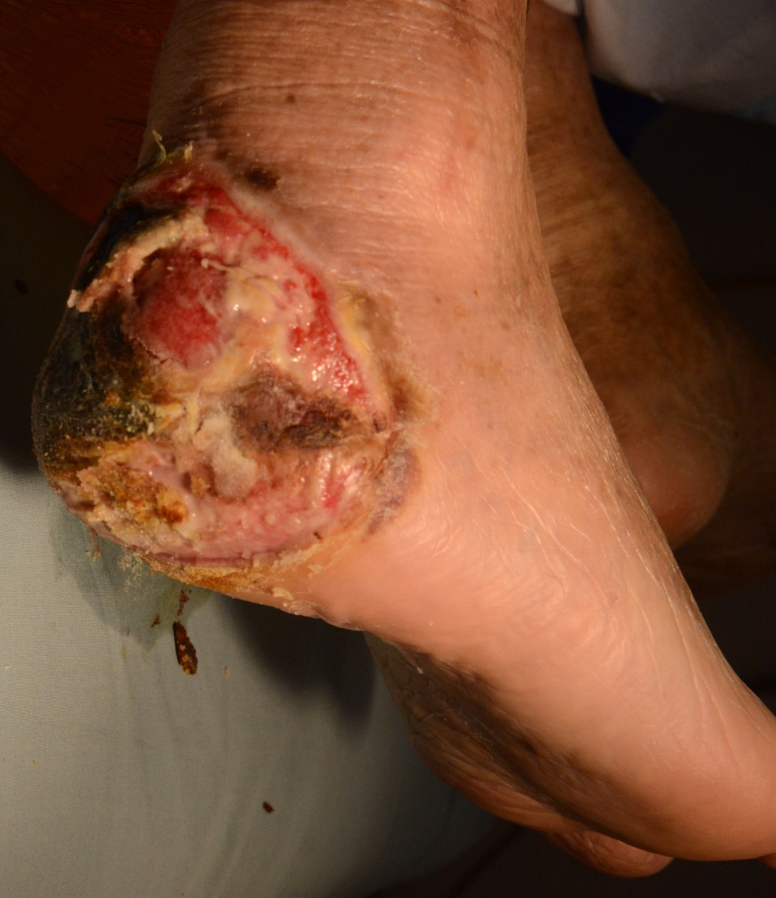
DG – Is This Osteomyelitis?

Slide 67
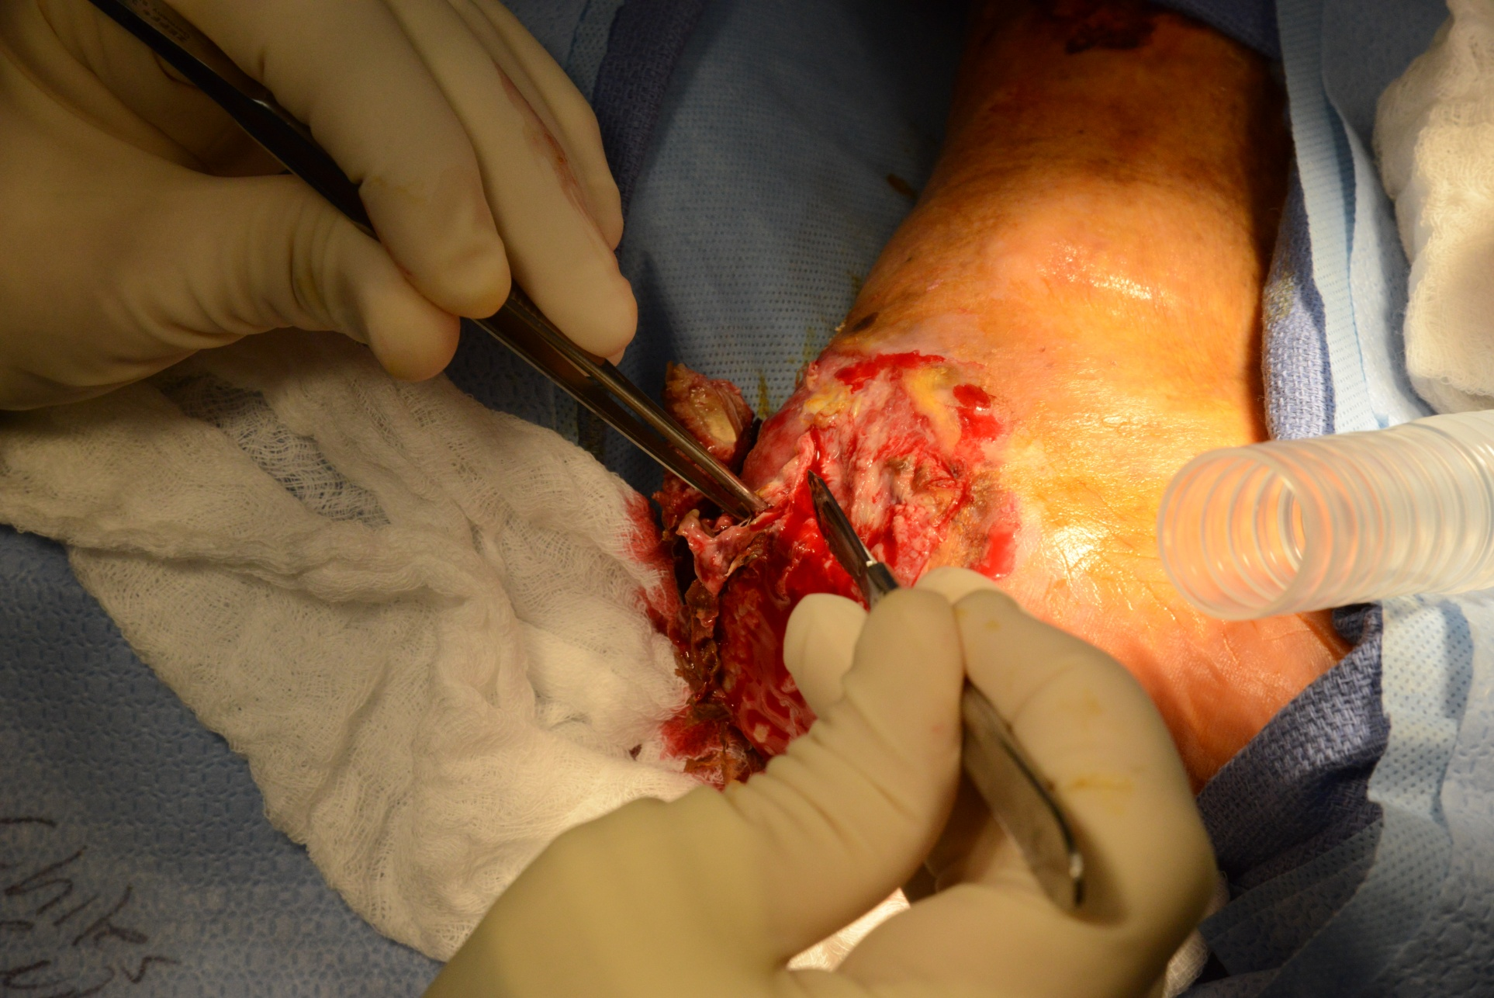
DG

Slide 68
XR Left Leg
Notes:
No gas noted
Pre-op xray with surgical clips. PSH b/l vein stripping.

Slide 69
Diagnosis of diabetic peripheral neuropathy in patients with lower extremity wounds
Retrospective chart review IRB #12452
60 cases diagnosed with diabetic peripheral neuropathy, 7 were found to have varying etiologies contributing to their neuropathy:
Gout (n= 2)
Trauma (n= 2)
Idiopathic (n= 2)
Chronic Inflammatory Demyelinating Polyneuropathy (CIDP) (n= 1)

Slide 70
Pathologic Diagnosis of Chronic Wounds - Pathognomonic Findings in patients with diabetes
Retrospective chart review, IRB #12452
827 patients over 12-month period
Five distinct pathological alterations complicating wound management
Vasculitis secondary to granulomatosis with polyangiitis
Acute osteomyelitis
Chronic osteomyelitis
Pyoderma gangrenosum
Necrotizing fasciitis

Slide 71
Diagnosis and Management of Patients with Necrotizing Fasciitis (NF)
Retrospective observation chart analysis
IRB #12452
Two year review, N= 14 patients with diagnosis of NF
Treatment algorithm
Comprehensive history, physical exam and risk factor assessment
Pathological confirmation
Adjunctive labs (c-reactive protein, total leukocyte count, hemoglobin, serum sodium, serum creatinine, and serum glucose)
Serial debridements
Admission & Resuscitation (IV fluids, antibiotics, IV pressors, HBOT)

Slide 72
What’s New in the Field of Wound Photography and Quantification

Slide 73
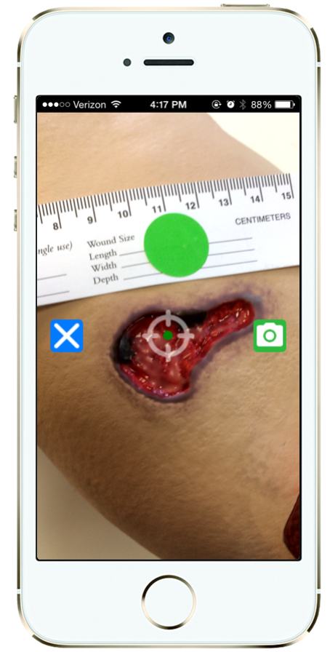
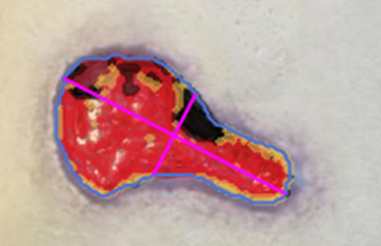
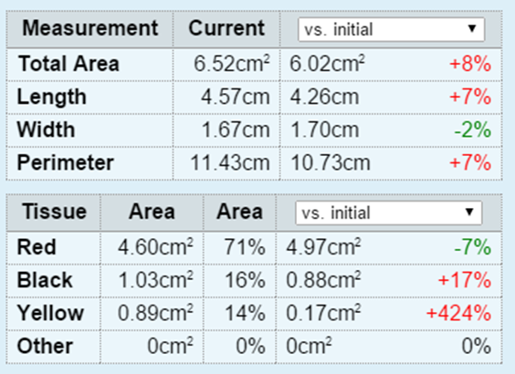
Mobile Wound Analysis
Automatic measurements using start-of-the art machine learning

Slide 74
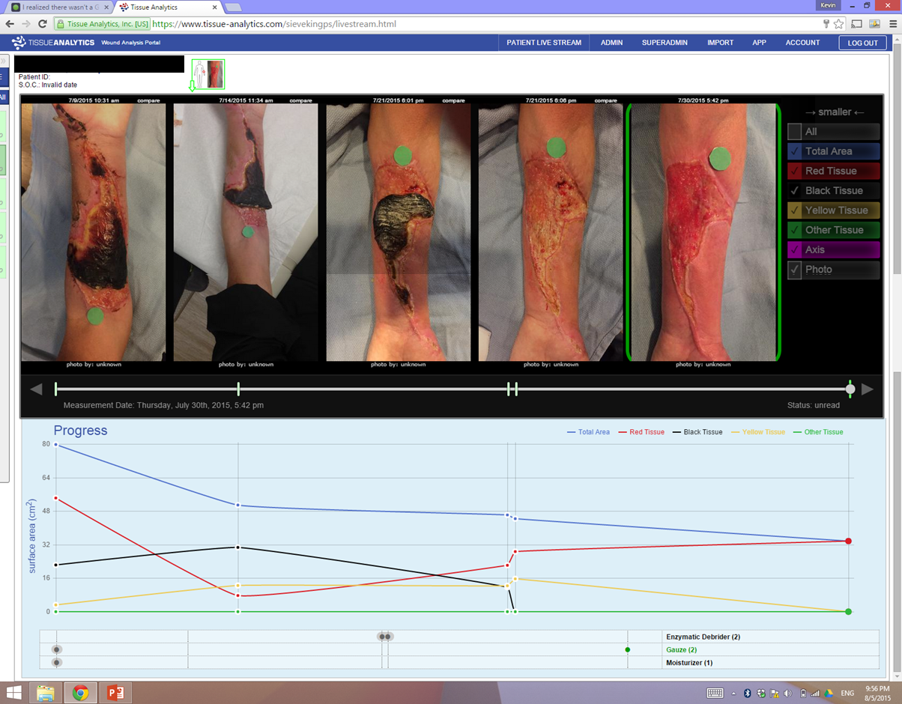
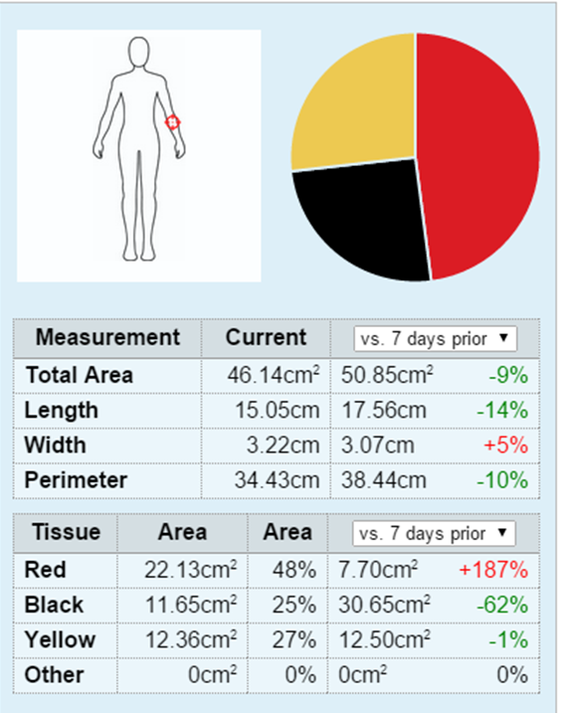
Web Portal for Wound Tracking
Chart of healing progress

Slide 75
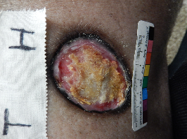
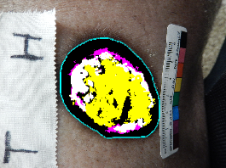
Wound Analysis
LEGEND
Granulation
Slough
Hyperpigmentation
Epithelium
Fascia/Scar
Necrosis
Hyperpigmentation
36%
Other
Type | Area (cm²) | Percentage
Granulation | 0 | 0
Slough | 2.28 | 42.07%
Hyperpigmentation | 2.05 | 37.82%
Epithelium | 0.54 | 9.96%
Fascia/Scar | 0.79 | 14.39%
Necrosis | 0 | 0
Other | 0 | 0
Total | 5.42 | 100%

Slide 76
Complete Wound Documentation
60 seconds to log in, take photograph, and complete documentation

