Slide 1
Dermatologic Wound Emergencies Wednesday, October 2, 2024
Notes:
1

Slide 2
Agenda
What are leading sking conditions that bring patients to ED?
What is new in laceration management?
How to manage lacerations?
What new materials are available to close lacerations?
How should the wound be anesthetized?
What types of dressings should be applied?
How to treat dental emergencies?
How to manage autonomic dysreflexia?
What is treatment for autonomic dysreflexia with neurologic complications?
What is acute compartment syndrome (ACS)?
How to treat acute ACS?
How to manage Steven Johnson syndrome?
How to prevent pressure injuries in the ED?
What are effects of antibiotics on culture yield of bone biopsy?
What is effect of withholding antibiotics prior to bone biopsy in patients with suspected osteomyelitis?
What is surgical treatment for diabetic forefoot osteomyelitis?
How to treat septic arthritis?
How to treat Fournier’s Gangrene with septic shock?
How to prevent peritoneal dialysis infections?
How to diagnose Pyoderma Gangrenosum versus chronic venous ulceration?
How can negative pressure wound therapy help in early-stage management of complex wounds?
What is the difference between negative pressure wound therapy with instillation and reticulated open cell foam dressing?
How to use negative pressure therapy?
Are antibiotic-impregnated calcium sulfate beads effective in accelerating healing?
What are the operative techniques for chronic wounds?
What are typical numbers for wound service?
What is basic framework for treating wounds?

Slide 3
What Are Leading Skin Conditions that Bring Patients to ED?
Percentage of each diagnostic category among patients seen in the emergency department (ED) for skin conditions. Among patients with skin infections, the fraction of those diagnosed as having cellulitis is in red.
Baibergenova A, et al. Skin Conditions That Bring Patients to Emergency Departments
JAMA Dermatology 2011 (147)1:118-120.

Slide 4
What Is New in Laceration Management?
Since the turn of the 21st century, the major advances that have improved outcomes are in the following areas:
Anesthetics
Closure methods
Dressings

Slide 5
How to Manage Lacerations
Although many aspects of laceration management are unchanged in recent decades, newer advances—such as anesthetics, closure methods, dressings, and follow-up care—have shown incremental improvement.
Antibiotics should be reserved for high-risk wounds, such as those with comorbidities, gross contamination, involvement of deeper structures, stellate wounds, and selected bite wounds.
Topical anesthetics have a role in select populations; the overwhelming majority of adult patients are able to tolerate infiltrated lidocaine. However, because of the time frame required to achieve surgical anesthesia, topical agents are not well-suited for routine ED use.
Rapid closure methods coupled with newer anesthetic recommendations are supplanting traditional sutures.
Maintaining a moist wound environment with occlusive dressings is more important than previously thought.
Most topical wound agents are of limited benefit.
Mankowitz, SL. “Laceration Management.” Journal of Emergency Medicine 2019 53(3):205-212.

Slide 6
What New Materials Are Available to Close Lacerations?
Closure using relatively painless methods, such as the HAT or skin adhesive are suitable for patients with fear of needls. When sutures are required, absorbable sutures can often be used in place of nonabsorbable sutures without concerns about dehiscence or infection
Surgical zippers: Although limited to linear lacerations, zippers offer painless and atraumatic closure and are generally faster than sutures. Similar to tissue adhesive, the zipper device peels off spontaneously after 7–10 days.
Newly developed subcuticular absorbable staples have shown promise in clinical studies. In one nonrandomized study of 100 patients undergoing breast surgery, the authors found comparable cosmetic outcomes between absorbable staples and traditional subcuticular sutures
Mankowitz SL, Laceration management. Journal of Emergency Medicine 2017 (53)3:369-382.

Slide 7
How Should the Wound Be Anesthetized?
Anesthetic | Maximum Dose | Maximum Volume (mL) | Onset (min) | Duration (h)
Lidocaine 1% ∗ | 5 mg/kg | 35 † | <2 | 0.5–1
Lidocaine 1% with epinephrine ‡ | 7 mg/kg | 49 † | <2 | 2–6
Bupivacaine 0.25% § | 175 mg | 70 | 2–10 | 2–4
Bupivacaine 0.25% with epinephrine ‡ | 225 mg | 90 | 2–10 | 3–7
Diphenhydramine 1% | 100 mg | 10 | 15 | 3
Procaine 0.25% | 600 mg | 240 | 2–5 | 1–1.5
Maximum volume refers to the amount of solution that can be infiltrated for a single procedure.
∗ Concentration of 1% means 1 g/100 mL, or 10 mg/mL.
† When using 2% lidocaine, the maximum volume is halved: 17 mL for lidocaine without epinephrine and 24 mL for lidocaine with epinephrine.
‡ Epinephrine concentration is normally written as 1:100,000 or 1:200,000, corresponding to 10 μg/mL and 5 μg/mL, respectively.
§ Maximum dosage of bupivacaine as given by manufacturer. For pediatrics, most sources list 1.5–2.5 mg/kg for local infiltrate.
Mankowitz SL, Laceration management. Journal of Emergency Medicine 2017 (53)3:369-382.

Slide 8
What Types of Dressings Should Be Applied?
Dressing Type | Description | Fluid Absorption | Dressing Change Frequency | Cost ∗ ($)
Gauze | Cotton or synthetic mesh, opaque | +++ | 12–24 h | 3.05
Film | Thin plastic transparent membrane | − | 7 d | 0.39
Hydrocolloid | Thicker plastic translucent membrane | + | 7 d | 0.41
Foam | Thick, opaque | ++ | 3 d | 1.65
∗ Cost is based on retail cost in US dollars as of May 2, 2017. Assumptions include purchase of sufficient quantities of dressings to cover a 5-cm diameter wound and last until suture removal in 7 days. Hospital acquisition cost is likely to be much less. Cost of gauze includes purchase of adhesive tape.
Mankowitz SL, Laceration management. Journal of Emergency Medicine 2017 (53)3:369-382.

Slide 9
How to Treat Dental Emergencies?
With traumatic fractures, loosening, or complete avulsion of the tooth, the primary goal of treatment is to preserve or restore the integrity of the tooth and the secondary goal is cosmesis.
Primary teeth are never replaced if avulsed.
Dental infections range from simple caries to life-threatening infections, such as acute necrotizing ulcerative gingivitis and Ludwig angina. In the emergency department (ED), assessing the extent of infection, antibiotic and analgesia administration, imaging, and prompt referral to a dentist or oral surgeon are paramount.
Key ED procedures include dental blocks for pain relief, reducing and splinting teeth, and achieving hemostasis.
Hammel JM, et al. Dental Emergencies. Emergency Medical Clinics of North America 2019 (37)1: 81-93.

Slide 10
How to manage Autonomic Dysreflexia
Individuals with high-thoracic or cervical complete spinal cord injury commonly experience severe, life-threatening bouts of hypertension (autonomic dysreflexia), which greatly increase risk of stroke.
Malignant episodes of autonomic dysreflexia leading to neurologic complications can be resolved through a combination of appropriate antihypertensive agents and central nervous system depressants.
Management of autonomic dysreflexia in the emergency department is extremely variable, and familiarity with current treatment guidelines is critical to avoid complications such as seizure, posterior reversible encephalopathy syndrome, cerebral hemorrhage or even death.
Squair JW, et al. Emergency management of autonomic dysreflexia with neurologic complications. CMAJ 2019 October 18;188(15):1100-1103.

Slide 11
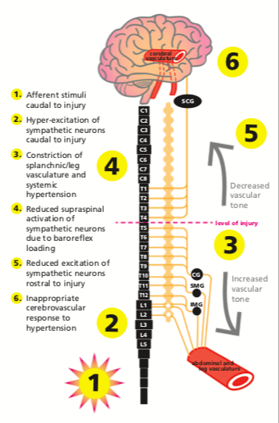
What Is Treatment for Autonomic Dysreflexia with Neurologic Complications?
Theoretical framework underlying cerebrovascular events induced by autonomic dysreflexia. In this case, the level of the patient’s injury may have played a role in the development of autonomic dysreflexia–induced posterior reversible encephalop- athy syndrome. Specifically, hyperexcitation of the sympathetic preganglionic neurons below the level of injury and a subse- quent increase in blood pressure would result in dilatation of the cerebral blood vessels because of intact supraspinal regulation of the superior cervical ganglion (SCG). Paradoxic baroreflex- mediated relaxation of the cerebral arteries would impair auto- regulation of the increasing blood pressure and expose the deli- cate cerebral microvasculature to insulting elevation in cerebral blood flow, potentially compromising the integrity of the blood– brain barrier. CG = celiac ganglion, IMG = inferior mesenteric gan- glion, SMG = superior mesenteric ganglion
Squair JW, et al. Emergency management of autonomic dysreflexia with neurologic complications. CMAJ 2016 (188)15:1100-1103.

Slide 12
What Is Treatment for Autonomic Dysreflexia with Neurologic Complications?
MRI consistent with posterior reversible encephalopathy syndrome. (A) Transverse imaging (T2, top; fluid-attenuated inversion recovery, middle; and diffusion- weighted imaging, bottom) shows cortical edema in the left pari- etal lobe (red arrows). The normal findings on diffusion-weighted imaging (bottom) suggest vasogenic rather than cytotoxic edema. (B) Contiguous sagittal fluid-attenuated inversion recovery images confirmed vasogenic edema in cortical (red arrows) and subcortical (white arrows) areas. Further areas of cortical and sub- cortical edema were present throughout the parietal and occipital lobes bilaterally (not shown). Given the patient’s acute, severe hypertension, the imaging findings were consistent with mild but evolving posterior reversible encephalopathy syndrome.
Squair JW, et al. Emergency management of autonomic dysreflexia with neurologic complications. CMAJ 2016 (188)15:1100-1103.

Slide 13
What is Acute Compartment Syndrome (ACS)
ACS is defined as “a clinical entity originated from trauma or other conditions that cause bleeding, edema, or that compromises perfusion in limbs.”
Diagnosis: Compartment syndrome clinical hallmarks have been defined as the 5Ps: pain out of proportion, pallor, paresthesias, paralysis, and pulselessness.
Immediate surgical fasciotomy can prevent severe sequelae of the ACS. However, controversy remains about the timing in order to avoid irreversible ischemic changes. Crucial to identify mechanism of injury: soft-tissue injury related, vascular injury related, fracture related. Prophylactic fasciotomy can also induce major complications, and the risk–benefit ratio should be weighed heavily.
For fracture patients with blister, indication for fasciotomy should be strictly controlled especially for patients without severe soft tissue injury.
Rigorous classification of traumatic etiology is essential for the treatment of these patients.
Guo J, et al. Acute compartment syndrome: cause, diagnosis, and new viewpoint. Medicine 2019 Jul;98(27):1-6.

Slide 14
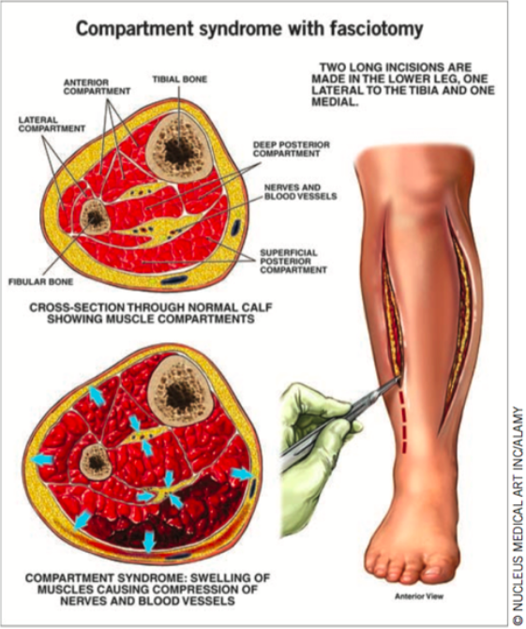
How to Diagnose and Treat Acute Compartment Syndrome?
Clinical hallmarks are defined as the 5Ps: pain out of proportion, pallor, paresthesia, paralysis, and pulselessness.
Immediate surgical fasciotomy can prevent severe sequelae
Timing is crucial in order to avoid irreversible ischemic changes. Prophylactic fasciotomy can induce major complications.
For fracture patients with blister, indication for fasciotomy should be strictly controlled especially for patients without severe soft tissue injury.
Determination of traumatic etiology is essential for the treatment of these patients.
Guo J, et al. Acute compartment syndrome: cause, diagnosis, and new viewpoint. Medicine 2019 ;98(27):1-6.

Slide 15
How to Manage Steven Johnson Syndrome?
The most frequently used treatments for SJS/TEN are systemic corticosteroids, immunoglobulins, and cyclosporine A.
Malik MN, et al. Pancytopenia in a Patient with Stevens-Johnson Syndrome: A Case Report with Literature Review. Cureus 2019 May; 11(5): e4702.

Slide 16
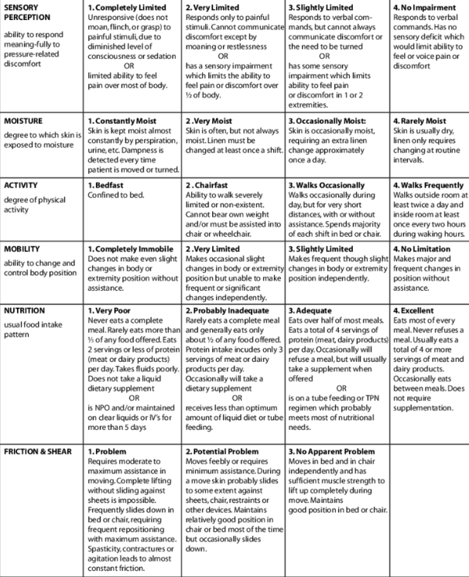
How to Prevent Pressure Injuries in the ED
PIs are the result of a complex number of biomechanical, physiological, and environmental interactions.
PI assessment should be conducted within 4 hours of admission to ED using the Braden scale. Rapid assessment can be carried out by focusing on age and presence of elevated CRP levels and the potential for the patient to remain in the ED for a protracted time.
Minimize exposure to unrelieved pressure, shear, and moisture through the implementation of repositioning schedules and ensuring the skin is protected from bodily fluids.
Remove medical devices (e.g., backboards and cervical collars) in the absence of spinal injury. Heel elevation using longitudinally positioned pillows or the use of specialty off‐loading devices significantly reduce heel PI development.
Santamaria N, et al. Preventing pressure injuries in the emergency department: Current evidence and practice considerations. International Wound Journal 2019; (16)3: 746-752.

Slide 17
What Are Effects of Antibiotics on Culture Yield of Bone Biopsy?
No significant difference in bacterial pathogen yield based on antibiotic exposure.
When studies including vertebral osteomyelitis were evaluated separately, there were fewer pathogens recovered than when antibiotics were administered prior to obtaining bone cultures.
Crisologo PA, et al. The Effect of Withholding Antibiotics Prior to Bone Biopsy in Patients With Suspected Osteomyelitis: A Meta-analysis of the Literature Wounds 2019; (31)8: 205-212.

Slide 18
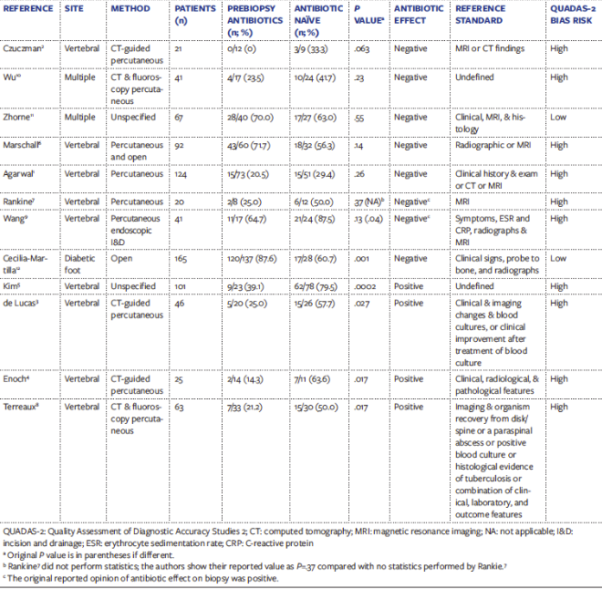
What Are Effects of Antibiotics on Culture Yield of Bone Biopsy?
Crisologo PA, et al. The Effect of Withholding Antibiotics Prior to Bone Biopsy in Patients With Suspected Osteomyelitis: A Meta-analysis of the Literature. Wounds 2019; (31)8: 205-212.

Slide 19
What is Effect of Withholding Antibiotics Prior to Bone Biopsy in Patients With Suspected Osteomyelitis
A meta-analysis of 12 studies showed that 8 failed to demonstrate that antibiotics administered prior to bone biopsy have an effect on culture yield, while 4 reported a significant effect on culture yield.
When vertebral osteomyelitis (VO) and nonvertebral osteomyelitis (NVO) studies were evaluated separately, the VO OR was 2.95 (95% CI, 1.40-6.24) and the prediction interval was 0.40-21.53. The OR for NVO was 0.66 (95% CI, 0.04-12.03) and the prediction interval was 0-114.53.
Conclusion: When all studies as well as when NVO studies only were evaluated, there was no significant difference in bacterial pathogen yield based on antibiotic exposure. When VO studies were evaluated separately, there were fewer pathogens recovered than when antibiotics were administered prior to obtaining bone cultures.
Crisologo PA, et al. The effect of withholding antibiotics prior to bone biopsy in patients with suspected osteomyelitis: A meta-analysis of the literature. Wounds 2019 Aug;31(8):205-212.

Slide 20
What Is Surgical Treatment for Diabetic Forefoot Osteomyelitis?
Clinical courses of all patients based on histopathological examinations. *1st Exam 5 1st histopathological confirmation of the bone margin after surgery based on MRI. **This patient had bilateral ischemic DFO and is included among the 16 pts with ischemic DFO who healed.
Fuji M, et al. Surgical treatment strategy for diabetic forefoot osteomyelitis. Wound Repair and Regeneration 2019; (24): 447-453.

Slide 21
How to Treat Septic Arthritis?
Diagnosis: Blood tests are inadequate to exclude septic arthritis. Blood cultures should be obtained in all patients with suspected septic arthritis, as they can help identify the etiologic agent if the synovial fluid culture is negative. (up to 14% of patients with negative synovial fluid cultures will have positive blood cultures)
Aspiration of synovial fluid is criterion standard for diagnosing septic arthritis. Synovial fluid analysis can also help with determining alternate etiologies for the joint effusion (e.g., including hemarthrosis, gout, etc.)

Slide 22
How to Treat Fournier’s Gangrene With Septic Shock
Zhou Z, et al. Fournier’s Gangrene With Septic Shock and Multiple Organ Dysfunction Syndrome. The International Journal of Lower Extremity Wounds 2019, 18(1): 94–96.

Slide 23
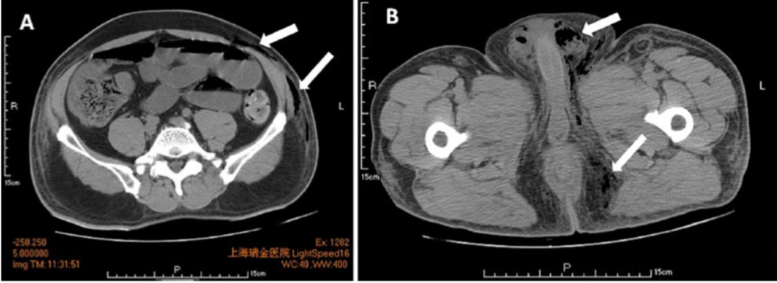
How to Treat Fournier’s Gangrene With Septic Shock
Diagnosis: Physical examination combined with CT, ultrasonography, and clinical findings
CT images can reveal perirectal abscesses and trace of fascial air along the perineum, scrotum, and lower abdomen.
Zhou Z, et al. Fournier’s Gangrene With Septic Shock and Multiple Organ Dysfunction Syndrome. The International Journal of Lower Extremity Wounds 2019, 18(1): 94–96.
Computed tomography (CT) image of the lower abdominal, scrotal, and perineal regions. The CT scan shows subcutaneous emphysema in addition to air in the lower abdomen, scrotum, and perianal fascia (arrows).

Slide 24
How to Prevent Peritoneal Dialysis Infections?
Peritonitis and exit site infections or tunnel infections are independent outcomes potentially responsive to different interventions.
Preoperative and perioperative intravenous vancomycin reduce peritonitis risk compared with placebo or cephazolin, but it does not affect early incidence of PD exit site or tunnel infections.
There are no significant differences between topical exit-site honey or intranasal mupirocin on the effects on PD catheter-related infections, hospitalizations, or technique failure or on microbial profiles of the infections.
Bolton L. Preventing peritoneal dialysis infections. Wounds 2019;31(6):163–165.

Slide 25
How to Prevent Peritoneal Dialysis Infections? (continued)
Cleansing the PD catheter exit site with sodium hypochlorite 10% aqueous solution reduced ESI incidence more than cleansing it with pH-neutral soap.
Incidence of PD-related peritonitis decreased in patients randomly assigned to receive systemic oral rifampin 300 mg twice daily for 5 days every 3 months¹³ after PD catheter insertion as compared with no oral antibiotic.
Bolton L. Preventing peritoneal dialysis infections. Wounds 2019;31(6):163–165.

Slide 26
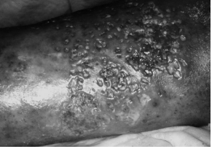
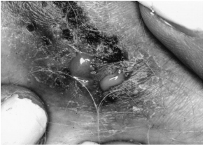
How to Diagnose Pyoderma Gangrenosum versus Chronic Venous Ulceration?
Peristomal pyoderma gangrenosum. Note the ulcer that began with pustules and crater-like holes around the patient’s stoma.
Pyoderma gangrenosum. Note multiple crater-like holes.
Early lesion of pyoderma gangrenosum. Crater-like holes represent the openings of pus-filled fistulous tracks. Pus can be expressed by applying pressure to adjacent skin.
Koo K, et al. Pyoderma Gangrenosum versus Chronic Venous Ulceration: Comparison of Diagnostic Features. Journal of Cutaneous Medicine and Surgery, 2006; 10(1):26-30.

Slide 27
How to Diagnose Pyoderma Gangrenosum versus Chronic Venous Ulceration?
Koo K, et al. Pyoderma Gangrenosum versus Chronic Venous Ulceration: Comparison of Diagnostic Features. Journal of Cutaneous Medicine and Surgery, 2006; 10(1):26-30.

Slide 28
How Can Negative Pressure Wound Therapy Help in Early-stage Management of Complex Wounds?
Early stage clinical decision points are indicated by purple boxes and options for wound preparation modalities are indicated by blue boxes. Dashed lines present potential early stage wound management options. NPWTi-d:Negative pressure wound therapy with instillation and dwell time. ROCF-CC:Reticulated open cell foam dressing with through holes. AWD: Advanced wound dressing.
Obst MA, et al. Early-stage Management of Complex Wounds Using Negative Pressure Wound Therapy With Instillation and a Dressing With Through Holes Wounds 2019;31(5):E33–E36..

Slide 29
What is the difference between negative pressure wound therapy with instillation (NPWTi-d) and reticulated open-cell foam dressing ROCF?
Obst MA, et al. Early-stage Management of Complex Wounds Using Negative Pressure Wound Therapy With Instillation and a Dressing With Through Holes Wounds 2019;31(5):E33–E36..

Slide 30
How to use negative pressure therapy?
Obst MA, et al. Early-stage Management of Complex Wounds Using Negative Pressure Wound Therapy With Instillation and a Dressing With Through Holes Wounds 2019;31(5):E33–E36..

Slide 31
How to use negative pressure therapy?
Obst MA, et al. Early-stage Management of Complex Wounds Using Negative Pressure Wound Therapy With Instillation and a Dressing With Through Holes Wounds 2019;31(5):E33–E36..

Slide 32
Are Antibiotic-impregnated calcium sulfate beads effective in accelerating healing?
Key outcome measures of patients (N=42) in each group
Dekker AP, et al. Do Antibiotic-impregnated Calcium Sulfate Beads Improve the Healing of Neuropathic Foot Ulcers with Osteomyelitis Undergoing Surgical Debridement? Wounds 2019;31(6):145-150..

Slide 33
Are Antibiotic-impregnated calcium sulfate beads effective in accelerating healing?
Dekker AP, et al. Do Antibiotic-impregnated Calcium Sulfate Beads Improve the Healing of Neuropathic Foot Ulcers with Osteomyelitis Undergoing Surgical Debridement? Wounds 2019;31(6):145-150..

Slide 34
What Are the Operative Techniques for Chronic Wounds?
General principles of debridement. Wounds exhibiting features necessitating debridement: (A) nonviable/ necrotic tissue, (B) callus, (C) nonmigratory heaped or rolled skin edges, (D) exudate, (E) tunneling, and (F) undermining.
Howell RS, et al. Wound Care Center of Excellence: Guide to Operative Technique for Chronic Wounds. J Am Coll Surg, 2018; 226(2):e7-e17.

Slide 35
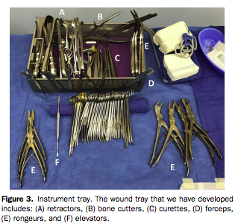
What Are the Operative Techniques for Chronic Wounds?
Howell RS, et al. Wound Care Center of Excellence: Guide to Operative Technique for Chronic Wounds. J Am Coll Surg, 2018; 226(2):e7-e17.

Slide 36
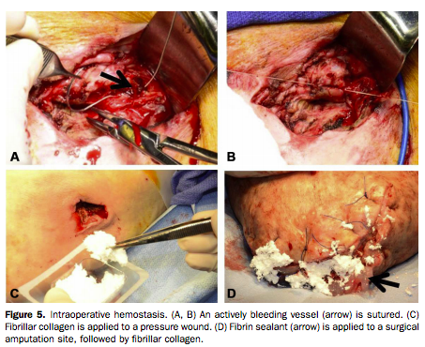
What Are the Operative Techniques for Chronic Wounds?
Howell RS, et al. Wound Care Center of Excellence: Guide to Operative Technique for Chronic Wounds. J Am Coll Surg, 2018; 226(2):e7-e17.

Slide 37
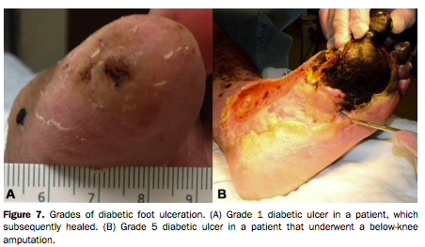
What Are the Operative Techniques for Chronic Wounds?
Howell RS, et al. Wound Care Center of Excellence: Guide to Operative Technique for Chronic Wounds. J Am Coll Surg, 2018; 226(2):e7-e17.

Slide 38
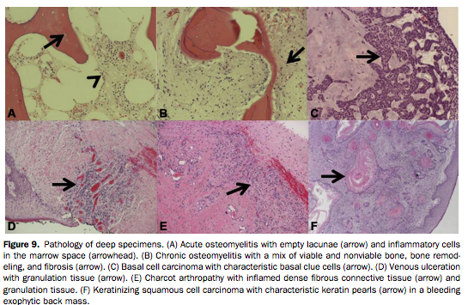
What Are the Operative Techniques for Chronic Wounds?
Howell RS, et al. Wound Care Center of Excellence: Guide to Operative Technique for Chronic Wounds. J Am Coll Surg, 2018; 226(2):e7-e17.

Slide 39
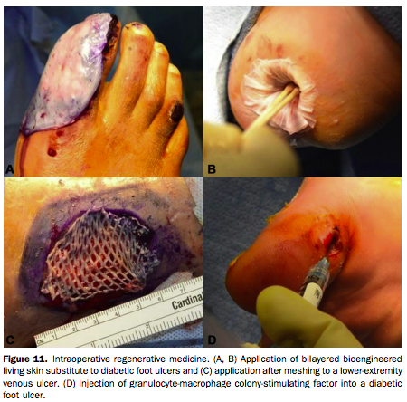
What Are the Operative Techniques for Chronic Wounds?
Howell RS, et al. Wound Care Center of Excellence: Guide to Operative Technique for Chronic Wounds. J Am Coll Surg, 2018; 226(2):e7-e17.

Slide 40
What Are the Operative Techniques for Chronic Wounds?
Howell RS, et al. Wound Care Center of Excellence: Guide to Operative Technique for Chronic Wounds. J Am Coll Surg, 2018; 226(2):e7-e17.

Slide 41
What are typical numbers for wound service?
Howell RS, et al. A Framework to Assist Providers in the Management of Patients with Chronic, Nonhealing Wounds. Advances in Wound Care, 2018; 31(11):491-501.

Slide 42
What is basic framework for treating wounds?
Howell RS, et al. A Framework to Assist Providers in the Management of Patients with Chronic, Nonhealing Wounds. Advances in Wound Care, 2018; 31(11):491-501.

Slide 43
What is basic framework for treating wounds?
Howell RS, et al. A Framework to Assist Providers in the Management of Patients with Chronic, Nonhealing Wounds. Advances in Wound Care, 2018; 31(11):491-501.

Slide 44
What is basic framework for treating wounds?
Howell RS, et al. A Framework to Assist Providers in the Management of Patients with Chronic, Nonhealing Wounds. Advances in Wound Care, 2018; 31(11):491-501.

Slide 45
What is basic framework for treating wounds?
Howell RS, et al. A Framework to Assist Providers in the Management of Patients with Chronic, Nonhealing Wounds. Advances in Wound Care, 2018; 31(11):491-501.

Slide 46
What is basic framework for treating wounds?
Howell RS, et al. A Framework to Assist Providers in the Management of Patients with Chronic, Nonhealing Wounds. Advances in Wound Care, 2018; 31(11):491-501.

Slide 47
What is basic framework for treating wounds?
Howell RS, et al. A Framework to Assist Providers in the Management of Patients with Chronic, Nonhealing Wounds. Advances in Wound Care, 2018; 31(11):491-501.

