Slide 1
Chronic Limb Threatening Ischemia Wednesday, October 2, 2024
Notes:
1

Slide 2
Agenda
What is Chronic Limb Threatening Ischemia (CLTI)?
What is classification of CLTI?
How to manage CLTI?
How to treat chronic limb threatening ischemia?
What are outcomes for patients with CLTI at six months?
What is prevalence of Peripheral Artery Disease (PAD)?
How is CLTI treated?
What is role of hyperbaric in acute limb ischemia?
Decreasing amputations
What is role of interdisciplinary teams in decreasing amputations?
What is probability of healing a diabetic foot ulcer: Society for Vascular Surgery
Patients with arterial wounds: Society for Vascular Surgery
What are Risks/benefits: Clinical stages: Society for Vascular Surgery
What are assessments for patients with arterial wounds?: Society for Vascular Surgery
Society for Vascular Surgery Lower extremity guidelines: Wifi Classification System

Slide 3
What is Chronic Limb Threatening Ischemia (CLTI)
CLTI is a clinical syndrome defined by the presence of peripheral arterial disease (PAD) in combination with rest pain, gangrene, or a lower limb ulceration >2 weeks duration. Venous, traumatic, embolic, and nonatherosclerotic etiologies are excluded.
Previously known as Critical Limb Ischemia (CLI)
Conte MS, Bradbury AW, Kolh P, White JV, Dick F, Fitridge R, Mills JL, Ricco JB, Suresh KR, Murad MH; GVG Writing Group. Global vascular guidelines on the management of chronic limb-threatening ischemia. J Vasc Surg. 2019 Jun;69(6S):3S-125S.e40.
Notes:
Acute vs chronic…. How do we decide? How should we think about this patient.

Slide 4
What is classification of CLTI

Slide 5
How manage CLTI?
Heparin gtt (drops per ML)
Vascular non-invasive studies
Intervention
Endovascular
Open
Hybrid

Slide 6
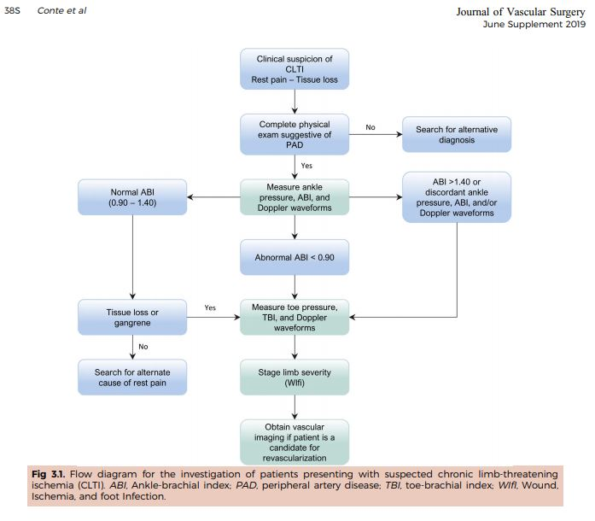
How to treat chronic limb threating ischemia?
Global Vascular Guidelines on Management of Chronic Limb threatening Ischemia. European Journal of Vascular and Endovascular Surgery2019;58(1): S1-S109

Slide 7
Natural History
What are outcomes for patients with CLTI at six months?

Slide 8
What is prevalence of Peripheral Artery Disease (PAD)?
Notes:
PAD is more prevalent than cancer or stroke and alzheimers together. The five year mortality rate for PAD is higher than stroke, coronary artery disease, or breast cancer. It is time to bring this number down!
Note: CHF = congestive heart failure

Slide 9
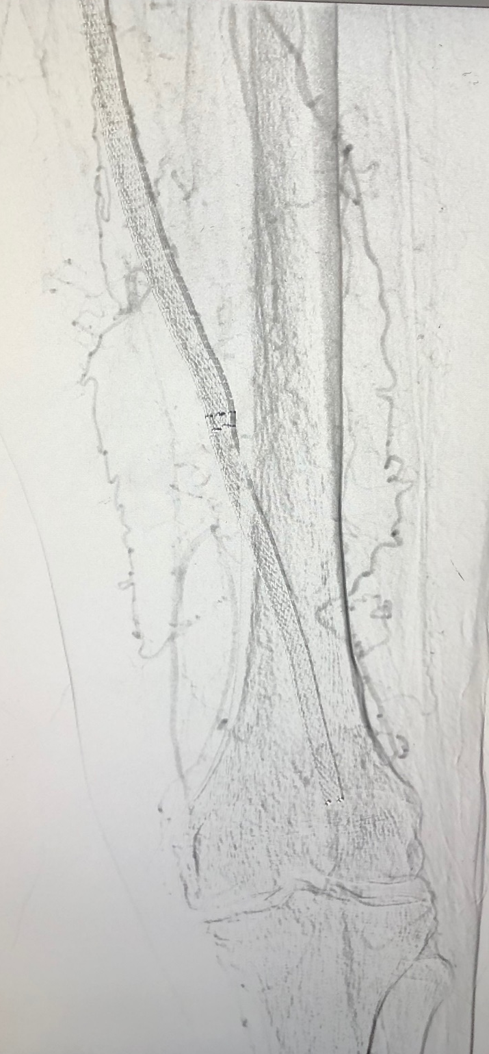
How is CLTI treated? Initial
SFA stent occlusion

Slide 10
How is CLTI treated? Final
Atherectomy with balloon angioplasty

Slide 11
What is role of hyperbaric in acute limb ischemia?
The documentation of significant beneficial biocellular and clinical effects have established hyperbaric oxygen as useful adjuvant therapy in the management osteoradionecrosis, clostridial myonecrosis, crush injury, radiation-induced soft-tissue injury, certain problem wounds, and compromised skin grafts and reconstructive flaps.
Using an objective and reproducible measurement (trancutaneous oxygen measurements, or TCOM, which evaluates degree of hypoxia in ischemic tissue) and a corresponding limit (> 10 torr) statistical significance regarding healing can be predicted.
Patients with TCOM values of <10 torr are unlikely to benefit from HBO therapy.
Grolman RE, Wilkerson DK, Taylor J, Allinson P, Zatina MA. Transcutaneous oxygen measurements predict a beneficial response to hyperbaric oxygen therapy in patients with nonhealing wounds and critical limb ischemia. Am Surg. 2001;67(11):1072-1080.

Slide 12
Decreasing amputations
In a systematic regarding non-traumatic amputations of patients with diabetes mellitus and peripheral vascular disease, the 5-year mortality rate of patients after a below-the-knee amputation was 40 to 82%, and mortality after an above-the-knee amputation was 40 to 90%. Many of these complications are preventable by a thorough annual foot exam and routine foot care.
Endocrinology, diabetology, vascular surgery, podiatry, orthotics, prosthetics, wound care nursing, and educators are crucial to caring for the diabetic foot. Other specialties that may play roles in diabetic foot care depending on medical issues and infection include infectious disease, nephrology, cardiology, dermatology, and others. Goals should be to medically optimize comorbidities, prevent pedal issues, and treat pedal complications.
Song K, Chambers AR. Diabetic Foot Care. [Updated 2020 May 18]. In: StatPearls [Internet]. Treasure Island (FL): StatPearls Publishing; 2020 Jan-. Available from: https://www.ncbi.nlm.nih.gov/books/NBK553110/

Slide 13
What is role of interdisciplinary teams and decreasing amputations?
Diabetic foot care requires interprofessional care. The severity of amputation, length of stay, and mortality rates improved in patients receiving care from a team when compared to those who did not.
A systematic review showed that multidisciplinary teams reduced major amputations in 94% of studies. These teams specifically addressed four key tasks: 1) glycemic control; 2) local wound management, including surgical débridement and minor amputation; 3) diagnosis and management of vascular disease, including revascularization; 4) and diagnosis and management of infection
Musuuza J, et al. A systematic review of multidisciplinary teams to reduce major amputations for patients with diabetic foot ulcers. J Vasc Surg. 2020;71(4):1433-1446.e3.

Slide 14
What is probability of healing a diabetic foot ulcer?: Society for Vascular Surgery
Mills JL Sr, Conte MS, Armstrong DG, et al. The Society for Vascular Surgery Lower Extremity Threatened Limb Classification System: risk stratification based on wound, ischemia, and foot infection (WIfI). J Vasc Surg. 2014;59(1):220-34.e342. doi:10.1016/j.jvs.2013.08.003

Slide 15
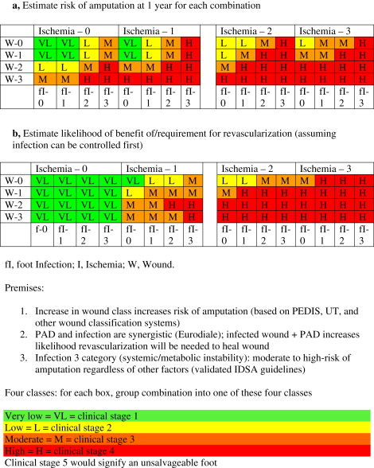
What are risks/benefits: Clinical stages: Society for Vascular Surgery
Mills JL Sr, Conte MS, Armstrong DG, et al. The Society for Vascular Surgery Lower Extremity Threatened Limb Classification System: risk stratification based on wound, ischemia, and foot infection (WIfI). J Vasc Surg. 2014;59(1):220-34.e342. doi:10.1016/j.jvs.2013.08.003

Slide 16
What are assessments for patients with arterial wounds: Society for Vascular Surgery
Vascular physical exam
palpable pedal pulses?
If present
objectify exam with non-invasive vascular study (pvr/segmentals (waveforms to the metatarsals and digits) plus TBI. If normal, usually no need for revascularization.
If absent :
• PVR/segmentals (waveforms to the metatarsals and digits) plus TBI.
• Classify patient within WiFi score.
• Assess patient for revascularization candidate based on WiFi score, ambulatory status, co-morbidities.
a. If revascularization candidate, need further imaging of anatomy (arterial duplex, CTA, MRA, vein mapping angiogram) based on:
i. proximal pulse exam (fem/pop pulses)
ii. presence of ckd – difficult to get CTA/MRA (contrast induced nephropathy)
iii. pace makers, defibrillators, presence of iliac stents – excludes MRA
b. Revascularization options:
i. Endovascular revascularization
ii. Hybrid revascularization
iii. Open revascularization
Hingorani A, LaMuraglia GM, Henke P, et al. The management of diabetic foot: A clinical practice guideline by the Society for Vascular Surgery in collaboration with the American Podiatric Medical Association and the Society for Vascular Medicine. J Vasc Surg. 2016;63(2 Suppl):3S-21S. doi:10.1016/j.jvs.2015.10.003

Slide 17
Patients with arterial wounds: Society for Vascular Surgery
General concepts:
ABI in isolation, especially in patients with dm and ckd is not accurate. ABI is a good test to rule in PAD if abnormal but not necessarily to rule out PAD.
Should not revascularize patients if wound is so extensive that foot is not salvageable (unless revascularization is necessary to heal proximal amputation).
Should not deem patient not a revascularization candidate without complete angiogram including images of the foot.
Patients all need medical therapy – antiplatelet therapy, statins, smoking cessation, optimization of co-morbities.
Hingorani A, LaMuraglia GM, Henke P, et al. The management of diabetic foot: A clinical practice guideline by the Society for Vascular Surgery in collaboration with the American Podiatric Medical Association and the Society for Vascular Medicine. J Vasc Surg. 2016;63(2 Suppl):3S-21S. doi:10.1016/j.jvs.2015.10.003

Slide 18
Society for Vascular Surgery Lower Extremity Guidelines: WIfI Classification System
An improved understanding of the underlying disease and advances in therapy, particularly endovascular procedures, has rendered existing classification schemes obsolete while simultaneously highlighting the need for a more comprehensive system. The concept of a single dichotomous hemodynamic cutoff point for CLI no longer applies to the majority of patients encountered in current clinical practice; various degrees of ischemia may prove “critical” depending on the overall status of the limb.
Ischemia, while of fundamental importance, is but one component among a triad of major factors that place a limb at risk for amputation.
The proposed SVS Lower Extremity Threatened Limb Classification System is based simply on grading each of the three major factors (Wound, Ischemia, and foot Infection [WIfI]).
This classification system is hereinafter referred to as SVS WIfI. It is based on a scale from 0 to 3, where 0 represents none, 1 mild, 2 moderate, and 3 severe.
This classification represents a synthesis of multiple previously published classification schemes that merges systems focused on diabetic foot ulcers and pure ischemia models.
Mills JL Sr, Conte MS, Armstrong DG, et al. The Society for Vascular Surgery Lower Extremity Threatened Limb Classification System: risk stratification based on wound, ischemia, and foot infection (WIfI). J Vasc Surg. 2014;59(1):220-34.e342. doi:10.1016/j.jvs.2013.08.003

Slide 19
Society for Vascular Surgery Lower Extremity Guidelines: WIFI Classification System
In 2014, The Society for Vascular Surgery Lower Extremity Guidelines Committee published a classification system for threatened lower limbs, categorizing and grading (0–3) the three major risk factors leading to amputation: wound, ischemia and foot infection (WIfI). The WIfI system merges existing classification systems, including the Infectious Diseases Society of America (IDSA) classification for diabetic foot infections, into a single concise system. After grading each category, one can then clinically stage the affected limb to estimate risk of amputation at one year.
Not only does WIfI predict amputation risk, it is the only system that can standardize outcome comparisons for accurate analysis of the increasing number of available therapies. The WIfI classification has the capability to improve guideline-based management of these complex and resource-intensive patients.
The Society for Vascular Surgery WIfI system is intended for any patient with a diabetic foot ulcer, non-healing foot ulcer present for two or more weeks, foot/lower extremity gangrene, or ischemic rest pain. It is not meant for patients with acute ischemia, emboli, trauma, non-atherosclerotic diseases such as vasospastic disorders, or pure venous ulcers.
Mills JL Sr, Conte MS, Armstrong DG, et al. The Society for Vascular Surgery Lower Extremity Threatened Limb Classification System: risk stratification based on wound, ischemia, and foot infection (WIfI). J Vasc Surg. 2014;59(1):220-34.e342. doi:10.1016/j.jvs.2013.08.003

Slide 20
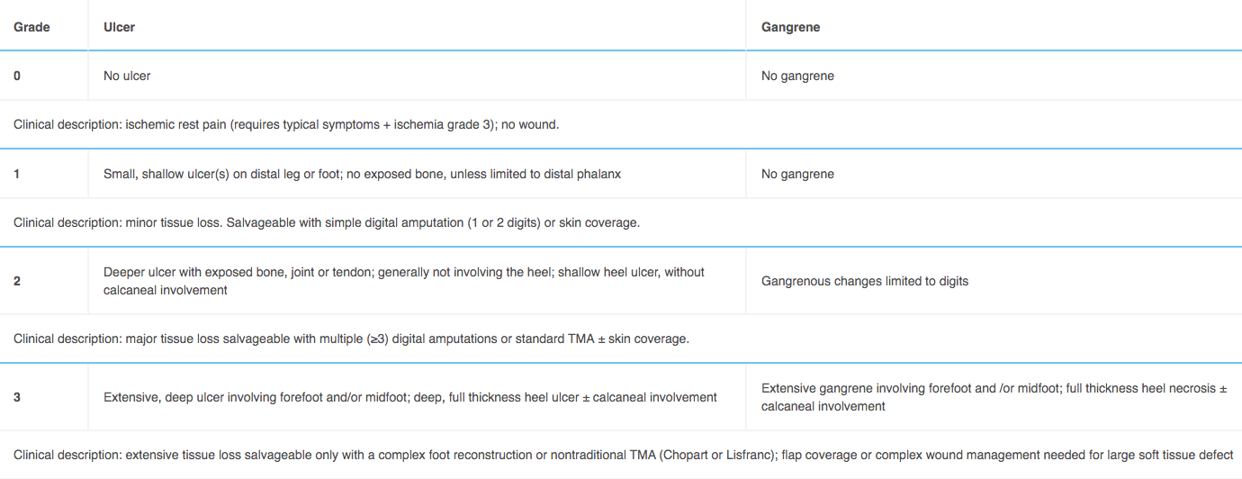
Society for Vascular Surgery Lower Extremity Guidelines: WIFI Classification System
Wound (“W”)
Mills JL Sr, Conte MS, Armstrong DG, et al. The Society for Vascular Surgery Lower Extremity Threatened Limb Classification System: risk stratification based on wound, ischemia, and foot infection (WIfI). J Vasc Surg. 2014;59(1):220-34.e342. doi:10.1016/j.jvs.2013.08.003

Slide 21
Society for Vascular Surgery Lower Extremity Guidelines: WIFI Classification System
Ischemia (“I”)
Mills JL Sr, Conte MS, Armstrong DG, et al. The Society for Vascular Surgery Lower Extremity Threatened Limb Classification System: risk stratification based on wound, ischemia, and foot infection (WIfI). J Vasc Surg. 2014;59(1):220-34.e342. doi:10.1016/j.jvs.2013.08.003

Slide 22
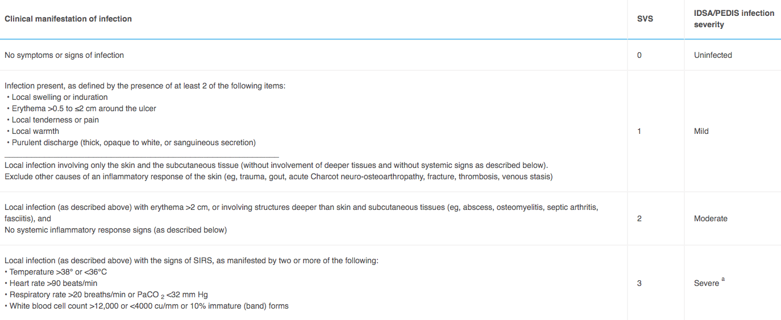
Society for Vascular Surgery Lower Extremity Guidelines: WIFI Classification System
Foot Infection (“FI”)
Mills JL Sr, Conte MS, Armstrong DG, et al. The Society for Vascular Surgery Lower Extremity Threatened Limb Classification System: risk stratification based on wound, ischemia, and foot infection (WIfI). J Vasc Surg. 2014;59(1):220-34.e342. doi:10.1016/j.jvs.2013.08.003

Slide 23
Society for Vascular Surgery Lower Extremity Guidelines: WIFI Classification System
Key summary points for use of Society for Vascular Surgery Lower Extremity Threatened Limb SVS Wifi classification system:
The full WiFI system, is to be used for initial, baseline classification of all patients with ischemic rest pain or wounds within the spectrum of chronic lower limb ischemia when reporting outcomes, regardless of form of therapy. The system is not to be employed for patients with vasospastic and collagen vascular disease, vasculitis, Buerger's disease, acute limb ischemia, or acute trauma (mangled extremity).Patients with and without diabetes mellitus should be differentiated into separate categories for subsequent outcomes analysis.
Presence of neuropathy (+) should be noted when possible in patients with diabetes in long-term studies of wound healing, ulcer recurrence, and amputation, since the presence of neuropathy (loss of protective sensation and motor neuropathic deformity) influences recurrence rate.
In the Wound (W) classification, depth takes priority over size. Although we recommend that a wound, if present, be measured, a shallow, 8-cm ² ulcer with no exposed tendon or bone would be classified as grade 1.
If a study of wound healing vs Wound (W) grade were performed, wounds would be classified by depth, and could also be categorized by size: small (<5 cm ²), medium (5-10 cm ²), and large (>10 cm ²)
TPs are preferred for classification of ischemia (I) in patients with diabetes mellitus, since ABI is often falsely elevated. TcPO ₂, SPP, and flat forefoot PVRs are also acceptable alternatives if TP is unavailable. All reports of outcomes with or without revascularization therapy require measurement and classification of baseline perfusion.
In reporting the outcomes of revascularization procedures, patients should be restaged after control of infection, if present, and/or after any debridement, if performed, prior to revascularization. (see risk/benefit table)
Group a patients: no infection within 30 days, or simple infection controlled with antibiotics alone
Group b patients: had infection that required incision and drainage or debridement/partial amputation to control
Mills JL Sr, Conte MS, Armstrong DG, et al. The Society for Vascular Surgery Lower Extremity Threatened Limb Classification System: risk stratification based on wound, ischemia, and foot infection (WIfI). J Vasc Surg. 2014;59(1):220-34.e342. doi:10.1016/j.jvs.2013.08.003

