Slide 1
Acell and Regenerative Medicine in Wound Healing Wednesday, October 9, 2024
Notes:
1

Slide 2
Agenda
What is regenerative medicine?
What regenerative medicine options are commercially available?
What classification systems have been developed to categorize skin substitutes?
What is Acell?
How does Acell work?
How effective is porcine mesothelium matrix as a biomaterial for wound healing?
What are the indications for Acell?
What other types of wounds is Acell used to treat?
When is Acell ineffective?

Slide 3
What Is Regenerative Medicine?
Porcine Urinary Bladder Matrix= Acell | Lyophilized sheet of intact basement membrane and subadjacent lamina propria of the porcine urinary ECM | Guides wound healing response by providing a complex molecular architecture that aids in biologic tissue repair
GRANULOCYTE-MACROPHAGE COLONY-STIMULATING FACTOR= LEUKINE | Cytokine | Promotes proliferation and differentiation of bone marrow-derived monocyte precursors into macrophages
Cryopreserved placental membrane | Source of MSCa, collagen matrix, growth factors (preserved structural and cellular integrity) | Anti-inflammatory, anti-microbial, angiogenic activities Create a moist environment
APLIGRAF | Type 1 bovine collagen dermal layer fibroblasts with overlying epidermal layer keratinocytes | Produces a great number of cytokines and growth factors that stimulate differentiation and proliferation in the nonhealing wound bed
Acellular matrix scaffold | Porcine small intestine submucosa ECM | Contains collagen, elastin, glycosaminoglycans, proteoglycans, and growth factors. Number cell types attach and migrate into the matrix Reduces level of MMPs
Dehydrated human amnion/chorion membrane allograft | Dehydrated human amnion/chorion membrane allograft | Provides matrix, nonimmunogenic, reduces inflammation/scar tissue/pain, antibacterial, contains GF and cytokines
Bilayered cross-linked type 1 bovine tendon collagen combined with chondroitin-6-sulfate and a semi-permeable silicone membrane | Bilayered cross-linked type 1 bovine tendon collagen combined with chondroitin-6-sulfate and a semi-permeable silicone membrane | Guides growth of the neo-dermis with silicone as a temporary epidermal barrier
Purified type 1 collagen with polyhexamethylenebiguanide | Purified type 1 collagen with polyhexamethylenebiguanide | Selectively binds and condenses bacterial DNA chromosomes
Howell R, et al. Wound Care Center of Excellence: Guide to Operative Technique for Chronic Wounds. Journal of American College of Surgery. 2018 Feb; 226(2): 7-8.

Slide 4
What are regenerative medicine options are commercially available ?
Apligraf | Organogenesis, Inc., Canton, MA, USA | Apligraf is a living, bilayered skin substitute. The lower dermal layer combines bovine type 1 collagen and human fibroblasts (dermal cells). The upper epidermal layer is formed by human keratinocytes (epidermal cells).
Cytal® wound matrix | Acell, Inc., Columbia, MD, USA | Cytal is composed of porcine urinary bladder matrix with an intact epithelial basement membrane.
Neox® Wound Allografts | Amniox Medical, Inc., Miami, FL, USA | Neox Wound Matrix is preserved human umbilical cord and amniotic membrane.
PuraPly® Antimicrobial (PuraPly AM) Wound Matrix (formally called FortaDerm) | Organogenesis, Inc. | PuraPly Antimicrobial Wound Matrix consists of a collagen sheet coated with 0.1% polyhex-methylenebiguanide hydrochloride.
Snyder D, Sullivan N, Margolis D, Schoelles K. Skin Substitutes for Treating Chronic Wounds. Rockville (MD): Agency for Healthcare Research and Quality (US); 2020.

Slide 5
What classification systems have been developed to categorize skin substitutes?
Some classification systems were based on the skin layers to be replaced and the source of material used in the product (human versus animal or synthetic) but did not distinguish between cellular and acellular products.
Cellularity the most important discriminator among skin substitutes since the presence of cells increases the rejection risk and manufacturing complexity. In this system, skin substitute products are divided first into acellular and cellular groups.
Acellular dermal substitutes made from natural biological materials are the most common commercially available skin substitute product for treating or managing chronic wounds (e.g., decellularized donated human dermis, human placental membranes, and animal tissue.
Snyder D, Sullivan N, Margolis D, Schoelles K. Skin Substitutes for Treating Chronic Wounds. Rockville (MD): Agency for Healthcare Research and Quality (US); 2020.
.

Slide 6
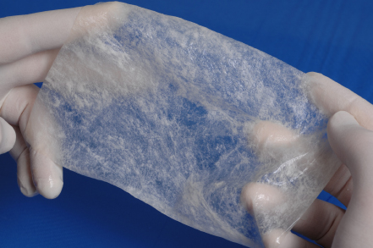
What Is ACell?
ACell’s ECM is derived from the lamina propria and basement membrane of a porcine Urinary Bladder Matrix (UBM). The lamina propria acts as a scaffold for cell infiltration while the basement membrane encourages the growth of site-specific tissue as the UBM resorbs. The UBM is offered in both sheet and powder form. The powder form has been informally referenced as “pixie dust” but is sold under the brand name of MicroMatrix . UBM is associated with accelerating DFU time to healing when compared to human skin equivalent and .
Liu Y, Panayi AC, Bayer LR, Orgill DP. Current and available cellular and tissue-based products for treatment of skin defects. Adv Skin Wound Care. 2019 Jan;32(1):19-25.

Slide 7
How does ACell work?
ACell (ACell, Inc.) is one of the newest xenograft biological dermal substitutes composed of extracellular matrix (ECM) derived from porcine urothelium that is lyophilized and dehydrated. Products maintain their natural collagen structure—the intact epithelial basement membrane enabling natural healing and tissue remodeling—and are subsequently resorbed by the body.
ACell MatriStem possesses several of the ideal graft attributes including barrier protection, pliability, and minimal preparation. Furthermore, it has not been identified as a vector for infectious agents. ACell has several forms, including singular and multi ply sheets, in addition to moralized granules.
Justine S. Kim, Alexander J. Kaminsky, J. Blair Summitt, and Wesley P. Thayer.Advances in Wound Care.Dec 2016.546-552.
.

Slide 8
How Does ACell Work?
In normal wound healing, the host Extracellular Membrane (ECM) is vital as it acts as a support structure for cell migration. The basement membrane is a particular type of ECM that provides, in its native state, a suitable substrate for epithelial cell growth in vivo. In living organisms in their native state, this membrane helps with regulation of cell proliferation, migration, and differentiation during tissue development.
ECM scaffolds derived from porcine liver, intestine, and urinary bladder have been tested for the intactness and integrity of the basement membrane component after being prepared and processed; the urinary bladder was found to be the only tissue to retain the basement membrane
Kimmel, H., Rahn, M., & Gilbert, T. W. (2010). The clinical effectiveness in wound healing with extracellular matrix derived from porcine urinary bladder matrix: a case series on severe chronic wounds. The journal of the American College of Certified Wound Specialists, 2(3), 55–59. https://doi.org/10.1016/j.jcws.2010.11.002

Slide 9
How Does ACell Work?
Urinary Bladder Matrix (UBM) has multiple regenerative properties that have been shown to be important in wound healing. UBM uses a largely and optimally intact ECM from porcine urinary bladder. As such, UBM differs from other available products that are synthesized from purified type I collagen in that it contains a complex mixture of proteins, glycosaminoglycans, and other biological molecules that are basically present in their normal concentrations and distributions.
Because of the specific layers of the tissue selected from this material, the basement membrane component of the ECM is naturally present on the original tissue, and studies have shown that the basement membrane is preserved through the manufacturing process. The distinctive ECM composition and ultrastructure of UBM appears to affect the response of host cells, thereby guiding the wound-healing response by providing a complex molecular architecture that appears to aid in biological tissue repair
Kimmel, H., Rahn, M., & Gilbert, T. W. (2010). The clinical effectiveness in wound healing with extracellular matrix derived from porcine urinary bladder matrix: a case series on severe chronic wounds. The journal of the American College of Certified Wound Specialists, 2(3), 55–59. https://doi.org/10.1016/j.jcws.2010.11.002

Slide 10
How effective is porcine mesothelium matrix as a biomaterial for wound healing?
Porcine mesothelium is a tissue rich in connective tissue (CT, e.g. collagens types I and III, elastin, fibronectin) and basement membrane (BM, e.g. collagen type IV and laminin) proteins and growth factors (e.g. FGF-2, TGF-β, VEGF)
Growth factors retained within the porcine mesothelium matrix promote wound healing events, such as cell proliferation and angiogenesis in vivo. Such features clearly illustrate their potential in the wound healing scenario, where cell proliferation, re-epithelialization, and angiogenesis are desirable events to be promoted.
Despite all these advantages, commercially available porcine mesothelium grafts have only been used in breast, cartilage, and nasal reconstruction and as a tendon protector sheet.
Capella-Monsonís H, Tilbury MA, Wall JG, Zeugolis DI. Porcine mesothelium matrix as a biomaterial for wound healing applications. Mater Today Bio. 2020;7:100057. Published 2020 May 17.
.

Slide 11
How effective is porcine mesothelium matrix as a biomaterial for wound healing?
Wound scaffolds derived from porcine bladder have been developed in particulate form (Micromatrix; ACell, Columbia, Maryland) and as a fenestrated sheet (Cytal; ACell), which is produced as both a single-layer, freeze-dried sheet and as a three-layer, laminated construct. These products have been applied for various indications ranging from diabetic wounds to partial-thickness burns and have been shown to facilitate wound healing.
In addition to conforming directly to the shape of irregular wounds, particulate ECM has been shown to increase the specific surface area (SSA) of the interface between the scaffold and the wound bed. A large SSA increases the cellular interactions required for tissue regeneration. Whereas scaffolds with small pore sizes and large SSA can physically constrain cells and blood vessels from growing into constructs, at larger pore sizes, SSA decreases, and there are fewer adhesion sites for cells. Therefore, there may be optimums for the 3D configuration of biomaterials.
Capella-Monsonís H, Tilbury MA, Wall JG, Zeugolis DI. Porcine mesothelium matrix as a biomaterial for wound healing applications. Mater Today Bio. 2020;7:100057. Published 2020 May 17.
.

Slide 12
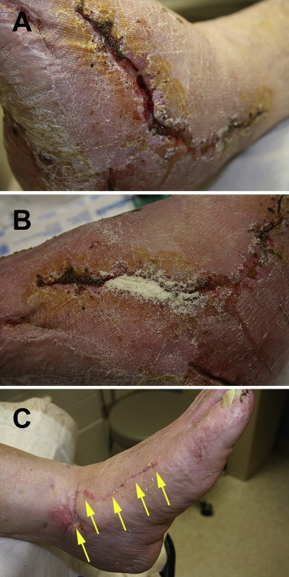
How effective is porcine mesothelium matrix as a biomaterial for wound healing?
A, Dehiscence to the lateral surgical wound that was present for 6 weeks and was nonresponsive to standard postoperative wound care of moist gauze dressings. B, UBM micronized particles were poured into the tunneling aspect of the wound and covered with a nonadherent dressing and sterile gauze. C, The wound was healed after 4 weeks of treatment.
Kimmel, H., Rahn, M., & Gilbert, T. W. (2010). The clinical effectiveness in wound healing with extracellular matrix derived from porcine urinary bladder matrix: a case series on severe chronic wounds. The journal of the American College of Certified Wound Specialists, 2(3), 55–59
.

Slide 13
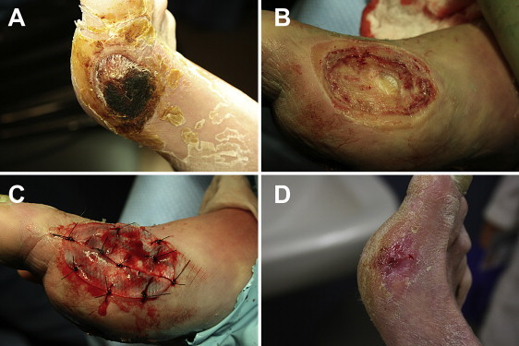
How effective is porcine mesothelium matrix as a biomaterial for wound healing?
A, A necrotic diabetic ulcer to the medial aspect of the patient’s right foot. B, Debridement in the operating room down to joint capsule. C, A thick UBM sheet was hydrated in normal saline, fenestrated, and then sutured to the wound base. D, The full thickness wound was healed in 13 weeks from the date of surgery.
Kimmel, H., Rahn, M., & Gilbert, T. W. (2010). The clinical effectiveness in wound healing with extracellular matrix derived from porcine urinary bladder matrix: a case series on severe chronic wounds. The journal of the American College of Certified Wound Specialists, 2(3), 55–59
.

Slide 14
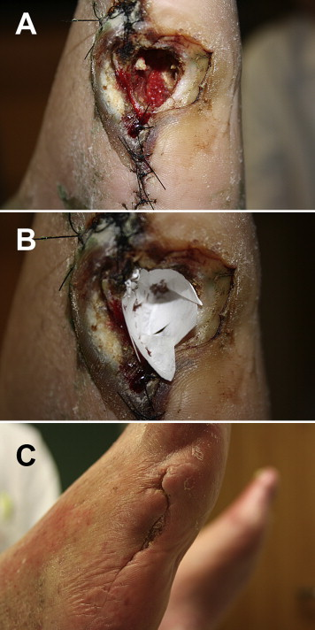
How effective is porcine mesothelium matrix as a biomaterial for wound healing?
A, An ulceration to the lateral aspect of this patient’s right foot probed to bone. Radiographs were suggestive of osteomyelitis to the fifth metatarsal head. Right partial fifth ray resection was performed and left open to allow further drainage of infection. Negative pressure wound therapy was used for 1 month, improving wound size. B, Negative pressure wound therapy was discontinued and once-a-week UBM treatments were initiated. C, The wound was completely healed in 9 weeks.
Kimmel, H., Rahn, M., & Gilbert, T. W. (2010). The clinical effectiveness in wound healing with extracellular matrix derived from porcine urinary bladder matrix: a case series on severe chronic wounds. The journal of the American College of Certified Wound Specialists, 2(3), 55–59
.

Slide 15
What are the indications for ACell?
When patients with pressure ulcers or lower extremity wounds refuse operative management or they are unable to be cleared medically to undergo flap reconstruction, adjunctive novel therapies can be employed including wound matrix application.
Porcine Urinary Bladder Matrix (UBM) maintains and supports a healing environment for wound management. It is indicated for the management of partial and full thickness wounds, pressure ulcers, venous ulcers, diabetic ulcers, chronic vascular ulcers, tunneled/undermined wounds, surgical wounds, traumatic wounds, and draining wounds.
When applied to a wound, porcine urinary bladder matrix changes the healing response, resulting in remodeled, functional, site specific tissue.
Broder K, et al. Use of porcine urinary bladder wound matrix in nursing home patients as a non-surgical option to heal a large stage IV ischial pressure ulcer and a limb-threatening lower extremity wound. JAMDA, 2015, March (16) 3, B3-B11.

Slide 16
What are the indications for ACell?
Flap Surgery: The use of urinary bladder matrix products provides a new approach to managing patients who are considered poor flap candidates or who are reluctant to undergo flap surgery unless absolutely necessary.
There is evidence that the use of UBM is effective in the management of lower extremity wounds that previously would have only been treated with a regional or free flap.
Complex wounds previously believed to be incapable of healing can now be closed with the use of these products alone or in conjunction with skin grafting.
UBM-ECM products have been found to facilitate healing despite the presence of exposed hardware and positive bacterial cultures — provided all grossly devitalized bone has been removed.
Further study is indicated to determine its role in lower extremity trauma wound management.
Kraemer BA, Geiger SE, Deigni OA, Watson JT. Management of Open Lower Extremity Wounds With Concomitant Fracture Using a Porcine Urinary Bladder Matrix. Wounds. 2016 Nov;28(11):387-394. PMID: 27861131.

Slide 17
What are the indications for ACell?
Pyoderma Gengrenosum: A case study of one patient with a Pyoderma Gangrenosum-related ulcer treated with a porcine urinary bladder matrix and negative-pressure wound therapy demonstrated that this treatment combination provided pain relief, coverage of the wound, an acceptable aesthetic outcome, and long-term stability.
A successful outcome can be achieved with the combination of UBM and VAC technology. In this case, this combination aided in the deposition of granulation tissue, which restored the defect to the level of the surrounding skin and provided an excellent bed for placement of a skin graft. The result was therefore durable and minimized scarring and contour abnormalities
Dillingham, Claire & Jorizzo, Joseph. (2019). Managing Ulcers Associated with Pyoderma Gangrenosum with a Urinary Bladder Matrix and Negative-Pressure Wound Therapy. Advances in Skin & Wound Care, 32, 70-76. https://doi.org/10.1097/01.ASW.0000546120.32681.bc

Slide 18
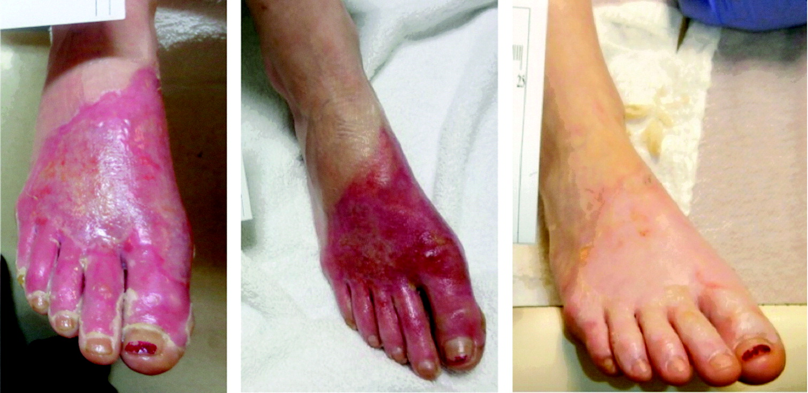
What other types of wounds is ACell used to treat?
Burn injury reconstruction: ACell has been shown to be effective in the treatment for deep partial-thickness burns. Data showed quick time to re-epithelialization and healing, no contracture development or postoperative complications, and eliminated the need for subsequent autografting.
ACell MatriStem product illustrations; (A) MicroMatrix, (B) Wound Matrix, (C) Multilayer Wound Matrix, (D) Burn Matrix.
A 21-year-old female with a grease burn. Images from left to right: initial injury, 14 days post-ACell, and 28 days post-ACell.
Justine S. Kim, Alexander J. Kaminsky, J. Blair Summitt, and Wesley P. Thayer.Advances in Wound Care.Dec 2016.546-552.
.

Slide 19
When is ACell Ineffective?
Despite the abundance of literature supporting the ability of ECM in general to improve tissue organization and healing of musculoskeletal tissues, there is a sizeable gap in the literature specifically related to the use of ECM products of any kind to treat tendon or ligament injuries.
Khatibzadeh SM, Menarim BC, Nichols AEC, Werre SR, Dahlgren LA. Urinary Bladder Matrix Does Not Improve Tenogenesis in an In Vitro Equine Model. J Orthop Res. 2019 Aug;37(8):1848-1859. doi: 10.1002/jor.24320. Epub 2019 May 15. PMID: 31042311.

